Slide 1

Phase 4 Project Update
For Hamvention 2018
Notes:
Communications is a solved problem.
There hasn’t been a compelling communications demonstration since Alexander Graham Bell. Forward error correcting codes are at or near the Shannon limit.
Machine learning can identify a modulation of almost any type within 40 symbols.
Cognitive radio can turn the spectrum into nothing more than a slightly raised noise floor.
With all signals sounding like noise and meshing together in harmony.
This noise floor will just be a little higher near cities.
Legacy radio users will never know the other users are there.
8 years olds can talk around the world on an ipad.
My kids have real friends across 8 time zones.
My daughter is in a competitive Minecraft Guild. They are based in Japan. She has learned conversational Japanese to compete and is now taking it as her foreign language in high school.
Almost anyone within any developed country is reachable by phone.
Cellular networks have become much more robust to failure.
The world is home to 7.2 billion gadgets capable of communications, and they’re multiplying five times faster than we are. That was in October 2014.
So. If communications is a solved problem, what are we all doing here? The way we do the work is where the best work is really at.

Slide 2
Who are we?
What do we do?
Why should you care?
What are we doing about it?
What does a P4G system look like?
What is the team doing?
What do we need?
What are the plans for a finished product?
What do these radios talk to?

Slide 3
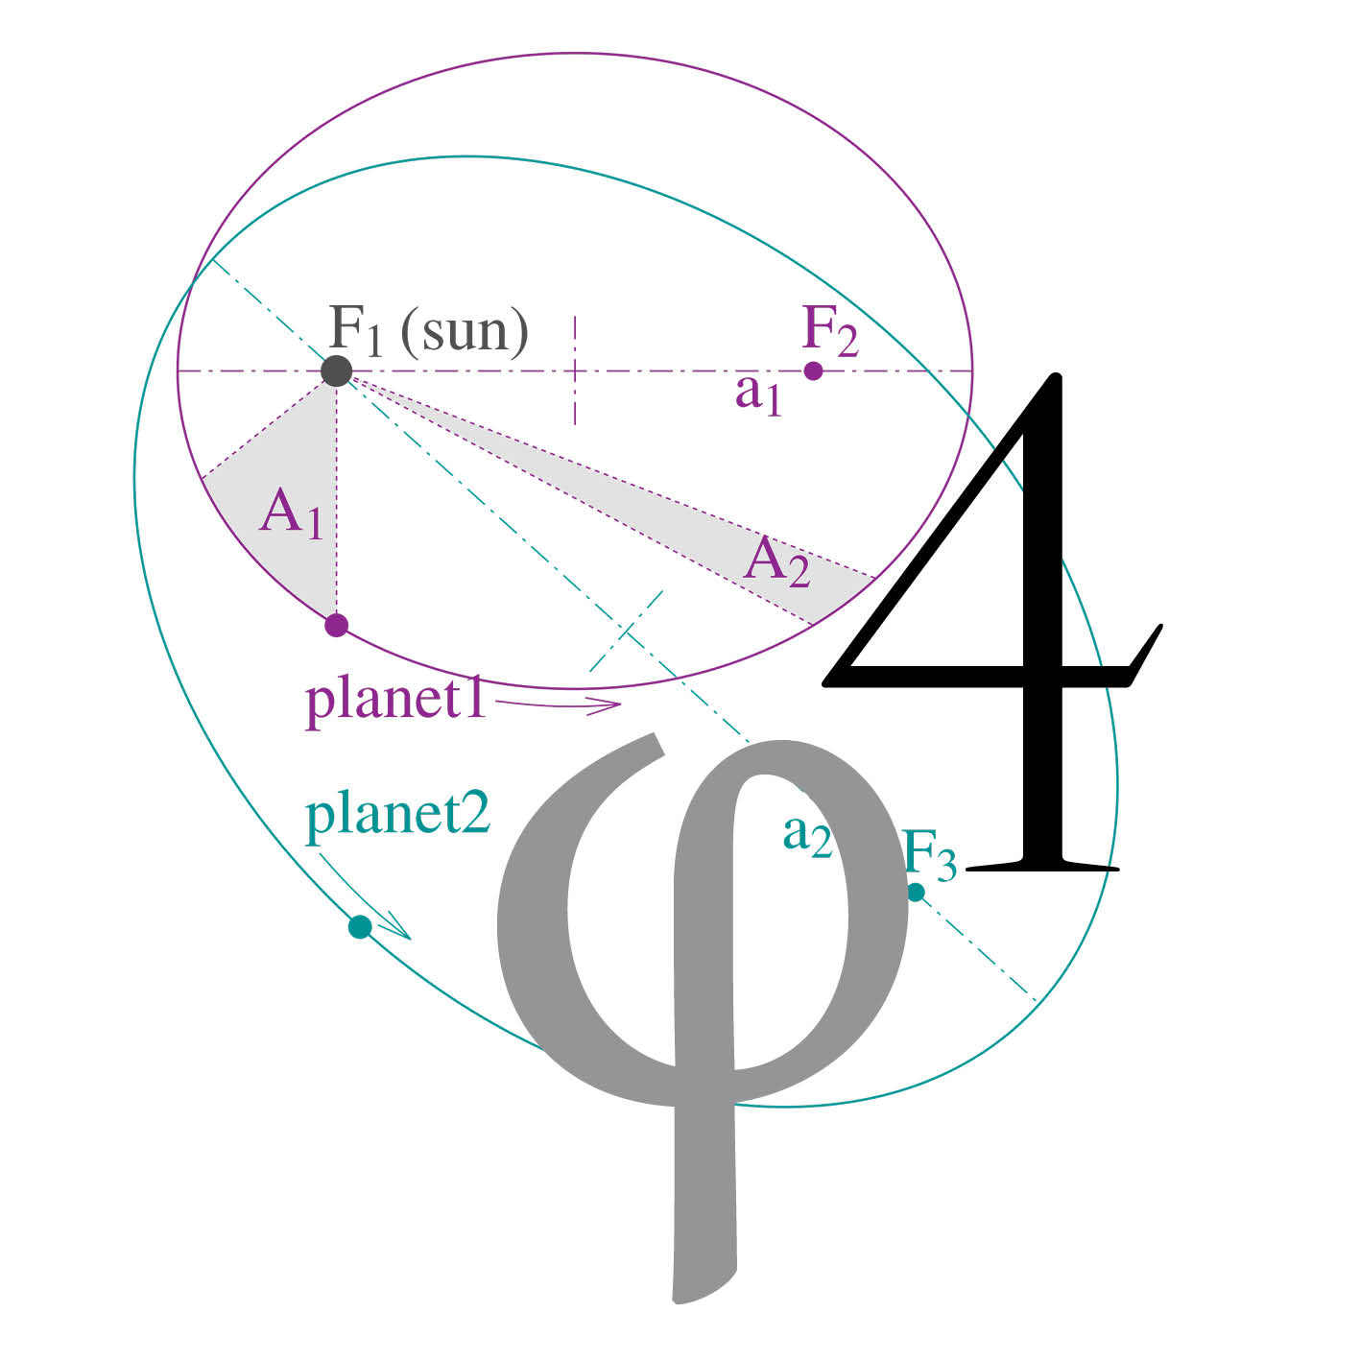
Who are we?
Open Research Institute, Inc. (ORI) is a non-profit
research and development organization
which provides all of its work to the general public
under the principles of Open Source
and Open Access to Research.
Notes:
We are Open Research Institute, a non-profit incorporated in California in March 2018. We have applied for 501c(3).
ORI was founded by myself, renowned open source activist Bruce Perens, and the President of GNU Radio Foundation Ben Hilburn, in order to provide a structure for the open source work we were all already doing and were interested in supporting.
We are a new organization. We are not new at what we do.

Slide 4

What do we do?
Notes:
We make happy little radios! Among other things like Open Cars and Open Codecs. Research Institutes are establishments founded for carrying out research. Research is creative and systematic work done to advance human knowledge in a particular area.
Our research is open. Open source, open access, and open process. This means all of our work is published, all of our source code shared, all of our hardware fully documented. Open access means it’s available to all. Open process means that decision-making along the way is open to input, intermediate results are revealed. It’s an ideal that we pursue, but not an absolute. Some phases of sausage making don’t have to to be published.
While the three of us on the board of directors are all hams, and amateur radio related research is a lot of what we do, our research projects are not limited to amateur radio. Other ORI research areas include Open Cars and Open CODECs and more. Our goal is to sponsor research and development anywhere there is a clear need for an open solution to replace a proprietary solution. If the open solution creates more value, provides more leverage, enables more good, over the proprietary one, then it’s a win in the end for everyone involved. That is what we look for. That is what motivates us.

Slide 5
Why should you care?
Because a surprisingly large amount of
software and hardware in amateur radio
is closed, proprietary, or licensed in ways
that make it very difficult to
improve, learn from, or adapt. And because of ITAR/EAR.
Notes:
Because a surprisingly large amount of software and hardware in amateur radio is closed, proprietary, or licensed in ways that make it very difficult to improve, learn from, or adapt.
Here’s one example. One of the most disappointing things in amateur radio are the low rate proprietary CODECs used in digital voice systems. This is a good example of a closed technology that needs to be replaced with an open technology. Your choice of CODEC should be open and it should be as high quality as you want. You should never have to strain to recognize a voice on the air. When voice is the product, and the perception is that the voice is of low quality, then it doesn’t matter whether the underlying design of the radio is advanced or beautiful. The user experience determines the perceived quality of the communications device. Proprietary CODECs are inherently worse than open ones because they increase cost, impose bizarre limitations like dongles, adds risk (what if the license terms change, what if the hardware dongle is discontinued), and prevents users or even developers from learning about what’s inside and how they work.
Here’s another example. Broadband digital waveforms and systems at microwave. At higher frequencies and higher bandwidths, higher rate higher quality CODECs really shine. You have all the bandwidth you can possibly consume and voice CODECs are no longer artificially squeezed. The majority of the waveforms here are not open. But they should be.
Our microwave bands are both highly desirable by commercial interests and very underutilized by amateur radio operators. These are the bands where high bandwidth advanced digital communications is possible. These are the bands where we need to be focusing a lot more attention on and building a lot more equipment for and writing a lot more digital signal processing (DSP) and field programmable gate array (FPGA) and application code for. This is primarily what I do. My formal education is in information theory and digital communications. This type of engineering is my vocation and passion.

Slide 6
What are we doing about it?
Liberating DVB-S2 and DVB-S2X
for amateur radio use! For Terrestrial AND Space.
Notes:
I lead Phase 4 Ground, which is an open source implementation of the DVB-S2 and DVB-S2X protocols for amateur radio terrestrial and space use. DVB stands for Digital Video Broadcast. DVB is a large family of high quality completely free widely used and widely implemented digital communications standards. S stands for satellite, and 2 for second generation. The X is an extension that added very low signal-to-noise (SNR) and very high SNR codes and modulations to DVB-S2.

Slide 7
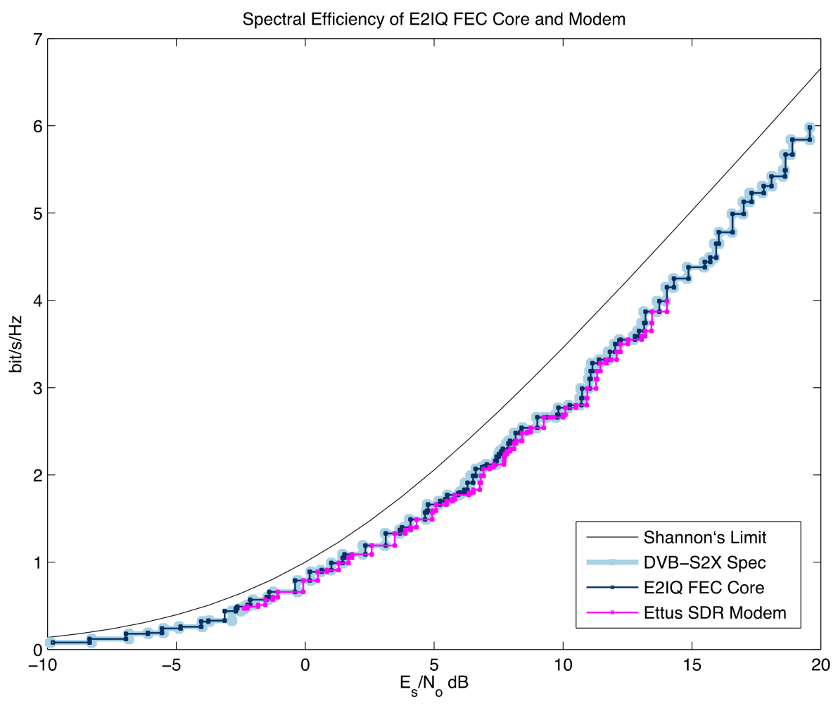
Notes:
One of the reasons DVB-S2/X is so cool. Adaptive coding and modulation! Here’s how it works.

Slide 8
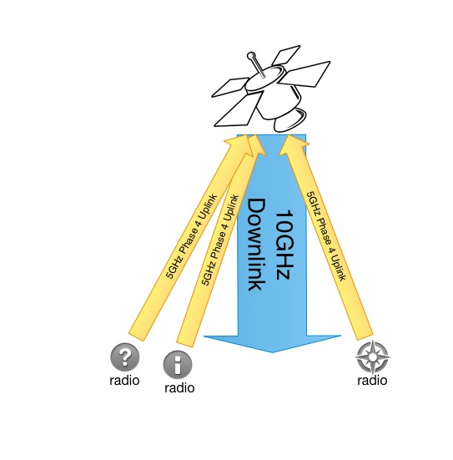
Phase 4 radios
5.645-5.655 GHz up
10.45-10.46 GHz down
What does it look like?
Notes:
DVB-S and DVB-S2 is the most widely used communications standard for the downlink for broadcast satellite television. The transport layer, or the part of the protocol that is delivering broadcast content, is usually MPEG video. We don’t want to be limited to MPEG video for an amateur radio system. MPEG is great for video. There’s a way to carry general data within the MPEG stream, but it’s not very efficient or elegant. Fortunately, this is a solved problem. There’s a protocol from DVB written and ready to go called generic stream encapsulation, or GSE. GSE replaces MPEG. Using GSE as the transport stream protocol in DVB-S2 turns it into a very useful digital pipe, capable of supporting lots of simultaneous users transmitting and receiving all types of data, from live voice, to voice memos, to images, to video, to files, to whatever your station supports. That’s what our downlink looks like.
The uplink is a channelized part of the spectrum, in our case 5GHz. The frequency division multiple access uplink is received by a polyphase filter bank, the streams are received and processed, the ones that will be retransmitted are combined and multiplexed into a time division packetized format, and that entire signal is transmitted as one “pipe” using DVB-S2/X on the downlink. Managing this multiplexing is a big job and requires careful protocol design.
Uplink channelization can be changed on the fly with advanced polyphase filter banks, but our current system design is to provide approximately 100kHz wide 4-ary minimum shift keying (4-ary MSK) channels. Your digital signal is assigned some number of channels. Your signal includes information about your radio and your identity. There is an acquisition protocol so that random kerchunking won’t do anything other than raise the noise floor. If you are not heard in the downlink channel assignment, then your radio won’t transmit. Being constant amplitude, this type of modulation relaxes some of the amplifier requirements at 5GHz. Work on the 5GHz transmitter side is going well and one of several proposed prototype board layout is under review right now.

Slide 9
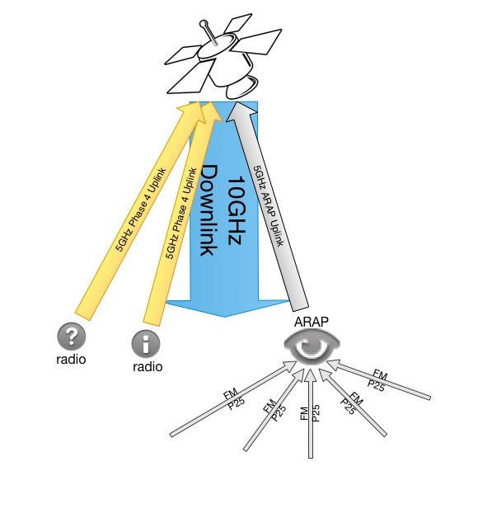
Phase 4 radios
5.645-5.655 GHz up
10.45-10.46 GHz down
What does it look like?
Notes:
What about legacy signals?

Slide 10
What is the team doing?
RTP multicast innovations
DVB correlators
Open Source LDPC
Dual Band Feed GSE published work
Filters! 5GHz amps!
ARAP demonstrations
Having tons of fun
Buying every SDR dev board
Notes:
User experience of voice doesn’t stop with the quality of the CODEC. We want you to be able to tune in to our downlink and listen to a roundtable, where the voices are distributed in a stereo field, as if you’re sitting around a table, talking with your friends. To support this goal, Phil Karn KA9Q has contributed a software defined radio (SDR) package that contains real time protocol (RTP) internet protocol (IP) multicast code that does exactly this. It will be built in to our implementation. He has a lot of other software defined radio work in the package that achieves this. All of this and more are at our project GitHub.
Another area of current work is a correlator tuned for DVB-S2/X. Correlation is a very important part of signal acquisition. The receiver looks for a pattern that it is told about in advance. That pattern marks the start of a frame of data. Once you find the start of the frame, you can unload the rest of the payloads and process them.
Another area of current work is the forward error correction. DVB-S2 is powerful for many reasons, but one of the biggest and more important is the way it can correct errors due to interference and noise. DVB version 2 has world class error correction. The type of error correction is low density parity check (LDPC) concatenated, or working in concert with, Bose–Chaudhuri–Hocquenghem BCH encoding. LDPC is really interesting because it was designed back in the 1960s, but only recently have we been able to make real world circuits that use this type of error correction. Powerful FPGAs and ASICs make this sort of algorithm possible. LDPC is so good that it is almost at the physical limit of what we can achieve with error correction. We have an implementation of the LDPC decoding that runs on a graphical processing unit (GPU). This is a big deal. There are some advantages and disadvantages of it running on a GPU. We want to get this code into an FPGA. Want to help?
5GHz uplink and 10GHz downlink done at the same time full duplex puts some burden on the feed design. Especially if you want to do all of this in one microwave dish. And, you do want to be able to do that, to make a radio much more easy to deploy. We have a dual-band feed design that provides enough separation from the second harmonic of the uplink. This design was completed by Paul Wade W1GHZ and has been tested in a commercial lab.
We have a high performance bandpass filter design for 10GHz and prototypes will be available shortly. The draft design is by Jeffrey Pawlan WA6KBL.
These are some of the areas of investigation and work on Phase 4 Ground. This project enables people to come together to learn about, experiment with, and produce hardware and software that is modern, and marketable, while also contributing to the common good of open source engineering.
DVB-S2 is a current, advanced, high quality digital communications protocol. Learning about it brings you all the way up to cutting edge communication technology. Some of it is difficult. None of it is completely out of reach to motivated amateurs. An open source implementation available to all experimenters is game changing. We completely believe in this project and we have a wonderful team that has coalesced over the past few years.

Slide 11
What do we need?
You!
Volunteers, cheerleaders, documentarians,
artists, designers, hardware hackers,
software, hardware, firmware,
Protocol design, testing, RF design,
And on and on!
everyone is welcome
Notes:
We need your help to complete this project faster and better. Volunteers, cheerleaders, documentarians, artists, designers, hardware hackers - everyone is welcome. We are collaborative, we have fun, we take risks, and we have a less formal and more flat structure that you might be used to. Our approach is typical of many open source projects. Our primary communication and documentation tools are an email list, a Slack, and our GitHub. We are a distributed team and have members all over the world.

Slide 12
Plans for finished products
Reference design in GNU Radio
Trans-Ionsopheric hackable badges
Trans-Ionspheric Radios
10GHz filters
Dual Band Feeds
Lots of other possibilities!
Notes:
These open standards do not have a complete open source implementation. We want to change that. Our digital signal processing (DSP) framework is GNU Radio, a free and open source DSP toolkit for software defined radio (SDR). For terrestrial use, having a reference design in GNU Radio enables people to build their own Phase 4 Ground radios from available SDRs. A reference design also enables us to build a radio system and produce hardware for sale so that people have an off the shelf option. Flex Radio has committed to being our manufacturing partner when the radio design is ready.
For terrestrial use, the central node that accepts 5GHz uplinks and produces a 10GHz downlink needs to be in a central location. Operators have radios that receive the 10GHz downlink and transmit the 5GHz uplink. With the multiplexing of individual streams, you can monitor, group, search, filter, set up rooms, transmit documents, images, video, voice, voice memos, and text. Our goal is as few impediments as possible. Our platform lead, for the application layer, is Steve Conklin.
Our first product is a radio peripheral fundraiser called Trans-Ionospheric. This is a hackable badge with a small processor onboard. It has keypads and a display and a lot of blinky lights. It has expansion ports and if you build a WiFi module for it, it can command a Flex Radio and we intend for it to eventually talk to your Phase 4 Ground radio and give you visual feedback on the uplink, downlink, and payload status. You can play games and interact with other badges over blue tooth low energy links. If you have ever wanted to learn more about BLE or embedded processing, then this is a really fun and stylish dev board and you should get one. Programming through a standard JTAG port is how you upload new code. There’s an SD card to store data. You can also talk to it at the command line via a smart phone app from the maker of the bluetooth module. All proceeds from this badge go directly to support Phase 4 Ground engineering efforts. Finances will be published and completely transparent. The point of doing this project is for team members to learn how to work together, sort out tools and workflow, and be ready for more ambitious designs.

Slide 13
What do these radios talk to?
Completing a payload
Getting a launch
Dealing with ITAR/EAR
Paying for a launch
A Groundsat
Each other!
Notes:
Space and ground
For space use, you need a payload. There are four big space-side challenges. Completing a payload, getting a launch, dealing with ITAR/EAR, and paying for a launch.

Slide 14
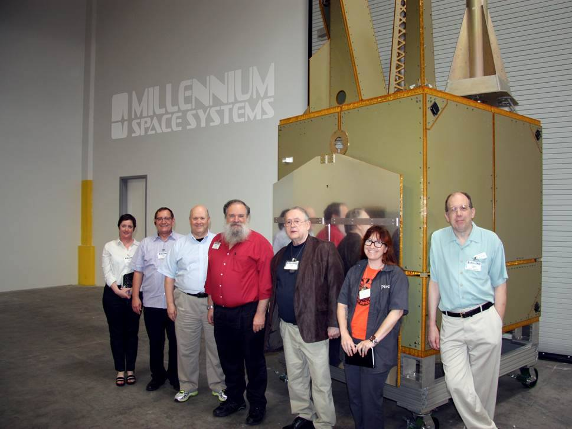
Notes:
We have at least one payload. It’s called 4B and was built by Virginia Tech. It’s a secondary payload on a geosynchronous satellite currently scheduled for a launch in 2020. This launch is expensive and the lifespan of the primary mission is 5 years. Virginia Tech’s secondary amateur radio payload has passed all engineering review and at this time is included in the launch. This achievement is huge and the opportunity is amazing. Having this come about, against many odds, was the result of a lot of hard work and negotiating and engineering.

Slide 15
Notes:
Inspired by the Libre Space UPSat project, Open Research Institute has kicked off an open source payload project. The goal is HEO and GEO or Interplanetary. Every bit of the work will be open source and public domain. This allows us to use the public domain exemption in ITAR/EAR. The way we address this particular challenge is laid out in our policy strategy. It can be found on our website at https://openresearch.institute/itar-and-ear-strategy/
The public domain management innovation is very powerful. Being able to work in the open, being able to work with friends in other countries, being able to get wide feedback, comment, and critique for the ideas and the work, and advancing the state of the radio art without the impediment of secrecy and fear are the fundamental principles of our team. People can contribute no matter where they are located.
Getting a launch and paying for a launch are big challenges, but we are prepared to try and to keep trying until we reach our goal of a broadband microwave digital payload for amateur radio at GEO, with fun, affordable, easy to use radios that work for both space and terrestrial.

Slide 16
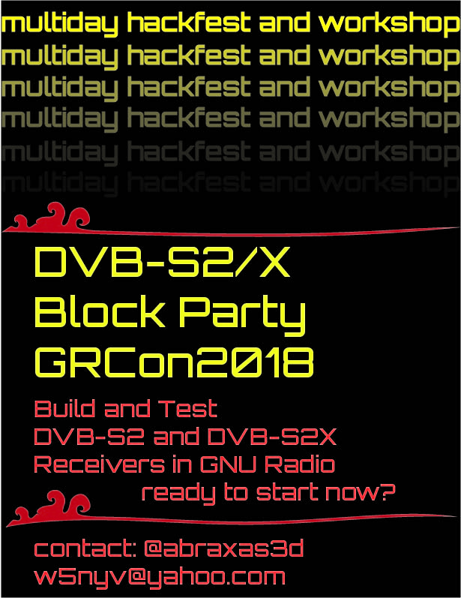
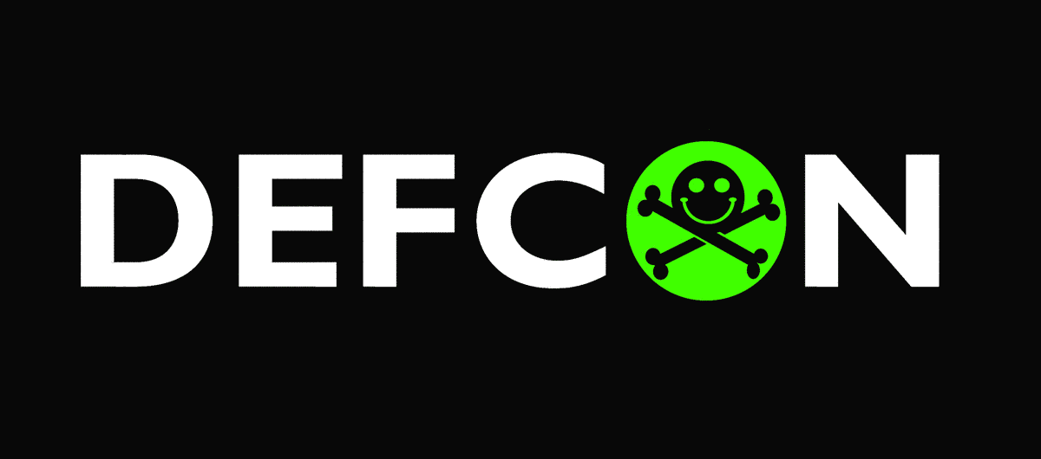

Notes:
Our next major summit is at DEFCON, and the one after that at GNU Radio Conference. Our events are called Block Parties. It is where GNU Radio functional blocks are designed, documented, coded, and tested. Published in the free and open source GNU Radio DSP toolchain, this work is available for all to use. Open Research Institute will present at the Interplanetary Cubesat Workshop in August 2018 at Goddard Space Center. We have a volunteer project coordinator that works in the industry and has built a successful cubesat. We have a starting team of volunteers with experience in building small satellites. We need lots more, so if you have always been interested in digital microwave satellites for amateur radio, and you would prefer it to be completely open source, then you are welcome here.

Slide 17
Phase 4 Ground GitHub: https://github.com/phase4ground
Phase 4 Space GitHub: https://github.com/phase4space
Mailing List: https://lists.openresearch.institute/
Open Research Institute homepage: https://openresearch.institute/
GNU Radio Homepage: https://gnuradio.org/
Libre Space UPSat: https://libre.space/projects/upsat/
Digital Video Broadcasting organization: https://www.dvb.org/

