Slide 1
GitHub Enterprise Proposal
A home for digital payload design at AMSAT

Slide 2
The Primary Need
AMSAT’s mission is to keep amateur radio in space.
Communications Satellites are regulated under ITAR or EAR.
AMSAT does not currently have a data management system that fully complies with ITAR or EAR.
Additional regulations go into effect at the end of December 2017 https://www.law.cornell.edu/cfr/text/48/252.204-7012
Information security standards and guidelines can be found here http://nvlpubs.nist.gov/nistpubs/SpecialPublications/NIST.SP.800-171.pdf

Slide 3
The Primary Need
Digital payload development does not have a legal AMSAT workspace.
There is a significant imbalance between the digital/legacy payload ratio outside AMSAT-NA compared to within AMSAT-NA.
There are a sufficient number of volunteers willing to do digital payload design for AMSAT in order to advance the radio art and compete for launches.

Slide 4
A Solution
There are several solutions for ITAR compliant data management and document sharing.
This proposal is for AMSAT to pay for GitHub Enterprise service.
This is a distributed appliance that we would run on a computer in our physical possession.
This repository service is modern, ITAR compliant, and successfully used by organizations similar to AMSAT.
They have provided a 25% discount to AMSAT because we are a 501c3.

Slide 6
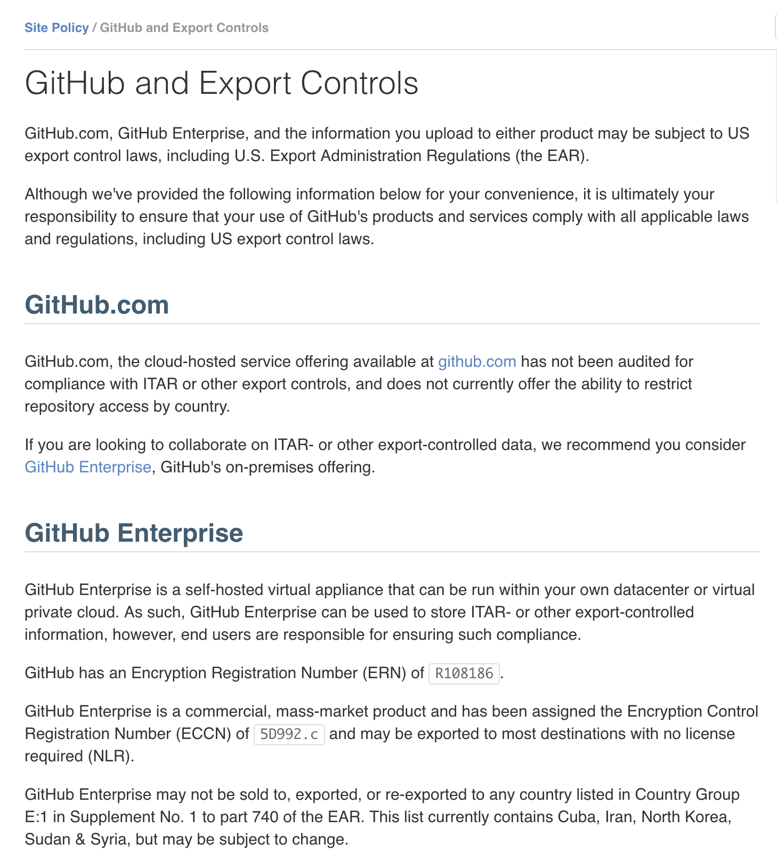

Slide 7
Pricing
GitHub Enterprise offers service in 10-user blocks.
One discounted license is $1,890, down from $2,520, paid annually. One license is 10 user license seats.
Helpful FAQ: https://enterprise.github.com/faq
A user account is considered to be dormant if it has not been active for at least a month. You may choose to suspend dormant users to free up license seats.
The 10 users can rotate among whoever is actively developing.
Full utilization would be $15.75 per user per month.

Slide 8
Other 501c3 Organizations Using GitHub Enterprise
- DLR Robotic & Mechatronics Center
- Battelle Ecology - LENA Research Foundation
- Project Management Institute
- Eduserv
- IMF
- Max Planck Institue for Molecular Genetics
- Max Planck Institute for Metabolism Research
- The Linux Foundation

Slide 9
Provisioning and Installation
There are a wide variety of ways to provision and install GitHub Enterprise. Since it’s a virtual machine, we have many options.
Amazon Web Service
Azure
Google Cloud
Hyper-V
OpenStack KVM
VMWare
XenServer
https://help.github.com/enterprise/2.11/admin/guides/installation/provisioning-and-installation/

Slide 10
Administration? Training? Maintenance? Benefits?
GitHub Enterprise requires some training to use. A variety of training is provided by GitHub Enterprise. Support for GitHub Enterprise is offered at no extra cost, 24 hours a day, 5 days a week.
A volunteer would be required to administer the virtual appliance. We believe this is less work and less risk than current servers and workspaces.
The primary benefit is that ITAR compliance is positively achieved by a certified service.
Digital payload design at AMSAT can dramatically increase, as it would have a modern, publicized, accessible, regulatory compliant workspace. This is key to recruiting and retaining volunteer engineering talent in a competitive environment.

Slide 11
Endorsements
Howie DeFelice
Wally Ritchie
Steve Conklin
Michelle Thompson

