Slide 1
Credit-worthiness
Project Title: Predict credit-worthiness of a person applying for a loan.
Abstract:
The goal of this project is to analyze the given data set and predict the whether a particular person is capable enough to pay off the loan. The data was divided into two parts i.e. the training and the test dataset. Models were developed based on the training dataset and applied to the test dataset to find out the accuracy of each model based on the predicted values generated. Based on these values we can determine how good a particular model is for prediction of loan defaulters.
Submitted By:
Abrish
Harshit
Pratik
Siddhesh

Slide 2
Table Of Content:
Introduction .................................................................................................................................................................. 3
Summary of the data/ Review of Literature ................................................................................................................. 4
Transforming Data ....................................................................................................................................................... 6
Treating missing data ...................................................................................................................................................6
Data Standardization ................................................................................................................................................... 7
Label Encoding ………................................................................................................................................................. 8
Data visualization ........................................................................................................................................................ 9
Steps performed ........................................................................................................................................................ 11
Results ...................................................................................................................................................................... 14
Conclusion ................................................................................................................................................................ 17
References ................................................................................................................................................................ 18

Slide 3
Credit-worthiness Project
DSP-27
Predict credit-worthiness of a person applying for a loan.
Introduction
In general, whenever an individual/corporation applies for a loan from a bank (or any loan issuer), their credit history undergoes a rigorous check to ensure that whether they are capable enough to pay off the loan (in this industry it is referred to as credit-worthiness). The data set contain complete loan data for all loans issued by XYZ Corp. through 2007-2015. The data contains the indicator of default, payment information, credit history, etc. By making use of given data we are building data model to predict the probability of loan default, so that loss can be avoided in such cases.
Number of observations in the given dataset: 855969
Number of variables in the given dataset:73

Slide 4
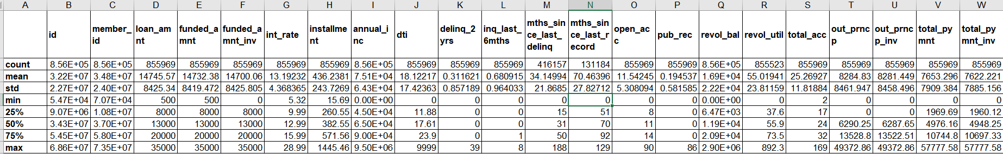
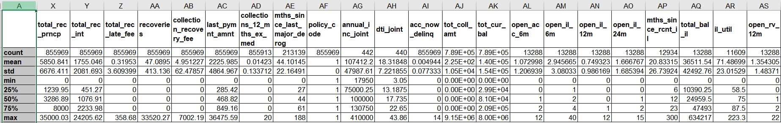
Summary of dataset
We can see that there are a total of 855969 observations in given dataset files contain complete loan data for all loans issued by XYZ Corp. through 2007-2015. As mentioned in problem statement we have devided the data into two parts training(May 2007 to May 2015) & testing(June 2015 to Dec 2015)
il_util variable contains the maximum number of missing values i.e.844360. il_util variable ratio of total current balance to high credit/credit limit on all install account.
Varibales which needs to be label encoded are “emp_length”“term”, “Grade”, “home_ownership”, “verification_status”, “purpose”, “application_type”, “initial_list_status”. Label encoding eases the task of reading the data for machine.
The variable “emp_length” has 10 levels which contains the information about each applicant's employment history.
The highest loan amount applied by applicant is 35000 & minimum is 500.

Slide 5
The Dataset • • •
Categorical Variables:
Term
Grade
home_ownership
verification_status
issue_d
Purpose
initial_list_status
application_type
Continuous Variables:
loan_amnt
funded_amnt
funded_amnt_inv
int_rate
Installment
emp_length
annual_inc
Dti
delinq_2yrs
inq_last_6mths
mths_since_last_delinq
open_acc
pub_rec
revol_bal
revol_util
total_acc
Continuous Variables:
out_prncp
total_pymnt
total_rec_prncp
total_rec_int
total_rec_late_fee
Recoveries
collection_recovery_fee
last_pymnt_amnt
collections_12_mths_ex_med
policy_code
application_type
acc_now_delinq
tot_coll_amt
tot_cur_bal
total_rev_hi_lim
default_ind

Slide 6
Transforming Data
Treating missing data
The missing data must be treated to ensure accurate analysis. We are dropping 34 variables from dataset as they are not important for our analysis. There are 7 variables from remaining contains missing data as we saw in the data summary. First, we will make a list of those variables which needs to be treated. Once list is created, we will use looping statements to replace the NA values with either mean or mode of that variable. We are using mean for continuous variable & mode for categorical variable here.
‘mths_since_last_delinq’ is the variables which are treated by filling ‘0’ in place of missing values.
Treatment of missing values ensures that the new data is the correct representation of the original data and it reduces the errors during analysis.
Variables treated: 'emp_length', 'tot_coll_amt', 'tot_cur_bal', 'total_rev_hi_lim','revol_util’
‘mths_since_last_delinq’, ‘collections_12_mths_ex_med’

Slide 7
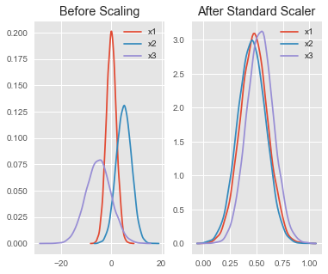
Data Standardization
StandardScaler() is used perform the task of data Standardization. Usually a dataset contains variables that are different in scale. For e.g. in our data set Loan_amnt column with values 500 to 35000 scale and int_rate column with values on scale 5.320 to 28.99.As these two columns are different in scale, they are Standardized to have common scale while building machine learning model.
Above example shows how standardization works.
StandardScaler(): In order to standardize the data set we are using SatndardScaler() on the data set. We are using the X train dataset to fit the data & transforming other datasets w.r.t. X train dataset.

Slide 8
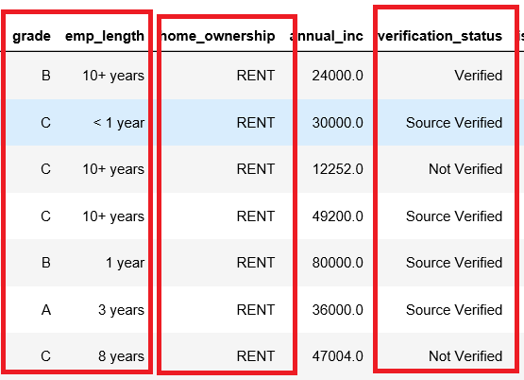
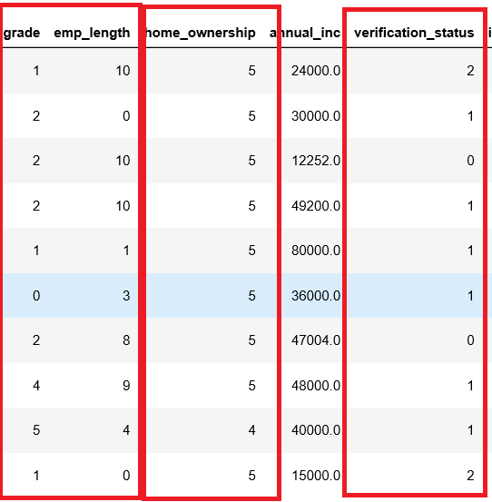
LABEL ENCODING
Label Encoding refers to converting the labels into numeric form so as to convert it into the machine-readable form. Machine learning algorithms can then decide in a better way on how those labels must be operated. It is an important pre-processing step for the structured dataset in supervised learning.
Label encoded variables in our DATA:
In “emp_length” we have converted values to 'emp_length' < 1 year':0,'1 year':1,'2 years':2,'3 years':3,'4 years':4,'5 years':5,'6 years':6,'7 years':7,'8 years':8,'9 years':9,'10+ years':10.
In our data we have used LabelEncoding for “term”, “Grade”, “home_ownership”, “verification_status”, “purpose”, “application_type”, “initial_list_status”.

Slide 9
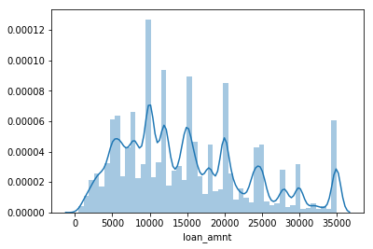
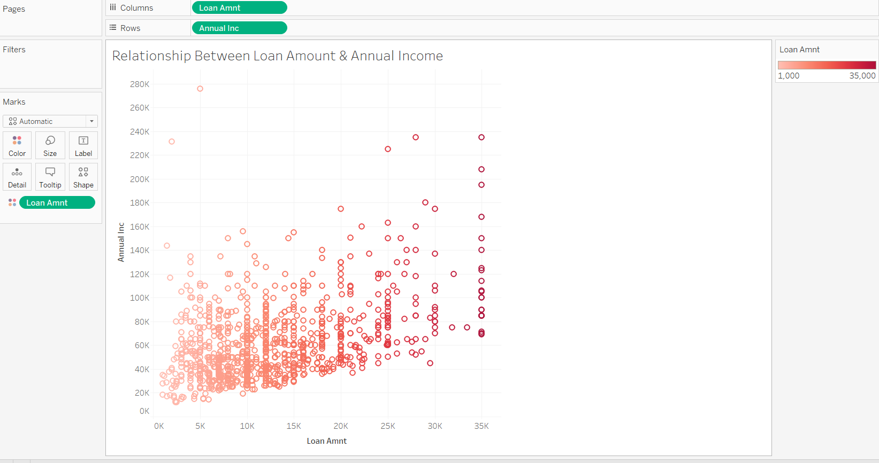
Data visualization
The distribution plot of the Loan_amnt variable is on the right and as we can see that this distribution is fairly normal.
We have also tried to plot relationship between the loan amount and annual income. We have only considered 1000 observations of original dataset. We can clearly see that higher the income higher the loan that a person can get.

Slide 10
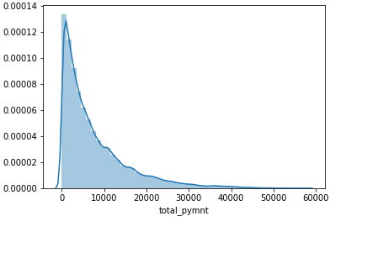
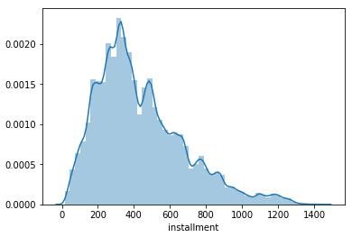
Data visualization (contd.)
On the other hand, if we see the distribution plot of variable total_pymnt and installment , it is positively skewed or right skewed.
Before performing any algorithm in data we need to transform data into bell-shaped or normal or symmetric distribution.
Here, we have used standard scaler for data transformation.

Slide 11
Steps
1. Importing required libraries
Numpy
Pandas
Scikit-learn
Seaborn
Matplotlib
2. Fetching the required packages from the library
3. Loading the data in Python(Spyder) from system storage
The data XYZCorp_LendingData.txt is a windows comma separated value (csv) file that contains 74 variables and 855969 observations.
Before performing any changes to data, created copy of original data.
4. Cleaning the data based on their importance
Dropping variables that are not required for analysis.
5. Treatment of missing data
Missing values needs to be treated in data before performing any analytical algorithm.

Slide 12
Steps(Contd.)
For that we have used measures of central tendency(i.e. mean, mode). We assigned the mean and mode to continuous variable and categorical variables respectively. In few variables missing values are treated by filling those with zeros because of their level of importance.
6. Creating levels
We used Label Encoder to convert categorical data, or text data, into numbers, which our predictive models can better understand.
8. Data Partition
Dividing data into two part training dataset (June 2007 - May 2015) and testing dataset(June 2015 - Dec 2015) as stated in problem statement.
9. Data Standardization
As we already seen from data visualization that shape of data is not symmetric or normal in some variables. Therefore we need to transform data to normalize the shape of data.
Here we have used Standard Scaler for transforming data.

Slide 13
10. Model Building
Several models used on the data set to get a good accuracy and sensitivity.
a. Logistic Regression – Logistic regression is a statistical model that in its basic form uses a logistic function to model a binary dependent variable. In the Model 1 we have used logistic regression algorithm to predict probabilities of borrower who may default their payment.
b. Decision Tree Classifier - A Decision tree is a flowchart like tree structure, where each internal node denotes a test on an attribute, each branch represents an outcome of the test, and each leaf node (terminal node) holds a class label. In the Model 2 we have used Decision Tree Classifier algorithm to predict probabilities of borrower who may default their payment.
c. Random Forest- Random forest classifier creates a set of decision trees from randomly selected subset of training set. It then aggregates the votes from different decision trees to decide the final class of the test object. In the Model 3 we have used Decision Tree Classifier algorithm to predict probabilities of borrower who may default their payment.
d. Boosting - The term ‘Boosting’ refers to a family of algorithms which converts weak learner to strong learners. Boosting is an ensemble method for improving the model predictions of any given learning algorithm. In the Model 4 we have used Adaboost Classifier algorithm to predict probabilities of borrower who may default their payment.
11. Analysis
Analyzing results from different models. Checking confusion-matrix, precision and recall(sensitivity and specificity) of the model.
12. Interpreting results
Comparing results obtained from models

Slide 14
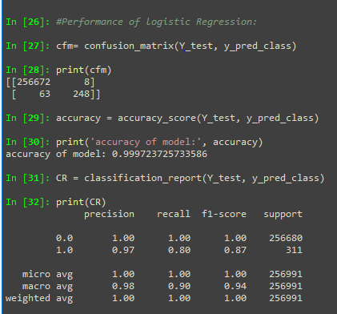
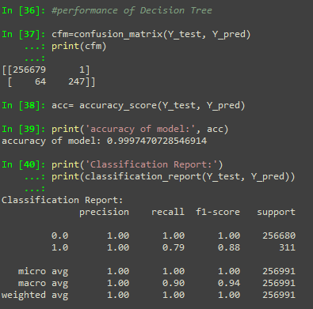
Results
Logistic Regression
Decision Tree

Slide 15
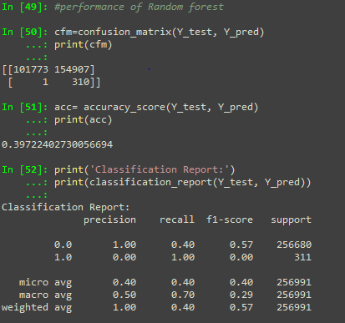
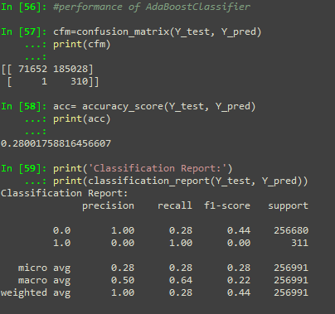
Results
Random Forest
Boosting

Slide 16
Result Description
As we see from results from the various model we have checked the confusion matrix and accuracy.
From logistic regression model we got accuracy of 99.97% accuracy and sensitivity of 80%.
From Decision Tree model we got accuracy of 99.97% accuracy and sensitivity of 79%.
From Random Forest model we got overall accuracy of 39.72% accuracy and sensitivity of 100%.
From Ensemble Boosting model we got accuracy of 28.001% accuracy and sensitivity of 100%.
If we compare all the models we se last two model are not precisely accurate.
However in comparison between Logistic regression model and Decision Tree Model, both are performing similarly. But in case of logistic regression model we get better sensitivity.
Therefore we are considering Logistic regression model as our final model for prediction of credit worthiness of borrower.

Slide 17
Conclusion
Banks seeks lot of information from borrower to provide credit/loan before making any credit decision. As we already see from this data set that bank collect information from various source like from borrower, credit agencies, third party vendor etc..
With the help of these information bank decides the credit-worthiness of borrower but if it done manually it will take lot of time as well as cost to bank.
However with the help of using analytical tools and algorithm bank will save a lot of time and cost as well as get more accurate results and can make better business decision.

Slide 18
References
en.wikipedia.org ( Theoretical Information )
https://scikit-learn.org
images.google.com ( Explanatory images)

