Slide 1
Protein Interface Prediction with GNNs
Does message passing improve contact prediction between two proteins?
Paper-guided PyTorch reimplementation of Fout et al. (NeurIPS 2017)
Solo course project · Official Docking Benchmark 5 features and labels
Protein Interface Prediction · Solo GNN project
1

Slide 2
1 · The prediction question
• A protein interface is the region where two proteins touch.
• Score a pair: one amino-acid residue from each protein.
• Positive label: non-hydrogen atoms within 6 Å in the bound complex.
• The bound cross-protein distance defines the answer, not an input.
Protein Interface Prediction · Solo GNN project
2

Slide 3
2 · Research data and leakage control
• Use the authors' official Docking Benchmark 5 data release.
• Input: 70 residue features from each unbound protein partner.
• Targets: pair contacts measured in the known bound complex.
• 175 development complexes and 55 separate official test complexes.
• Downloaded files are checked against published MD5 hashes.
Protein Interface Prediction · Solo GNN project
3

Slide 4
3 · Node-average graph convolution
hᵢ(next) = ReLU(Wc hᵢ + Wn mean of 20 neighbors)
• Each residue is a graph node with 20 spatial nearest neighbors.
• Center and neighbor features have separate learned weights.
• Two shared 64-unit layers encode each protein independently.
• This is a small version of Fout et al.'s Equation (1).
Protein Interface Prediction · Solo GNN project
4

Slide 5
4 · Pair scoring and matched baseline
• One shared encoder produces a vector for each residue on both proteins.
• Pair head uses sum, absolute difference, and elementwise product.
• These features make the score invariant to swapping partners.
• Baseline: same node inputs and pair head, with no neighbor aggregation.
Protein Interface Prediction · Solo GNN project
5

Slide 6
5 · Experimental protocol
• Fixed 140/35 development split; choose epoch by validation median AUC.
• Retrain each selected model on all 175 development complexes.
• Evaluate every released pair label in the 55 official test complexes.
• Test: 4,958,317 labeled pairs, but only 4,871 contacts (0.0982%).
• Primary metric: median ROC AUC across complexes; also report AP.
Protein Interface Prediction · Solo GNN project
6

Slide 7
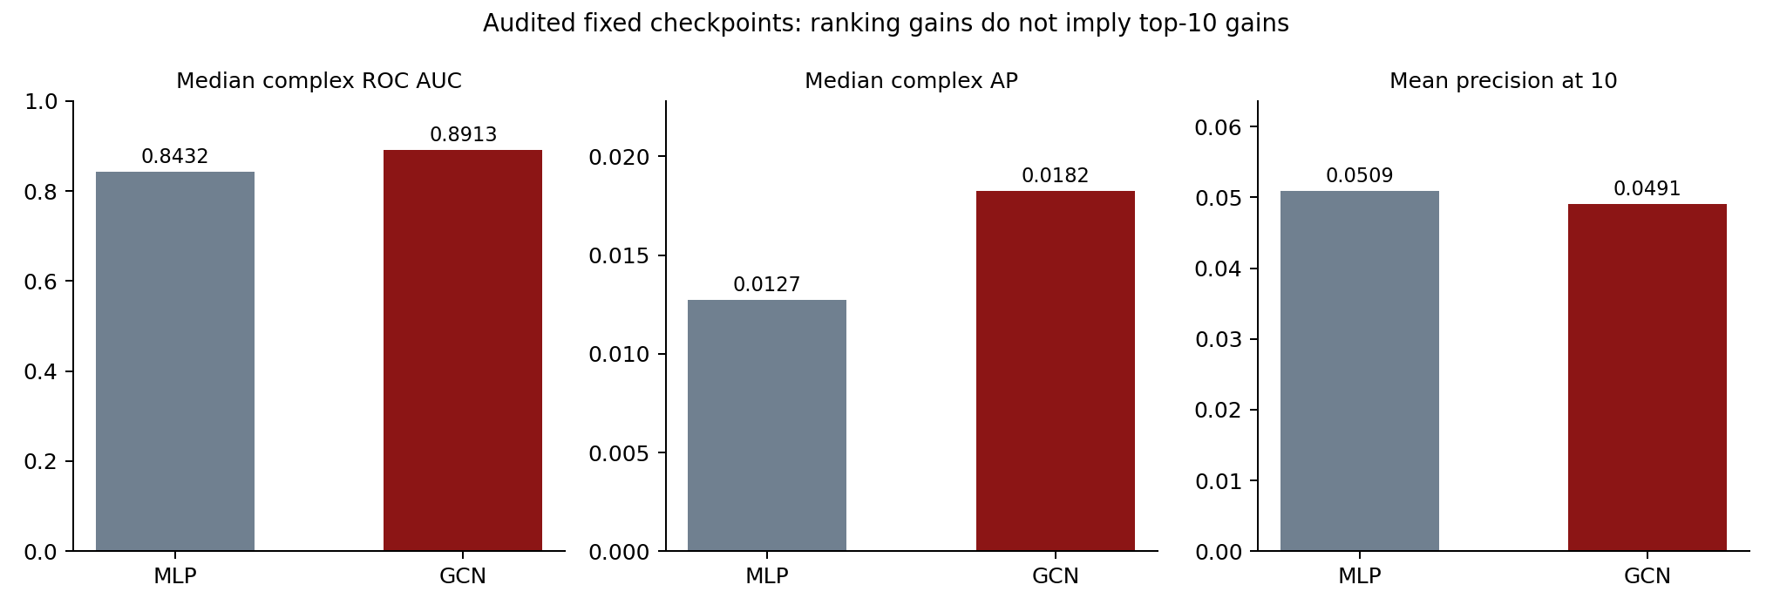
6 · Overall ranking and early retrieval
GCN AUC 0.891
MLP AUC 0.843
Higher GCN AUC on 42/55 complexes.
Top-10 precision: GCN 4.91%; MLP 5.09%.
Protein Interface Prediction · Solo GNN project
7

Slide 8
7 · Why these metrics are different
• Median complex ROC AUC: overall ordering; gives each complex one vote.
• AP: contact concentration through the ranking; differs from trapezoidal PR area.
• Precision/recall at K: usefulness under a limited inspection budget.
• GCN retrieves 27/550 top-10 contacts; MLP retrieves 28/550.
• Report the measures where GCN loses as well as where it improves.
Protein Interface Prediction · Solo GNN project
8

Slide 9
8 · Raw score 0.5 is a diagnostic
• GCN: 2,702 true positives and 475,316 false positives.
• Precision 0.565%; recall 55.47%.
• F1 0.01119; MCC 0.04869; threshold not validated.
• Negative sampling and class weighting make raw sigmoid scores uncalibrated.
• Always-negative accuracy is 99.9018%, despite finding no contact.
Protein Interface Prediction · Solo GNN project
9

Slide 10
9 · Audit evidence and remaining limits
• Saved-checkpoint AUC and AP reproduced exactly; independent formulas agree.
• Tie handling, labels, pair indices, checksums and split IDs were checked.
• One training seed; different parameter counts; published study used ten runs.
• 24 test cases were used earlier; the historical 31-case AUC interval includes zero.
• Next: independent validation/calibration and a fresh external test set.
Conclusion: stronger overall ranking; top-10 retrieval does not improve.
Protein Interface Prediction · Solo GNN project
10

