Slide 1

Team Name :
TechMatrix Solvers
Team Members:
Kripanshu Gupta (2022-2026) MERN Stack Developer
Abhay Gupta (2022-2026) ML & Full-Stack Developer
Jay Kumar (2022-2026) ML & Front-end Developer Simran Koshta (2023-2027) Full Stack Developer (NIT Calicut CSE)
Institute:
Shri Ram Institute of Technology
Contact details for the team lead:
Phone:- 7067058400
Email:- gkripanshustranger@gmail.com
LINK OF THE DEMO VIDEO
Part 1 https://youtu.be/V4u56VDxRTY
Part 2 https://youtu.be/b4--EaAh6wA

Slide 2

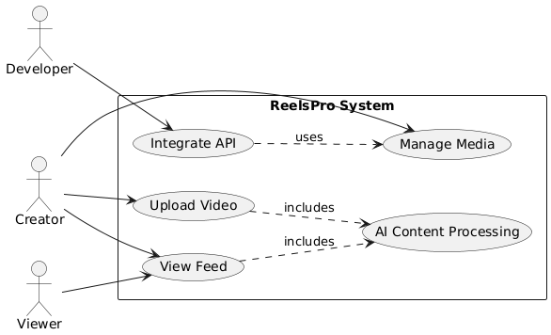
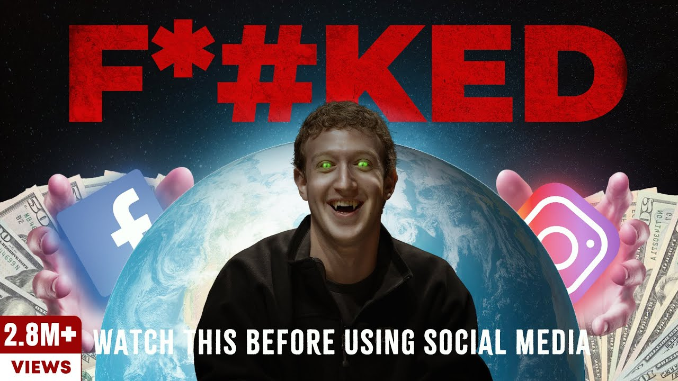
One-line problem statement:- Efficiently manage and stream short-form video content with seamless performance without Explicit content.
Brief context:- Our challenge is to develop a streamlined, scalable platform that leverages modern web technologies and services like ImageKit to simplify media management, reduce load times, and enhance the content delivery experience for users worldwide.
Who faces this problem (target users)?:-
-Independent creators,
-content platforms,
-developers
-building video-based web apps.
Notes:
Idea Submissions Form – Details of the form Topic
Thesis Abstract Concept Note What is the solution Build? Business use case (Less than 100 – 200 words) Judge and filter becomes easy

Slide 3
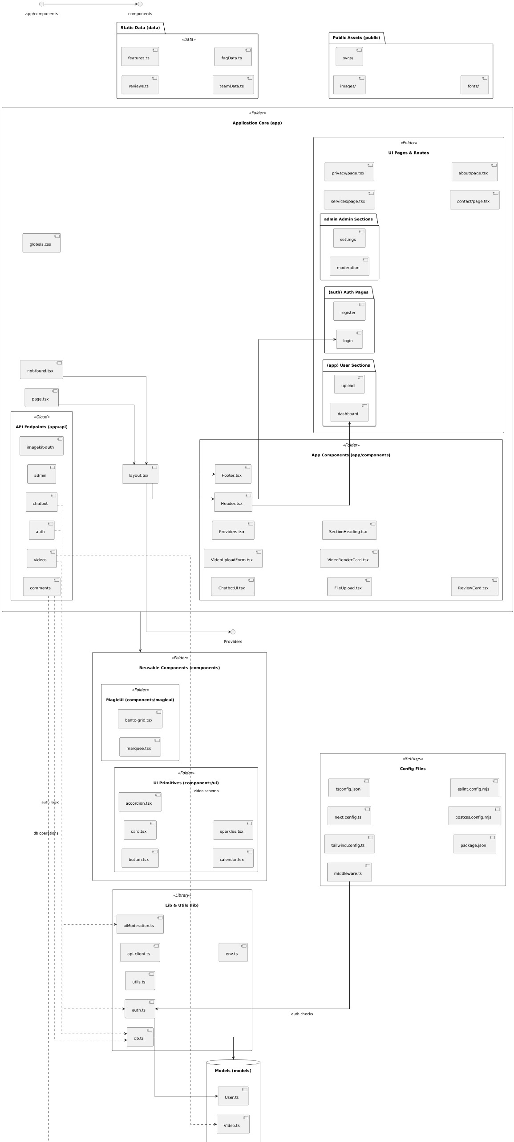
One-liner on what your solution does:- ReelsPro simplifies uploading, processing, and globally distributing short-form video content using modern web technologies.
Key features or functionalities:-
- Drag-and-drop video upload
- ImageKit integration for media optimization
- Responsive video player.
- Serverless deployment-ready
How AI is used:-
-Generate tags or descriptions for uploaded images using SoTA AI (State of The Art) models .
-Use AI to detect inappropriate or harmful content in uploaded images before publishing by tag.
-Apply AI-powered image filters, upscaling, or background removal in future.
-Analyze user interactions to recommend trending reels or personalize the feed.
ARCHITECTURE OF THE REELS PRO
Notes:
Idea Submissions Form – Details of the form Topic
Thesis Abstract Concept Note What is the solution Build? Business use case (Less than 100 – 200 words) Judge and filter becomes easy

Slide 4
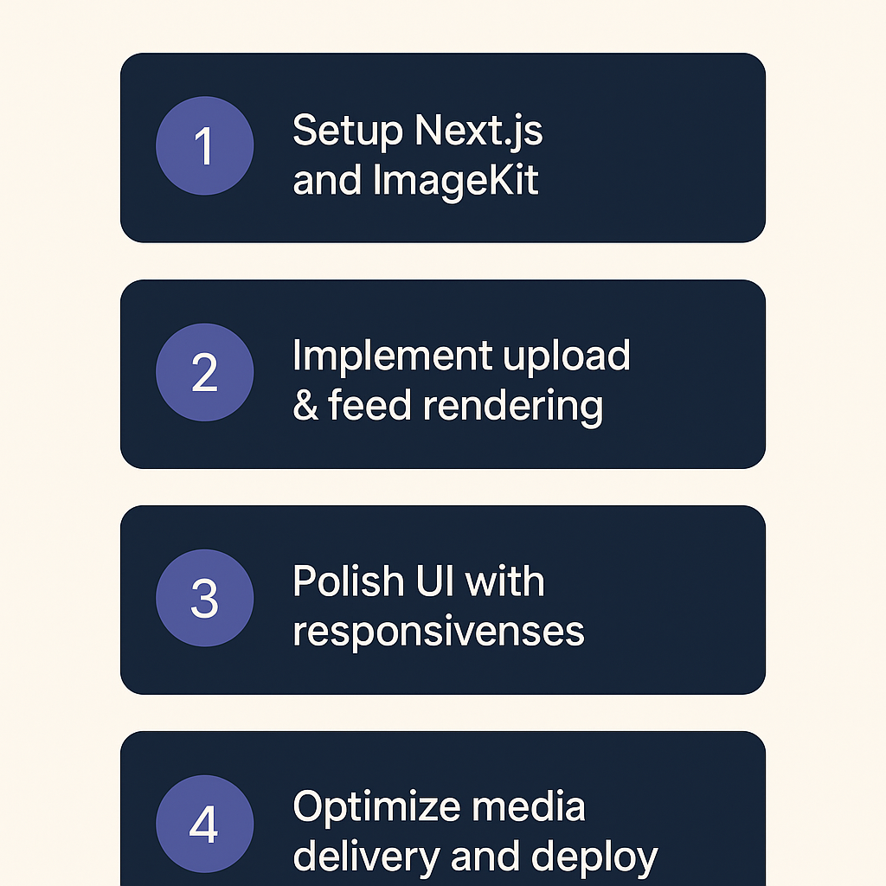
ROADMAP FOR PROJECT
Tech stack/tools/frameworks to be used:-
- Front-end : Next JS 15, React 19, Typescript
- Styling : Tailwind CSS , Daisy UI
- Backend/Media: ImageKit.io
- Authentication : NextAuth.JS, JWT
- Database : MongoDB with Mongoose
- Form Handling :- React Hook Form
- Deployment: Vercel
Short development plan (how you’ll execute in 36 hours):-
1. Setup Next.js and ImageKit
2. Implement upload & feed rendering
3. Polish UI with responsiveness
4. Optimize media delivery and deploy
Team role distribution:
- Kripanshu Gupta : Building and maintaining server-side logic & database interactions for the web app
- Abhay Gupta : Deploying and maintaining the backend application on a cloud platform .
- Jay Kumar : Designing the user interface and user experience of the web application . - Simran Koshta : Managing Full Stack application and MLOPs Engineering.
Notes:
Idea Submissions Form – Details of the form Topic
Thesis Abstract Concept Note What is the solution Build? Business use case (Less than 100 – 200 words) Judge and filter becomes easy

Slide 5
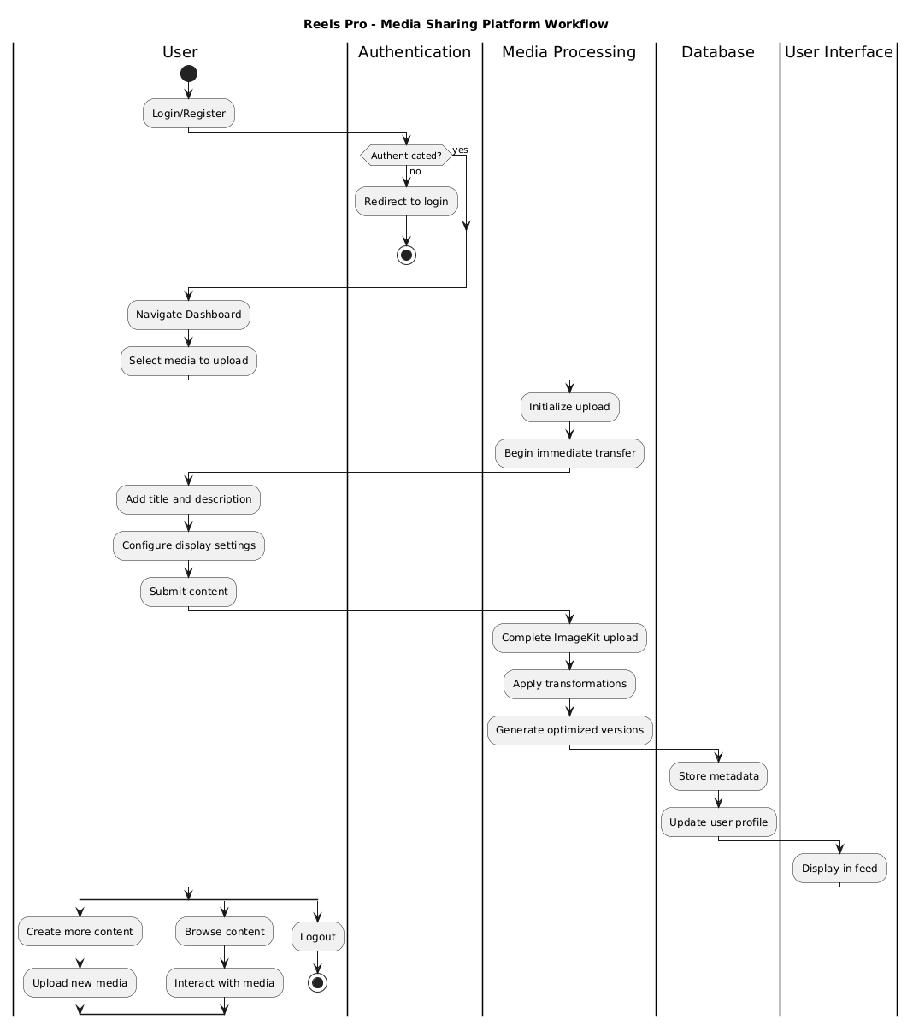
Expected outcome :
- Functional media sharing platform with user accounts, media uploads, feeds, and display.
- Efficient media management (ImageKit) for optimized storage, transformation, and delivery.
- Responsive and user-friendly interface (Next.js).
- Deployable Application.
value created:
- For Users: Platform to share and view visual content with fast loading and optimized media.
- For Content Creators: Platform to showcase work and manage media.
Potential social, economic, or tech impact:
- Faster content delivery, enhanced user experience, platform-agnostic use
What’s next? (How it can scale after the hackathon):
- AI-driven content moderation and curation
- Analytics dashboards for user engagement
- Monetization support for creators
Notes:
Idea Submissions Form – Details of the form Topic
Thesis Abstract Concept Note What is the solution Build? Business use case (Less than 100 – 200 words) Judge and filter becomes easy

Slide 6

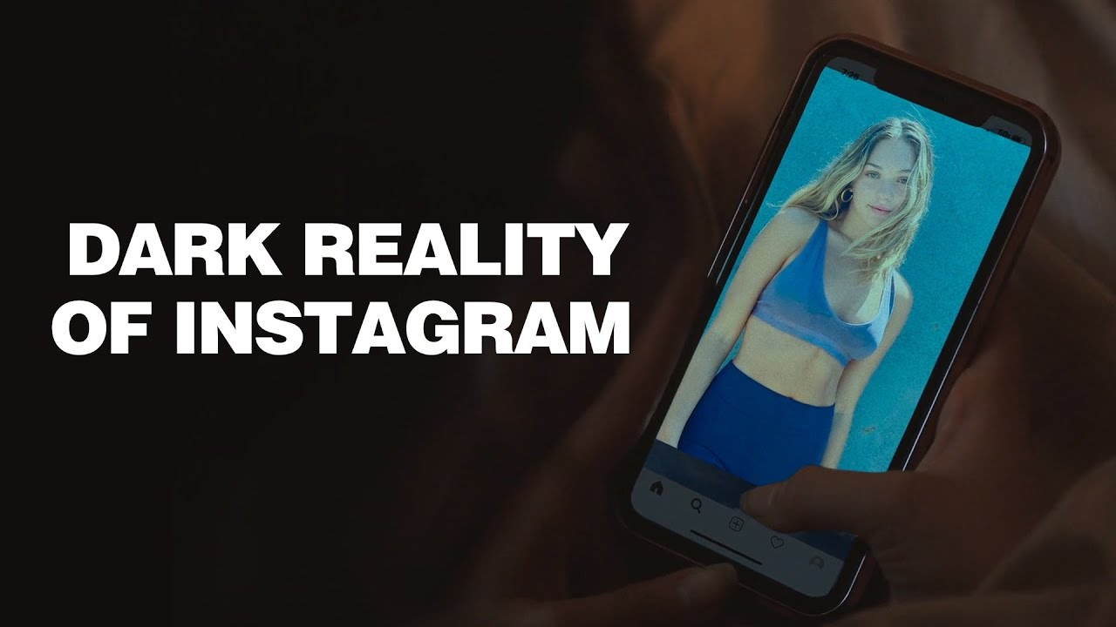
How it is different from Existing?
How ReelsPro is Different from Existing Platforms:
WITHOUT Fear of Shame daily Vlog Upload. No Explicit Content
Deep AI integration: tagging, moderation, and feed personalization, unlike most platforms that offer only basic AI features.
Seamless drag-and-drop uploads and real-time media optimization via ImageKit, reducing load times and manual steps.
Platform backend for developers to build custom video apps, not just a consumer-facing social feed in future.
Serverless, scalable deployment for cost-effective growth.
Focus on actionable analytics and future monetization support for creators, beyond simple content sharing
Free from explicit content different from InstaGram

Slide 7
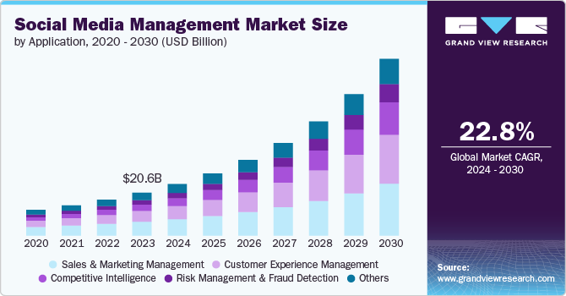
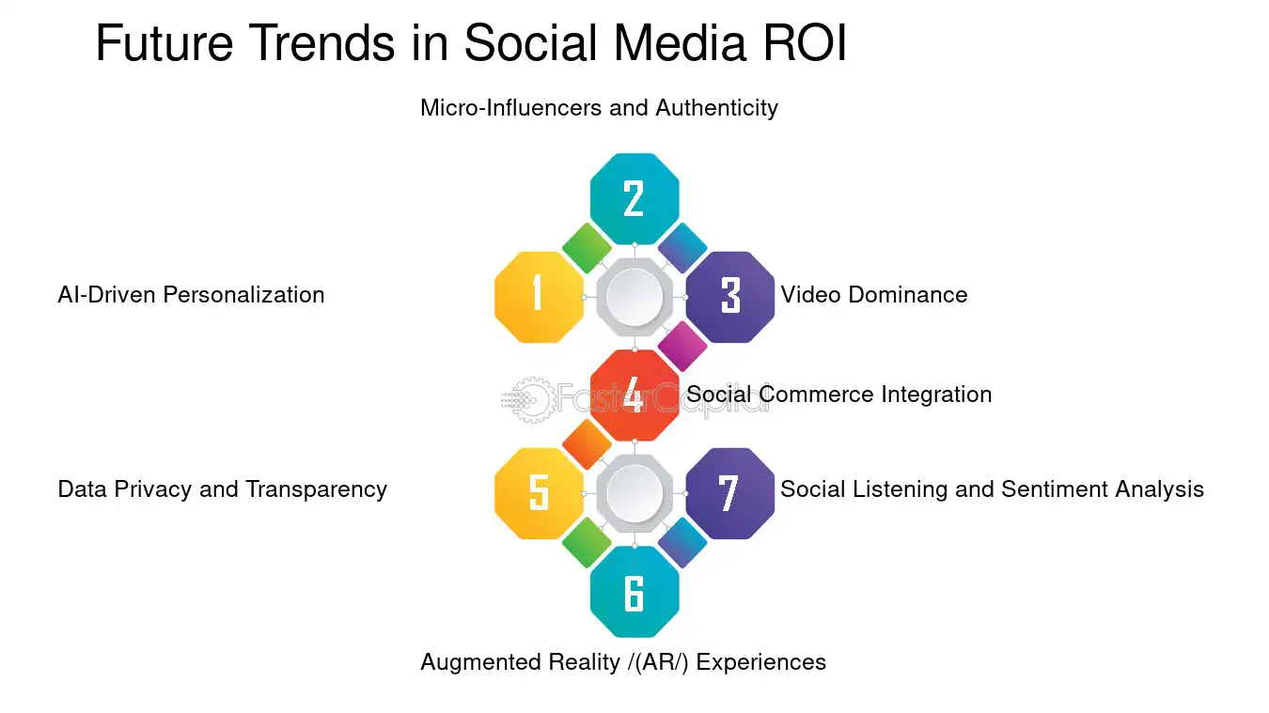
Future Integration and Financial Feasibility
Future Integration:
By 2025, AI-driven features like automated content creation, hyper-personalized feeds, and advanced moderation will become standard, lowering entry barriers and boosting engagement. Integrating analytics dashboards and monetization tools will further scale reach, aligning with projected 12.5% CAGR annual market growth and rising AI adoption
Financial Feasibility:
The short video platform market is projected to grow from $2.22B in 2025 to $3.55B by 2029 (12.5% CAGR), driven by AI-powered automation, which can cut video production costs by up to 80%. However, financial sustainability requires balancing regulatory costs, monetization, and responsible AI integration

Slide 8
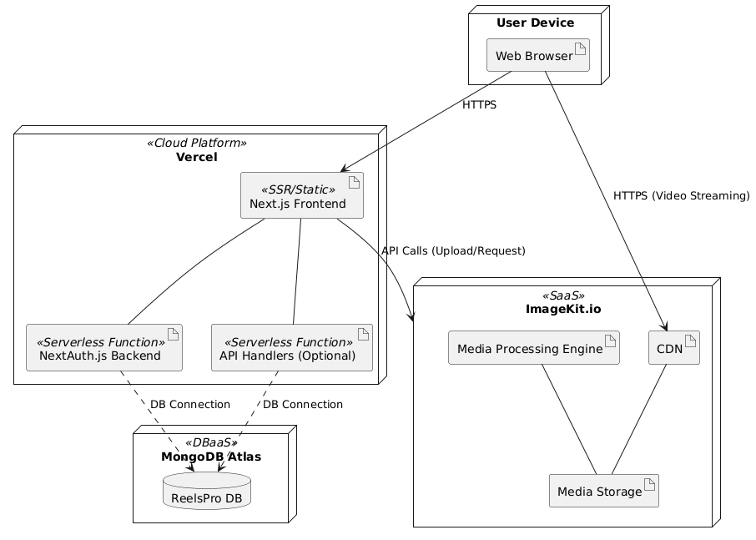
System Flow And Deployment Diagram
Video Entity: Includes attributes like ModerationStatus and potentially AIGeneratedDescription, explicitly marked as outputs from AI processes.
Tag Entity: Tags themselves are often generated by AI (TagName). The relationship Video }o--o{ Tag is noted as being "AI Assigned".
Interaction Entity: While not directly created by AI, this entity's data (user views, likes) is crucial input for the AI Feed Personalization algorithm, as indicated by the note.
These diagrams provide a structural overview (ERD) and a data flow perspective (SFD) of the ReelsPro system, incorporating the planned AI functionalities based on your presentation.

Slide 9
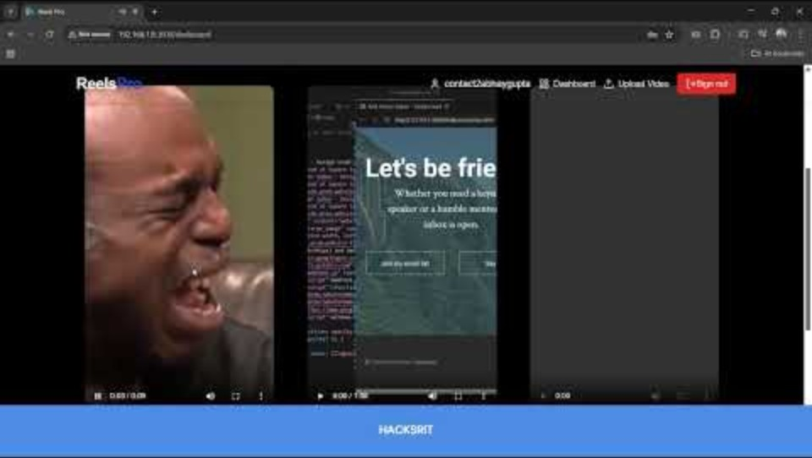
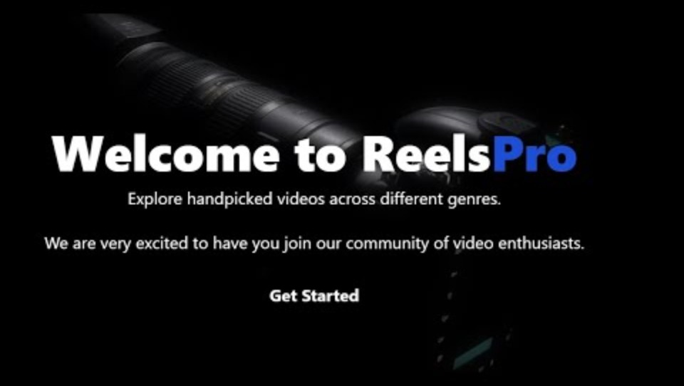
Updated Links for DEMO
PART-1 ReelsPRO
PART-2 Special Features

Slide 10



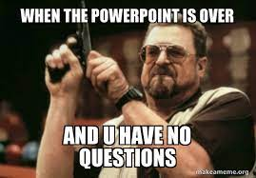
VIEW PROJECT DEMO
Thank You
Contact me on Email ID
gkripanshustranger@gmail.com contact2abhaygupta@gmail.com

