Slide 1



SHRI RAM INSTITUTE OF TECHNOLOGY, JABALPUR (M.P.)
Department Of Computer Science & Engineering MAJOR PROJECT-I
Session 2025-26
PROJECT NAME:
Helmet_Detection_OCR_ANPR
TEAM LEADER :
Bhumika Patel
Team Member
Abhay Gupta – 0205CCC221005
Aditi Lakhera – 0205CC221011
Bhumika Patel – 0205CC221050
Balraj Patel – 0205CC221049
SUBMITTED To :
Prof. Deepak Singh Rajput
BASE REASEARCH PAPER
Project GitHub Link

Slide 2

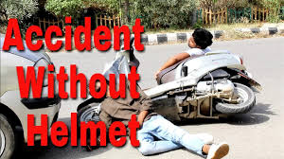
PROBLEM
STATEMENT
I
n countries like India, Brazil, Thailand, majority of population uses motorcycles for daily commute. In India, In most of these countries, wearing helmet for motorcyclists is mandatory by law. Also, considering safety of people using motorcycles, wearing helmet is inevitable.
Currently, in practice, Traffic Police are entrusted with the task of ensuring that motorcycle riders wear helmet. But this method of monitoring motorcyclists is inefficient due to insufficient police force and limitations of human senses also leads to CORRUPTION.
Also, all major cities use CCTV surveillance-based methods. But, those require human assistance and are not automated. Due to the increasing number of motorcycles and the concern for human safety, there has been a growing amount of research in the domain of road transport.
The system proposed in this paper automates the task of monitoring motorcyclists.
BASE REASEARCH PAPER
Helmet_Detection_OCR_ANPR
Project GitHub Link

Slide 3
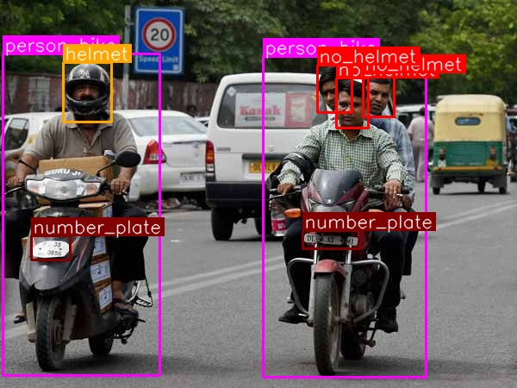
SOLUTION
W
e are proposing In India road accidents are increased very rapidly and lots of deaths are occur due to head injuries because number of peoples not wearing helmets ,so to avoid the system that automatically detects the peoples who are not wearing helmet and also detect number plates of the motorcycles to penalize that persons.
Project GitHub Link
BASE REASEARCH PAPER
Helmet_Detection_OCR_ANPR

Slide 4
Administrator (Traffic Police)
1. The administrator is equipped with secure login credentials to access the central management system. 2. Can monitor the operational status of the helmet detection system, including camera functionalities and algorithm efficiency. 3. Empowered to update system parameters, manage user access, and enhance security measures.
MODULE
Customer (Rider)
1. Every rider is registered in the system with a unique ID. 2. Riders register using personal details such as name, contact information, and vehicle details.
3. Can select or modify helmet detection services and view past detection history.
Manager (System Operators)
1. Responsible for the continuous monitoring of the helmet detection system. 2. Manages and coordinates the real-time data flow between detection systems and data storage. 3. Generates regular compliance reports and system status updates for administrative review.
Technical Support (Maintenance and Development Team):
1. Ensures the smooth operation of helmet detection technologies and infrastructures. 2. Regularly updates software, including the YOLOv11 detection models, and maintains hardware components. 3. Handles troubleshooting and technical issues, ensuring high system reliability and efficiency.
BASE REASEARCH PAPER
Helmet_Detection_OCR_ANPR
Project GitHub Link

Slide 5
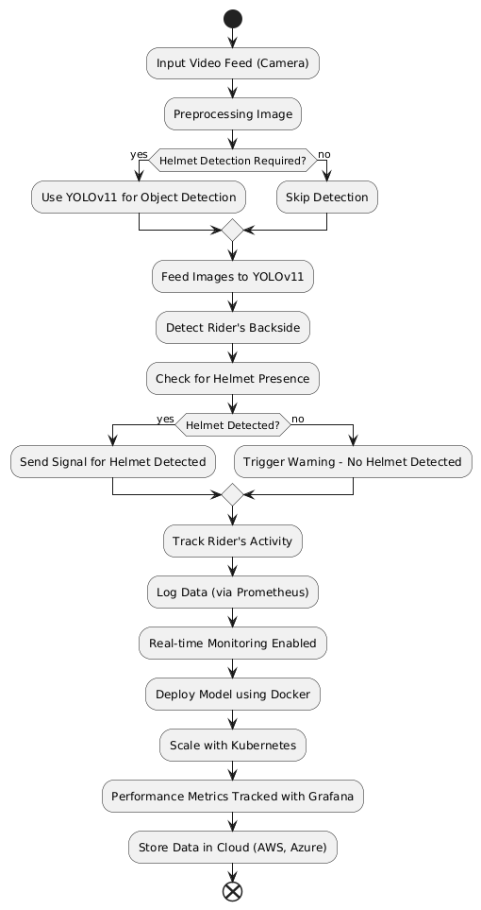
T
E
C
The Helmet Detection System ANPR uses modern technologies:
H
N
Front-end Development: Crafted with HTML5, CSS3, JavaScript, and Bootstrap to provide a seamless and accessible user interface.
O
L
O
Back-end Development: Utilizes Node.js with an Express framework for efficient server-side operations, while MongoDB offers a scalable and robust database for data management.
G
Y
Object Detection: The core of our detection capabilities lies with the YOLOv11 algorithm, which is renowned for its real-time processing speed and accuracy.
Data Management and Analytics: Prometheus is used for detailed data logging, whereas Grafana provides powerful visualization tools to monitor system performance and compliance metrics dynamically
BASE REASEARCH PAPER
Helmet_Detection_OCR_ANPR
Project GitHub Link

Slide 6

















System Requirements
BASE REASEARCH PAPER
Helmet_Detection_OCR_ANPR
Project GitHub Link
Any Operating System
Any WebBrowser
Internet Connectivity
Authentication Access
Technology Used
HTML5
CSS3
JavaScript
Bootstrap
Node.js
MongoDB
A.W.S.
Front-end development
Front-end development
Front-end development
Front-end development
Back-end development
Database
Server

Slide 7
Proposed System
T
Existing System
he architecture is designed for durability and scalability. It integrates a network of high-resolution cameras linked to a central server that processes the video feeds through the YOLOv11 algorithm. The system identifies whether riders are wearing helmets and logs this data for analysis. Alerts are generated instantly if non-compliance is detected, ensuring that interventions can be made in real-time. This robust setup allows the system to handle extensive data and traffic volumes, making it adaptable to diverse environments, from bustling urban areas to remote industrial sites.
Current helmet detection systems, while developed with good intentions, have been plagued by several limitations like CORRUPTION that drastically reduce their effectiveness and scalability. Many of these systems suffer from low detection accuracy, often failing to recognize helmets accurately in varying lighting conditions, weather, or complex backgrounds.
BASE REASEARCH PAPER
Helmet_Detection_OCR_ANPR
Project GitHub Link

Slide 8

Cost Estimation
Small Scale Deployment: Hardware Costs: ₹20,000 per camera (2-4 cameras) and ₹50,000 for a basic server. (Camera Already Installed) Software Development: ₹1,50,000 for basic setup and customizations. Operational Costs: ₹10,000 per month for maintenance, ₹5,000 for cloud services. Total Initial Costs: ₹2,00,000 to ₹2,40,000. Recurring Costs: ₹15,000 per month.
Large Scale Deployment:
Hardware Costs: ₹20,000 per camera (50+ cameras), ₹10,00,000 for high-capacity servers, ₹10,00,000 for 20 NVIDIA Jetson Nano units. (Camera Already Installed)
Software Development: ₹15,00,000 for AI integrations, ₹5,00,000 for TensorRT licenses, ₹3,00,000 annually for OpenAI API.
Operational Costs: ₹1,00,000 per month for maintenance, ₹50,000 for cloud services, ₹2,00,000 annually for community programs.
Total Initial Costs: ₹55,60,000.
Recurring Costs: ₹1,50,000 per month.
Medium Scale Deployment:
Hardware Costs: ₹20,000 per camera (10-15 cameras), ₹1,50,000 for robust servers. (Camera Already Installed)
Software Development: ₹3,00,000 for advanced integrations.
Operational Costs: ₹25,000 per month for maintenance, ₹15,000 for cloud processing.
Total Initial Costs: ₹4,50,000 to ₹6,50,000.
Recurring Costs: ₹40,000 per month.
Project GitHub Link
BASE REASEARCH PAPER
Helmet_Detection_OCR_ANPR

Slide 9
MODULES
ADMIN
Helmet Safety Manager Details about the administrative module and dashboard for monitoring.
2. Compliance Officer
Details about modules managing helmet detection compliance for employees or users.
3. Rider Safety Tracker Details about modules tracking helmet usage for delivery personnel.
4. User Awareness Hub Details about modules engaging customers in safety practices or helmet-related information.
BASE REASEARCH PAPER
Helmet_Detection_OCR_ANPR
Project GitHub Link

Slide 10
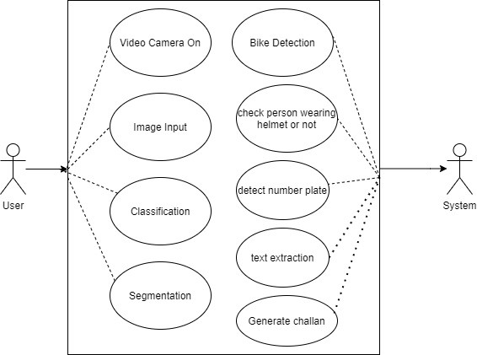
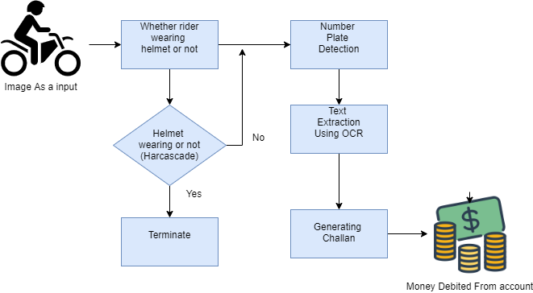
Use Case Diagram
Project GitHub Link
BASE REASEARCH PAPER
Helmet_Detection_OCR_ANPR

Slide 11
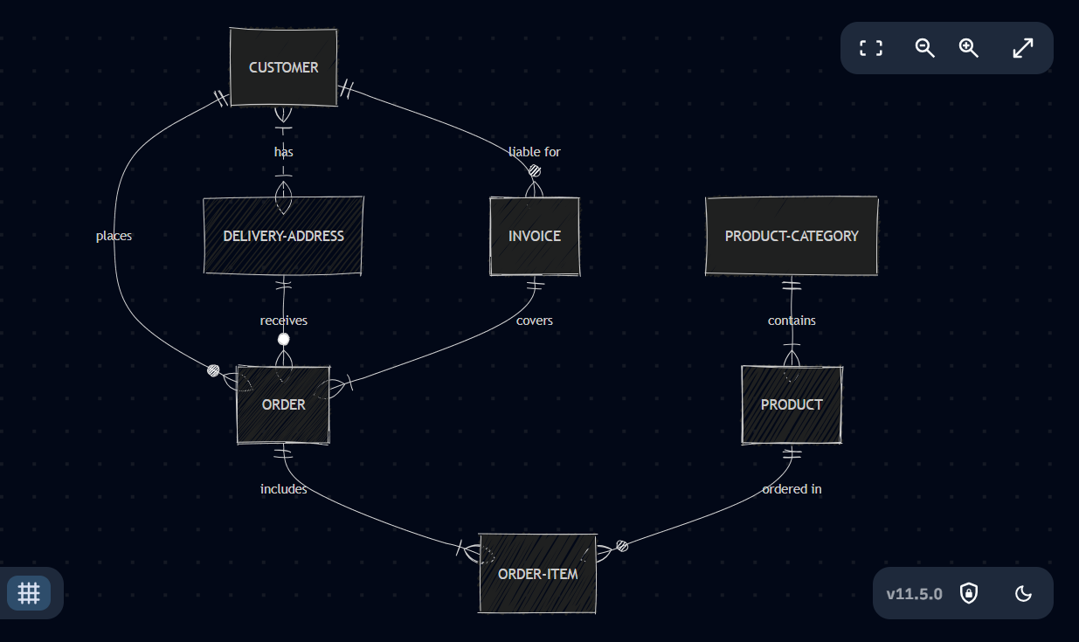
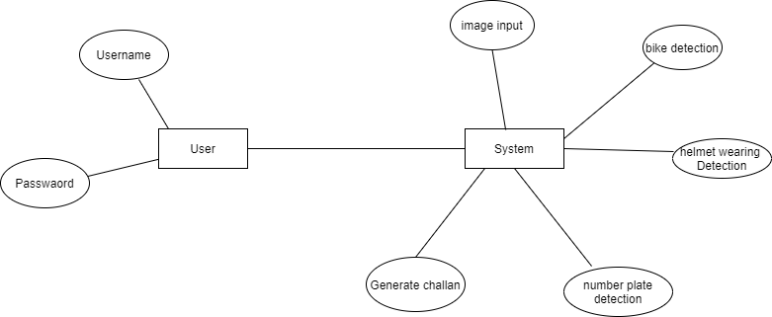
ER Diagram
BASE REASEARCH PAPER
Helmet_Detection_OCR_ANPR
Project GitHub Link

Slide 12
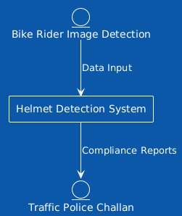

Level-0 DFD Diagram
BASE REASEARCH PAPER
Helmet_Detection_OCR_ANPR
Project GitHub Link

Slide 13
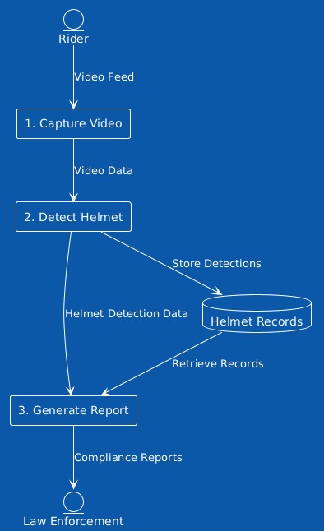
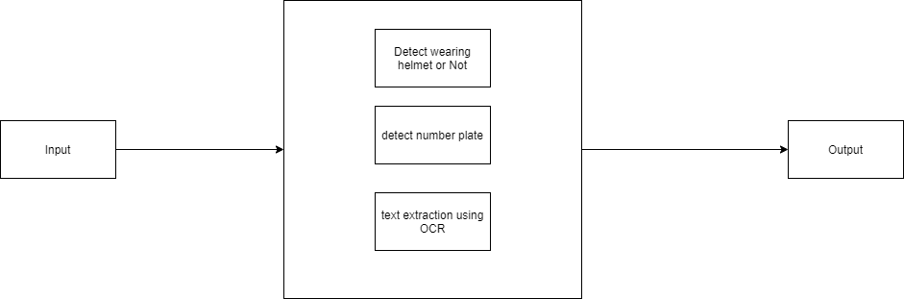
Level-1 DFD Diagram
BASE REASEARCH PAPER
Helmet_Detection_OCR_ANPR
Project GitHub Link

Slide 14
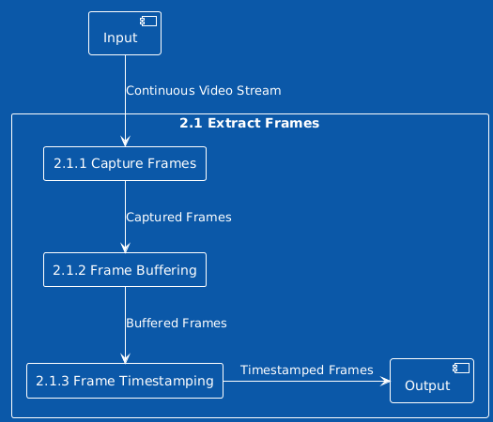
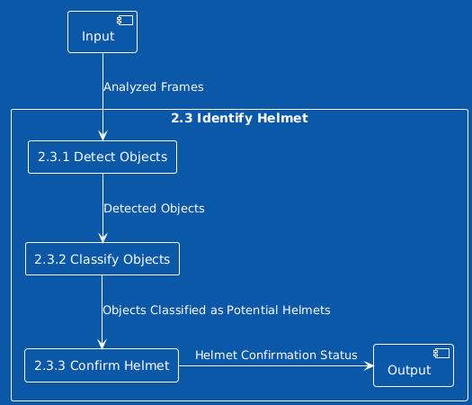
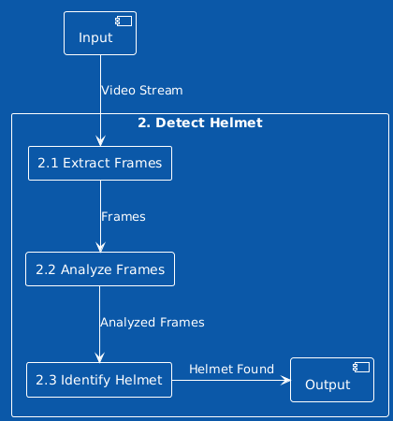
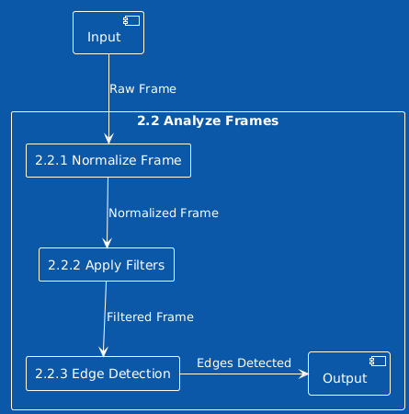
Level-2 DFD Diagram
BASE REASEARCH PAPER
Helmet_Detection_OCR_ANPR
Project GitHub Link

Slide 15
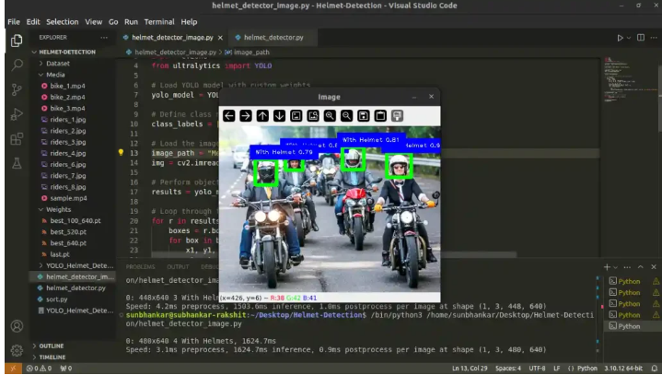
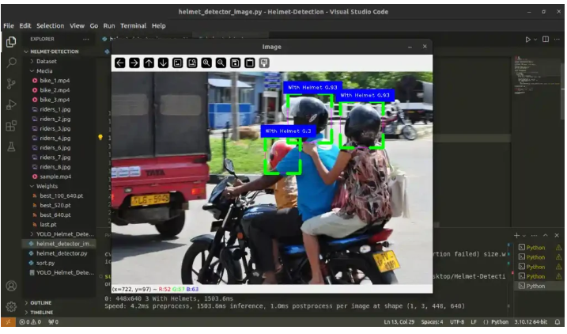
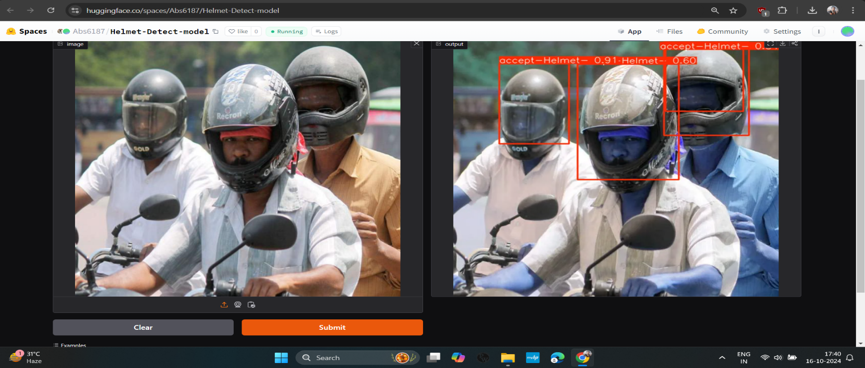

LINK
Project GitHub Link
Project Demo
BASE REASEARCH PAPER
Helmet_Detection_OCR_ANPR

Slide 16
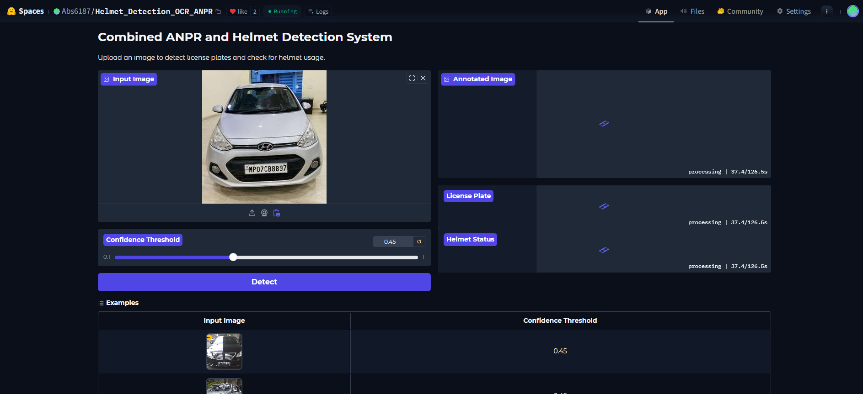
CONCLUSION
​The project "Helmet_Detection_OCR_ANPR" hosted on Hugging Face is designed to detect helmets, perform Optical Character Recognition (OCR), and Automatic Number Plate Recognition (ANPR) in images or video streams.
Project GitHub Link
Helmet_Detection_OCR_ANPR
BASE REASEARCH PAPER

Slide 17

THANKS
We, are thankful to our beloved HODs for their fruitful guidance.
We are also thankful to Prof. Priyanka Jain & Prof. Sandeep Rao for wonderful guidance and help.
BASE REASEARCH PAPER
Helmet_Detection_OCR_ANPR
Project GitHub Link

