Slide 1






HOLISTIC VERIFICATION OF BLOCKCHAIN CONSENSUS
Nathalie Bertrand, Vincent Gramoli, Igor Konnov, Marijana Lazic, Pierre Tholoniat, Josef Widder
Tholoniat

Slide 2
Blockchain
Tx1: Mallory gives all her coins to Alice
PODC 22

Slide 3
Double Spending
Tx1: Mallory gives all her coins to Alice
Mallory
Tx2: Mallory gives all her coins to Bob
PODC 22

Slide 4
Loss of Assets
Alice
Bob
PODC 22

Slide 5

Loss of Assets
Alice
Bob
PODC 22

Slide 6
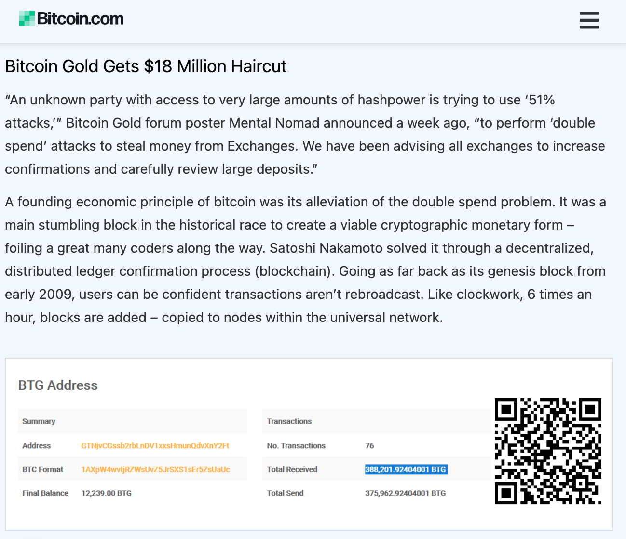
Loss of Assets
Alice
Bob
PODC 22

Slide 7
The Need for Byzantine Consensus
Alice
Bob
PODC 22

Slide 8









Impact of Human Errors
PODC 22

Slide 9
Red Belly Blockchain [IEEE S&P’21]
Builds upon DBFT, a partially synchronous consensus protocol
Can scale, its performance increasing with the system size
Peaks at 660,000 transactions per second
Deployed on 1000 machines across 4 continents
Achieves 3 second finality (commit time)
PODC 22

Slide 10
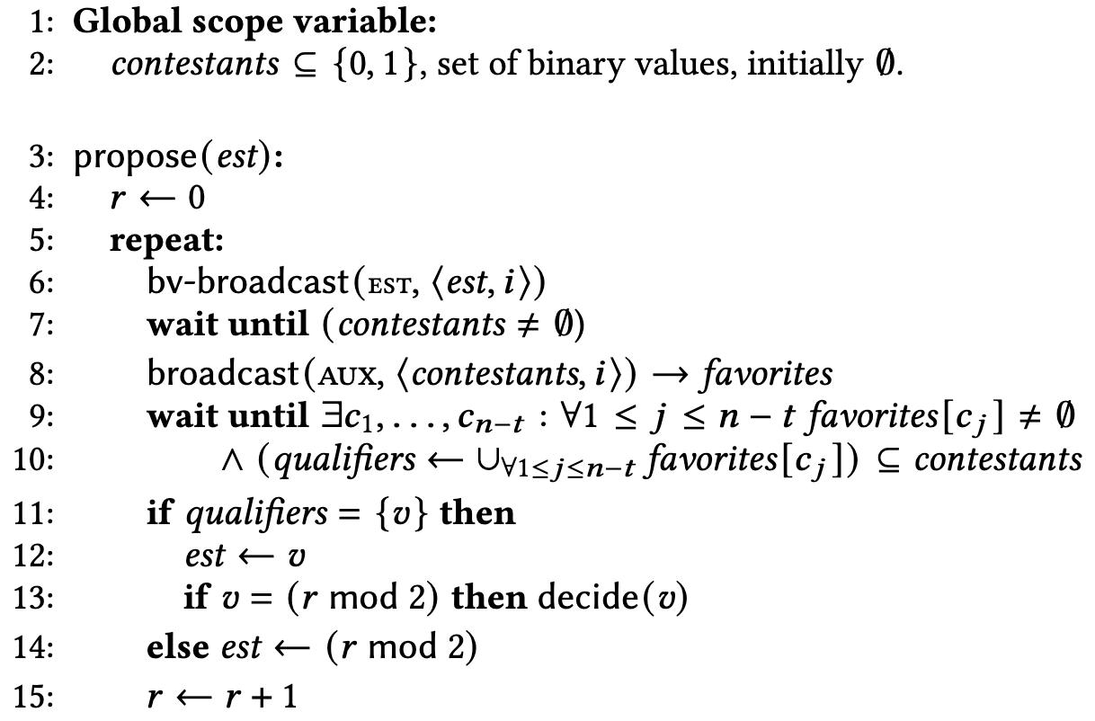
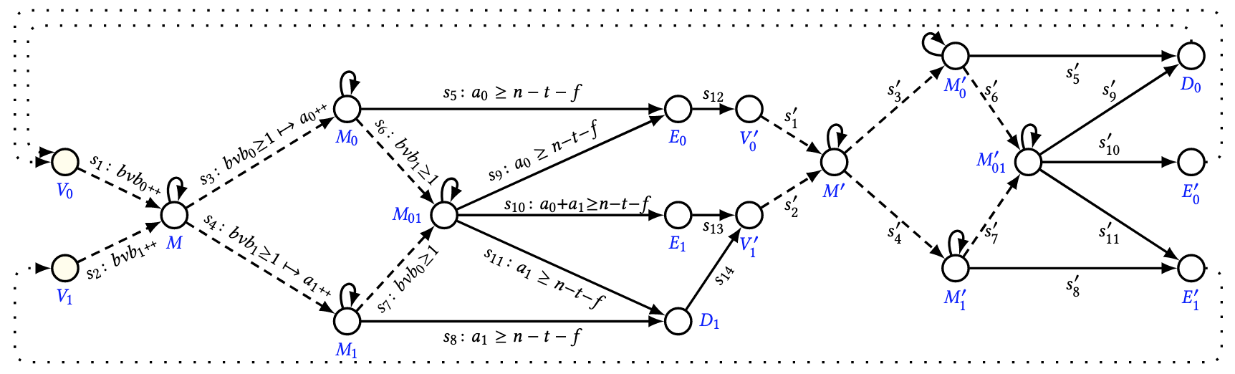




Holistic Verification of DBFT
1. Fairness
DBFT
[NCA’18]
2. Alg. to TA [OPODIS’17]
3. DBFT TA Specification
Byzantine Consensus Problem
3. LTL Problem Specification
ByMC [POPL 2017]
PODC 22

Slide 11
Holistic Verification of DBFT
1. Fairness
DBFT
[NCA’18]
DBFT solves the Byzantine Consensus Problem
for any number n of processes and
for any number f<n/3 of Byzantine failures
2. Alg. to TA [OPODIS’17]
3. DBFT TA Specification
Byzantine Consensus Problem
3. LTL Problem Specification
ByMC [POPL 2017]
PODC 22

Slide 12
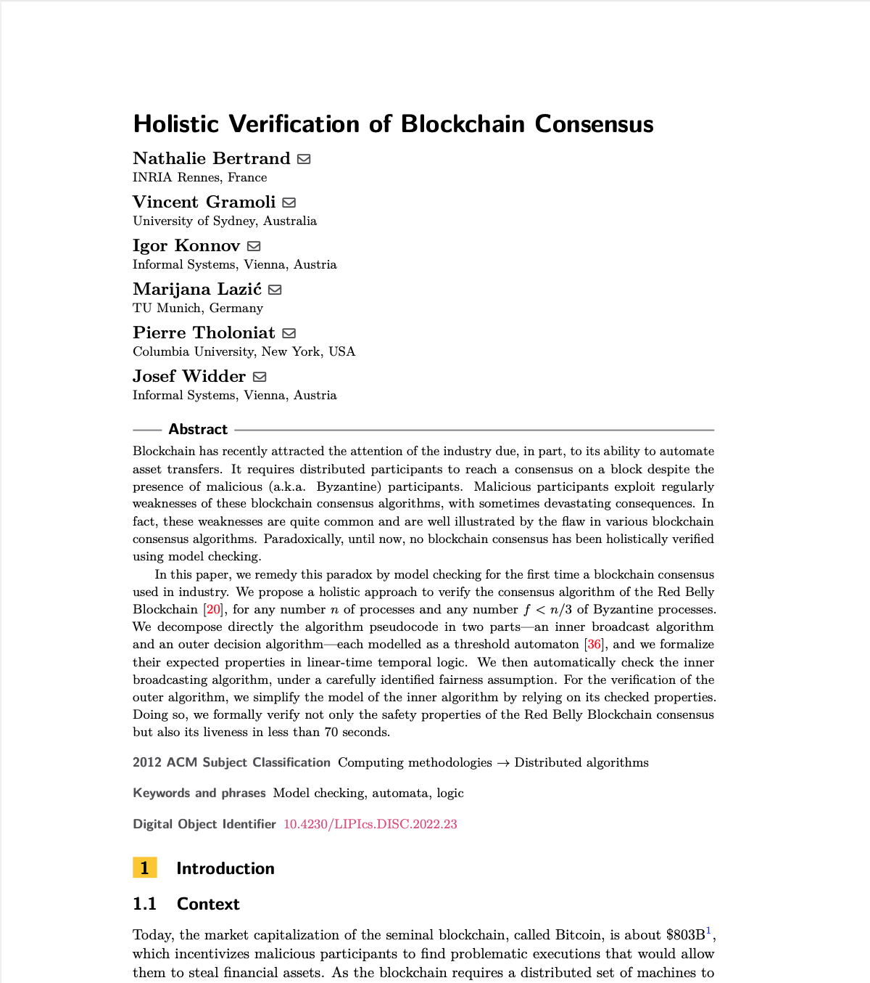
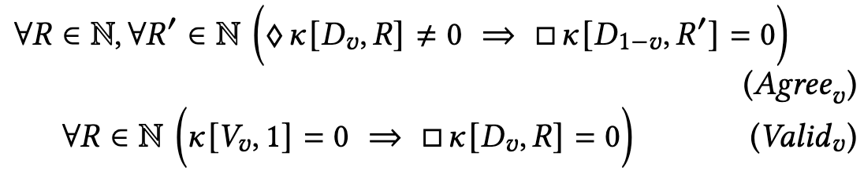
Holistic Verification of DBFT
1. Fairness
DBFT
[NCA’18]
2. Pseudocode
to TA
3. Specification
3. Linear Temporal Logic
ByMC, [POPL 2017]
PODC 22

Slide 13


Vincent.Gramoli@sydney.edu.au
PODC 22

Slide 14
Relater Work
- Theorem prover were used to prove parts of Stellar (not its quorum system) [DISC’19]
The safety of Byzantine Paxos was proved by refinements (not its liveness) [DISC’11]
Symbolic model checkers proved algorithms for fixed number of processes (n=10) [Dist. Comp. 2011]
TLA+ model checker TLC was used for consensus with benign faults [RP’19]
Bosco is a fast-path for consensus whose safety was proven with ByMC, but it needs to rely on another Byzantine consensus protocol [OPODIS’17]
PODC 22

