Slide 1
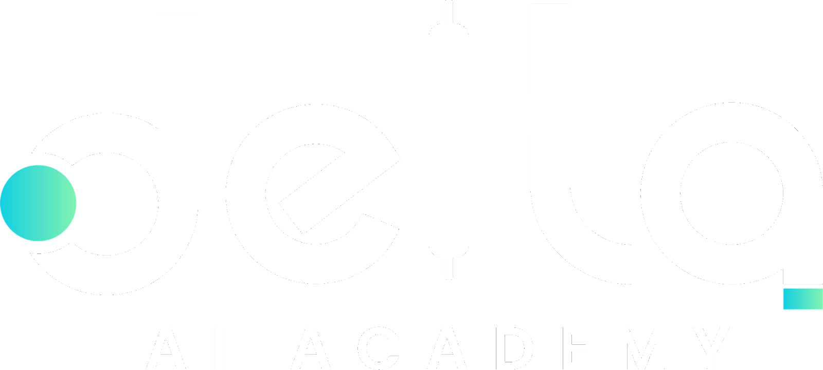
Master AI.
Learn to command AI — at its highest quality.
DELTA AI ACADEMY

Slide 2
THE OPPORTUNITY
Meet your 24/7 AI assistant.
24/7
An assistant that works anytime, anywhere, on almost any task — and guides you even when you don't know where to start.
That assistant already exists: Artificial Intelligence.
Anytime · Anywhere · Any task

Slide 3
MEET DELTA AI ACADEMY
We teach you to control, guide,
and master AI.
✓
Master AI
✓
Turn big tasks into small ones
✓
Scale your skills
✓
Build your own AI workflows & assistants
✓
Boost your productivity

Slide 4
THE ACADEMY STRUCTURE
Three Phases.
01
02
03
Software
Creative
Automation

Slide 5
PHASE ONE · SOFTWARE
Build software without code.
01
Production-ready apps, websites & SaaS
Your ideas — built anytime you want
SOFTWARE
No agencies, no waiting, no extra charges
₹1,00,000+ → a fraction of the cost

Slide 6
PHASE TWO · CREATIVE
Marketing, video & motion graphics.
02
Ads & marketing campaigns
Videos & motion graphics
CREATIVE
Cinematic-quality content — faster

Slide 7
PHASE THREE · SYSTEMS
Automation & workflow systems.
03
Automate repetitive daily tasks
Intelligent, time-saving workflows
SYSTEMS
Built on your Phase 1 skills

Slide 8
BY THE NUMBERS
Why it matters.
3
100%
24/7
₹1L+
Phases to master
No-code build
AI on demand
Saved vs agencies

Slide 9
The future is at your fingertips.
The AI era has already started — it's happening right now.
Ready to learn, adapt, and scale?

Slide 10
Welcome aboard.
Start your AI journey today · deltaaiacademy.com

