Slide 1

Smart Academic Performance
Monitoring System
Enhancing Student Performance Through Data-Driven Insights
BY ABSOLOM ORIANGA
•.

Slide 2

PROBLEM STATEMENT
Enhancing Student Performance Through Data-Driven Insights
Uganda’s Vision 2040 promotes digital innovation in education, yet many institutions still use outdated manual methods to track student performance, resulting in delays, errors, and poor communication. Current systems lack real-time monitoring and data analytics, leading to issues like falsified records and grading inaccuracies. The Smart Academic Monitoring System (SAMS) addresses these challenges by providing an integrated, automated platform for real-time performance tracking, attendance monitoring, and timely reporting—enhancing accuracy, accountability, and supporting SDG 4: Quality Education.

Slide 3
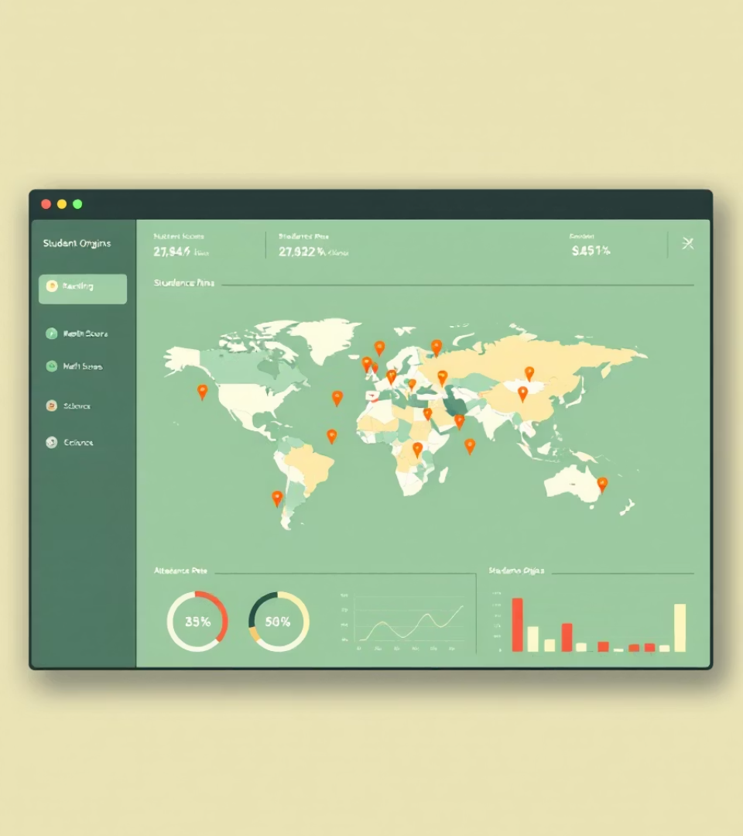





System Benefits
Improved Performance Monitoring
Automated tracking ensures timely feedback for students.
Enhanced Attendance
Biometric/RFID systems eliminate fraudulent attendance.
Real-time Alerts
Automated alerts for absenteeism and poor performance.
Data-Driven Decisions
Informed academic interventions.
Increased Parent Engagement
1.Parents can access their children’s academic reports and receive notifications on performance trends.

Slide 4

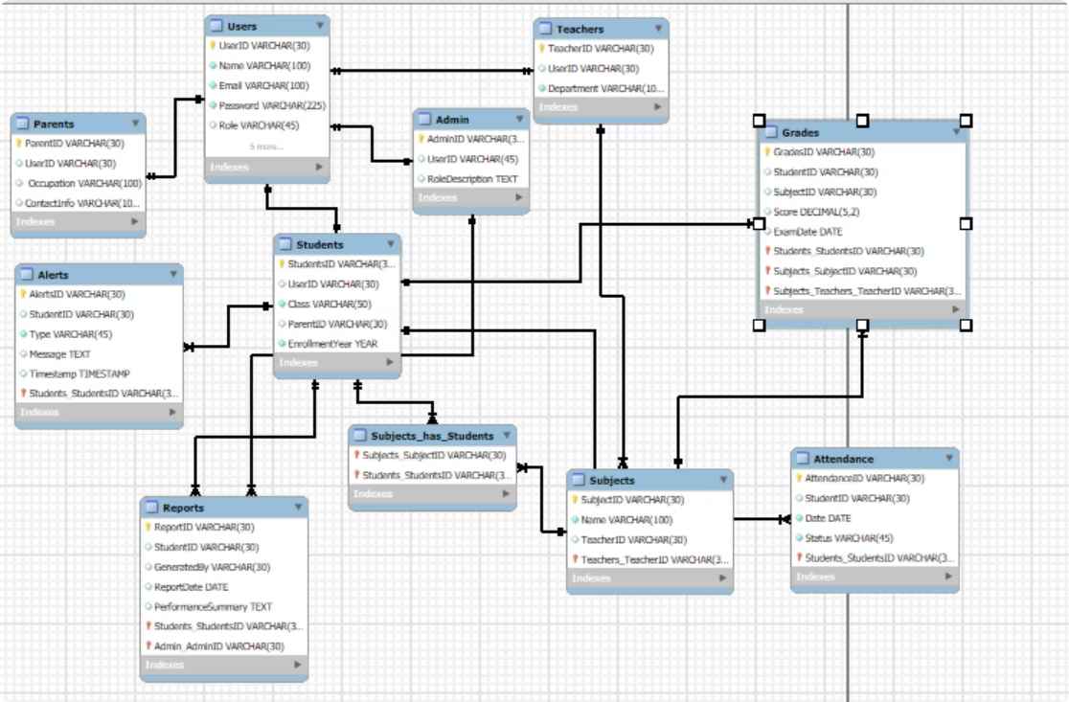
Entity Relationship Diagram
.

Slide 5
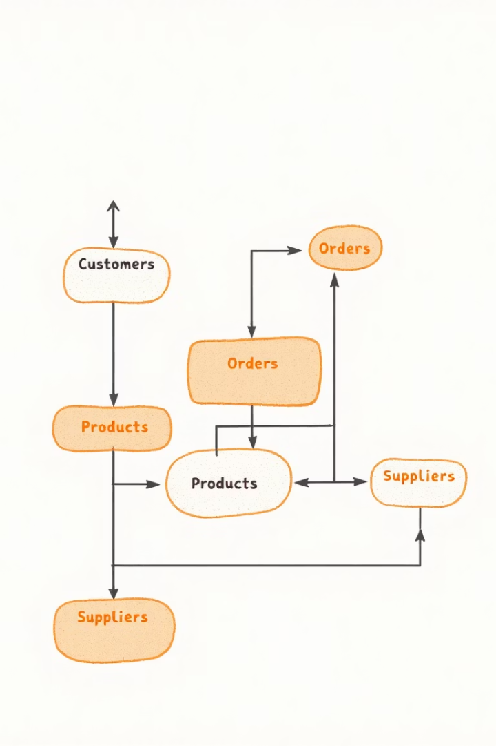
CONCLUSION
•The Smart Academic Performance Monitoring System offers an efficient, user-friendly solution for tracking student progress and managing academic data. By supporting multiple user roles and automating key functions like grading, reporting, and alerts, it enhances communication, accuracy, and accountability. The system empowers stakeholders with real-time insights, promoting transparency and continuous improvement in line with modern educational needs.

