Slide 1
Learn Programming Basics (C Language)
Lesson #000 DOWNLOAD AND INSTALLATION

Slide 2
Introduction
Not be using any IDE (Integrated Development Environment).
Relying on IDE makes you lazy and more careless.
Be known of your own mistake, learn through emotional pain.
Use Google search to search for the different kinds of errors and understand what its means.
Read the entire PowerPoint slide again if needed.
Download and INSTALL (notepad++):
https://notepad-plus-plus.org/downloads/
you can use notepad, but its too hardcore, not recommended
Download and INSTALL (meld):
https://meldmerge.org/
File comparison software
Download and INSTALL (cygwin):
https://cygwin.com/install.html:
Cygwin is a Linux environment based command prompt

Slide 3
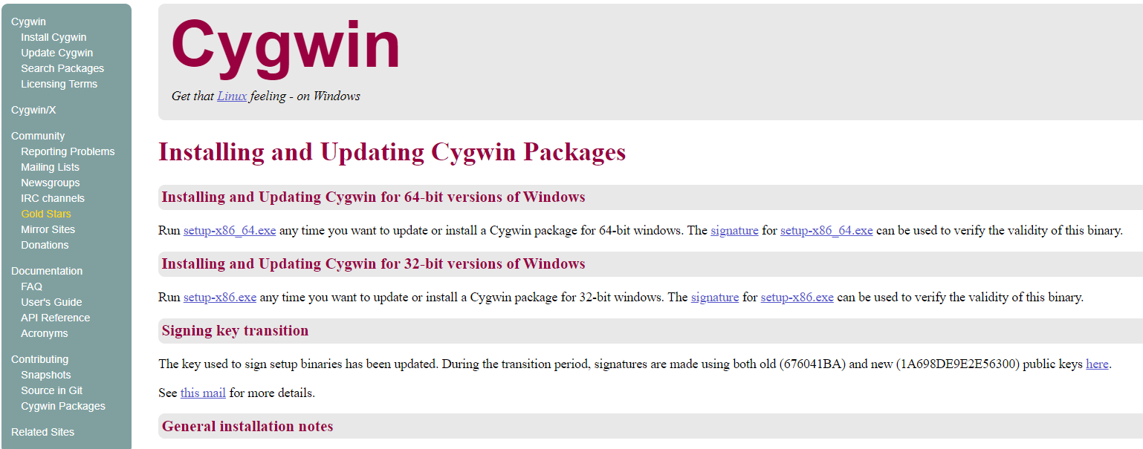
Download Cygwin
Download at https://cygwin.com/install.html:
Click install Cygwin
Download the setup file
setup-x86_64.exe for 64-bit computer
setup-x86.exe for 32-bit computer

Slide 4
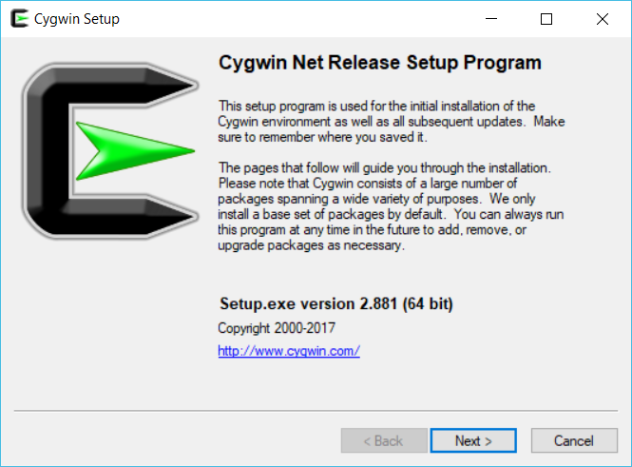

Slide 5
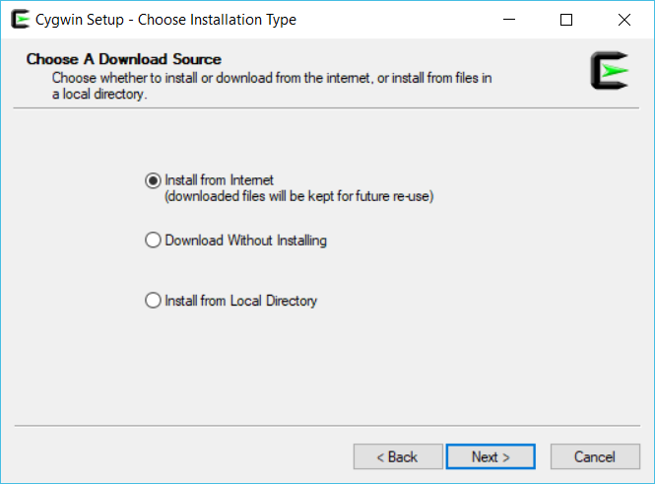

Slide 6
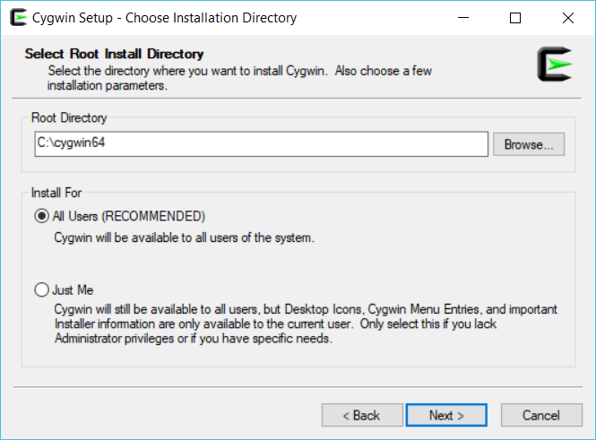
Use default root directory (recommended)

Slide 7
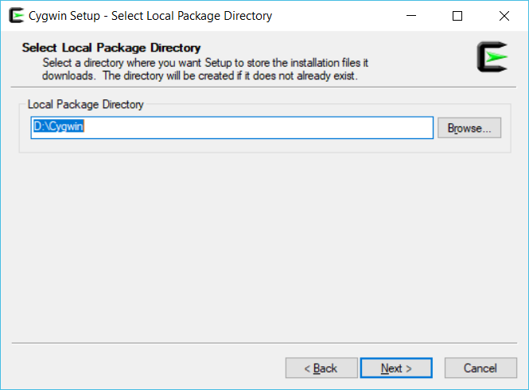
Local Package Directory can be installed anywhere, for example in D:\Cygwin

Slide 8
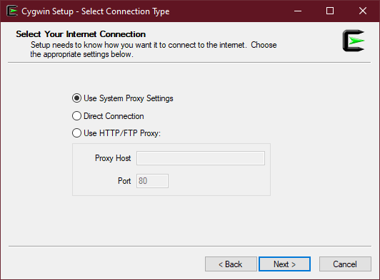
Use System Proxy Settings

Slide 9
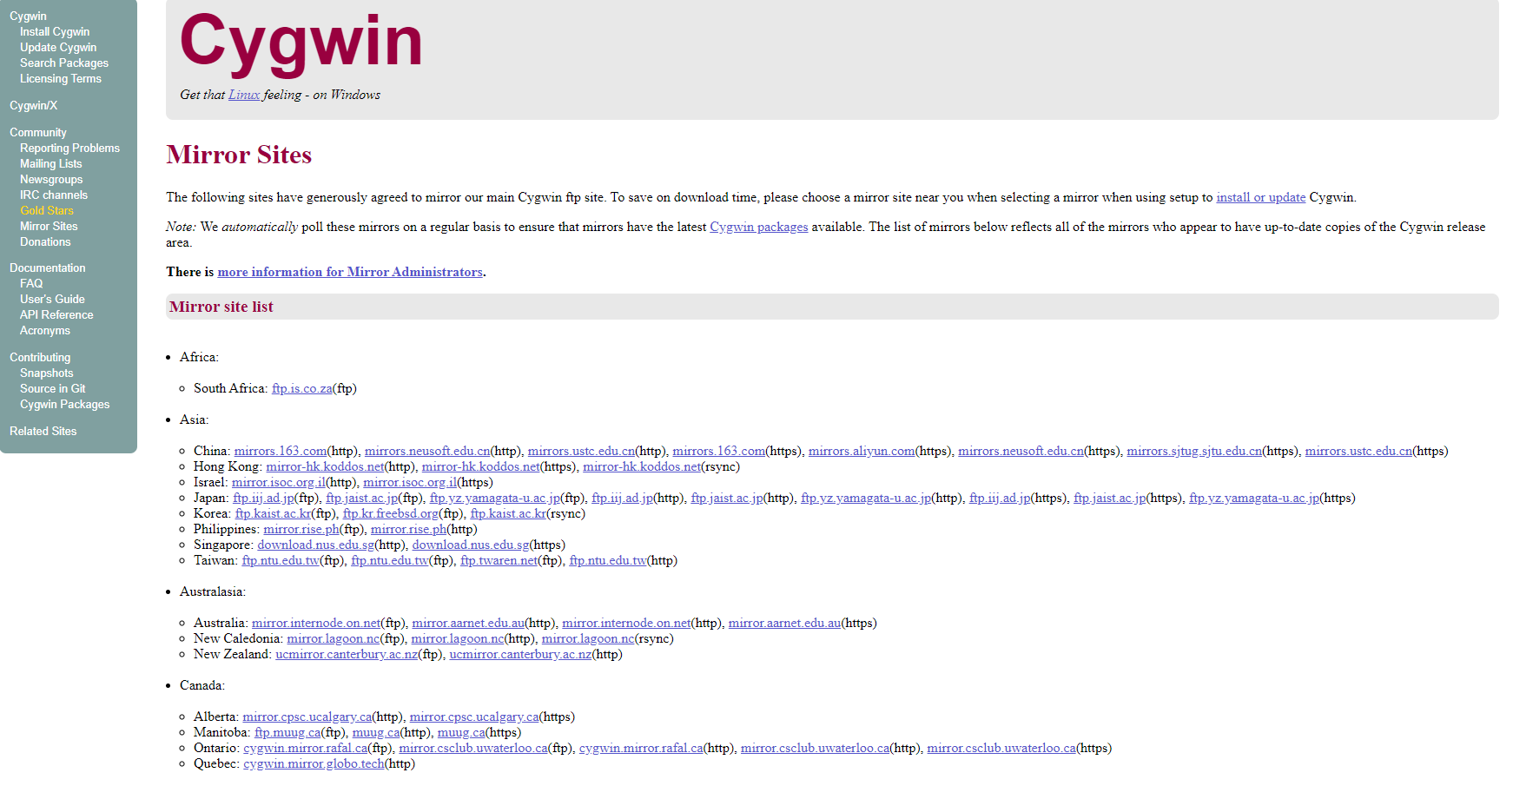
Find your respective region and download mirror site (Optional)
https://cygwin.com/install.html

Slide 10
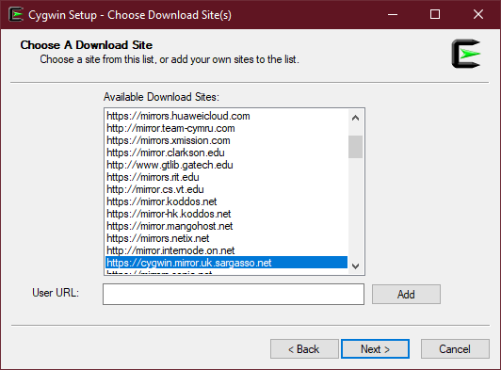
Choosing download site
Choose a HTTPS website.
Choosing a download site is tricky it’s a trial and error of choosing which download site.
In this case the highlighted website is chosen;
then Click Next and wait for setup to complete.
If the installation got stuck, close and restart the setup

Slide 11
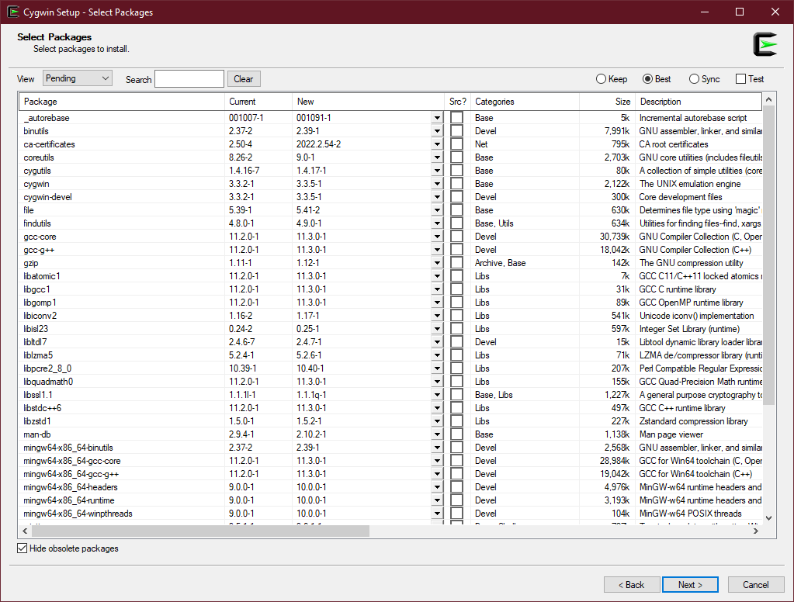
If the installation success, you should see something this:

Slide 12
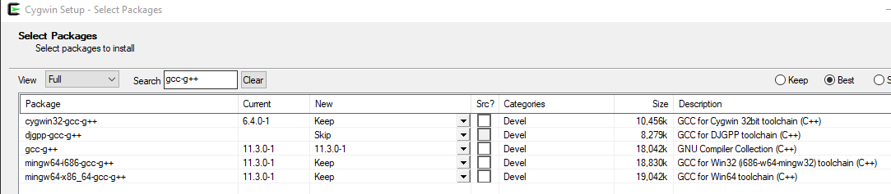
Package to download:
gcc-core
gcc-g++
make
mingw64-i686-gcc-g++ (32-bit optional)
mingw64-x86_64-gcc-g++
Example image:

Slide 13
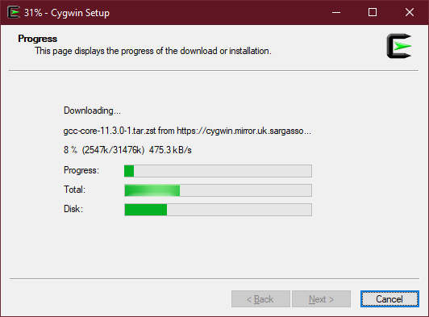
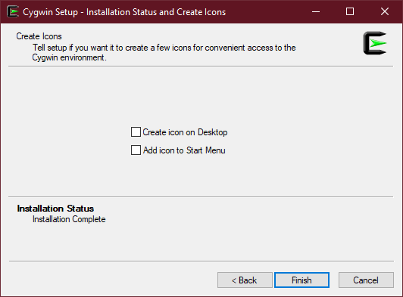
Click next and next and install all package

Slide 14
Testing

Slide 15

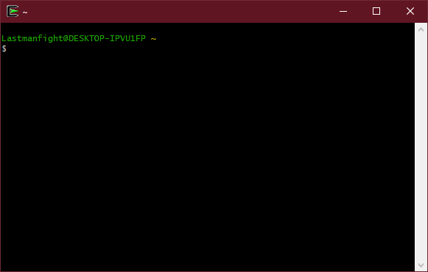
After installation, you should see Cygwin64 Terminal on your desktop
Double click it and a command prompt should be opened
Must open the command prompt first, as it will create a folder in your root

Slide 16
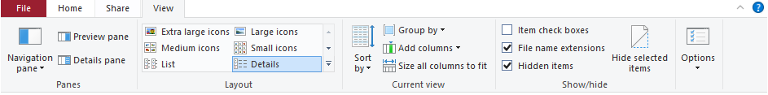
Go to your working default folders
On first installation, you MUST open the Cygwin terminal at least once to generate the default folder.
Go to: This PC → C: → cygwin64 → home → $(your PC’s username)
Turn on [File name extensions]
Turn on [Hidden Items] (optional)

Slide 17
Test Cygwin by writing your first programming text file
Create a txt file and rename your file to “a.c”.
make sure to change the file extension as well.
Open the file using notepad++, set as default application to open this type of file for ease of use.
Copy this exact code snippet into your a.c file.
#include <stdio.h>
int main(){
printf("DONKEY BALLS");
scanf(“%d”);
return 0;
}

Slide 18
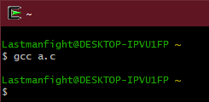
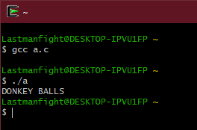
Test Cygwin by Compiling your first program
Enter the command: “gcc a.c”.
If no error occurs, you should see these;
An “a.exe” file should be generated in the same directory as the file.
Run your .exe file
Enter the command: “./a.exe” OR “./a” to run the file.
It should print out these, and then Crtl + C to stop:

Slide 19
Test Cygwin by Compiling your first program
Enter the command: “x86_64-w64-mingw32-gcc a.c” OR;
Enter the command: “x86_64-w64-mingw32-g++ a.c”.
If no error occurs, you should see these;
An “a.exe” file should be generated in the same directory as the file.
Run your .exe file
Double click “./a.exe”.
Should see no errors.
Ctrl + C to close console.
Ctrl + L to clear console.

