Slide 1
LESSON #001 INTRODUCTION to Programming
Learn Programming Basics (C Language)

Slide 2
Basic programming using Programming C
1. introduction
2. some Unix/Linux command using cygwin
3. stages of Compiling
4. introduction, data types
5. printf, scanf, Precedence Table
6. if, else if, else, ternary, switch, break
7. for loop, while, do while, continue, break
8. function declaration, definition nation, read complex declaration
9. array, read complex declaration
10. pointer, pointer and array relation, double pointer
11. malloc(memory allocation)
12. struct, union
13. struct memory layout, size of struct/union
never move onto the next topic if absolute zero idea on how pointer works.

Slide 3
C++ topic
1. namespace, scoping
2. r reference
3. CPP class, default ctor, ctor, copy ctor, const function, ctor/dtor order
4. CPP compiler generate ctor, class member initialization, this,
5. Operator function overload
6. vector, string, stack, queue etc... copy ctor methods
7. function template
8. function overloading
9. read complex declaration 2
10. iterator
11. class template, template specialization
12. template T
13. inheritance

Slide 4
Advanced C++
1. move ctor, constructor/dtor order recap
2. virtual function, virtual table, abstract class
3. inheritance with virtual function
4. read complex declaration 3, a little bit on goto:,
5. static_cast, dynamic_cast, reinterpret_cast, const_cast
6. ref collapsing rules
7. functor, lamda
8. std::forward, std::move,
9. varadic template
.. type erasure, meta programming, tuple, reflection etc…
10. On your own, good luck

Slide 5
Why learn C and C++ for starters?
By learning to drive an auto car, requires you to relearn manual car.
By learning to drive a manual car, you can learn auto car on you own.
C and C++ is just like a manual car.
The rest of any programming languages is an auto car.

Slide 6
What is typing?
The act of typing text using a keyboard.
The act of typing text on a text-based program in a human-readable languages such as English etc…

Slide 7
What is programming?
The act of typing text using a programming language.

Slide 8
2 type of things on a computer
There are only 2 main categories in a computer
text file (.txt, .png, .jpg, .mp3, .mp4 etc… )
application (.exe file, cmd console, game.exe, etc… )

Slide 9
What is a text file? (details)
text file
plain old text file:
.txt file
.cpp file
human readable
Encrypted file
.png, .jpg, .mp3, .mp4, .dll etc...
Mostly unreadable
This file is “open” by using a program to “decrypt” these text file to view the content
When the file is “open”, the program provides user interfaces to display the file as picture, video or music etc…

Slide 10
What is a text file? (details)
It is a pretty gray area on the what's define a text file, but this is just a very simplified meaning
Technically there is really only 2 main categories in a computer
text file (.txt, .png, .jpg, .mp3, .exe etc… )
application (exe file, binary file)
Folders is a just a feature to categories things in different location

Slide 11
What is a computer program?
a computer program is an executable file (.exe)
It’s also known as application

Slide 12
What is a computer program? (Details)
the compilation of 1 or more text file(s).
the compilation of all the necessary text files needed to create the computer program.
After a successful compile, the computer-readable binary file is generated known as executable file (.exe) in windows OS.
Example: notepad is a computer program

Slide 13
How does a program being created? (Details)
An executable file (.exe) is generated by compiling text file(s) using its’ respective compiler.
A compiler is a program that converts a text file into instructions and then into machine-code, in 1 and 0 known as binaries, so that the program can be executed or “read” by a computer.
Therefore, a computer program is referred to or being called as an executable file OR an application OR .exe file
text file
Compile successfully
.exe application

Slide 14
How to run a computer program?
double clicking the (.exe) file (automatically, it’s a feature)
select the (.exe) file and press enter
run using command console (manually)
etc…

Slide 15
Stages of compiling overview
Text file (source code):
E.g. .txt, .c, .cpp
Pre-processing
All source codes (#include, #define, inline etc…)
Compiling
.s file (Assembly code)
Assembling
.o file (Object code in binaries)
Linking
.exe file (Executable file)

Slide 16
Von Neumann Architecture
A super simplified diagram of a computer diagram
Memory
(RAM)
CPU (Central Processing Unit)
ALU (Arithmetic Logical Unit)
Output
Input

Slide 17
4 Basic cycle of computer system (CPU)
Fetch
Fetch data from memory/control unit.
Decode
breaks down the information to opcode and operands.
Execute (ALU)
processed the decoded data in the ALU for results.
Write Back
write back the result to storage.
or use it as output.
or return cycle etc…
Predict? Revert? …

Slide 18
Memory - RAM (Random Access Memory)
Stored data and instruction for program execution temporary.
Temporary allocated space for computer programs to run it’s program instructions.

Slide 19
What is instruction?
Instruction are expression of basic operation.
Computer instruction are made up of op-code, operands and sources.
Basic expressions of basic operations:
e.g. +, -, *, /

Slide 20
Example: Opcode
z <- x + y
x, y, z are what we called operands
x, y are called sources.
z are called destination operands.
Representation of instructions in 1 and 0
+ | z | x | y
Encoded
0x5B | 0x9B | 0x7B | 0x6B

Slide 21
Etc…

Slide 22
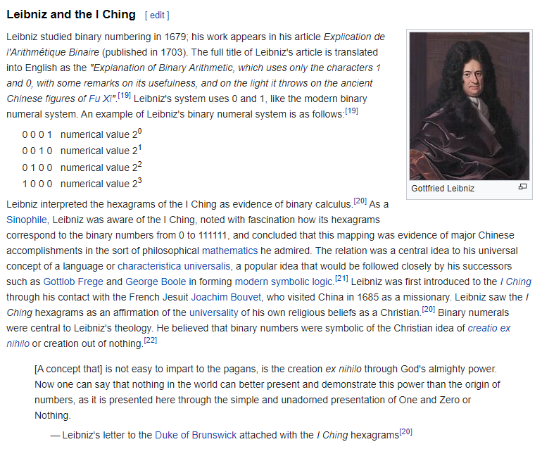
History

Slide 23
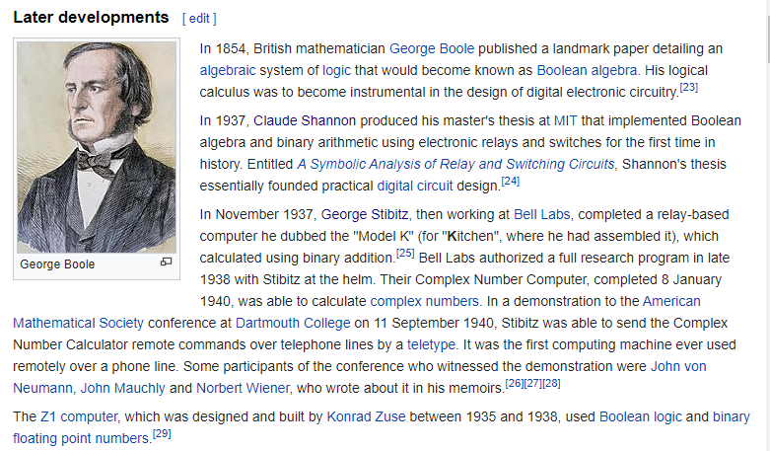
History
What if I can calculate math automatically?

Slide 24
What is an algorithm?
A very detailed step by step instructions to solve problems.
It can be written in point form but mostly written in the form of flowchart for better visual representation.

Slide 25
Example how do you pick a box from point A to point B?
A
B
Start at point A in front of the box
Bend left elbow 90 degree anti-clockwise
Bend right elbow 90 degree anti-clockwise
Bend your back 90 degree clockwise
Shift Left palm towards right palm
Can left palm continue shifting towards right? Yes - to step 7, No to step 5
Shift right palm towards left palm
Can right palm continue shifting towards left ? Yes - to step 9, No to step 7
Bend your back 90 degree anti-clockwise
Now walk algorithm
blah blah blah bend thigh, bend knee, bend toes, Ski-bi dibby dib yo da dub dub
reach point B? No to step 11 yes to step 13
Stop

Slide 26
GCD Euclid Algorithm (300 B.C)
find the Greatest Common Divisor
Start
Let a and b be 2 positive number
if a < b, go to step 4, else go to step 5
let r = remainder of b/a (b mod a), go to step 6
let r = remainder of a/b (a mod b)
let if r = 0 then go to step 8
let a = b, b = r, go to step 5
GCD is b
stop
Example:
a = 24, b = 18
24 < 18
r = 6 (24 mod 18)
a = 18, b = 6
r = 0 (18 mod 6)
GCD = 6
stop

Slide 27
Type of programming language
Human Readable
Computer Readable
(Binaries)
(can be learn on how to read)
High-level language
Low-level language
asm
ARM
Web
HTML
CSS
etc..
Normal or scripting
C
C++
C#
Python
Go
Java Script
LUA
Ruby
Perl
Etc…
Server
SQL
Etc…

Slide 28
A basic program memory layout
Text
Global Variables
High memory Address
0x12345678
0x12345670
0x1234566F
0x12345668
.
.
.
Stack
(local variables)
(grows downwards)
Heap
(dynamic memory allocation)
(grows upwards)
.
.
.
0x0000000F
0x00000008
0x00000000
Low memory Address

