Slide 1
LESSON #000 Von Neumann Diagram
Computer Science

Slide 2
Von neumann diagram is a extreme simplify diagram of a computer hardware

Slide 3
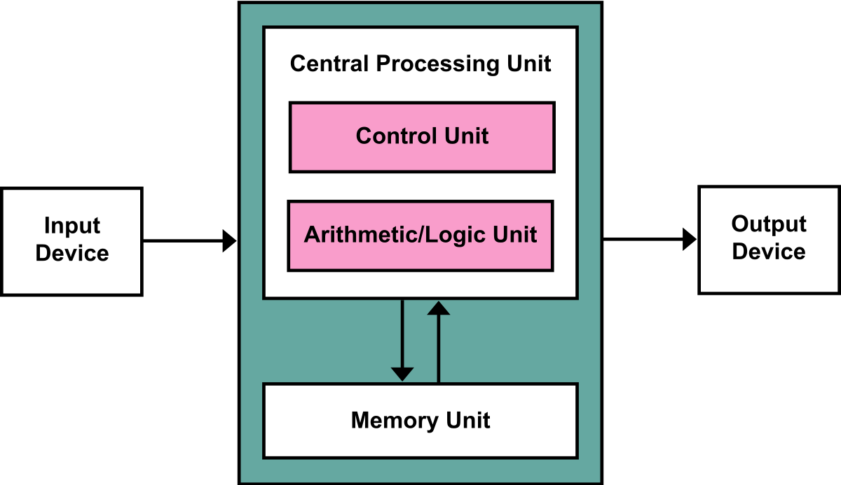
Notes:
https://www.google.com/search?q=von+neumann+diagram&rlz=1C1SQJL_enSG921SG921&sxsrf=ALeKk00kAhXG5nHDcGLeZTijCQgF-V5Bzg:1604454951333&source=lnms&tbm=isch&sa=X&ved=2ahUKEwj1pbq75OfsAhUX9nMBHWcpD-UQ_AUoAXoECAQQAw&biw=1366&bih=625

Slide 4
Problem Solving
Computer Science

Slide 5
Divide and Conquer

