Slide 1
LESSON #003 Boolean Algebra
Computer Science

Slide 2
Lesson Objective:
Learn “logic” in programming/in digital devices
Learning to write “conditional expression”
Purpose:
Understand how digital electronics communicate with each other
Logical Circuit

Slide 3
Truth Table

Slide 4
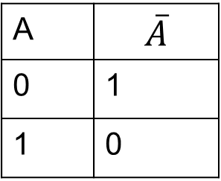
NOT table – (!)
A | $$\overline{A}$$
0 | 1
1 | 0
A

Slide 5
AND table – (A * B)
Input | B | Output
A | B | A * B
0 | 0 | 0
0 | 1 | 0
1 | 0 | 0
1 | 1 | 1
A
A * B
B

Slide 6

OR table – (A + B)
Input | B | Output
A | B | A + B
0 | 0 | 0
0 | 1 | 1
1 | 0 | 1
1 | 1 | 1
A
A * B
B

Slide 7

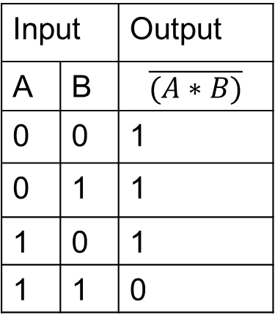
NAND table – $\overline{(A∗B)}$
Input | B | Output
A | B | $$\overline{(A∗B)}$$
0 | 0 | 1
0 | 1 | 1
1 | 0 | 1
1 | 1 | 0

Slide 8

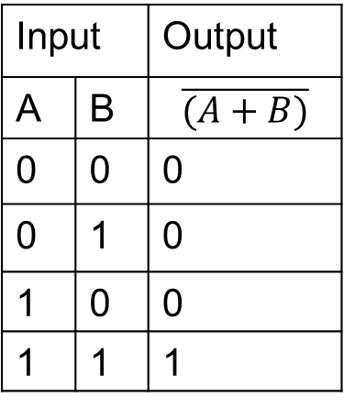
NOR table – $\overline{(A+B)}$
Input | B | Output
A | B | $$\overline{(A+B)}$$
0 | 0 | 0
0 | 1 | 0
1 | 0 | 0
1 | 1 | 1

Slide 9

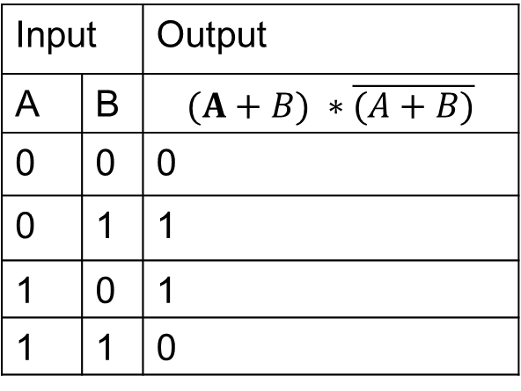
XOR table – $(A+B) ∗\overline{(A+B)}$
Input | B | Output
A | B | $$(A+B) ∗\overline{(A+B)}$$
0 | 0 | 0
0 | 1 | 1
1 | 0 | 1
1 | 1 | 0

