Slide 1
LESSON #000 FlowChart/UML
Computer Science

Slide 2
Flow Chart
Computer Science

Slide 3
Flowchart tutorial
https://www.youtube.com/watch?v=SWRDqTx8d4k
https://www.youtube.com/watch?v=DF2XAc07eI0
Free drawing of flow chart
export png/jpeg
file save draw.io
downloadable
draw.io - https://app.diagrams.net/

Slide 4
Flowchart diagram:
 | Start or Stop/End
 | Input or Output data
 | Decision Making (mostly for if, else if and else)

Slide 5
Flowchart diagram:
 | Process
 | Predefined Process
 | Looping

Slide 6
Flowchart diagram:
 | connector

Slide 7
UML
Computer Science

Slide 8
Type of UML
Package Diagram
Object Diagram
Composite Structure Diagram / Class Diagram
Use Case Diagram
Activity Diagram
Sequence Diagram
Interaction Overview Diagram
Timing Diagram
Communication Diagram
State Diagram
Component Diagram
Deployment Diagram
Notes:
https://www.smartdraw.com/uml-diagram/#UMLMeaning

Slide 9
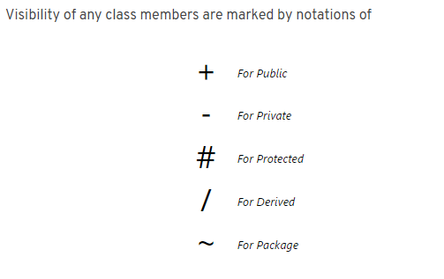
Type of UML

Slide 10
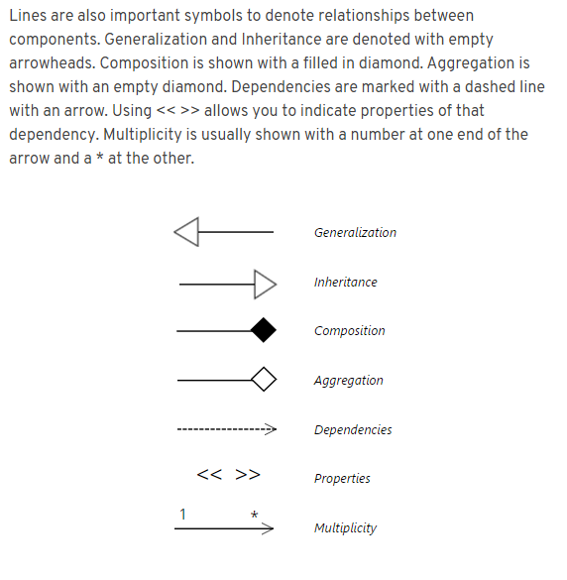
Type of UML

