Slide 1
LAB #000 DOWNLOAD AND INSTALLATION
Learn Programming Basics (C Language)

Slide 2
Introduction
Not be using any IDE (Integrated Development Environment).
Relying on IDE makes you lazy and more careless.
Be known of your own mistake, learn through emotional pain.
Use Google search to search for the different kinds of errors and understand what its means.
Read the entire PowerPoint slide again if needed.
Download and INSTALL (notepad++):
https://notepad-plus-plus.org/downloads/
you can use notepad, but its too hardcore, not recommended
Download and INSTALL (meld):
https://meldmerge.org/
File comparison software
Download and INSTALL (cygwin):
https://cygwin.com/install.html:
Cygwin is a Linux environment based command prompt

Slide 3
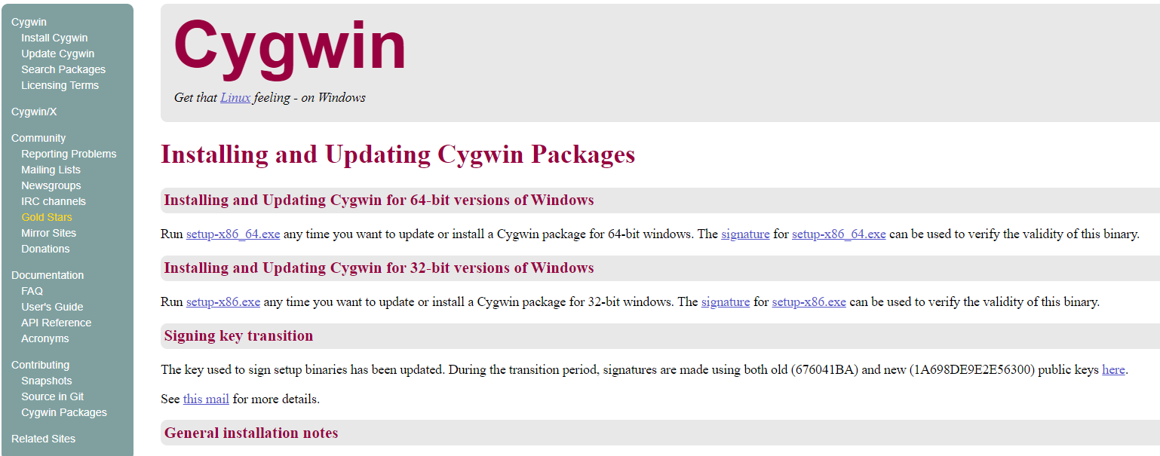
Download Cygwin
Download at https://cygwin.com/install.html:
Click install Cygwin
Download the setup file
setup-x86_64.exe for 64-bit computer
setup-x86.exe for 32-bit computer

Slide 4
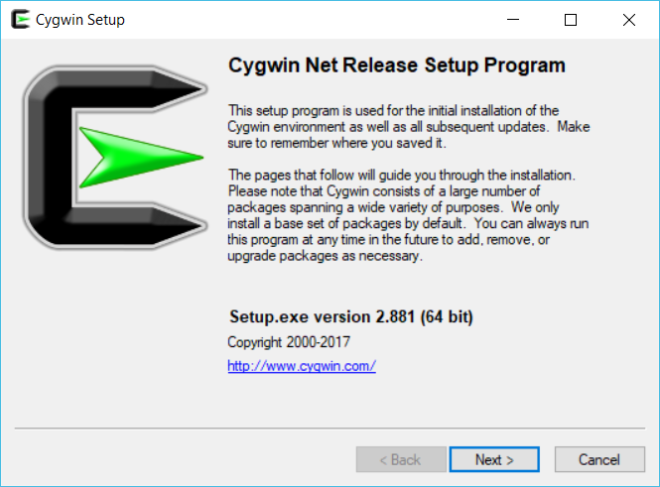

Slide 5
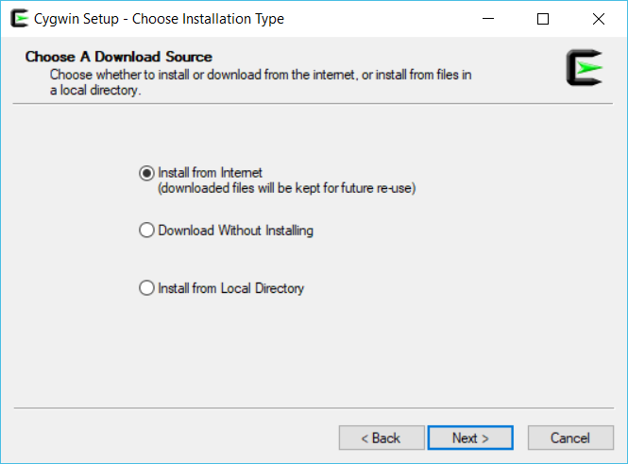

Slide 6
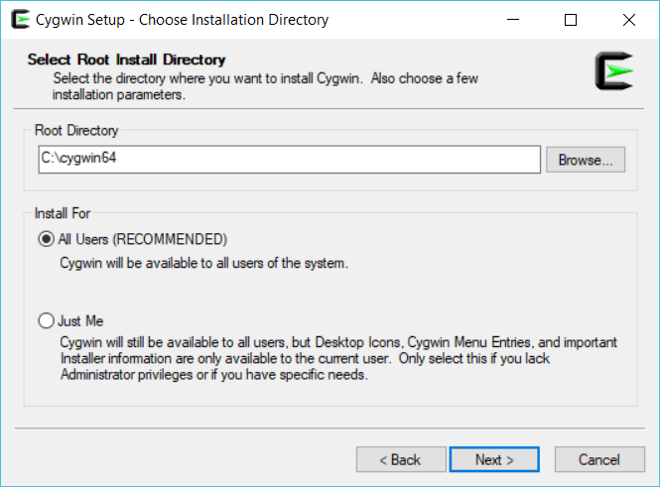
Use default root directory (recommended)

Slide 7
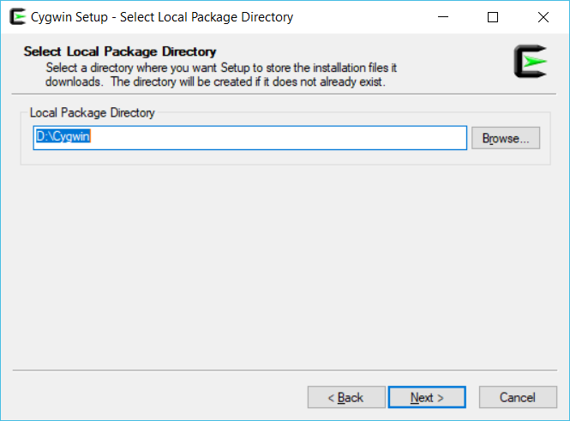
Local Package Directory can be installed anywhere, for example in D:\Cygwin

Slide 8
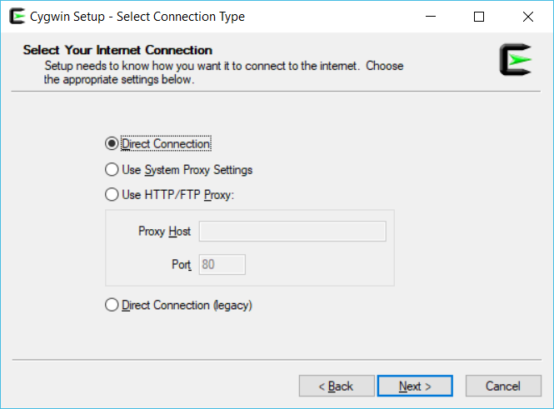
Select Direct Connection

Slide 9
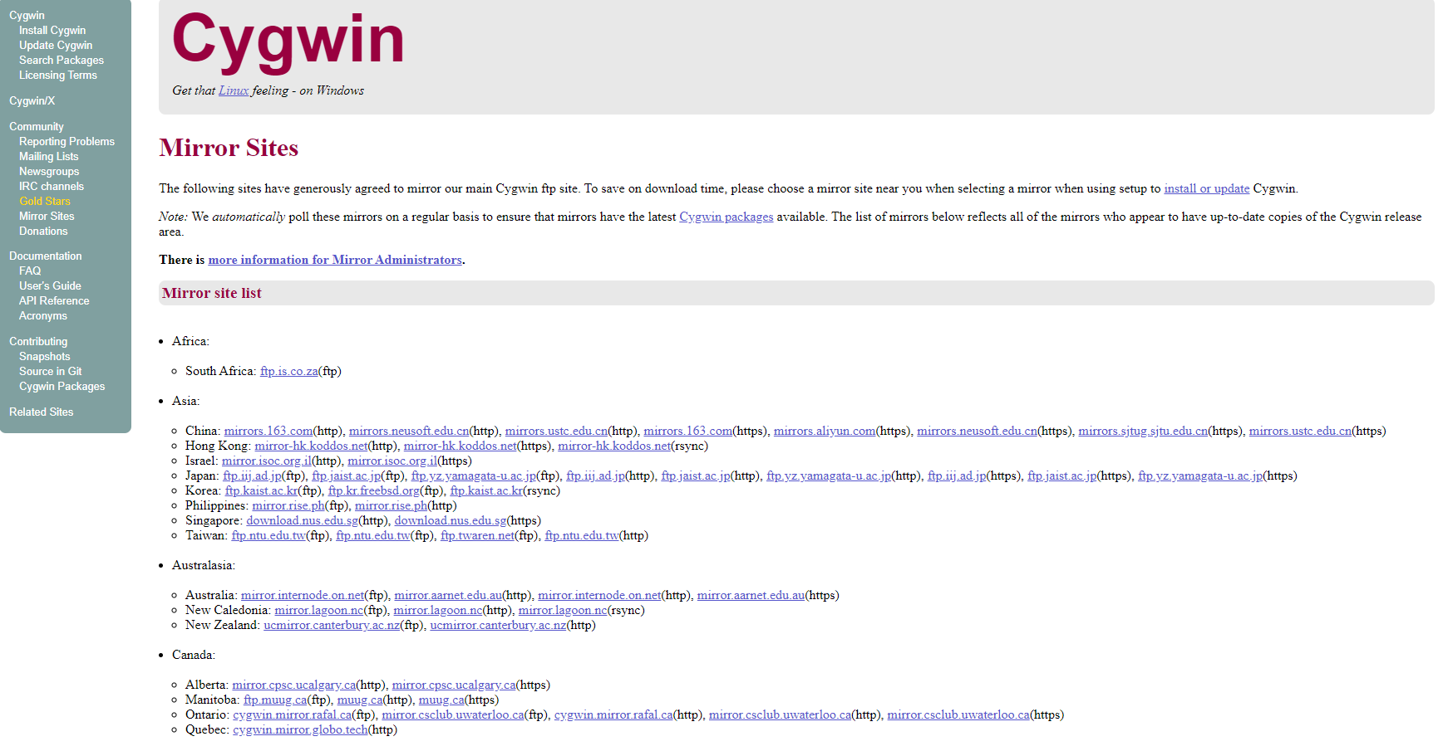
Find your respective region and download mirror site (Optional)
https://cygwin.com/install.html

Slide 10
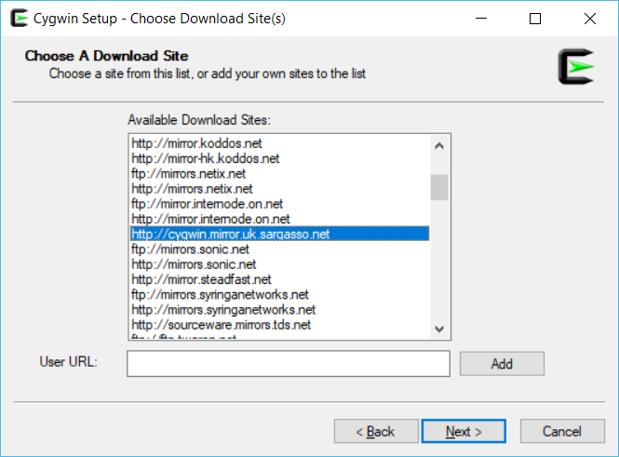
Choosing download site
Choose a https website.
Choosing a download site is tricky it’s a trial and error of choosing which download site.
In this case the highlighted website is chosen;
then Click Next and wait for setup to complete.

Slide 11
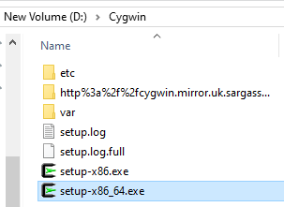
If the installation got stuck, close the setup and restart
Find and choose the next download site

Slide 12
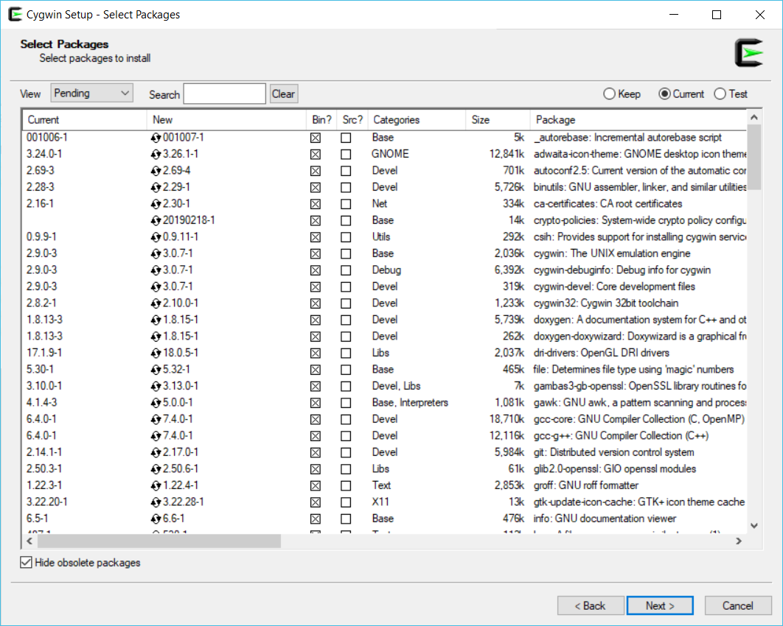
Download success, should see something this

Slide 13
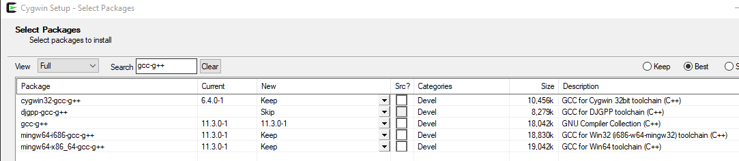
Package to download:
cygwin32-gcc-core
cygwin32-gcc-g++
gcc-g++
make
mingw64-i686-gcc-g++
mingw64-x86_64-gcc-g++
Example image:

Slide 14
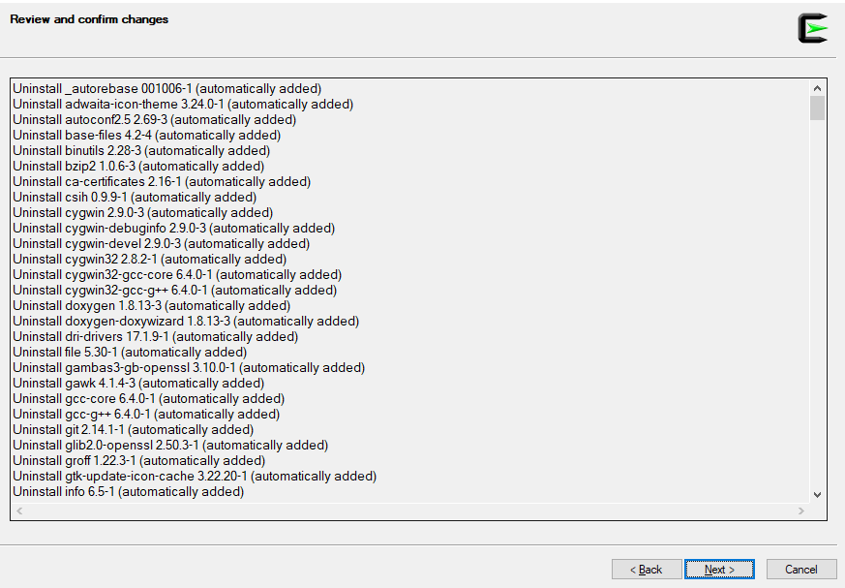
Click next and next and install all package

Slide 15

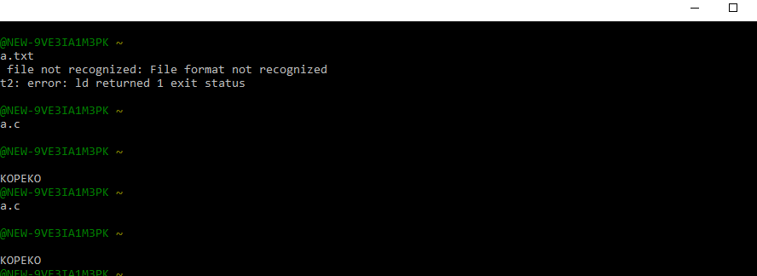
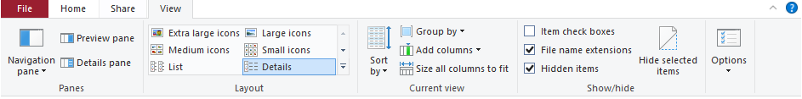
After installation, you should see Cygwin on your desktop
Double click it and a command prompt should be opened
Must open the command prompt first, as it will create a folder in your root
Open your folder to
"This pc > windows (C:) cygwin64 > home > ${your PC’s username}”
Make sure you turn on file name extensions view
Create a txt file and rename your file to “a.c”

Slide 16
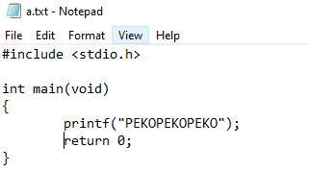
Test Cygwin by writing your first programming text file
Open your file using notepad++
Copy this exact code into your a.c file

Slide 17

Test Cygwin by Compiling your first program
Enter the command: “gcc a.c”
a.exe file should be generated in the same directory as the file
Run your .exe file
Enter the command: “./a.exe” OR “./a” to execute the file
It should print out these:

