Slide 1
LESSON #003
Stages of Compiling
Learn Programming Basics (C Language)

Slide 2
Purpose
able to understand when, where and what errors are occurs at which stage in programming
Objective
learn the stages of how your code is being compiled
Notes:
https://chortle.ccsu.edu/java5/Notes/chap09A/ch09_5.html

Slide 3
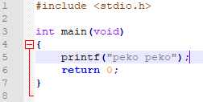
Create a text file and rename it to “a.c” (change its extension as well)
Copy the snippet of code exactly

Slide 4
Explanation
<- include <stdio.h> library
.h means header file

Slide 5
Explanation
<- main point of entry of a program

Slide 6
Explanation
the function “printf” is comes from the library <stdio.h>

Slide 7
Explanation
the function “printf” came from the library <stdio.h>
if #include<stdio.h> is removed, it considered as a linker error during the linking stage,
The error says that it could not find the function’s declaration, More details in next future lessons

Slide 8
Explanation
return 0; is to return (return a value if applicable) to end a function execution
More details in next future lessons

Slide 9
Demonstration
(Compiling a program)

Slide 10
Text file (source code):
E.g. .txt, .c, .cpp
Pre-processing
All source codes (#include, #define, inline etc…)
Compiling
“Compile your code”
.s file (Assembly code)
Assembling
.o file (Object code in binaries)
Linking
.exe file (Executable file)

Slide 11
Example 1: printing out a “string literal”
<- prints the string “peko peko”
Compile with this command line, follow by the file “a.c”:
gcc -Werror -Wall -Wextra -ansi -pedantic a.c
Run the program command line: ./a.exe OR ./a
Compile and run, it should print “peko peko”

Slide 12
What does this mean?
gcc (run the C compiler program)
-Werror (flag, make all warnings into errors)
-Wall (flag, enables all warnings flag)
-Wextra (flag, enables more extra warnings flag)
-ansi (flag, standalizse flag enable)
-pedantic (flag, enable warning flag)
a.c (filename)
for the purpose of learning, strict rules to follows during compiling to learn better, compiling arguments may change accordingly
Notes:
(W flag) https://gcc.gnu.org/onlinedocs/gcc/Warning-Options.html
(ansi) https://stackoverflow.com/questions/17480543/why-do-ansi-and-std-c11-conflict-in-g#:~:text=So%20if%20you%20want%20to,before%20later%20features%20were%20added.

Slide 13
Pre-processing stage

Slide 14
Text file (source code):
E.g. .txt, .c, .cpp
Pre-processing
All source codes (#include, #define, inline etc…)
Compiling
.s file (Assembly code)
Assembling
.o file (Object code in binaries)
Linking
.exe file (Executable file)

Slide 15
Pre-Processing Stage
Read Libraries, etc
Remove comments from all compiling files

Slide 16
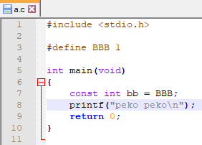
Copy this code into a.c
Try this command: gcc -E a.c
What do you see or observe?

Slide 17
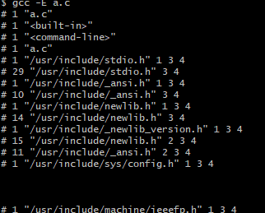
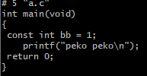
You found a very long chunk of code at the top
And the very bottom you should see this:

Slide 18
Sees something familiar?

Slide 19
Compile stage

Slide 20
Text file (source code):
E.g. .txt, .c, .cpp
Pre-processing (-E)
All source codes (#include, #define, inline etc…)
Compiling
.s file (Assembly code)
Assembling
.o file (Object code in binaries)
Linking
.exe file (Executable file)

Slide 21
Compiling Stage
Translation of C code into Assembly code

Slide 22
Try this command: gcc -s a.c
A “a.s” file should be generate in your pwd, open the file with notepad++ or notepad

Slide 23
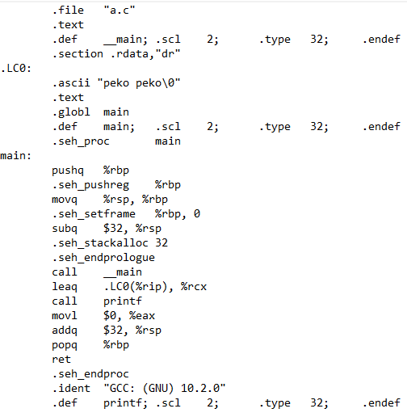
You should sees a bunch of instructions with arguments a.k.a
low-level language (still human readable codes)
In this stage, High-level language is converted into assembly code, which is to be prepared to be converted into opcode and operands, in binaries
(machine code)

Slide 24
Assembling stage

Slide 25
Text file (source code):
E.g. .txt, .c, .cpp
Pre-processing (-E)
All source codes (#include, #define, inline etc…)
Compiling (-s or -S)
.s file (Assembly code)
Assembling
.o file (Object code in binaries)
Linking
.exe file (Executable file)

Slide 26
Assembling Stage
Translation of into Assembly code into Incomplete machine code

Slide 27
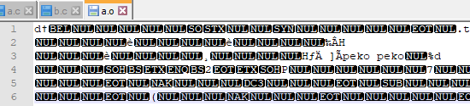
Try this command: gcc -c a.c
An object file, “a.o” should be generated, what you see are incomplete machine code

Slide 28
Linking stage

Slide 29
Text file (source code):
E.g. .txt, .c, .cpp
Pre-processing (-E)
All source codes (#include, #define, inline etc…)
Compiling (-s or -S)
.s file (Assembly code)
Assembling (-c)
.o file (machine code)
Linking (gcc)
.exe file (Executable file, binaries)

Slide 30
Linking Stage
Combination of all incomplete machine code into one complete file
Linking error happens here
it means that a called “component” is missing

Slide 31
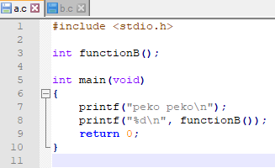
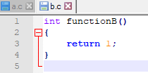
Copy these code into a.c and b.c respectively
Try this command: gcc -c a.c
Try this command: gcc -c b.c

Slide 32

Two object file should appear, a.o and b.o
Next, type the command: gcc a.o b.o
Run the program: ./a

Slide 33
What’s really happening:
a.c
b.c
All source codes (#include, #define, inline etc…)
All source codes (#include, #define, inline etc…)
.s file (Assembly code)
.s file (Assembly code)
Assembling (-c)
Assembling (-c)
.o file (Object code in binaries)
.o file (Object code in binaries)
Linking (gcc)
.exe file (Executable file)

Slide 34
Errors Occuring

Slide 35
no errors most of the time
Text file (source code):
E.g. .txt, .c, .cpp
Pre-processing (-E)
“compile error” syntax error mostly, member access etc…
All source codes (#include, #define, inline etc…)
Compiling (-s or -S)
no errors most of the time
.s file (Assembly code)
Assembling (-c)
.o file (machine code)
“linking error”
missing linkage such as missing files, missing definition, libraries etc…
Linking (gcc)
.exe file (Executable file, binaries)
“runtime error”
memory out of range/segmentation fault, out of memory(RAM), dereferencing null pointer (access staff that doesn’t exist), explicitly added code to quit the application when error occurs etc…

Slide 36
Compile Error
Happens when the program is compiling
syntax error mostly, member access etc…

Slide 37
Linker Error
Happens after the program compiled successfully and right before generating .exe file
missing linkage such as missing files, missing definition, libraries etc…

Slide 38
Runtime Error
Happens when the program is running;
memory out of range/segmentation fault;
out of memory(RAM);
dereferencing null pointer (accessing staff that doesn’t exist);
explicitly coded to quit the application when error occurs
etc.…

Slide 39
Purpose
able to understand when, where and what errors are occurs at which stage in programming
eventually you will identify the types of errors on which stage and where etc.…; the more you code
Objective
learn the stages of how your code is being compiled
Notes:
https://chortle.ccsu.edu/java5/Notes/chap09A/ch09_5.html

