Slide 1
LESSON #004
Introduction to C Programming
Learn Programming Basics (C Language)

Slide 2
Topic for C programming
2. some Unix/Linux command
3. stages of Compiling
4. introduction, data types
5. printf, scanf, Precedence Table
6. if, else if, else, ternary, switch, break
7. for loop, while, do while, continue, break
8. function declaration, definition nation, read complex declaration
9. array, read complex declaration
10. pointer, pointer and array relation, double pointer
11. malloc(memory allocation)
12. struct, union
13. struct memory layout, size of struct/union
never move onto the next topic if you do not understand pointer (number 9.)

Slide 3
#include, data types, string literal, statement, variables
Learn Programming Basics (C Language)

Slide 4
#include

Slide 5
Directories are library that lies in a C Program that begins with a “#” symbol
2 kinds:
#{command} <{arguments}>,
#command “{arguments}”
#include <library.h>
is found in the library-include in the user directories somewhere in your computer
#include “abc.h”
is found in the user-defined directories,
default path is in the same directory as the current C file

Slide 6
the ‘#’ symbol is a pre-processing symbol
There is a few things that can be done using “#”; Example:
#define MARCO value
#ifdef, #else, #endif, #elif, … etc.
Predefined symbol is being compile during the pre-processing stage

Slide 7
Pre-Processing Stage
Read Libraries
example: #include <stdio.h>
Remove Comment
/* c/c++ comments */
// for c++ comments only

Slide 8
Path directory

Slide 9
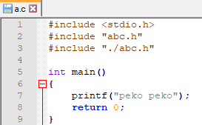
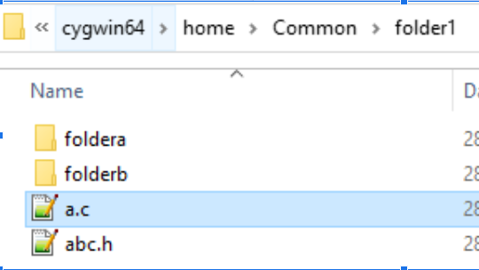

Example: Your file name is a.c in folder1
#include “abc.h” (same path as your current file)
#include “./abc.h” (same path as your current file)
#include “./folderb/abc.h” (next folder in the same path as your file)

Slide 10
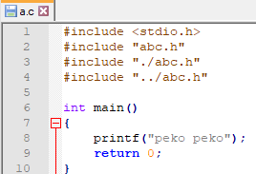
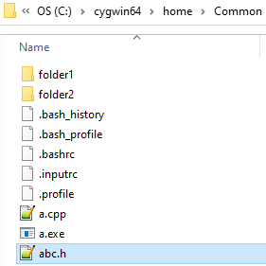
Example: Your file name is a.c in folder1
#include “../abc.h” (the folder up, previous folder)

Slide 11
Data types

Slide 12
built-in type
user-defined type
bool (at least 1 byte)
char (1 byte)
short (2 byte)
unsigned short
int (4 byte)
unsigned int
float(4 byte)
double(8 byte)
long(at least 4 byte)
unsigned long
1 byte = 8 bits
e.g. in c++
std::string
std::vector

Slide 13
char
char is represent using a single quote (‘ ‘)
Example:
‘a’
‘a’, ‘b’, ‘c’, ‘!’
char a = ‘a’; (initializing a variable type char)
char a[5] = {‘a’, ‘b’, ‘c’, ‘d’, ‘e’}; (an array of char)

Slide 14
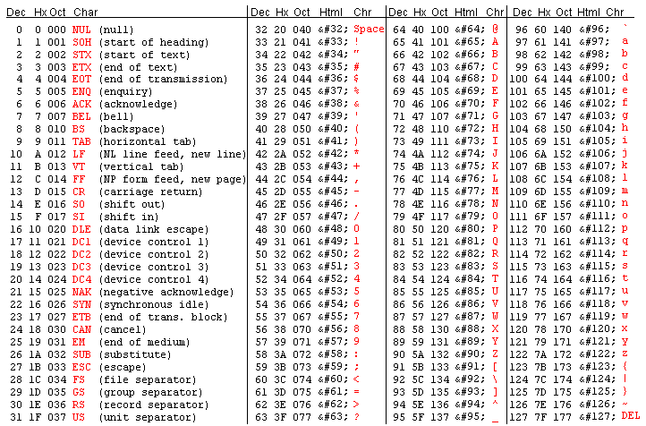
char (ASCII table)
Idea to represent each character using 8 bit size
Readable character from #0-127
Non-readable character from #128-255

Slide 15
String Literal

Slide 16
string literal
Is whatever in between the “ “ (double quote), with un-escaped characters
Example:
“This is a string literal”
“This is a string\n”
“ “
“”
contains:
whitespaces (e.g. space, tab)
char
escape characters (e.g. \n, \\, \$ … )
“\n” – next line
“\t” – tab

Slide 17
Statement

Slide 18
A Statement
A statement is a line that ends with semi-colon;
Nested Statement
A nested or compound statement is represented within a scope { … }

Slide 19
Variables Declaration, Initialization, Assignment

Slide 20
Variables
Objects that represent real world things, or ideas, simulation, representation or alias
TRUTH: Computers only reads 1 and 0
Variables are assigned with a value to give meanings to it, to represent these value
a variable is a representation of a value with its type and name
An alias
When a program is successfully compiled and linked,
Each declared variable is assigned to a specific memory location during RUNTIME
Notes:
https://chortle.ccsu.edu/java5/Notes/chap09A/ch09_5.html

Slide 21
Identifier
a name
Naming of variables in programming:
Only these characters can be used:
A B C D E F G H I J K L M N O P Q R S T U V W X Y Z
a b c d e f g h i j k l m n o p q r s t u v w x y z
0 1 2 3 4 5 6 7 8 9
_ (underscore)
an Identifier CANNOT begins with a number as the 1st character:
1 B-ob (compile error)
345221_Bob (compile error)
Notes:
https://chortle.ccsu.edu/java5/Notes/chap09A/ch09_5.html

Slide 22
Declaration
syntax:
(dataType) variableName;
int a;
int b, c, d, e; (multiple declaration of type int)
declared a variable with it’s name and type
declared variables without initializing contains rubbish/unknown value
Notes:
https://chortle.ccsu.edu/java5/Notes/chap09A/ch09_5.html

Slide 23
Initialization
syntax:
(dataType) variableName = value;
int a = 1;
int b = 1, c = 2, d = 3, e = 4;
float f = 0.01f;
double g = 0.1;
char h[] = “Haachama”;
char i[3]= {‘a’, ‘b’, ‘c’};
An initial value is initialized to a variable in the beginning
Declaration ≠ Initialization
Notes:
https://chortle.ccsu.edu/java5/Notes/chap09A/ch09_5.html

Slide 24
int a = 1;
int b = 1, c = 2, d = 3, e = 4;
float f = 0.01f;
double g = 0.1;
Assignment
syntax:
DeclaredVariableName = value;
a = 2;
b = 10, c = 20, d = 30, e = 40;
f = 0.0001f;
g = 0.01;
value assigned to a variable after its has been declared or initialized, is called assignment/assigning a value
Notes:
https://chortle.ccsu.edu/java5/Notes/chap09A/ch09_5.html

Slide 25
Keywords

Slide 26
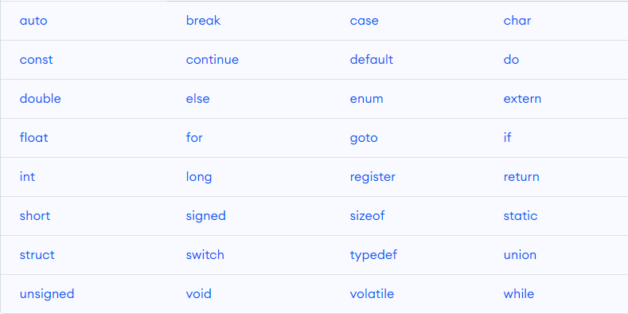
Reserved words
Notes:
https://www.programiz.com/c-programming/list-all-keywords-c-language

Slide 27
Example - sizeof
sizeof is an operator, not a function
try it out:
printf(“sizeof bool:%d”, sizeof(bool));
printf(“sizeof char:%d”, sizeof(char));
printf(“sizeof short:%d”, sizeof(short));
printf(“sizeof int:%d”, sizeof(int));
printf(“sizeof float:%d”, sizeof(float));
printf(“sizeof double:%d”, sizeof(double));
Notes:
https://chortle.ccsu.edu/java5/Notes/chap09A/ch09_5.html

