Slide 1
LESSON #005 (Lab)
printf/scanf, precedence table, lvalue, rvalue
Learn Programming Basics (C Language)

Slide 2
Purpose
printf prints characters on console
scanf scan characters on console and convert into type
Objective
learn some basic programming typing starting with printf and scanf
learn the basic of input and output
learn how printf works
learn how scanf works
learn about some operator
Notes:
https://chortle.ccsu.edu/java5/Notes/chap09A/ch09_5.html

Slide 3
printf – Intro (part 1)

Slide 4
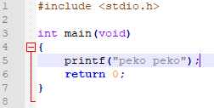
Remember this snippet of code?

Slide 5
Remember this snippet of code?
<- include <stdio.h> library

Slide 6
Remember this snippet of code?
<- main point of entry of a program

Slide 7
Remember this snippet of code?
the function “printf” is from the library <stdio.h>

Slide 8
Remember this snippet of code?
the function “printf” came from the library <stdio.h>
if without the #include<stdio.h>, it causes a linker error during the linking stage,
The error will be compainling that it could not find the function’s declaration, More details in next future lessons

Slide 9
Remember this snippet of code?
return 0; is to return a value to end a function execution / returning resources. More details in next future lessons

Slide 10
What is printf?
printf is a function that allows to print out variables’ value or data in string format
it’s a output function
document:
http://www.cplusplus.com/reference/cstdio/printf/
Notes:
http://www.cplusplus.com/reference/cstdio/printf/

Slide 11
printf - Format (Specifier) (part 2)

Slide 12
Example 1: printing out a string literal
<- print the string “peko peko”
Compile with this command line, follow by the file “a.c”
Compile and run, it should print “peko peko”

Slide 13
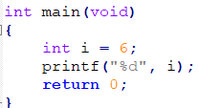

Example 2: printing out an int
Example 3: printing out a float

Slide 14
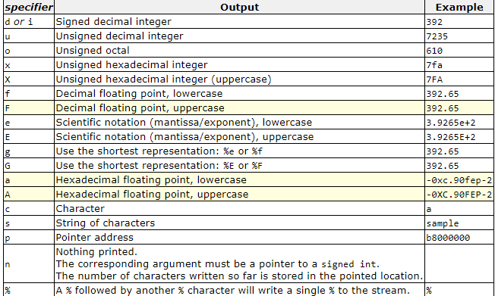
Reference: http://www.cplusplus.com/reference/cstdio/printf/
specifier is used to specify what kind of type you want to print

Slide 15
Most commonly used
“%d” (prints integers)
“%f” (prints floating number)
“%c” (prints char)
“%s” (prints strings of character)
“\n” (next line)

Slide 16
printf - Format (Width, precision) (part 3)

Slide 17
Reference: http://www.cplusplus.com/reference/cstdio/printf/
%[flags][width][.precision][length]specifier
Focus on width, precision and specifier which is mostly used
width
the minimum number of characters that will be printed for the current specifier
extra spaces is added if the width is shorter than the minimum number
precision
The amount of floating point to display

Slide 18
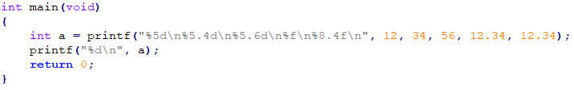
Full example:
Number of space | 1 | 2 | 3 | 4 | 5 | 6 | 7 | 8 | 9 | 10 | 11 | 12 | 13 | 14 | 15
%5d: |  |  |  | 1 | 2
%5.4d: |  | 0 | 0 | 3 | 4
%5.6d: | 0 | 0 | 0 | 0 | 5 | 6
%f | 1 | 2 | . | 3 | 4 | 0 | 0 | 0 | 0
%8.4f |  | 1 | 2 | . | 3 | 4 | 0 | 0
a = 37, a represent the number of characters printed successfully

Slide 19
Analyze 1 (int):
%5d: |  |  |  | 1 | 2
minimum width of 5 characters to be printed
empty spaces is added to the front to “fill up” at least 5 characters

Slide 20
Analyze 2 (int):
%5.4d: |  | 0 | 0 | 3 | 4
minimum width of 5 characters to be printed
a precision of 4
zeros is added instead of empty spaces for the case of integer

Slide 21
Analyze 3 (int):
%5.6d: | 0 | 0 | 0 | 0 | 5 | 6
minimum width of 5 characters to be printed
a precision of 6
zeros is added

Slide 22
Analyze 4 (float):
%f | 1 | 2 | . | 3 | 4 | 0 | 0 | 0 | 0
be default, floating point is printed with a precision of 6 floating point

Slide 23
Analyze 5 (float):
%8.4f |  | 1 | 2 | . | 3 | 4 | 0 | 0
minimum width of 8 characters to be printed
a precision of 4

Slide 24
Try it yourself

Slide 25
scanf

Slide 26
What is scanf?
scanf is a function that takes in user’s keys input, and store the data into the memory for usage
it’s a input function
http://www.cplusplus.com/reference/cstdio/scanf/
%[*][width][length]specifier
Focus only on specifier which is mostly used

Slide 27
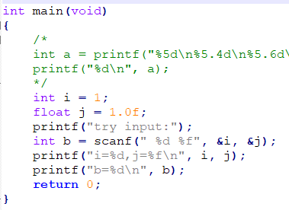
Lets analyze 1:
b represent the number of characters successfully, “scanned”
compile and run the program
try the following input:
22 33.33
-33.33
.33
a11.11

Slide 28

Lets analyze 1a step by step:
scanf(“ |  | %d |  | %f | “),&i,&j
firstly, scanf scan the first specification, in this case it’s a space,
scanf will either ignore whitespaces or follow through if the input buffer exist
input buffer: | 2 | 2 |  | 3 | 3 | . | 3 | 3
scanf finds no “whitespaces”
scanf finds no “whitespaces”

Slide 29
Lets analyze 1a step by step:
scanf(“ |  | %d |  | %f | “),&i,&j
next, scanf points to the next buffer and it finds “%”,
it will trigger and continue to find a specifier which is “d”, an integer
scanf will now stop, and read from the input buffer again
input buffer: | 2 | 2 |  | 3 | 3 | . | 3 | 3
scanf finds the input buffer that is an integer,

Slide 30
Lets analyze 1a step by step:
scanf(“ |  | %d |  | %f | “),&i,&j
input buffer: | 2 | 2 |  | 3 | 3 | . | 3 | 3
scanf continues to read the input buffer and finds a “space” which is not an integer, and stops reading

Slide 31
Lets analyze 1a step by step:
scanf(“ |  | %d |  | %f | “),&i,&j
scanf read “22” and convert into integer and store it back to “i”
input buffer: | 2 | 2 |  | 3 | 3 | . | 3 | 3
then stores whatever it have read and store convert into integer and store it

Slide 32
Lets analyze 1a step by step:
scanf(“ |  | %d |  | %f | “),&i,&j
now scanf continues to read and it and finds “whitespaces”, and ignore
input buffer: | 2 | 2 |  | 3 | 3 | . | 3 | 3

Slide 33
Lets analyze 1a step by step:
scanf(“ |  | %d |  | %f | “),&i,&j
likewise scanf now finds “%f” and stop
scanf now read from the input buffer and finds anything that represent floating number
input buffer: | 2 | 2 |  | 3 | 3 | . | 3 | 3
“whitespaces” at the front are ignored
reads the entire buffer that can represent floating number
it stop reading when reaching characters that can’t be represented as floating number or it stops when it reached the end of buffer

Slide 34
Lets analyze 1a step by step:
scanf(“ |  | %d |  | %f | “),&i,&j
scanf now convert “33.33” to float and store it in j
input buffer: | 2 | 2 |  | 3 | 3 | . | 3 | 3

Slide 35
Lets analyze 1a step by step:
scanf(“ |  | %d |  | %f | “),&i,&j
reach the end of buffer and stop
input buffer: | 2 | 2 |  | 3 | 3 | . | 3 | 3

Slide 36
Lets analyze 1b (tips and tricks):
scanf(“ |  | %d |  | %f | “),&i,&j
ignore “whitespaces”
ignore “whitespaces”
input buffer: | - | 3 | 3 | . | 3 | 3
i = -33, j = 0.33

Slide 37
Lets analyze 1c (tips and tricks):
scanf(“ |  | %d |  | %f | “),&i,&j
ignore “whitespaces”
scanf stops all operation when it does not match
input buffer: | # | 3 | 3

Slide 38
Lets analyze 1c (tips and tricks):
scanf(“ |  | %d |  | %f | “),&i,&j
scanf stops all operation when it does not match
input buffer: | # | 3 | 3

Slide 39
Lets analyze 1d (tips and tricks):
scanf(“ |  | %d |  | %f | “),&i,&j
ignore “whitespaces”
scanf stops all operation when it does not match
input buffer: | a | 1 | 1 | . | 1 | 1

Slide 40
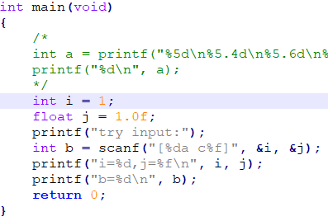
Let’s analyze 2:
b represent the number of characters successfully “scanned”
compile and run the program
try the following input:
[22ac11.33
[22a c 11. 33
[22a c..33]
[0a c.11.333

Slide 41
Lets analyze 2a (tips and tricks):
scanf(“ | [ | %d | a |  | c | %f | ] | “),&i,&j
stops here
input buffer: | [ | 2 | 2 | a | c | 1 | 1 | . | 3 | 3
i = 22, j = 11.33

Slide 42
Lets analyze 2b (tips and tricks):
scanf(“ | [ | %d | a |  | c | %f | ] | “),&i,&j
stops here
input buffer: | [ | 2 | 2 | a |  | c |  | 1 | 1 | . |  | 3 | 3
i = 22, j = 11.000000

Slide 43
Lets analyze 2c (tips and tricks):
scanf(“ | [ | %d | a |  | c | %f | ] | “),&i,&j
stops here
input buffer: | [ | 2 | 2 | a |  | c | . | . | 3 | 3
i = 22, j = 1.0

Slide 44
Lets analyze 2d (tips and tricks):
scanf(“ | [ | %d | a |  | c | %f | ] | “),&i,&j
stops here
input buffer: | [ | 0 | a |  | c | . | 1 | 1 | . | 3 | 3 | 3
i = 0, j = 0.11

Slide 45
precedence table

Slide 46
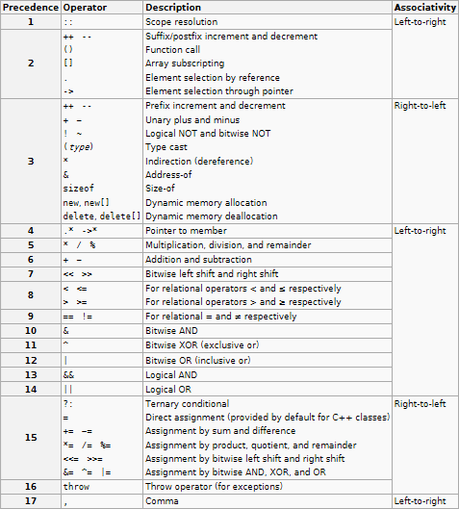

Slide 47
what is precedence?
setting the priority of operation
example: 1 + 3 * 5 - 2 / 4
what operation to be done first?

Slide 48
postfix increment/decrement
i++ , j--
Evaluate to the original value of i
and then Increment/decrement by one to itself.
int i = 1
printf(“i=%d”,i++); putput: i=1
printf(“i=%d”,i); output: i=2
int j = 1
printf(“j=%d, j=%d”, j--, j); putput: j=1, j=0

Slide 49
prefix increment/decrement
++i , --j
Increment/decrement by one to itself firstly
int i = 1
printf(“i=%d, i=%d”,++i, i); putput: i=2, i=2
printf(“i=%d”,i); output: i=2
int j = 1
printf(“j=%d, j=%d”, --j, j); putput: j=0, j=0

Slide 50
L-value, R-value

Slide 51
Lvalue
Objects that have a memory location
Rvalue
Objects that does not have a memory location
Objects that will be discarded if is not assigned to another object
a.k.a temporary value
Every C operator operation evaluate to a Rvalue

Slide 52
Example:
int i = 2, j = 3, k = 0;
k = i + j
right not, i, j, k is a Lvalue
Evaluation:
i
2
Lvalue
j
3
Lvalue
i+j
5
Rvalue
k=
5
The evaluated value has becomes Lvalue

Slide 53
Exercise:
int i = 10, j = 15, k = 20;
i++ - ++j + --k
++i - j++ + k--
++i + i++ + i++

