Slide 1
Kernel Panic In The Cisco!
eVentor
Raghav Samavedam - Frontend Lead, Android Extraordinaire, SQL Sorcerer
Eostre Emily Danne - Backend Hacker, FreeBSD Fanatic, Sysadmin Supreme
Sean McCormack – Synergistic Supervisor, Penguin In Training
Ashwin Nair – Java Jockey

Slide 2
Personal Anecdote

Slide 3
Guiding Question
Problem:
  People aren’t getting together enough.
  People can’t get together if the don’t have places to be.

Slide 4
Guiding Question
Solution:
  Give people a platform on which to post events

Slide 5
eVentor – Overview, What Is It?
eVentor is a community-driven “event inventor” - a way for community members to get together and do things.
  Features:
    Community creation of events
    Community-provided feedback on created events
    Dynamic community-decided trust system
    Tied to real-life

Slide 6

Look Familiar?

Slide 7
(Except we don’t spy on you)

Slide 8
(Or leak your data to Cambridge Analytica)

Slide 9
Inspirations
Points/Trust system
  Reddit
Community Aspect
  Facebook

Slide 10
Reiteration: Goals
Community Unity
Promotion of Peace

Slide 11
Reiteration: Goals
Community Unity
Promotion of Peace
$$$

Slide 12
Monetization
  (We’ve gotta pay the bills somehow!)

Slide 13
Monetization
Advertisement Injection
  Have /get-events-by-tag insert an advertisement into a percent of posts

Slide 14
Monetization
Advertisement Injection
  Have /get-events-by-tag insert an advertisement into a percent of posts
Donations
  Many FLOSS (Free/Libre Open Source Software) projects survive on donations
    Mastodon
    Linux
    GNU

Slide 15
Monetization
Anecdote

Slide 16
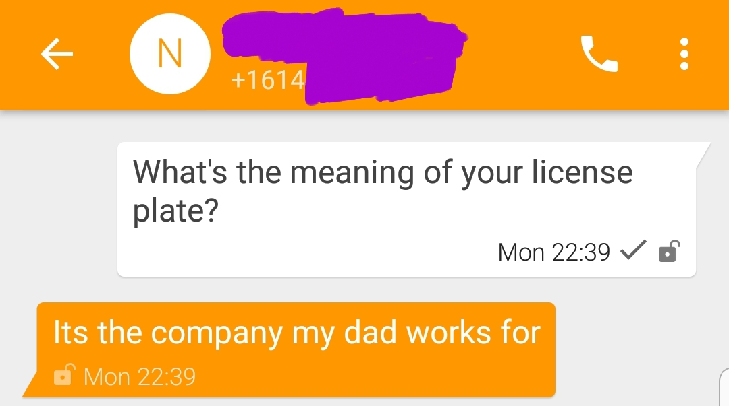
Monetization

Slide 17

Monetization
There are no new ideas in software

Slide 18
Black Magic of Backend
Flask on Python on Apache on FreeBSD on Linode

Slide 19
Black Magic of Backend
Flask on Python on Apache on FreeBSD on Linode
  Flask
    API server framework
    Python
    Widely used in the Python world

Slide 20
Black Magic of Backend
Flask on Python on Apache on FreeBSD on Linode
  Flask
  Python
    Programming language
    Beautifully simple
    Ease of use
    Wide support

Slide 21
Black Magic of Backend
Flask on Python on Apache on FreeBSD on Linode
  Flask
  Python
  Apache
    Web server
    Simple configuration

Slide 22
Black Magic of Backend
Flask on Python on Apache on FreeBSD on Linode
  Flask
  Python
  Apache
  FreeBSD
    Operating system
    4.4BSD-derived
    Secure by default

Slide 23
Black Magic of Backend
Flask on Python on Apache on FreeBSD on Linode
  Flask
  Python
  Apache
  FreeBSD
  Linode
    Hosting company
    Full* control over servers

Slide 24
Gray Magic of Frontend
Android

Slide 25
Gray Magic of Frontend
Android
(Java on Google on GNU on Linux on aarch64)

Slide 26
Gray Magic of Frontend
It was a long journey

Slide 27
Gray Magic of Frontend
Starting Knowledge:
Ending Knowledge:

Slide 28
Gray Magic of Frontend
Starting Knowledge:
Ending Knowledge:
  How to make an Android app
  How to make an Android app with networking
  How to connect to an API
  How to format JSON
  How to read JSON
  How to compile an APK

Slide 29
(We didn’t miss a slide transition there)

Slide 30
Gray Magic of Frontend
Starting Knowledge:
Ending Knowledge:
  How to make an Android app
  How to make an Android app with networking
  How to connect to an API
  How to format JSON
  How to read JSON
  How to compile an APK

Slide 31
Gray Magic of Frontend
Things learned (cont)
  How to compile an APK
  How to write to Logcat
  How to do Java multithreading
  How to use ListFragments
  How to do Java file I/O
  How to switch between activities
  What activities even are
  etc.

Slide 32
Aesthetics
(Insert images and GIFs here)

Slide 33
Roadmap
2018Q2 (Now):
  Top priority: completely functional API
  Second priority: functional frontend
  Goals:
    Beautiful frontend

Slide 34
Roadmap
2018Q3
  Beautify the code
    (Unspaghettify the spaghetti code)
  Add Nexosis to frontend
  Add iPhone support

Slide 35
Roadmap
2018Q4
  Self-host prod and dev
    Ditch Linode
  API 2.0
    Ditch SQL in favor of Python-native ORMs
    Outsource authentication to auth0

Slide 36
Roadmap
2019Q1
  Federation support

Slide 37
Q/A
Ask us anything

