Slide 1

CSCI E-83 Introduction to Clustering Models
Steve Elston
Copyright 2020,2021, Stephen F Elston. All rights reserved.

Slide 2
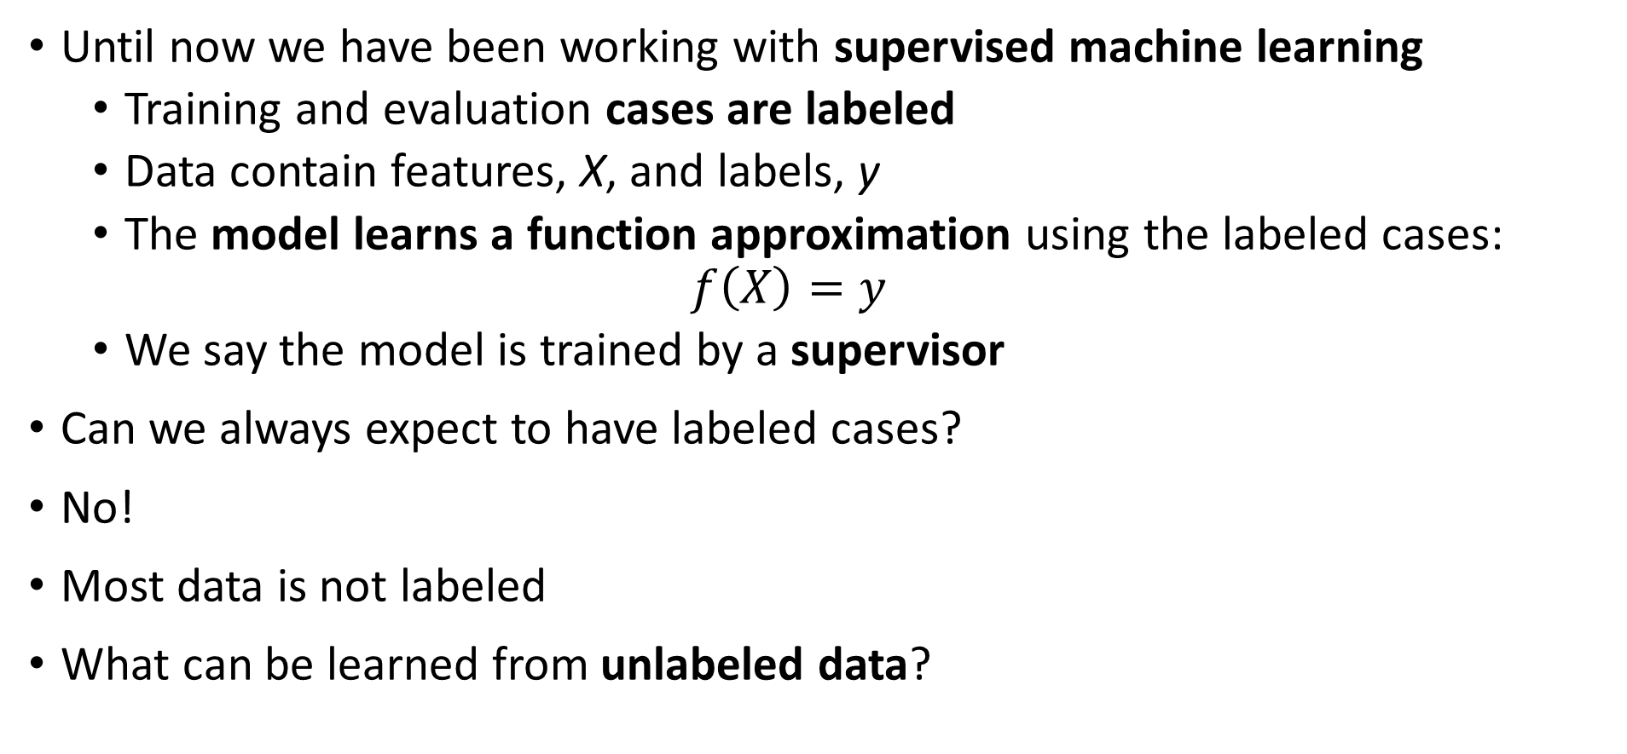
Introduction to Unsupervised Learning
Until now we have been working with supervised machine learning
Training and evaluation cases are labeled
Data contain features, X, and labels, y
The model learns a function approximation using the labeled cases:
$$f\left(X\right)=y$$
We say the model is trained by a supervisor
Can we always expect to have labeled cases?
No!
Most data is not labeled
What can be learned from unlabeled data?

Slide 3
Introduction to Unsupervised Learning
Without labeled data, what can a model learn?
Can learn structure of data
Structure is learned by determining association between cases
Association based on measures of proximity, distance or dissimilarity
Clustering algorithms are data mining methods
Data mining seeks to find interesting relationships in data
We have already encountered feature importance as a data mining method

Slide 4
Introduction to Unsupervised Learning
Algorithms can use different distance or dissimilarity metrics
Structure based on distance metrics
Different algorithms use different metrics
What are the ideal properties of clusters?
Good clusters have two properties
Compactness: We what the clusters to be small with members close to each other
Separation: We want the clusters are well separated, a closeness property

Slide 5
Introduction to Unsupervised Learning
Why should we care about unsupervised learning?
Most data is not labeled
Learning data structure is useful in many applications
Find groups of similar purchases
Discover unusual or outlier events
Similar genes in microsassay data
Find groups of people similar behaviors – e.g. voting
Find patients with related symptoms
Data compression algorithms
And many more...

Slide 6
Introduction to Unsupervised Learning
Different dissimilarity metrics will give different results
Dissimilarity metrics usually matter more than model choice
But which one should we use?
Evaluation is a significant problem with for unsupervised learning
There are no labels for objective evaluation
Evaluation is often subjective
But, do we have to pick one best model?
No
Different models can show different useful relationships

Slide 7
Introduction to Unsupervised Learning
No we have to pick one best model?
There are many classes of models
Models seeking compactness
Models seeking affinity between points
Models seeking high density regions

Slide 8
Measuring distance or dissimilarity
Structure in data is based on dissimilarity measured by some distance metric
The variables or cases generally have multiple observations or measurements
Distance measures are therefore multivariate
Distance metrics can be computed for three types of variables
Numeric distance for numeric variables
Rank difference for ordinal variables
Coded difference, usually binary, for unordered categorical variables

Slide 9
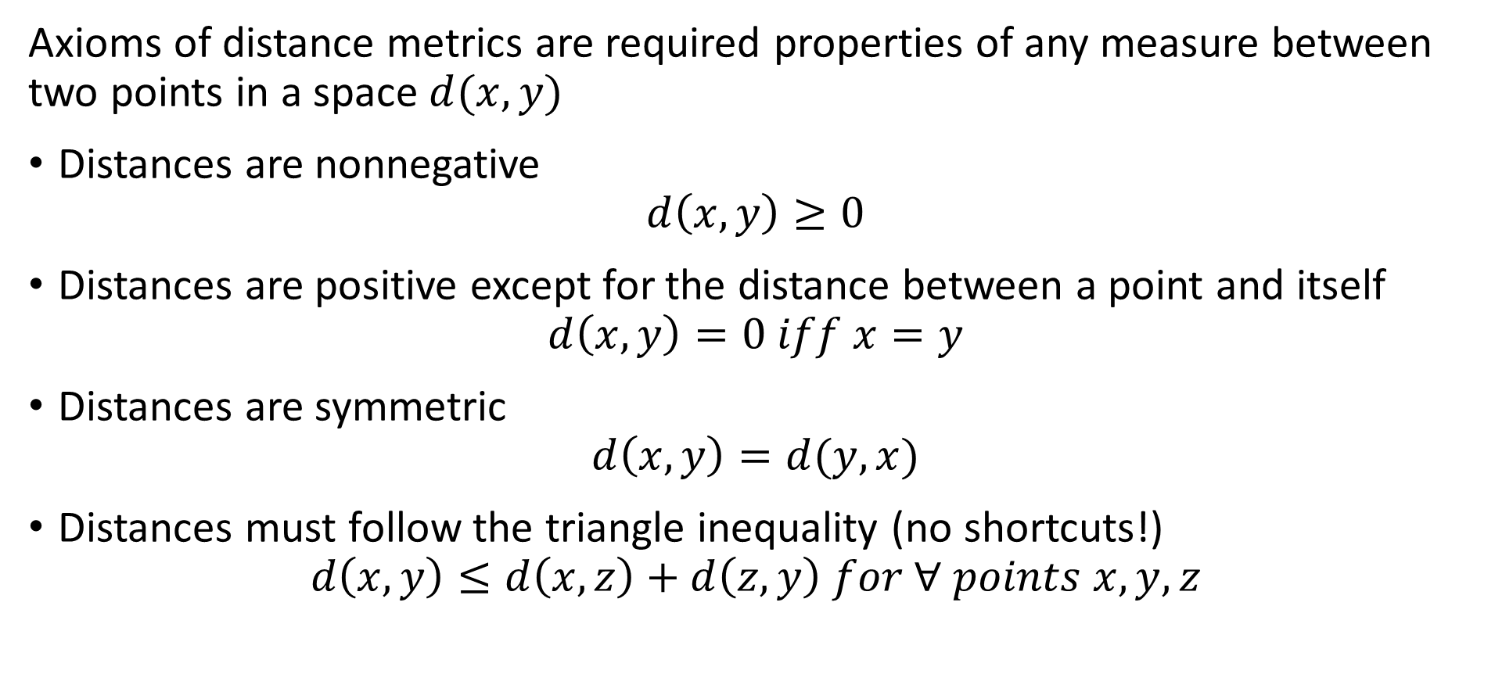
Measuring distance or dissimilarity
Axioms of distance metrics are required properties of any measure between two points in a space $d(x,y)$
Distances are nonnegative
$$d\left(x,y\right)≥0$$
Distances are positive except for the distance between a point and itself
$$d\left(x,y\right)=0 iff x=y$$
Distances are symmetric
$$d\left(x,y\right)=d(y,x)$$
Distances must follow the triangle inequality (no shortcuts!)
$$d\left(x,y\right)≤d\left(x,z\right)+d\left(z,y\right) for ∀ points x,y,z$$

Slide 10
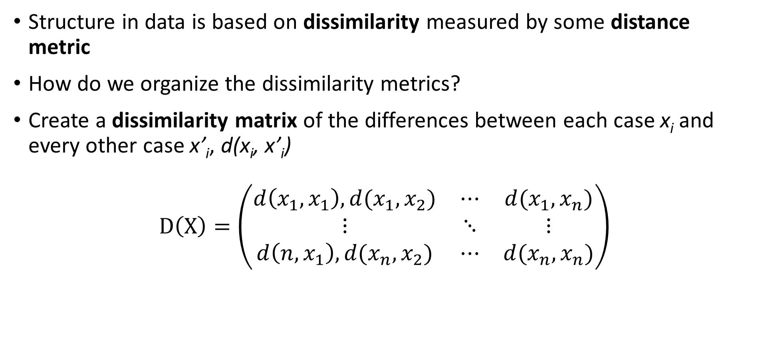
Measuring distance or dissimilarity
Structure in data is based on dissimilarity measured by some distance metric
How do we organize the dissimilarity metrics?
Create a dissimilarity matrix of the differences between each case x_{i} and every other case x’_{i}, d(x_{i}, x’_{i})
$$D\left(X\right)=\left(\begin{matrix}d\left(x_{1},x_{1}\right), d(x_{1},x_{2}) & ⋯ & d(x_{1},x_{n}) \\ ⋮ & ⋱ & ⋮ \\ d\left(n,x_{1}\right),d(x_{n},x_{2}) & ⋯ & d(x_{n},x_{n})\end{matrix}\right)$$

Slide 11
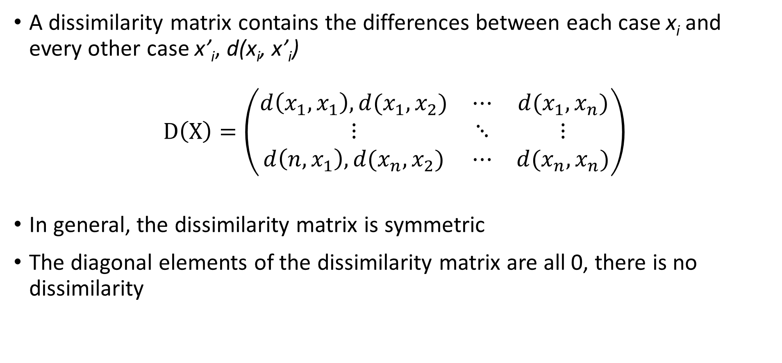
Measuring distance or dissimilarity
A dissimilarity matrix contains the differences between each case x_{i} and every other case x’_{i}, d(x_{i}, x’_{i})
$$D\left(X\right)=\left(\begin{matrix}d\left(x_{1},x_{1}\right), d(x_{1},x_{2}) & ⋯ & d(x_{1},x_{n}) \\ ⋮ & ⋱ & ⋮ \\ d\left(n,x_{1}\right),d(x_{n},x_{2}) & ⋯ & d(x_{n},x_{n})\end{matrix}\right)$$
In general, the dissimilarity matrix is symmetric
The diagonal elements of the dissimilarity matrix are all 0, there is no dissimilarity

Slide 12
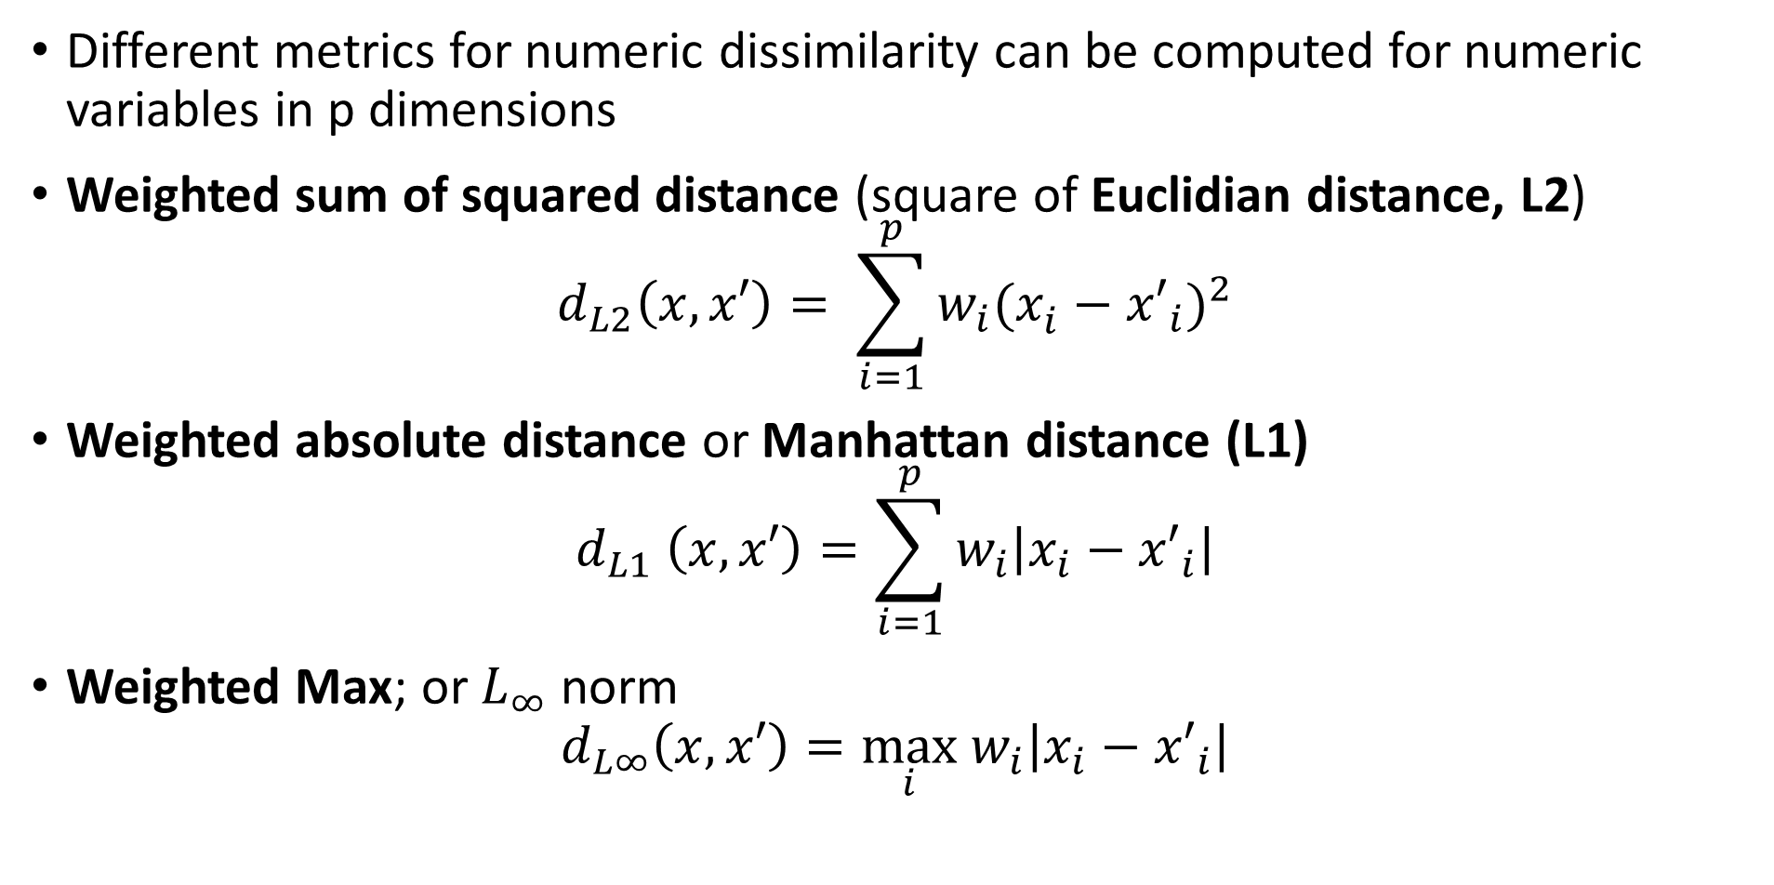
Measuring distance or dissimilarity
Different metrics for numeric dissimilarity can be computed for numeric variables in p dimensions
Weighted sum of squared distance (square of Euclidian distance, L2)
$$d_{L2}\left(x,x′\right)= \sum_{i=1}^{p}{w_{i}(x_{i}^{ }−{x′}_{i})^{2}}$$
Weighted absolute distance or Manhattan distance (L1)
$$d_{L1} \left(x,x′\right)=\sum_{i=1}^{p}{w_{i}\left|x_{i}−{x′}_{i}\right|}$$
Weighted Max; or $L_{∞}$ norm
$$d_{L∞}\left(x,x′\right)=\max_{i} w_{i}\left|x_{i}−{x′}_{i}\right|$$

Slide 13
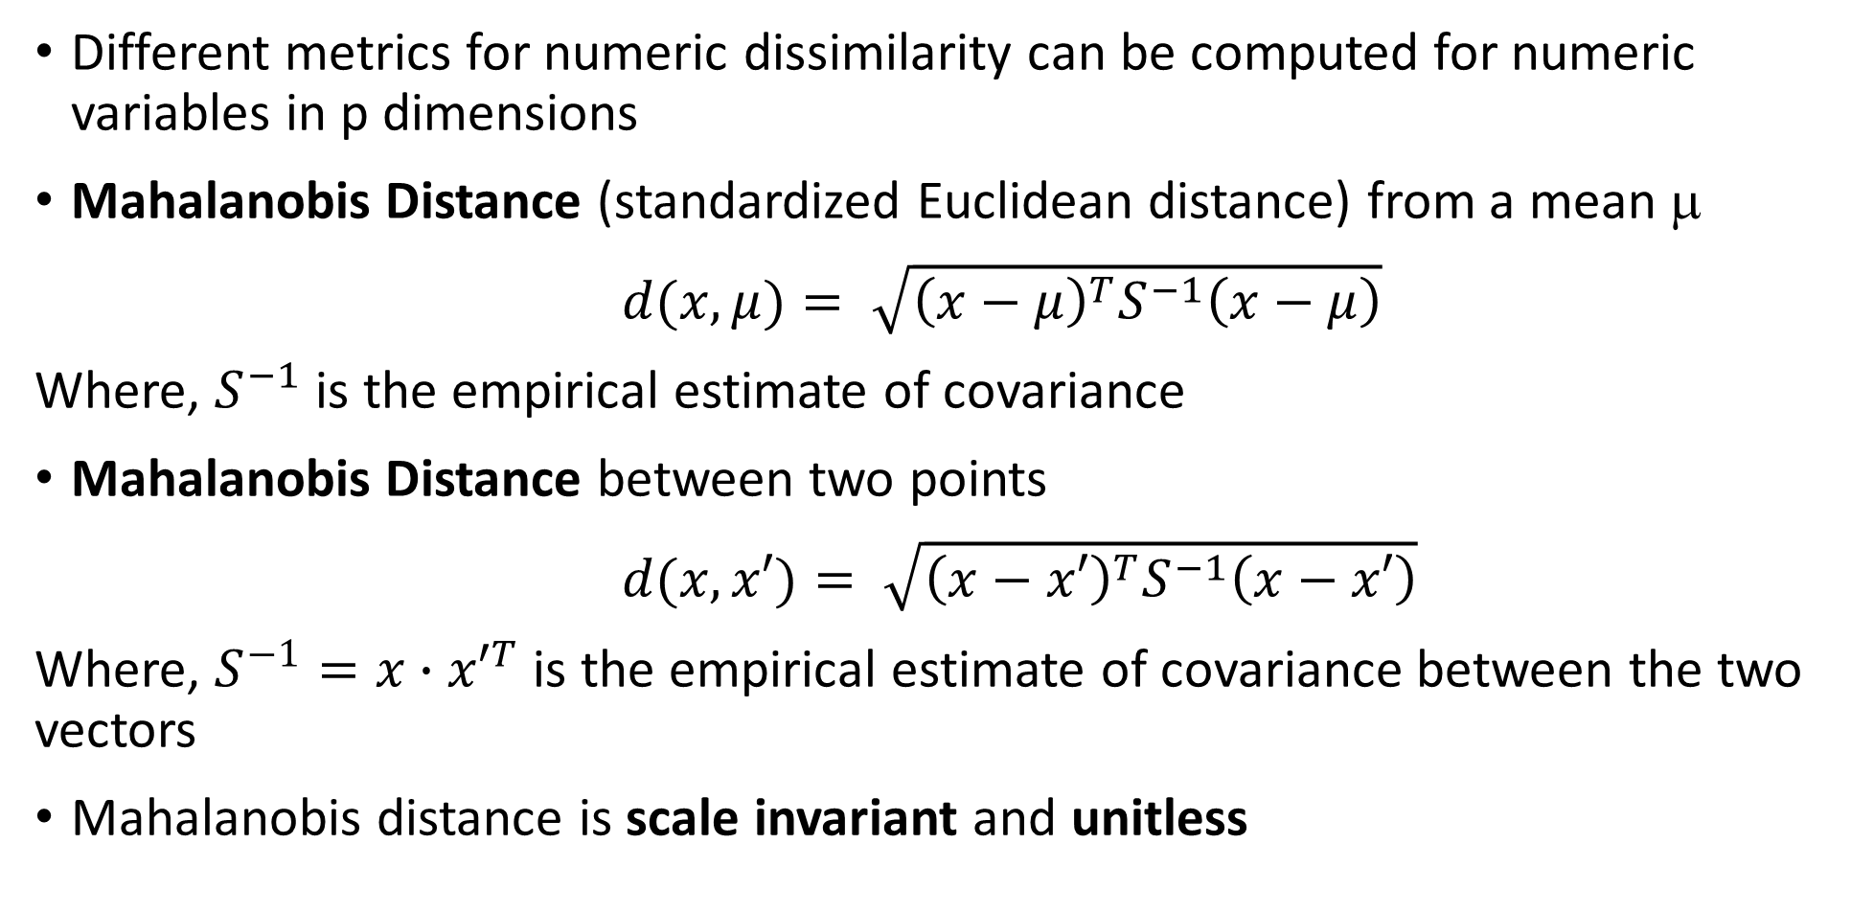
Measuring distance or dissimilarity
Different metrics for numeric dissimilarity can be computed for numeric variables in p dimensions
Mahalanobis Distance (standardized Euclidean distance) from a mean μ
$d(x,μ)= \sqrt{{\left(x−μ\right)}^{T}S^{−1}\left(x−μ\right)}$
Where, $S^{−1}$ is the empirical estimate of covariance
Mahalanobis Distance between two points
$d(x,x′)= \sqrt{{\left(x−x′\right)}^{T}S^{−1}\left(x−x′\right)}$
Where, $S^{−1}=x∙{x′}^{T}$ is the empirical estimate of covariance between the two vectors
Mahalanobis distance is scale invariant and unitless

Slide 14
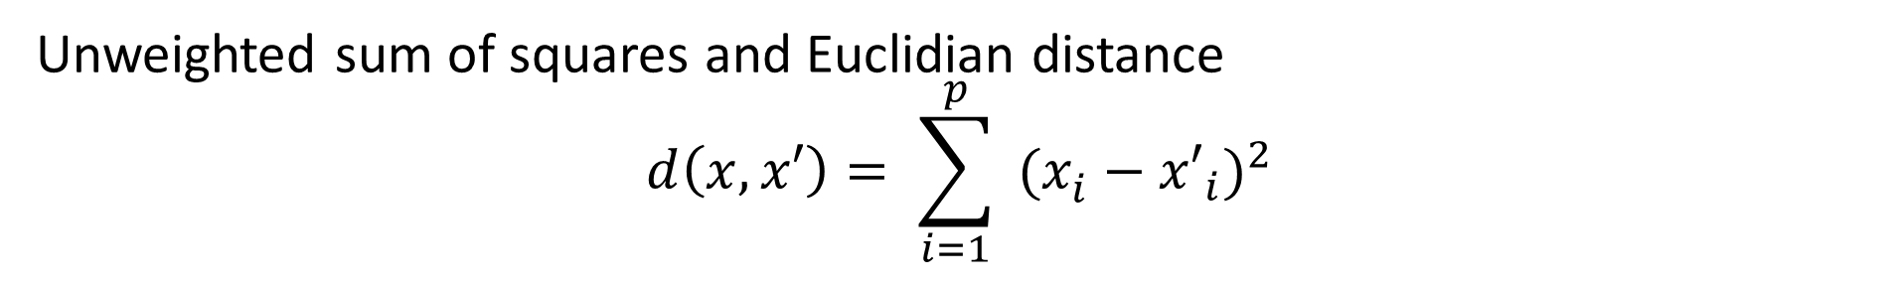
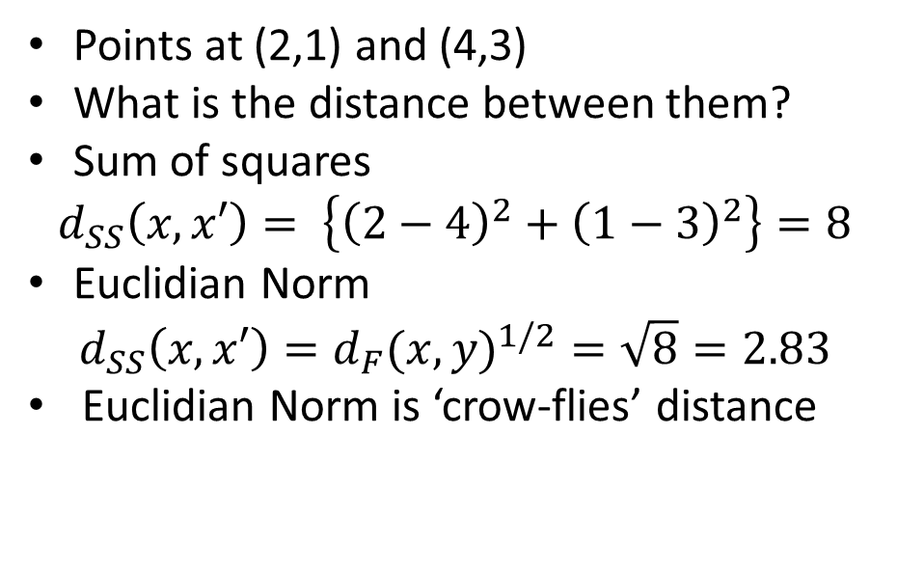
Measuring distance or dissimilarity
Unweighted sum of squares and Euclidian distance
$$d\left(x,x′\right)= \sum_{i=1}^{p}{ (x_{i}^{ }−{x′}_{i})^{2}}$$
Points at (2,1) and (4,3)
What is the distance between them?
Sum of squares
$$d_{SS}\left(x,x′\right)= \left\{{\left(2−4\right)}^{2}+{\left(1−3\right)}^{2}\right\}=8$$
Euclidian Norm
$$d_{SS}\left(x,x′\right)={d_{F}(x,y)}^{1/2}=\sqrt{8}=2.83$$
Euclidian Norm is ‘crow-flies’ distance
(4,3)
X₂
(2,1)
X₁

Slide 15
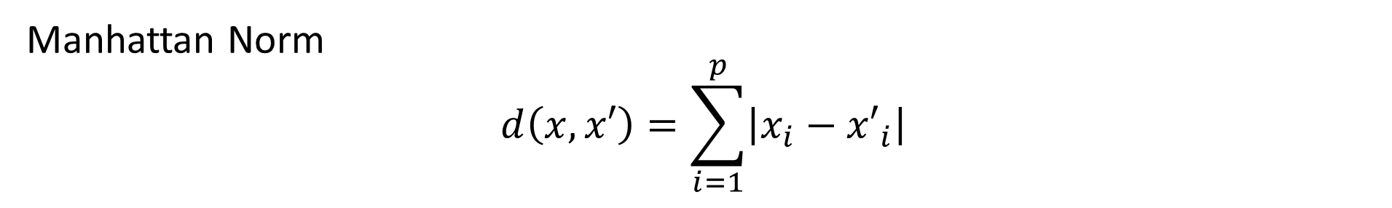
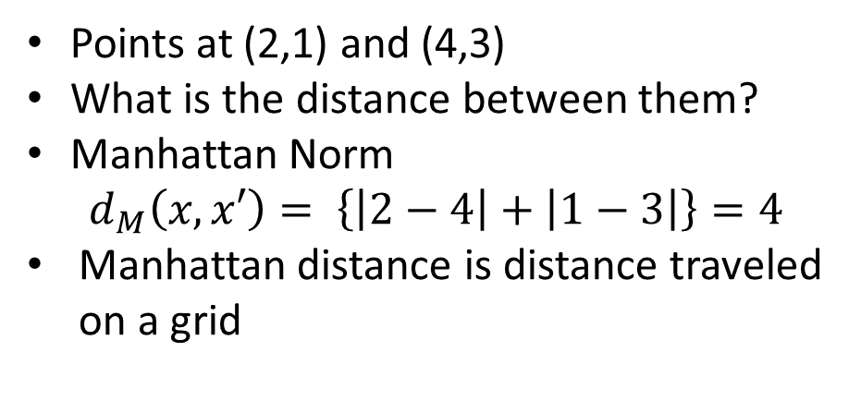
Measuring distance or dissimilarity
Manhattan Norm
$$d\left(x,x′\right)=\sum_{i=1}^{p}{\left|x_{i}−{x′}_{i}\right|}$$
Points at (2,1) and (4,3)
What is the distance between them?
Manhattan Norm
$$d_{M}\left(x,x′\right)= \left\{\left|2−4\right|+\left|1−3\right|\right\}=4$$
Manhattan distance is distance traveled on a grid
(4,3)
X₂
(2,1)
X₁

Slide 16
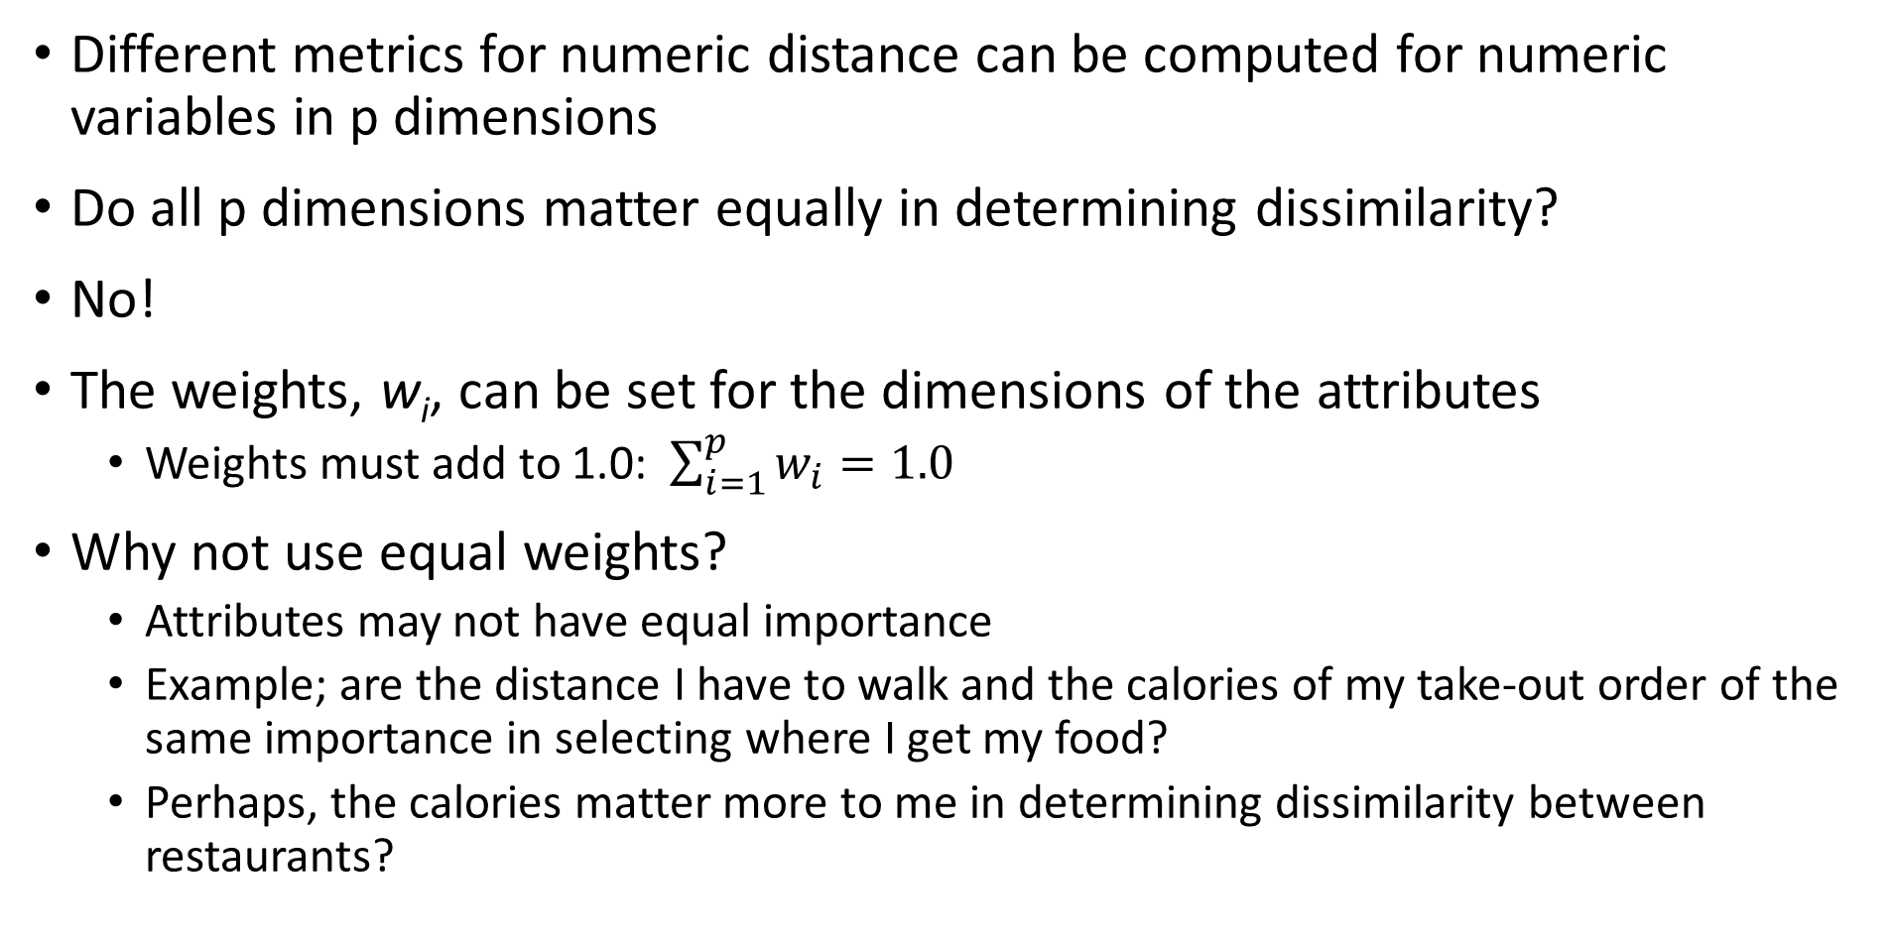
Measuring distance or dissimilarity
Different metrics for numeric distance can be computed for numeric variables in p dimensions
Do all p dimensions matter equally in determining dissimilarity?
No!
The weights, w_{i}, can be set for the dimensions of the attributes
Weights must add to 1.0: $\sum_{i=1}^{p}{w_{i}=1.0}$
Why not use equal weights?
Attributes may not have equal importance
Example; are the distance I have to walk and the calories of my take-out order of the same importance in selecting where I get my food?
Perhaps, the calories matter more to me in determining dissimilarity between restaurants?

Slide 17
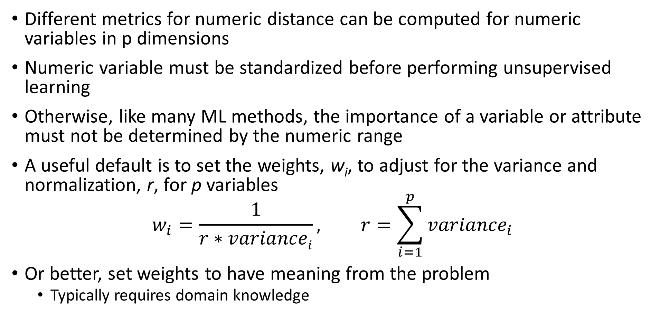
Measuring distance or dissimilarity
Different metrics for numeric distance can be computed for numeric variables in p dimensions
Numeric variable must be standardized before performing unsupervised learning
Otherwise, like many ML methods, the importance of a variable or attribute must not be determined by the numeric range
A useful default is to set the weights, w_{i}, to adjust for the variance and normalization, r, for p variables
$$w_{i}=\frac{1}{r∗variancei}, r=\sum_{i=1}^{p}{{variance}_{i}}$$
Or better, set weights to have meaning from the problem
Typically requires domain knowledge

Slide 18
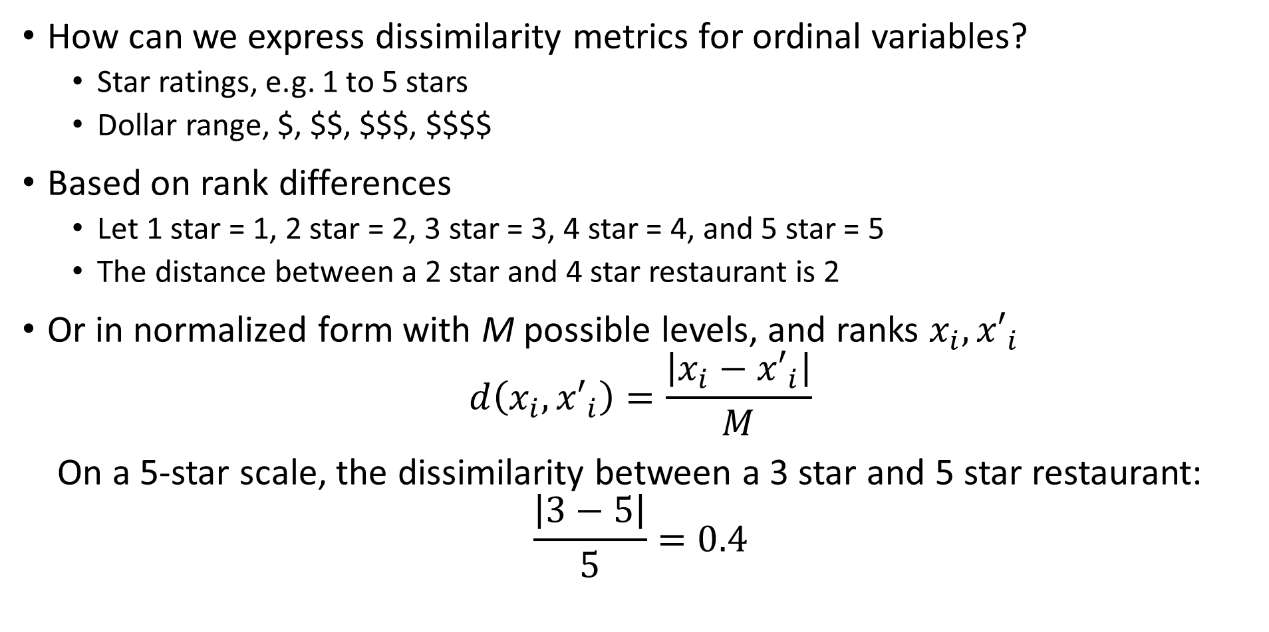
Measuring distance or dissimilarity
How can we express dissimilarity metrics for ordinal variables?
Star ratings, e.g. 1 to 5 stars
Dollar range, $, $$, $$$, $$$$
Based on rank differences
Let 1 star = 1, 2 star = 2, 3 star = 3, 4 star = 4, and 5 star = 5
The distance between a 2 star and 4 star restaurant is 2
Or in normalized form with M possible levels, and ranks $x_{i},{x′}_{i}$
$$d\left(x_{i},{x′}_{i}\right)=\frac{\left|x_{i}−{x′}_{i}\right|}{M}$$
On a 5-star scale, the dissimilarity between a 3 star and 5 star restaurant:
$$\frac{\left|3−5\right|}{5}=0.4$$

Slide 19
Measuring distance or dissimilarity
How can we express dissimilarity metrics for unordered categorical variables?
Use a coding scheme
e.g. a binary scheme, 1 if different categories, 0 if the same
Then normalize
e.g., normalize by dividing by number of categories
Example; restaurant type from 4 choices:
Vegetarian, Thai, Mexican, Pizza, Burgers,….
Distance Vegetarian to Burgers = ¼ = 0.25
Distance Burgers to Burgers = 0
Can have more complex scheme if required

Slide 20
Measuring distance or dissimilarity
Can we combine dissimilarities of different types of variables
Yes, but with can!
Scaling is important so some variable types do not dominate as a result of coding
The numeric range of values must be similar
e.g. We do not want ordinal variables to dominate numeric and categorical
But, weighting is problem dependent!
Unfortunately, no simple procedure for correct weighting
Do I care more about the star rating or type of food at a restaurant?

Slide 21
Measuring distance or dissimilarity
An example of computing dissimilarity between restaurants
Absolute dissimilarity between R1 and R4, a Mexican and vegetarian restaurant
[¼ + |0.8-0.3| + |0.7-0.1| + |3-1|/4 + |5-4|/5]/6 = [0.25 + 0.5 + 0.6 + 0.5 + 0.2]/6 = 0.342
Absolute dissimilarity between R2 and R3, two pizza places
[0 + |0.9-0.8| + |0.6-0.4| + |3-2|/4 + |4-3|/5]/6 = [0 + 0.1 + 0.2 + 0.25 + 0.2]/6 = 0.125
Restaurant | Type | Calories | Distance | Price Range | Stars
R1 | Mexican | 0.8 | 0.1 | $ | 4
R2 | Pizza | 0.9 | 0.4 | $$ | 3
R3 | Pizza | 0.8 | 0.6 | $$$ | 4
R4 | Vegetarian | 0.3 | 0.7 | $$$ | 5
R5 | Thai | 0.6 | 0.3 | $$ | 4

Slide 22
Measuring distance or dissimilarity
Another example of computing dissimilarity between restaurants
Squared dissimilarity between R1 and R4, a Mexican and vegetarian restaurant
[0.25² + 0.5² + 0.6² + 0.5² + 0.2²]/6 = [0.125 + 0.25 + 0.36 + 0.25 + 0.04]/6 = 0.171
Squared dissimilarity between R2 and R3, two pizza places
[0 + 0.1² + 0.2² + 0.25² + 0.2²]/6 = [0 + 0.01 + 0.04 + 0.125 + 0.04]/6 = 0.029
Restaurant | Type | Calories | Distance | Price Range | Stars
R1 | Mexican | 0.8 | 0.1 | $ | 4
R2 | Pizza | 0.9 | 0.4 | $$ | 3
R3 | Pizza | 0.8 | 0.6 | $$$ | 4
R4 | Vegetarian | 0.3 | 0.7 | $$$ | 5
R5 | Thai | 0.6 | 0.3 | $$ | 4

Slide 23
Measuring distance or dissimilarity
How much do different metrics matter?
A lot!
Compare dissimilarity metrics between the restaurants
The squared distance emphasizes larger differences
 | Mexican – Vegetarian | 2 Pizza Places
Absolute distance | 0.342 | 0.125
Squared distance | 0.171 | 0.029

Slide 24
Measuring distance and similarity
Do we always work with dissimilarity?
No!
Some methods use measures of similarity
The closer points in a space are (smaller distance) the more similar they are
In many cases, similarity measures can be transform to dissimilarity
For data with positive and negative coding similarity must be in the range [-1,1]
Similarity = 1, maximum similarity, points are at the same location in the space
Similarity = 0, points are orthogonal in the space, no similarity
Similarity = -1, minimum similarity, points have completely opposite coding
For non-negative data similarity in range [0,1]
Example, binary data

Slide 25
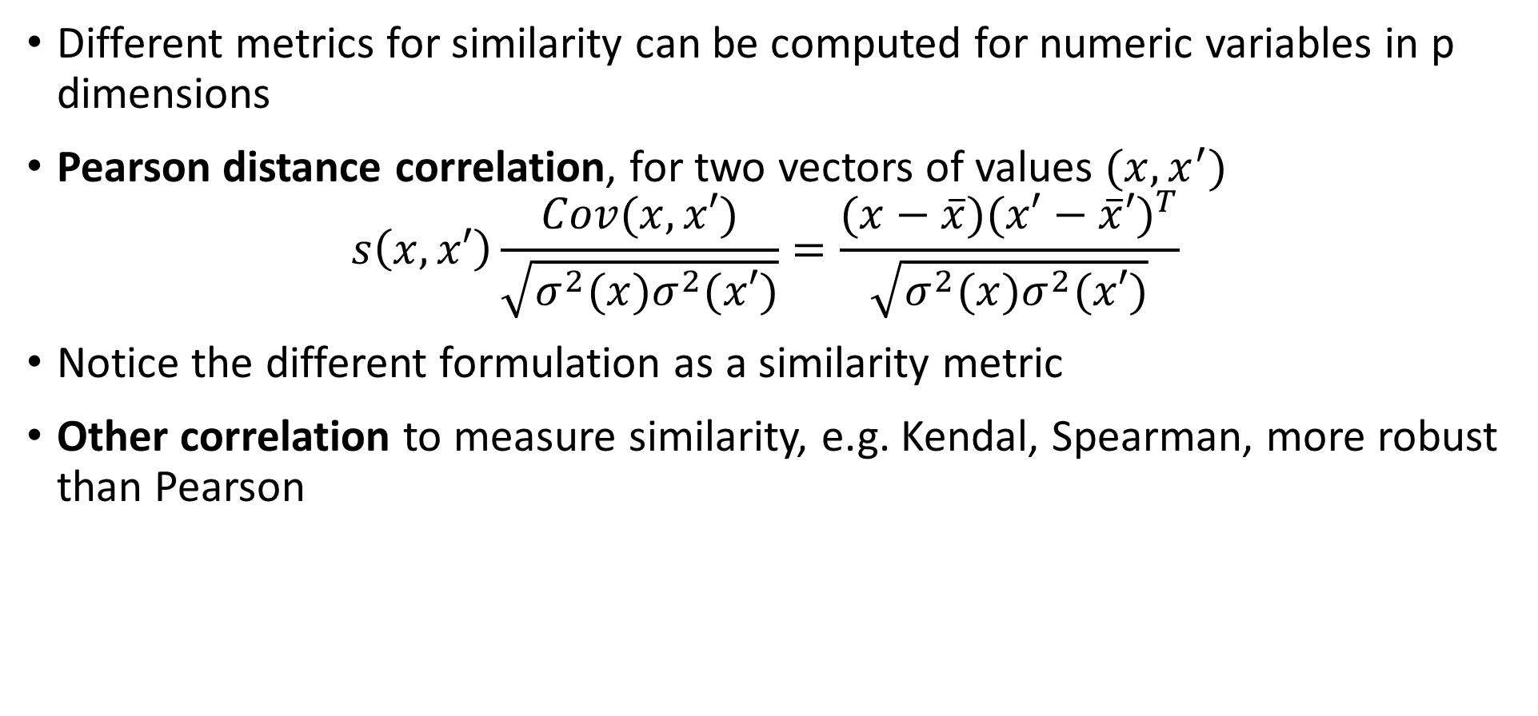
Measuring Similarity
Different metrics for similarity can be computed for numeric variables in p dimensions
Pearson distance correlation, for two vectors of values $(x,x^{′})$
$$s\left(x,x′\right)\frac{Cov(x,x′)}{\sqrt{σ^{2}(x)σ^{2}(x′)}}=\frac{(x−\overline{x}){(x′−\overline{x}′)}^{T}}{\sqrt{σ^{2}(x)σ^{2}(x′)}}$$
Notice the different formulation as a similarity metric
Other correlation to measure similarity, e.g. Kendal, Spearman, more robust than Pearson

Slide 26
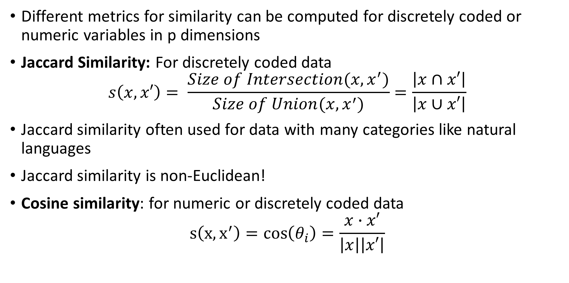
Measuring Similarity
Different metrics for similarity can be computed for discretely coded or numeric variables in p dimensions
Jaccard Similarity: For discretely coded data
$$s\left(x,x′\right)= \frac{Size of Intersection(x,x^{′})}{Size of Union(x,x^{′})}=\frac{\left|x∩x′\right|}{\left|x∪x′\right|}$$
Jaccard similarity often used for data with many categories like natural languages
Jaccard similarity is non-Euclidean!
Cosine similarity: for numeric or discretely coded data
$$s\left(x,x^{′}\right)=cos\left(θ_{i}\right)=\frac{x∙x′}{\left|x\right|\left|x′\right|}$$

Slide 27
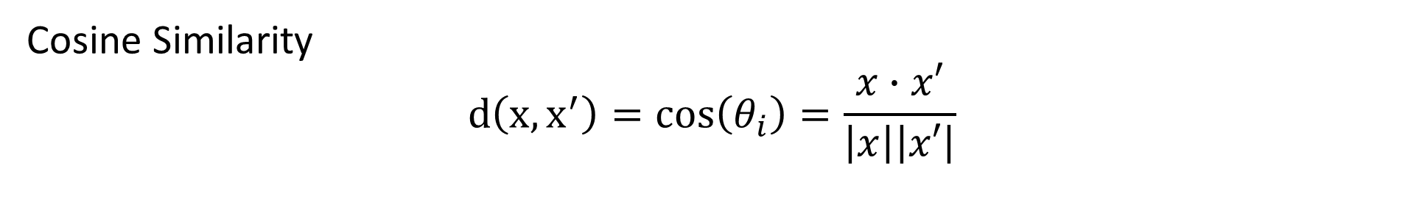
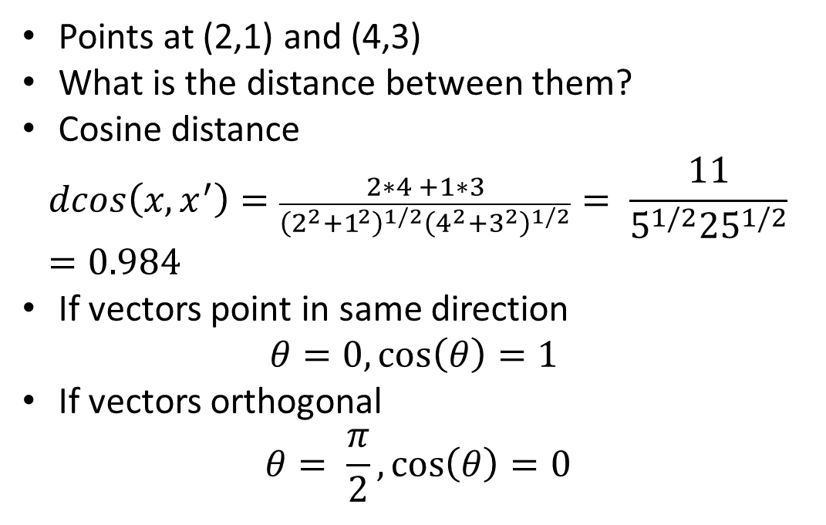
Measuring Similarity
Cosine Similarity
$$d\left(x,x^{′}\right)=cos\left(θ_{i}\right)=\frac{x∙x′}{\left|x\right|\left|x′\right|}$$
Points at (2,1) and (4,3)
What is the distance between them?
Cosine distance
$$dcos\left(x,x^{′}\right)=\frac{2∗4 +1∗3}{{\left(2^{2}+1^{2}\right)}^{1/2}{\left(4^{2}+3^{2}\right)}^{1/2}}= \frac{11}{5^{1/2}{25}^{1/2}}=0.984$$
If vectors point in same direction
$$θ=0,\cos\left(θ\right)=1$$
If vectors orthogonal
$$θ= \frac{π}{2},\cos\left(θ\right)=0$$
(4,3)
X₂
θ
(2,1)
X₁

Slide 28
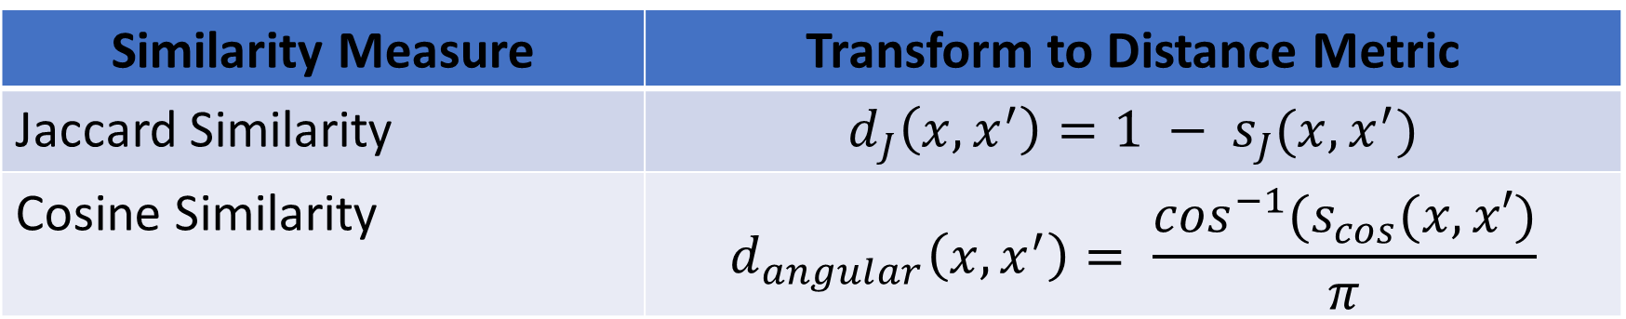
Relationship Between Similarity and Distance
Some similarity measures can be transformed to distance metrics
Transform is an inverse function
Resulting distance usually has limited range (limited support)
Examples:
Similarity Measure | Transform to Distance Metric
Jaccard Similarity | $$d_{J}\left(x,x^{′}\right)=1 − s_{J}(x,x^{′})$$
Cosine Similarity | $$d_{angular}\left(x,x^{′}\right)= \frac{\cos^{−1}(s_{cos}(x,x′)}{π}$$

Slide 29
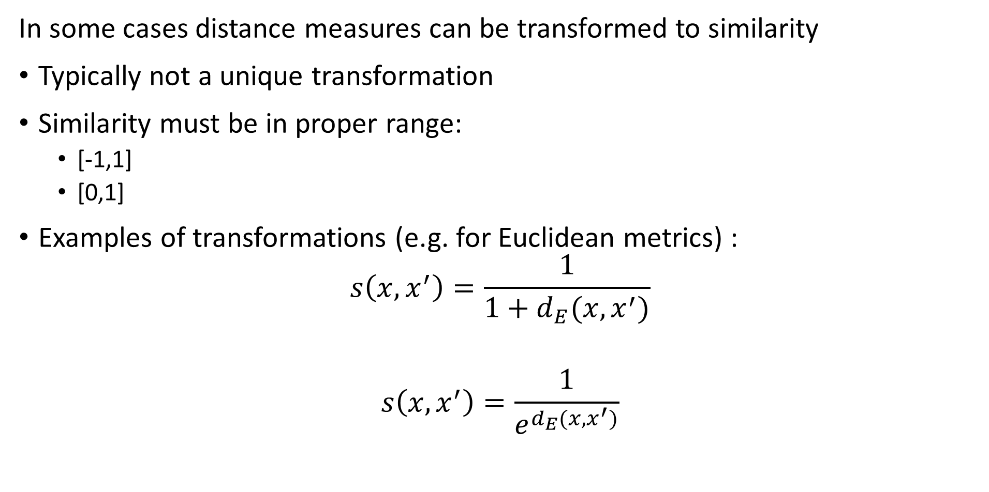
Relationship Between Distance and Similarity
In some cases distance measures can be transformed to similarity
Typically not a unique transformation
Similarity must be in proper range:
[-1,1]
[0,1]
Examples of transformations (e.g. for Euclidean metrics) :
$$s\left(x,x^{′}\right)=\frac{1}{1+d_{E}(x,x^{′})}$$
$$s\left(x,x^{′}\right)=\frac{1}{e^{d_{E}(x,x^{′})}}$$

Slide 30
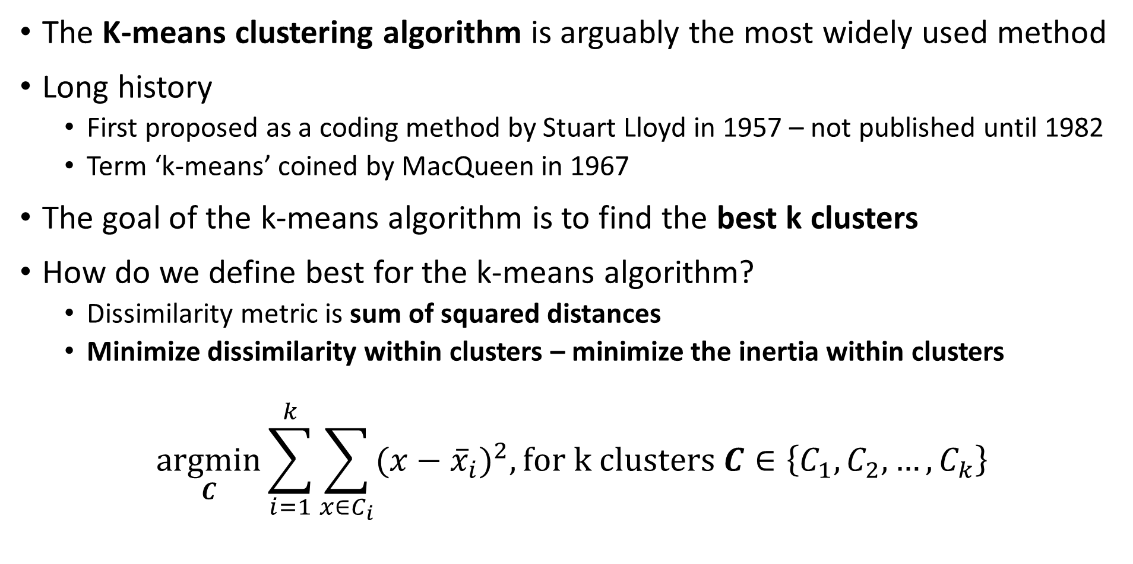
K-Means Clustering
The K-means clustering algorithm is arguably the most widely used method
Long history
First proposed as a coding method by Stuart Lloyd in 1957 – not published until 1982
Term ‘k-means’ coined by MacQueen in 1967
The goal of the k-means algorithm is to find the best k clusters
How do we define best for the k-means algorithm?
Dissimilarity metric is sum of squared distances
Minimize dissimilarity within clusters – minimize the inertia within clusters
$$\underset{C}{argmin}{\sum_{i=1}^{k}{\sum_{x∈C_{i}}^{ }{(x−{\overline{x}}_{i})^{2}, for k clusters C∈\left\{C_{1},C_{2},…,C_{k}\right\}}}}$$

Slide 31
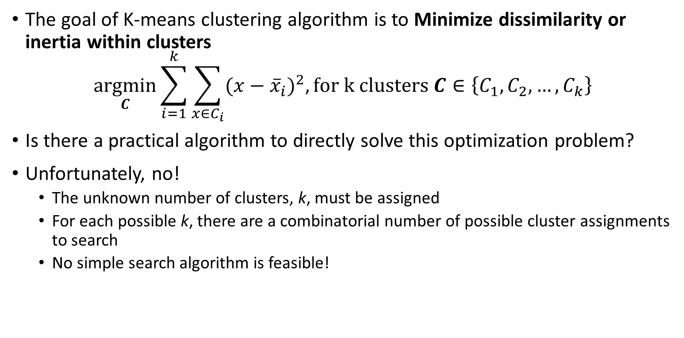
K-Means Clustering
The goal of K-means clustering algorithm is to Minimize dissimilarity or inertia within clusters
$$\underset{C}{argmin}{\sum_{i=1}^{k}{\sum_{x∈C_{i}}^{ }{(x−{\overline{x}}_{i})^{2}, for k clusters C∈\left\{C_{1},C_{2},…,C_{k}\right\}}}}$$
Is there a practical algorithm to directly solve this optimization problem?
Unfortunately, no!
The unknown number of clusters, k, must be assigned
For each possible k, there are a combinatorial number of possible cluster assignments to search
No simple search algorithm is feasible!

Slide 32
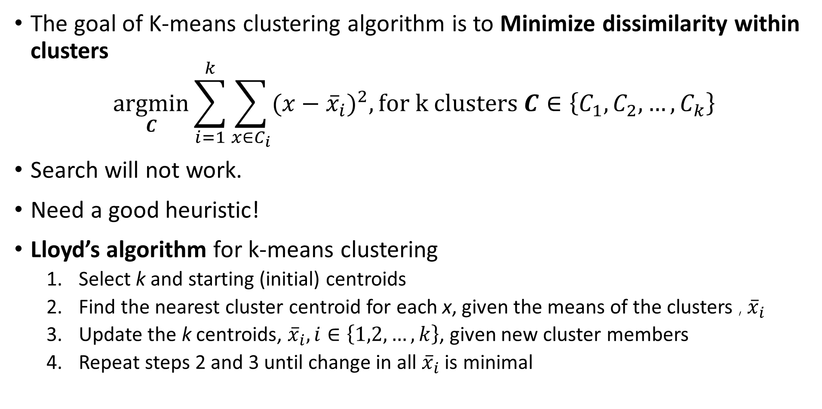
K-Means Clustering
The goal of K-means clustering algorithm is to Minimize dissimilarity within clusters
$$\underset{C}{argmin}{\sum_{i=1}^{k}{\sum_{x∈C_{i}}^{ }{(x−{\overline{x}}_{i})^{2}, for k clusters C∈\left\{C_{1},C_{2},…,C_{k}\right\}}}}$$
Search will not work.
Need a good heuristic!
Lloyd’s algorithm for k-means clustering
Select k and starting (initial) centroids
Find the nearest cluster centroid for each x, given the means of the clusters , ${\overline{x}}_{i}$
Update the k centroids, ${\overline{x}}_{i}, i∈\left\{1,2,…,k\right\}$, given new cluster members
Repeat steps 2 and 3 until change in all ${\overline{x}}_{i}$ is minimal

Slide 33
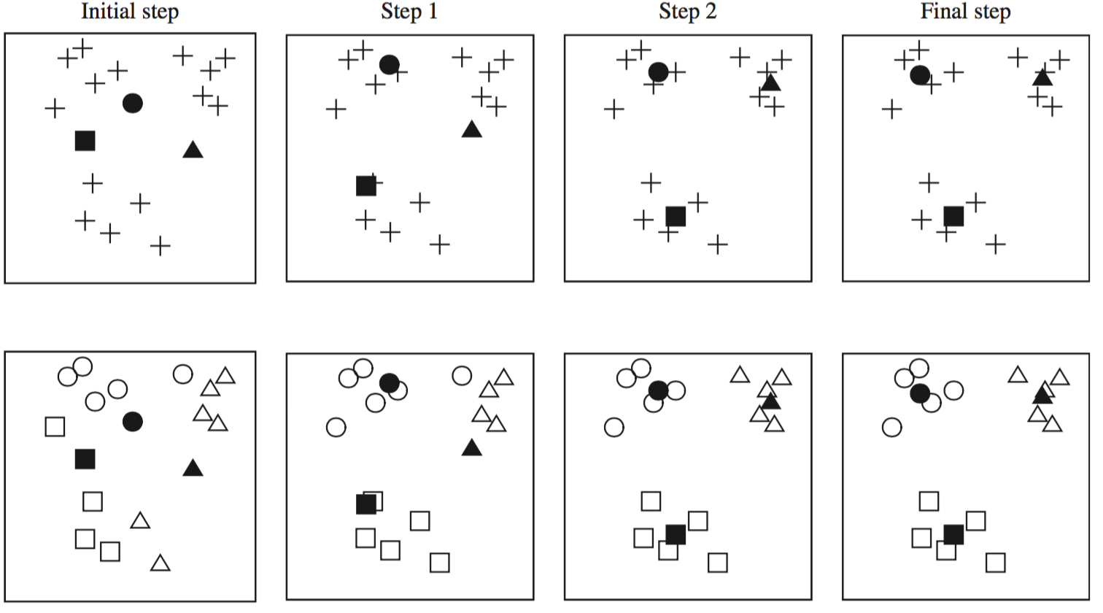
K-Means Clustering
Lloyd’s algorithm for k-means clustering, initializes with random start and iterates over several steps
Credit: Data Mining, Practical Machine Learning Tools and Techniques, Whitten et. al., fourth edition, 2016

Slide 34
K-Means Clustering
Lloyd’s algorithm for k-means clustering, initializes with random start and iterates over several steps
X
X
X
X
X
X
X
X
X
X
X
X
X
X
Start with data points
Initial cluster assignments
Update cluster centers and assignments
Iterate cluster centers and assignments until convergence
Assign Random cluster centers

Slide 35
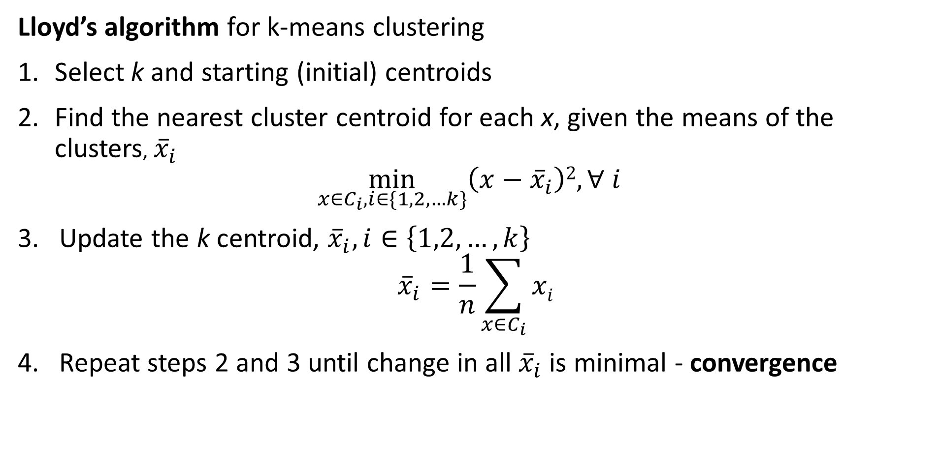
K-Means Clustering
Lloyd’s algorithm for k-means clustering
Select k and starting (initial) centroids
Find the nearest cluster centroid for each x, given the means of the clusters, ${\overline{x}}_{i}$
$$\min_{x∈C_{i},i∈\{1,2,…k\}}\left(x−{\overline{x}}_{i}\right)2, ∀ i$$
Update the k centroid, ${\overline{x}}_{i}, i∈\left\{1,2,…,k\right\}$
$${\overline{x}}_{i}=\frac{1}{n}\sum_{x∈C_{i}}{xi}$$
Repeat steps 2 and 3 until change in all ${\overline{x}}_{i}$ is minimal - convergence

Slide 36
K-Means Clustering
There are several difficulties with using the k-means algorithm
Using sum of square distance leads to only convex clusters
What is the value of k, the number of clusters?
The number of clusters should reflect fundamental organization of the data
Is there anyway to know k in advance for high dimensional problems?
No, k is usually found empirically, and the selection is often a bit subjective
How to find good starting values of the centroids?
At convergence the resulting clusters depend on the starting values
Is there any algorithm for finding good starting values?
No!
So, multiple random starts are often used
Copyright 2020, Stephen F Elston. All rights reserved.

Slide 37
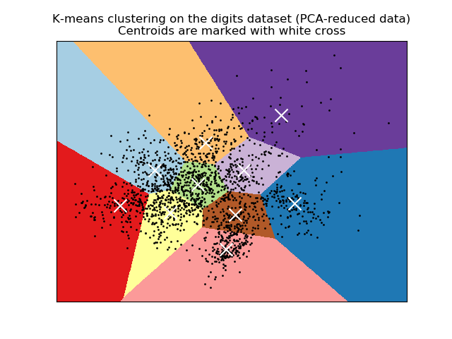
K-Means Clustering
K-means clustering produces convex clusters
Clusters are linearly separated
Clusters are Voronoi regions
Analogous to k-NN methods
Credit: Scikit-Learn development team; Pedregosa et al., JMLR 12, pp. 2825-2830, 2011

Slide 38
Evaluating Clustering Models
How do we evaluate clustering models?
No direct measure as with supervised machine learning
Can we use cross validation?
No, not directly, we have no labels
Use metrics that measure the properties of the clusters
Compactness of clusters
Separation between clusters
For k-means clustering the distance metric is quadratic
Use sum of square metrics

Slide 39
Evaluating Clustering Models
How do we evaluate clustering models?
Within and between cluster sum of squares
Can compare cluster models
Determine k
Other methods
Silhouette coefficients – Useful for small datasets
Calinski-Harabasz index
Many others…….
Notice that all of these methods assume clusters are Normally distributed!

Slide 40
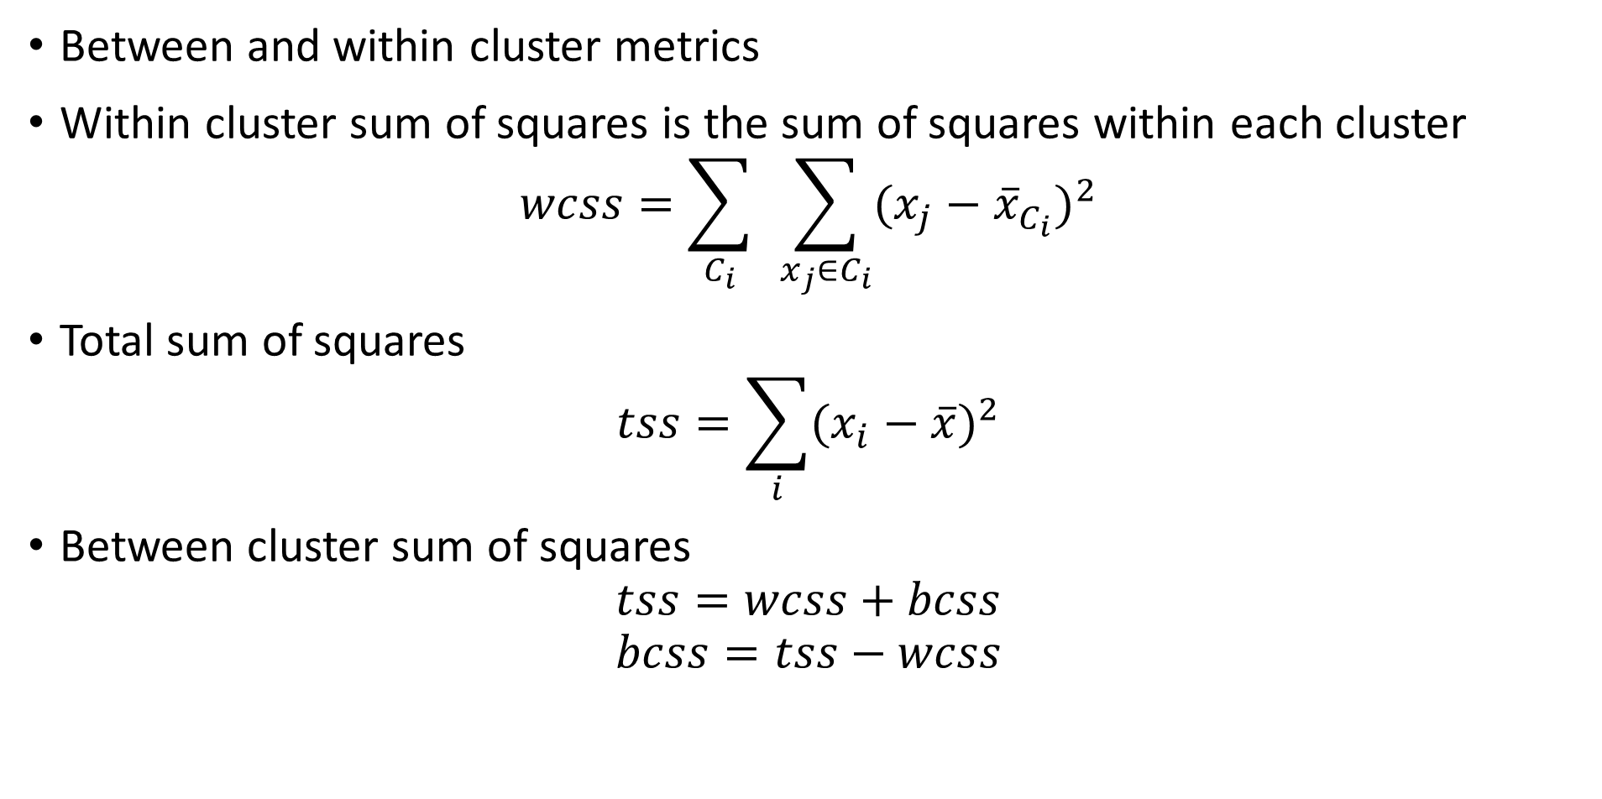
Evaluating Clustering Models
Between and within cluster metrics
Within cluster sum of squares is the sum of squares within each cluster
$$wcss=\sum_{C_{i}}^{ }{ }\sum_{x_{j}∈C_{i}}{(x_{j}−{\overline{x}}_{C_{i}})^{2}}$$
Total sum of squares
$$tss=\sum_{i}{(x_{i}−\overline{x})^{2}}$$
Between cluster sum of squares
$$tss=wcss+bcss$$
$$bcss=tss−wcss$$

Slide 41
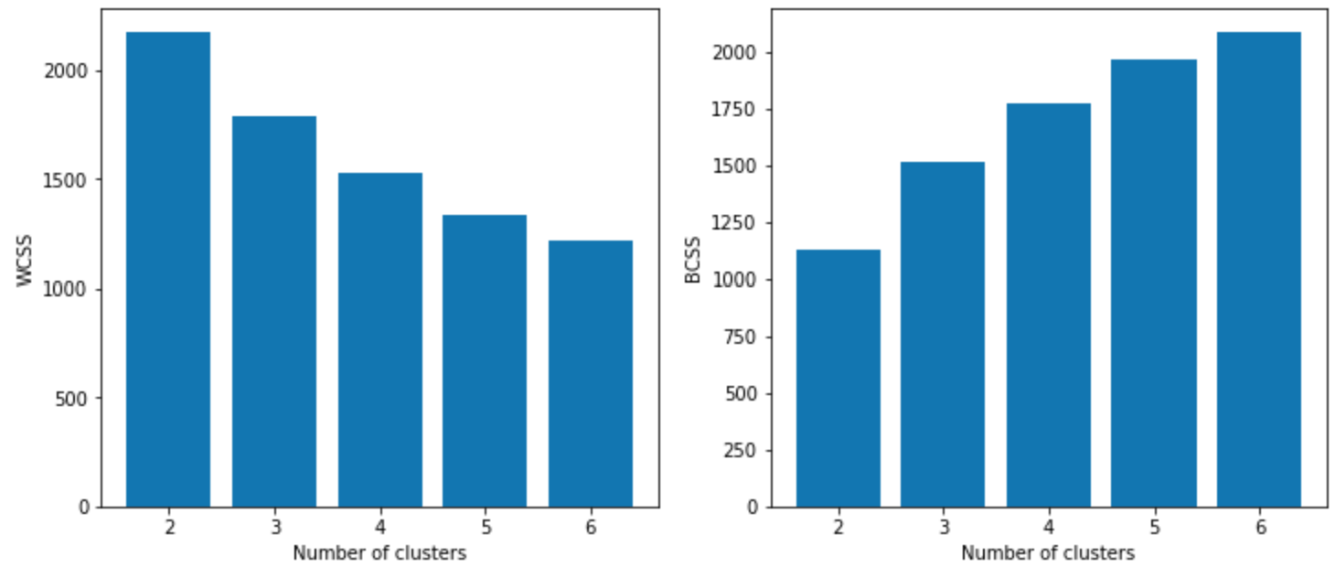
Evaluating Clustering Models
Use WCSS and BCSS to compare clustering models
Limit number of clusters where WCSS and BCSS have marginal changes

Slide 42
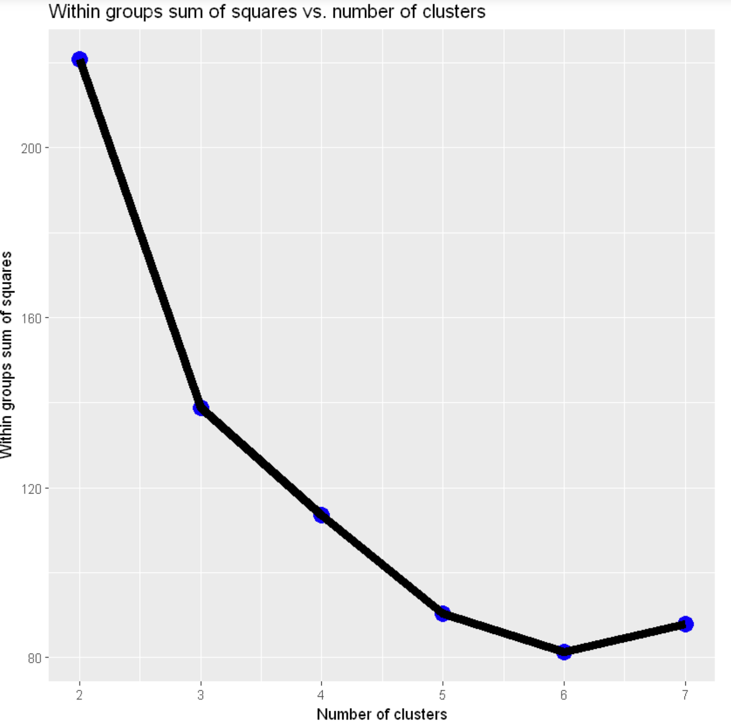
Evaluating Clustering Models
Use WCSS to find best number of clusters
Can use knee in WCSS curve to determine best k
In the example shown, pick k=4, or k=5
Prefer simpler models – Occam’s razor!
Too many clusters is an over-fit model

Slide 43
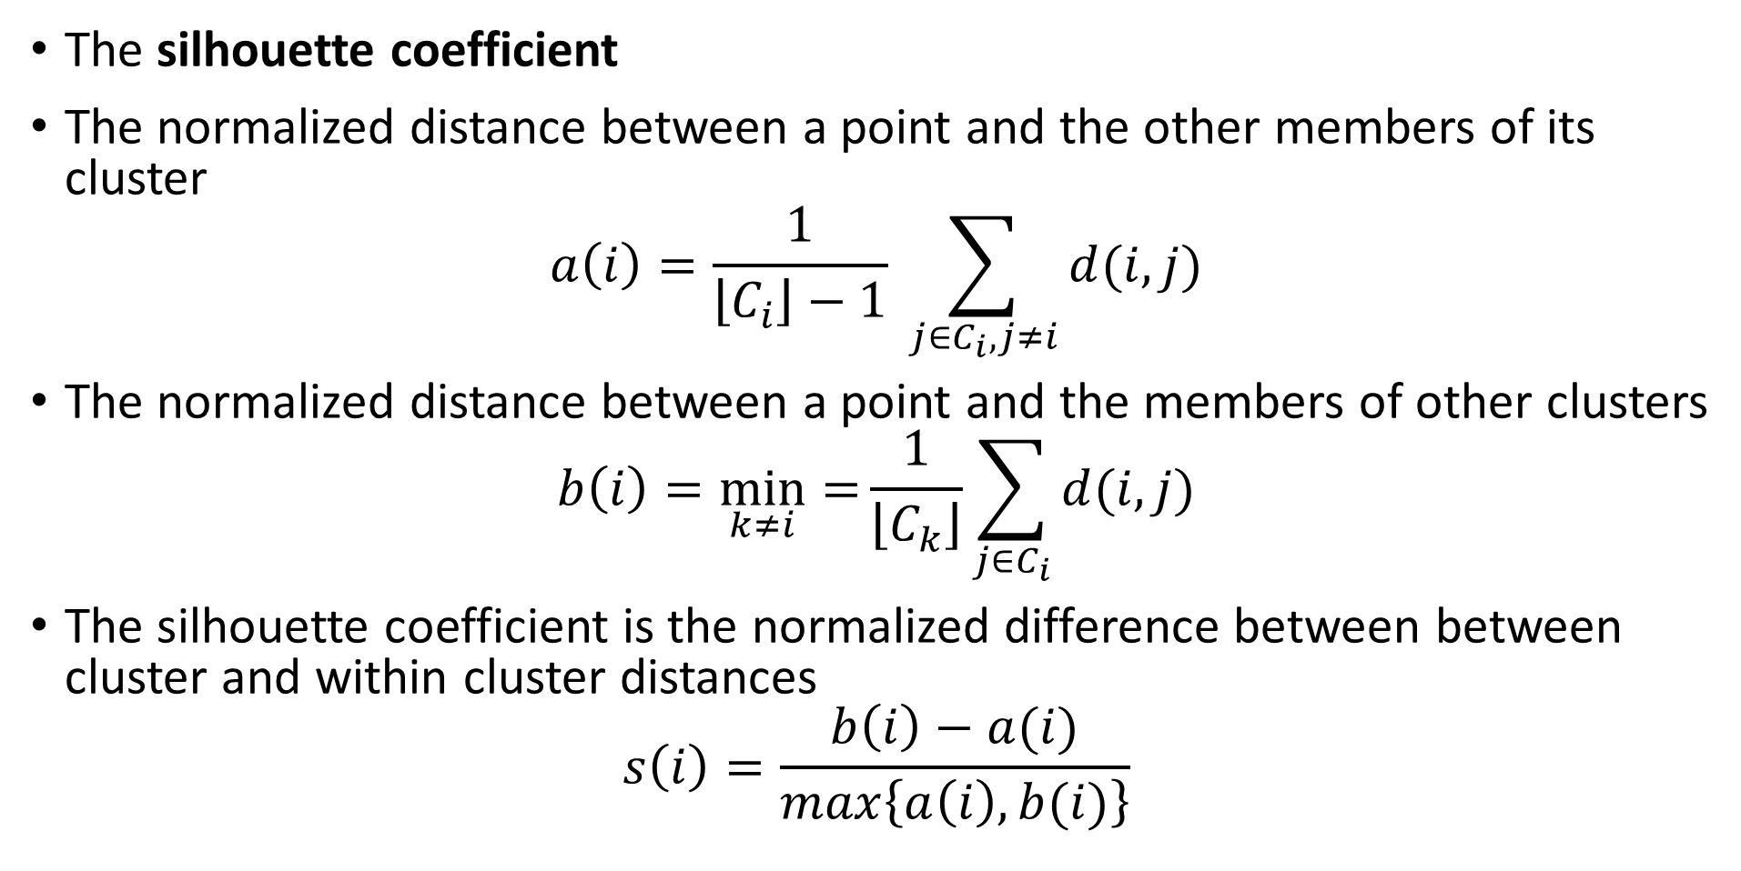
Evaluating Clustering Models
The silhouette coefficient
The normalized distance between a point and the other members of its cluster
$$a\left(i\right)=\frac{1}{\left\lfloor C_{i}\right\rfloor −1} \sum_{j∈C_{i},j≠i}^{ }{d(i,j)}$$
The normalized distance between a point and the members of other clusters
$$b\left(i\right)=\min_{k≠i}{=}\frac{1}{\left\lfloor C_{k}\right\rfloor }\sum_{j∈C_{i}}^{ }{d(i,j)}$$
The silhouette coefficient is the normalized difference between between cluster and within cluster distances
$$s\left(i\right)=\frac{b\left(i\right)−a(i)}{max\left\{a\left(i\right),b(i)\right\}}$$

Slide 44
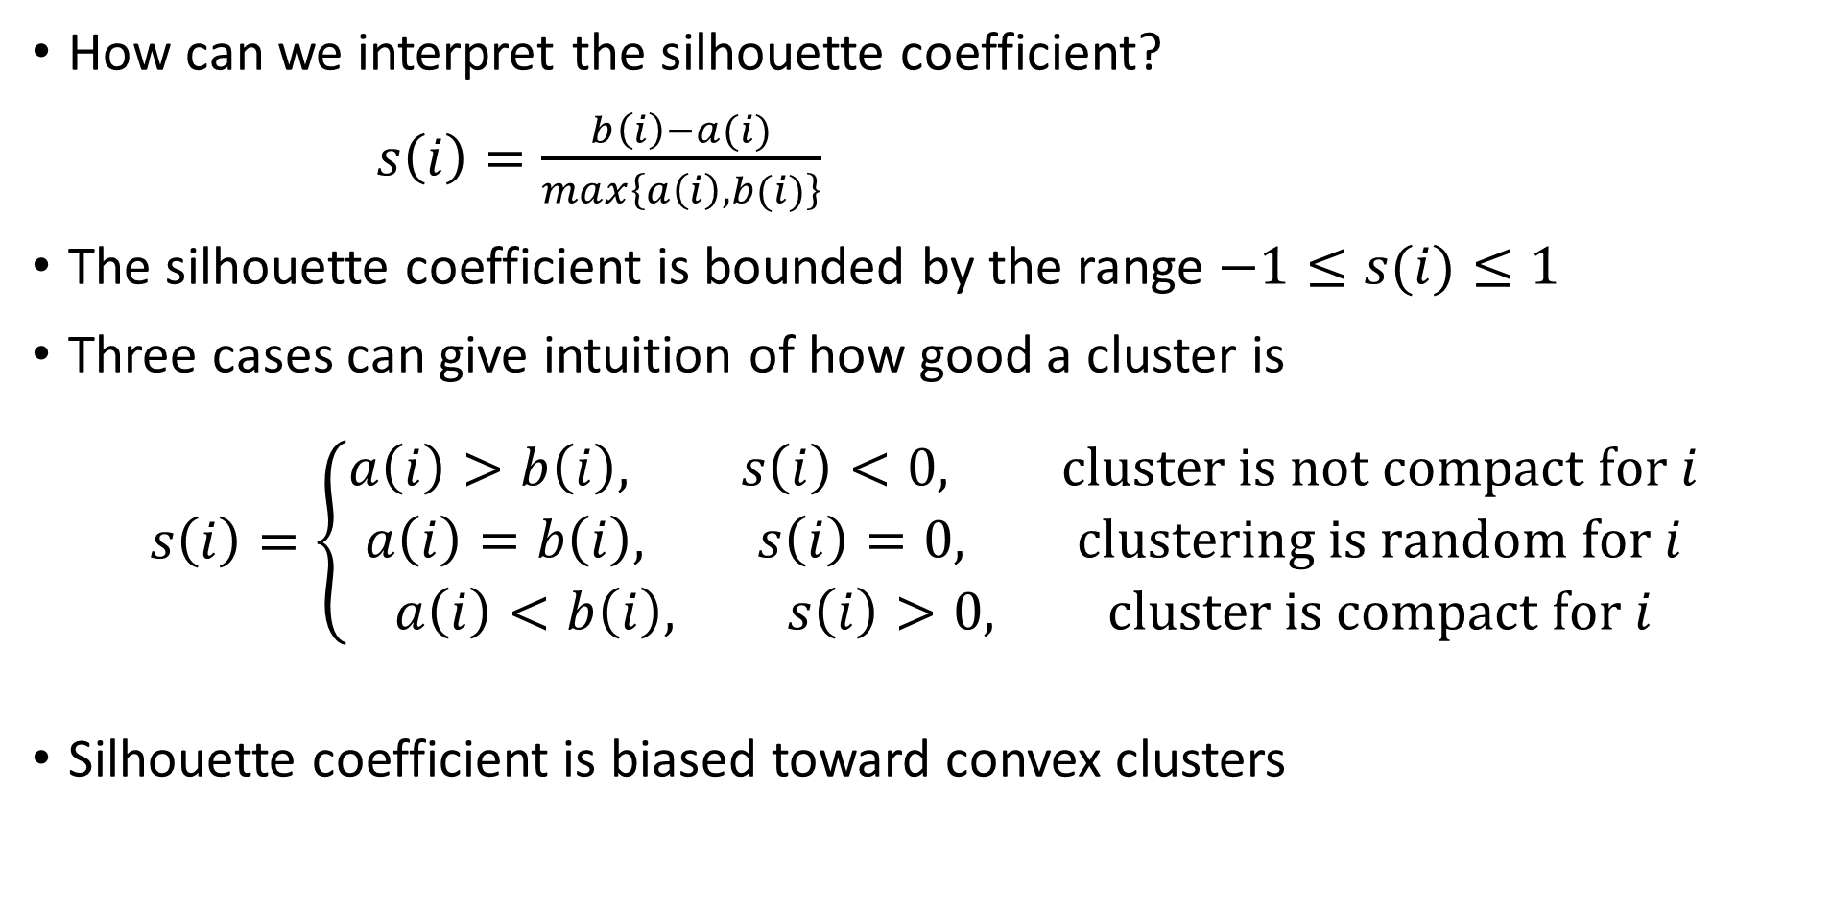
Evaluating Clustering Models
How can we interpret the silhouette coefficient?
$s\left(i\right)=\frac{b\left(i\right)−a(i)}{max\left\{a\left(i\right),b(i)\right\}}$
The silhouette coefficient is bounded by the range $−1≤s(i)≤1$
Three cases can give intuition of how good a cluster is
$$s\left(i\right)=\left\{\begin{aligned}a\left(i\right)>b\left(i\right), s\left(i\right)<0, cluster is not compact for i \\ a\left(i\right)=b\left(i\right), s\left(i\right)=0, clustering is random for i \\ a\left(i\right)<b\left(i\right), s\left(i\right)>0, cluster is compact for i\end{aligned}\right.$$
Silhouette coefficient is biased toward convex clusters

Slide 45
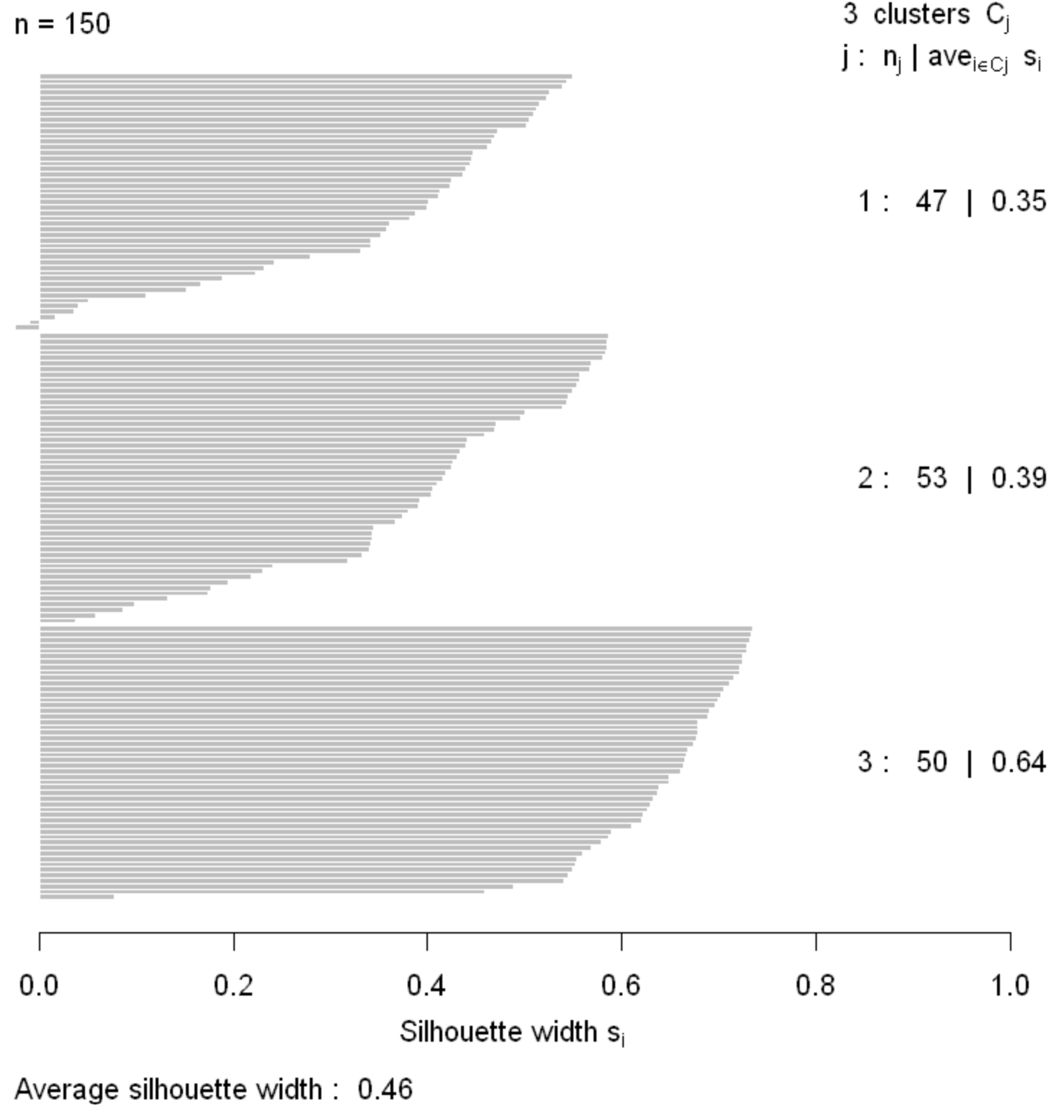
Evaluating Clustering Models
Silhouette coefficients can be graphed
Plot shows how compact and well separated the clusters are
Negative silhouette coefficients indicate sample incorrectly clustered

Slide 46
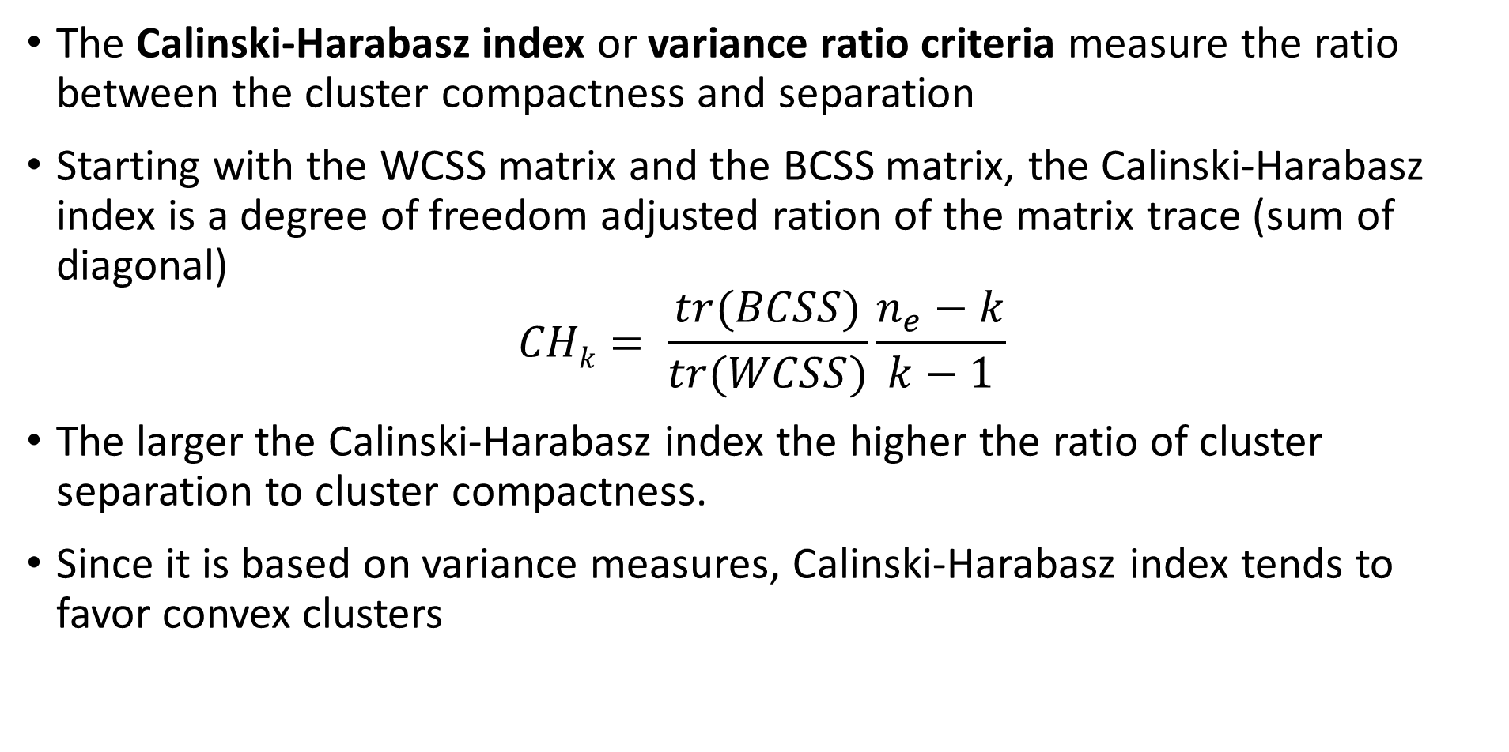
Evaluating Clustering Models
The Calinski-Harabasz index or variance ratio criteria measure the ratio between the cluster compactness and separation
Starting with the WCSS matrix and the BCSS matrix, the Calinski-Harabasz index is a degree of freedom adjusted ration of the matrix trace (sum of diagonal)
$$CHk= \frac{tr(BCSS)}{tr(WCSS)}\frac{n_{e}−k}{k−1}$$
The larger the Calinski-Harabasz index the higher the ratio of cluster separation to cluster compactness.
Since it is based on variance measures, Calinski-Harabasz index tends to favor convex clusters

Slide 47
Hierarchical Clustering Algorithms
K-means algorithms form clusters with maximum compactness
Are there other ways to create clusters with compact clusters?
Hierarchical clustering algorithms create compact clusters
Algorithm sequentially considers groups of points
Maximum compact clusters created at each step of sequential algorithm
Create hierarchy of possible clusters
One cluster with all samples at the top
Single sample clusters at the bottom

Slide 48
Hierarchical Clustering Algorithms
Two possible approaches to hierarchical clustering
Divisive clustering – top down
Start will all samples in one large clusters
Recursively split into compact clusters
Stop when only single samples at leaves – singletons
Not discussed further here
Agglomerative clustering – bottom up
Start with each sample in an individual cluster - singletons
Build maximumly compact clusters, until all samples in one cluster
Forms a tree with singletons at the leaves and all samples at the root

Slide 49
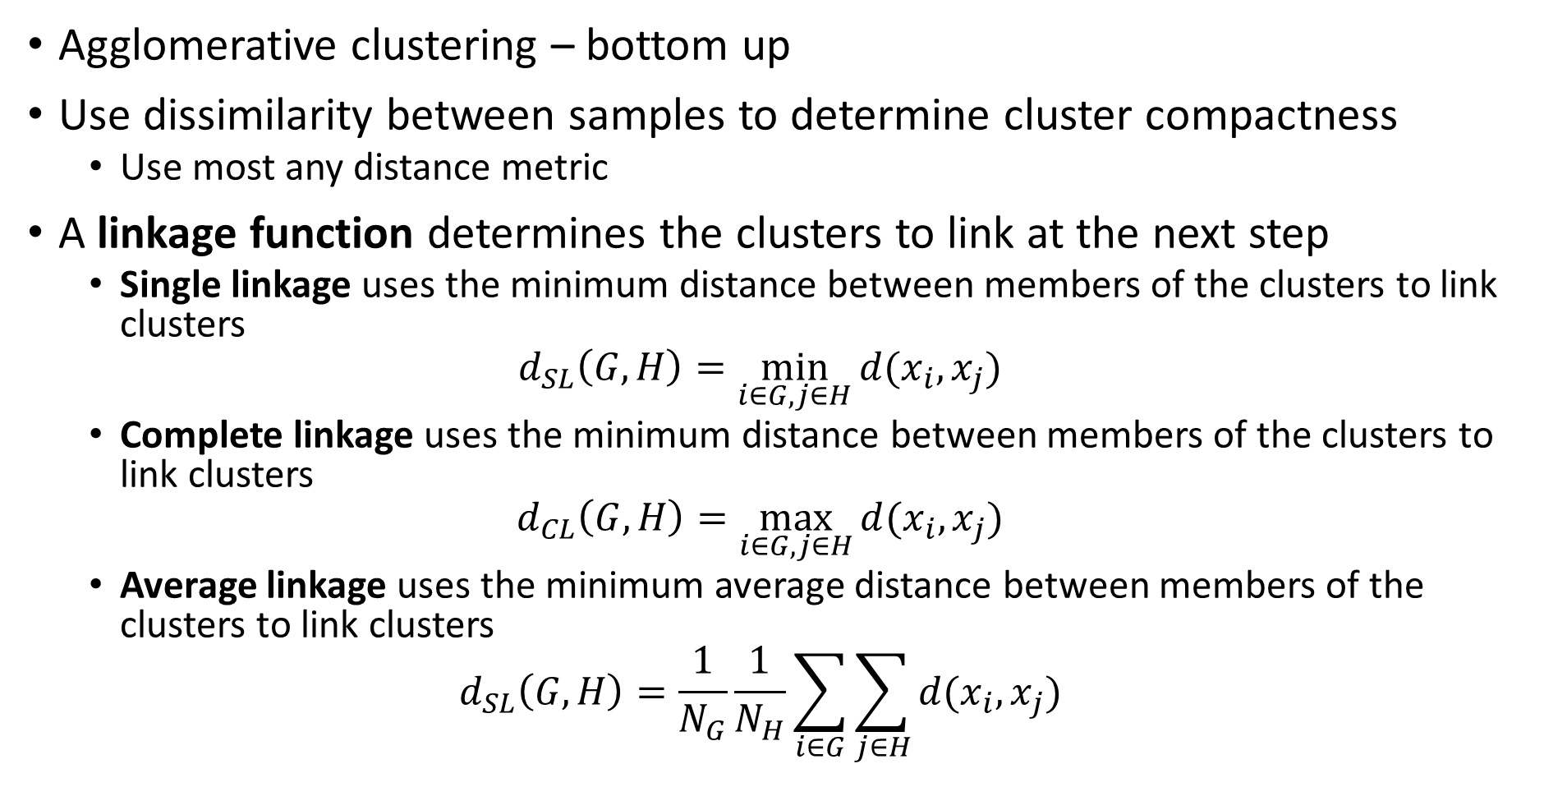
Hierarchical Clustering Algorithms
Agglomerative clustering – bottom up
Use dissimilarity between samples to determine cluster compactness
Use most any distance metric
A linkage function determines the clusters to link at the next step
Single linkage uses the minimum distance between members of the clusters to link clusters
$$d_{SL}\left(G,H\right)=\min_{i∈G,j∈H}{d(x_{i},x_{j})}$$
Complete linkage uses the minimum distance between members of the clusters to link clusters
$$d_{CL}\left(G,H\right)=\max_{i∈G,j∈H}{d(x_{i},x_{j})}$$
Average linkage uses the minimum average distance between members of the clusters to link clusters
$$d_{SL}\left(G,H\right)=\frac{1}{N_{G}}\frac{1}{N_{H}}\sum_{i∈G}^{ }{\sum_{j∈H}^{ }{d(x_{i},x_{j})}}$$

Slide 50
Hierarchical Clustering Algorithms
Single linkage:
Uses single closest pair of samples to link clusters
Can combine clusters with low threshold, chaining behavior
Often produces clusters with poor compactness
Complete linkage:
Uses single furthest pair of sample to link clusters
Creates compact clusters
May have poor separation
Average linkage:
Uses average distances to links clusters
Tries to balance compactness and separation

Slide 51
Agglomerative Clustering Example
Start with data points in a 2-dimensional Euclidian space
Use Euclidean distance and average linkage to find the first points to link –the leaves of the hierarchy
Continue to link points into clusters
At termination of algorithm all points are linked at root of hierarchy
5
3
2
6
4
1

Slide 52
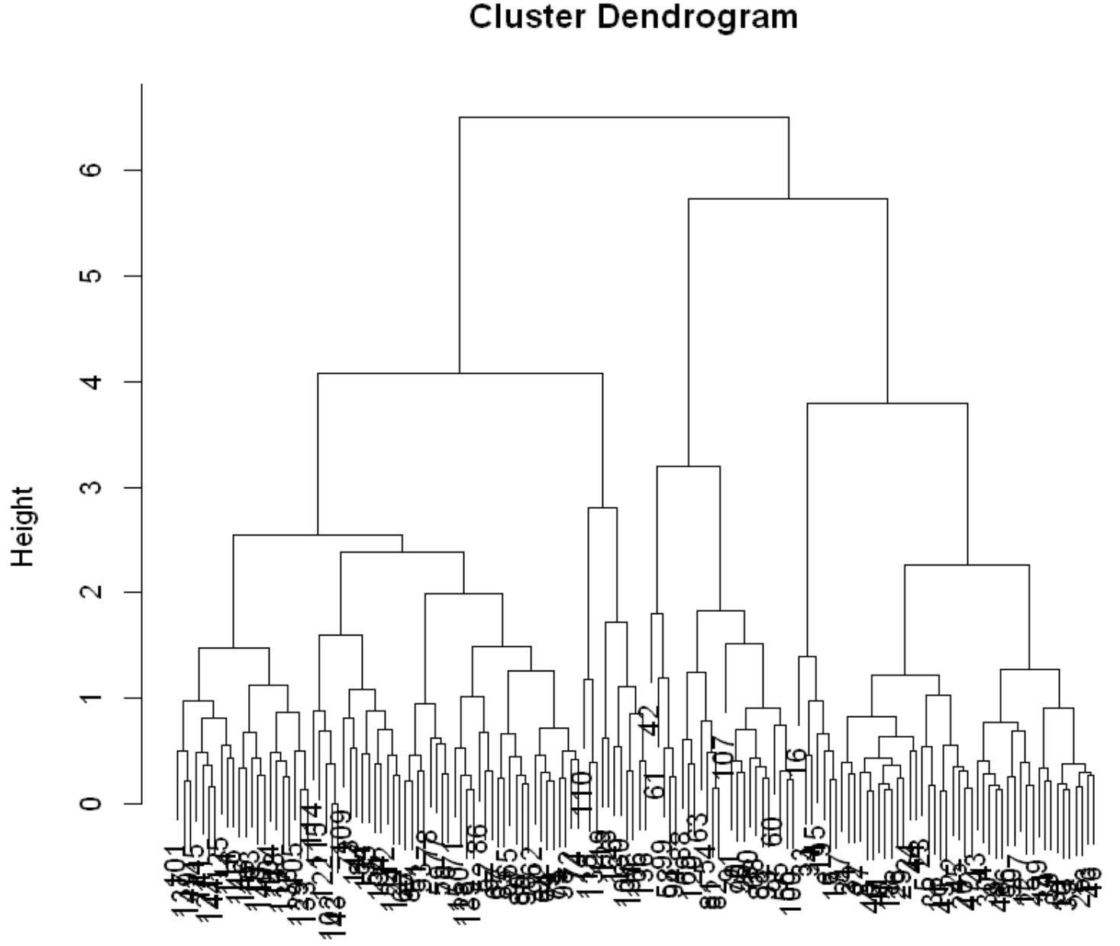
Hierarchical Clustering
Hierarchical cluster creates dendrogram
Number of clusters determined by depth of cut point
For example the cut-point shown results in 6 clusters
Or maybe 3 clusters?
Need some domain knowledge to determine which is useful

Slide 53
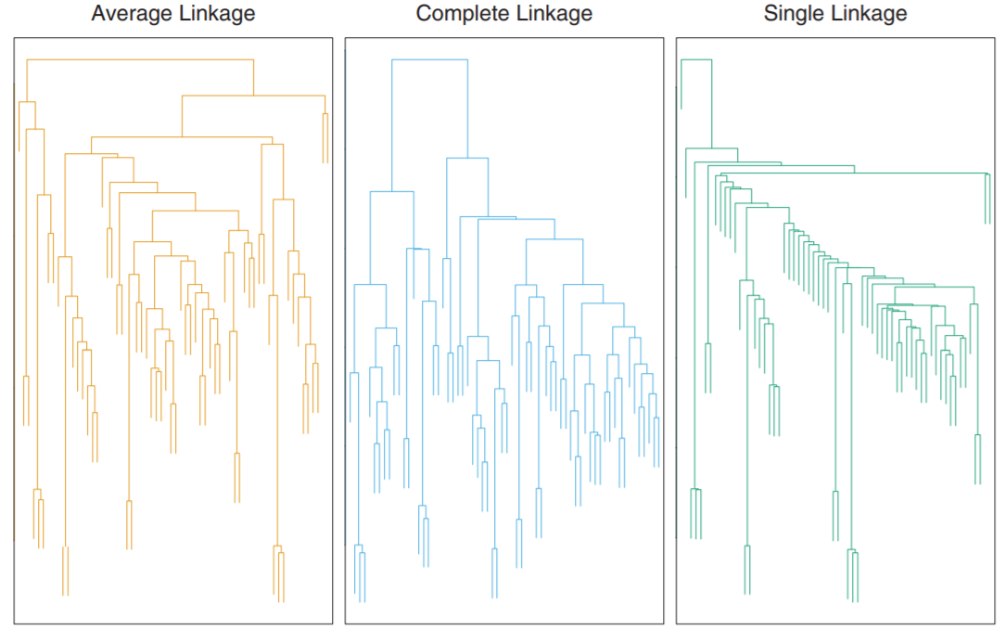
Hierarchical Clustering
Example of microassay of human tumors
The dendrograms are quite different
Choice of linkage function creates different hierarchy
Credit: Hastie, Tibsheirani and Friedeman, 2009

Slide 54
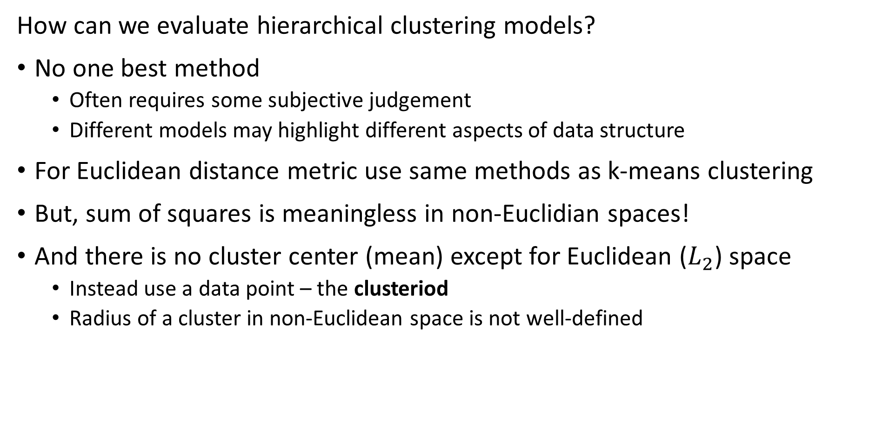
Evaluating Hierarchical Clustering
How can we evaluate hierarchical clustering models?
No one best method
Often requires some subjective judgement
Different models may highlight different aspects of data structure
For Euclidean distance metric use same methods as k-means clustering
But, sum of squares is meaningless in non-Euclidian spaces!
And there is no cluster center (mean) except for Euclidean ($L_{2}$) space
Instead use a data point – the clusteriod
Radius of a cluster in non-Euclidean space is not well-defined

Slide 55
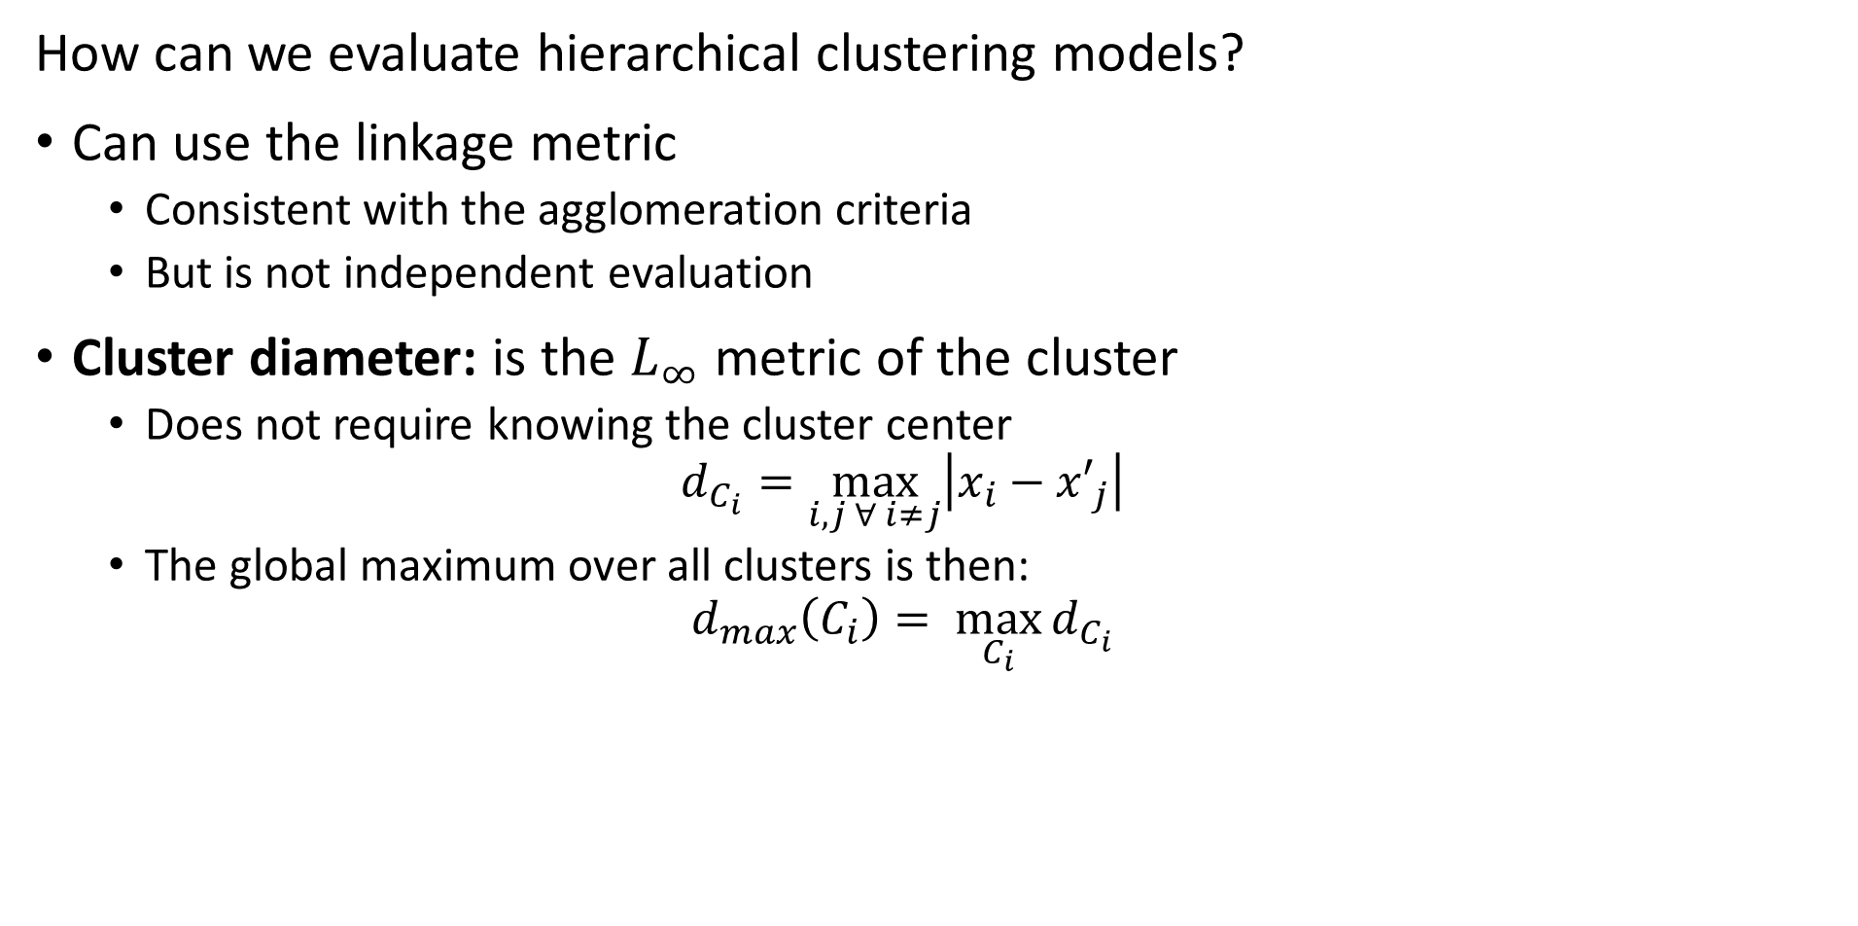
Evaluating Hierarchical Clustering
How can we evaluate hierarchical clustering models?
Can use the linkage metric
Consistent with the agglomeration criteria
But is not independent evaluation
Cluster diameter: is the $L_{∞}$ metric of the cluster
Does not require knowing the cluster center
$$d_{C_{i}}=\max_{i,j ∀ i≠j}\left|x_{i}−{x′}_{j}\right|$$
The global maximum over all clusters is then:
$$d_{max}\left(C_{i}\right)= \max_{C_{i}}{d_{C_{i}}}$$

Slide 56
What Could Possibly Go Wrong? Curse of Dimensionality!
Cluster models scale poorly with dimensionality
Consider sampling required to maintain the same uniformly distributed density in a hypercube:
An example of the Curse of Dimensionality!
Dimensions | Samples
1 | 10
2 | 100
3 | 1,000
5 | 10⁵
10 | 10¹⁰

Slide 57
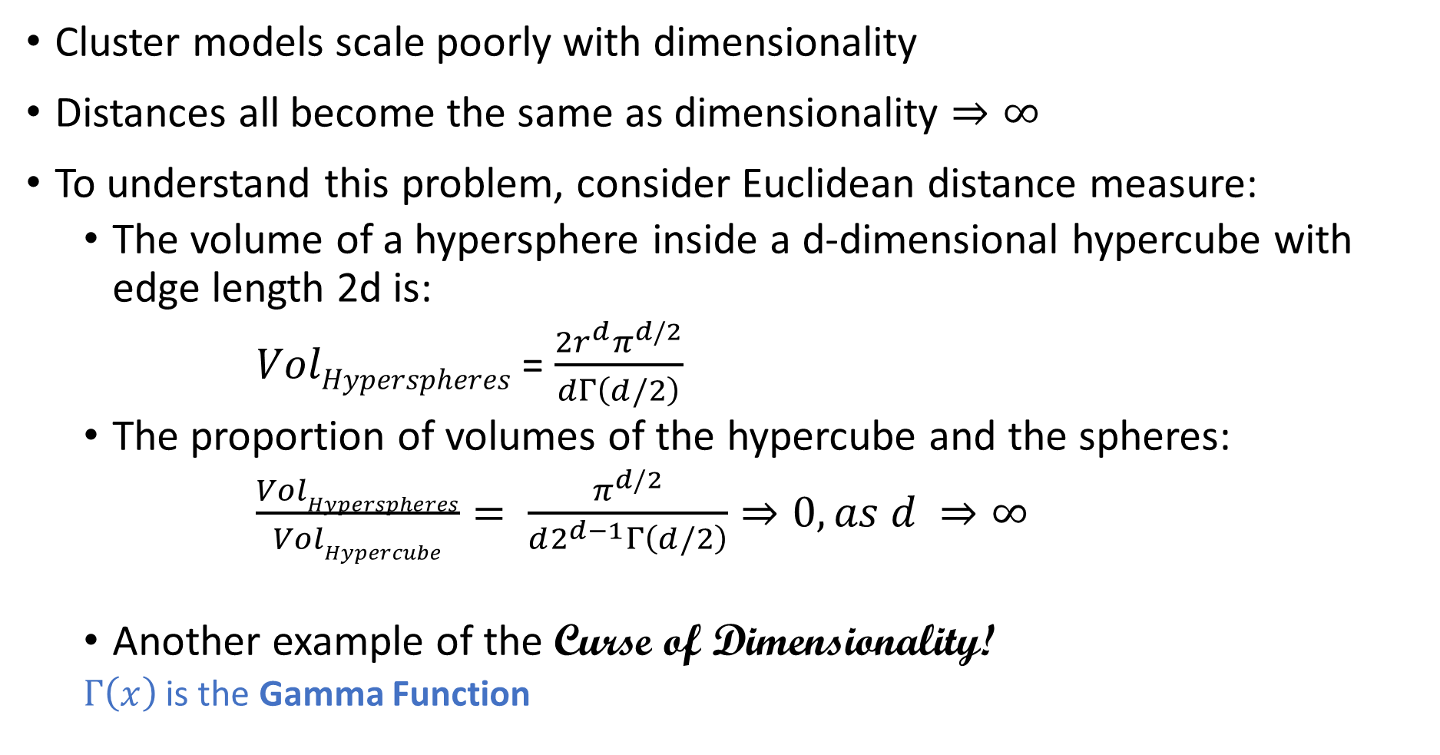
What Could Possibly Go Wrong? Curse of Dimensionality
Cluster models scale poorly with dimensionality
Distances all become the same as dimensionality $⇒∞$
To understand this problem, consider Euclidean distance measure:
The volume of a hypersphere inside a d-dimensional hypercube with edge length 2d is:
$VolHyperspheres$ = $\frac{2r^{d}π^{d/2}}{dΓ\left(d/2\right)}$
The proportion of volumes of the hypercube and the spheres:
$\frac{VolHyperspheres}{VolHypercube}= \frac{π^{d/2}}{d2^{d−1}Γ\left(d/2\right)}⇒0, as d ⇒∞$
Another example of the Curse of Dimensionality!
$Γ\left(x\right)$ is the Gamma Function

Slide 58
What Could Possibly Go Wrong? Curse of Dimensionality
The curse of dimensionality means that all clusters are the same in high dimensions
Sampling density decreases exponentially
Distances are converge to the same size in a finite space
The choice of metric does not help
Implication is that high-dimensional cluster models are easy to overfit!!
Reducing dimensionality can help

Slide 59
Affinity Clustering
Can we build a clustering algorithm using a relationship to a few prototypes or exemplar points?
Yes
Affinity clustering uses a message passing algorithm to find these responsible or exemplar points and create a connected graph of cluster members
Affinity clustering provides useful results in several areas
Document similarity
Computer vision
Computational genetics

Slide 60
Affinity Clustering
Can we build a clustering algorithm using a relationship to a few prototypes or exemplar points?
The number of representative points, and clusters, are determined by the algorithms
No need to specify number of clusters apriori
The message passing algorithm iteratively determines
Responsibility, r(i,k), of sample k to be the exemplar of sample i
Availability, a(i,k), of sample k to be the exemplar of sample i

Slide 61
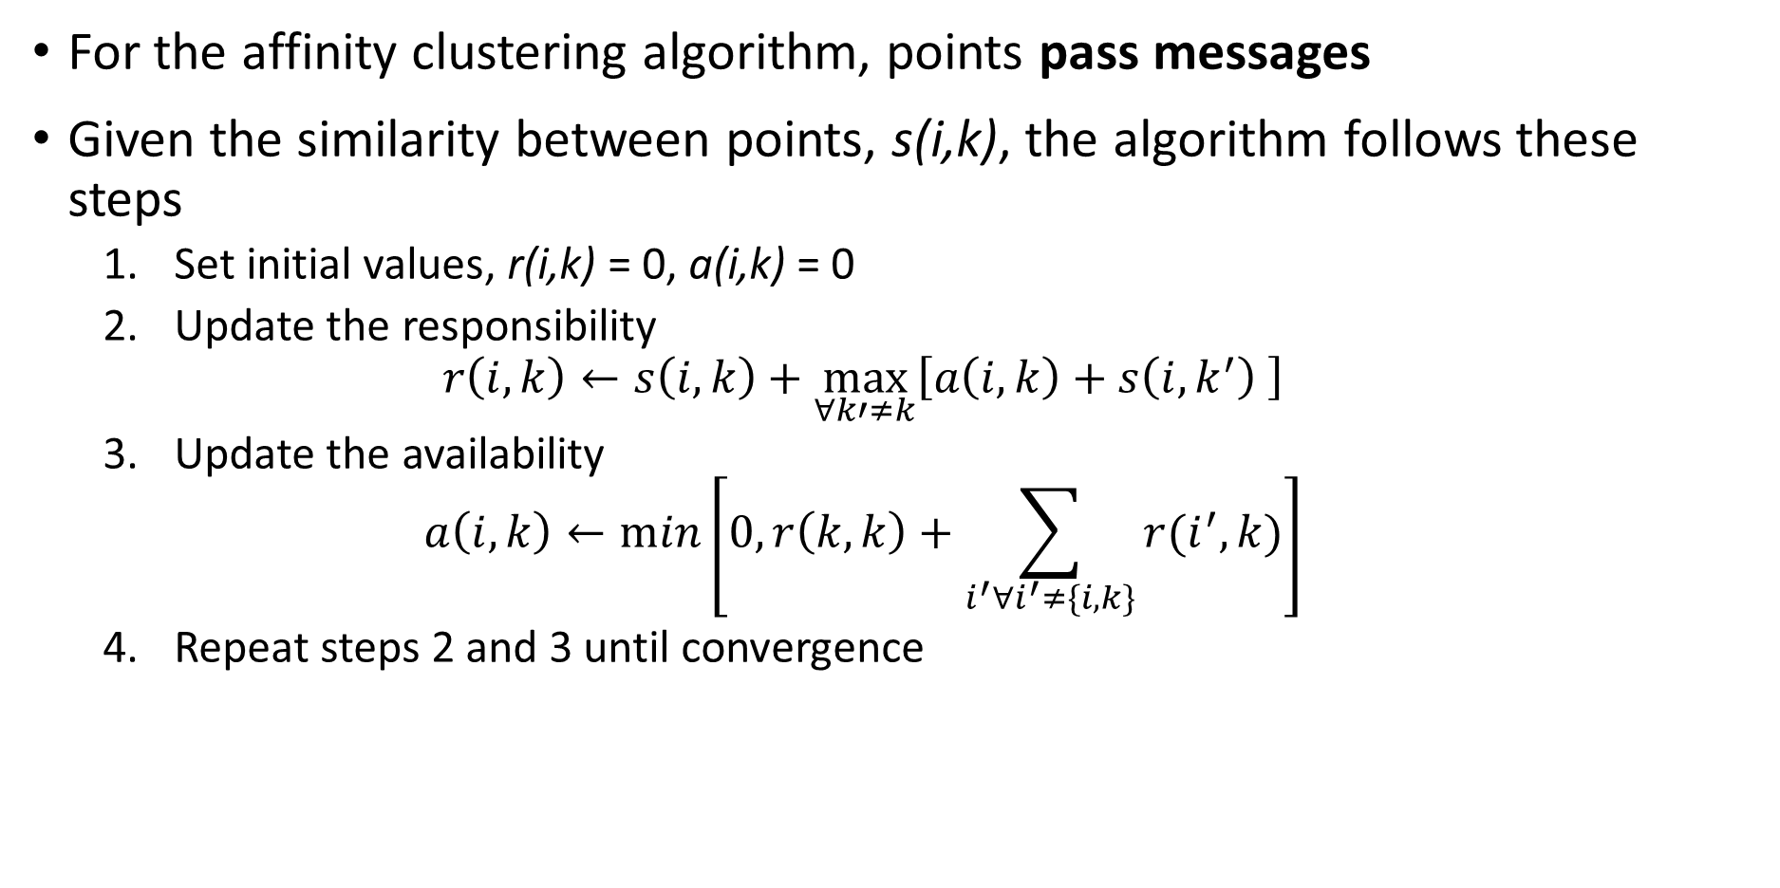
Affinity Clustering
For the affinity clustering algorithm, points pass messages
Given the similarity between points, s(i,k), the algorithm follows these steps
Set initial values, r(i,k) = 0, a(i,k) = 0
Update the responsibility
$$r\left(i,k\right)←s\left(i,k\right)+\max_{∀k′≠k}{⁡\left[a\left(i,k\right)+s\left(i,k^{′}\right) \right]}$$
Update the availability
$$a\left(i,k\right)←min⁡\left[0,r\left(k,k\right)+\sum_{i^{′}∀i^{′}≠\{i,k\}}^{ }{r(i^{′},k)}\right]$$
Repeat steps 2 and 3 until convergence

Slide 62
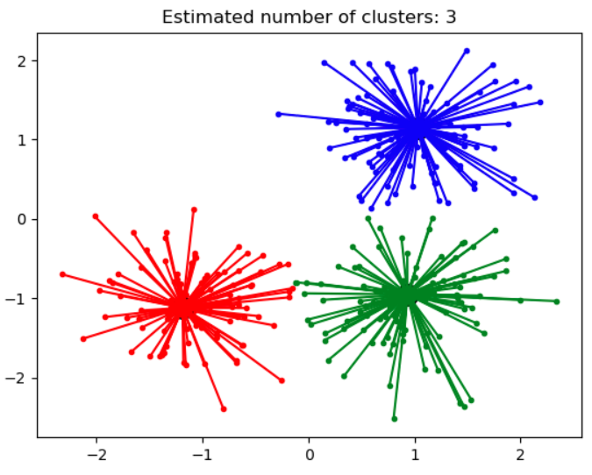
Affinity Clustering
Affinity propagation determines a number of clusters
Clusters linearly separated and convex
Can define clusters as Voronoi regions
Different similarity metrics create different clusters
Algorithm can be slow, O(n²) complexity
Credit: Scikit-Learn development team; Pedregosa et al., JMLR 12, pp. 2825-2830, 2011

Slide 63
Density Clustering
Using sample density is another way to form clusters
High density points form clusters
How can we find high density points?
Find points with large number of near neighbors
Form clusters around these high density points
Naive algorithms have high complexity
Scalable algorithms are largely heuristic
Many algorithms, including
DBSCAN
OPTICS

Slide 64
Density Clustering
DBSCAN is the first (1996) large-scale density-based clustering algorithm
Still in use today
Many variations created
Scales to out of memory dataset size
DBSCAN minimizes the number of passes through the data base
DBSCAN finds a graph of nearest neighbors
Core points define the high density areas
Reachable non-core points are in a cluster but not core
Unreachable points are not in a cluster
Graph edge is bidirectional if both points are core
Graph edges from core to reachable non-core point is unidirectional

Slide 65
Density Clustering
DBSCAN has two hyperparameters
minPts is the minimum number of near neighbors a core point must have
ε is the maximum distance between neighbors
How do we define reachability?
Must have a path on the graph between points p₁ and p_{n}
The path can pass through other points, {p₁,p₂,…,p_{n}}
Distance to neighbors must be less than ε
Points not reachable from any other point are not reachable
DBSCAN makes passes thorough a database to create the graph
Highly scalable, O(n log(n))
Uses memory, O(n²)

Slide 66
Density Clustering
What are the steps of DBSCAN?
Start with some samples or observations
For each point, find near neighbors within distance ε
A point is core if it has > minPts near neighbors (2 in this example)
If two point are core, connect with bidirectional edge
If point is non-core, connect with unidirectional edge
If point further that ε from neighbors, point is non-reachable

Slide 67
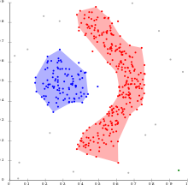
Density Clustering
What are some properties of DBSCAN?
Can find non-convex clusters
Is fast and efficient
Optimized for uniform sample density of clusters with fixed ε and minPts
Selecting maximum distance to neighbors, ε, is difficult in high dimensions
Clusters depend on distance metric
Clusters robust to noise, non-reachable samples
Credit: Wikipedia commons

Slide 68
Density Clustering
How can we overcome the limitations of DBSCAN?
Optimized for uniform density clusters
Hard to find good value of ε in high dimensions
The OPTICS algorithm is an attempt to improve on DBSCAN
OPTICS uses a heuristic to find two distances
Core distance determines if a sample is core
Reachability distance determines if one sample is reachable from the other

Slide 69
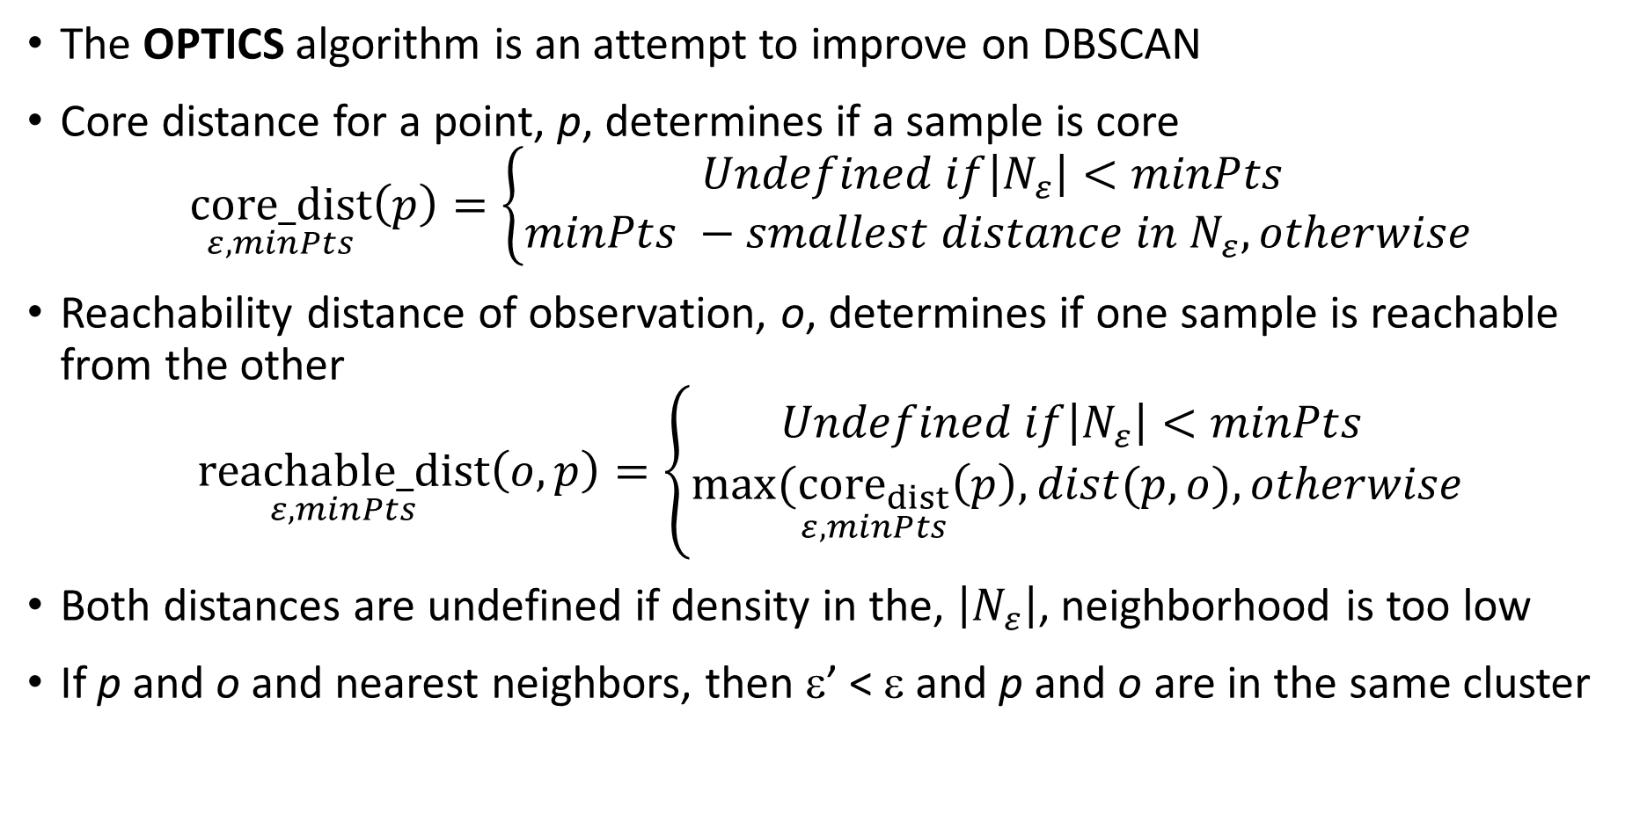
Density Clustering
The OPTICS algorithm is an attempt to improve on DBSCAN
Core distance for a point, p, determines if a sample is core
$$\underset{ε,minPts}{core_dist}\left(p\right)=\left\{\begin{aligned}Undefined if\left|N_{ε}\right|<minPts \\ minPts −smallest distance in N_{ε}, otherwise\end{aligned}\right.$$
Reachability distance of observation, o, determines if one sample is reachable from the other
$$\underset{ε,minPts}{reachable_dist}\left(o,p\right)=\left\{\begin{aligned}Undefined if\left|N_{ε}\right|<minPts \\ max⁡(\underset{ε,minPts}{{core}_{dist}}\left(p\right),dist(p,o), otherwise\end{aligned}\right.$$
Both distances are undefined if density in the, $\left|N_{ε}\right|$, neighborhood is too low
If p and o and nearest neighbors, then ε’ < ε and p and o are in the same cluster

Slide 70
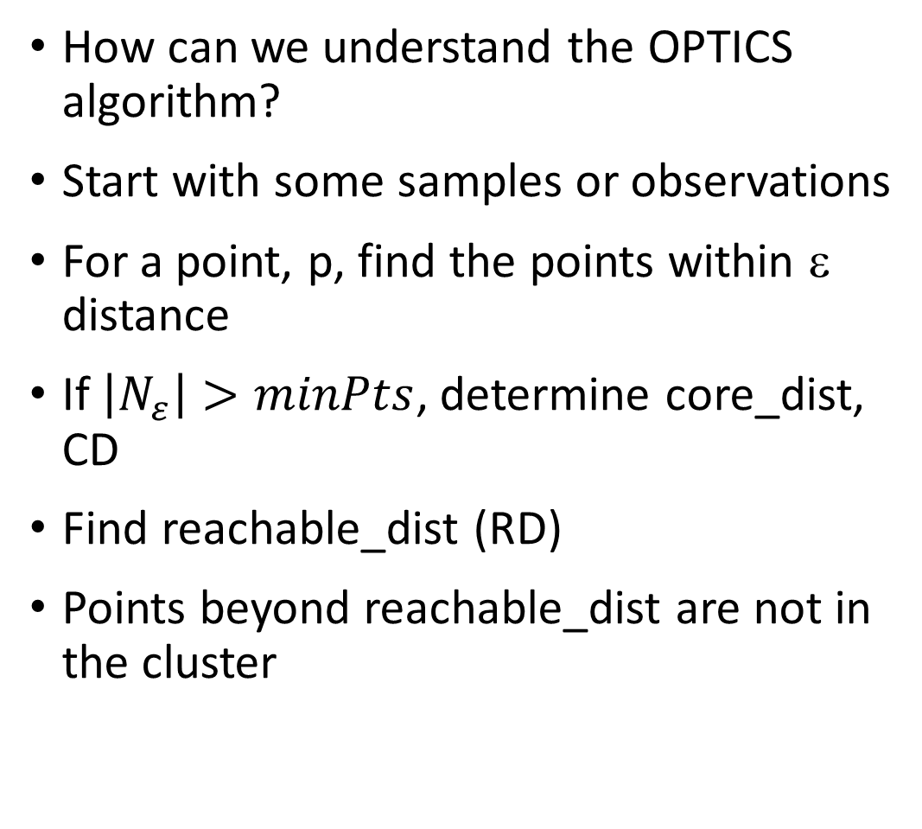
Density Clustering
How can we understand the OPTICS algorithm?
Start with some samples or observations
For a point, p, find the points within ε distance
If $\left|N_{ε}\right|>minPts$, determine core_dist, CD
Find reachable_dist (RD)
Points beyond reachable_dist are not in the cluster
ε
CD
RD

Slide 71
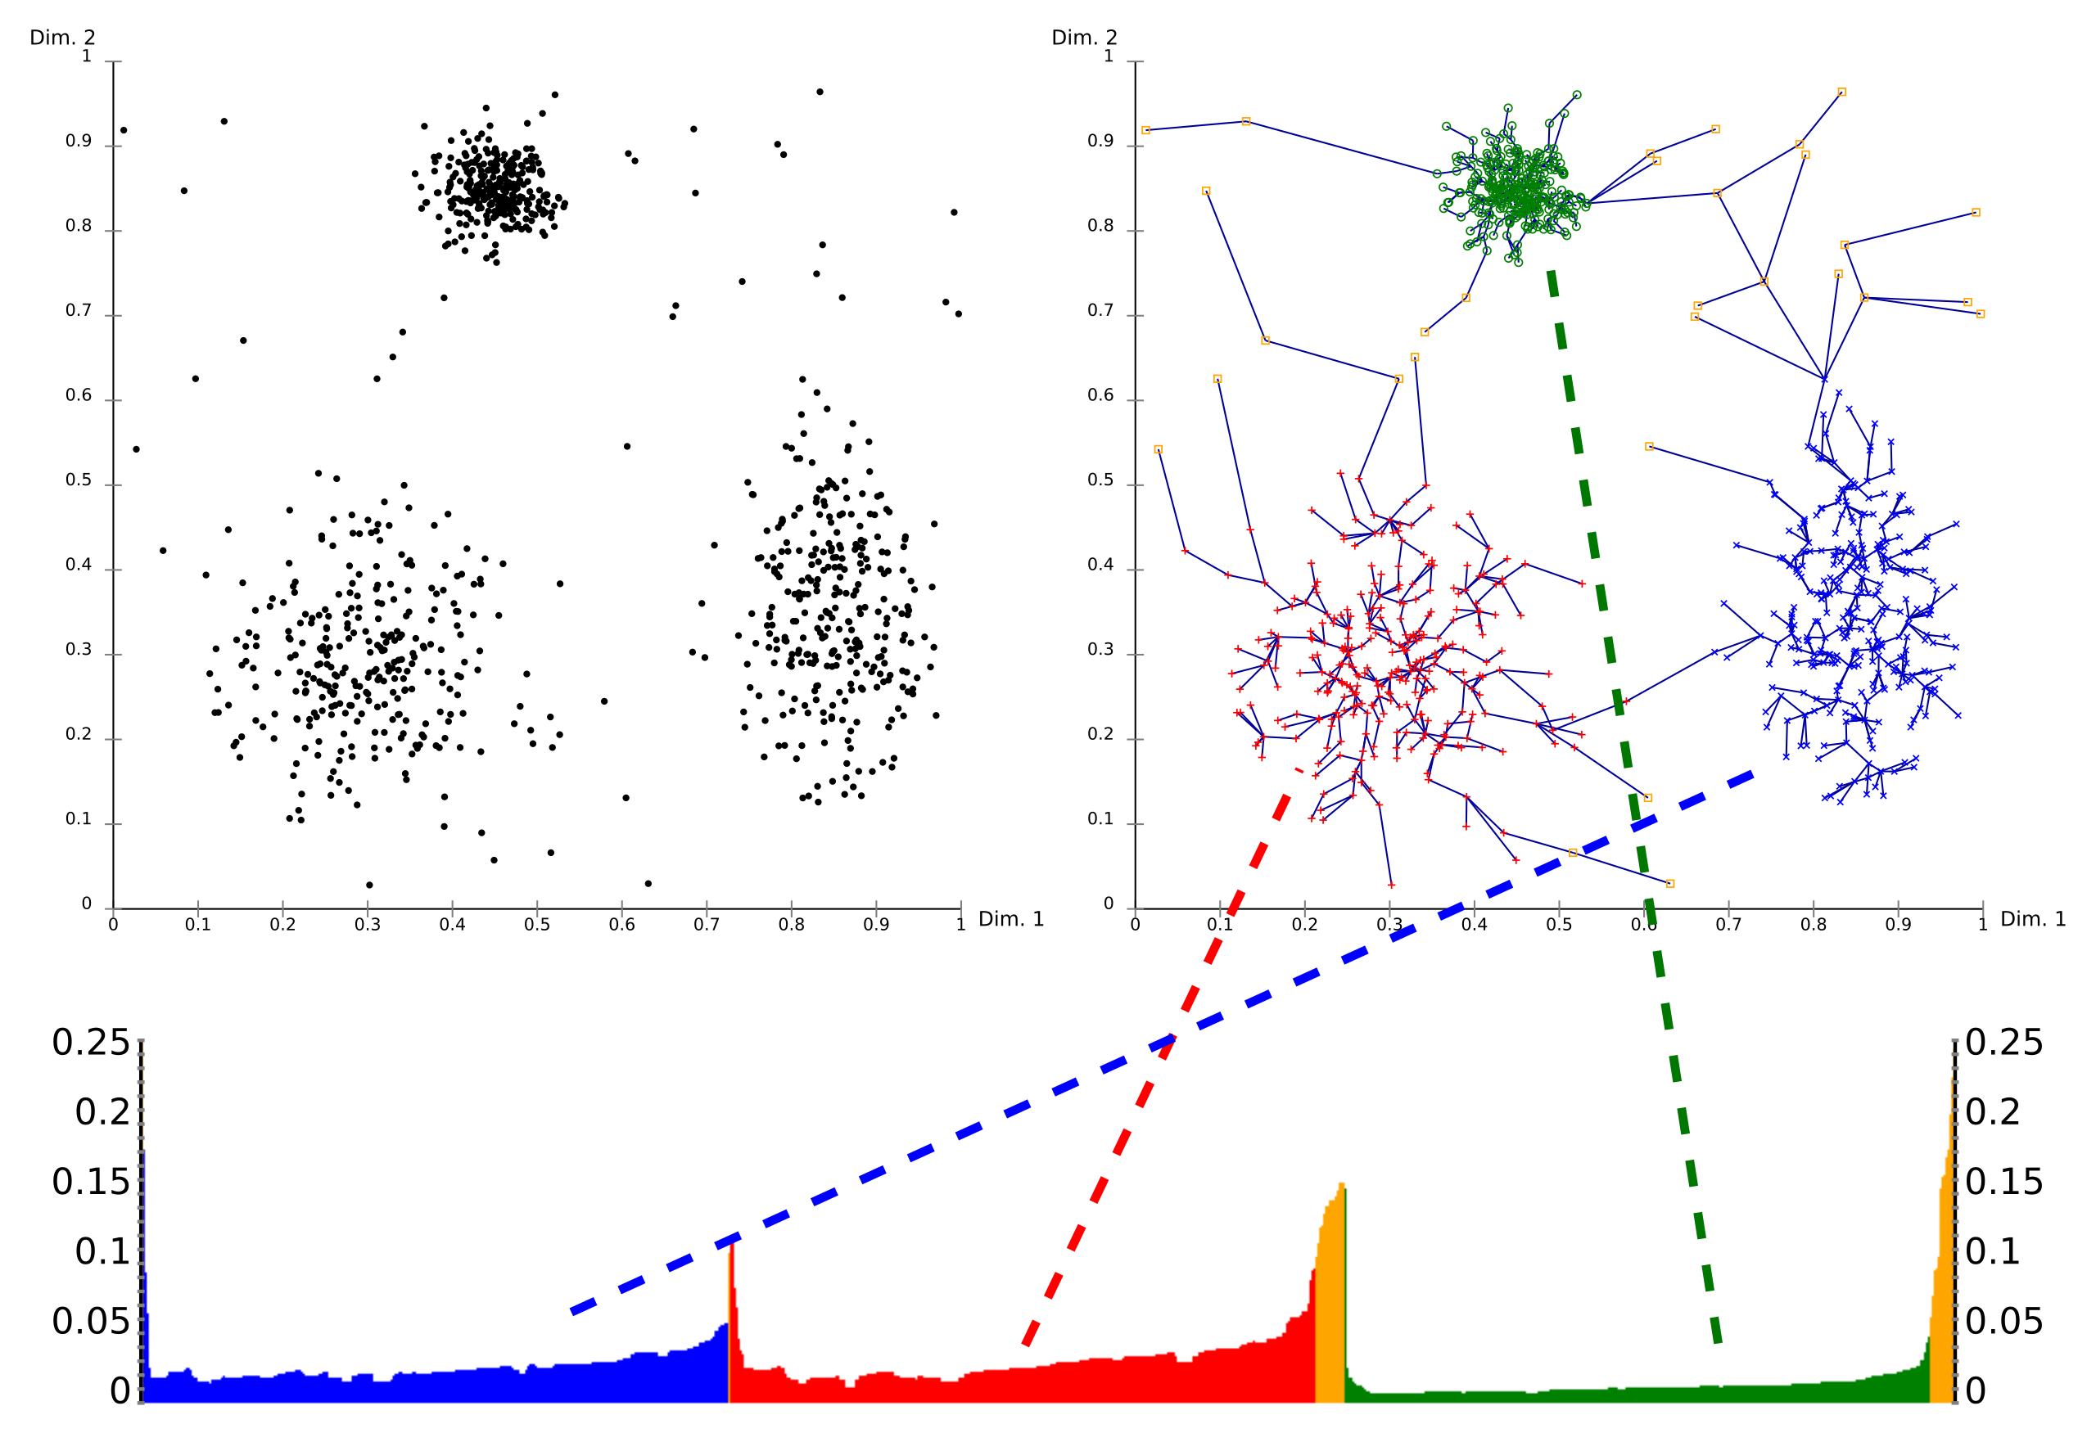
Density Clustering
What are some properties of OPTICS?
OPTICS builds a graph with the distances determining clusters
The graph defines a dendogram
The reachability plot (bottom) shows the path distances in the dendogram
A cutoff on the reachability plot defines the clusters
Credit: Wikipedia commons

Slide 72
Density Clustering
What are some properties of OPTICS?
Dynamically determining core_dist helps with with variable sample density
Computation complexity higher on average than DBSCAN
Credit: Wikipedia commons

Slide 73
Summary
Unsupervised learning methods learn structure of data
Structure is learned by determining association between cases
Association based on measures of proximity, distance or dissimilarity
Clustering algorithms are data mining methods
Data mining seeks to find interesting relationships in data
We have already encountered feature importance as a data mining method

Slide 74
Summary
Algorithms can use different distance or dissimilarity metrics
Structure based on distance metrics
Different algorithms use different metrics
What are the ideal properties of clusters?
Good clusters have two properties
Compactness: We what the clusters to be small with members close to each other
Separation: We want the clusters are well separated, a closeness property

Slide 75
Summary
Different models and dissimilarity metrics will give different results
Dissimilarity metrics usually matter more than model choice
But which one should we use?
Evaluation is a significant problem with for unsupervised learning
There are no labels for objective evaluation
Evaluation is often subjective
But, do we have to pick one best model?
No
Different models can show different useful relationships

Slide 76
Summary
Different models have different results and advantages
Algorithm | Method | Cluster characteristic | Characteristics | Scalability
K-means | Maximizes cluster compactness | Convex | Need to find k Assumes equal variance | Very high, O(n)
Agglomerative hierarchical | Clusters into dendrogram | Convex | Very dependent on linkage function | Very high, O(n)
Affinity clustering | Responsible point in cluster | Convex | Less scalable | Limited, O(n²)
DBSCAN | Density graph | Nonconvex | Uniform density | Very High, O(n log(n))
OPTICS | Density graph | Nonconvex | Variable density | High, O(n²)

