Slide 1
Bala subramani A
Final Project
3/21/2024 Annual Review

Slide 2
PROJECT TITLE
Automated Text Summarization Using Natural Language Processing
3/21/2024 Annual Review

Slide 3


AGENDA
Problem Statement
Project Overview
Who are the end users?
Solutions and value of propositions
WOW factor in the solution
Modelling
Results
3/21/2024 Annual Review

Slide 4

PROBLEM STATEMENT
Develop an Automated Text Summarization System that utilizes Natural Language Processing techniques to extract key information and generate concise summaries from large volumes of text. The system should be capable of analyzing text documents, identifying important sentences, and generating summaries that accurately capture the main points of the original content. The goal is to provide users with a time-efficient solution for processing and digesting large amounts of textual data, enabling them to extract relevant insights quickly and effectively.
3/21/2024 Annual Review

Slide 5

PROJECT OVERVIEW
The "Automated Text Summarization Using NLP" project focuses on creating a system that can automatically summarize large volumes of text. By leveraging Natural Language Processing (NLP) techniques, the system preprocesses input text, identifies key terms through frequency analysis, scores sentences based on their relevance, and generates concise summaries. The project aims to save time for users by quickly extracting essential information from text documents, ensuring scalability to handle varying document lengths, maintaining accuracy in summary generation, and offering a user-friendly interface for easy interaction.
3/21/2024 Annual Review

Slide 6

WHO ARE THE END USERS?
Researchers and Academics: Scholars and researchers who need to review and summarize academic papers, articles, and research studies.
Professionals in Business and Industry: Professionals in business, finance, marketing, and other industries who need to analyze reports, market trends, customer feedback, and textual data for decision-making.
Journalists and Media Professionals: Journalists, editors, and media professionals who need to summarize news articles, press releases, and other sources for staying updated.
Students and Educators: Students who need to summarize textbooks, lectures, and research materials for studying, and educators who create study guides.
Legal and Medical Professionals: Legal experts, lawyers, medical practitioners, and healthcare professionals who require concise summaries of legal briefs, medical records, and case studies.
Content Aggregators and Curators: Platforms and websites that aggregate and curate content from various sources, providing users with summarized information on specific topics or trends.
3/21/2024 Annual Review

Slide 7

YOUR SOLUTION AND ITS VALUE PROPOSITION
Solution:
Our "Automated Text Summarization Using NLP" system automates the summarization of large volumes of text using advanced Natural Language Processing techniques. It saves time, ensures accuracy, and offers scalability, making it an efficient tool for extracting key insights from text data.
Value Proposition:
Time Savings: Quickly extracts essential information from lengthy text documents.
Accuracy: Ensures accurate summarization of main points and key insights.
Scalability: Handles varying document lengths and formats for processing large volumes of text.
Efficiency: Streamlines text analysis workflows, enabling users to make informed decisions faster.
User-Friendly Interface: Simplifies input and access to summaries, enhancing usability for all users.
3/21/2024 Annual Review

Slide 8

THE WOW IN YOUR SOLUTION
The "wow" factor in Our "Automated Text Summarization Using NLP" system is a game-changer, seamlessly condensing vast amounts of text into concise summaries with lightning speed and unmatched accuracy.
Instant Insight: Instantly distills mountains of text into succinct summaries, empowering users to extract key insights with lightning speed.
Precision: Harnesses the power of cutting-edge NLP algorithms to ensure each summary encapsulates the essence of the original content with pinpoint accuracy.
Endless Scalability: Seamlessly scales to handle vast volumes of text data, from individual documents to entire archives, without compromising performance.
Unmatched Efficiency: Revolutionizes text analysis workflows, freeing up valuable time and resources for users to focus on strategic decision-making and innovation.
Intuitive Interface: Redefines user experience with an intuitive interface that simplifies text input and access to summaries, ensuring effortless navigation and seamless integration into existing workflows.
3/21/2024 Annual Review
8

Slide 9
MODELLING
Preprocessing: Prepare text data by tokenization, stop word removal, and punctuation removal.
Feature Extraction: Extract relevant features such as word frequencies or word embeddings.
Sentence Scoring: Assign scores to sentences based on relevance to the overall content.
Model Selection: Choose between extractive (e.g., TextRank) or abstractive (e.g., sequence-to-sequence models) approaches.
Training: Train models on annotated datasets to learn how to generate summaries.
Evaluation: Assess model performance using metrics like ROUGE to measure summary quality.
Fine-Tuning and Optimization: Adjust hyperparameters and explore different architectures for improved performance.
3/21/2024 Annual Review
9

Slide 10
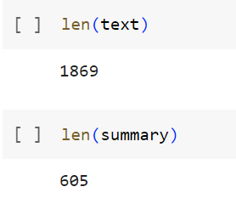
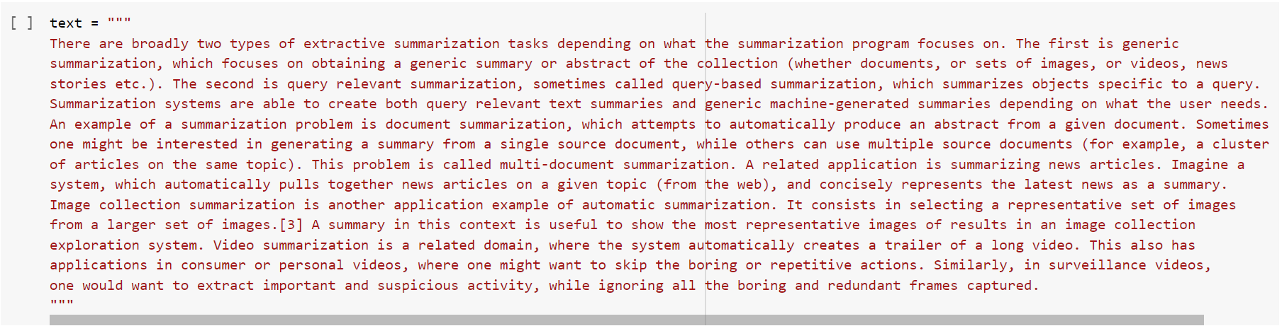
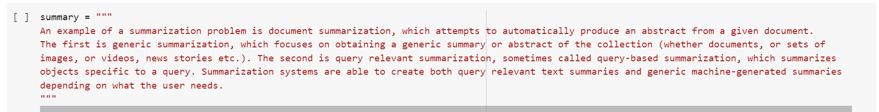
RESULTS
Before:
After:
Demo Link
3/21/2024 Annual Review
10

