Slide 1
Bus Shuttle Log
Collection System
Taneia Reed, Taylor Slusher, Keith DeSimini

Slide 2
Project Description
Transportation and Facilities Management at Ball State wants to replace their old paper log collection system with a brand new computer-based system.
They collect information from each of the shuttles running around BSU like how many people get on the bus at each stop throughout the day. They are currently utilizing a paper-based system where each driver has a paper to write out details at each stop. Then, each paper is computerized by someone at the end of the day.
They want to make this collection process centralized and to also adopt a software to put in each shuttle bus with an appropriate mounted device. Then, have the collected information pushed to a computer database in the transportation offices..

Slide 3
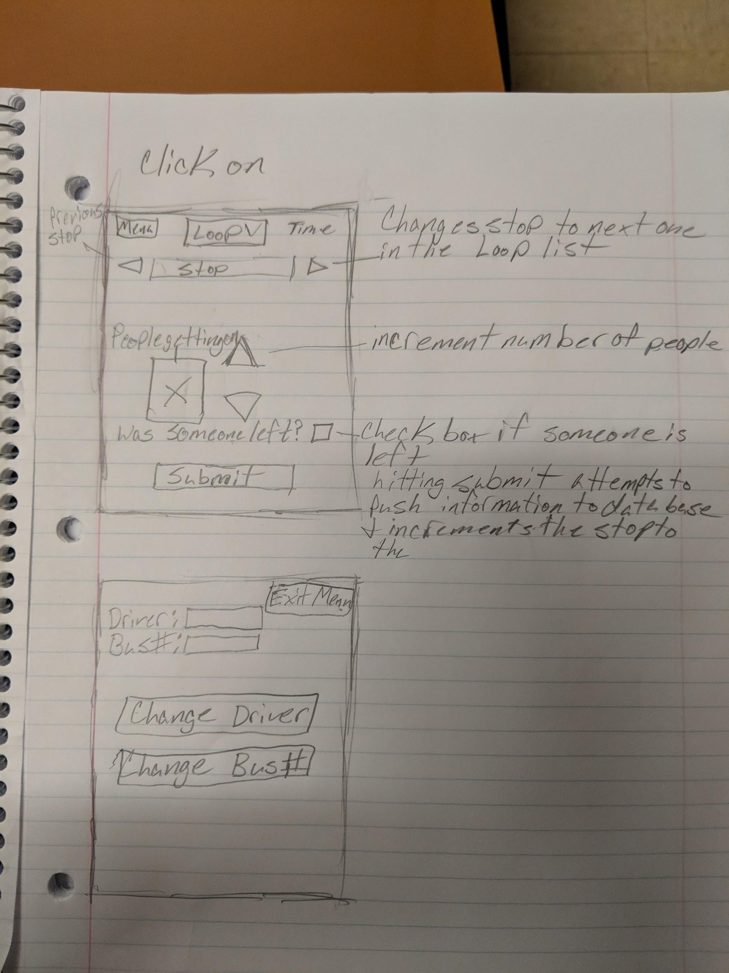
Prototypes

Slide 4
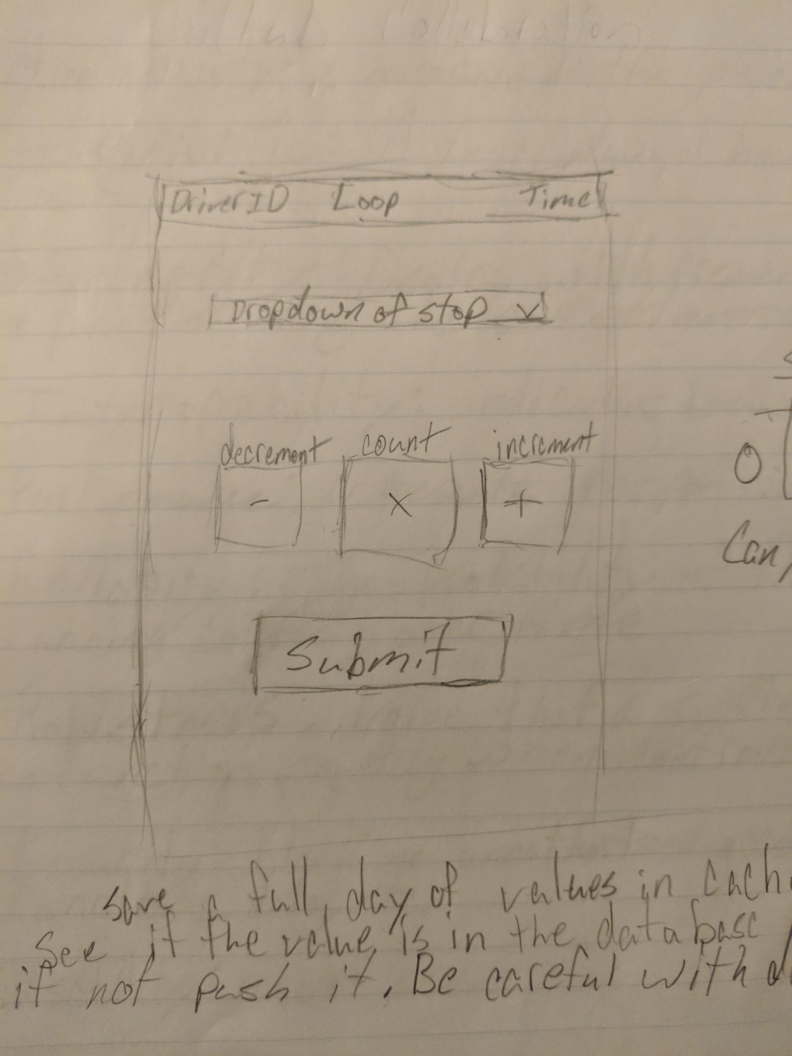

Slide 5
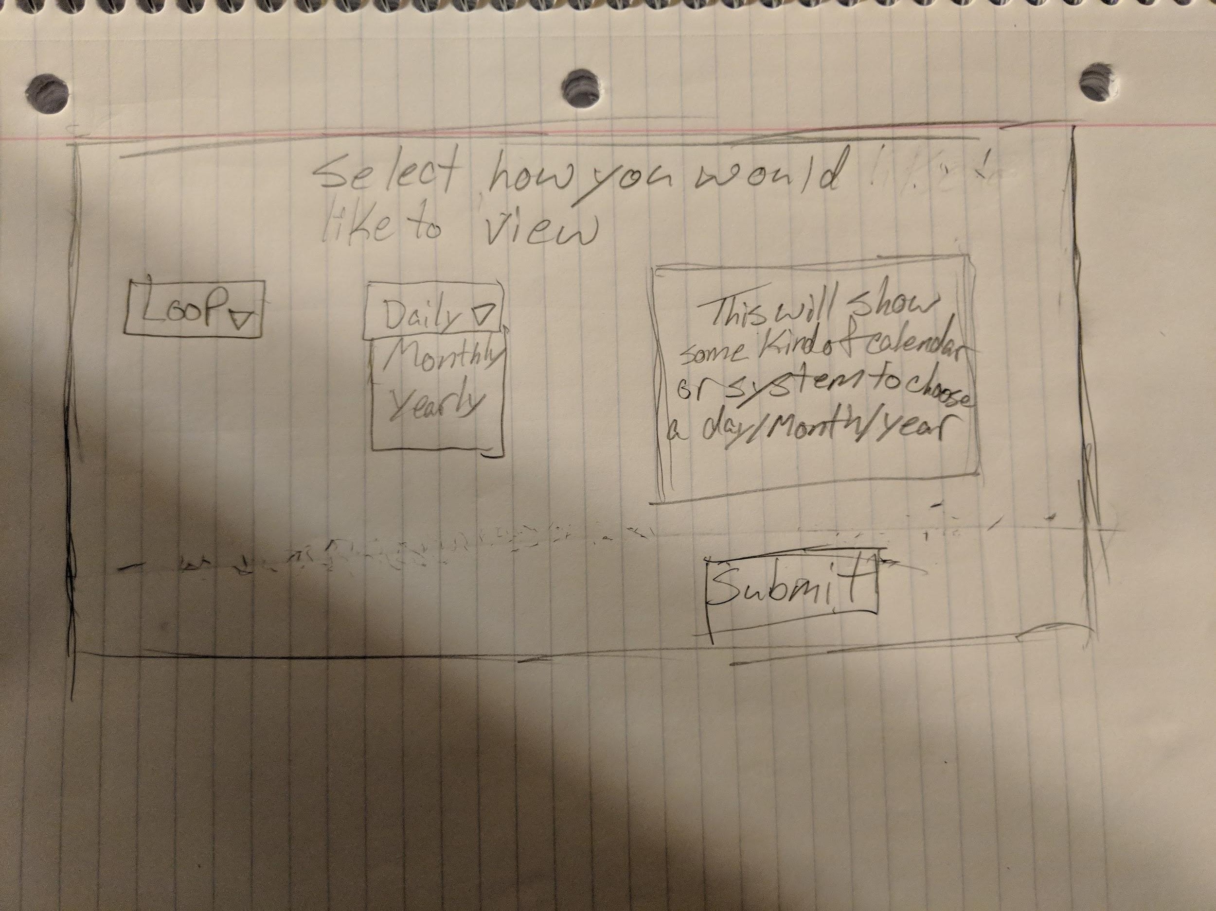

Slide 6
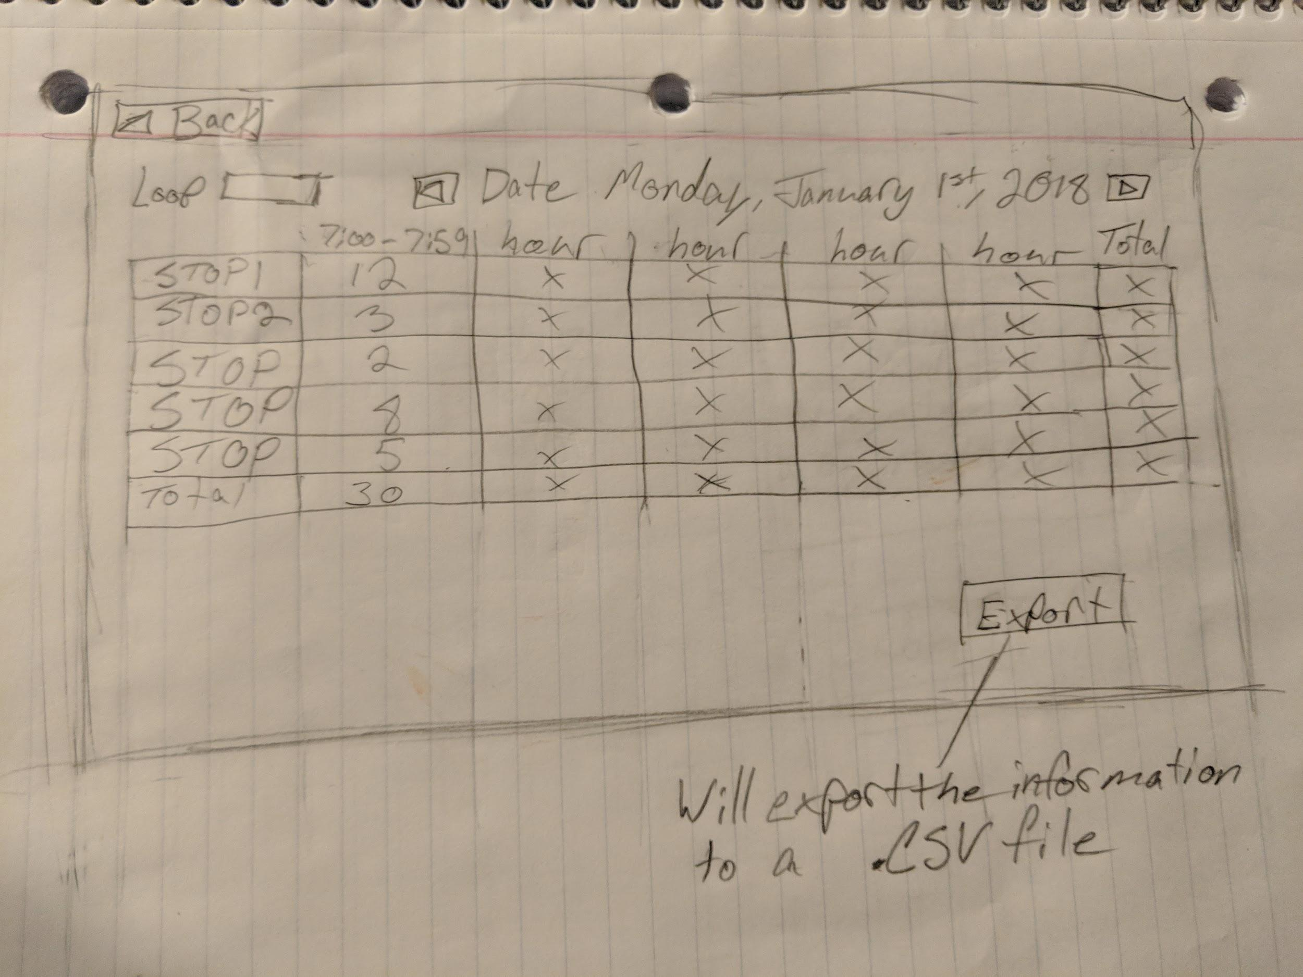

Slide 7
Meeting With The Client
What did you end up with?
Better understanding on how the process works and what they want the software to do
How was the meeting?
Very informative
Explained what they needed and what they liked and disliked
Minute Recorder:
No designated minute recorder, 1-hour meeting
Important Moments:
Examples of how data was transferred/collected
Copies of papers used by shuttle drivers

Slide 8
Meeting With The Client
Unusual Reaction:
Initial Deadline
May Deadline
Overall Observation:
Knew what they wanted
Had a solution previously that did not work
Pleasant to work with
What we found easy/difficult:
Answered most of our questions
Client jumped around a lot
Monthly Meetings:
TBD

Slide 9
Planning
Document planning
Questions for the client.
iPad holders on bus
Prioritization
Additional Features
Students left at stops

