Slide 1
Bus Shuttle Log Collection System
Taneia Reed, Taylor Slusher, Keith DeSimini

Slide 2
Refresher: The Project
Shuttle bus tracking system (students)
Currently collecting information on clipboards
This information helps determine how/when to change loops/stops
Centralized System
How this will be easier for Transportation and Facilities Management

Slide 3
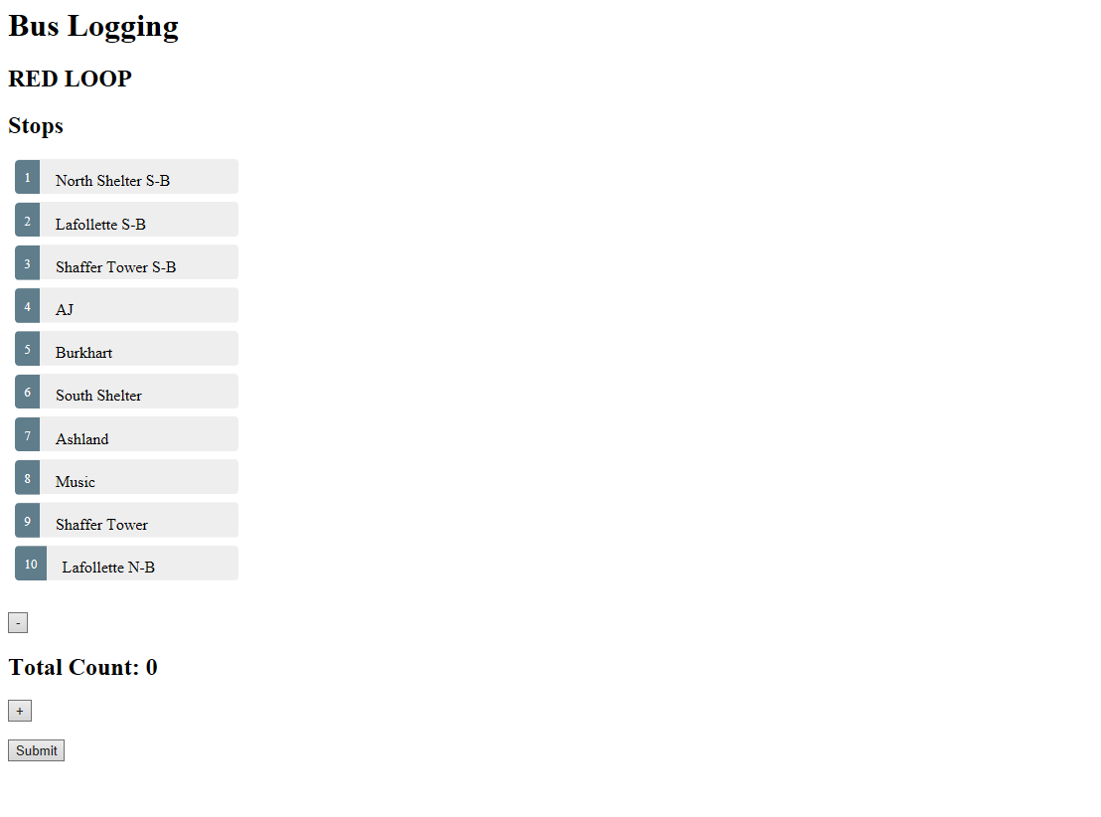

Slide 4

FrontEnd
Angular 7
HTML, CSS, Typescript
Webpage cached using Google’s Workbox, a set of service worker libraries used by browsers
Data that is sent with an offline connection is queued by Workbox’s Background Sync Module

Slide 5
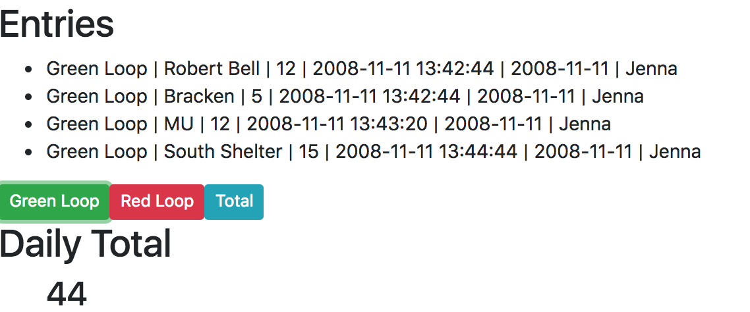
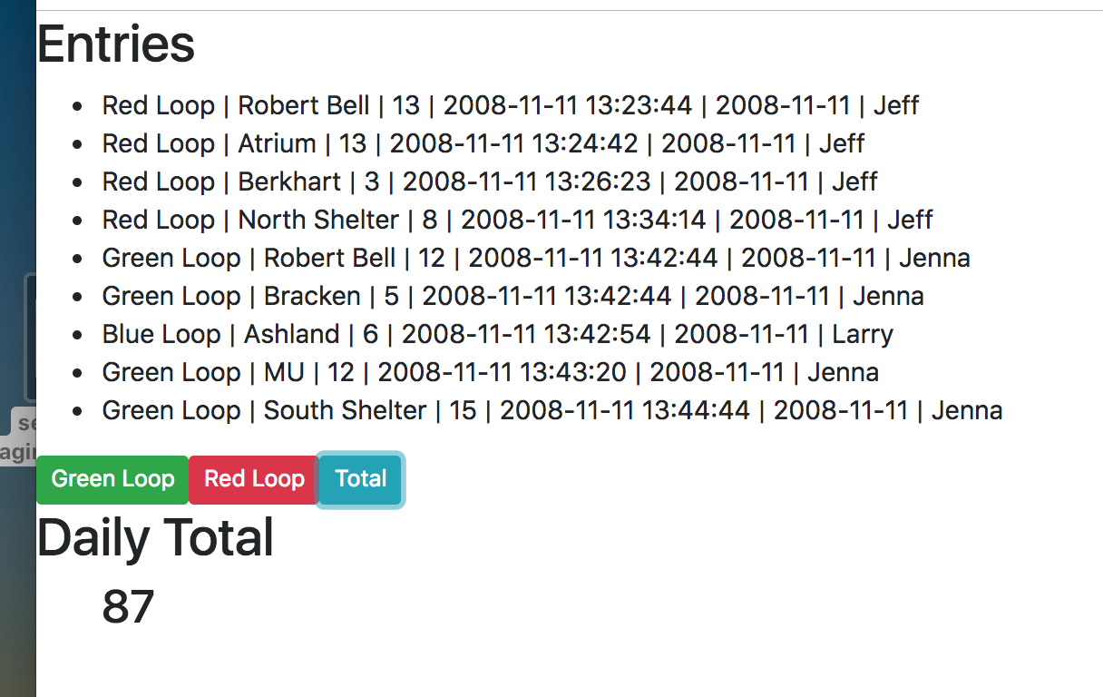
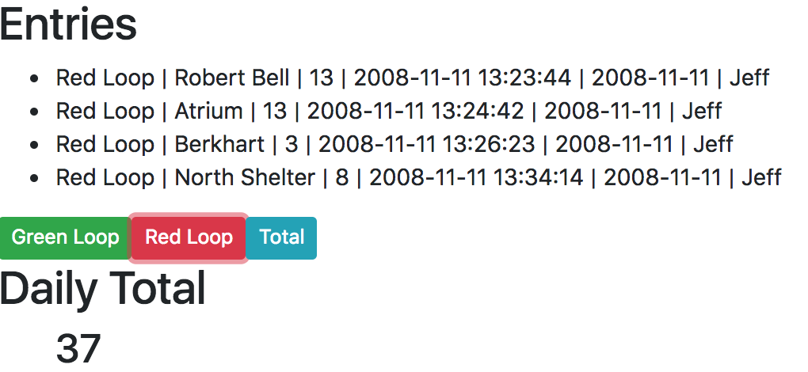
Backend

Slide 6



Backend
Data is fetched through an API built in PHP
MySQL
Apache

Slide 7
Overall Meeting - Monday, 2:30pm
What we went over:
We explained what we have done so far.
We discussed what we plan to accomplish for the second iteration.
We demoed the Driver’s bus log.
We demoed the Office log viewing system.
Bruce discussed that he would like to have a working mobile system a month before school let out, so they could train drivers.
Bruce brought up that he would like to have a system included into the application to keep track of daily bus inspections, if there is enough time.

Slide 8
Important Moments
Showing the demo of the Driver’s logging system.
Showing the demo of the Office log view system.
Being asked if it is possible to include a daily bus inspection system.

