Slide 1
Automation of ARK Data Collection and Analysis
Oscar Daniel

Slide 2
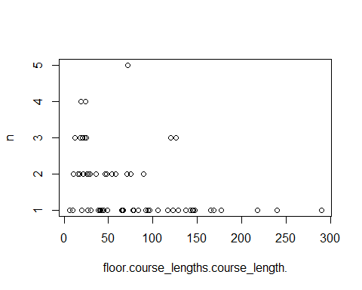
Preamble
Call libraries, set numbers not to display as exponents and import raw data
library(tidyverse) library(dplyr) library(lubridate) library(ggplot2) library(ggthemes) options(scipen = 999) raw_data <- read.csv(file = "RAW_DATA\\Data Extract.csv") Clean_Data <- raw_data
Data Tidying
Before data analysis can be done, the data needs to be changed so that it only has information that we want to look at, that the data is in the correct format and that there is no sensitive information contained within it.
Anonymise NHS No.
Full NHS numbers are included in our raw data so we want to anonymise this to prevent sensitive data being shared. Turning the NHS number into an arbitrary ID number is an easy way to do this whilst still retaining the grouping of data to an individual.
#change NHS# into an arbitrary Patient ID No PID <- Clean_Data %>% # Create ID by group group_by(NHS.) %>% mutate(ID = cur_group_id()) Clean_Data$NHS. <- PID$ID
Convert Data into Correct Format
As the date columns come in character format, we need to convert them into date types so we can manipulate them properly later on. We can also set our character data to one case so that it is more readable and predictable.
#make columns dates not characters Clean_Data$Prescription.start <- dmy_hm(Clean_Data$Prescription.start) Clean_Data$Prescription.end <- dmy_hm(Clean_Data$Prescription.end) #make all character columns same case to reduce number of duplicates and ease readability Clean_Data$Reason.given <-str_to_upper(Clean_Data$Reason.given, locale ="en") Clean_Data$Name <-str_to_title(Clean_Data$Name, locale ="en") Clean_Data$Route <-str_to_title(Clean_Data$Route, locale ="en") #take the difference between the start and end times of each rx, then make that a new column Clean_Data$Prescription_Length <- interval(Clean_Data$Prescription.start, Clean_Data$Prescription.end) / hours(1) head(select(Clean_Data, c(NHS., Prescription_Length)))
## NHS. Prescription_Length ## 1 1 50.750000 ## 2 2 1.933333 ## 3 2 34.550000 ## 4 3 25.050000 ## 5 3 27.450000 ## 6 3 1.633333
Remove inappropriate data
First we need to format data remove any irrelevant or erroneous data.
#remove duplicates Clean_Data <- Clean_Data[!duplicated(Clean_Data), ] #remove prescriptions before Dec 1st 2021 and ending after 2022 Clean_Data <- filter(Clean_Data, Prescription.start >= as.POSIXct("2021-12-01 00:00")) Clean_Data <- filter(Clean_Data, Prescription.end < as.POSIXct("2022-12-31 00:00")) #remove any stat, bleed, prophylactic abx, leg cramps, hepatic encephalopathy, SIADH or nystatin rx Clean_Data <- Clean_Data %>% filter(!(grepl("*BLEED*", Reason.given) | grepl("*PROPHY*", Reason.given) | grepl("*CRAMP*", Reason.given) | grepl("MS", Reason.given) | grepl("*ONCE*", Frequency) | grepl("H.ENCEPH*", Reason.given) | grepl("*HEPATIC ENCEPHALOPATHY*", Reason.given) | grepl("NYSTATIN", Name) | grepl("NYSTAN", Name) | grepl("SIADH", Reason.given) | grepl("^Amantadine", Name))) #remove any prescriptions where they could not have had more than one dose Clean_Data <- filter(Clean_Data, Frequency == "THREE times a DAY" & Prescription_Length > 8 | Frequency == "FOUR times a DAY" & Clean_Data$Prescription_Length > 6 | Frequency == "TWICE a DAY" & Prescription_Length > 12)
Regular expressions
Use some regex to normalise common indication names, remove ambiguous abbreviations and correct for some spelling mistakes
#make all UTIs display as Urinary Tract Infection Clean_Data$Reason.given <- gsub( "UTI", "URINARY TRACT INFECTION",Clean_Data$Reason.given) #make all community acquired pneumonia display as CAP Clean_Data$Reason.given <- gsub("CAP", "COMMUNITY ACQUIRED PNEUMONIA", Clean_Data$Reason.given) #make all IEoCOPD as IECOPD Clean_Data$Reason.given <- gsub("IECOPD", "INFECTIVE EXACERBATION OF CHRONIC OBSTRUCTIVE PULMONARY DISEASE", Clean_Data$Reason.given) #make all LRTI full name Clean_Data$Reason.given <- gsub("LRTI", "LOWER RESPIRATORY TRACT INFECTION", Clean_Data$Reason.given) #make any blank indications "Unrecorded" Clean_Data$Reason.given <- sub("^$", "UNRECORDED", Clean_Data$Reason.given) #correct common spelling mistakes Clean_Data$Reason.given <- gsub("PYONEPHRITIS", "PYELONEPHRITIS", Clean_Data$Reason.given) Clean_Data$Reason.given <- replace(Clean_Data$Reason.given,grep("DIFF",Clean_Data$Reason.given),"CLOSTRIDIUM DIFFICILE") Clean_Data$Reason.given <- str_to_title(Clean_Data$Reason.given) head( select(Clean_Data, c(NHS.,Name, Reason.given)))
## NHS. Name Reason.given ## 1 1 Piperacillin Community Acquired Pneumonia ## 2 2 Amoxicillin Lower Respiratory Tract Infection ## 3 3 Tigecycline Sbp ## 4 3 Piperacillin Serious Intra-Abdominal Infection ## 5 3 Nystatin Oral Thrush ## 6 3 Vancomycin Serious Intra-Abdominal Infection
Data Wrangling
This is where we start to manipulate and extract important information from our dataset to be used in our visualisations.
Find Pertinent Information
To help us understand what data is in each column we can look at the distinct values in each. This is much faster than looking through and making a note of what we see. For the indication this is useful to see if there are any common ways that things are misspelled;
indications <- distinct(Clean_Data ,Clean_Data$Reason.given) %>% head()
This can further inform our tidying process and clean up more commonly misspelled words and phrases.
Pivoting
Now that we have our data fairly tidy and we have the necessary information added, we want to arrange the data in a way which will reflect the way the ark project wants the data to look;
#pivot wide abx_per_indication <- Clean_Data %>% arrange(Prescription.start) %>% group_by(NHS.) %>% group_by(NHS., Reason.given) %>% mutate(rn = row_number()) %>% pivot_wider(values_from = c(Name,Route,Prescription.start,Prescription.end, Dose, Frequency, ARK.category, Prescription_Length ), names_from = rn)
This groups the data by person and by the indication (as in ARK antibiotics should only be grouped by the same indication), and makes each row a course of antibiotics for an illness, rather than single prescriptions.
Now that our data is better presented we can look for certain things.
For example we may want to find the most commonly prescribed antibiotics, or the most common reasons that antibiotics are prescribed;
Find popular antibiotics and popular indications over time
#find top n most frequently prescribed abx pop_abx <- Clean_Data %>% count(Name) %>% top_n(10) %>% arrange(-n) %>% head() #get the agents lined up by their start times and find their frequency on that day agent_by_date <- Clean_Data %>% group_by(Prescription.start) %>% count(Name) #then find their cumulative frequency over time agent_by_date <- agent_by_date %>% group_by(Name) %>% mutate(Cum_n = cumsum(n)) #find top n most frequent indications pop_indic <- abx_per_indication %>% group_by(Reason.given) %>% count(Reason.given) %>% arrange(-n) pop_indic <- head(pop_indic, n = 10) #then select only the most commonly prescribed abx pop_agent_by_date <- filter(agent_by_date, Name %in% pop_abx$Name) agent_by_reason <- Clean_Data %>% group_by(Reason.given) %>% count(Name) agent_by_reason <- filter(agent_by_reason,Reason.given %in% pop_indic$Reason.given) %>% print()
## # A tibble: 73 x 3 ## # Groups: Reason.given [10] ## Reason.given Name n ## <chr> <chr> <int> ## 1 Aspiration Pneumonia Amoxicillin 1 ## 2 Aspiration Pneumonia Aztreonam 1 ## 3 Aspiration Pneumonia Benzylpenicillin 5 ## 4 Aspiration Pneumonia Metronidazole 11 ## 5 Aspiration Pneumonia Piperacillin 2 ## 6 Cellulitis Amoxicillin 2 ## 7 Cellulitis Benzylpenicillin 4 ## 8 Cellulitis Cefotaxime 1 ## 9 Cellulitis Clarithromycin 5 ## 10 Cellulitis Clindamycin 1 ## # ... with 63 more rows
#organise pop indic by date and count how many over time indic_by_date <- Clean_Data %>% group_by(Prescription.start) %>% count(Reason.given) #find most common indications indic_by_date <- indic_by_date %>% filter(Reason.given %in% pop_indic$Reason.given) #find totals over time indic_by_date <- indic_by_date %>% mutate(Reason.given = str_to_title(Reason.given)) %>% group_by(Reason.given) %>% mutate(cum_n = cumsum(n))
Record Decisions
As ARK wants us to record the decisions that were made between each prescription, such as IV to Oral, Oral to IV or stopped.
To speed up processing time during testing just take a sample of 100 patients
abx_per_indication = abx_per_indication[sample(1:nrow(abx_per_indication),100),]
abx_per_indication <- abx_per_indication %>% mutate(interval_1 = interval(Prescription.start_1, Prescription.start_2) / hours (1), interval_2 = interval(Prescription.start_2, Prescription.start_3) / hours (1), interval_3 = interval(Prescription.start_3, Prescription.start_4) / hours (1), interval_4 = interval(Prescription.start_4, Prescription.start_5) / hours (1), interval_5 = interval(Prescription.start_5, Prescription.start_6) / hours (1), )
#classify each change as per ARK protocol #firstly, what was actually commenced abx_per_indication <- abx_per_indication %>% mutate(Decision_1 = case_when( Route_1 == "Intravenous" & Route_2 == "Intravenous" & interval_1 < 12 & Prescription_Length_1 > 12 ~ 'Dual IV therapy started', Route_1 == "Intravenous" & Route_2 == "Oral" & interval_1 < 12 & Prescription_Length_1 > 12 ~ 'IV and Oral started', Route_1 =="Oral" & Route_2 == "Intravenous" & interval_1 < 12 ~ "IV and Oral started", Route_1 == "Intravenous" & Route_2 == "Oral" & interval_1 < 12 & Prescription_Length_1 > 12 ~ 'Dual Oral therapy started', interval_1 > 12 | is.na(interval_1) | Prescription_Length_1 <=12 ~ paste0(Route_1, " started"), TRUE ~ 'something else' ))
```{ deprecated} test <- filter(abx_per_indication, NHS. == 121)
#what happened after the initial prescription
abx_per_indication <- abx_per_indication %>% mutate(Decision_2 = case_when(Route_1 == Route_2 & Name_1 == Name_2 & Dose_1 == Dose_2 & Frequency_1 == Frequency_2 ~ paste0(Route_2, ” “, Name_2,” continued”), Route_1 == Route_2 & Name_1 != Name_2 & Decision_1 == “Oral started” ~ paste0(‘Agent switched to’, Name_2), Route_1 == Route_2 & Name_1 != Name_2 & Decision_1 == “Intravenous started” ~ paste0(‘Agent switched to’, Name_2), Route_1 == Route_2 & Dose_1 != Dose_2 & Frequency_1 != Frequency_2 & Name_1 == Name_2 ~ paste0(‘Regiment changed to’, Dose_2, ” “,Frequency_2),
Route_1 =="Intravenous" & Route_2 == "Intravenous" & ARK.category_2 == "FINAL" ~ paste0('Finalised as IV ', Name_2), Route_1 =="Oral" & Route_2 == "Oral" & is.na(Route_3) & ARK.category_2 == "FINAL" ~ paste0('Finalised as Oral ', Name_2), #see if there was a single agent switch Prescription.end_1 < Prescription.start_2 + 1 & Decision_1 != "IV and Oral started" ~ paste0(Route_1, " to ", Route_2, " switch"), Prescription.end_1 < Prescription.start_2 + 1 & Decision_1 != "Dual IV therapy started" ~ paste0(Route_1, " to ", Route_2, " switch"), Prescription.end_1 > Prescription.start_2 + 1 & Decision_1 != "IV and Oral started" ~ paste0(Route_2, " " ,Name_2, " added"), Prescription.end_1 > Prescription.start_2 + 1 & Decision_1 != "Dual IV therapy started" ~ paste0(Route_2, " " ,Name_2, " added"), is.na(Route_2) & Prescription_Length_1 <=72 ~ paste0('Stopped as ', Route_1, ' within 72 hours'), is.na(Route_2) & Prescription_Length_1 > 72 ~ paste0('Stopped as ', Route_1, ' beyond 72 hours'), TRUE ~ "something else",)) #Decision_1 == "IV and Oral started" # then becomes what decision three would look AT #Route_1 == Route_2 & Name_1 == Name_2 & Dose_1 == Dose_2 & Frequency_1 == Frequency_2 ~ 'No Change'
```{ deprecated} abx_per_indication <- abx_per_indication %>% mutate(Decision_2 = case_when(Prescription.end_1 < Prescription.start_3 +1 & Prescription.end_2 < Prescription.start_3 +1 & Decision_1 == "IV and Oral started" & Name_3 != NA ~ paste0( "IV and Oral to ", Route_3, " switch"), Prescription.end_1 < Prescription.start_3 & Prescription.end_2 < Prescription.start_3 & Decision_1 == "Dual IV therapy started" ~ paste0(Route_1, " to ", Route_3, " switch"),))
abx_per_indication <- abx_per_indication %>% mutate(Decision_2 = case_when( #if two agents were started at once, see if one of them was stopped and what replaced it Decision_1 == "IV and Oral started" & Prescription.end_1 < Prescription.start_3 + 10 & Prescription.start_4 > Prescription.start_3 + 10 ~ paste0(Name_1," ", Route_1 , " to ", Route_3 ," ", Name_3, " partial switch"), Decision_1 == "IV and Oral started" & Prescription.end_2 < Prescription.start_3 + 10 & Prescription.start_4 > Prescription.start_3 + 10 ~ paste0(Name_2," ", Route_2 , " to ", Route_3 ," ", Name_3, " partial switch"), Decision_1 == "Dual IV therapy started" & Prescription.end_1 < Prescription.start_3 + 10 & Prescription.start_4 > Prescription.start_3 + 10 ~ paste0(Name_1," ", Route_1 , " to ", Route_3 ," ", Name_3, " partial switch"), Decision_1 == "Dual IV therapy started" & Prescription.end_2 < Prescription.start_3 + 10 & Prescription.start_4 > Prescription.start_3 + 10 ~ paste0(Name_1," ", Route_1 , " to ", Route_3 ," ", Name_3, " partial switch"), #what if one was stopped and nothing replaced it Decision_1 == "IV and Oral started" & Prescription.end_2 < Prescription.end_1 + 6 & is.na(Name_3) ~ paste0(Name_2," ", Route_2 , " stopped"), Decision_1 == "IV and Oral started" & Prescription.end_1 < Prescription.end_2 + 6 & is.na(Name_3) ~ paste0(Name_1," ", Route_1 , " stopped"), #see if both agents were stopped and what replaced them Decision_1 == "IV and Oral started" & Prescription.end_1 < Prescription.start_3 + 10 & Prescription.end_2 < Prescription.start_3 + 10 & Prescription.start_4 > Prescription.start_3 + 10 ~ paste0(Route_2," and ", Route_1 , " to ", Route_3 ," ", Name_3, " total switch"), Decision_1 == "Dual IV therapy started" & Prescription.end_1 < Prescription.start_3 + 10 & Prescription.end_2 < Prescription.start_3 + 10 & Prescription.start_4 > Prescription.start_3 + 10 ~ paste0(Route_2," and ", Route_1 , " to ", Route_3 ," ", Name_3, " total switch"), #if both were stopped and that was the end of the course Decision_1 == "IV and Oral started" & is.na(Name_3) & between(interval(Prescription.end_1, Prescription.end_2) / hours(1), -1, 1 ) & Prescription_Length_1 <= 72 | Decision_1 == "Dual IV therapy started" & is.na(Name_3) & between(interval(Prescription.end_1, Prescription.end_2) / hours(1), -1, 1 ) & Prescription_Length_1 <= 72 ~ paste0("Both stopped within 72 hours"), Decision_1 == "IV and Oral started" & is.na(Name_3) & between(interval(Prescription.end_1, Prescription.end_2) / hours(1), -1, 1 ) & Prescription_Length_1 <= 72 | Decision_1 == "Dual IV therapy started" & is.na(Name_3) & between(interval(Prescription.end_1, Prescription.end_2) / hours(1), -1, 1 ) & Prescription_Length_1 > 72 ~ paste0("Both stopped beyond 72 hours"), #what if just one agent was initially prescribed and just re-prescribed exactly as it was Decision_1 != "IV and Oral started" & Decision_1 != "Dual IV therapy started" & Decision_1 != "Dual Oral therapy started" & Name_1 == Name_2 & Route_1 == Route_2 & Dose_1 == Dose_2 & Frequency_1 == Frequency_2 ~ paste0("Prescription continued, reviewed after ",interval_1, " hours"), #what if just one agent was initially prescribed, and then was changed Decision_1 != "IV and Oral started" & Decision_1 != "Dual IV therapy started" & Prescription.end_1 < Prescription.start_2 +1 & Name_1 != Name_2 & Route_1 != Route_2 & Dose_1 != Dose_2 & Frequency_1 != Frequency_2 ~ paste0(Name_1, " ", Route_1, " to ",Route_2, " ", Name_2, " switch" ), #what if something was added, before the first one was stopped? Decision_1 != "IV and Oral started" & Decision_1 != "Dual IV therapy started" & Decision_1 != "Dual Oral therapy started" & Prescription.start_2 < Prescription.end_1 +1 & is.na(Name_3) | Decision_1 != "IV and Oral started" & Decision_1 != "Dual IV therapy started" & Prescription.start_2 < Prescription.end_1 +1 & Prescription.end_2 < Prescription.start_3 +10 ~ paste0(Name_2, " ", Route_2, " added"), #between value between(value, lower limit, upper limit) #if only one agent was given is.na(Name_2) & Prescription_Length_1 <= 72 ~ paste0("Stopped as ", Route_1, " within 72 hours"), is.na(Name_2) & Prescription_Length_1 > 72 ~ paste0("Stopped as ", Route_1, " beyond 72 hours"), )) # Route_2 =="Intravenous" & Route_3 =="Oral" ~ 'IV to Oral Switch', # Route_2 =="Oral" & Route_3 =="Intravenous" ~ 'Oral to IV Switch', # Route_2 =="Intravenous" & Route_3 == "Intravenous" & is.na(Route_4) ~ 'Finalised as IV', # Route_2 =="Intravenous" & is.na(Route_3) & Prescription_Length_2 <=72 ~ 'Stopped as IV within 72 hours', # Route_2 =="Oral" & is.na(Route_3) & Prescription_Length_2 <=72 ~ 'Stopped as Oral within 72 hours', # Route_2 =="Intravenous" & is.na(Route_3) & Prescription_Length_2 > 72 ~ 'Stopped as IV beyond 72 hours', # Route_2 =="Oral" & is.na(Route_3) & Prescription_Length_2 > 72 ~ 'Stopped as Oral beyond 72 hours', # Route_2 =="Oral" & is.na(Route_3) ~ 'Stopped as Oral', # Route_2 == Route_3 & Name_2 == Name_3 & Dose_2 == Dose_3 & Frequency_2 == Frequency_3 ~ 'No Change', # Route_2 == Route_3 & Name_2 != Name_3 ~ 'Agent changed', # Decision_1 == "Finalised as Oral" | Decision_1 == "Finalised as IV" ~ (""), # Route_2 == Route_3 & Dose_2 != Dose_3 | Frequency_2 != Frequency_3 ~ ('Regiment changed'), # TRUE ~ 'something else' #))
abx_per_indication <- abx_per_indication %>% mutate(Decision_3 = case_when( Route_2 == Route_3 & Name_2 == Name_3 & Dose_2 == Dose_3 & Frequency_2 == Frequency_3 ~ paste0(Route_3, " ", Name_3, " continued"), Route_2 == Route_3 & Name_2 != Name_3 ~ paste0('Agent switched to ', Name_3), Route_2 == Route_3 & Dose_2 != Dose_3 & Frequency_2 != Frequency_3 & Name_2 == Name_3 ~ paste0('Regiment changed to ', Dose_3, " ",Frequency_3), Route_2 =="Intravenous" & Route_3 == "Intravenous" & ARK.category_3 == "FINAL" ~ paste0('Finalised as IV ', Name_3), Route_2 =="Oral" & Route_3 == "Oral" & is.na(Route_3) & ARK.category_3 == "FINAL" ~ paste0('Finalised as Oral ', Name_3), Prescription.end_2 < Prescription.start_3 + 1 ~ paste0(Route_2, " to ", Route_3, " switch"), Prescription.end_2 > Prescription.start_3 + 6 ~ paste0(Route_3, " " ,Name_3, " added"), is.na(Route_3) & Prescription_Length_2 <=72 ~ paste0('Stopped as ', Route_2, ' within 72 hours'), is.na(Route_3) & Prescription_Length_2 > 72 ~ paste0('Stopped as ', Route_2, ' beyond 72 hours'), is.na(Route_2) ~ "", TRUE ~ 'something else' )) temp <- abx_per_indication %>% select(c(Name_1,Route_1,Prescription.start_1, Prescription.end_1, Decision_1, Decision_2, Decision_3, Name_2, Route_2,Name_3,Route_3, Prescription.start_2,Prescription.end_2,interval_1))
We will also be able to group people by the number of prescriptions there were in their antibiotic course;
#first get rid of superfluous columns ark_results <- abx_per_indication %>% select(c(Name_1,Route_1, Name_2,Route_2, Name_3,Route_3,Name_4,Route_4,Decision_1,Decision_2,Prescription_Length_1,Prescription_Length_2,Prescription_Length_3,Prescription_Length_4, Prescription.start_1)) %>% arrange(Name_4, Name_3, Name_2) single_rx <- ark_results %>% filter(is.na(Name_2)) %>% select(c(Name_1,Route_1,Decision_1,Decision_2,Prescription_Length_1, Prescription.start_1)) double_rx <- ark_results %>% filter(is.na(Name_3)) %>% select(c(Name_1,Route_1,Prescription_Length_1, Decision_1,Decision_2, Name_2,Route_2,Prescription_Length_2)) triple_rx <- ark_results %>% filter(is.na(Name_4)) %>% select(-c(Name_4,Route_4)) quad_rx <- ark_results %>% filter(!is.na(Name_4))
We want to know how long patients’ total courses were, so let’s do that;
#get rid of all missing values, then add course lengths together course_lengths <- abx_per_indication course_lengths$Prescription_Length_2[is.na(course_lengths$Prescription_Length_2)] <- 0 course_lengths$Prescription_Length_3[is.na(course_lengths$Prescription_Length_3)] <- 0 course_lengths$Prescription_Length_4[is.na(course_lengths$Prescription_Length_4)] <- 0 course_lengths <- course_lengths %>% mutate( course_length = (Prescription_Length_1 + Prescription_Length_2 + Prescription_Length_3 + Prescription_Length_4))
#make course length the difference in time from the first agent being started and the last agent being finished course_lengths <- abx_per_indication %>% mutate(course_length = case_when( is.na(Name_2) ~ Prescription_Length_1, is.na(Name_3) ~ interval(Prescription.start_1, Prescription.end_2)/ hours(1), is.na(Name_4) ~ interval(Prescription.start_2, Prescription.end_3)/ hours(1), is.na(Name_5) ~ interval(Prescription.start_3, Prescription.end_4)/ hours(1), is.na(Name_6) ~ interval(Prescription.start_4, Prescription.end_5)/ hours(1), is.na(Name_7) ~ interval(Prescription.start_5, Prescription.end_6)/ hours(1),)) plot_lengths= data.frame(floor(course_lengths$course_length)) %>% filter(course_lengths$course_length<600) plot_lengths = plot_lengths %>% group_by(floor.course_lengths.course_length.) %>% count(floor.course_lengths.course_length.) plot(plot_lengths )

Slide 3
course_lengths <- course_lengths %>% select(c(course_length, Prescription.start_1,Prescription.start_2,Prescription.start_3,Prescription.start_4))
A course counts towards the month that it started in, not the month that it ended in.
ARK also wants to know how many prescriptions were stopped or changed within 72 hours each month, this could be changed to weekly or even hourly if we so desired.
#floor all rx dates so they are organised by month. #then count the number in each month rx_in_month <- select(Clean_Data, c(Prescription.start,Prescription_Length)) rx_in_month$Prescription.start <- floor_date(rx_in_month$Prescription.start, "month") rx_in_month <- rx_in_month %>% group_by(Prescription.start) %>% count(Prescription.start) #do the same as above, but then look for only the rx under 72hrs rx_under_month <- select(Clean_Data, c(Prescription.start,Prescription_Length)) rx_under_month$Prescription.start <- (floor_date(rx_under_month$Prescription.start, "month")) rx_under_month <- rx_under_month %>% mutate(short_rx = Prescription_Length <= 72) rx_under_month <- rx_under_month %>% filter(short_rx == TRUE) rx_under_month <- rx_under_month %>% group_by(Prescription.start) %>% count(short_rx) #then divide the short rx by total rx percent_in_month <- data.frame(rx_in_month$Prescription.start) %>% mutate(percent_short = rx_under_month$n/rx_in_month$n *100)
We can then select for people who only had one prescription and whether that was stopped in 72 hours or less; / total course was less than 72 hours
stopped_less_72 <- filter(single_rx, Prescription_Length_1 <= 72) percent_stopped_72 <- nrow(stopped_less_72) / nrow(ark_results) *100
Now we want to see the previous result broken down by week
rx_under_week_stopped <- select(single_rx, c(Prescription.start_1,Prescription_Length_1,Route_1)) rx_under_week_stopped$Prescription.start_1 <- (floor_date(rx_under_week_stopped$Prescription.start_1, "week")) rx_under_week_stopped <- rx_under_week_stopped %>% mutate(short_rx = Prescription_Length_1 <= 72) rx_under_week_stopped <- rx_under_week_stopped %>% filter(short_rx == TRUE) rx_under_week_stopped <- rx_under_week_stopped %>% group_by(Prescription.start_1) %>% count(short_rx)
Then we can find the total number of courses each week
rx_in_week <- select(Clean_Data, c(Prescription.start,Prescription_Length,Route)) rx_in_week$Prescription.start <- floor_date(rx_in_week$Prescription.start, "week") rx_in_week <- rx_in_week %>% group_by(Prescription.start) %>% count(Prescription.start)
Then compare them against each other
percent_in_week_stopped <- data.frame(rx_in_week$Prescription.start) %>% mutate(percent_short = rx_under_week_stopped$n/rx_in_week$n *100)
Same as above but only select IV antibiotics
rx_under_week_stopped_IV <- select(single_rx, c(Prescription.start_1,Prescription_Length_1,Route_1)) rx_under_week_stopped_IV <- rx_under_week_stopped_IV %>% filter(Route_1 =="Intravenous" ) rx_under_week_stopped_IV$Prescription.start_1 <- (floor_date(rx_under_week_stopped_IV$Prescription.start_1, "week")) rx_under_week_stopped_IV <- rx_under_week_stopped_IV %>% mutate(short_rx = Prescription_Length_1 <= 72) rx_under_week_stopped_IV <- rx_under_week_stopped_IV %>% filter(short_rx == TRUE) rx_under_week_stopped_IV <- rx_under_week_stopped_IV %>% group_by(Prescription.start_1) %>% count(short_rx)
Then compare them against each other
percent_in_week_stopped_IV <- data.frame(rx_in_week$Prescription.start) %>% mutate(percent_short = rx_under_week_stopped_IV$n/rx_in_week$n *100)

Slide 4
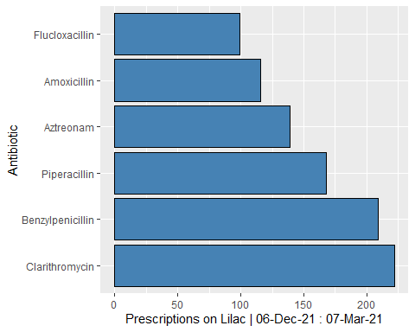
Data Visualisation
Make a graph of the most common antibiotics used on lilac
#top ten prescriptions ggplot(data=pop_abx, aes(y=reorder(Name, -n), x = n)) + # if wanting abx name on x axis- scale_x_discrete(guide = guide_axis(n.dodge=3)) + geom_bar(stat = "identity", fill="Steel Blue", colour="black") + xlab("Prescriptions on Lilac | 06-Dec-21 : 07-Mar-21") + ylab("Antibiotic")

Slide 5
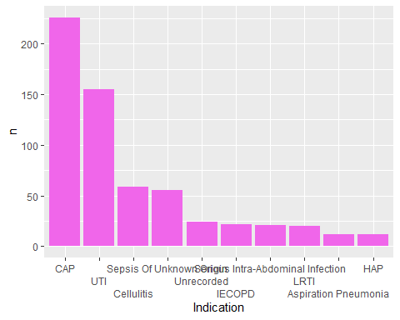
Make a graph of the most common indications
ggplot(pop_indic, aes(x =reorder(Reason.given, -n), y = n)) + scale_x_discrete("Indication", guide = guide_axis(n.dodge=3), labels = c("Community Acquired Pneumonia" = "CAP", "Infective Exacerbation Of Chronic Obstructive Pulmonary Disease" = "IECOPD", "Lower Respiratory Tract Infection" = "LRTI", "Urinary Tract Infection" = "UTI", "Healthcare Associated Pneumonia" = "HAP")) + geom_bar(stat = "identity", fill = "#F066EA")

Slide 6
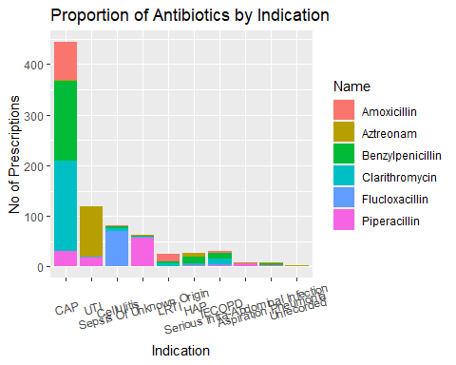
Stacked bar graph of antibiotic for each indication
#stacked bar graph, abx by indic Abx_indic_stacked <- agent_by_reason %>% filter(Name %in% pop_abx$Name) %>% mutate(Reason.given = str_to_title(Reason.given)) %>% mutate(Name = str_to_title(Name)) Abx_indic_stacked %>% ggplot(aes(x = reorder(Reason.given, -n), y = n, fill =Name)) + theme(axis.text.x = element_text(angle = 15, vjust = 0.6)) + geom_bar(position='stack', stat='identity') + labs(x= "Indication", y= "No of Prescriptions", title="Proportion of Antibiotics by Indication") + scale_x_discrete("Indication", labels = c("Community Acquired Pneumonia" = "CAP", "Infective Exacerbation Of Chronic Obstructive Pulmonary Disease" = "IECOPD", "Lower Respiratory Tract Infection" = "LRTI", "Urinary Tract Infection" = "UTI", "Healthcare Associated Pneumonia" = "HAP"))

Slide 7
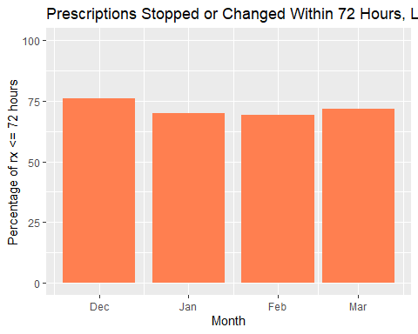
ARK Pertinent Graphs
Percent of individual prescriptions that had either stopped or been changed in 72 hours or less by month
percent_in_month %>% ggplot(aes(x = rx_in_month.Prescription.start, y = percent_short)) + ylim(0,100)+ labs(x = "Month", y = "Percentage of rx <= 72 hours", title = "Prescriptions Stopped or Changed Within 72 Hours, Lilac Ward Dec '21 - Mar '22") + geom_bar(stat = "identity", fill = "coral")

Slide 8
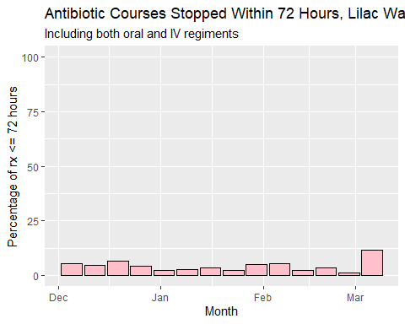
Percent of people who had a total course of less than or equal to 72 hours, by week;
percent_in_week_stopped %>% ggplot(aes(x = rx_in_week.Prescription.start, y = percent_short)) + ylim(0,100)+ labs(x = "Month", y = "Percentage of rx <= 72 hours", title = "Antibiotic Courses Stopped Within 72 Hours, Lilac Ward Dec '21 - Mar '22", subtitle = "Including both oral and IV regiments") + geom_bar(stat = "identity", colour = "black", fill = "pink")

Slide 9
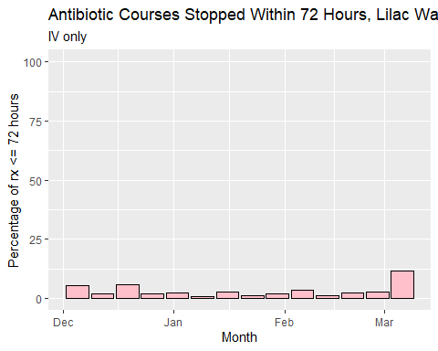
Then look at just IV
percent_in_week_stopped_IV %>% ggplot(aes(x = rx_in_week.Prescription.start, y = percent_short)) + ylim(0,100)+ labs(x = "Month", y = "Percentage of rx <= 72 hours", title = "Antibiotic Courses Stopped Within 72 Hours, Lilac Ward Dec '21 - Mar '22", subtitle = "IV only") + geom_bar(stat = "identity", colour = "black", fill = "pink")

Slide 10
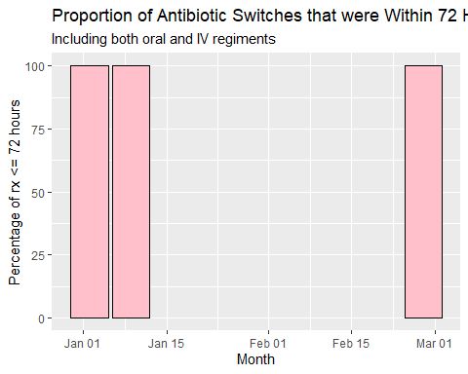
Then we can work out the number of people who had their prescription changed to another agent, and what percentage of those people had their first switch in <=72 hours.
#get all courses where the second decision was that the drug was switched rx_switched <- ark_results %>% filter(grepl("*switch*", Decision_2, ignore.case = TRUE) | grepl("*change*", Decision_2, ignore.case = TRUE)) #floor by week to group them together rx_switched$Prescription.start_1 <- floor_date(rx_switched$Prescription.start_1, "week") #then take those and count how many there were each week rx_switched_week <- rx_switched %>% group_by(Prescription.start_1) %>% count(Prescription.start_1) #then select only the short ones rx_switched_short <-rx_switched %>% filter(Prescription_Length_1 <= 72) #then count how many there were each week rx_switched_short_week <- rx_switched_short %>% group_by(Prescription.start_1) %>% count(Prescription.start_1) #then compare them percent_in_week_switched <- data.frame(rx_switched_week$Prescription.start_1) %>% mutate(percent_short = rx_switched_short_week$n/rx_switched_week$n *100)
Then put them into a graph!
percent_in_week_switched %>% ggplot(aes(x = rx_switched_week.Prescription.start_1, y = percent_short)) + ylim(0,100)+ labs(x = "Month", y = "Percentage of rx <= 72 hours", title = "Proportion of Antibiotic Switches that were Within 72 Hours, Lilac Ward Dec '21 - Mar '22", subtitle = "Including both oral and IV regiments") + geom_bar(stat = "identity", colour = "black", fill = "pink")

Slide 11
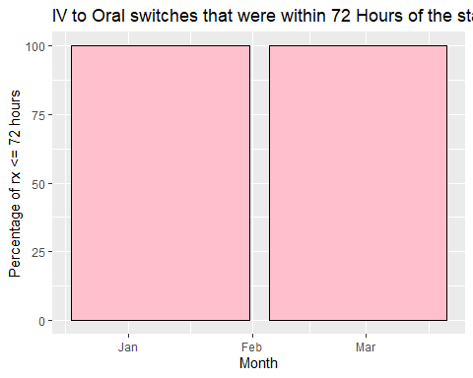
#get all courses where the first decision was IV to oral switch rx_switched <- ark_results %>% filter(grepl("*Intravenous to Oral*", Decision_2)) #floor by week to group them together rx_switched$Prescription.start_1 <- floor_date(rx_switched$Prescription.start_1, "week") #then take those and count how many there were each week rx_switched_week <- rx_switched %>% group_by(Prescription.start_1) %>% count(Prescription.start_1) #then select only the short ones rx_switched_short <-rx_switched %>% filter(Prescription_Length_1 <= 72) #then count how many there were each week rx_switched_short_week <- rx_switched_short %>% group_by(Prescription.start_1) %>% count(Prescription.start_1) #then compare them percent_in_week_switched <- data.frame(rx_switched_week$Prescription.start_1) %>% mutate(percent_short = rx_switched_short_week$n/rx_switched_week$n *100)
percent_in_week_switched %>% ggplot(aes(x = rx_switched_week.Prescription.start_1, y = percent_short)) + ylim(0,100)+ labs(x = "Month", y = "Percentage of rx <= 72 hours", title = "IV to Oral switches that were within 72 Hours of the start of a course | Lilac Ward Dec '21 - Mar '22") + geom_bar(stat = "identity", colour = "black", fill = "pink")

