Slide 1
REVISION OF PREVIOUS CLASS
Heart Block
Arrythmia

Slide 2
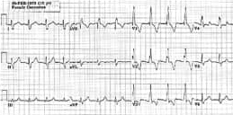
Choose the correct diagnosis for this ECG?
A.LBBB
B. RBBB
C. LAFB
D. RBBB + LAFB
E. RBBB + LPFB

Slide 3
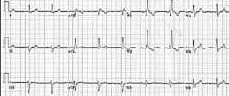
Choose the correct diagnosis for this ECG?
A.LBBB
B.RBBB
C.LAFB
D.RBBB +LAFB
E. RBBB +LPFB

Slide 4
Atrial flutter is similar to atrial fibrillation, but the rhythm in your atria is more organized and less chaotic than the abnormal patterns common with atrial fibrillation.
True
False

Slide 5
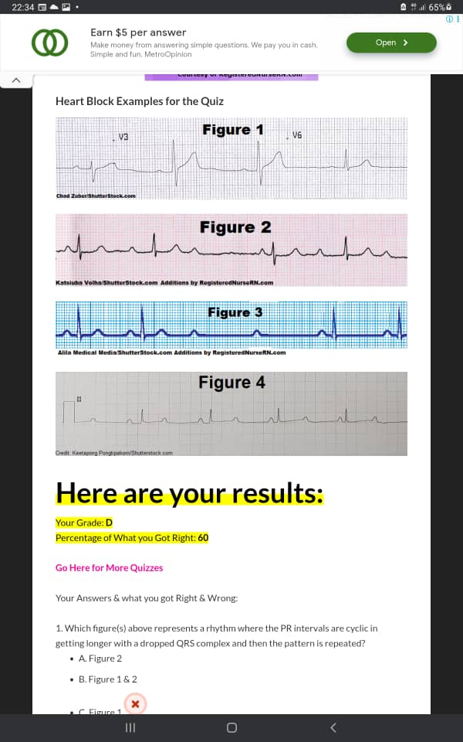
Which figure(s) above represents a rhythm where the PR intervals are cyclic in getting longer with a dropped QRS complex and then the pattern is repeated?
A. Figure 2
B. Figure 1 & 2
C. Figure 1
D. Figure 3

Slide 6
Figure 4 is known as what type of rhythm?
A. 2nd Degree Type 2 (Mobitz II)
B. 1st Degree AV Block
C. Wenckeback
D. 3rd Degree Heart Block

Slide 7
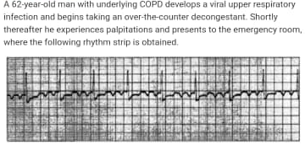
What is the most likely diagnosis?
A Normal sinus rhythm
B. Junctional rhythm
c. Atrial Flutter with 4:1 atrioventricular block
D. Paroxysmal atrial tachycardia with 2:1 atrioventricular block
E. Complete heart block with 2:1 atrioventricular block

Slide 8
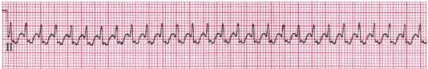
A new nurse observes the rhythm pictured and interprets it as which of the following?
A Supraventricular tachycardia
B Sinus tachycardia
C Atrial fibrillation
D Atrial flutter

Slide 9
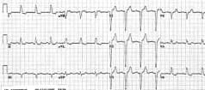
Choose the correct diagnosis for the ECG?
A. LBBB
B. RBBB
C. LAFB
D. RBBB + LAFB
E. RBBB + LPFB

Slide 10
Atrial fibrillation may be:
A Occasional
B Persistent
C Long-standing persistent
D Permanent
E All of the above

Slide 11
A normal PR interval measures ?
A 0.12 to 0.20 seconds
B great than 0.20 seconds
C 0.06 to 0.16 seconds
D 0.20 to 0.26 seconds

Slide 12
In degree heart block, the SA node generates impulses but those impulses do not go the ventricles. therefore, the atrial and ventricles are independent
A True
B False

Slide 13
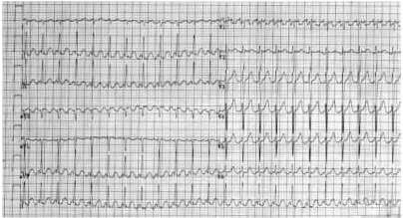
A 45 year old business man presents with a feeling that his heart is racing. He also has some shortness of breath. This is his ECG. Present your findings and give a diagnosis.

Slide 14
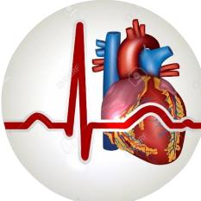
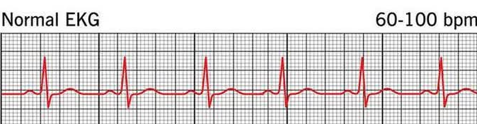
Premature Ventricular Complex(PVC)
Torsad de pontis (TdP)
Agonal Rhythms,
mISS haastrup Temitope

Slide 15
OUTLINE
Definition
Causes
Clinical features
ECG finding
Origin of PVC
Shape of PVC
Types of PVC

Slide 16
Premature Ventricular Complex (PVC)
Definition:
It occur as a result of irritation focuses on the ventricle
It is also called Ventricular premature beat and escape beat

Slide 17
Cause of PVC
Cardiac condition
Non-cardiac condition
Medication

Slide 18
Cardiac Condition
Hypertension induce LVH
Concentric LVH
Congenital heart disease
Acute myocardia infraction
Heart Attack
congestive heart disease
Heart Failure

Slide 19
Non-Cardiac Condition
Thyroid disease i.e hyperthyroidism
Gonadal disorder i.e hypo and hyper gonadal disorder
Electrolyte abnormality i.e hypocalcemia and hypomegnisum
Hypoxia
Sleep apnea
COPD (chronic obstructive pulmonary disease)
Pulmonary hypertension

Slide 20
Medication/Substance
Beta block drug
Antihistamin drug
cocain
caffein
Nicotin
Alcohol

Slide 21
Clinical Features
Asymptomatic
Palpitation
Syncope
Dizziness

Slide 22
ECG FINDING
Absence of P-wave
wide bizarre QRS complex > 0.12s
Compensatory pause-wave

Slide 23
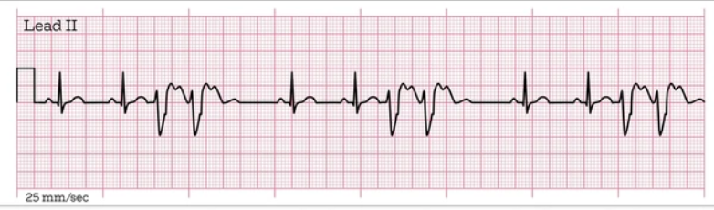
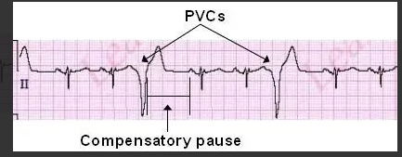

Slide 24
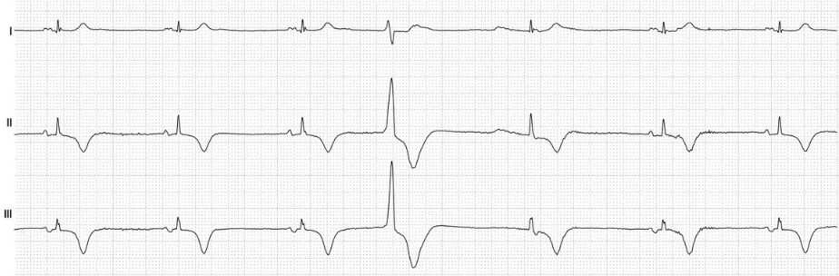

Slide 25
Origin of PVC
PVC arising from the right ventricle it will show a LBBB morphology
PVC arising from the base of the ventricle, it will show upright (Positive R-wave) in lead ii, iii and aVL (inferior lead)
PVC arising from the apex of the ventricle, it show downward displacement (negative deflection of R-wave) in lead ii,iii and aVL

Slide 26
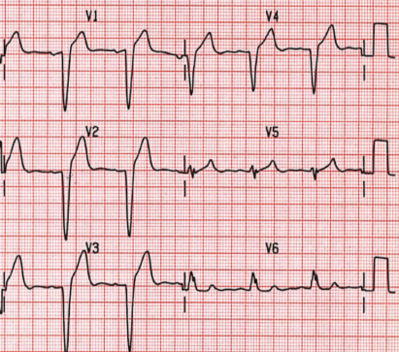
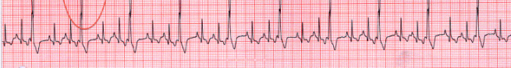

Slide 27
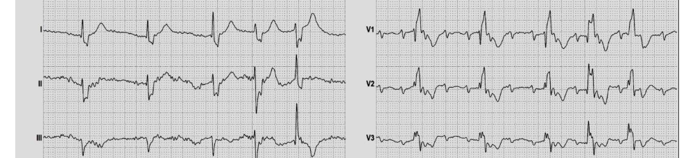

Slide 28
Shape of PVC
Unifocus: PVC with same shape (mono)
Mutifoci: PVC with different shape

Slide 29
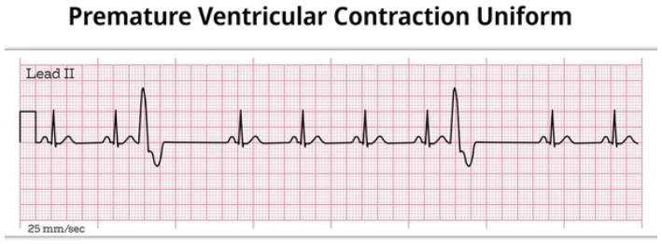
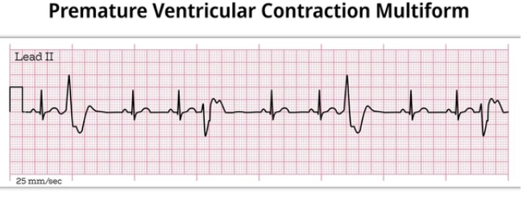

Slide 30
Types of PVC
Bigeminy
Trigeminy
Quadrigeminy
Ventricular tachycardia increase than 2PVC
Couplet two PVC occurring consentively

Slide 31
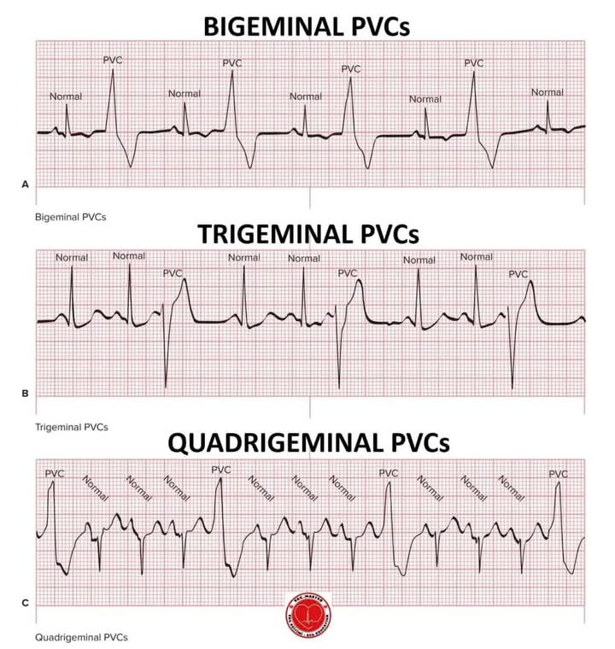

Slide 32
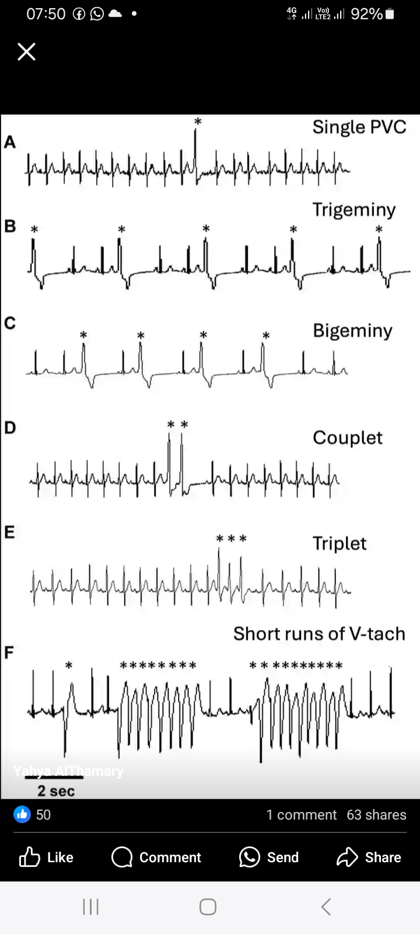
Types of PVC

Slide 33
TORSADE DE POINTES
It is an uncommon and distinctive form of polymorphic ventricular tachycardia (VT).
It is often referred as torsade and is associated with prolong QT interval
TDP starts in the heart’s lower chamber (ventricle)
Characterized by gradual change in the amplitude and twisting of the QRS complex around isoelectric line.
It may be acquired or congenital.
TDP may degenerate into ventricular fibrillation (VT).

Slide 34
SYMPTOMS
Palpitation
Dizziness
Syncope that corresponds to arrhythmia episodes

Slide 35
ECG FEATURE
QRS complex having twisting morphology around the isoelectric line
Heart rate > 220bpm
Presence of abnormal (“giant”) T- U waves may precede TDP.

Slide 36
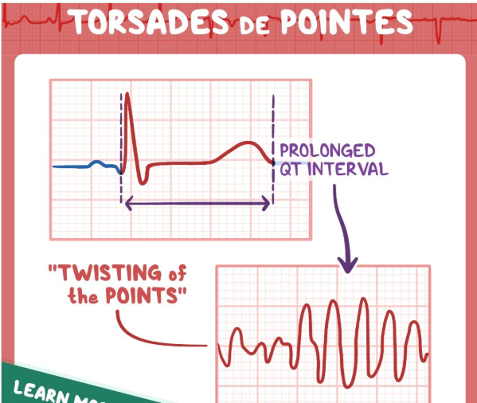

Slide 37
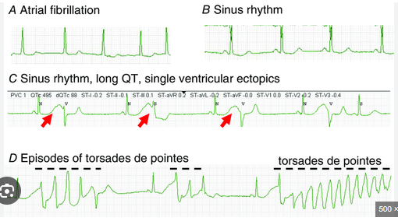

Slide 38
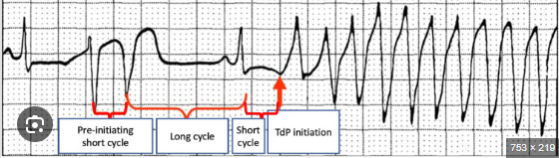

Slide 39
AGONAL RHYTHM
Definition:
Agonal rhythm is an abnormally slow, erratic rhythm originating from the heart’s lower chamber (ventricles).
It is a severe arrhythmia that occur after the heart’s upper chambers have stopped working.

Slide 40
AGONAL RHYTHM
Heart rate less than 20 bpm
No p-waves
Wide QRS complex

Slide 41
SYMPTOMS
Heart rate less than 20 bpm
Loss or losing of consciousness

Slide 42
CAUSES
Cardiac tamponade
Cardiac trauma
Ventricular fibrillation

Slide 43
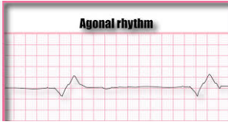

Slide 44
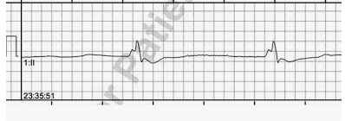

Slide 45
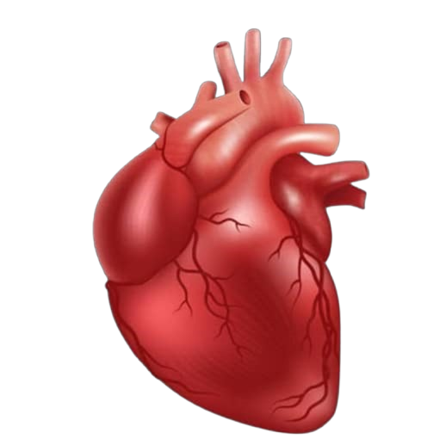
THANK YOU

