Slide 1
S.T.E.M.I AND N.S.T.E.M.I(S.T ELEVATION MYOCARDIAL INFARCTION AND NON-S.T SEGMENT MYOCARDIAL INFARCTION)
It is a type of heart attack caused by a complete blockage of a coronary artery.It is a medical emergency that requires immediate attention.
STEMI is diagnosed primarily using ECG.Findings are:
-Elevation of ST segment in two or more contiguous leads.
-Threshold for diagnosis
.>1mm in limb leads(I,II,III,aVL and aVF)
.>2mm in chest leads in men >40 years
.>1.5mm in chest leads (V2-V3)
-The elevation should be convex upwards or tombstone-shaped
-Pathologic Q waves
may develop later
sign of irreversible myocardial necrosis.
-T waves inversion
may follow ST elevation as part of evolution

Slide 2
STEMI
Localizing the STEMI on ecg .
Anterior wall(V1-V4) LEFT ANTERIOR DESCENDING(LAD)
Lateral wall(I,AVL,V5 and V6) LEFT CIRCUMFLEX(LCx)
Inferior wall (II,III and AVF.) RIGHT CORONARY ARTERY(RCA)
Posterior wall ST DEPRESSION IN V1-V3 RCA OR LCx(posterior branch)

Slide 3
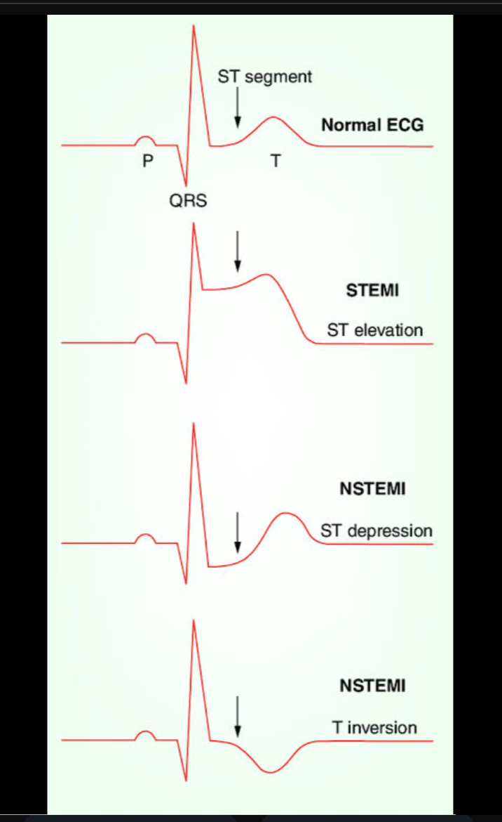

Slide 4
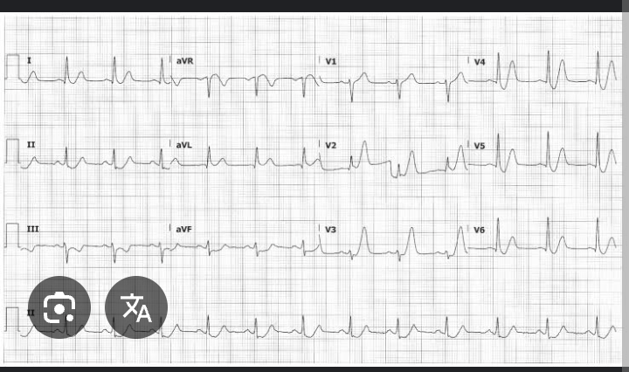

Slide 5
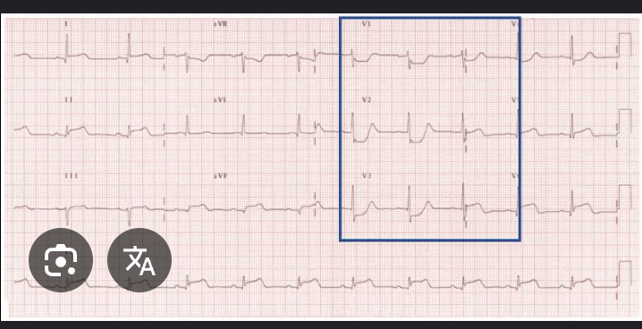

Slide 6
