Slide 1
Music Genre Classification Using Machine Learning
Abtahi Chowdhury

Slide 2
Music Information Retrieval (MIR)
Science of retrieving information from music
Applications:
Automated music recommendation system
Music recognition systems
Music generation
Music classification
Speech recognition

Slide 3
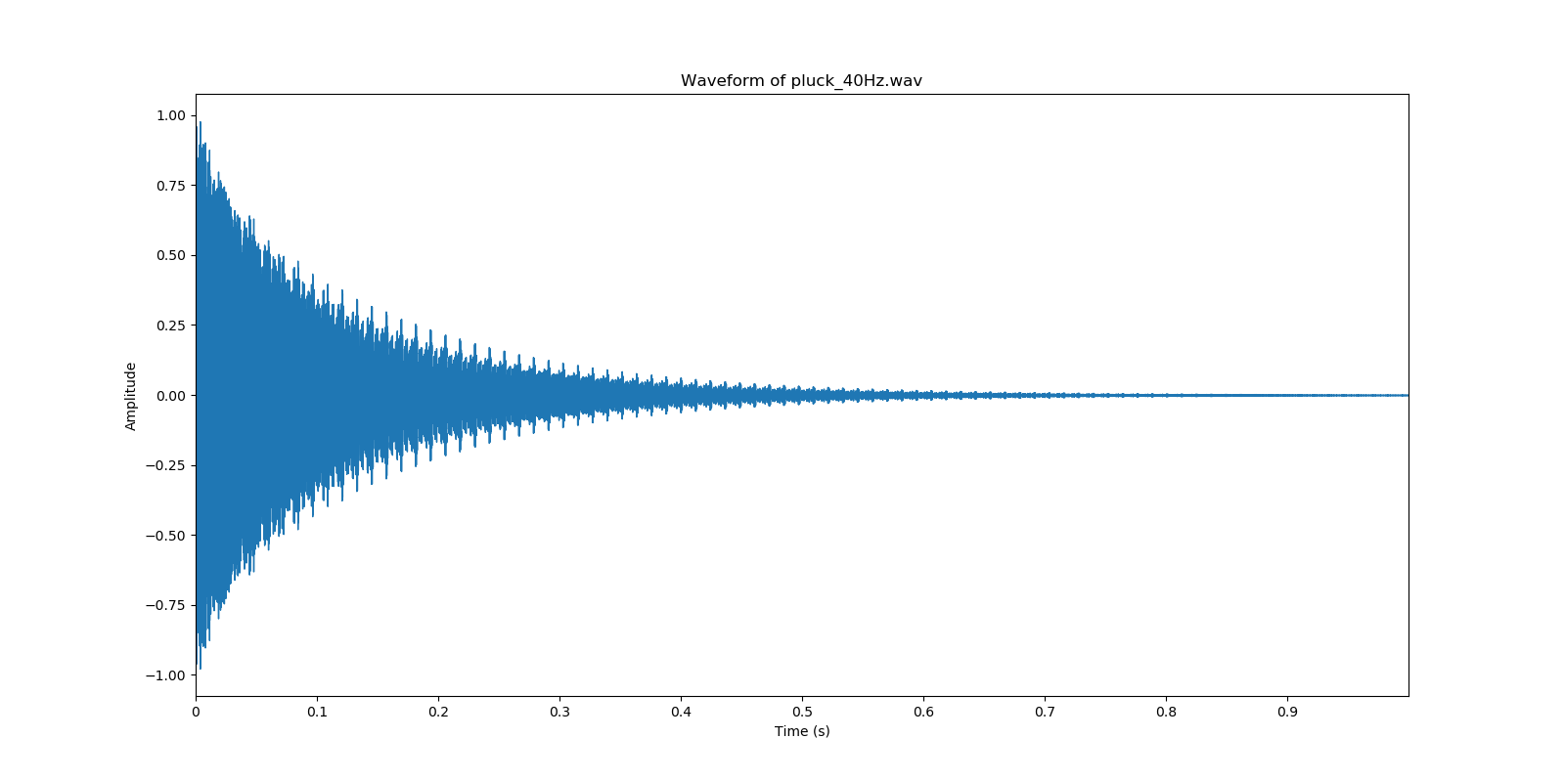
Audio Representation - Waveform

Slide 4
Fast Fourier Transform and Short Time Fourier Transform
Fast Fourier Transform (FFT)
Used to convert time domain audio signal data into frequency domain data
Loses time information
Short Time Fourier Transform (STFT)
Computes FFT of fixed durations at fixed intervals of the audio data
Preserves time information

Slide 5
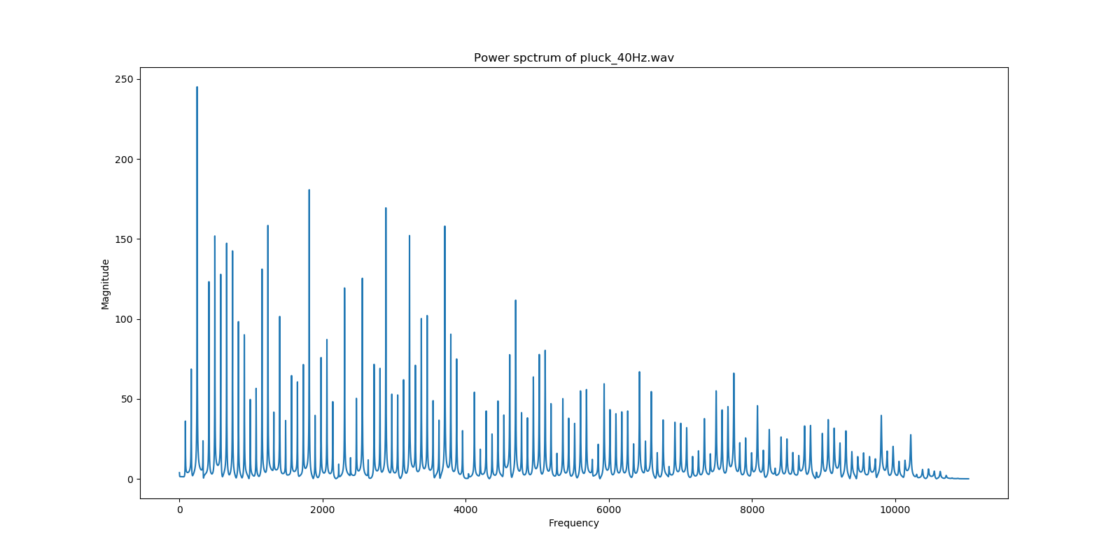
Audio Representation - Spectrum

Slide 6
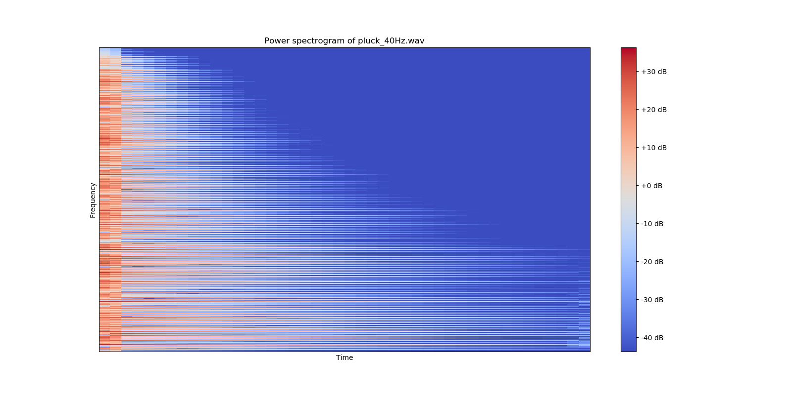
Audio Representation - Spectrogram

Slide 7
Traditional ML Preprocessing
Amplitude envelope
0-crossing rate
Spectral flux
Spectral centroid
Etc.
Machine Learning Model

Slide 8
Modern ML Preprocessing - MFCC
Mel-Frequency Cepstral Coefficients
Designed to mimic the human auditory system by modeling the timbre (a.k.a. the perceived sound quality) of audio data
Used extensively in speech recognition and music classification
Calculating MFCCs
Perform the fft on the audio data at that frame
The output spectrum is then run through a mel-scaling function to convert the frequencies into a perceptual pitch scale.
The output of the mel-spectral spectrum is then run through a log-scaling function to smooth out the amplitude.
Finally a discrete cosine transformation (DCT) is performed on the mel-spectral log-scaled coefficients.
Keep a certain amount of these resultant coefficients and discard the rest. Generally for music analysis around 13-40 coefficients are kept.

Slide 9
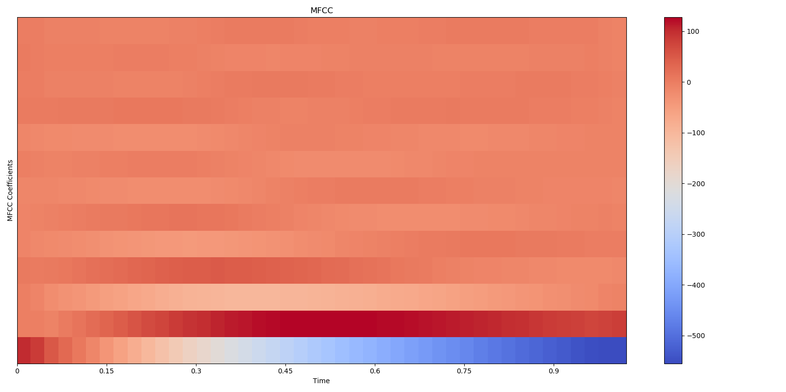
MFCC Plot

Slide 10
Dataset and Models Used
GTZAN music dataset
10 genres, 100 30-second clips per genre
http://marsyas.info/downloads/datasets.html
Models used
K-Nearest Neighbors
Support Vector Machines
Neural Network
Convolutional Neural Network
Long Short Term Memory Recurrent Neural Network

Slide 11
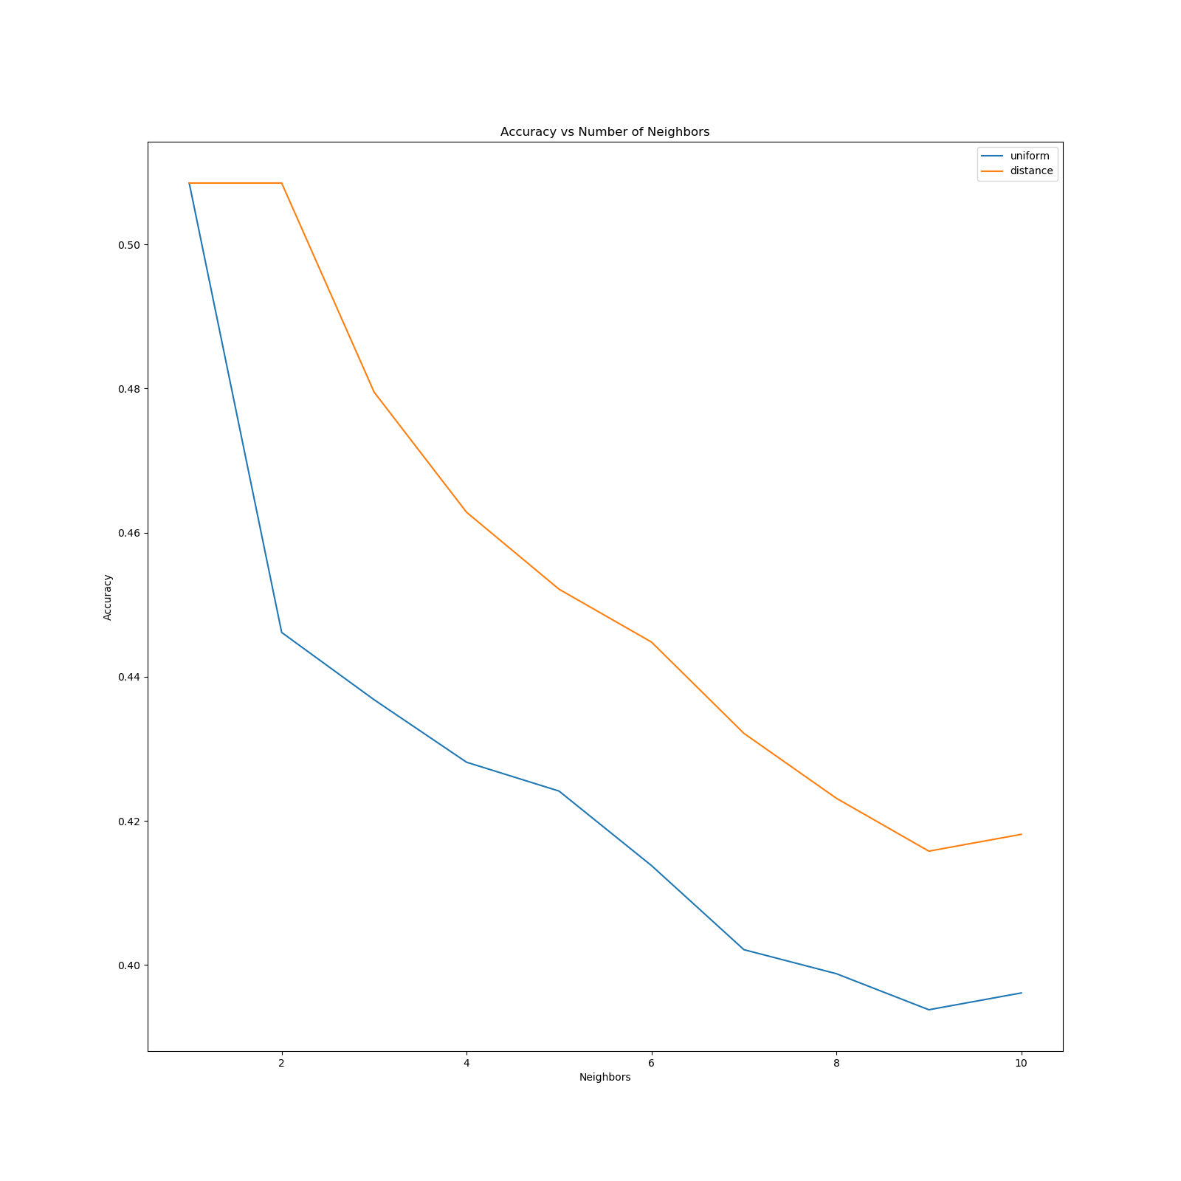
K-Nearest Neighbors - Accuracy
Tested Uniform and Distance weights
Ranges number of neighbors from 1 to 10

Slide 12
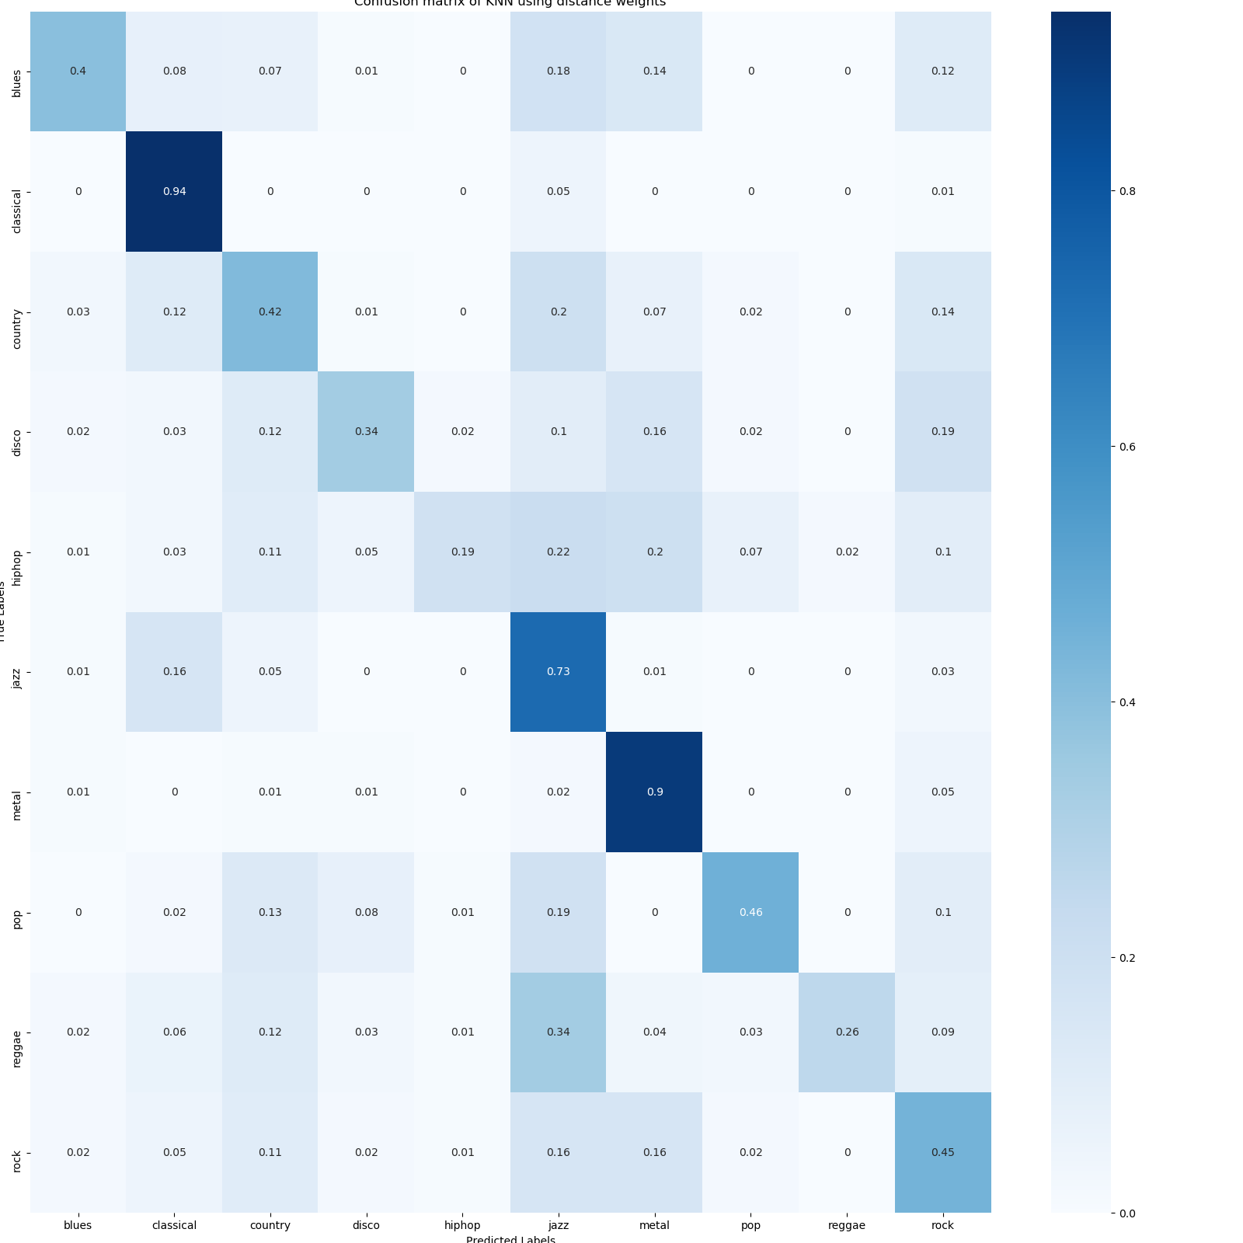
K-Nearest Neighbors - Confusion Matrix

Slide 13
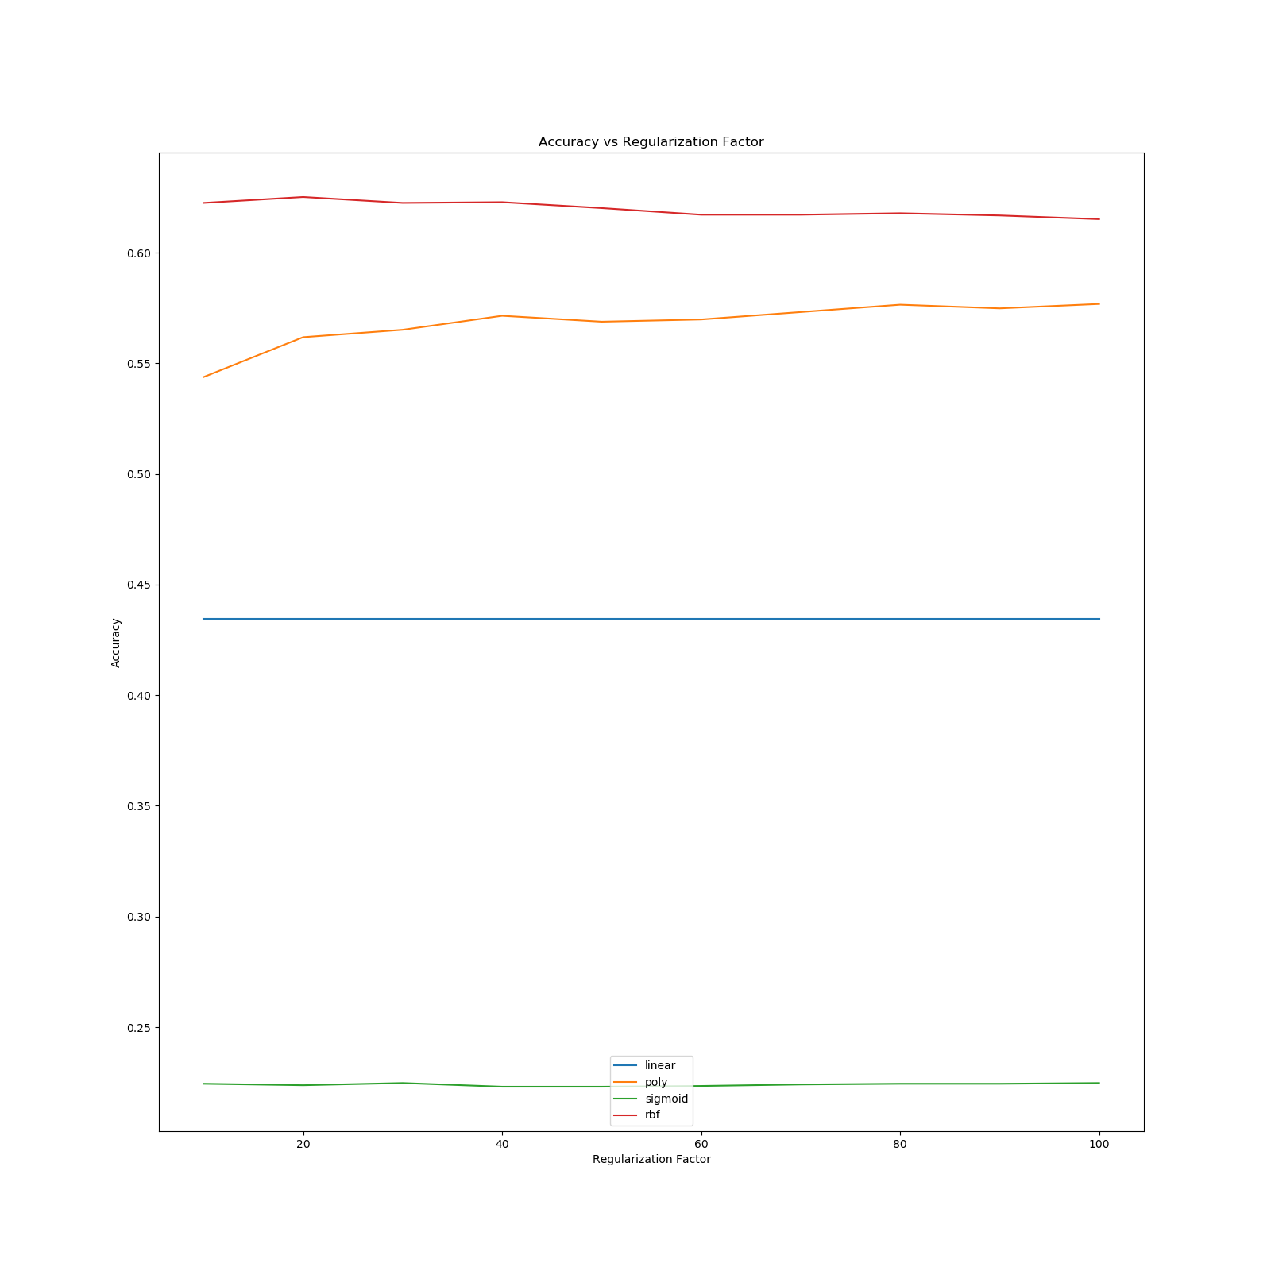
Support Vector Machine
Tested linear, poly, sigmoid, and rbf kernel
Ranged regularization factor from 10 - 100 with step size of 10

Slide 14
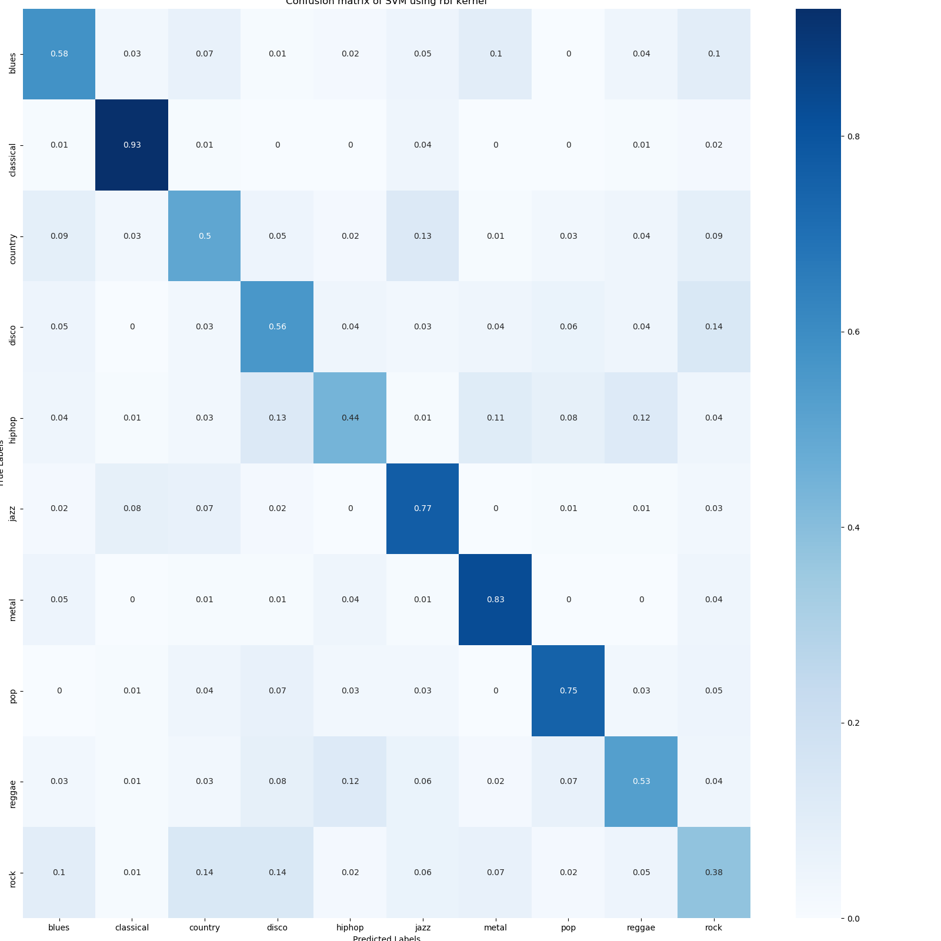
Support Vector Machine - Confusion Matrix

Slide 15
Neural Network
Optimizer
Adam optimizer with learning rate 0.0001
Loss
Sparse categorical crossentropy
Layers
Flatten layer
Dense layer
512 units
Relu activation function
L2 regularizer with factor of 0.001
Dropout layer with 30% dropout rate
Dense layer
256 units
Relu activation function
L2 regularizer with factor of 0.001
Dropout layer with 30% dropout rate
Dense layer
64 units
Relu activation function
L2 regularizer with factor of 0.001
Dropout layer with 30% dropout rate
Dense layer
10 units
Softmax activation function

Slide 16
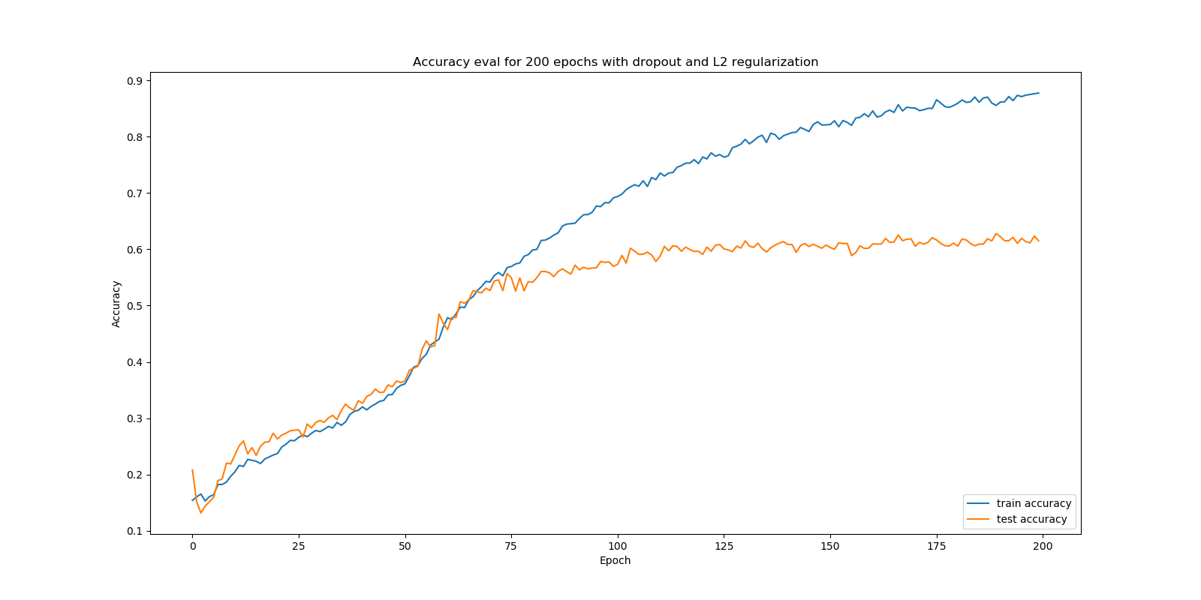
Neural Network - Accuracy

Slide 17
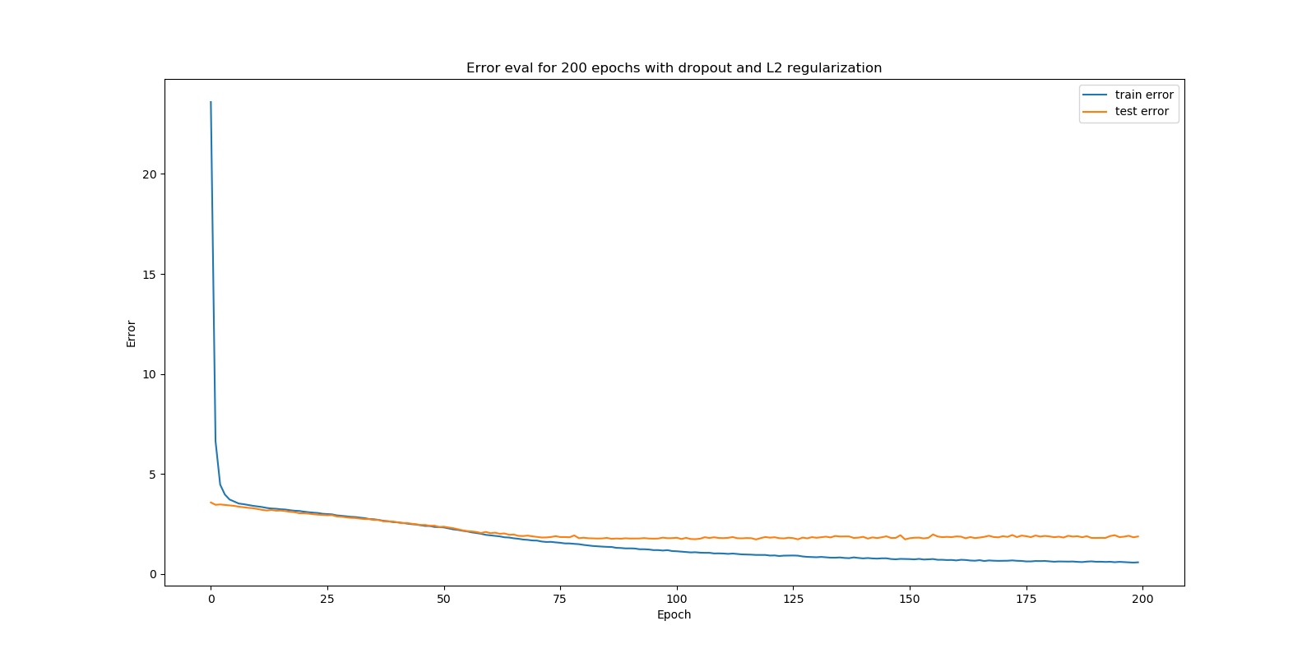
Neural Network - Error

Slide 18
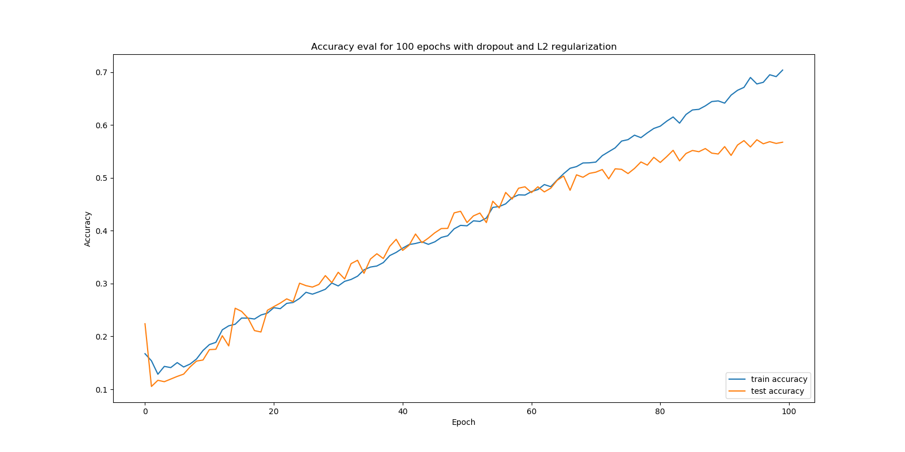
Neural Network - Accuracy

Slide 19
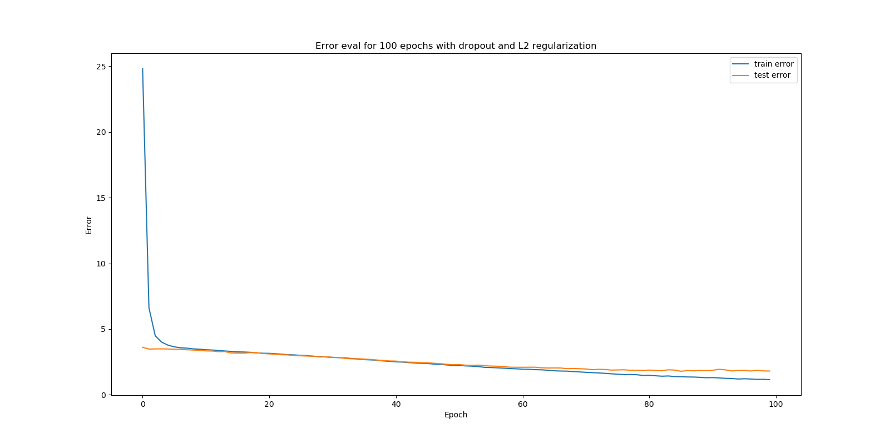
Neural Network - Error

Slide 20
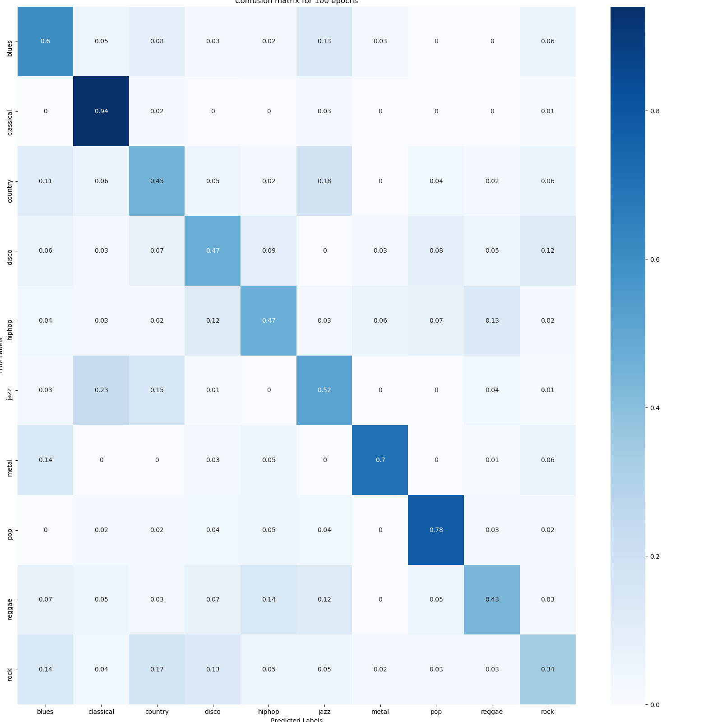
Neural Network - Confusion Matrix

Slide 21
Convolutional Neural Network
MaxPool2D layer
2x2 pool size
2x2 strides
Same padding
Batch Normalization layer
Flatten layer
Dense layer
64 units
Relu activation
Dropout layer with 30% dropout rate
Dense layer
10 units
Softmax activation function
Layers
Conv2D layer
32 filters
3x3 kernel size
Relu activation
MaxPool2D layer
3x3 pool size
2x2 strides
Same padding
Batch Normalization layer
Conv2D layer
32 filters
3x3 kernel size
Relu activation
MaxPool2D layer
3x3 pool size
2x2 strides
Same padding
Batch Normalization layer
Conv2D layer
32 filters
2x2 kernel size
Relu activation
Optimizer
Adam optimizer with learning rate 0.0001
Loss
Sparse categorical crossentropy

Slide 22
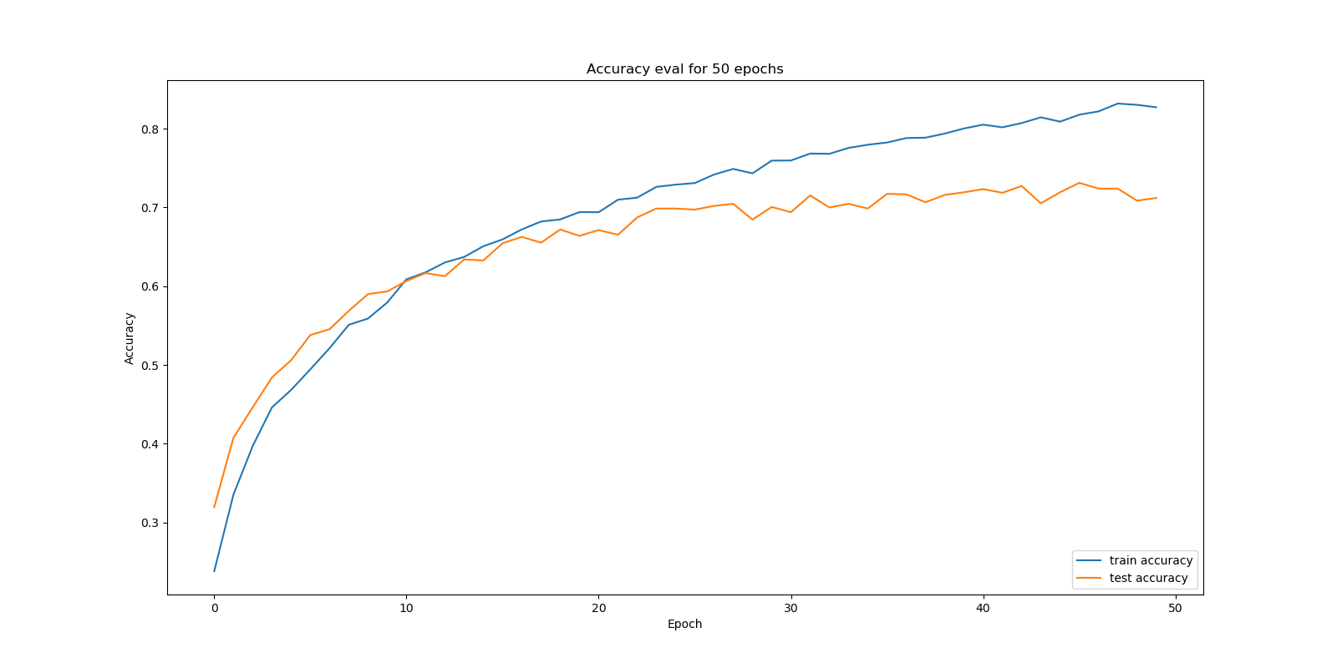
Convolutional Neural Network - Accuracy

Slide 23
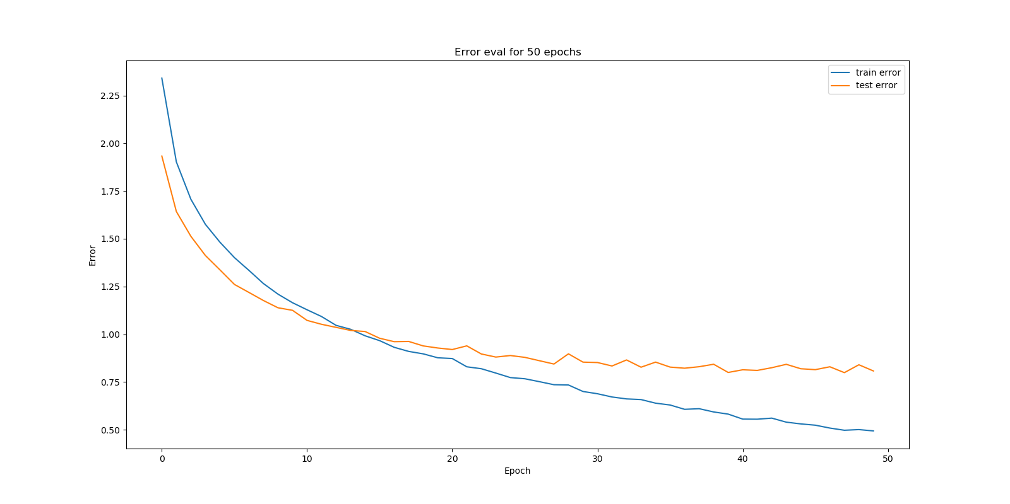
Convolutional Neural Network - Error

Slide 24
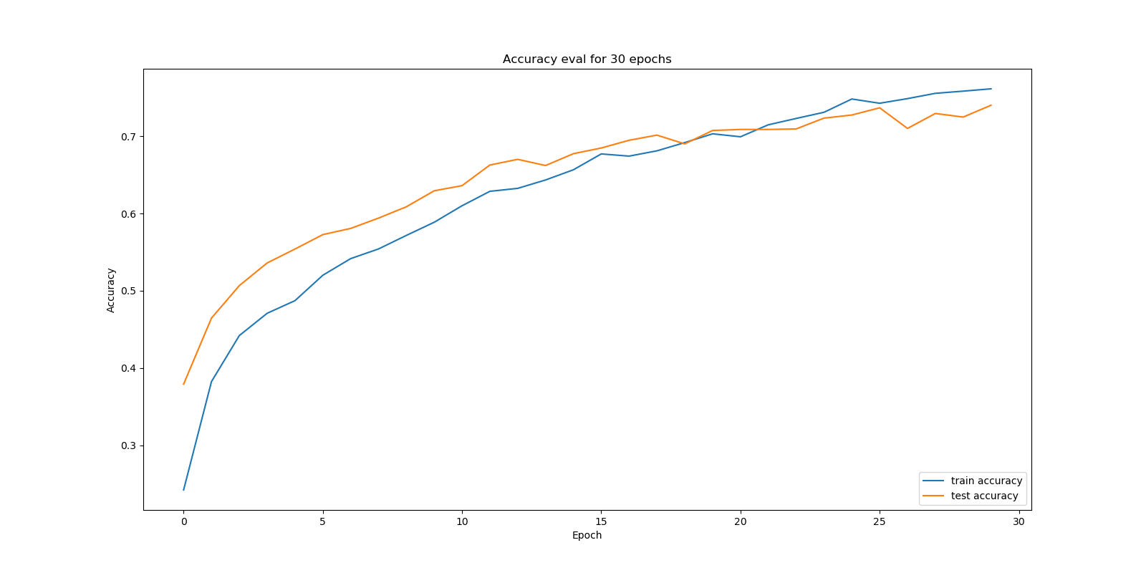
Convolutional Neural Network - Accuracy

Slide 25
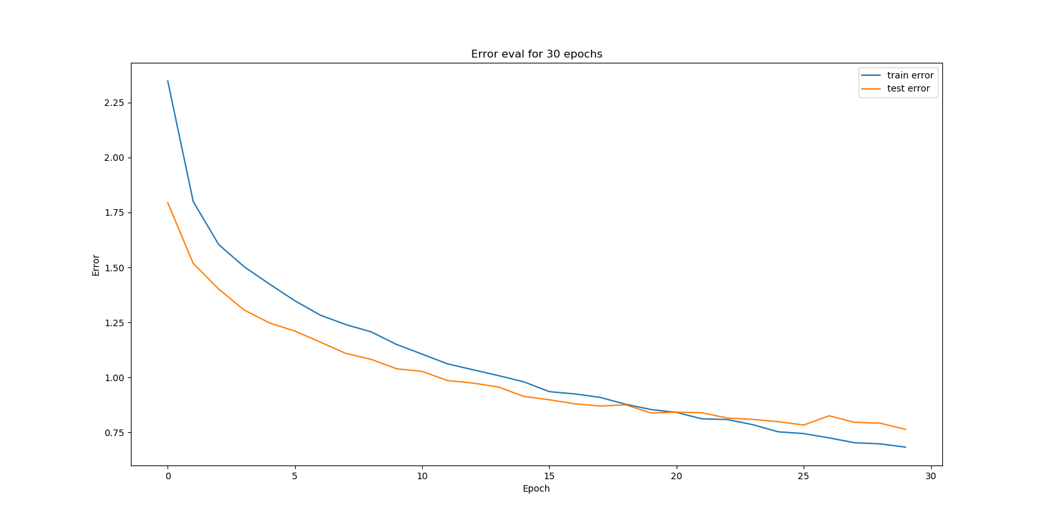
Convolutional Neural Network - Error

Slide 26
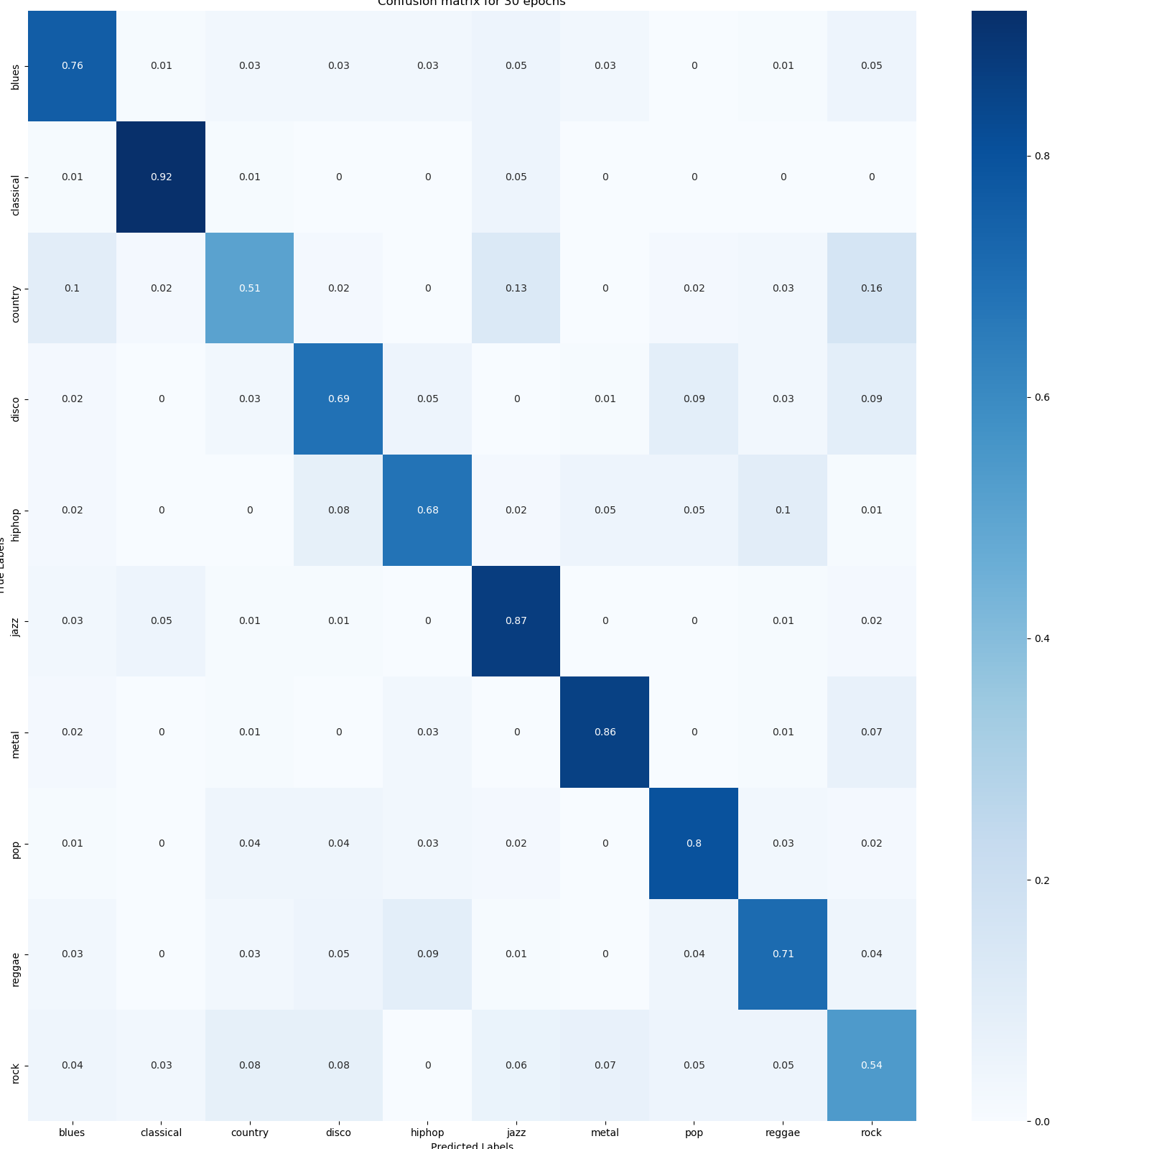
Convolutional Neural Network - Confusion Matrix

Slide 27
Recurrent Neural Network
Optimizer
Adam optimizer with learning rate 0.0001
Loss
Sparse categorical crossentropy
Layers
LSTM layer
64 units
Return sequence set to true
LSTM layer
64 units
Dense layer
64 units
Relu activation
Dropout layer with 30% dropout rate
Dense layer
10 units
Softmax activation function

Slide 28
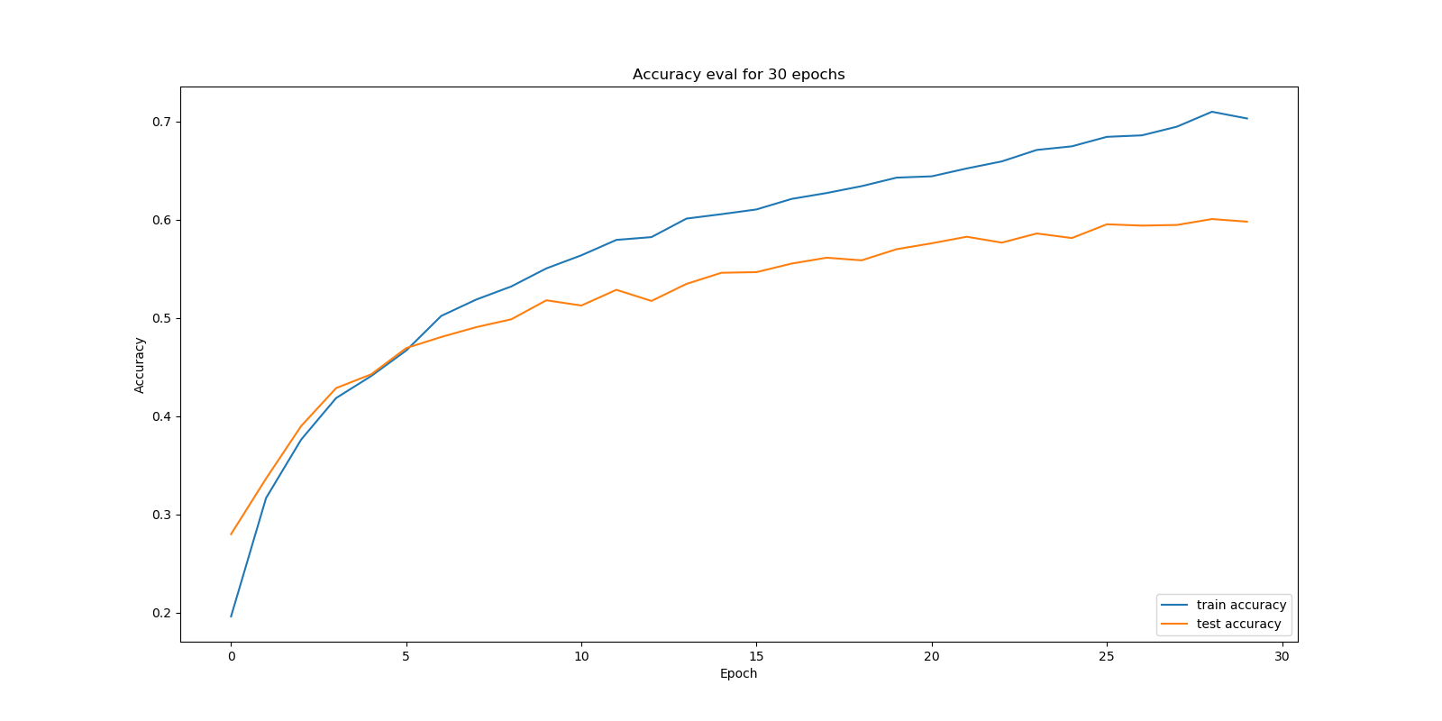
Recurrent Neural Network - Accuracy

Slide 29
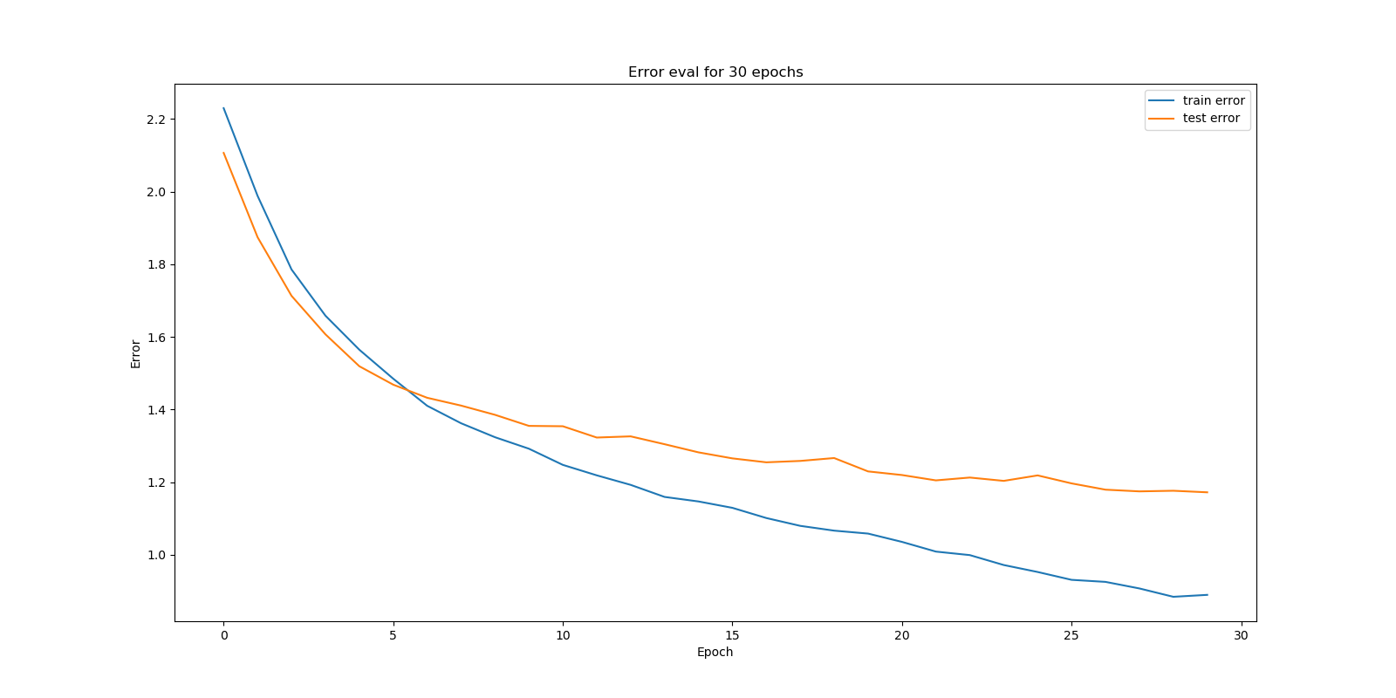
Recurrent Neural Network - Error

Slide 30
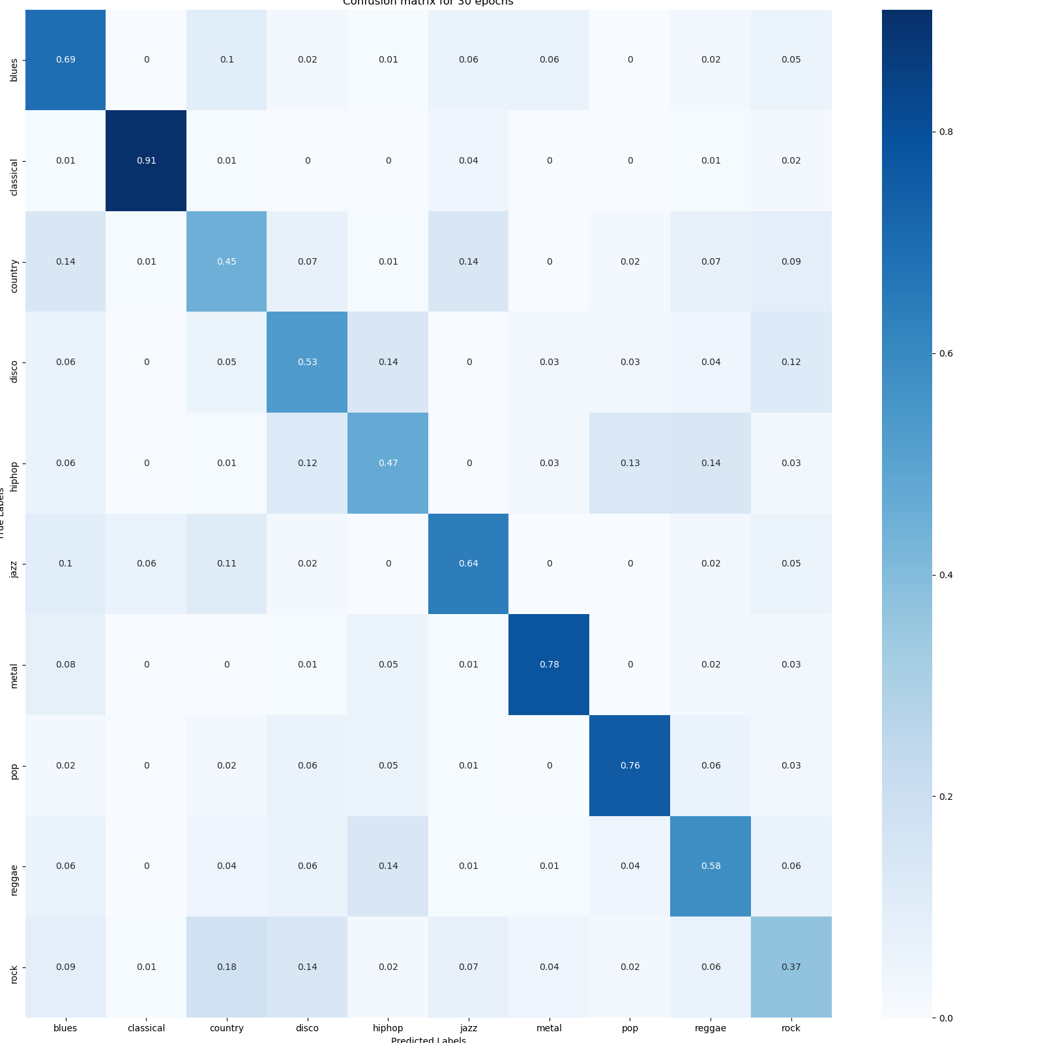
Recurrent Neural Network - Confusion Matrix

Slide 31
Final Results
Model | Accuracy
K-Nearest Neighbor | 0.55
Support Vector Machine | 0.64
Neural Network | 0.59
Convolutional Neural Network | 0.70
Recurrent Neural Network | 0.61

Slide 32
Future Projects
LSTM model supports varying feature lengths
Try running on real world data (i.e. full length songs)
Use LSTM for music generation

Slide 33
Questions

