Slide 1
MOBILE APP DEVELOPMENT
MOBILE MONEY
WALLET
A simple way to track money received and money spent.
Project team: Mubiru Twaha • Ssentongo Steven • Nalwanga Shadia
GitHub repository: https://github.com/Abtwahitwaha/MOBILE-MONEY-WALLET
01

Slide 2
01 | What is the idea?
A personal record of mobile money activity
Keep your money activity in one place.
My Wallet
• Register and log in securely
• Record income and expenses
• Organise transactions by category
• View transaction history and spending patterns
• Edit or delete a transaction when needed
AVAILABLE BALANCE
UGX 250,000
Money received
+ 80,000
Transport
− 10,000
Airtime
− 5,000
Illustrative app concept
02

Slide 3
02 | What problem are we solving?
From guessing to understanding spending
It can be difficult to remember where mobile money goes.
Hard to remember
No clear spending picture
Scattered records
Users may forget small payments, transfers, or money received.
Without records, it is harder to see how much is spent by category.
Transaction details may be spread across messages, notes, or memory.
Our solution: one simple app to record, organise and review personal money activity.
Note: The app records transactions for tracking; it does not itself transfer or hold money.
03

Slide 4
03 | Team members and roles
Three members • Clear responsibilities
Mubiru Twaha
Ssentongo Steven
Nalwanga Shadia
BACKEND LEAD
• REST API and database
• Authentication and protected endpoints
FLUTTER LEAD
• App screens and navigation
• Forms and API integration
ANALYST & INTEGRATION LEAD
• Requirements and ERD
• API documentation, testing and integration
We will coordinate our work through a shared GitHub repository.
04

Slide 5
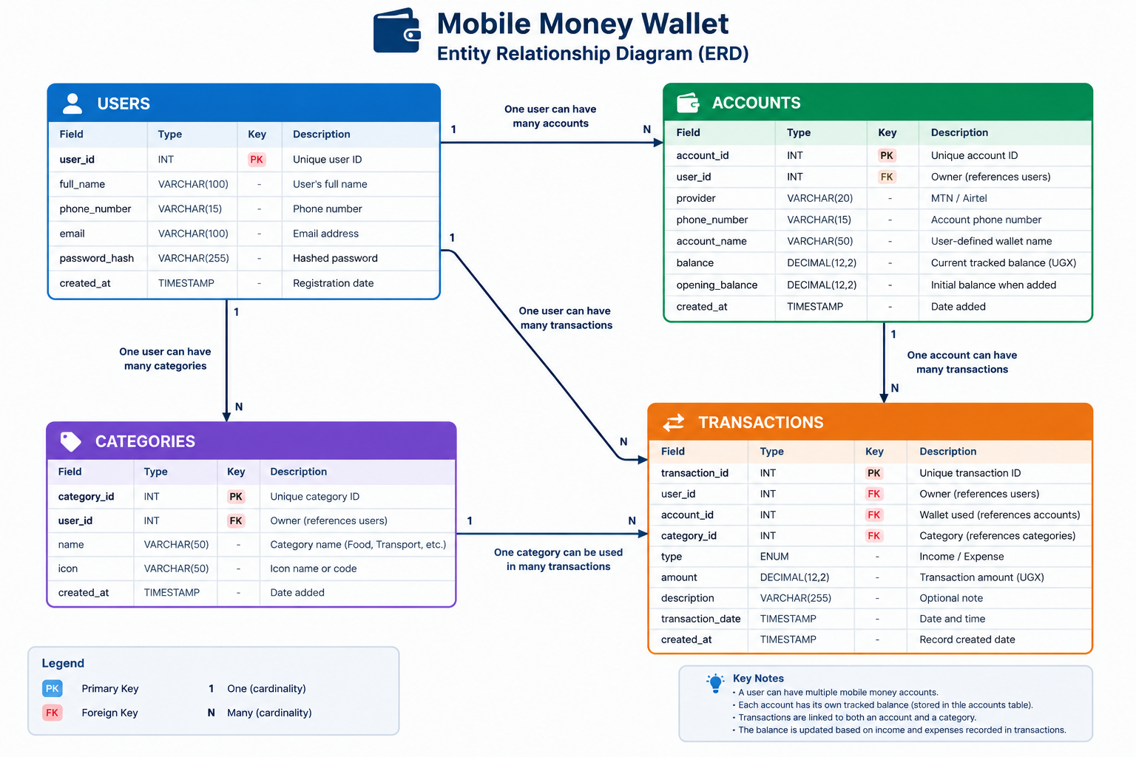
Database design | ERD
Four core tables and their relationships
PK = Primary Key • FK = Foreign Key • 1:M = One-to-many relationship
05

Slide 6
04 | GitHub working link
Our repository will contain the source code, database design, API documentation and project files.
https://github.com/Abtwahitwaha/MOBILE-MONEY-WALLET
Thank you!
Mobile Money Wallet — track it, understand it, manage it.
Questions?
06

