Slide 1
DATE-A-SCIENTIST
Predicting Traits from 60,000 OkCupid Profiles
Income · Relationship Status · Sex — three predictive modeling case studies
A Technical Walkthrough

Slide 2
Dataset at a Glance
OkCupid dating profiles — demographics, self-reported lifestyle habits, and ten free-text essay prompts.
59,946
31
10
3
Profiles
Data fields
Essay questions
Traits predicted
Three modeling exercises test how well profile data predicts income (financial), relationship status (platform behavior), and sex (physical trait) — each with very different results.
Date-A-Scientist
2

Slide 3
How We Built the Models
1
Feature engineering
Ordinal-encode lifestyle habits (drinks, smokes, drugs, education). One-hot encode categoricals (job, diet, body type). Engineer essay length as a proxy for profile effort.
2
Train / test split
80/20 split per task, stratified where classes are imbalanced. Numeric features scaled with MinMaxScaler before fitting.
3
Models
Linear / Logistic Regression for an interpretable baseline; K-Nearest Neighbors as a non-parametric comparison on every task.
Date-A-Scientist
3

Slide 4
01
Predicting Income
Can lifestyle traits predict what someone earns?
Date-A-Scientist
4

Slide 5
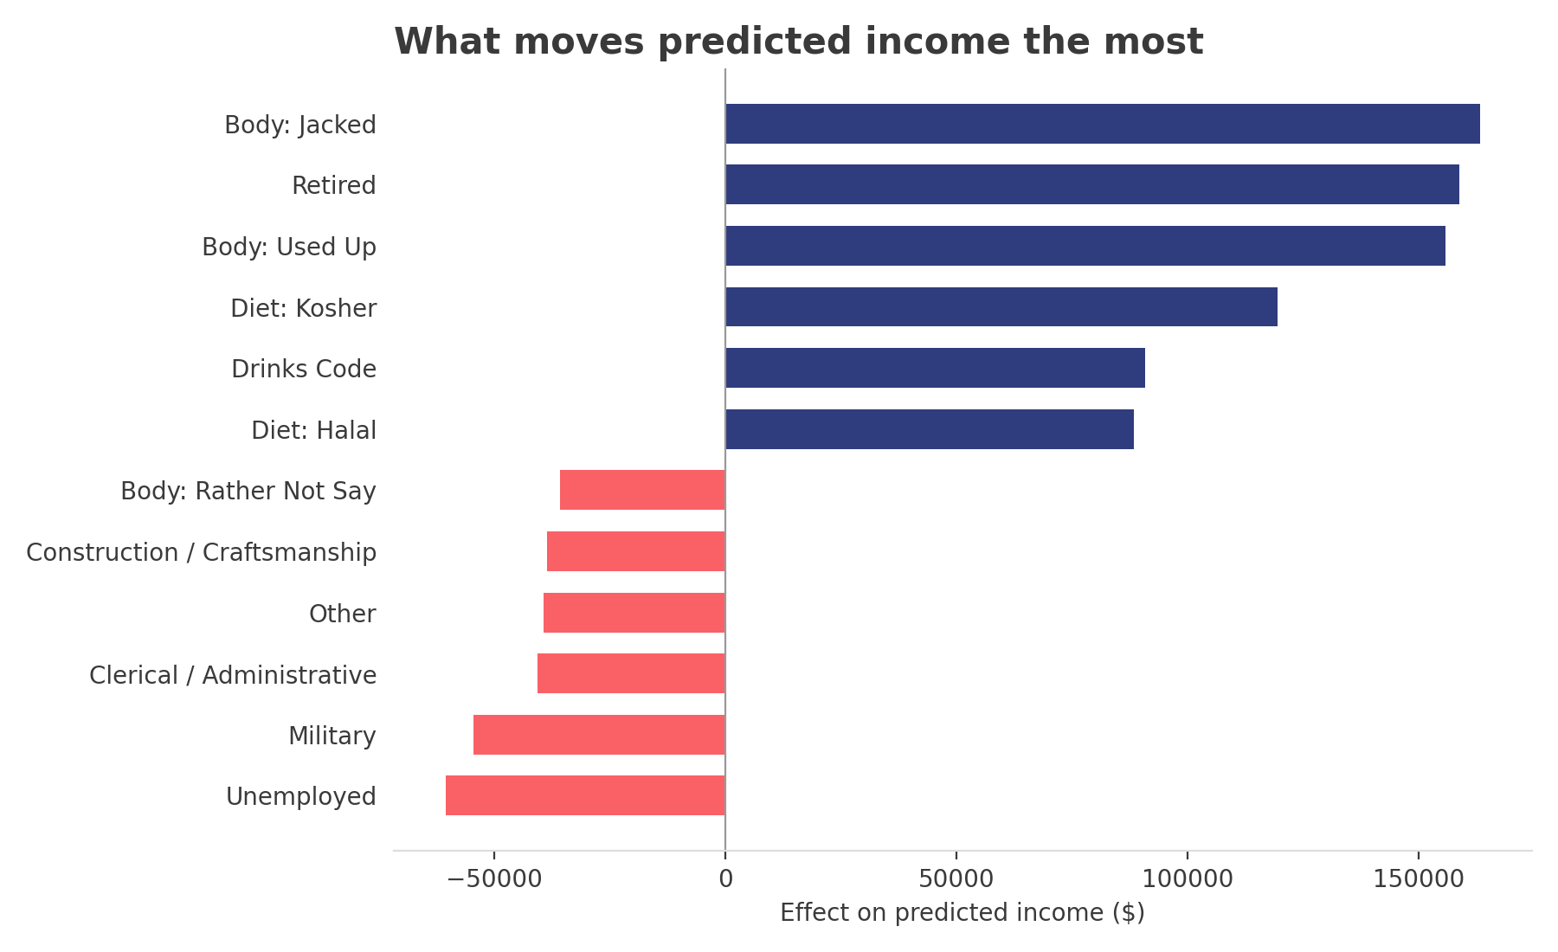
Income Is Barely Predictable
19.2%
of profiles report an income
R² = 0.075
Linear Regression (best model)
±$88.7K
typical prediction error (MAE)
Limitation: only 11,504 of 59,946 profiles disclose income, and reported values are bucketed into round numbers ($20K, $50K, $100K…) rather than measured continuously — that caps how well any model can fit, regardless of algorithm.
Part 1 — Income
5

Slide 6
02
Predicting Relationship Status
Does the platform itself distort what we can learn?
Date-A-Scientist
6

Slide 7
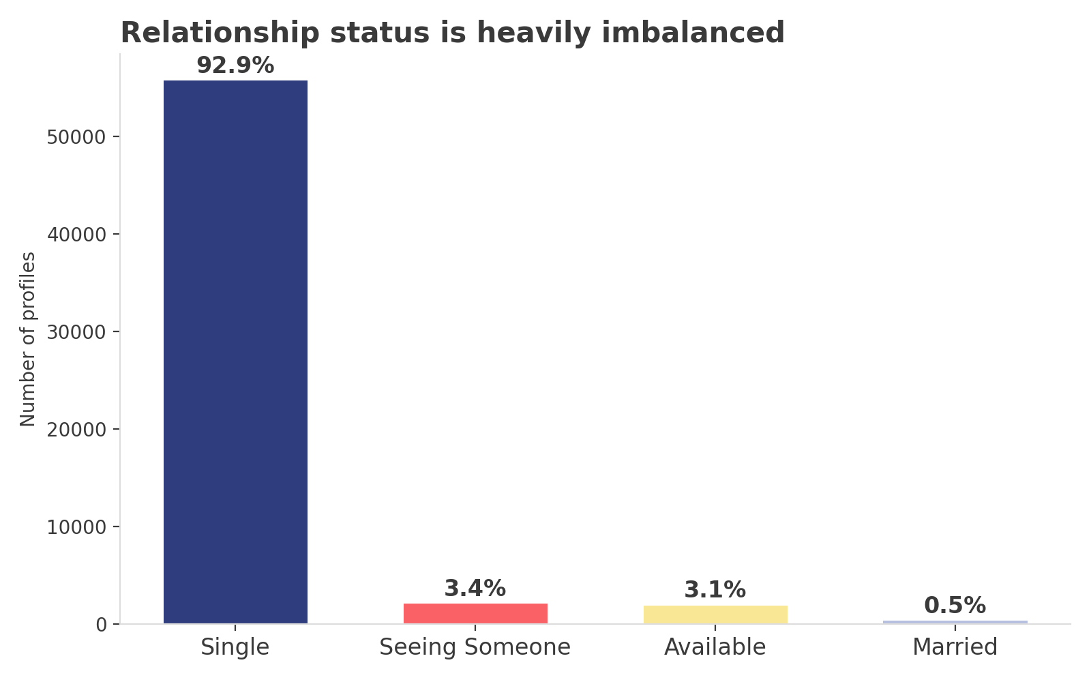
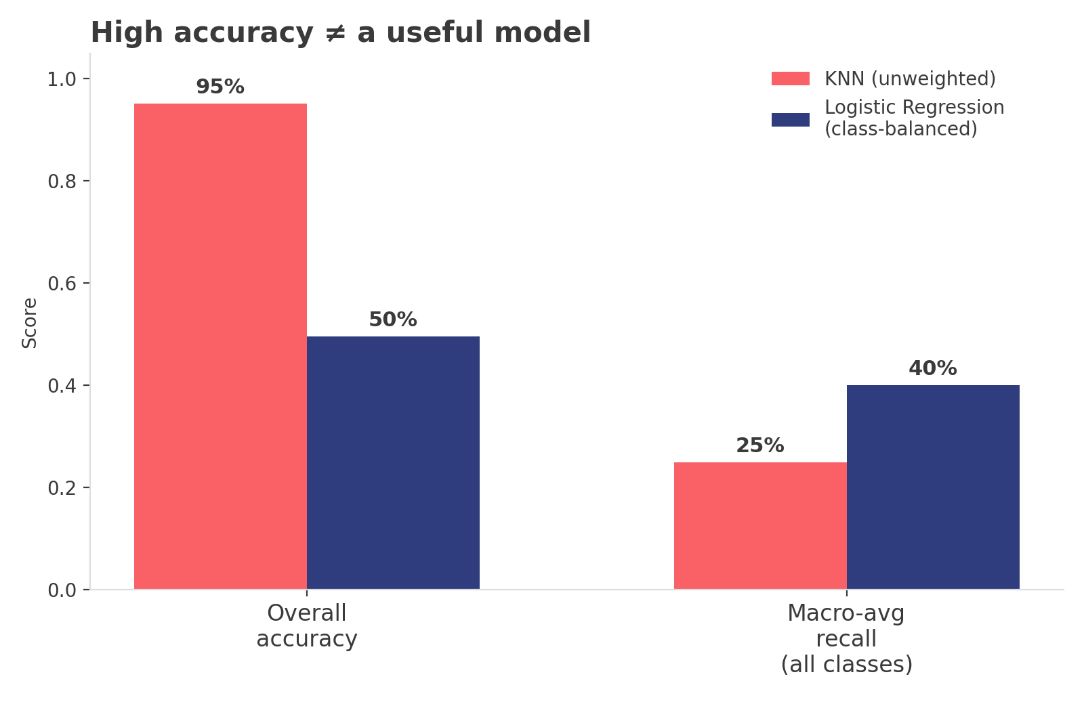
Beware the Accuracy Paradox
93% of profiles are simply “single.” A model can look excellent while ignoring every minority class.
KNN hits 95.2% accuracy by always predicting “single” — 0% recall on married, seeing someone, or available. Class-balanced Logistic Regression trades accuracy (49.6%) for actually detecting them.
Part 2 — Relationship Status
7

Slide 8
03
Predicting Sex
A target free of platform bias — does the model finally work?
Date-A-Scientist
8

Slide 9
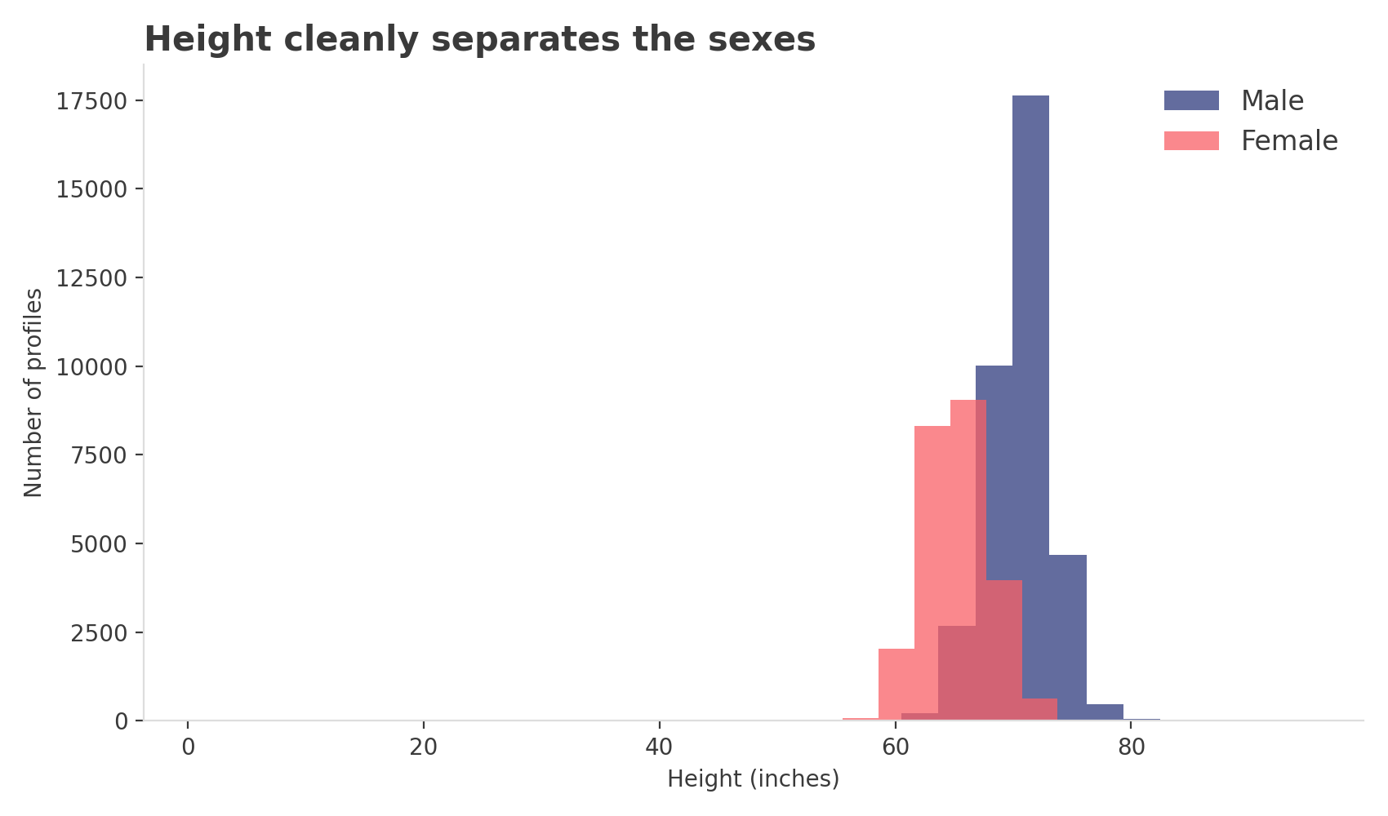
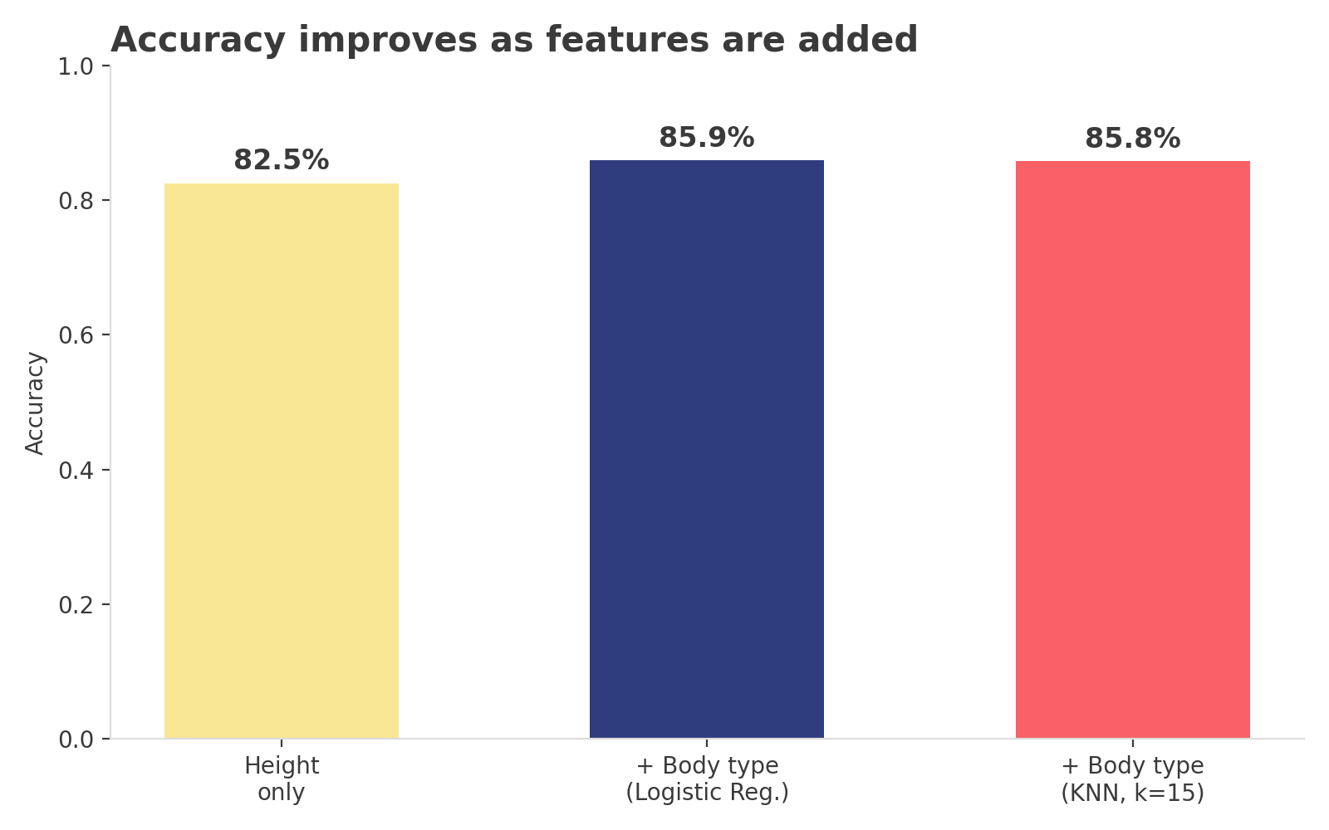
A Model That Actually Works
86%
60 / 40
0.85 / 0.81
accuracy (height + body type)
male / female split — balanced
F1-score, male / female — no collapse
Part 3 — Sex
9

Slide 10
Three Targets, Three Outcomes
Target | Type | Best Result | Verdict
Income | Regression | R² ≈ 0.08 | Weak — undisclosed & bucketed
Relationship Status | Classification (4-class, 93/5/3/1) | 95% accuracy, ~0% minority recall | Misleading — accuracy paradox
Sex | Classification (~60/40 split) | 86% accuracy, balanced precision/recall | Strong — real, balanced signal
The pattern across all three: model quality tracked signal strength and class balance — not algorithm choice.
Date-A-Scientist
10

Slide 11
The Takeaway
1
Signal strength matters most
Height genuinely predicts sex; lifestyle habits don't genuinely predict income.
2
Class balance matters as much as accuracy
A 93/7 imbalance makes accuracy alone meaningless — check per-class recall.
3
Algorithm choice matters less than the data
Linear/Logistic Regression and KNN landed in the same place on every task.
Date-A-Scientist — Predicting Traits from OkCupid Profiles

