Slide 1

AI vs. AI: Detecting Deepfake Voices
Md Rabiul Hasan
2410234
Dept. of CSE, University of Oulu
Abu Taher
2410233
Dept. of CSE, University of Oulu
Yushun Xiao
Researcher
Machine vision and signal analysis

Slide 2
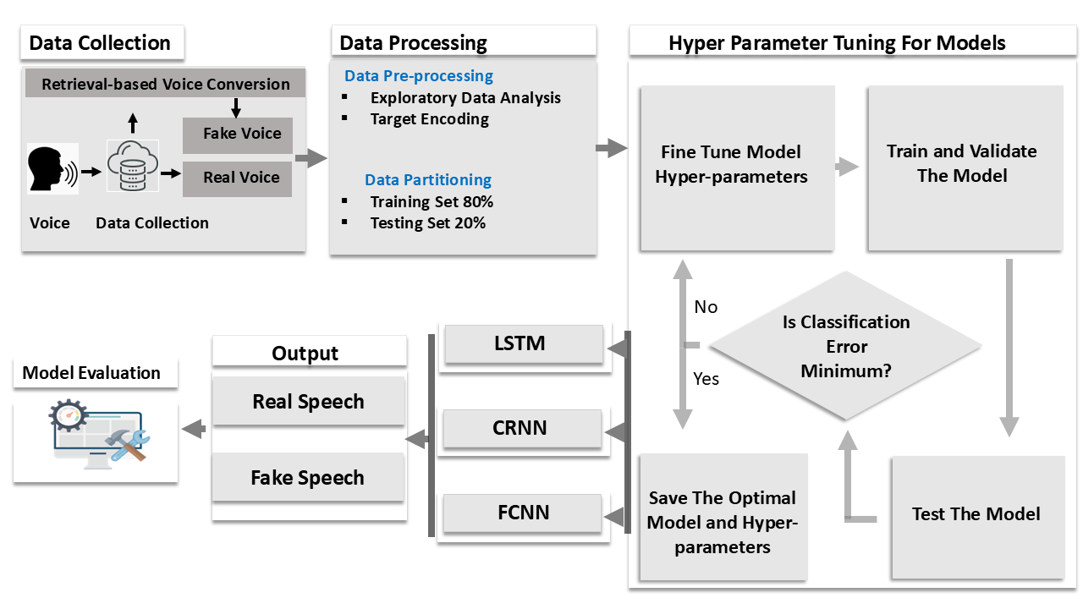
Proposed Method
Fig1: Proposed methodology for deep fake speech detection

Slide 3
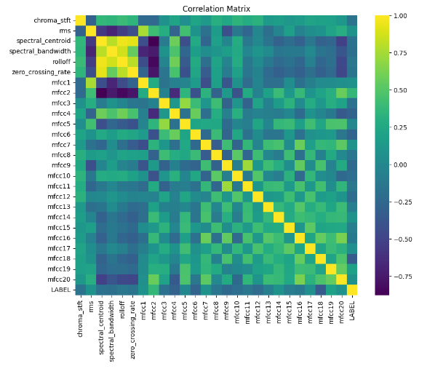
Data Processing
Fig 2: Correlation matrix for the features

Slide 4
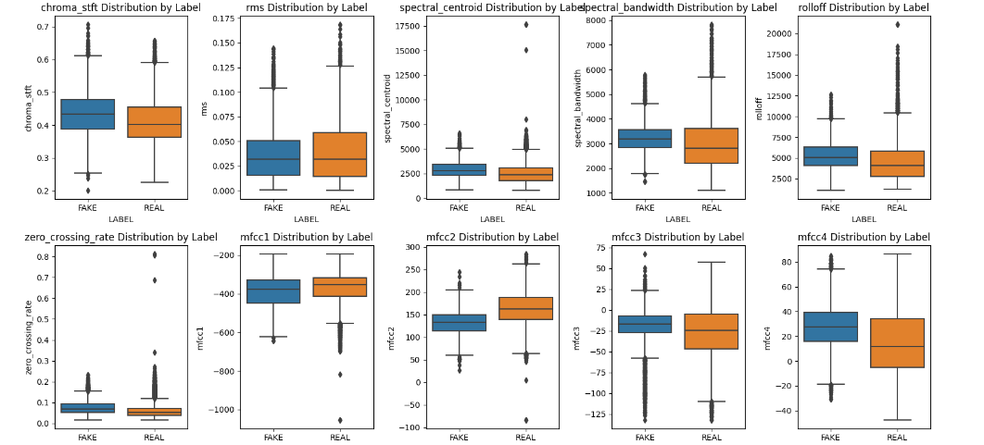
Data Processing

Slide 5
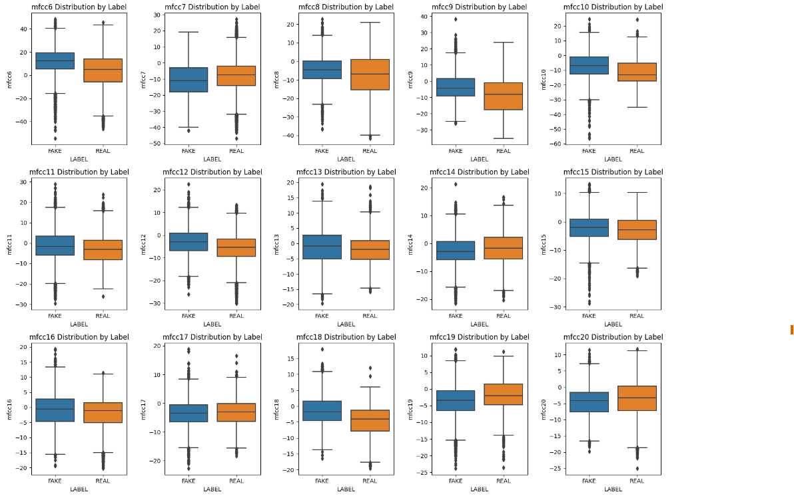
Data Processing
Fig 3: Box plot of features related to speech emotion

Slide 6
Emotion Analysis
Table 1: Significant features related to speech emotion
Feature | P value
chroma stft | 1.255482e-67
rms | 6.812161e-15
spectral centroid | 5.306269e-74
spectral bandwidth | 3.118181e-96
rolloff | 2.509645e-49
zero crossing rate | 3.000349e-65
mfcc1 | 6.695210e-16
mfcc2 | 0.000000e+00

Slide 7
Hyper Parameter Training for Models
Table 2: Hyperparameters of LSTM, CRNN, and FCNN models.
Hyperparameter | LSTM | CRNN | FCNN
Learning Rate | 0.0001 | 0.0001 | 0.0001
Batch Size | 32 | 32 | 32
Number of Layers | 2 | 4 | 2
Dropout Rate | 0.3 | 0.3 | 0.5
Optimizer | Adam | Adam | Adam
Epochs | 100 | 50 | 100
Activation Function | ReLU | ReLU | ReLU

Slide 8
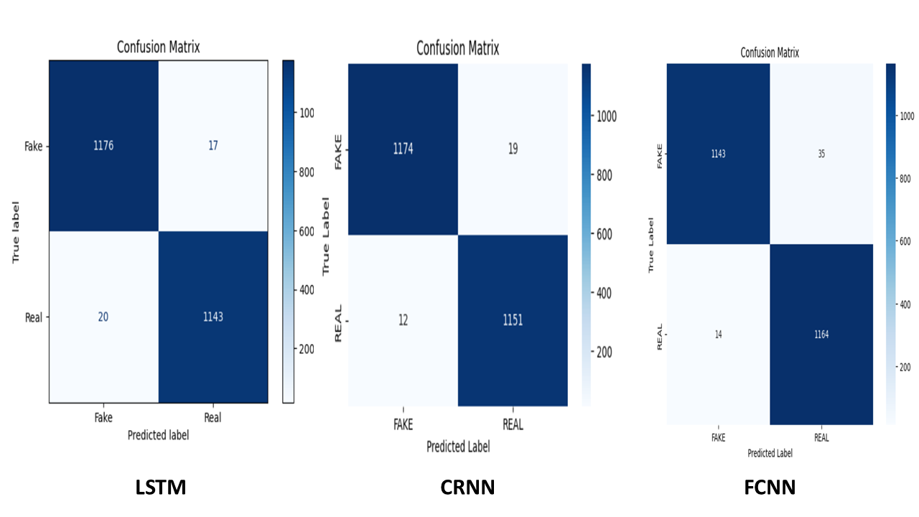
Result Analysis
Confusion Metrics of Individual Models
Fig 4: Confusion metrics of LSTM, CRNN and FCNN models

Slide 9
Result Analysis
Table 3: Performance comparison of different models
Model | Accuracy | Precision |  | Recall |  | F1-score
 |  | 0 | I | 0 | 1 | 0 | I
LSTM | 98 | 98 | 99 | 99 | 98 | 98 | 98
CRNN | 99 | 99 | 98 | 98 | 99 | 99 | 99
FCNN | 98 | 99 | 97 | 97 | 99 | 98 | 98

Slide 10
Result Analysis
Accuracy Comparison of LSTM, CRNN and FCNN models
Fig 5: Accuracy comparison of LSTM, CRNN and FCNN models

Slide 11
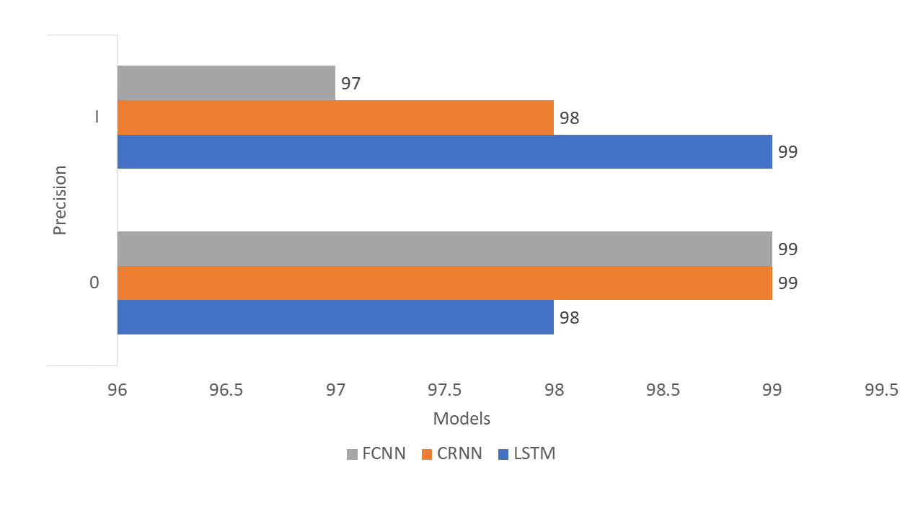
Result Analysis
Precision Comparison of LSTM, CRNN and FCNN models
Fig 6: Precision comparison of LSTM, CRNN and FCNN models

Slide 12
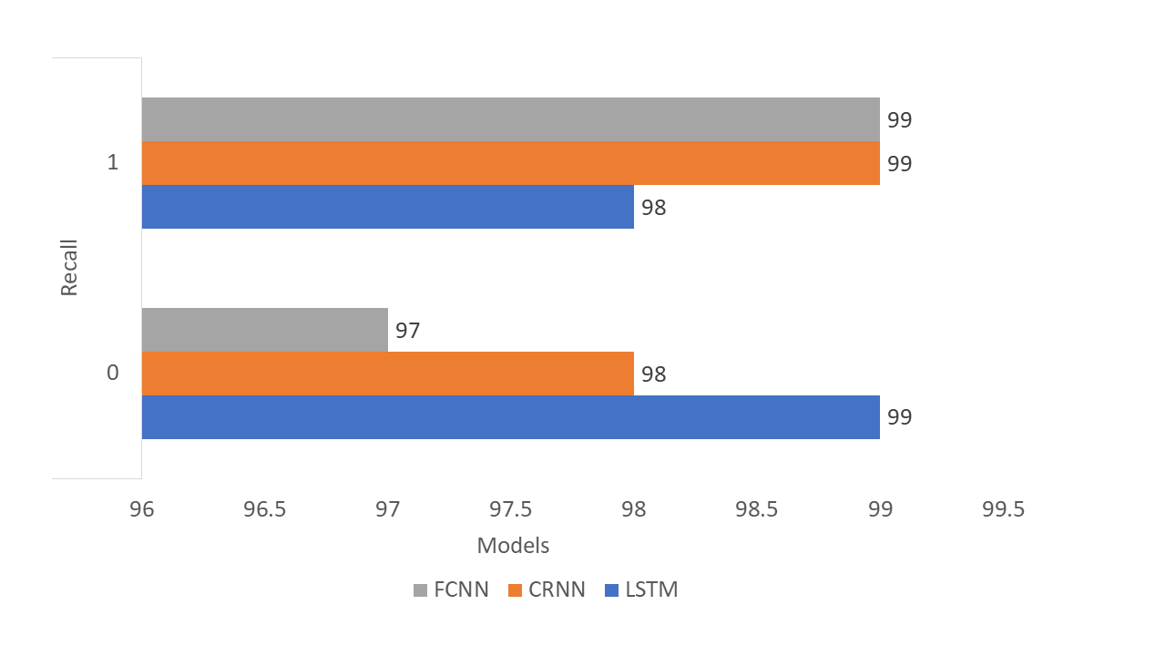
Result Analysis
Recall Comparison of LSTM, CRNN and FCNN models
Fig 7: Recall comparison of LSTM, CRNN and FCNN models

Slide 13
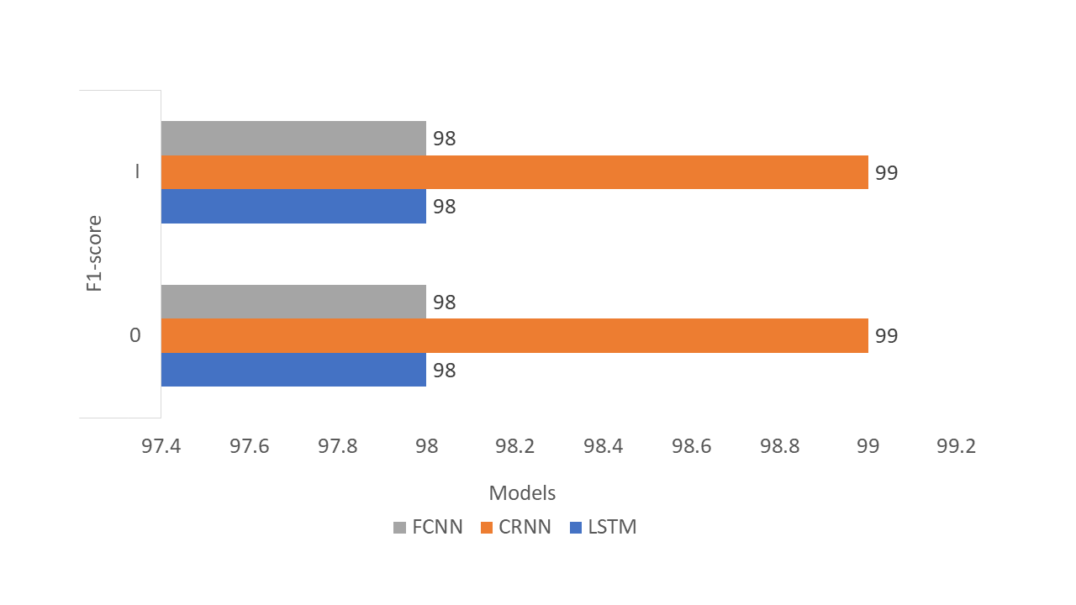
Result Analysis
F1-score Comparison of LSTM, CRNN and FCNN models
Fig 8: F1-score comparison of LSTM, CRNN and FCNN models

Slide 14
Future Work
Incorporate our proposed model in a web application
Test our model for huge volume of dataset

Slide 15
Conclusion
The performance of deep learning models has been evaluated
The outcome CRNN model is good comparing to existing models
We have optimized the model more accurately and precisely

Slide 16
References
[1] Yunfei Chu, Jin Xu, Qian Yang, Haojie Wei, Xipin Wei,Zhifang Guo, Yichong Leng, Yuanjun Lv, Jinzheng He,
Junyang Lin, et al. Qwen2-audio technical report. arXiv preprint arXiv:2407.10759, 2024.
[2] Phillip L De Leon, Bryan Stewart, and Junichi Yamagishi. Synthetic speech discrimination using pitch pattern
statistics derived from image analysis. In Proc. Interspeech: Portland, Oregon, USE. 20.
[3] Jingyi Deng, Chenhao Lin, Pengbin Hu, Chao Shen, Qian Wang, Qi Li, and Qiming Li. Towards benchmarking and evaluating deepfake detection. IEEE Transactions on Dependable and Secure Computing, pages 1–16, 2024..
[4] Thien-Phuc Doan, Long Nguyen-Vu, Souhwan Jung, and Kihun Hong. Bts-e: Audio deepfake detection
using breathing-talking-silence encoder. In ICASSP 2023-2023 IEEE International Conference on Acoustics, Speech and Signal Processing (ICASSP), pages 1–5. IEEE, 2023.
[5] Yihui Fu, Luyao Cheng, Shubo Lv, Yukai Jv, Yuxiang Kong, Zhuo Chen, Yanxin Hu, Lei Xie, Jian Wu, Hui Bu, et al. Aishell-4: An open source dataset for speech enhancement, separation, recognition and speaker diarization in conference scenario. arXiv preprint arXiv:2104.03603, 2021

