Slide 1
Antenna Engineering Laboratory
ECE-3208
Dual Band Dipole Antenna
Presented By:
Ayesha Sultana_1709001
Faijah Rashid_1709002
Abu Taher_1709003
Project Supervisor:
Dr. Md. Mostafizur Rahman
Professor, Dept of ECE, KUET
Md. Ebtidaul Karim
Lecturer, Dept of ECE, KUET

Slide 2
Contents
Aim of the Design
Theory
Input Parameters
Calculated Parameters
Technical Objectives
Design Optimization
Output Considerations
Design Accuracy
Finally
S- parameter
Reference Impedance
VSWR
Gain
Directivity
Radiation Patter (1-D & 2-D)

Slide 3
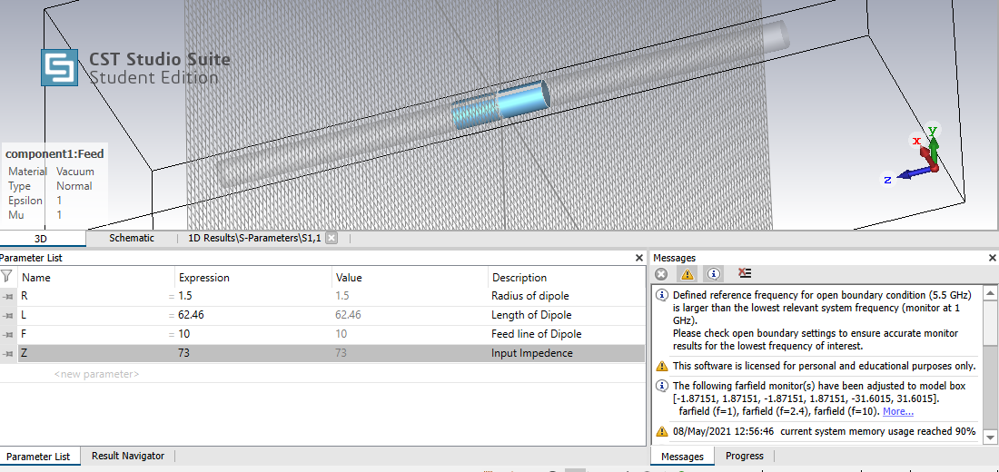
AIM OF THE DESIGN
Our aim is to design and simulate a basic dual band dipole antenna on a particular frequency and study radiation properties and frequency response with the help of various antenna parameters.
The process is done with the help of CST simulator Software.

Slide 4
Theory
Consists of two identical conductive elements
Lowest impedance
Voltage and current varies along the radiating section
Resonant condition

Slide 5
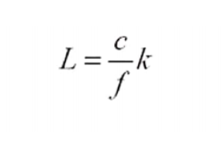

Input Parameters
Length of the Dipole
Where,
L= length of dipole
f= frequency of dipole antenna
c= velocity of light
k= adjustment factor ( generally 0.95)
= wavelength of dipole antenna
Radius of the Dipole
r=

Slide 6

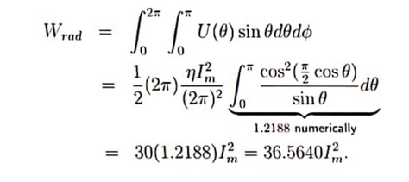

Input Parameters
Input Impedance of the dipole
Radiation Intensity of the dipole,
Radiated Power by the antenna,
Input Impedance, Z=

Slide 7
Calculated Parameters
Frequency of the antenna= 2.4 GHz
Symbols | Value | Description
R | 1.5 | Radius of Dipole
L | 62.46 | Length of Dipole
F | 10 | Feed line of Dipole
Z | 73 | Input Impedance of Dipole

Slide 8
Technical Objectives
To design a dual band dipole antenna, the following parameters should be considered-
Radiation Pattern
Frequency Response
Gain

Slide 9
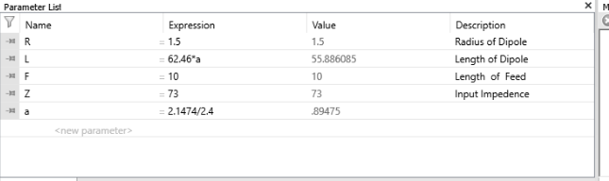
Design Optimization

Slide 10
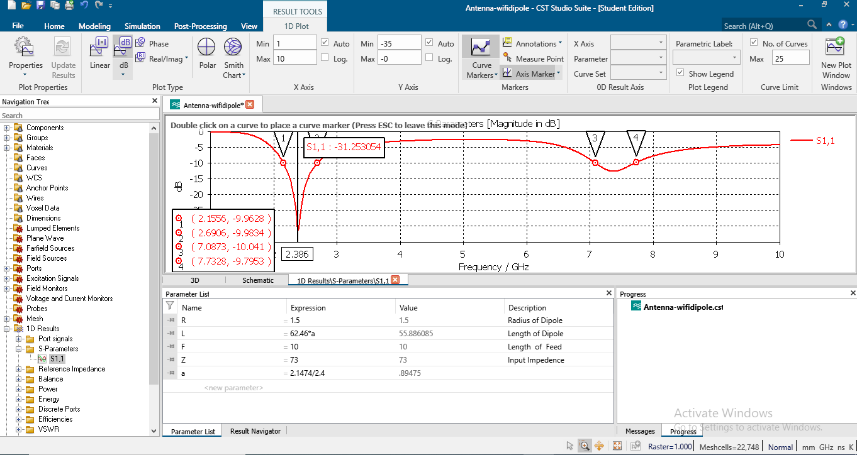
Output Considerations
S-parameter
Fig-01: S-parameter of dual band dipole antenna

Slide 11
Bandwidth Calculation from S-parameters
Dual Band dipole antenna
Hence, there will be two bandwidths
From the previous figure,
BW1= (2.6906-2.1556)
= 0.535 GHz
BW1= (7.7328-7.0873)
= 0.645 GHz

Slide 12
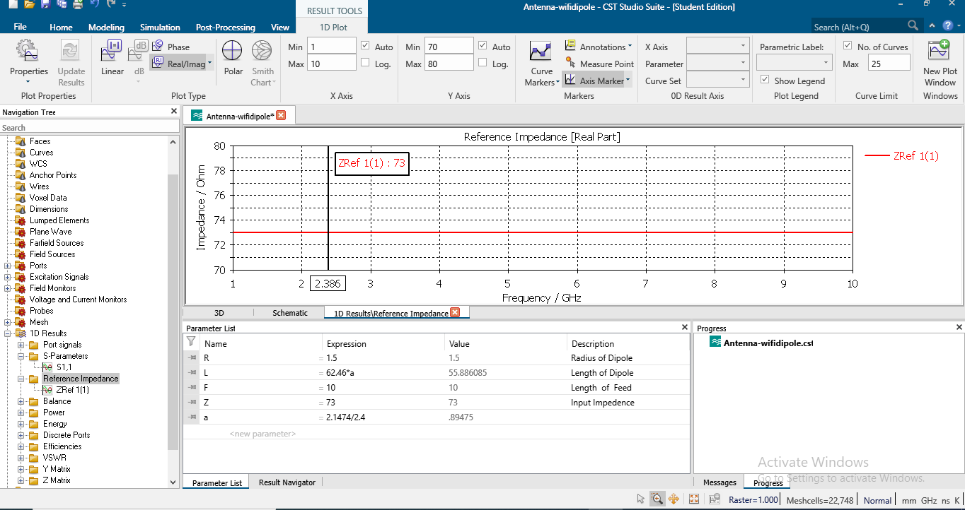
Reference Impedance
Fig-02: Input Impedance of dual band dipole antenna

Slide 13
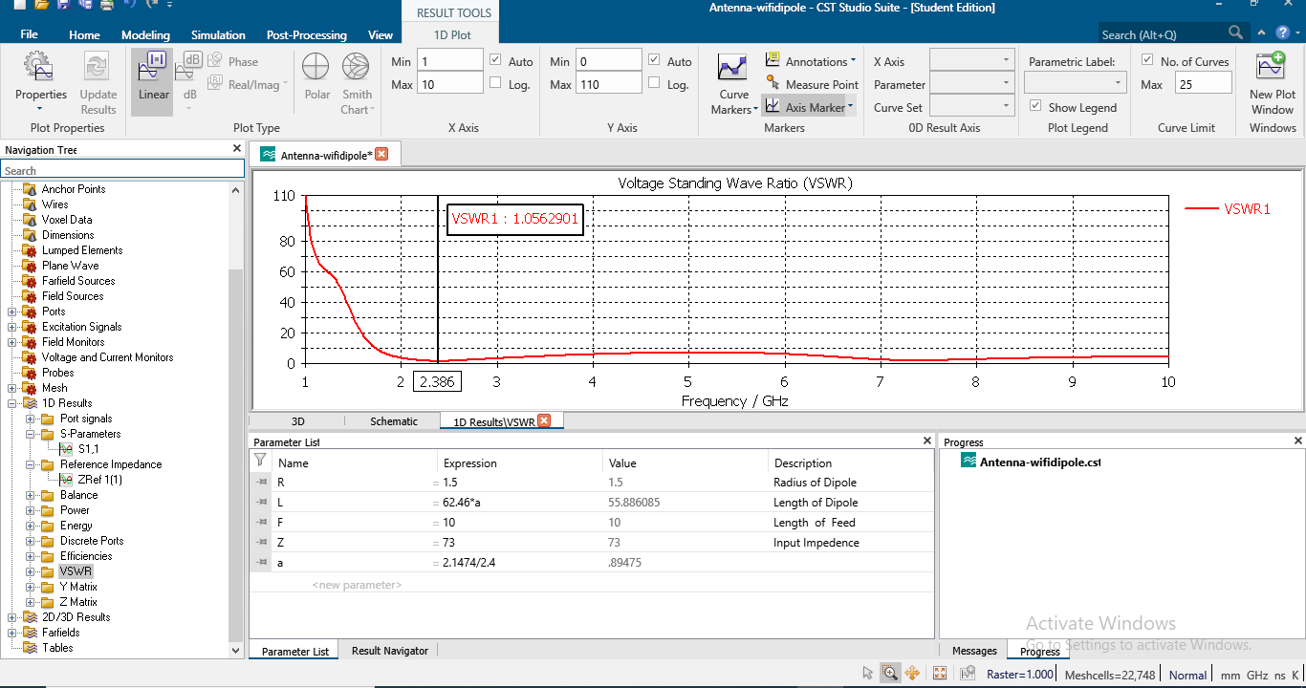
VSWR
Fig-03: VSWR of dual band dipole antenna

Slide 14
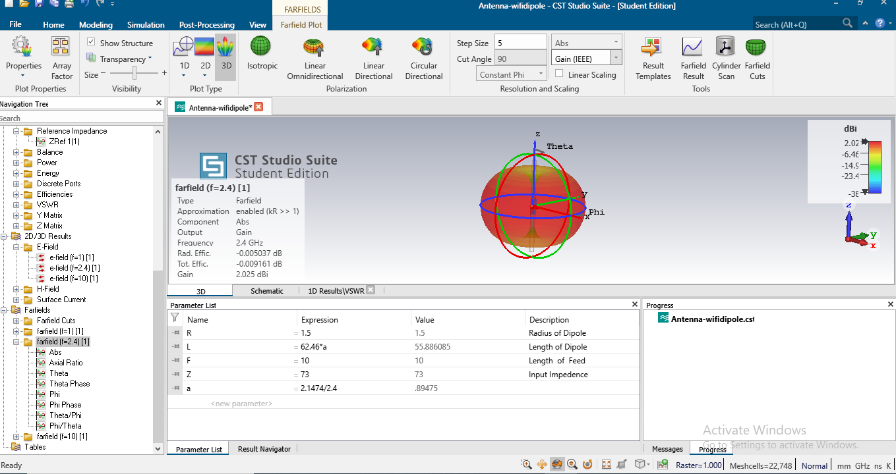
Gain
Fig-04: Gain of the dual band dipole antenna
(Gain= 2.025 dBi)

Slide 15

Directivity
Fig-05: Directivity of dual band dipole antenna

Slide 16
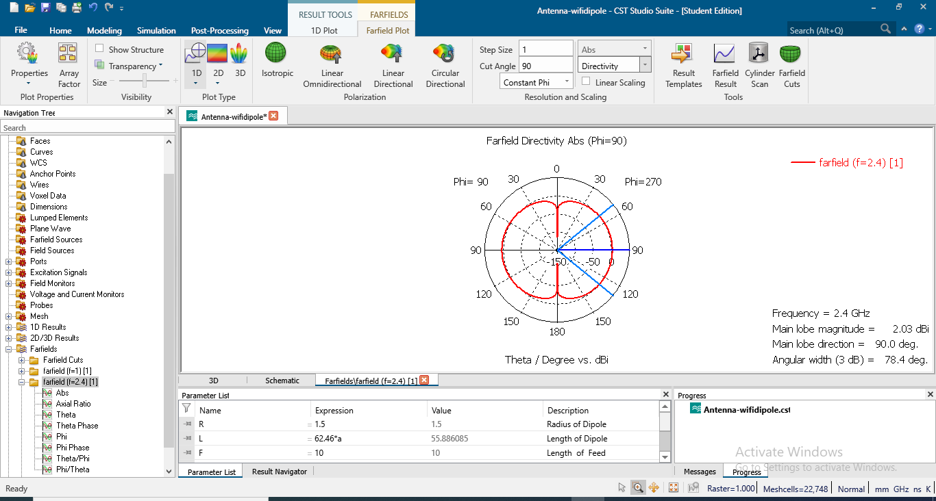
Radiation Pattern (1-D)
Fig-06: 1-D Radiation Pattern of Dipole Antenna

Slide 17
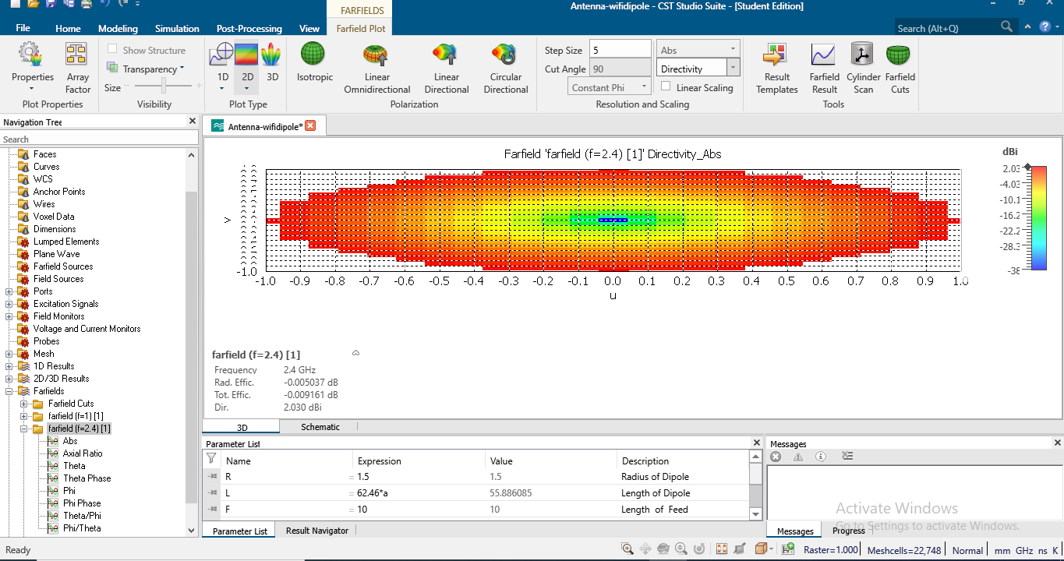
Radiation Pattern (2-D)
Fig-07: 2-D Radiation Pattern of Dipole Antenna

Slide 18
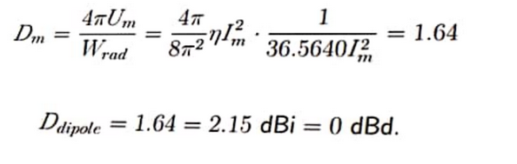
Design Accuracy
Directivity of the dipole,
(Calculated)
From the figure, we can determine the directivity of the dipole achieved by the simulation process.
Directivity= 2.030 dBi
(simulated)

Slide 19
Finally…
A dual band dipole antenna designed successfully.
All the output parameters are found with maximum accuracy.

Slide 20


