Slide 1
Progress Report (01 April – 16 April)
Presented by:
Abu Taher (MSc) (Abu.Taher@oulu.fi)
Research Assistant,
Center for Wireless Communication,
University of Oulu, Finland,
Date: 16 April, 2025.
Supervised by:
Erkki Harjula (Erkki.Harjula@oulu.fi)
Assistant Professor(Tenure Track),
Adjunct Professor (Docent)
Center for Wireless Communication,
University of Oulu, Finland,
Date: 16 April, 2025.

Slide 2
Outline
Summary of Reviewed Articles
Note taking methodology
Key insight and observation
Practical Questions
Challenges
Next steps

Slide 3
Summary of Reviewed Articles
Item | Description
Total articles | 57
Published | 36
Submitted | 4
In progress | 17
Reviewed | 18
Method | Handwritten and GitHub page

Slide 4
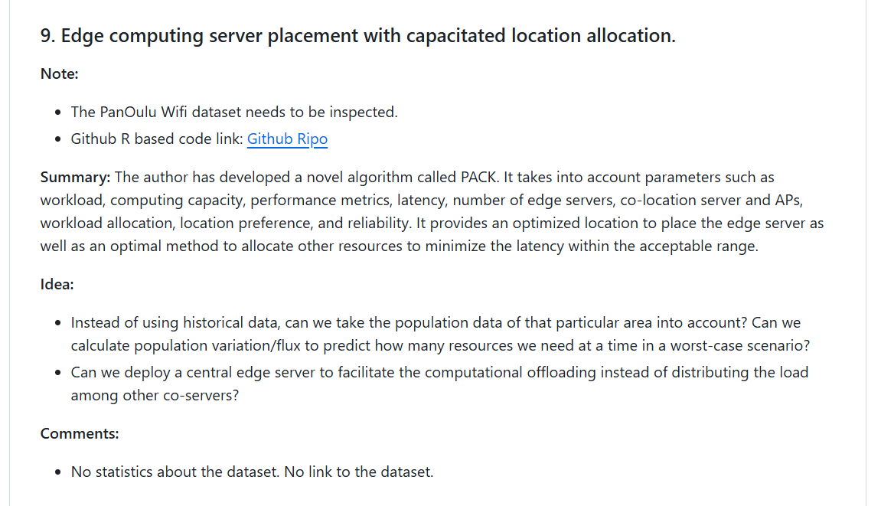
Note-Taking Methodology
For each paper, I documented:
Notes: Interesting points for future use
Summary: Core ideas, methods, and conclusions
Comments: Critical analysis of missing or unclear elements
Ideas: Research directions inspired by the paper
Figure 1: Screen shot of a note section.

Slide 5
Key Insights and Observations
Some papers tested the feasibility of three tier architecture
Some papers addressed practical challenges related to this new paradigm.
I think the main question is ‘how do we use the edge layer efficiently?’ We don’t want the edge to be very big or very small. We want something in between. We also imposed some constrains to fix our goal within a boundary.
Main issue are resource management and security. Some of the papers were related to resource slicing which uses three types of methods AI, ML and algorithms. The resources could be CPU, GPU, RAM, Storage, bandwidth and latency.
Some papers was related to the security of the overall systems. Blockchain has been incorporated as a trust mechanism.
Security related paper explored biometric system and many other network type attack like DoS, DDoS etc.

Slide 6
Key Insights and Observations
Delay aware resource orchestration – DRESIN
Distributed edge AI for tomographic imaging
Energy aware resource slicing
Reinforcement learning for anomaly detection
KPI for 5G hospital network
Reallocation storm
Edge cloud offloading
SDN enhanced resource orchestration – handover related
Server placement in geographic location
Reinforcement learning based resource allocation
Secure biometric identification for Naked world
Energy profiling of 5G network
AI based slicing - semantic slicing
Distributed network architecture

Slide 7
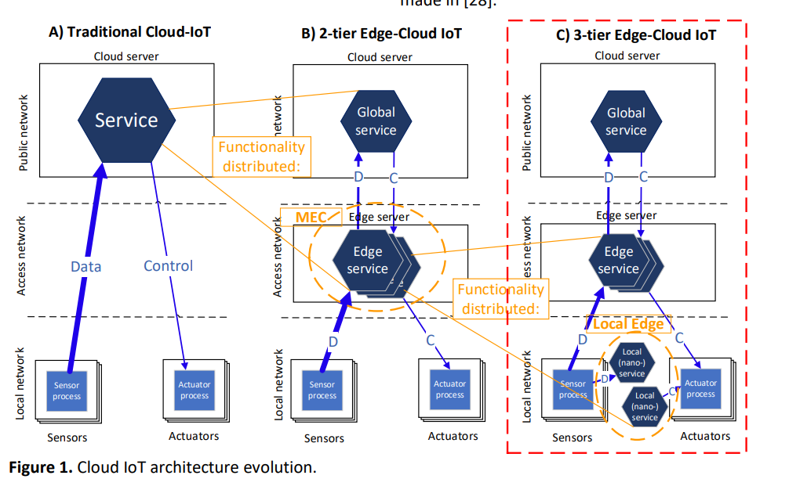
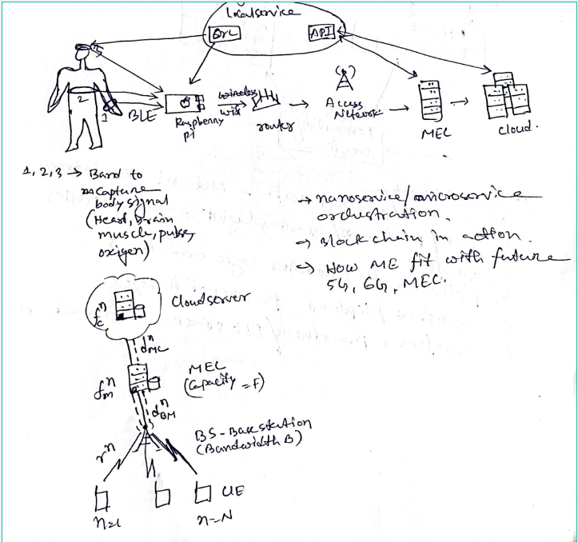
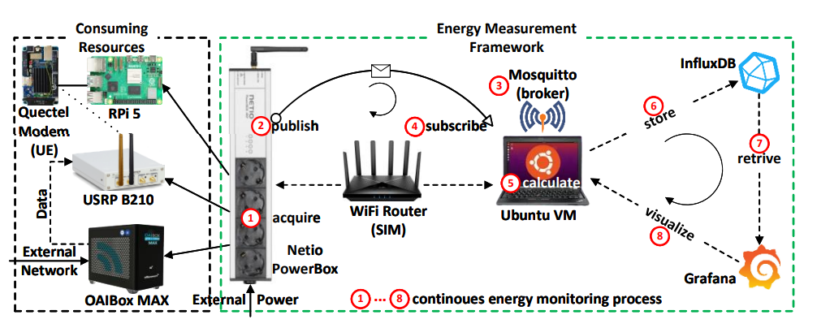
Some Important Diagram
Figure 2: Edge cloud continuum
Figure 3: Testbed for energy profiling test
Figure 4: Data communication between nodes

Slide 8
Practical Questions
How are microservice/nanoservice images stored and managed in orchestration?
Can Raspberry Pi handle multiple dynamic containers given storage and compute limitations?
Where and how is blockchain integrated into edge systems?
How do 5G/6G architectures integrate edge servers—what is their practical positioning?

Slide 9
Challenges
Conceptual Gaps: Limited exposure to blockchain integration
Practical Gaps: Need to replicate at least one experiment to understand architecture behavior
Knowledge Gaps: Deeper understanding needed for 5G/6G systems and their relationship to edge

Slide 10
Next Steps
Continue reviewing remaining articles
Begin recreating an experiment (testbed or simulation)
Explore 5G/6G architecture fundamentals
Learn basics of blockchain in edge-IoT context
Experiment with container orchestration on resource-constrained devices

Slide 11
Thank You Very Much
For Your Attention

