Slide 1
Cryptography in Network Security
UT CS361S
Fall 2020
Lecture Notes

Slide 2
This is NOT a Crypto Course
This course: Network Security
Network Security ≠ Cryptography
But, crypto is used extensively in network security
We will discuss some basic crypto concepts
But mostly, we will see how crypto is used to secure networks

Slide 3
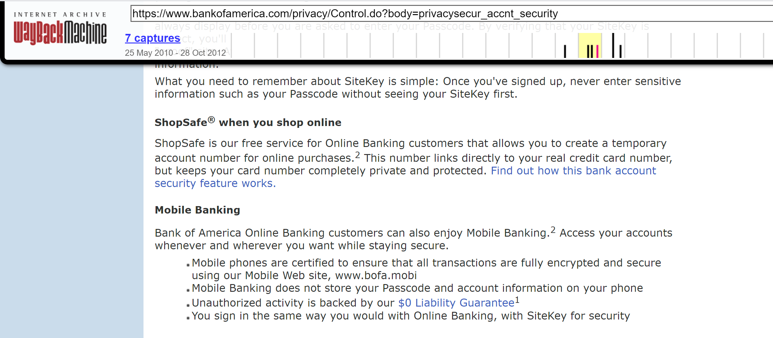
What is “Cryptography”?

Slide 4
Cryptography ≠ Confidentiality
“Secret” codes usually gets the most attention from non-experts
Websites used to emphasize “security” by talking encryption
In crypto terms, encryption typically provides “confidentiality”
Confidentiality is not the only property, nor even the “most important”

Slide 5
Cryptography Definition
Assume definition of “information” is axiomatic
Study of mathematical techniques related to information security such as
confidentiality,
data integrity,
entity authentication, and
data origin authentication
(See, HAC Definition 1.1)

Slide 6
Information Security
“Protect” information
This is the goal (i.e., the (Anderson) security policy)
Cryptography is just one approach (i.e., mechanism) to enforcement

Slide 7
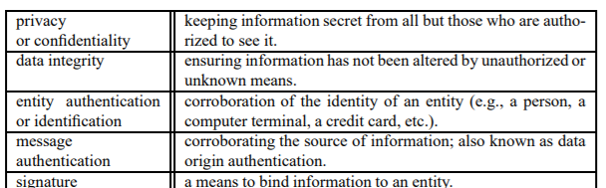
Information Security Objectives

Slide 8
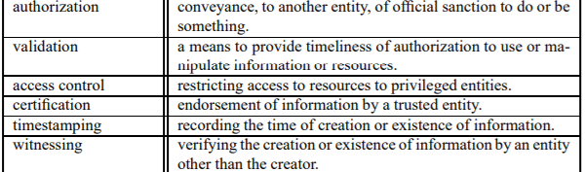
Information Security Objectives

Slide 9
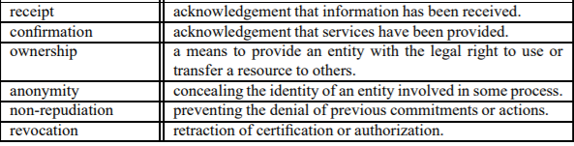
Information Security Objectives

Slide 10
Crypto’s Primary Objectives
Confidentiality
Data Integrity
Authentication
Entity Authentication
Data Origin Authenticaiton
Non-repudiation
Other objectives built on top of these four properties

Slide 11
States* of Data
Data at Rest
Data in Motion
Data in Use
*Analogous to States of Matter (solid, liquid, gas)

Slide 12
Crypto in Network Security
Protecting Data In Motion gets most of the attention
Common objective: Over-the-network entity authentication
Common objective: Secure Authenticated Channel
Protecting Data-at-Rest and Data-in-Use from network-based adversaries
Common objective: Maintain data confidentiality (prevent exfiltration)
Common objective: Maintain data integrity (prevent tampering)
(* Not a comprehensive list!)

Slide 13
EXAMPLE Secure Authenticated Channels
Authenticate
Authenticate Entities
Identify
Identify the current communication session
Obtain
Obtain session-specific security parameters, including keys
Validate
Validate that session setup has freshness and integrity
Tx/Rx
Transmit/Receive session data ensuring security properties

Slide 14
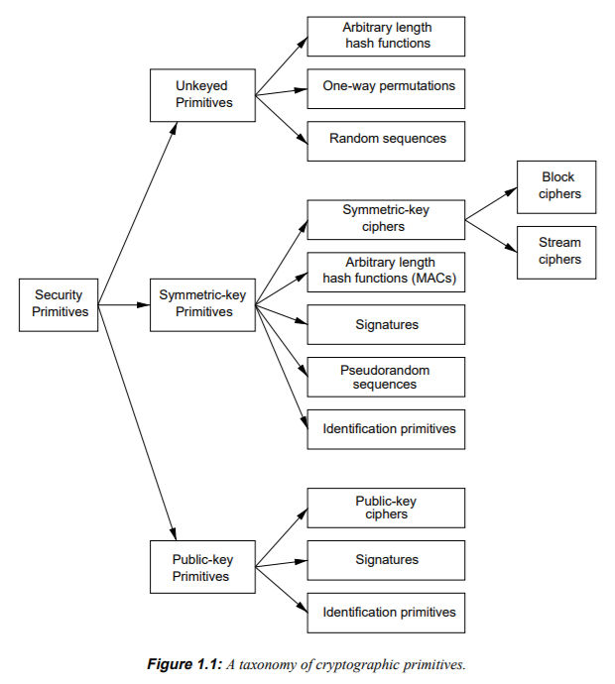
Cryptographic “Primitives”

Slide 15
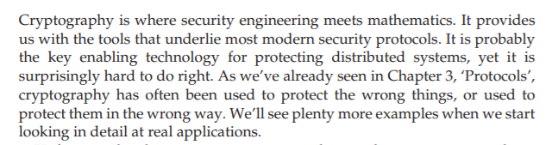
Anderson’s Intro

Slide 16
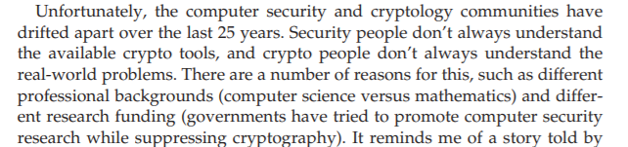
Security vs Cryptography

Slide 17
YANAC
YOU ARE NOT A CRYPTOGRAPHER
You will acquire some knowledge in this class
That could make you more dangerous, not less!
Do NOT roll your own cryptography
Know when to tell your boss to hire a cryptography expert

Slide 18
My Objective
Students are conversant about basic cryptography terms and vocab
Students can recognize/understand cryptographic errors/failures
Students understand how crypto can enforce policy
Students can recognize mismatches in policy/enforcement
Students understand the crypto in common network protocols
Students know when to seek out subject-matter experts

Slide 19
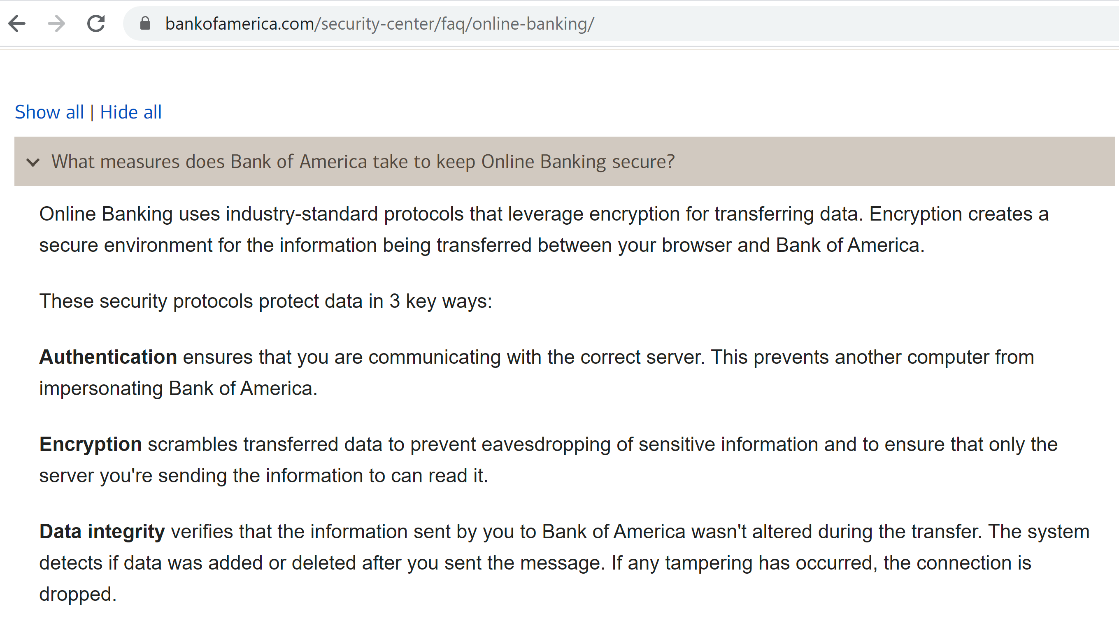
Improvement!

