Slide 1
Symmetric Cryptography
UT CS361S
Fall 2020
Lecture Notes

Slide 2
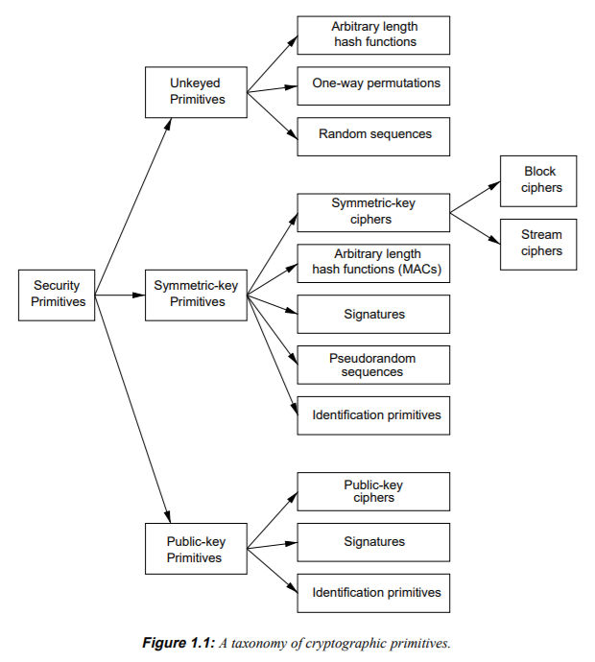
Technology Review

Slide 3
Symmetric Cryptography
All parties in the protocol share a unique key
If |parties| is 1, “secret key”
If |parties| > 1, “shared key”
For today’s examples, assume pre-shared key

Slide 4
Symmetric-Cipher Types
Block Cipher
Data split in fixed-size blocks
1:1 map from plaintext block to ciphertext block
“Substitution Cipher”
Stream Cipher
Encrypted 1 symbol at a time
Combined with a Stream of key material (key stream)

Slide 5
Monoalphabetic Substitution (Caesar cipher)
Each letter of plaintext maps to exactly one cipher symbol
(Block Size: 1 letter)
Let’s race! Decrypt the following:
RYG WKXI CSLVSXQC NY IYE RKFO?
It’s a question, when you decrypt it, shout out the answer!

Slide 6
Caesar Cipher: “Shift” Cipher
Write out all letters and move them over (wrapping around)
A B C D E F … X Y Z
X Y Z A B C … U V W
KEY SPACE: How many keys are there for this algorithm?

Slide 7
Permutation Cipher
Any letter can be mapped to any letter:
A B C D E F G H I J K L M
X N B Y A M L S V P R K W
N O P Q R S T U V W X Y Z
Z C G I U D T F O H J Q E
Key space is now how big?
Block size is still 1

Slide 8
Why Size Matters
Key Space is related to exhaustive/brute-force search
Even without a computer, a 25/26 key space is easy to brute force
Block Size is related to cryptanalysis e.g., frequency analysis
A one-letter block does not conceal enough information

Slide 9
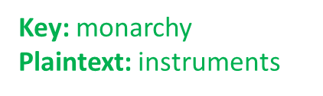
Playfair Cipher
1854 by Charles Wheatstone
Named after Lord Playfair who promoted it (classic politician)
Example: https://geeksforgeeks.org/playfair-cipher-with-examples

Slide 10
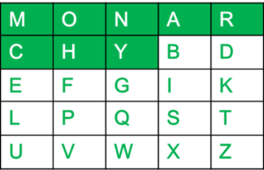
Playfair Keyblock
5×5 grid of alphabets that acts as the key (Key Expansion)
One letter of the alphabet (usually J) is omitted from the table
(If the plaintext contains J, then it is replaced by I)

Slide 11
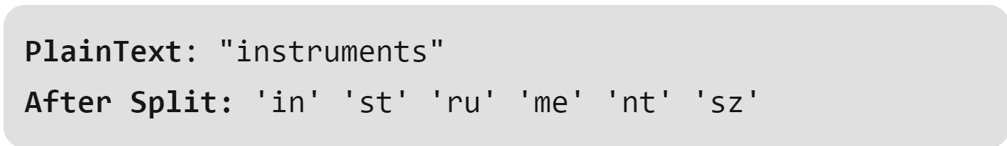
Playfair Encipherment
The plaintext is split into pairs of two letters (digraphs).
If there is an odd number of letters, a Z is added to the last letter

Slide 12
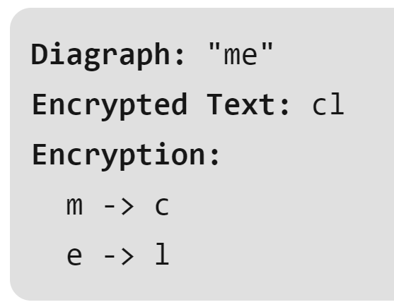
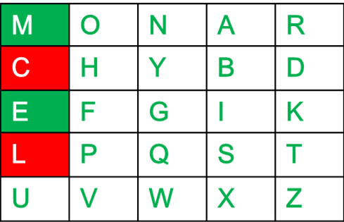
Playfair Encipherment
If both the letters are in the same column:
Take the letter below each one

Slide 13
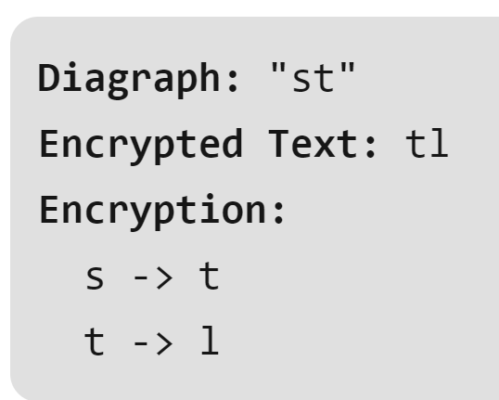
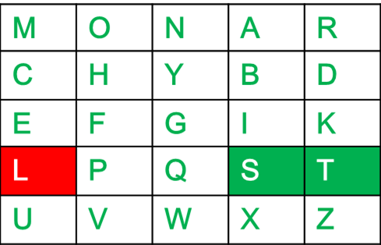
Playfair Encipherment
If both the letters are in the same row:
Take the letter to the right of each one

Slide 14
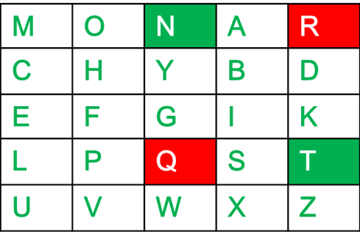
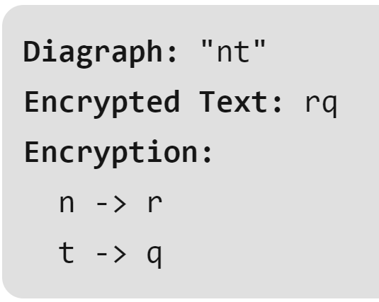
Playfair Encipherment
If letters do not share a row or column:
Form a rectangle with the two letters and take the letters on the horizontal opposite corner of the rectangle

Slide 15
Playfair Ciphertext:
Plain Text: "instrumentsz"
Encrypted Text: gatlmzclrqtx

Slide 16
How “Strong” is Playfair?
What’s the key space? How long to brute force?
What about “cryptanalysis”?

Slide 17
Cryptanalysis Considerations
Our example playfair ciphertext might be “uncrackable”
But what if the plaintext was longer?
How much ciphertext before patterns emerge?
Digraph (2-letter “blocks”) are better, but not good enough

Slide 18
Modern Requirements*
Symbols are just bits (can represent all info)
Blocks are large (used to be 64, now 128 bit)
Key size is large (currently 128 min, soon 256 bit min)
Algorithm has “Avalanche” property
*Not a formal list of all requirements; These are the ones that
Dr. Nielson runs into most often

Slide 19
AES: Common Block Cipher
Block size is ALWAYS 128 bits
Key size can be 128, 192, or 256
But at its core, still a “substitution” cipher.
AES-128 encryption of ”My name is Seth!” w/ a “zero” key:
E94B 69E7 13C6 B4F9 B834 FEA5 95F7 8F2A

Slide 20

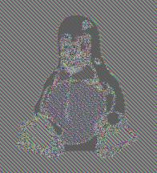
Block Cipher Weaknesses
What happened here?

Slide 21
Patterns
Remember, AES still 1-to-1 mapping of 128 bits
If input 128 bits is the same, output 128 bits is the same
Patterns between blocks NOT ERASED
Solution: “link” output in some way

Slide 22
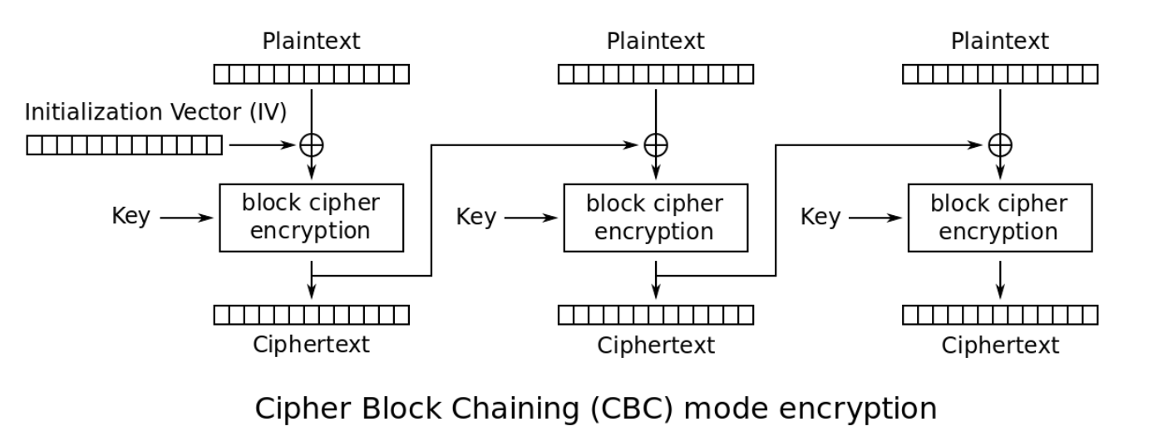
Cipher-Block Chaining (CBC)

Slide 23
What is an IV?
Initialization Vector
Similar to “salting” a hash
Eliminates deterministic output
You should almost never reuse a key
BUT YOU SHOULD NEVER EVER reuse a KEY and IV

Slide 24
Quasi-Deprecated CBC
CBC “works” when used correctly
However, has various weaknesses and is error prone
In many cases, CBC is being deprecated

Slide 25
One-Time Pad (OTP)
Before talking about AES-Counter Mode, let’s talk about OTP
OTP uses keys that are the same size as the plaintext!
If you have a 1GB file, you would have to have 1GB of random data!
Encryption is to XOR the plaintext with the random data
OTP has certain provable security characteristics for confidentiality
Stream ciphers mimic OTP by deriving key material from a key

Slide 26
Counter Mode (CTR)
Converts a block cipher into a STREAM CIPHER
Does NOT encrypt the plaintext directly
Rather, is used to generate a key stream
Keystream = AES( IV + 0 ), AES( IV + 1 ), AES( IV + 2 )…
Ciphertext = Plaintext XOR Keystream
Plaintext = Ciphertext XOR Keystream

Slide 27
Don’t Reuse Keystream
C1 = K1 xor M1
C2 = K1 xor M2
C1 xor C2 = K1 xor M1 xor K1 xor M2
= K1 xor K1 xor M1 xor M2
= M1 xor M2

Slide 28
Confidentiality does NOT provide Integrity
Start with a ciphertext C1 = K XOR M1
Suppose an attacker knows the plaintext M1 (or part of it!)
Suppose attacker can intercept/change the message
Attackers wants to change M1 to M2
Attacker produces C2 = C1 xor (M1 xor M2)
= K xor M1 xor M1 xor M2
= K xor M2
ALSO WORKS ON OTP (“provably secure”)

Slide 29
Integrity in History
Message integrity also pre-dates modern cryptography
Bank transfers in the 19th century used the telegraph
How to keep a telegraph operator from sending a false message?
Banks developed code but this did nothing for message integrity
Banks developed code books with a “test key”
The test key had one-way calculations for money, dates, currency, etc
The test key computed and the test key transmitted had to match
Not great by today’s standards, but worked until the 1980’s!!!

Slide 30
Modern Hashing
Compression
Ease of Computation
Preimage Resistance
2nd Preimage Resistance
Collision Resistance
In practice, also has the Avalanche property

Slide 31
Message Authentication Code
MAC is a symmetric key code that is used for message integrity
Commonly implemented as a keyed hash
Super simple MAC: hash(message + key)
HMAC is more complicated, but same basic idea:
HMAC_k(M) = h(k xor A, h(k xor B, M))
A = repeated 0x36
B = repeated 0x5c

Slide 32
Composite Mode
Also known as
Authenticated Encryption or
AEAD – Authenticated Encryption with Additional Data
Integrity + Confidentiality
AES-GCM is counter mode with a built-in MAC (called a “tag”)
AES-CCM is counter mode with CBC-MAC
Only AEAD ciphers supported in TLS 1.3
TAKEAWAY MESSAGE: USE AEAD WHENEVER POSSIBLE!!!!!!!!

