Slide 1
Authentication
UT CS361S
Fall 2020
Lecture Notes

Slide 2
Authentication/Authorization
Validating Identity
Permissions Assigned to a Validated Identity

Slide 3
The Authentication Process
CLAIM: Identity X
Prove your claim
AUTHENTICATOR
PROOF 1: Identity X
PROOF 2: Identity X
PROOF n: Identity X

Slide 4
Authentication Mechanism
VERIFIER
COMPUTATION & ALGORITHMIC COMPONENTS
INPUT
TRANSPORT
DATABASE

Slide 5
The Big Three
Something you KNOW
Something you HAVE
Something you ARE

Slide 6

KNOW: Passwords
Security Requirements
The password is ONLY known by the party seeking authentication
The password cannot be easily guessed by human or computer
The password will not be forgotten by the party seeking authentication

Slide 7
Password Registration
COMPUTATION & ALGORITHMIC COMPONENTS
TERMINAL
NETWORK
Compute
D = HASH(Y, salt k)
Transport
Identity X
Password Y
Input
Identity X
Password Y
DATABASE
ID X: k, D
Store identity, Salt, Hash

Slide 8
Password Verification
COMPUTATION & ALGORITHMIC COMPONENTS
TERMINAL
NETWORK
Verify
D’ = HASH(Y, salt k)
Load D
Compare D == D’?
Transport
Identity X
Password Y
Input
Identity X
Password Y
DATABASE
ID X: k, D

Slide 9
Common Problems
Interception
COMPUTATION & ALGORITHMIC COMPONENTS
TERMINAL
NETWORK
Forgot PW
Shared PW
Easily Guessed PW
DATABASE
ID X: k, D
Trojans
Insiders
WeakHash
Key Logers

Slide 10
Challenge Response Symmetric
CLAIM: Identity X
CHALLENGE: k
RESPONSE: HASH(Y,k)
ID MODULE
Shared Secret Y
DATABASE
ID X: Shared Secret Y

Slide 11
Challenge Response Asymmetric
CLAIM: Identity X
CHALLENGE: k
RESPONSE: SIGN(k)
ID MODULE
Private Key Y⁻¹
DATABASE
ID X: Public Key Y

Slide 12
Man-In-The-Middle (MITM)
CLAIM: Identity X
CLAIM: Identity X
CHALLENGE: k
CHALLENGE: k
RESPONSE: HASH(Y,k)
RESPONSE: HASH(Y,k)

Slide 13

Something you Have
Security Assumptions
The “token” is ONLY possessed by the party seeking authentication
The token cannot be easily forged or duplicated
The authentication protocol is secure

Slide 14
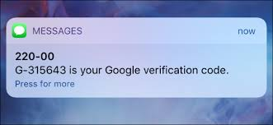
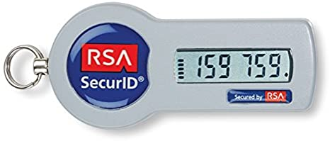
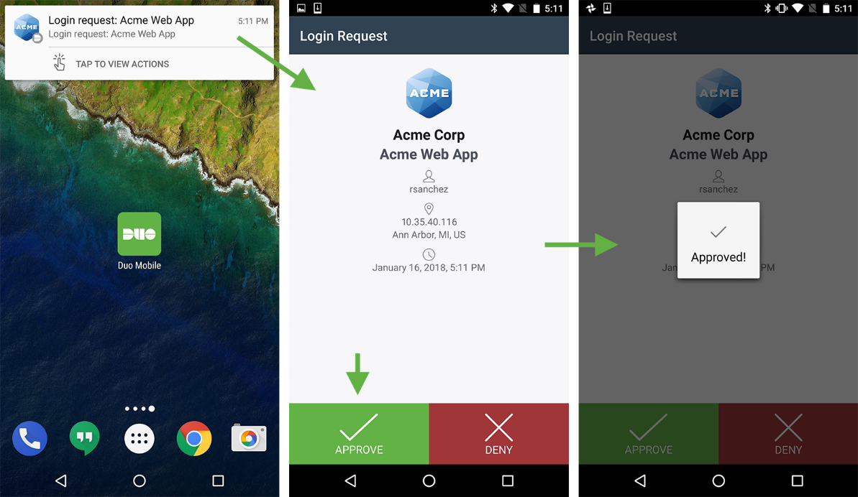
Something you Have Examples

Slide 15

Problems with “Tokens”
Is it REALLY something you have?
Is sending a code by email 2-factor?
What about phone cloning?
What about network interception?
Is an RSA Token’s seed just something you know?
“Something you can respond with”

Slide 16
Something you Are
Security Assumptions
The “characteristic” is effectively unique
Can effectively measure, record, or detect the characteristic
Characteristic cannot be forged, replicated, or otherwise “lost”
Characteristic will not change (too much) over time
Characteristic will never need to be revoked
The Authentication Protocol is Secure!

Slide 17
False Positives vs False Negatives
False Negative – Do not authorize party with valid characteristic
False Positive – Authorize party with invalid characteristic

Slide 18

Receiver Operating Characteristic
The trade off between FP and FN
Decreasing one typically increases the other
Equal Error Rate is when FP approximately equals FN
In most biometrics, False Negatives are worse

Slide 19
Problems with Biometrics
Fingerprinting has been *seriously* misused in Courts (see Anderson at pp. 469-470)
Interpretation of results and understanding of statistics
Variable accuracy in scanning mechanism
“Freshness”
Belief in infallibility leads to security culture problems
Biometrics exclude a *lot* of people (e.g., differently abled)
Cvil Rights and Privacy issues
Injury that alter the characteristic (e.g., fingerprint)

Slide 20
One other “Authentication”
“SomeWHERE you Are”
Almost universally used as an ancillary form of authentication
Generally used do disprove rather than prove identity

Slide 21
Complaints about KIZZA
Overstates strength of “something you are” authentication
“Client Authentication” (p. 214) – Not sure what he’s talking about
“Good” passwords are NOT vulnerable to brute force (p. 214)
Most passwords/secrets are not sent in the clear (p.215)
Challenge Response “problems” overstated/oversimplified (p. 216)
No deep discussion of Something you Have or Something you Are

