Slide 1
NUTRIVISION
PROBLEM
Healthy cooking takes
more than a recipe
Choose meals. Shop. Measure. Cook.
Beginners
Athletes
Busy households
Cooking can feel intimidating
without practical guidance.
Need clearer information
about protein and portions.
Face the daily decision
of what to prepare.
The result can be more takeaway, unused ingredients and inconsistent eating habits.
01
Notes:
Today, people who want to eat healthier have to choose meals, shop for ingredients, measure portions, and figure out how to cook them. For beginners, cooking can feel intimidating. Athletes need clearer information about protein and portions. Homemakers and busy families face the daily task of deciding what to prepare. These difficulties can lead to frequent takeaway orders, unused ingredients, and inconsistent eating habits. Finding a recipe only solves part of the problem. People also need the right ingredients, equipment, and guidance.

Slide 2
NUTRIVISION
SOLUTION
NutriVision makes home cooking easier
01
Choose a meal
Order one meal, a full day, or a weekly or monthly subscription.
02
Receive measured ingredients
A starter kit adds measuring spoons, a scoop, a thermometer and a scale.
03
Cook with step-by-step guidance
The app shows instructions and estimated calories and nutrients per serving.
02
Notes:
With Sufra, customers choose a meal and receive a box of measured ingredients with clear cooking instructions. A starter kit includes measuring spoons, a scoop, a food thermometer, and a food scale. The app guides customers through preparation step by step and displays estimated calories and nutrients per serving. Customers can purchase one meal, a full day of meals, or a weekly or monthly subscription. Our goal is to help people prepare familiar meals with greater confidence while reducing the effort of planning and shopping.

Slide 3
NUTRIVISION
MARKET
A Bahrain-wide market with a focused pilot
30
Initial audience
Young adults, couples, beginners and busy people who want an easier way to cook at home.
customers in the proposed pilot
Across Bahrain
Recruitment target.
No existing traction claimed.
The long-term goal is delivery across all areas. The household market size still needs verification.
Expand based on repeat purchases and delivery capacity.
03
Notes:
NutriVision aims to serve customers across Bahrain. The initial target customers are young adults, couples, beginners and busy people who want to cook at home but need an easier process. We propose starting with a pilot of 30 customers, then expanding based on repeat purchases and delivery capacity. The number of eligible households still needs to be verified before making a market-size claim.

Slide 4
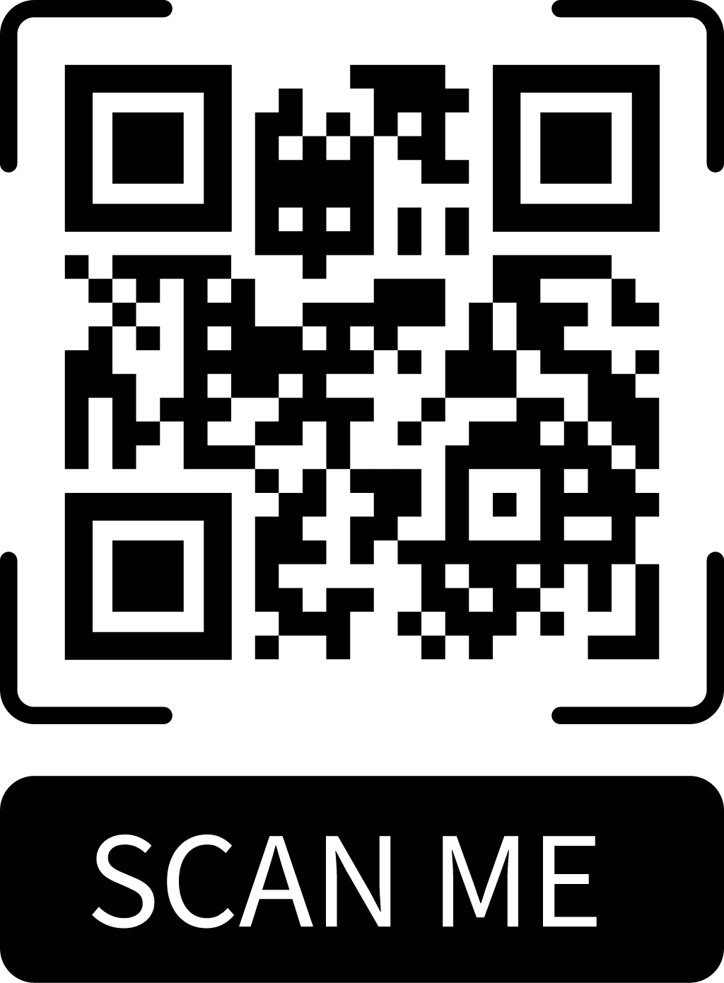
NUTRIVISION
PRODUCT
The NutriVision meal-kit prototype
Built in Flutter
Four purchase options
Scan to explore
the prototype
Arabic storefront, recipe browsing, audience filters, favourites and a basket.
One meal
1 box
Full day
Breakfast, lunch, dinner
Pricing, starter-kit selection, ingredient checklists, guided cooking and local demo orders.
Weekly
5 meal boxes
Monthly
20 boxes over 4 weeks
Full application testing remains outstanding.
Each box serves two. Weekly and monthly packages cover one meal per day, five days per week.
Payments and live fulfillment are not connected. Pilot sourcing, packing and delivery require manual handling.
04
Notes:
We have built a Flutter prototype with an Arabic storefront, recipe browsing, audience filters, favourites, and a basket. Customers can configure four purchase options: one meal box; a full day containing breakfast, lunch, and dinner; a weekly package containing five meal boxes; or a monthly package containing twenty meal boxes across four weeks. Each box currently serves two people. Weekly and monthly packages cover one meal per day, five days per week. The prototype includes pricing calculations, starter-kit selection, ingredient checklists, guided cooking, and local demo orders. Full application testing remains outstanding. Payments and live fulfillment are not connected. Supplier coordination, packing, and delivery would require manual handling during an initial pilot.

Slide 5
NUTRIVISION
CUSTOMER RESEARCH
Early interest supports a small pilot
More than 20
More than 10
people interviewed
would try a box below BHD 5
Main difficulty
Buying preference
Buying all the ingredients and finding suitable recipes.
Most preferred one box or a daily package. Only one person showed interest in a monthly order.
No paid preorders have been collected yet.
05
Notes:
We interviewed more than 20 people about their cooking habits. Their main difficulties were buying all the required ingredients and finding suitable recipes. More than 10 people said they would try NutriVision if one box costs less than BHD 5. Most preferred trying one box or a daily package first. Only one person showed interest in ordering monthly. These responses show early interest, but no paid preorders have been collected yet.

Slide 6
NUTRIVISION
FOUNDER
Why I’m building NutriVision
Reducing the time and effort needed
to prepare meals at home.
The problem I observed
My strength
People may forget an ingredient or buy more than they need.
Application development. I built the prototype to turn the idea into a working product.
Next: test real orders and build relationships with food suppliers, nutrition specialists and delivery partners.
06
Notes:
I created NutriVision to reduce the time and effort involved in preparing meals. People sometimes forget an ingredient while shopping or buy more than they need. NutriVision provides the correct ingredients in measured quantities, making cooking easier and reducing waste. My main strength is application development, which I used to build the prototype. Supplier, nutrition and delivery partnerships still need to be established.

