Slide 1

DHAKA METRO RAIL TICKETING SYSTEM

Slide 2
Section: 01
Group: B1
Submitted by:
Tanvir Ahmed Aadeef
Mohsina Tabassum
Fahim Faisal Rhythm
Abu Ahamed Rafi
Aniqa Tabassum
Submitted to:
Dr. Rubaiyet Islam

Slide 3

Dhaka Metro Rail Ticketing System using Google Cloud Infrastructure
Google Cloud infrastructure is being used to provide a secure, reliable, and cost-effective ticketing system for Dhaka Metro Rail, utilizing a variety of components including VMs, Buckets, VPCs, Subnets, VPC peering, and a SQL instance.

Slide 4
Project Goals
Enabling Log-in Info for commuters
The ability to book tickets anytime through the internet.
To create a database of tickets issued and passenger information which are scanned physically at turnstiles.
Ensure high availability and fault tolerance for the ticketing system.
Provide secure and scalable storage for ticketing data.
Establish a network architecture that enables seamless communication between system components.
Implement robust security measures to protect sensitive data.
Monitor and manage the infrastructure effectively.

Slide 5

Opportunities
Carriage seat allocation
Train timing
Point-to-Point route subsystem
General feedback on how to improve the system
Use feedback to decrease maintenance time
Discount for off-time tickets in advance

Slide 6
Infrastructure Overview
Two VMs for processing power
Google Cloud Storage with two buckets for data, files, and media storage
Two VPCs for a secure network environment
Two subnets for network traffic control
VPC peering for secure communication and data exchange
One SQL instance for data storage and retrieval

Slide 7

Security and Access Control
Network security rules and firewall regulations
Access Control Lists (ACLs) to limit access
Encryption to secure data
Google Cloud Identity and Access Management (IAM) to control user access and permissions
Fine-grained access control to limit access to resources

Slide 8
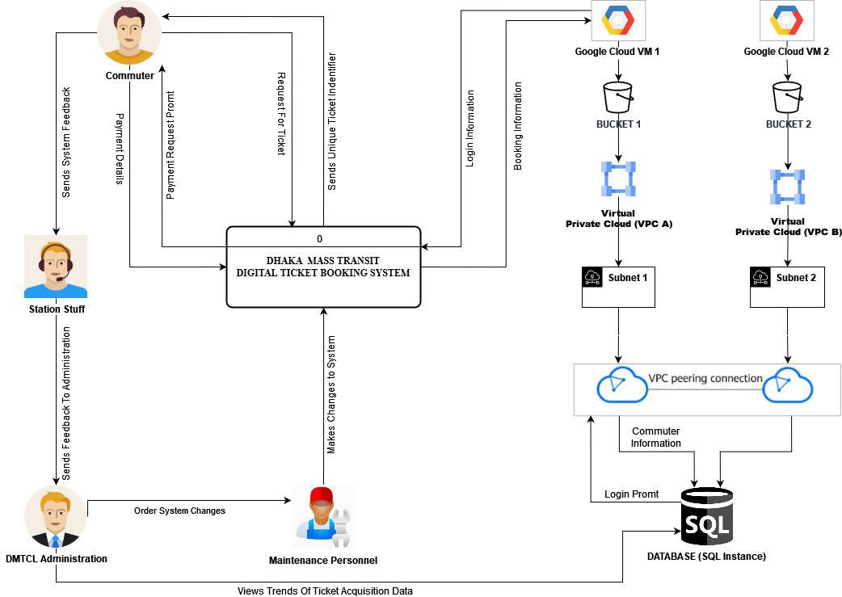
The Rich picture

Slide 9

Cost Calculation

Slide 10
Bucket Pricing
The monthly estimated cost of 1 bucket in our uses based on current google pricing is
Storage: $0.02 per GB-month x 10 GB = $0.2
Network progress: $0.12 per GB x 10 GB = $1.22
Total monthly cost: $1.42/month
Since 2 buckets so total price will be $1.42 x 2 = $2.84/month

Slide 11
SQL Pricing
Compute Engine instance cost: $24.61/month (e2-standard-1 instance in Montreal)
MySQL database cost: $0.0474/hour x 730 hours/month = $34.60/month (using Google Cloud SQL)
Persistent disk cost: $0.040/GB/month x 10GB = $0.40/month
Network egress cost: 0.12$/GB x 2 GB = $0.24/month (assuming you use the maximum network throughput)
Backup storage cost: $0.026/GB/month x 10GB = $0.26/month (assuming the backup size is the same as the persistent disk)
Total estimated monthly cost: $60.11/month

Slide 12
VM Pricing
For VM’s the estimated monthly cost would be
Compute Engine instance cost: $26.93/month (e2-medium instance in US regions)
Persistent disk cost: $0.11/GB/month x 10GB = $1.10/month (using balanced persistent disk)
Total estimated monthly cost: $28.03/month
As two VM’s are used, the total price will be: $28.032= $56.06/month

Slide 13
Advantages of using GCP
Highly scalable resources that can easily grow to meet needs
Large number of data centers located around the world
Extensive security measures to ensure the platform is secure
Variety of big data analytics tools and services
Variety of machine learning tools and services

Slide 14
Disadvantages of using GCP
Complex setup and configuration
Can be cost-effective for smaller businesses, but expensive for larger enterprises
Limited support compared to other cloud-based services
Limited availability of third-party applications
Requires technical expertise to use

Slide 15
Security Features
Identity and Access Management (IAM)
Encryption for data at rest and in transit
DDoS protection
Security key enforcement
Compliance with industry standards and regulations

Slide 16
Comparison between GCP Microsoft Azure AWS

Slide 17
Compute Services:
AWS: Elastic Compute Cloud (EC2) instances, Amazon Lightsail, AWS Lambda
Azure: Virtual Machines, Azure Functions, Azure Batch
GCP: Compute Engine, Google Kubernetes Engine (GKE), Cloud Functions

Slide 18
Storage Services:
AWS: Amazon Simple Storage Service (S3), Amazon Elastic Block Store (EBS), Amazon Glacier
Azure: Azure Blob Storage, Azure File Storage, Azure Table Storage
GCP: Cloud Storage, Cloud SQL, Cloud Bigtable

Slide 19
Database Services:
AWS: Amazon Relational Database Service (RDS), Amazon DynamoDB, Amazon ElastiCache
Azure: Azure SQL Database, Azure Cosmos DB, Azure Cache for Redis
GCP: Cloud SQL, Cloud Spanner, Cloud Bigtable

Slide 20
Networking Services:
AWS: Amazon Virtual Private Cloud (VPC), Elastic Load Balancing, AWS Direct Connect
Azure: Virtual Network, Azure Load Balancer, Azure ExpressRoute
GCP: Virtual Private Cloud (VPC), Cloud Load Balancing, Cloud Interconnect

