Slide 1
THREATIQ v4.1 — SYSTEM EXTENSION
Closing the Loop:
SIEM Integration & Open CTI Standards
Bidirectional SIEM integration, STIX 2.1 / MITRE ATT&CK Navigator export, and cross-source correlation — added and verified under the same live-execution methodology as ThreatIQ v4.0.
Bangladesh University of Professionals · 5th National Research Project Contest 2026

Slide 2
MOTIVATION
Two gaps the original architecture left open
1 · Classification stops short of action
2 · Interoperability tied to one platform
▸ CTI feeds in, classification out — but nothing closes the loop to a SOC's actual detection surface.
▸ A SIEM was only ever a data consumer of ThreatIQ's dashboards, never a participant in the pipeline.
▸ Result: high-confidence classifications had no operational path to becoming a detection rule.
▸ Enrichment only exported through a MISP-shaped connector.
▸ The field converged on vendor-neutral standards years ago — STIX 2.1 (OASIS) for indicators, the MITRE ATT&CK Navigator layer format for technique coverage.
▸ Result: output was only as useful as MISP itself, not to the wider CTI tooling ecosystem.
2

Slide 3
ARCHITECTURE
Closing the loop
CTI Sources
ThreatIQ
MISP Export
Wazuh SIEM
MISP · CIRCL · OTX
Classify + GAT predict
Publishes events
Auto-generates rules
WazuhConnector pulls alerts back in as a new CTI source
Pull: WazuhConnector treats SIEM alerts as another CTI source — identical fetch_recent(limit) interface, identical offline-fallback contract as MISP/CIRCL/OTX.
Push: MISPExporter filters classified IoCs by confidence/severity and publishes them to MISP; Wazuh's own MISP integration module then auto-generates detection rules.
3

Slide 4
RIGOR FIRST
What a direct code audit found before anything was added
1
88%
0
hardcoded live API key
found as a config default,
already committed to git
repository size reduction
(48MB → 5.4MB) removing
stray venvs + a duplicated
nested project copy
other hardcoded secrets
found after a full
codebase grep
Why this belongs in the presentation:
The exposed credential was found by direct static audit, not by live execution — a distinct finding from the original paper's live-verification defects, and reported for the same reason: under-reporting operational findings, whatever method locates them, understates the real cost of running CTI tooling. The key was rotated and the default removed before any new feature work began.
4

Slide 5
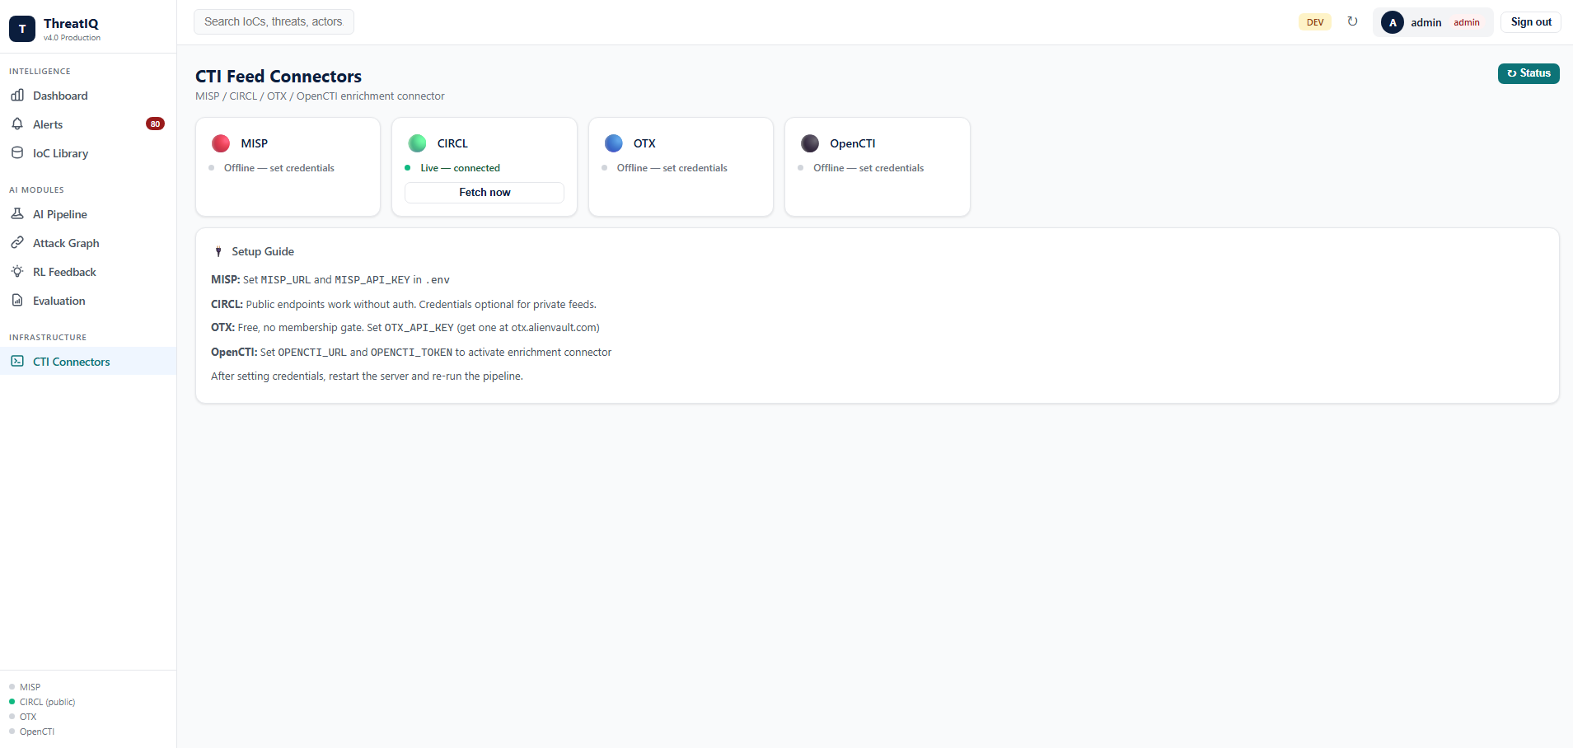
FEATURE 1 · SIEM INTEGRATION
Wazuh joins the connector grid
▸ Same interface, no special-casing: fetch_recent(limit) -> list[dict], identical to every existing connector.
▸ Offline-fallback contract: curated sample alerts when unconfigured, so the whole pipeline demos without live Wazuh.
▸ Live mode: queries the Wazuh indexer's OpenSearch-compatible search API for alerts at or above a minimum rule severity.
▸ "Correlate Sources" button: fetches all four connectors and boosts confidence on cross-source matches.
CTI Feed Connectors page — MISP / CIRCL / OTX shown; Wazuh now appears as a fifth connector with the same status/fetch UI.
5

Slide 6
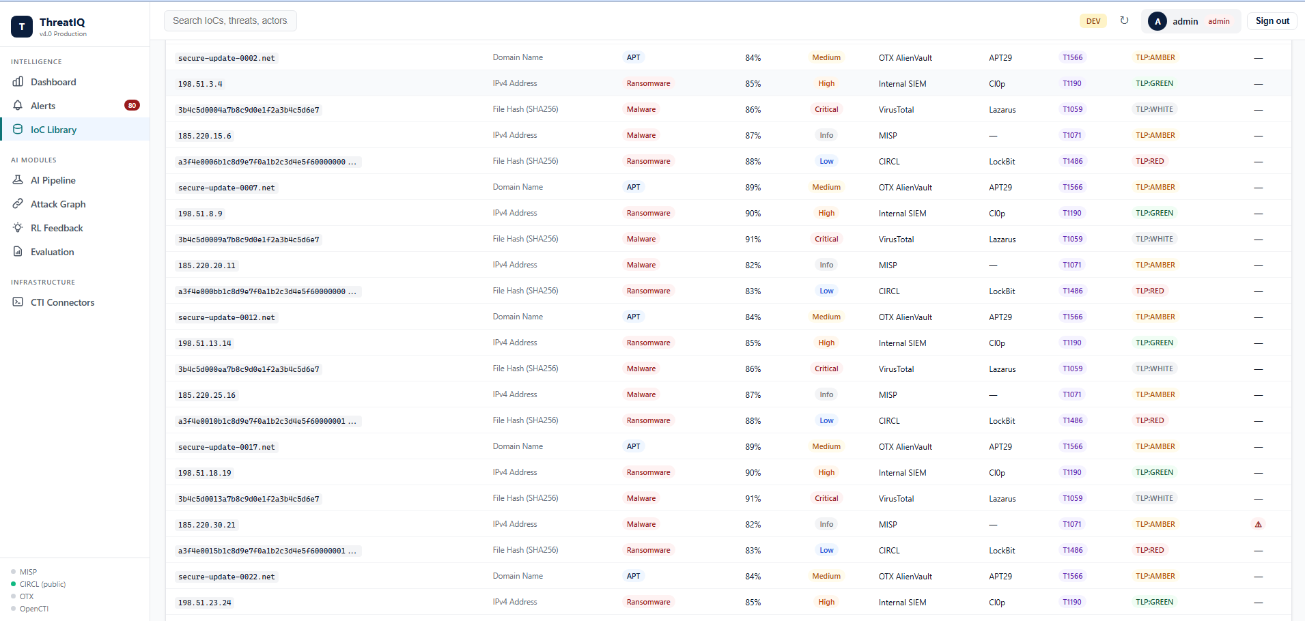
FEATURE 2 · OPEN STANDARDS
STIX 2.1 export — not a proprietary format
▸ OASIS standard: any STIX/TAXII-consuming tool can ingest the bundle — not just MISP.
▸ Deterministic IDs: UUIDv5 derived from the indicator value; re-exporting the same IoC yields the same object ID.
▸ Spec-correct confidence: converted to STIX's integer 0–100 scale, not ThreatIQ's internal 0.0–1.0 float.
▸ Honest type mapping: CVEs become proper Vulnerability objects; types with no clean STIX observable (e.g. a bare hostname) are annotated via Note, never faked.
IoC Library — now has an "Export STIX 2.1" button alongside CSV/JSON, next to the existing source filter (Wazuh SIEM included).
6

Slide 7
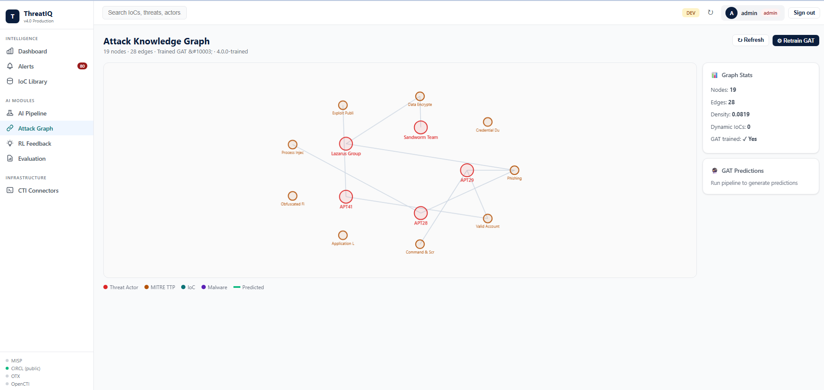
FEATURE 3 · OPEN STANDARDS
MITRE ATT&CK Navigator layer export
▸ The most-used free analyst tool: mitre-attack.github.io/attack-navigator — no code required to consume ThreatIQ's predictions.
▸ Technique ID resolution: GAT predictions carry node names; the export resolves each back to its real MITRE technique ID.
▸ Max, not sum: a technique predicted by several distinct actors keeps the strongest score — not diluted by averaging.
Attack Knowledge Graph — GAT's predicted actor-technique links now export as a Navigator layer via the new button next to Retrain GAT.
7

Slide 8
FEATURE 4 · CROSS-SOURCE CORRELATION
Corroboration is evidence, not just volume
Grounded in the Admiralty (NATO) intelligence-grading system's separation of source reliability from information credibility — agreement between independent sources is itself evidence.
Worked example
203.0.113.9 reported by 3 independent sources:
OTX AlienVault
60%
Confidence boost formula
MISP
55%
boost = headroom × (1 − (1 − 0.35)ⁿ⁻¹)
Wazuh SIEM
70%
▸ headroom = 1.0 − highest individual confidence
▸ n = number of distinct corroborating sources (capped at 4)
▸ Never exceeds 1.0 · never reduces confidence for a single-source hit
Correlated confidence
84.6%
Higher than any single source — corroboration itself is signal.
8

Slide 9
VERIFICATION
Same live-execution discipline, applied again
56 → 100
4
3
0
automated tests
new endpoints
RBAC roles tested
paper metrics changed
all passing
live curl-verified
admin / analyst / viewer
GAT weights restored via git
What was actually run, live:
▸ Full pipeline run with WAZUH in the source list — log shows alerts ingested alongside MISP/CIRCL/OTX, all classifiers passed the overfitting gate
▸ Every new endpoint hit with real HTTP requests under admin, analyst, and viewer tokens — RBAC denials confirmed, not assumed
▸ GAT weights artifact deliberately restored via git checkout after an earlier verification step retrained it — the paper's cited Hits@1/MRR numbers remain reproducible
9

Slide 10
Four things weren't true before this pass
▸ A SIEM is a bidirectional participant in the pipeline, not just a downstream dashboard consumer
▸ ThreatIQ's output speaks STIX 2.1 and MITRE ATT&CK Navigator — standards the field actually uses
▸ Cross-source corroboration is a first-class confidence signal, grounded in established intelligence tradecraft
▸ Verified the same way as everything else in this project: live tests against a running instance, not just unit tests
10

