Slide 1
Student Entity
Student
Composite Attribute
Key
StudName
StudId
Data of birth
Age
Derived
Attribute
FName
LName

Slide 2
Cardinality Ratio
M
N
Student
Grades
Course
supervisor
1
Supervision
Employee
supervisee
M
1
1
HeadOfSchool
Manages
School
HOS
Notes:
When entities of one entity set are considered, their cardinality ratio is placed near the figure of the other entity type. So, the procedure is:
take one (arbitrary) entity of one class,
answer the question: "What is the maximal number of the other class entities the perceived entity can be associated with",
if the answer is more than one, put N (or M) near the graphical representation of the other entity class,
other wise put one,
mind, cardinality ratio can't be less than 1 (otherwise the entities of the considered sets are not related)

Slide 3
Enhanced ER Data Model
Enhanced ER data model brings a number of new concepts:
  Supercalss / subclass relationship

Slide 4
Superclass / Subclass Relationship
An entity class can posses groups of such entities that contain some special properties, not immanent to the other ones
e.g.
  Person class contains many such groups like: students, employees, children, retired,…
  Student class may be divided into full time and part time students, or undergraduate, graduate, master, and doctorate students
To enhance the semantic power of the ER data model, there is a superclass / subclass relationship introduced

Slide 5
Superclass / Subclass Relationship
EmployeeID
Name
Position
Employee
Works_
for
M
1
Position
Department
Superclass
Project
1
Secretary
Programmer
M
Works_
on
TypeSpeed
NoOfLang
Subclass

Slide 6
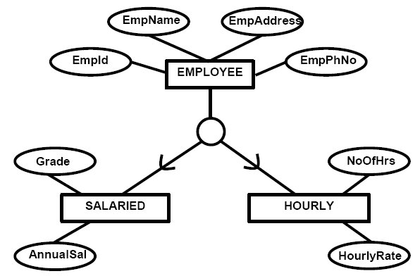
Superclass / Subclass Relationship
Entity Relationship Modelling

Slide 7
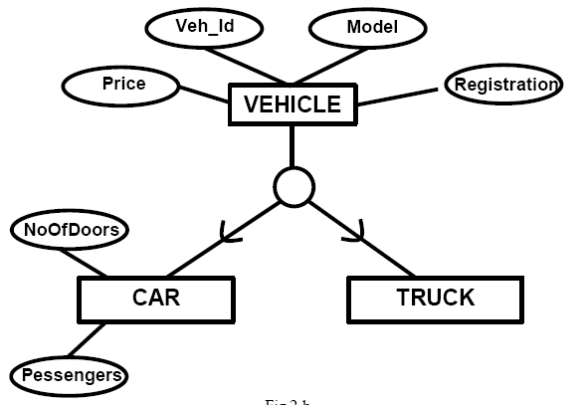
Superclass / Subclass Relationship
Entity Relationship Modelling

Slide 8
Superclass / Subclass Relationship
A subclass contains only specific attributes and may participate in relationship types by its own
A subclass is a specialization of its superclass
The superclass is generalization of all its subclasses
Specialization and generalization are inverses of each other
An instance of the subclass is also an instance of the superclass
These two instances represent the same real entity
A subclass instance inherits all the superclass attribute values and all relationship participations from its image in the superclass

Slide 9
Entity Type
Strong Entity Type
  Entity type that is not existence-dependent on some other entity type.
Weak Entity Type
  Entity type that is existence-dependent on some other entity type.

Slide 10
Weak Entity Type Examples
M
Weak relationship type
Weak entity type
DepName
M
1
Dependent
Has
Employee

