Slide 1
Digital Fundamentals
CHAPTER 4
Boolean Algebra and Logic Simplification

Slide 2
Chapter Outline
4–1 Boolean Operations and Expressions
4–2 Laws and Rules of Boolean Algebra
4–3 DeMorgan’s Theorems
4–4 Boolean Analysis of Logic Circuits
4–5 Logic Simplification Using Boolean Algebra
4–6 Standard Forms of Boolean Expressions
4–7 Boolean Expressions and Truth Tables
4–8 The Karnaugh Map
4–9 Karnaugh Map SOP Minimization
4–10 Karnaugh Map POS Minimization
4–11 The Quine-McCluskey Method
4–12 Boolean Expressions with VHDL Applied Logic

Slide 3
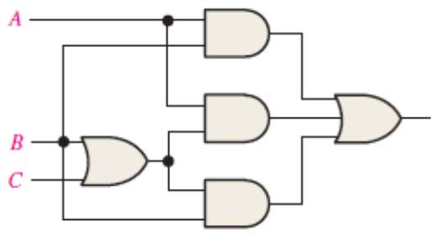

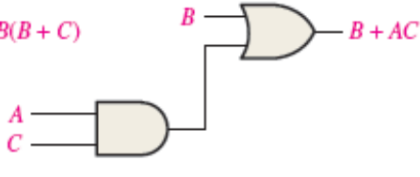
4–5 Logic Simplification Using Boolean Algebra
A simplified Boolean expression uses the fewest gates possible to implement a given
expression.
Using Boolean algebra techniques, simplify this expression:
AB + A(B + C) + B(B + C)
Solution
The following is not necessarily the only approach.
Step 1: Apply the distributive law to the second and third terms in the expression, as follows:
AB + AB + AC + BB + BC
Step 2: Apply rule 7 (BB = B) to the fourth term.
AB + AB + AC + B + BC
Step 3: Apply rule 5 (AB + AB = AB) to the first two terms.
AB + AC + B + BC
Step 4: Apply rule 10 (B + BC = B) to the last two terms.
AB + AC + B
Step 5: Apply rule 10 (AB + B = B) to the first and third terms.
B + AC

Slide 4
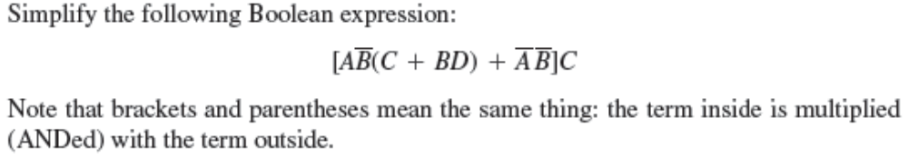
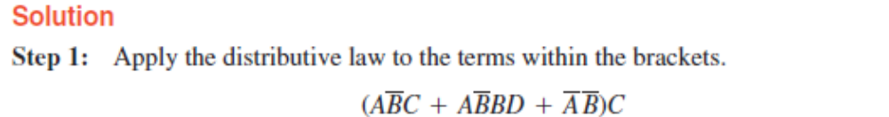
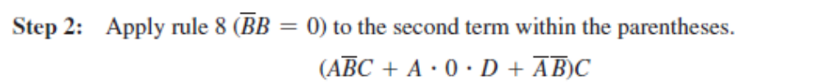
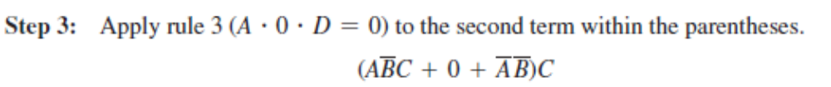
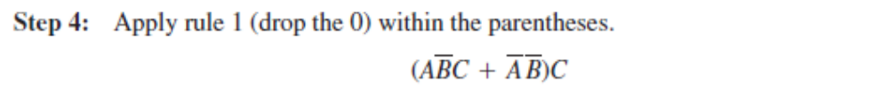
4–5 Logic Simplification Using Boolean Algebra

Slide 5
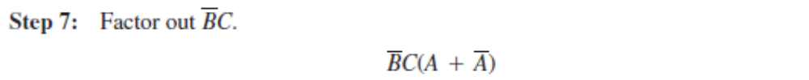
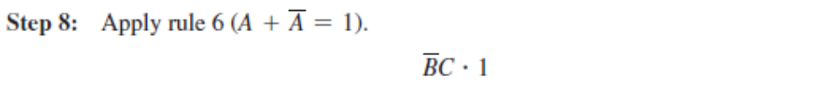
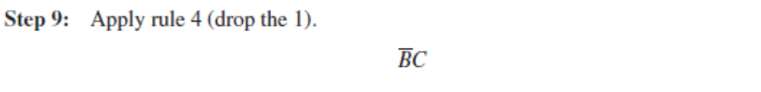
4–5 Logic Simplification Using Boolean Algebra

Slide 6
4-6 Standard Forms of Boolean Expressions
Identify a sum-of-products (SOP) expression or product-of-sums (POS) form
Determine the domain of a Boolean expression
Convert any SOP or POS expression to a standard form
Evaluate a standard expression in terms of binary values
Convert from one standard form to the other

Slide 7
Standard Forms of Boolean Expressions
The sum-of-product (SOP) form
    Example: X = AB + CD + EF
The product of sum (POS) form
    Example: X = (A + B)(C + D)(E + F)
Notes:
All Boolean expressions, regardless of their form, can be converted into either of two standard forms: the sum-of-products form or the product-of-sums form
Standardization makes the evaluation, simplification, and implementation of Boolean expressions much more systematic
and easier.

Slide 8
The Sum-of-Products (SOP) Form
A product term: a term consisting of the product (Boolean multiplication) of literals (variables or their complements).
When two or more product terms are summed by Boolean addition, the resulting expression is a sum-of-products(SOP).
AB + ABC
ABC + CDE + BCD
AB +ABC + AC

Slide 9
Domain of a Boolean Expression
The domain of a general Boolean expression is the set of variables contained in the expression in either complemented or un-complemented form. For example,
AB + ABC is the set of variables A, B, C
ABC + CDE + BCD is the set of variables A, B, C, D, E.

Slide 10
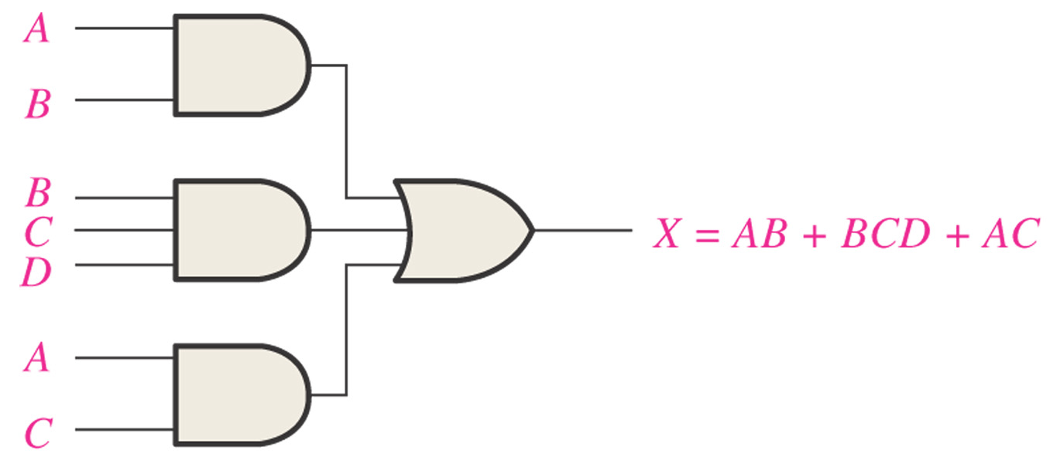
Figure 4–18 Implementation of the SOP expression AB + BCD + AC.

Slide 11
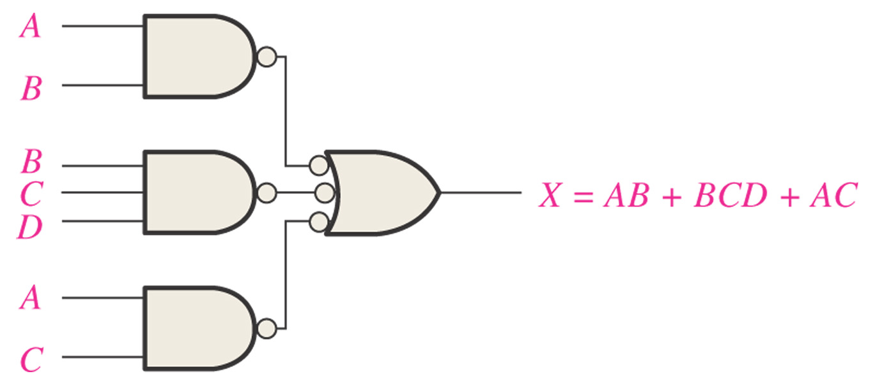
Figure 4–19
This NAND/NAND implementation is equivalent to the AND/OR in Figure 4–18.

Slide 12
Conversion of a General Expression to SOP Form
Any logic expression can be changed into SOP form by applying Boolean algebra techniques.
For example,
A(B + CD)
=> AB + ACD //distributive law:

Slide 13
Example: Conversion of a General Expression to SOP Form
(1)
(A + B)(B + C + D)
= AB + AC + AD + BB + BC + BD
(2)
(A + B)+C
=(A + B)C
=(A + B)C
=AC+BC

Slide 14
The Standard SOP Form
A standard SOP expression is one in which all the variables in the domain appear in each product term in the expression. For example,
ABCD + A BCD + ABC D

Slide 15
Converting Product Terms to Standard SOP
A nonstandard SOP expression is converted into standard form using Boolean algebra rule 6
A + A = 1
Step 1: Multiply each nonstandard product term by a term made up of the sum of a missing variable and its complement. This results in two product terms.
Step 2:Repeat Step 1 until all resulting product terms contain all variables in the domain in either complemented or uncomplemented form.
In converting a product term to standard form, the number of product terms is doubled for each missing variable.

Slide 16

EXAMPLE: Converting Product Terms to Standard SOP
Domain of this SOP expression is A, B, C, D
Take one term at a time. The first term, ABC, is missing variable D or D, so multiply the first term by D + D as follows:
ABC = ABC(D + D) = ABCD + ABCD
The second term, A B, is missing variables C or C and D or D, so
first multiply the second term by C + C as follows:
A B = A B(C + C)= A BC + A B C
The two resulting terms are missing variable D or D, so multiply both terms by D + D as follows:
A B = A BC + A B C = A BC(D + D) + A B C(D + D)
= A BCD + A BCD + A B C D + A B C D
In this case, four standard product terms are the result.
The third term, ABCD, is already in standard form. The complete standard SOP form is as follows:
ABCD + ABCD+ A BCD + A BCD + A B C D + A B C D+ ABCD

Slide 17
Binary Representation of a Standard Product Term
A standard product term is equal to 1 for only one combination of variable values. For example, the product term ABCD is equal to 1 when A = 1, B = 0, C = 1, D = 0, as shown below, and is 0 for all other combinations of values for the variables.
ABCD = 1 . 0 . 1 . 0 = 1 x 1 x 1 x 1 = 1
In this case, the product term has a binary value of 1010 (decimal ten).
An SOP expression is equal to 1 only if one or more of the product terms in the expression is equal to 1.

Slide 18
EXAMPLE: Binary Representation of a Standard Product Term
Determine the binary values for which the following standard SOP expression is equal to 1:
ABCD + AB CD + A B C D
Solution
The term ABCD is equal to 1 when
A = 1, B = 1, C = 1, and D = 1.
ABCD = 1 . 1 . 1 . 1 = 1
AB CD is equal to 1 when A = 1, B = 0, C = 0, and D = 1.
AB CD =1 . 0 . 0 . 1 = 1 . 1 . 1 . 1 = 1
A B C D is equal to 1 when A = 0, B = 0, C = 0, and D = 0.
A B C D= 0 . 0 . 0 . 0 = 1 . 1 . 1 . 1 = 1
The SOP expression equals 1 when any or all of the three product terms is 1

Slide 19
The Product-of-Sums (POS) Form
A sum term is defined as a term consisting of the sum (Boolean addition) of literals (variables or their complements).
When two or more sum terms are multiplied, the resulting expression is a product-of-sums (POS). Some examples are
1. (A + B)(A + B + C)
2. (A + B + C)(C + D + E)(B + C + D)
3. A(A + B)(A + B + C)(A + C)

Slide 20
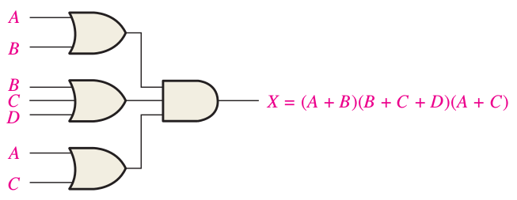
FIGURE 4–24 Implementation of the POS expression (A + B)(B + C + D)(A + C).

Slide 21
The Standard POS Form
A standard POS expression is one in which all the variables in the domain appear in each sum term in the expression. For example,
(A + B + C + D)(A + B + C + D)(A + B + C + D)
Any nonstandard POS expression (referred to simply as POS) can be converted to the standard form using Boolean algebra

Slide 22
Converting a Sum Term to Standard POS
A nonstandard POS expression is converted into standard
form using Boolean algebra rule 8 (A . A = 0)
Step 1: Add to each nonstandard product term a term made up of the product of the missing variable and its complement. This results in two sum terms.
Step 2: Apply rule 12 from Table 4–1: A + BC = (A + B)(A + C)
Step 3: Repeat Step 1 until all resulting sum terms contain all variables in the domain in either complemented or uncomplemented form.

Slide 23

EXAMPLE: Converting a Sum Term to Standard POS
Solution
The domain of this POS expression is A, B, C, D. Take one term at a time. The first term, A + B + C, is missing variable D or D, so add DD and apply rule 12 as follows:
The second term, B + C + D, is missing variable A or A, so add AA and apply rule 12 as follows:
The third term, A + B + C + D, is already in standard form. The standard POS form of the original expression is as follows:

Slide 24
Binary Representation of a Standard Sum Term
A standard sum term is equal to 0 for only one combination of variable values. For example, the sum term A + B + C + D is 0 when A = 0, B = 1, C = 0, and D = 1, as shown below, and is 1 for all other combinations of values for the variables.
A + B + C + D = 0 + 1 + 0 + 1 = 0 + 0 + 0 + 0 = 0
In this case, the sum term has a binary value of 0101 (decimal 5).
Remember, a sum term is implemented with an OR gate whose output is 0 only if each of its inputs is 0. Inverters are used to produce the complements of the variables as required.
A POS expression is equal to 0 only if one or more of the sum terms in the expression is equal to 0.

Slide 25
EXAMPLE: Binary Representation of a Standard Sum Term
Determine the binary values of the variables for which the following standard POS expression is equal to 0:
(A + B + C + D)(A + B + C + D)(A + B + C + D)
The term A + B + C + D is equal to 0 when A = 0, B=0, C=0, and D= 0.
A + B + C + D = 0 + 0 + 0 + 0 = 0
The term A + B + C + D is equal to 0 when A = 0, B = 1, C = 1, and D = 0.
A + B + C + D= 0 + 1 + 1 + 0 = 0 + 0 + 0 + 0 = 0
The term A + B + C + D is equal to 0 when A = 1, B = 1, C = 1, and D = 1.
A + B + C + D = 1 + 1 + 1 + 1 = 0 + 0 + 0 + 0 = 0
The POS expression equals 0 when any of the three sum terms equals 0.

Slide 26
Converting Standard SOP to Standard POS
The binary values of the product terms in a given standard SOP expression are not present in the equivalent standard POS expression. Also, the binary values that are not represented in the SOP expression are present in the equivalent POS expression. Therefore, to convert from standard SOP to standard POS, the following steps are taken:
Step 1: Evaluate each product term in the SOP expression. That is, determine the binary numbers that represent the product terms.
Step 2: Determine all of the binary numbers not included in the evaluation in Step 1.
Step 3: Write the equivalent sum term for each binary number from Step 2 and express in POS form.
Using a similar procedure, you can go from POS to SOP.

Slide 27
Converting Standard SOP to Standard POS
Convert the following SOP expression to an equivalent POS expression:
A B C + ABC + ABC + ABC + ABC
Solution
The evaluation is as follows:
000 + 010 + 011 + 101 + 111
Since there are three variables in the domain of this expression, there are a total of eight (2³ ) possible combinations. The SOP expression contains five of these combinations, so the POS must contain the other three which are 001, 100, and 110. Remember, these are the binary values that make the sum term 0. The equivalent POS expression is
(A + B + C)(A + B + C)(A + B + C)

Slide 28
Checkup
1. Identify each of the following expressions as SOP, standard SOP, POS, or standard POS:
(a) AB + ABD + ACD (b) (A + B + C)(A + B + C)
(c) ABC + ABC (d) (A + C)(A + B)
Solution
1. (a) SOP (b) standard POS (c) standard SOP (d) POS
2. Convert each SOP expression in Question 1 to standard form.
3. Convert each POS expression in Question 1 to standard form.

Slide 29
4–7 Boolean Expressions and Truth Tables
All standard Boolean expressions can be easily converted into truth table format using binary values for each term in the expression.
The truth table is a common way of presenting, in a concise format, the logical operation of a circuit.
Also, standard SOP or POS expressions can be determined from a truth table.

Slide 30
Converting SOP Expressions to Truth Table Format
The first step in constructing a truth table is to list all possible combinations of binary values of the variables in the expression.
Next, convert the SOP expression to standard form if it is not already.
Finally, place a 1 in the output column (X) for each binary value that makes the standard SOP expression a 1 and place a 0 for all the remaining binary values.

Slide 31
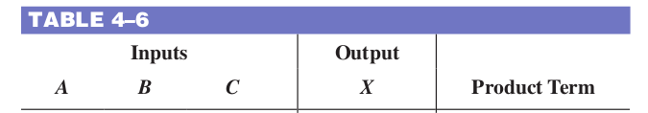
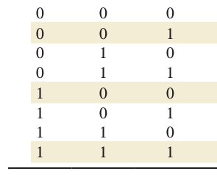
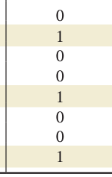
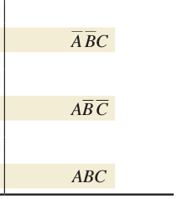
EXAMPLE: Converting SOP Expressions to Truth Table Format
Develop a truth table for the standard SOP expression
A BC + AB C + ABC.
001 + 100 + 111
Domain: A, B, C so 2³=8

Slide 32
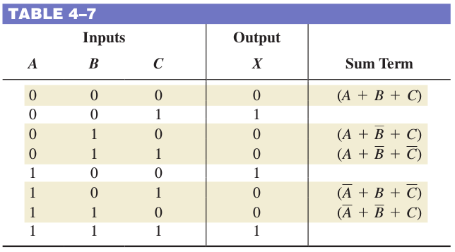
EXAMPLE: Converting POS Expressions to Truth Table Format
Determine the truth table for the following standard POS expression:
(A + B + C)(A + B + C)(A + B + C)(A + B + C)(A + B + C)
(000) (010) (011) (101) (110)
Domain: A, B, C so 2³=8

Slide 33
Determining Standard Expressions from a Truth Table
To determine the standard SOP
  list the binary values of the input variables for which the output is 1.
  Convert it to product term by replacing each 1 with the corresponding variable and each 0 with the corresponding variable complement.
1010  ABCD
To determine the standard SOP
  list the binary values of the input variables for which the output is 0.
  Convert it to product term by replacing each 0 with the corresponding variable and each 1 with the corresponding variable complement.
1001  A+B+C+D

Slide 34
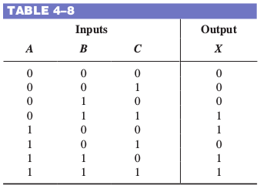

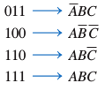
EXAMPLE: Determining Standard Expressions from a Truth Table
From the truth table in Table 4–8, determine the standard SOP expression and the equivalent standard POS expression.

