Slide 1

Wassay Haider
Abubaker Attique

Slide 2
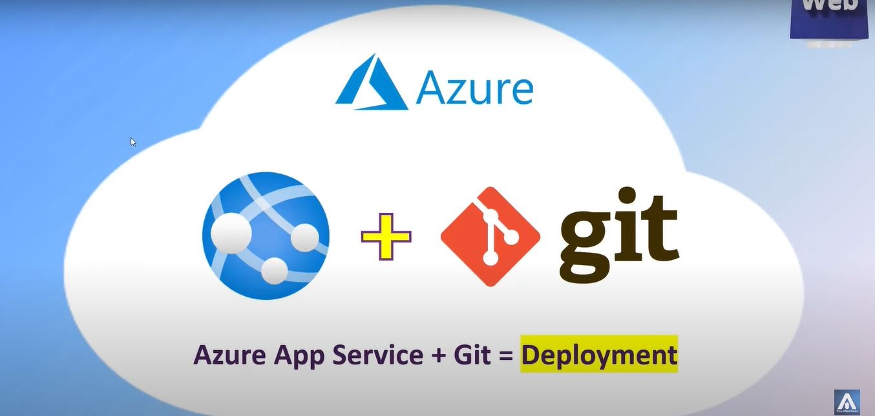

Slide 3
What is Azure ?
Azure is a cloud computing platform and service offered by Microsoft.
It provides a wide range of cloud-based services, including computing, storage, analytics, networking, and other functionality, that can be used to build, deploy, and manage applications and services.

Slide 4
What is Azure App Service?
Quickly Create powerful cloud apps for web and MobileAzure
Azure App Service is an HTTP-based service for hosting web applications, REST APIs, and mobile back ends. You can develop in your favorite language, like .NET, NET Core, Java, Ruby, Node. js, PHP, or Python.
App Service (Paas) not only adds the power of Microsoft Azure to your application, such as security, load balancing, autoscaling, and automated management. You can also take advantage of its DevOps capabilities, such as continuous deployment from Azure DevOps, GitHub, Docker Hub etc.
with App Service, you pay for the Azure compute resources you use.

Slide 5
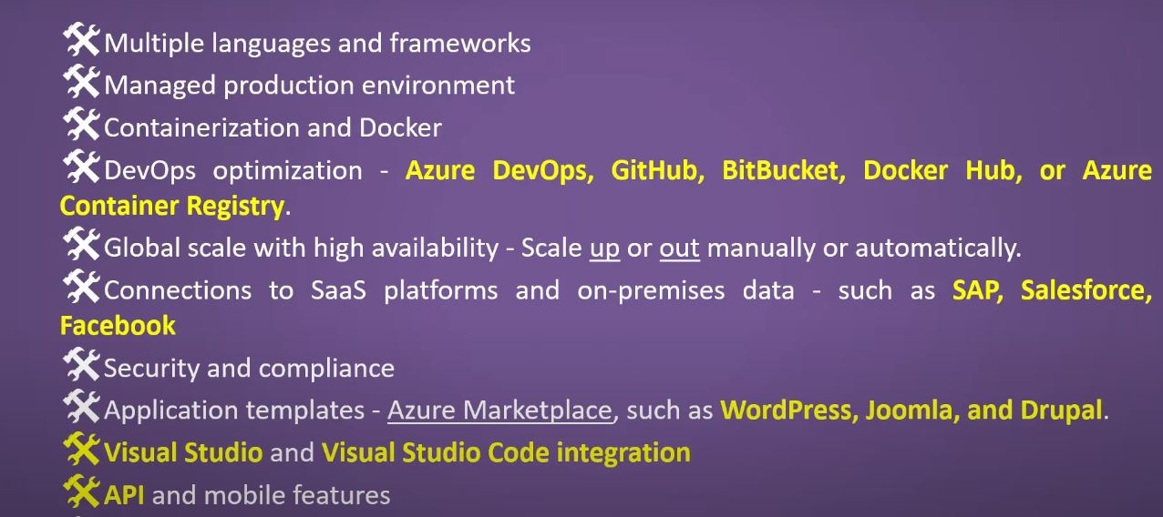
Why use App Service ?

Slide 6
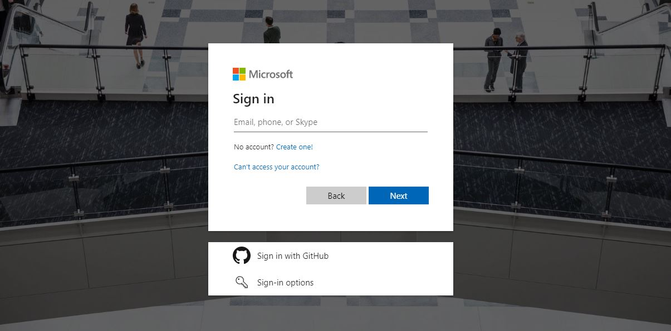

Slide 7
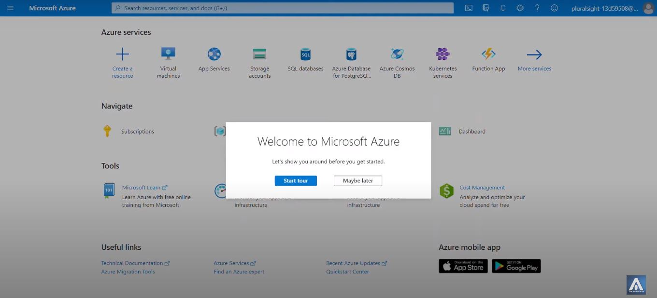

Slide 8
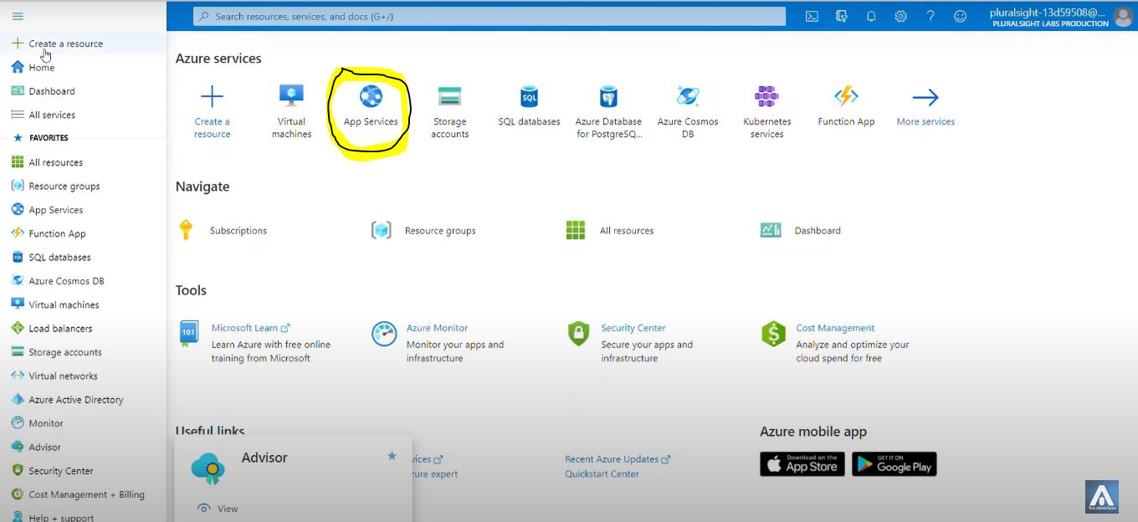

Slide 9
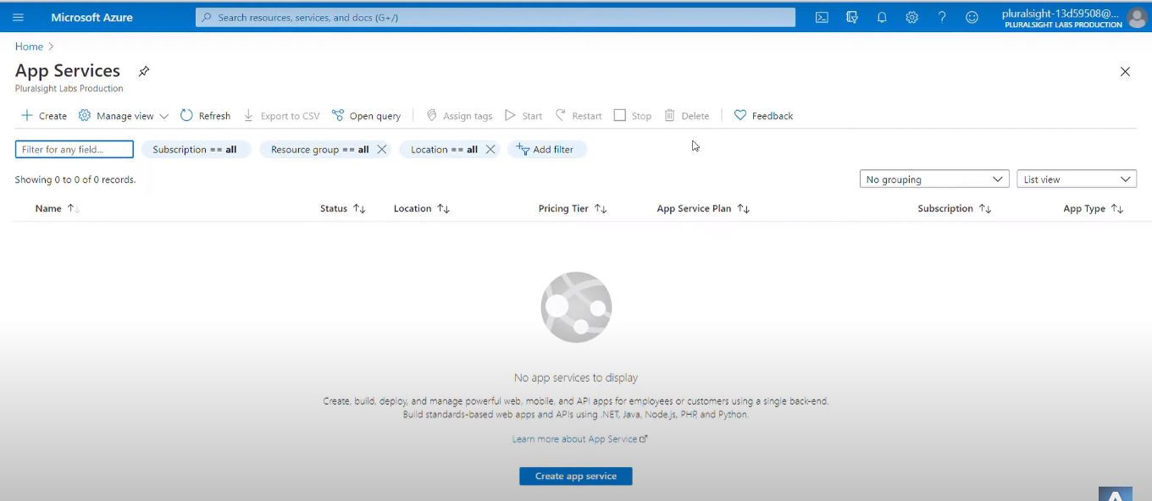

Slide 10
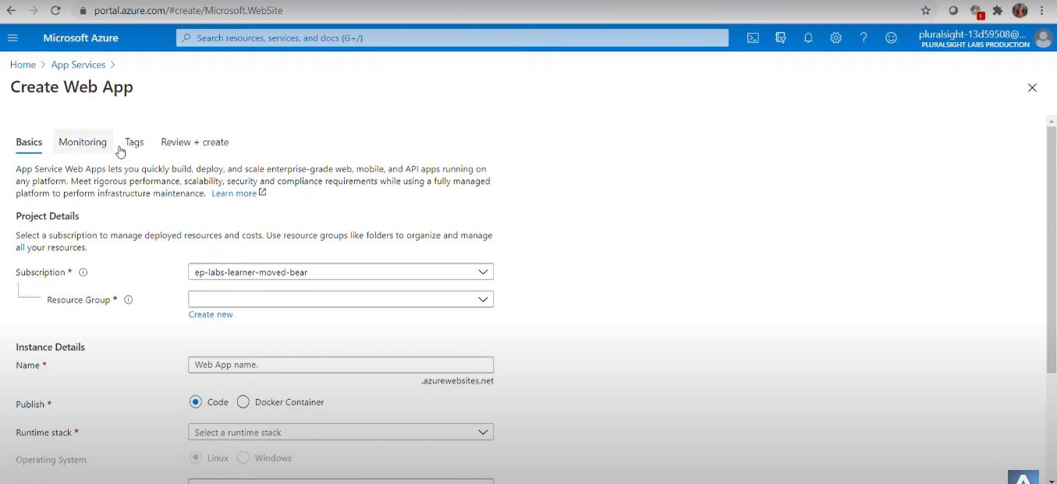

Slide 11
Live Demo

