Slide 1
Fuzzy logic controller
Spring mass damper system

Slide 2
Students ID number
1. Jihad Khair Al-Deen Al-Kenani 1737379
2. Mohammed Nabeal Nofal 1342551
3. Adham Ra'ed Al-A'li 1431415
4. Ramzi Abd-Alhafeed A'amer 1538630
5. Mu'men Fayez Abu-Zeneh 1636716

Slide 3
Objectives
Vibration is a big problem in many industries. So active control for vibration is a very important topic with lot of applications and physical benefit.
In this project fuzzy logic algorithm will be used in MATLAB Simulink for modeling a vibration control system.
In this project we want to control a spring-mass-damper system using fuzzy logic controller.
The primary goal of this project is to observe the control system and construct a rule base that works effectively.

Slide 4
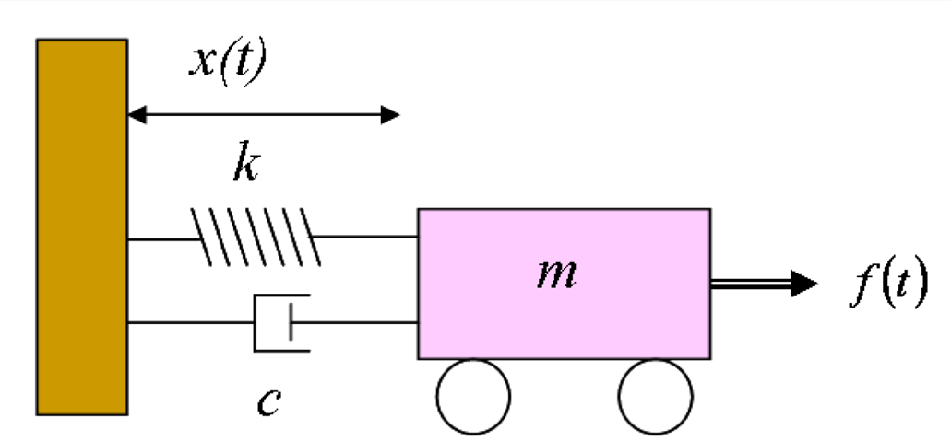
The system

Slide 5
Systems parameters
M : mass = 10 kg
K : spring coefficient = 5 N/m
C : damping coefficient = 5 kg/s
F(t) : external force applied to the system
X(t) : displacement.

Slide 6
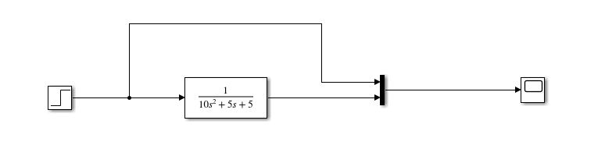
Uncontrolled system

Slide 7
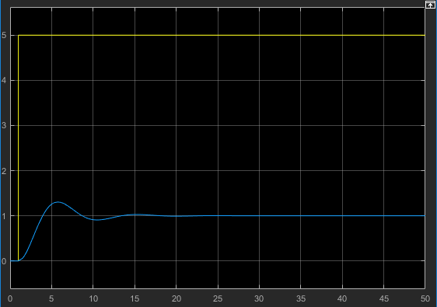
Step input = 5N

Slide 8
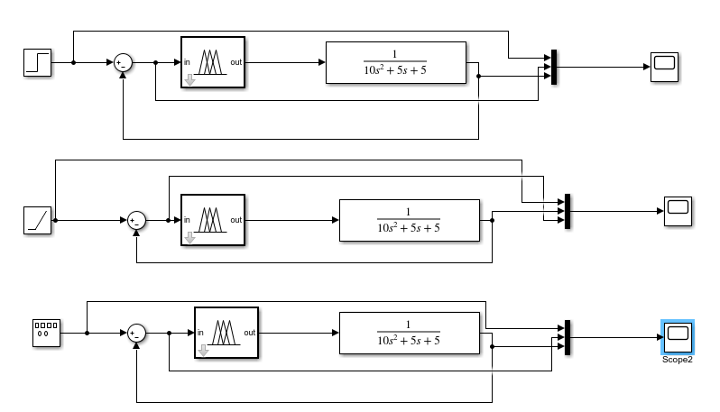

Slide 9
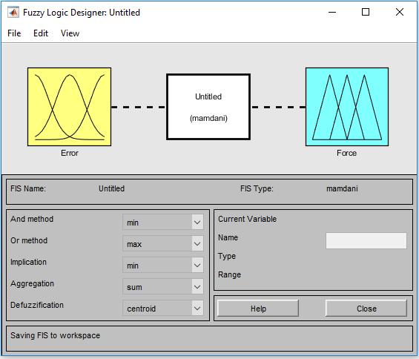

Slide 10
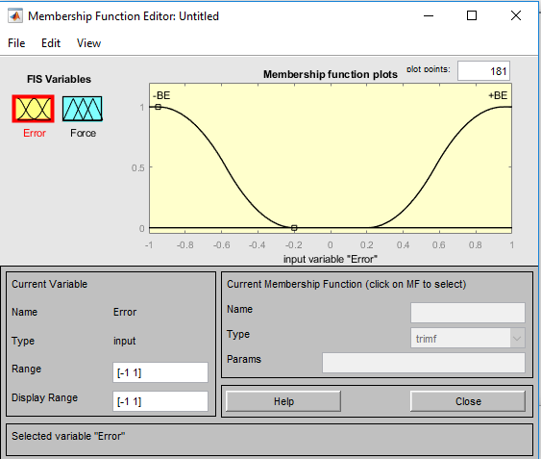

Slide 11
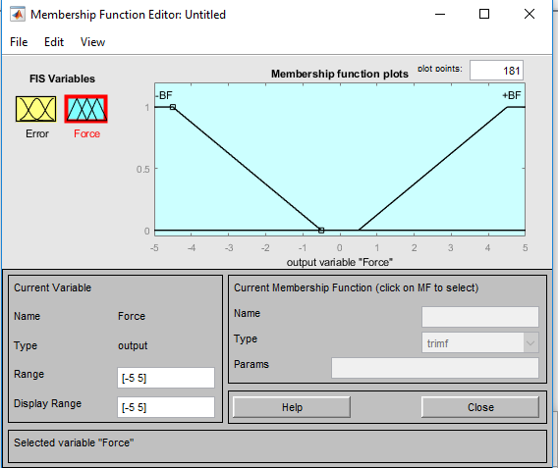

Slide 12
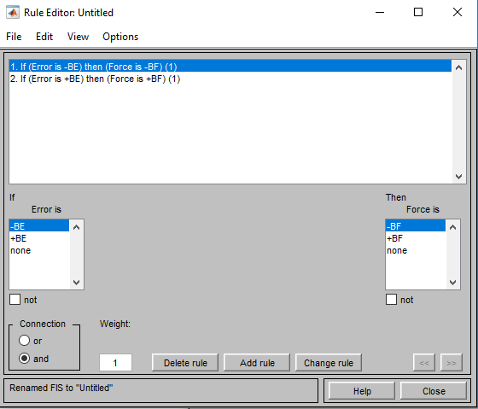

Slide 13
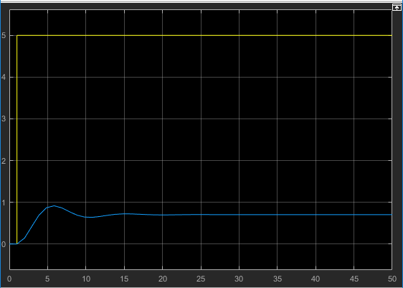

Slide 14
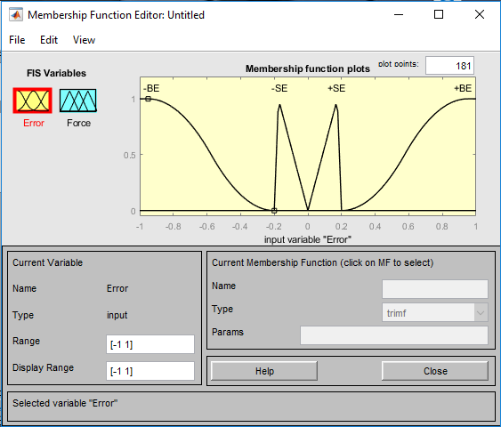

Slide 15
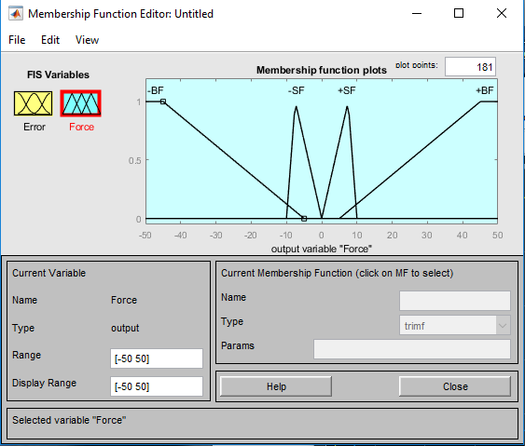

Slide 16
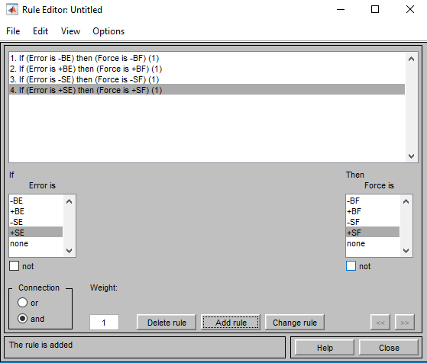

Slide 17
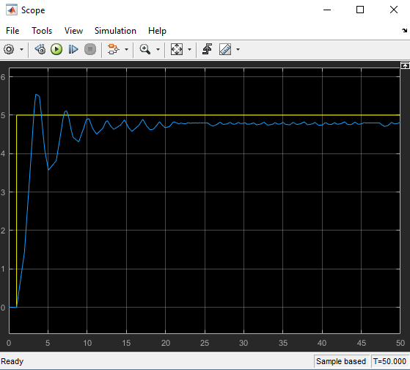

Slide 18
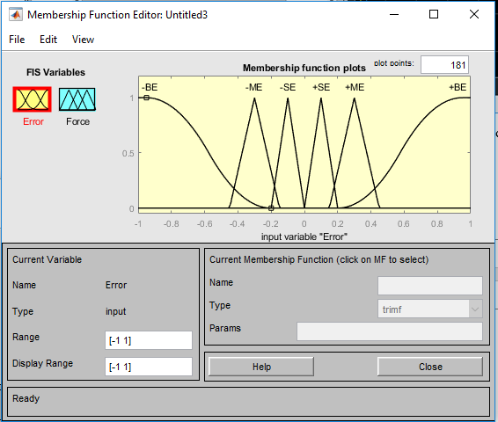

Slide 19
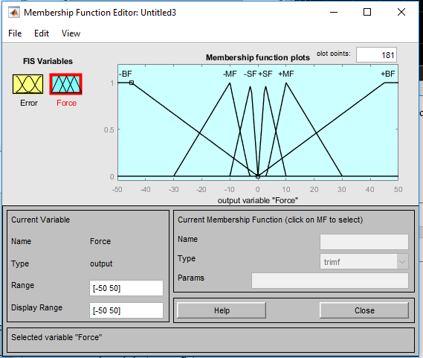

Slide 20
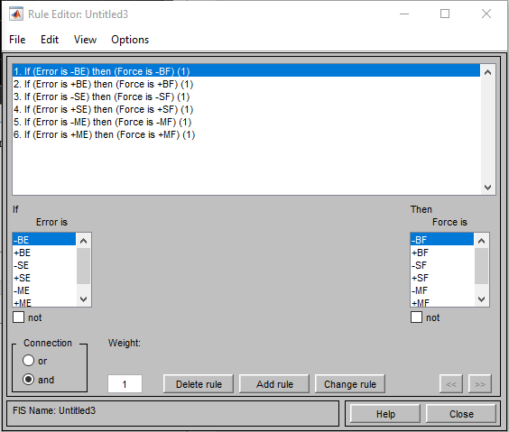

Slide 21
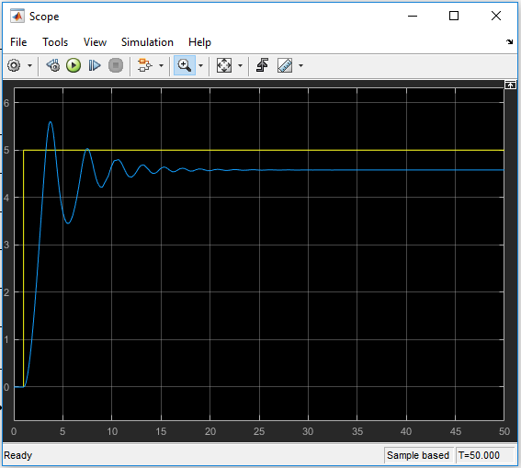

Slide 22
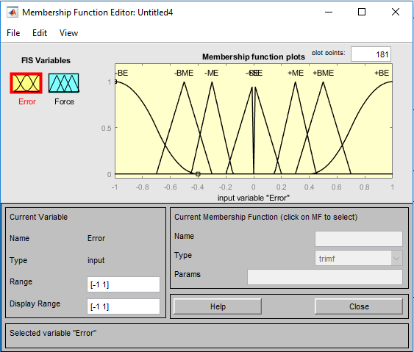

Slide 23
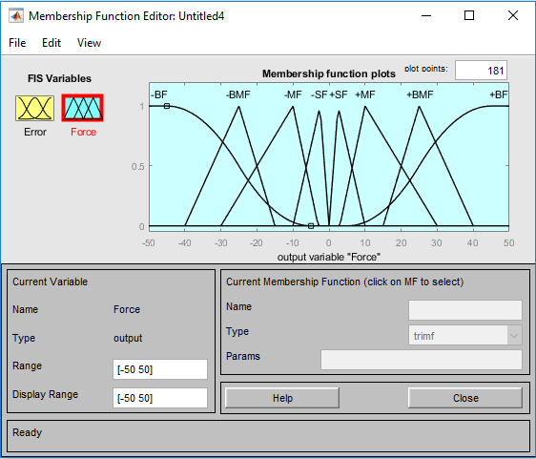

Slide 24
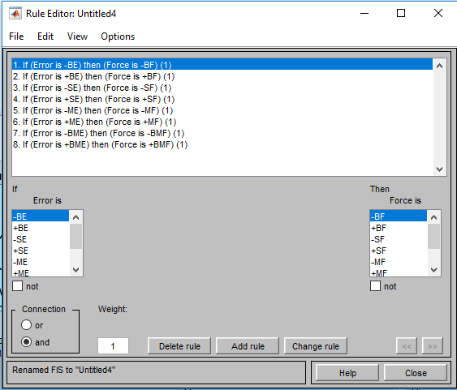

Slide 25
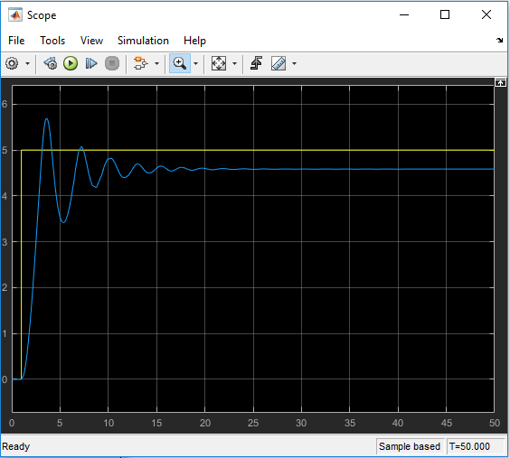

Slide 26
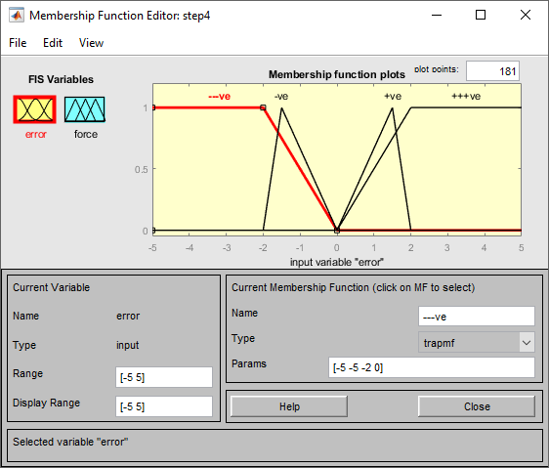

Slide 27
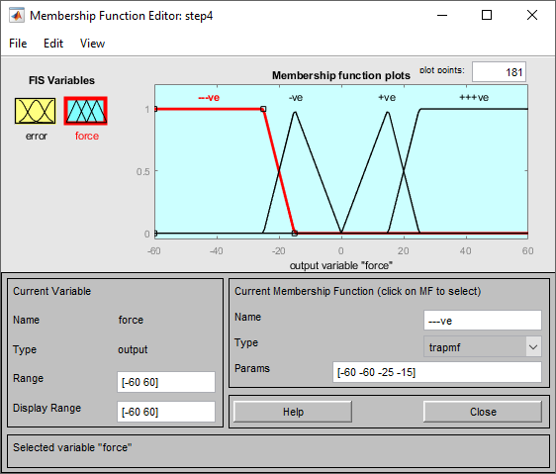

Slide 28
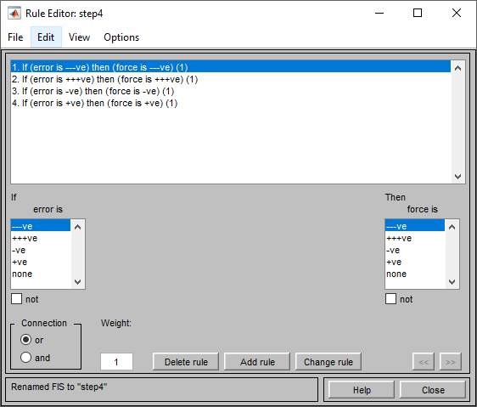

Slide 29
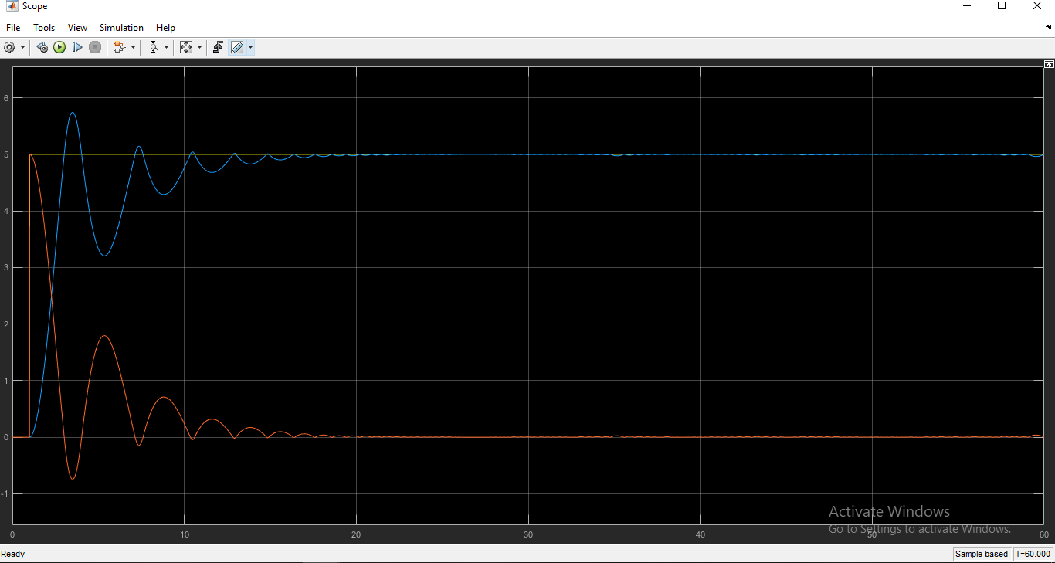

Slide 30
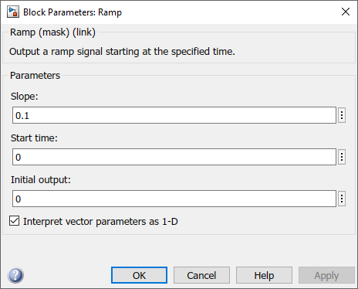

Slide 31
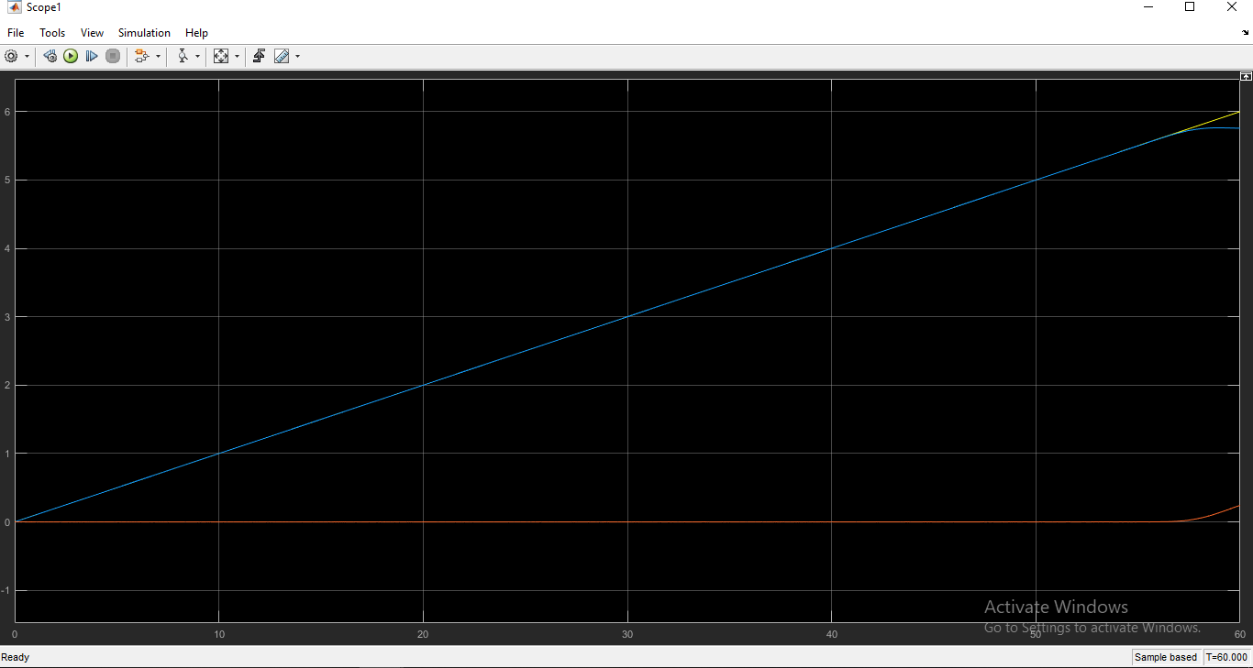

Slide 32
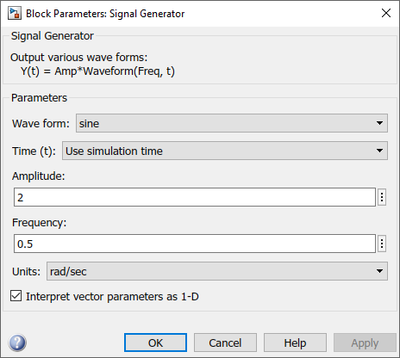

Slide 33
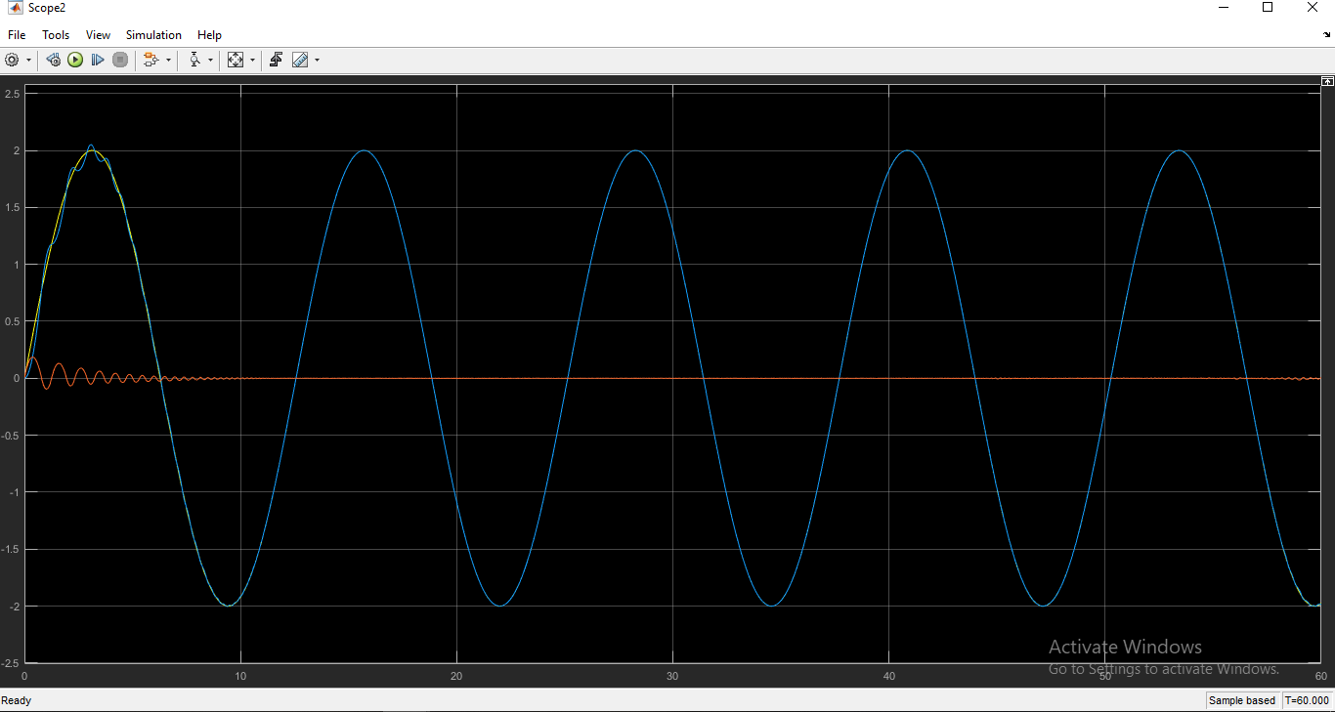

Slide 34
The End

