Slide 1
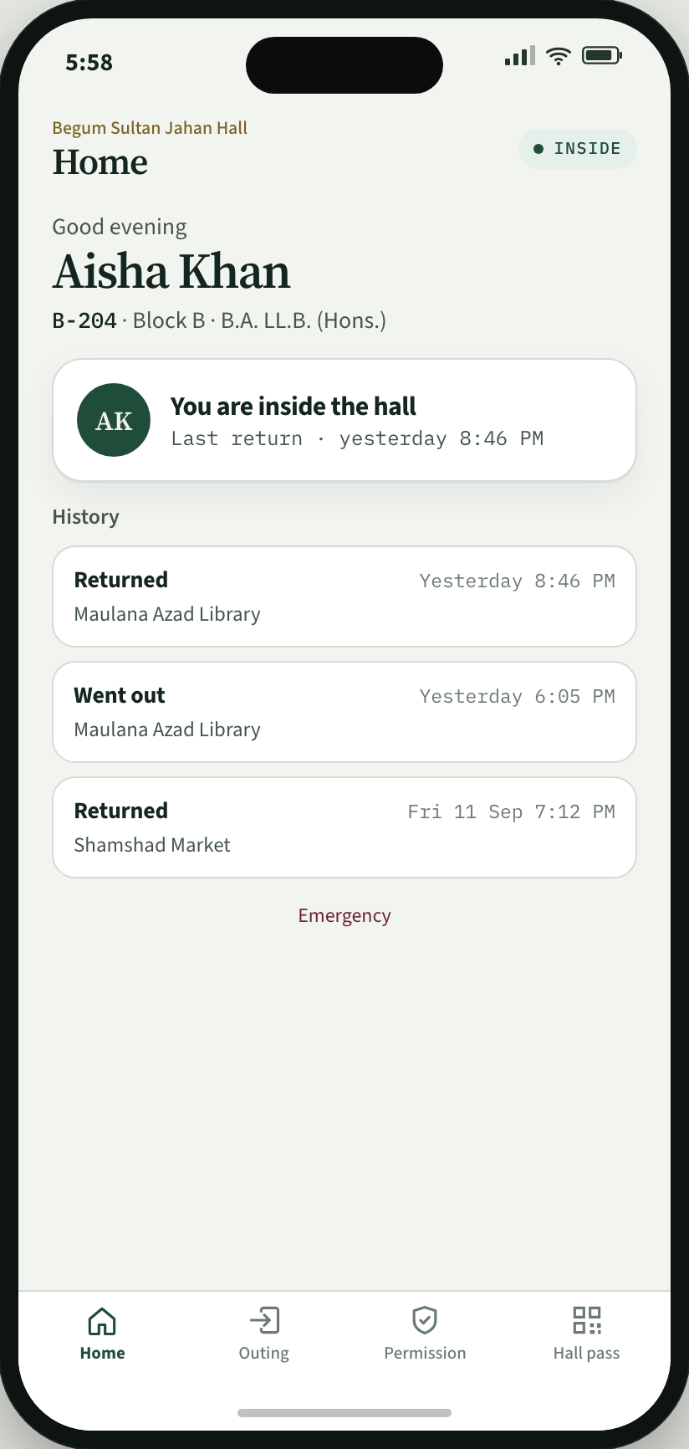
Begum Sultan Jahan Hall
Aligarh Muslim University
Hostel Management App Proposal
Built for
Resident
Warden
Gate staff
Provost
Try a demo
bsj-hostel-demo.vercel.app
Begum Sultan Jahan Hall
bsj-hostel-demo.vercel.app
1

Slide 2
The case
Today
With the app
Movement is a paper register at the gate.
Students and admins check in and check out from one app.
Residents request special permission.
Wardens approve special permission.
Parents are notified if a resident is late.
Begum Sultan Jahan Hall
2

Slide 3
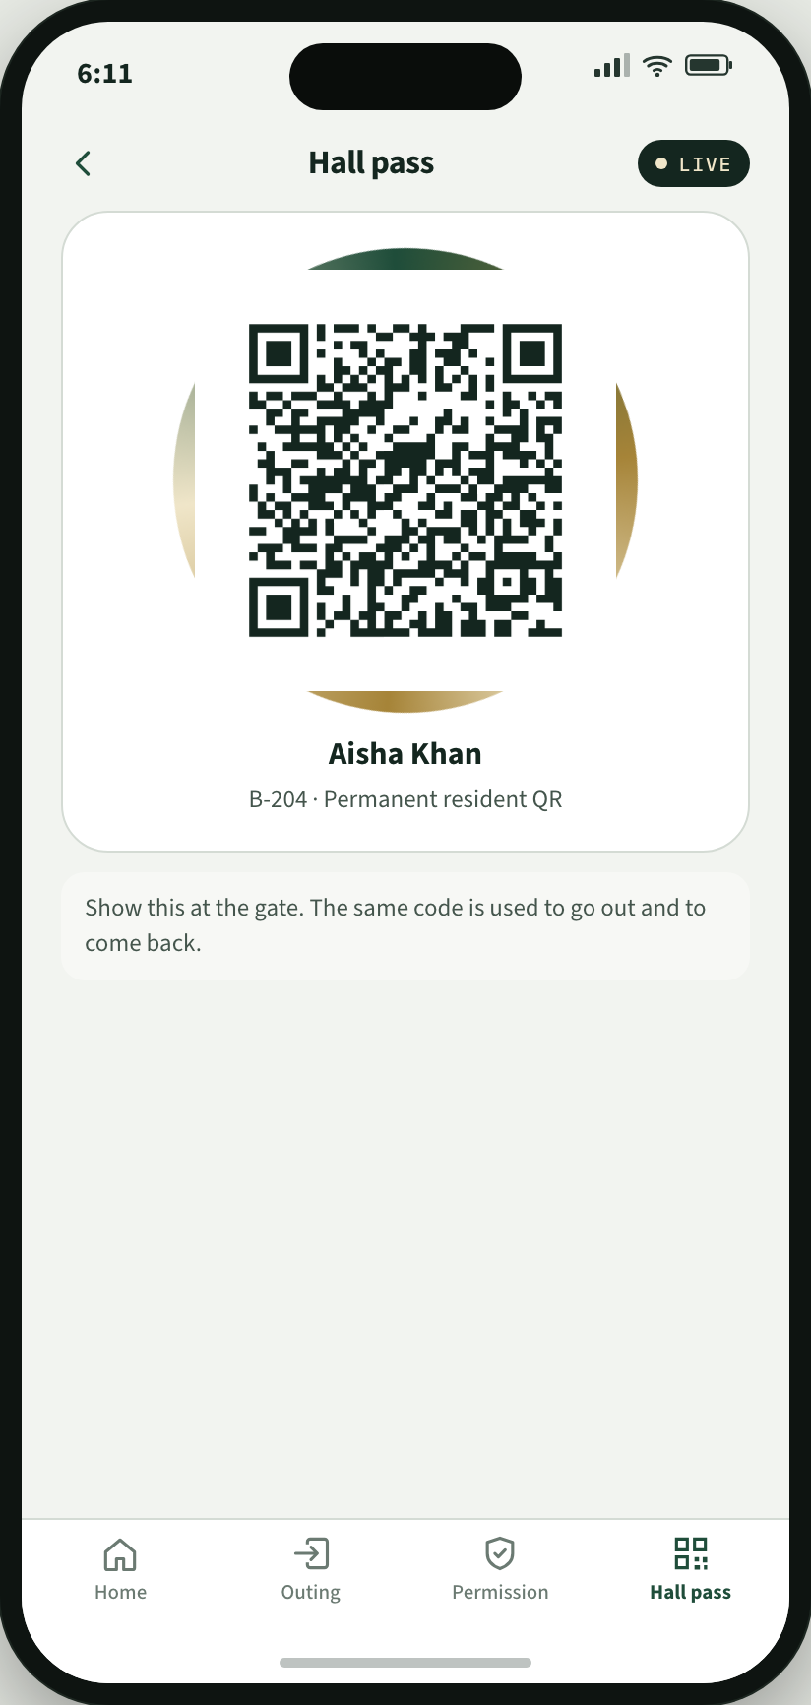
How the hall pass works
Every resident has a hall pass on the phone: a QR code. At the gate, staff scan this hall pass. The app already knows whether that resident is inside the hall or outside.
If the resident is inside the hall
The resident shows the hall pass. Gate staff scan it. The app records that the resident has gone out. Destination and return time were already set in the app.
If the resident is outside
The resident shows the same hall pass. Gate staff scan it. The app records that the resident has come back. Nothing extra to fill in.
Begum Sultan Jahan Hall
3

Slide 4
Built for everyone
Resident
Warden
Plans an outing, requests special permission, and shows the hall pass at the gate.
Sees who is inside, outside, or late. Approves or rejects special permission.
Gate staff
Provost
Scans the resident hall pass. The app records exit or return.
Sees the whole hall. Can export the register.
Begum Sultan Jahan Hall
4

Slide 5
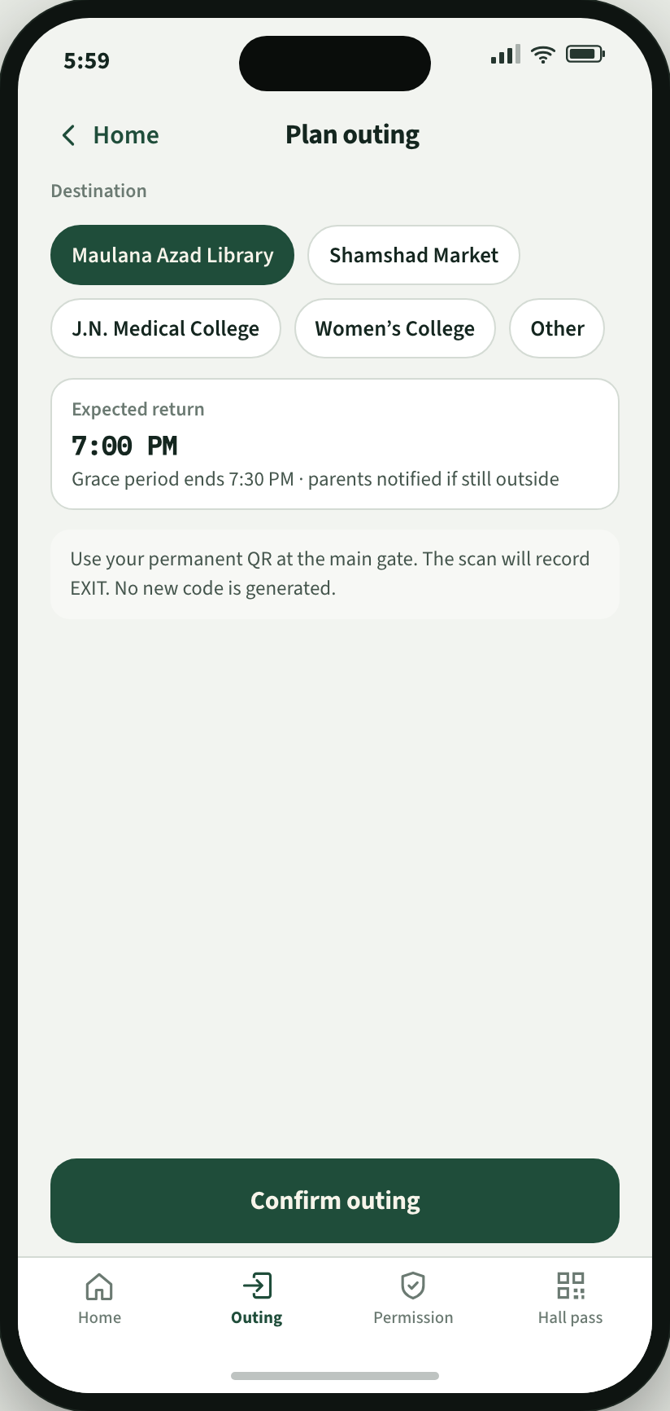
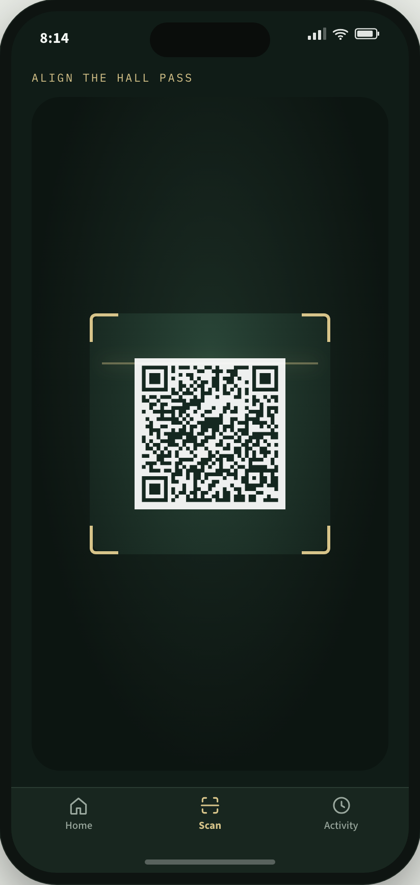
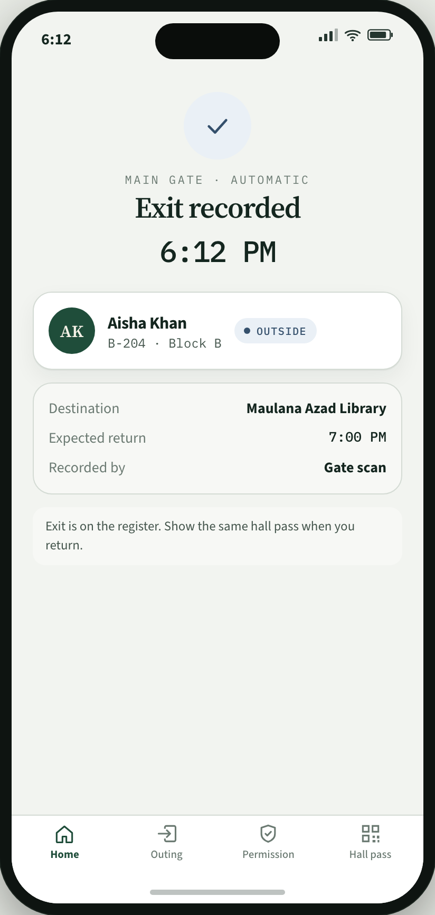
Scenario 1. Normal outing
Resident
Resident
Gate staff
Resident
1
Sets destination and return time.
2
Opens the hall pass at the gate.
3
Scans the hall pass.
4
Exit is recorded.
Begum Sultan Jahan Hall
https://bsj-hostel-demo.vercel.app/outing
5

Slide 6
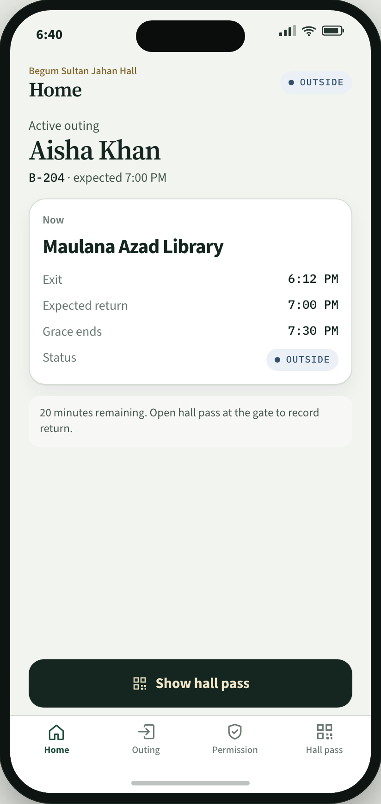
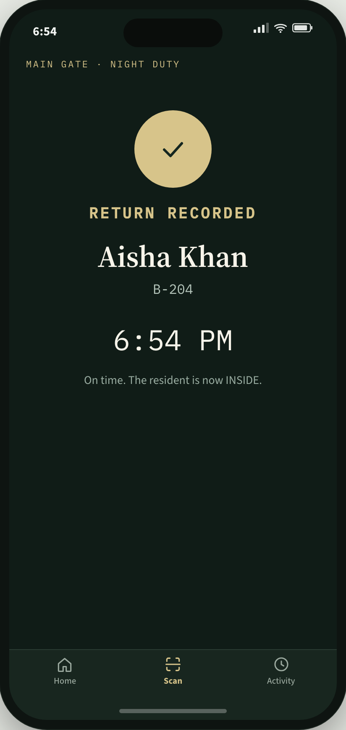
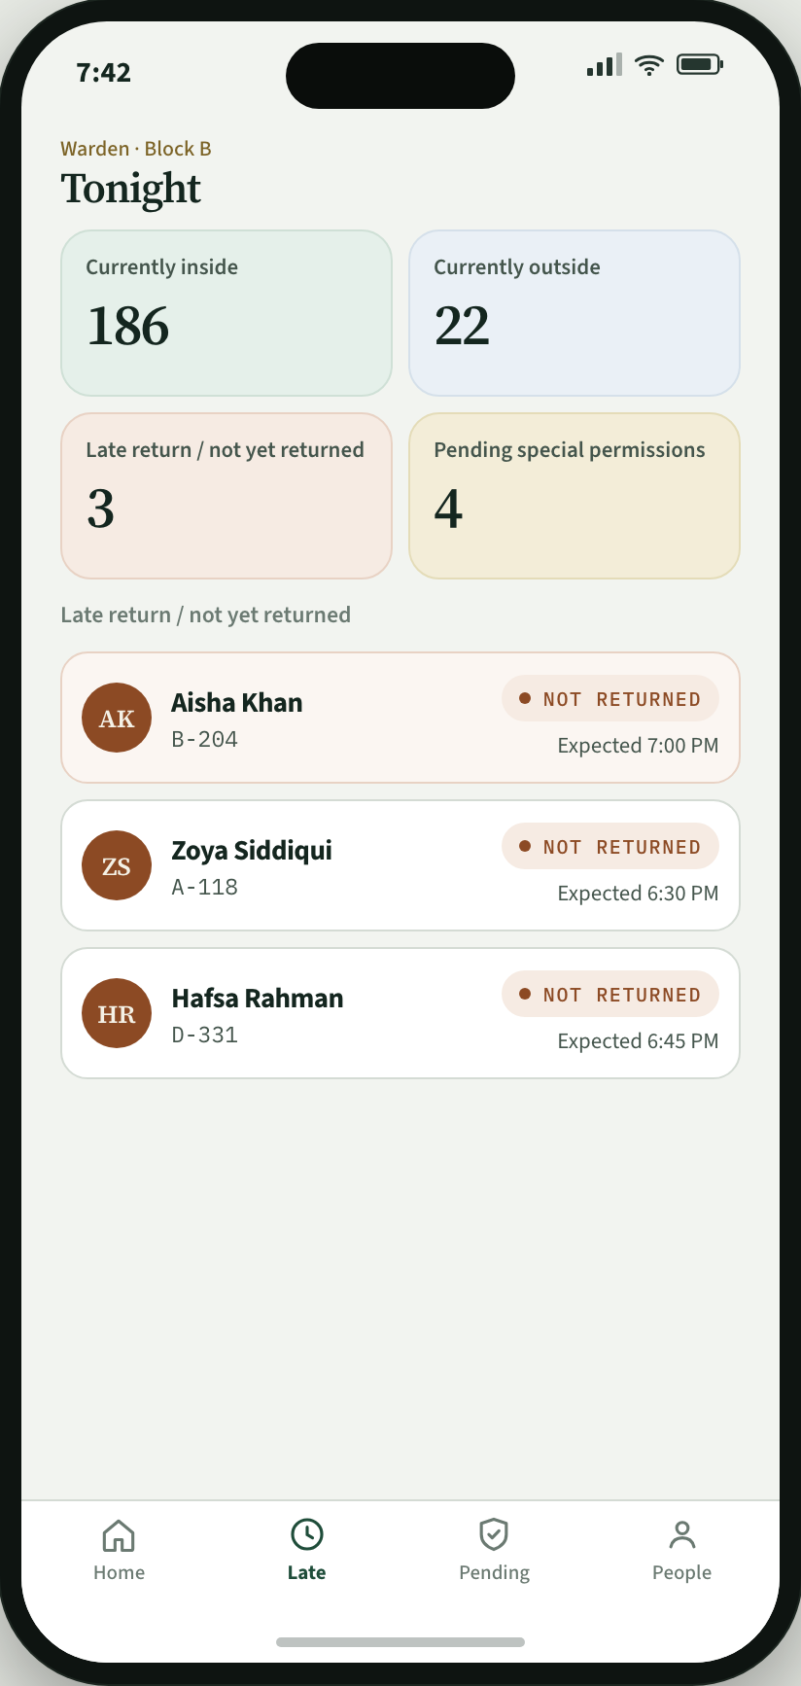
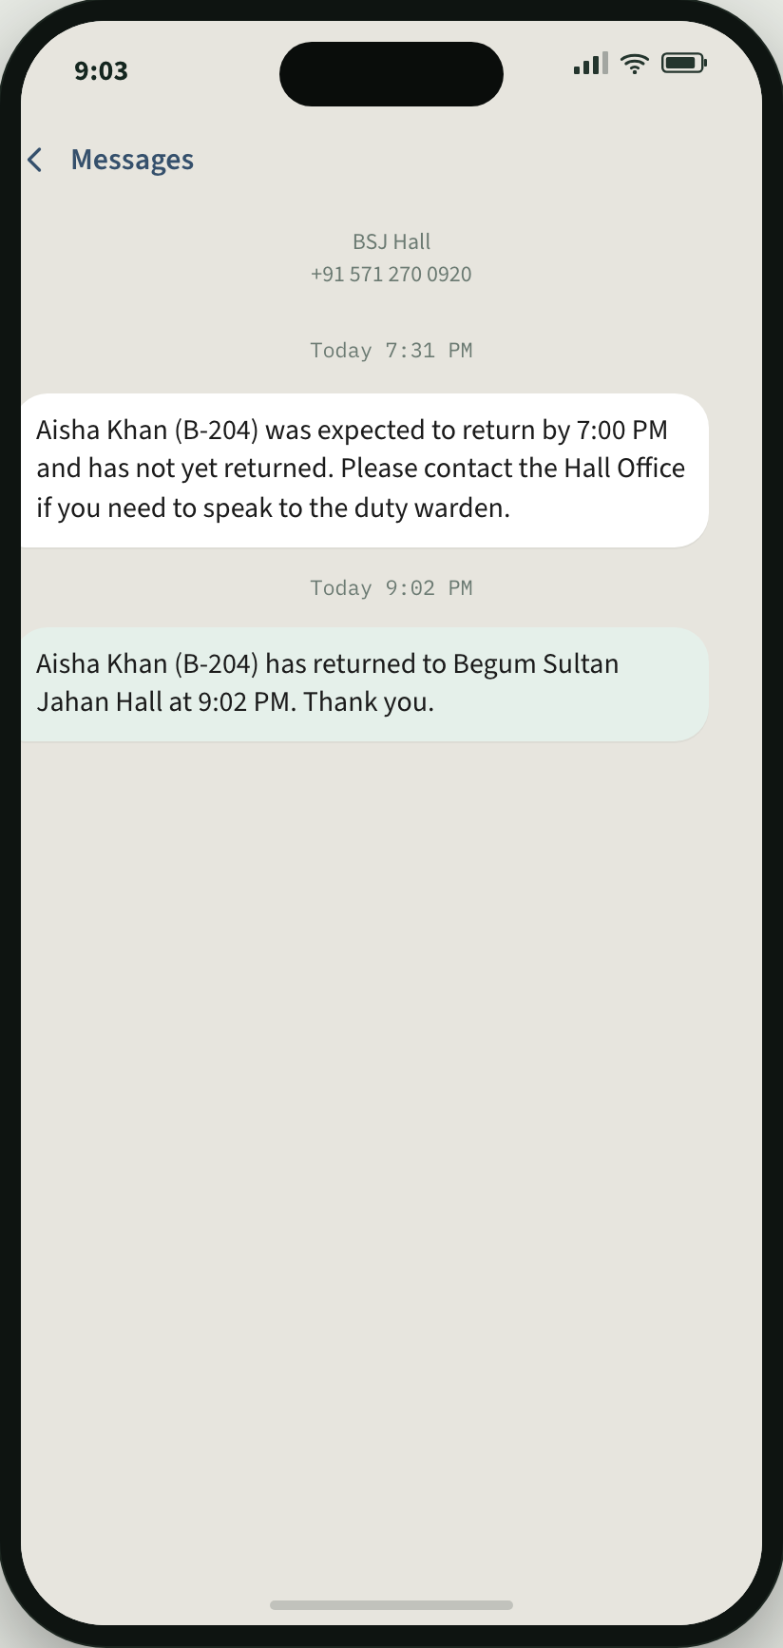
Scenario 2. A resident comes back
Resident
Gate staff
Warden
Parent phone
1
Opens the same hall pass.
2
Scans it. Return is recorded.
3
If late, the warden sees the late list.
4
A parent SMS is sent, then another on return.
Begum Sultan Jahan Hall
https://bsj-hostel-demo.vercel.app/return
6

Slide 7
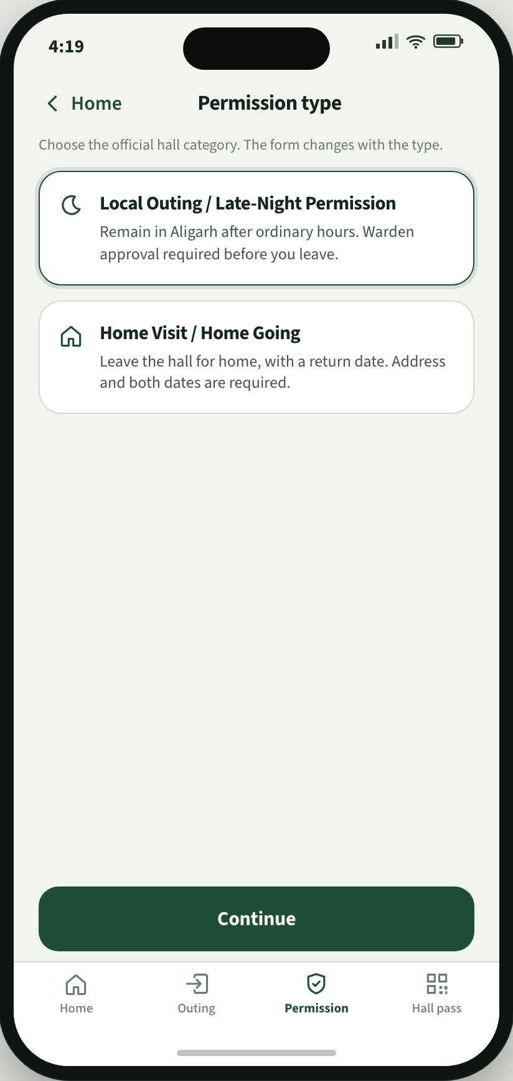
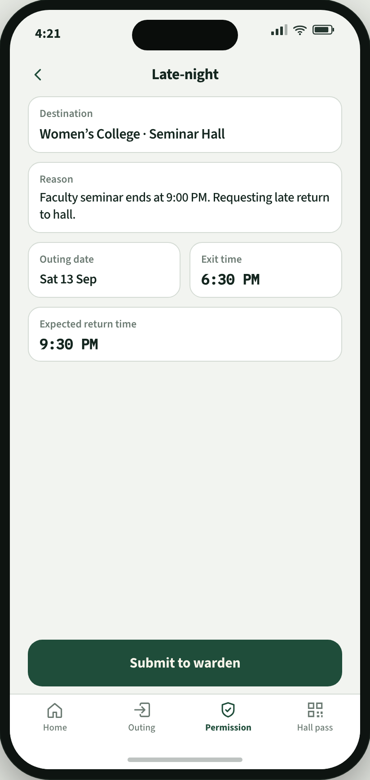
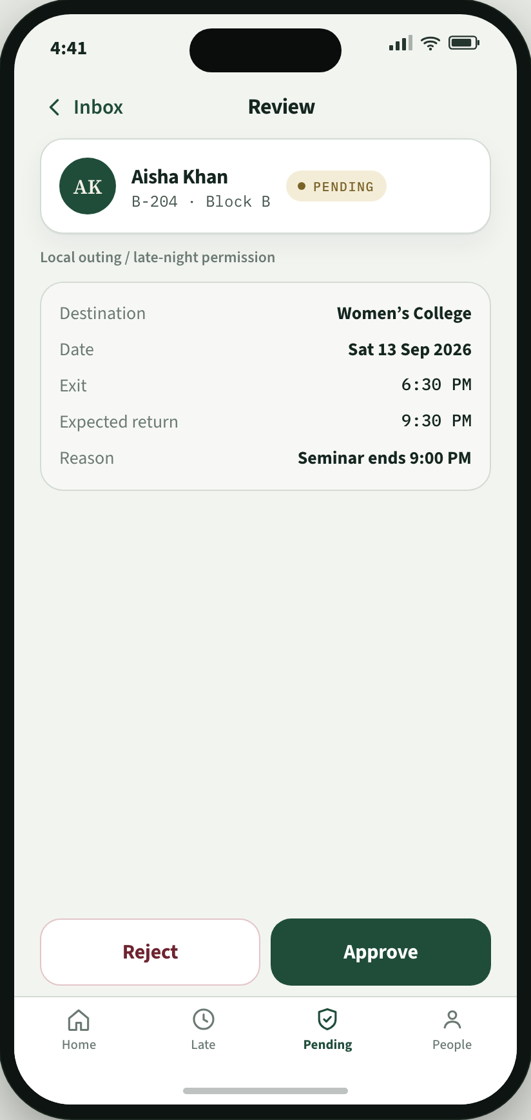
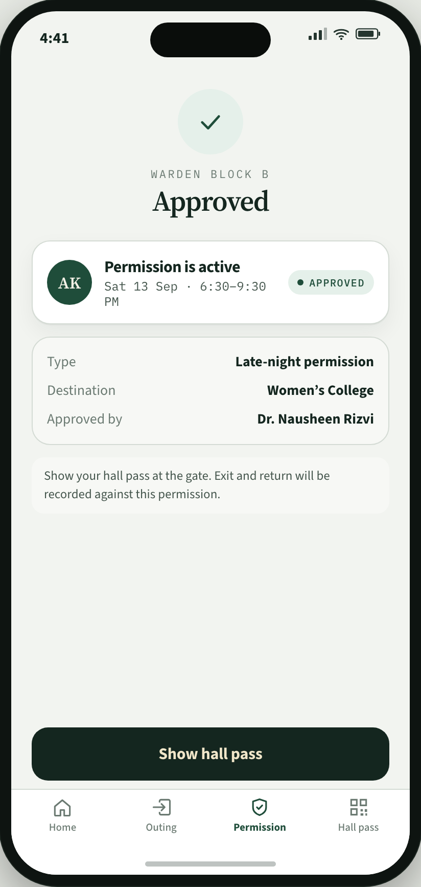
Scenario 3. Special permission
Resident
Resident
Warden
Resident
1
Chooses late-night or home going.
2
Fills the form and sends it to the warden.
3
Approves or rejects.
4
If approved, the same hall pass is used at the gate.
Begum Sultan Jahan Hall
https://bsj-hostel-demo.vercel.app/permission
7

Slide 8
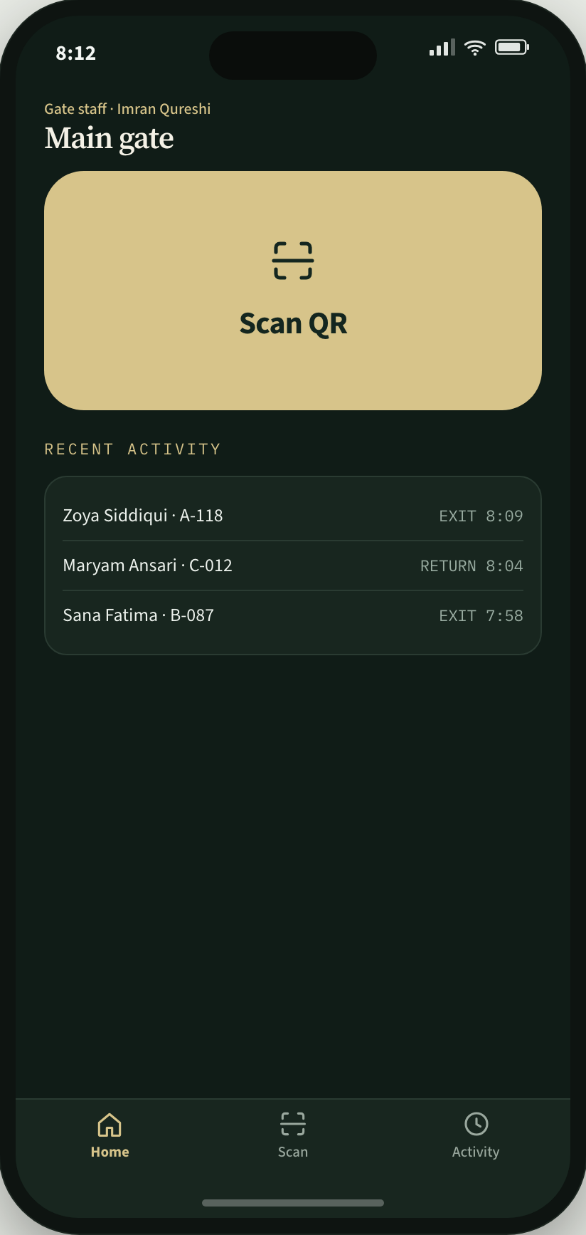
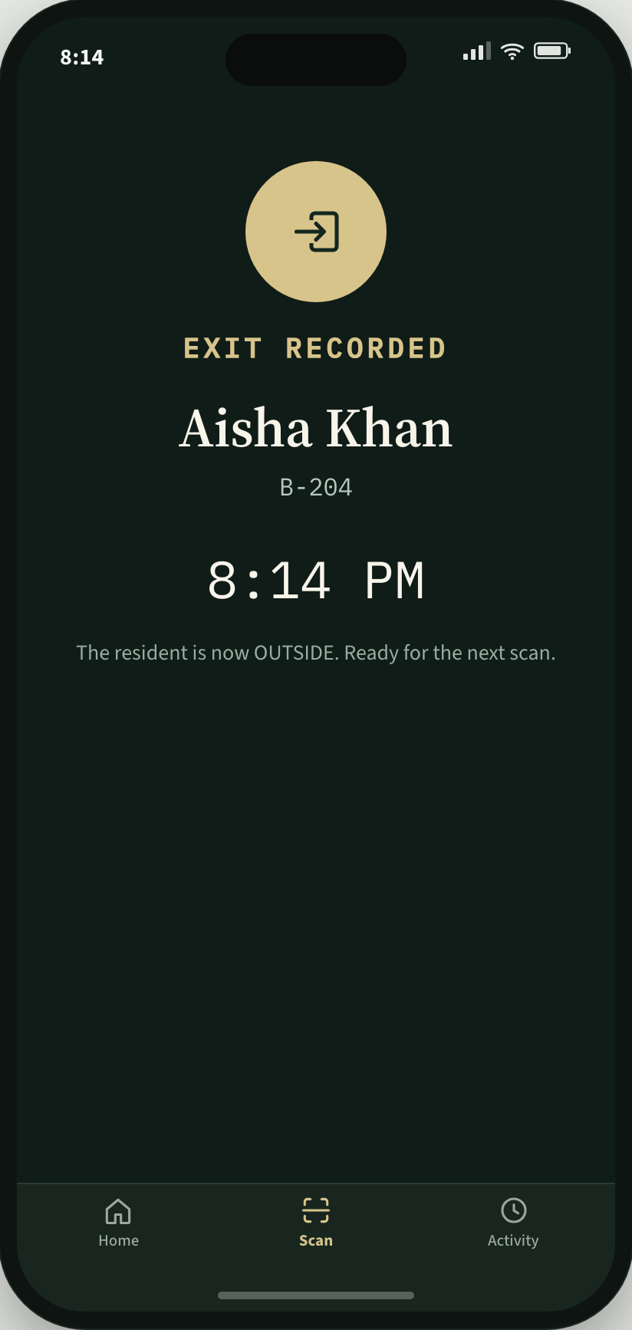
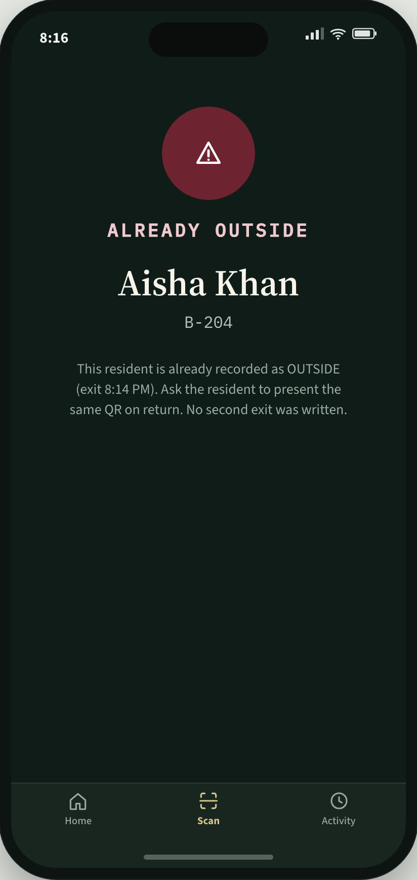
Scenario 4. Gate staff
Gate staff
Gate staff
Gate staff
Gate staff
1
Opens Scan QR.
2
Scans the resident hall pass.
3
Shows Exit recorded or Return recorded.
4
If the scan cannot be used, the screen says what to do.
Begum Sultan Jahan Hall
https://bsj-hostel-demo.vercel.app/gate
8

Slide 9
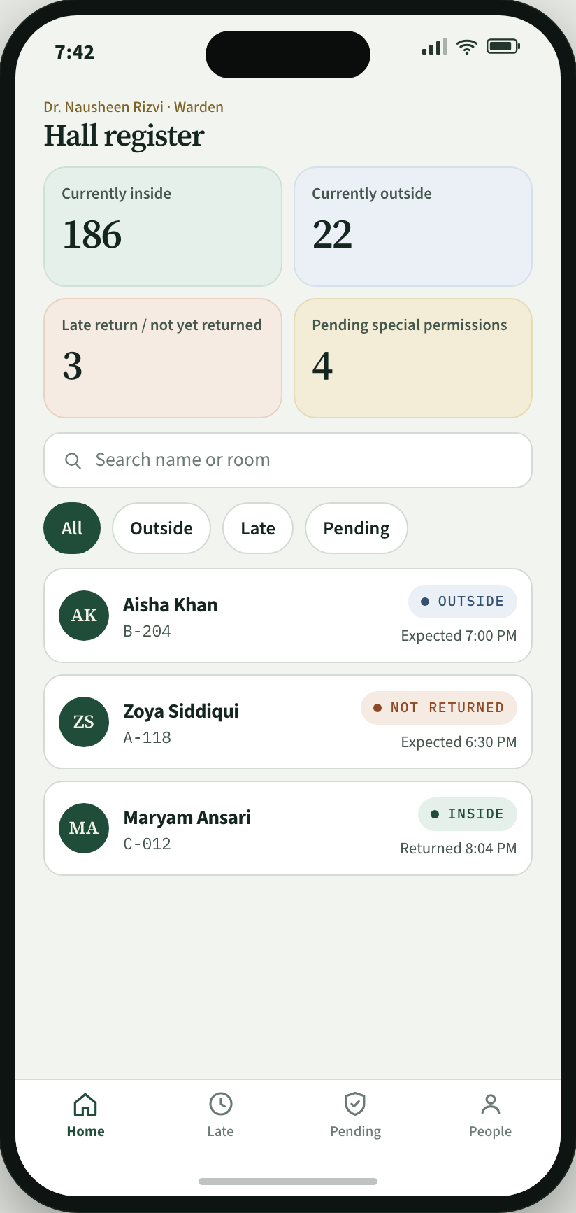
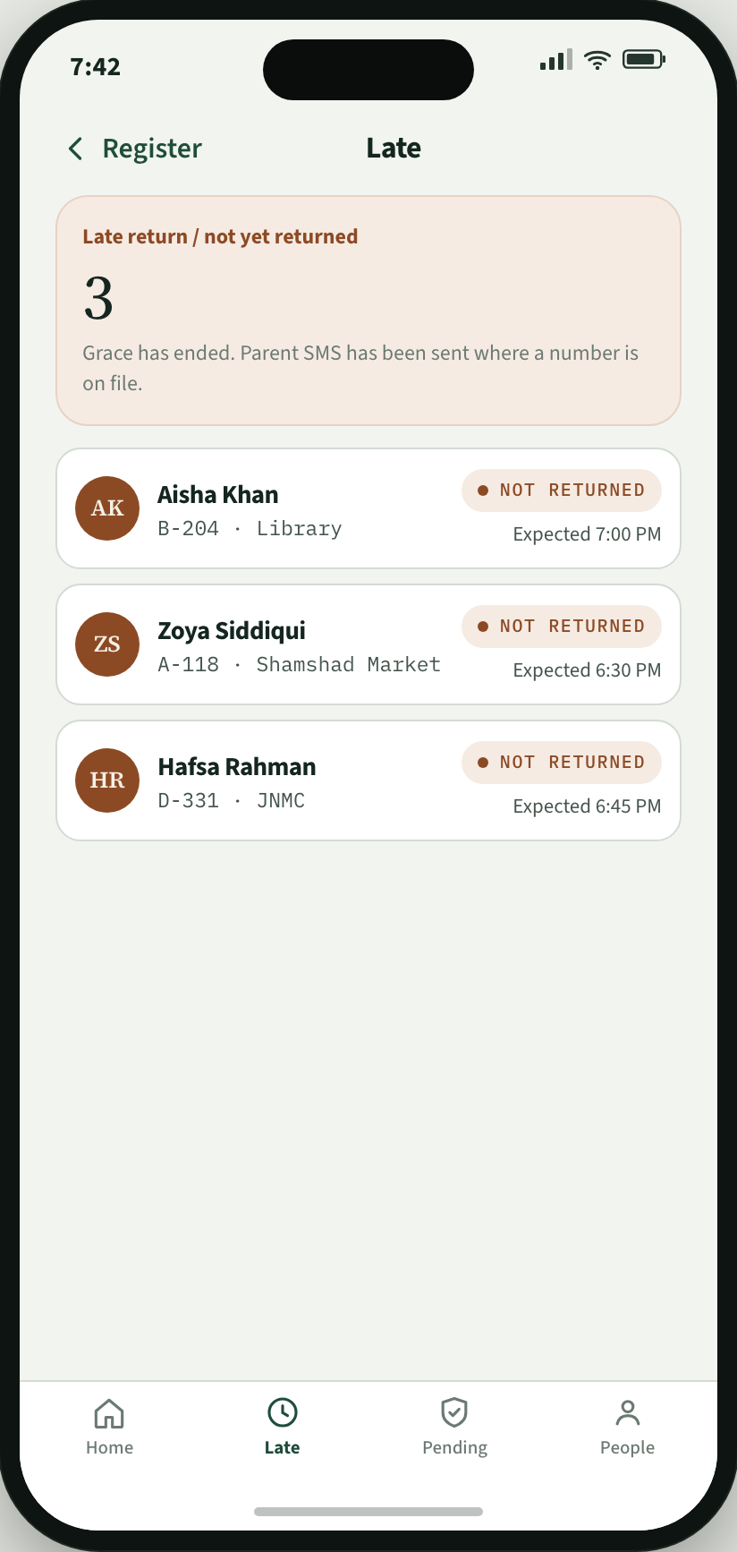
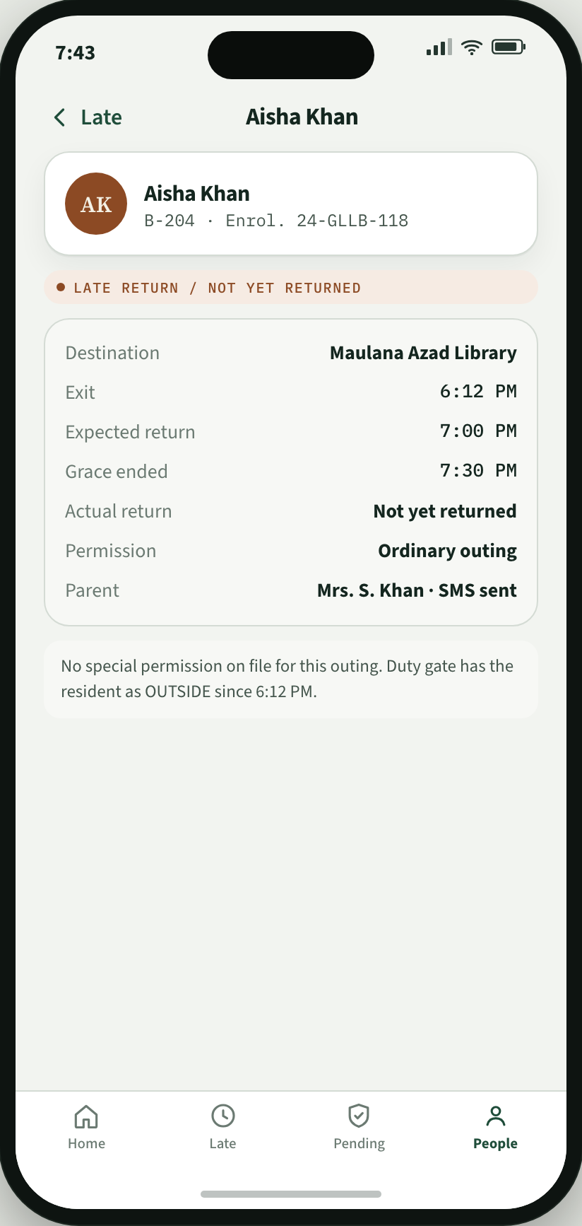
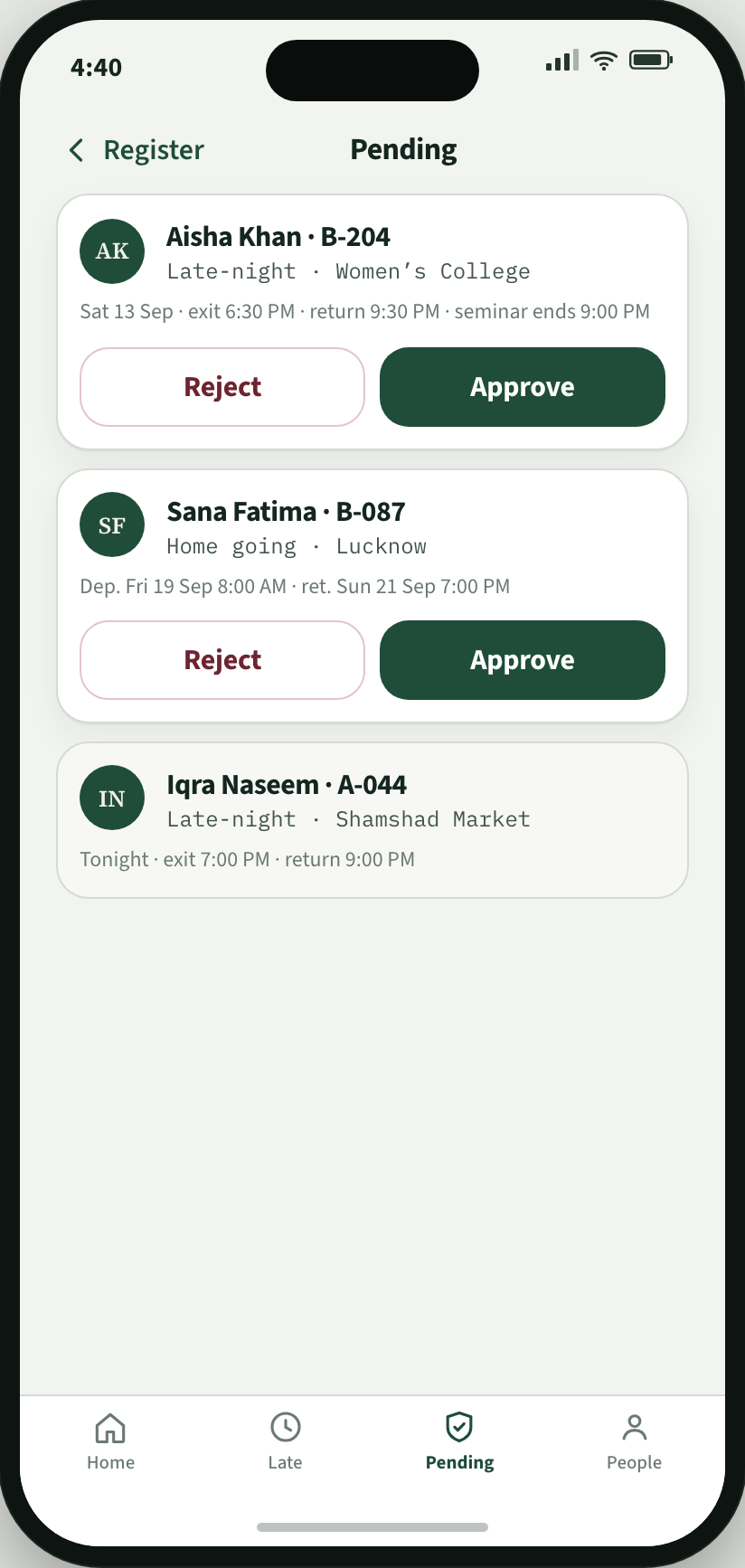
Scenario 5. Warden
Warden
Warden
Warden
Warden
1
Opens the hall register.
2
Opens the late list.
3
Opens a resident record.
4
Approves or rejects special permission.
Begum Sultan Jahan Hall
https://bsj-hostel-demo.vercel.app/warden
9

Slide 10
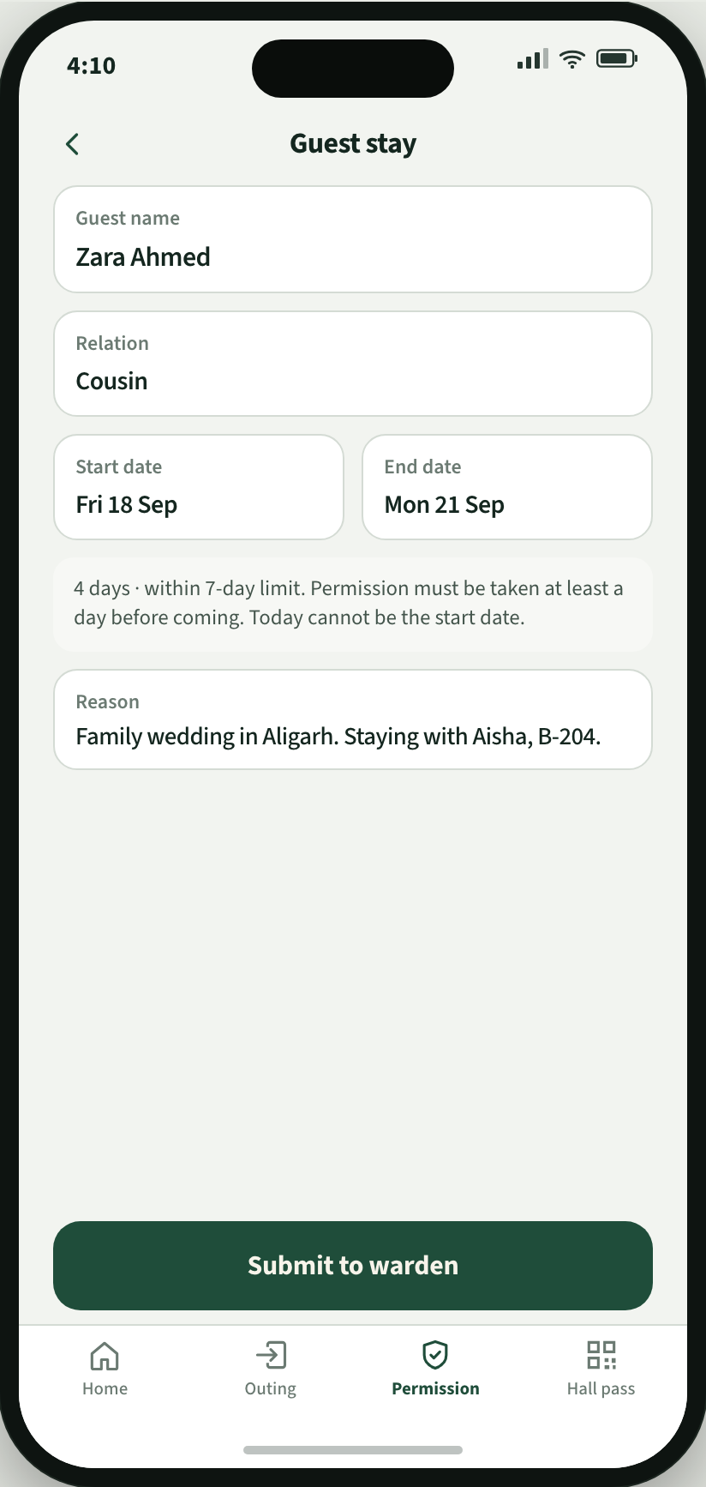
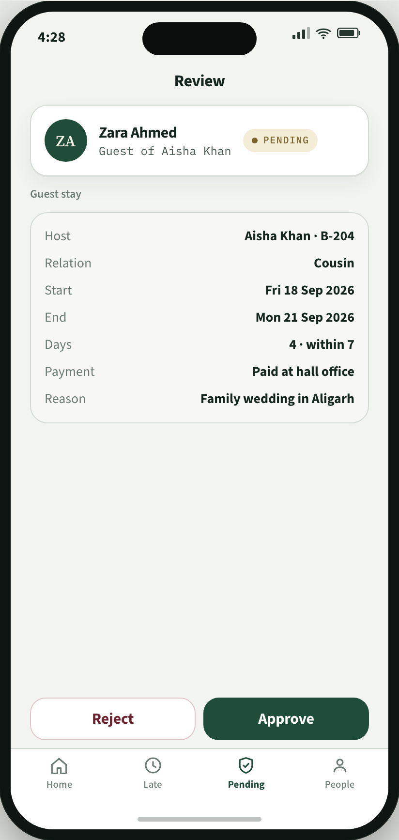
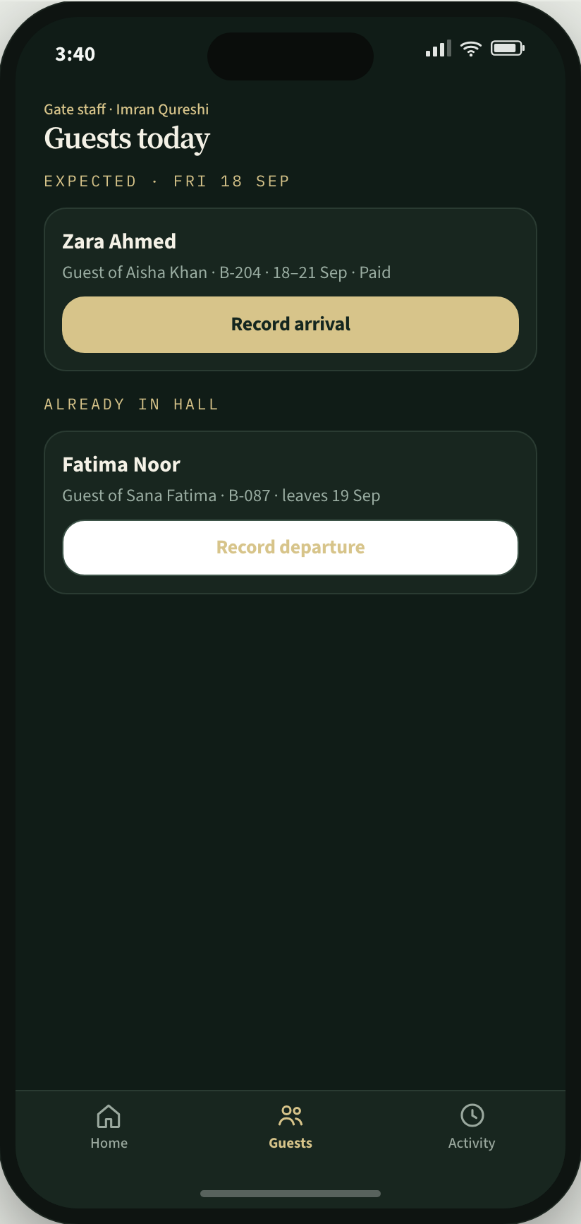
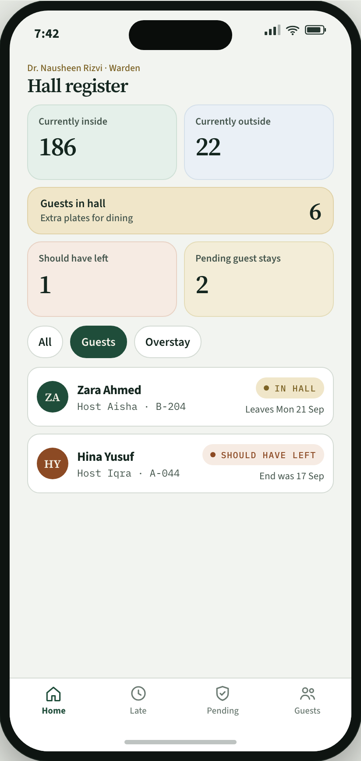
Scenario 6. Guest stay
Resident
Warden
Gate staff
Warden
1
Applies with start date and end date. At least a day before. Up to 7 days.
2
Approves. Payment is marked at the hall office.
3
Records the guest in or out. Guests do not have a hall pass.
4
Guests in hall is on the register. That number is for dining.
Begum Sultan Jahan Hall
https://bsj-hostel-demo.vercel.app/guest
10

Slide 11
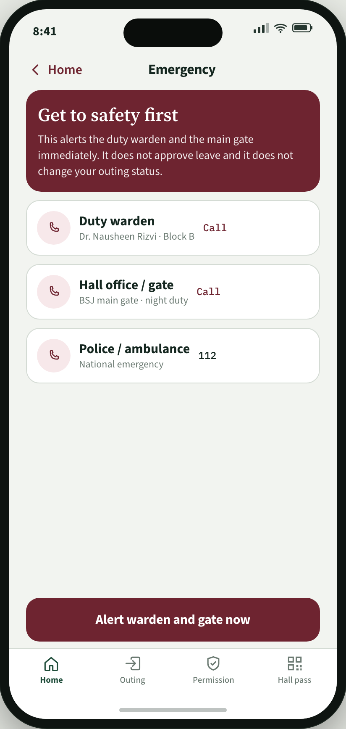
Optional
Emergency
A resident can alert the duty warden and the gate, and call from the phone. This is not a leave form.
Skip this if the hall does not want it in the first version.
Begum Sultan Jahan Hall
11

Slide 12
What we will build
1
Normal outing: destination, return time, scan at the gate. No special permission.
2
Return, including late return and parent SMS
3
Special permission: late-night and home going
4
Gate scanning
5
Warden register: inside, outside, late, pending, guests in hall
6
Paid guest stay: start and end date, at least a day before, up to 7 days. Gate records in and out.
Optional: emergency contacts on the resident phone.
Begum Sultan Jahan Hall
12

Slide 13
Running cost (estimate)
Estimate for 400 residents and 10 admins. iPhone and Android app. Developer cost to be confirmed.
Item | Amount
Developer cost, one-time | To be confirmed
India VPS, 2 GB, about ₹500 a month | ₹6,000 each year
Parent SMS, late returns only | ₹2,000 each year
App Store, Apple Developer $99 a year | ₹8,500 each year
Play Store, Google $25 once | ₹2,100 in year 1
Estimated total with Apple and Google accounts, year 1 | ₹18,600
Estimated total with Apple and Google accounts, each year after | ₹16,500
With personal Apple and Google accounts, same as the ICACON Companion app, App Store and Play Store are ₹0. Running cost is then ₹8,000 a year.
India VPS: one 2 GB server in an Indian data centre (Mumbai or Bangalore) is about ₹500 a month, so ₹6,000 a year. It runs the app backend, the database, and a nightly backup. 400 residents and 10 admins fit on this size.
Parent SMS: only if a resident is late. Two texts: one when grace ends, one when they return. About 8 late returns a night × 250 term days × 2 texts ≈ 4,000 SMS a year. Indian transactional SMS is about ₹0.20 each, about ₹800. We estimate ₹2,000 so a busier year still fits.
Begum Sultan Jahan Hall
13

