Slide 1
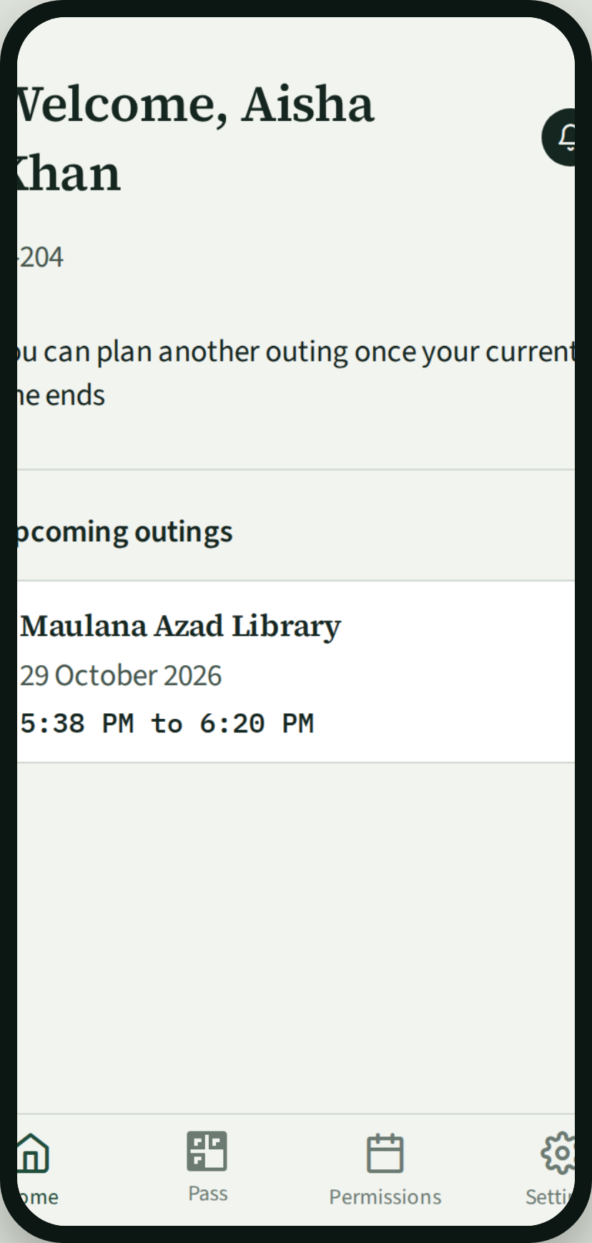
Begum Sultan Jahan Hall
Aligarh Muslim University
Hostel Management App
One app for students, the gate, and the provost.
Begum Sultan Jahan Hall
1

Slide 2
Who uses it
Role | Job
Student | Creates her account, plans ordinary outings, asks for special permission, and shows her hall pass at the gate.
Gate staff | Scans the hall pass. The app records exit or return. Records guest arrival and departure.
Provost | Sees who is inside, outside, or late. Approves special permission and guest stays. Runs the hall office.
Begum Sultan Jahan Hall
2

Slide 3
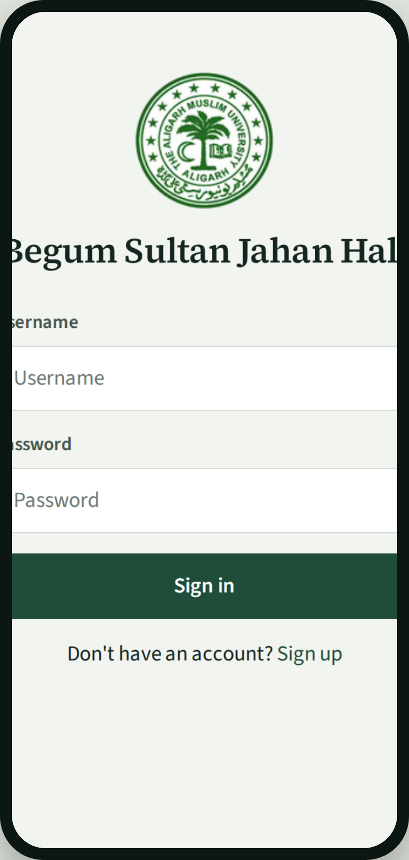
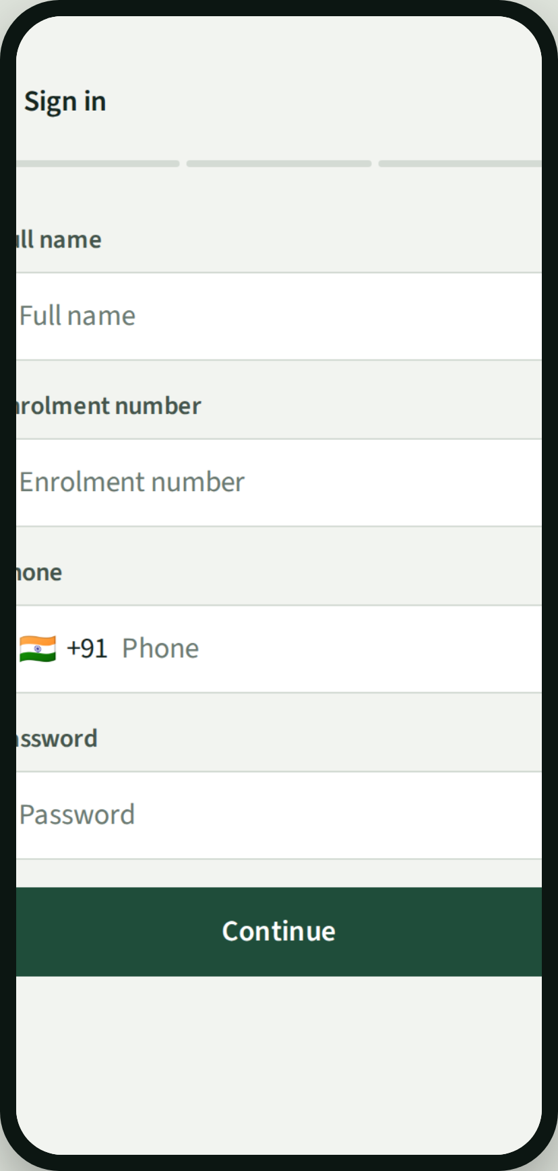
Student joins
Student
Student
Student
1
Opens the app and signs in with her enrolment number.
2
Or signs up: name, enrolment, phone, password, guardian, and room.
3
Home shows her name, room, and any planned outing.
Begum Sultan Jahan Hall
3

Slide 4
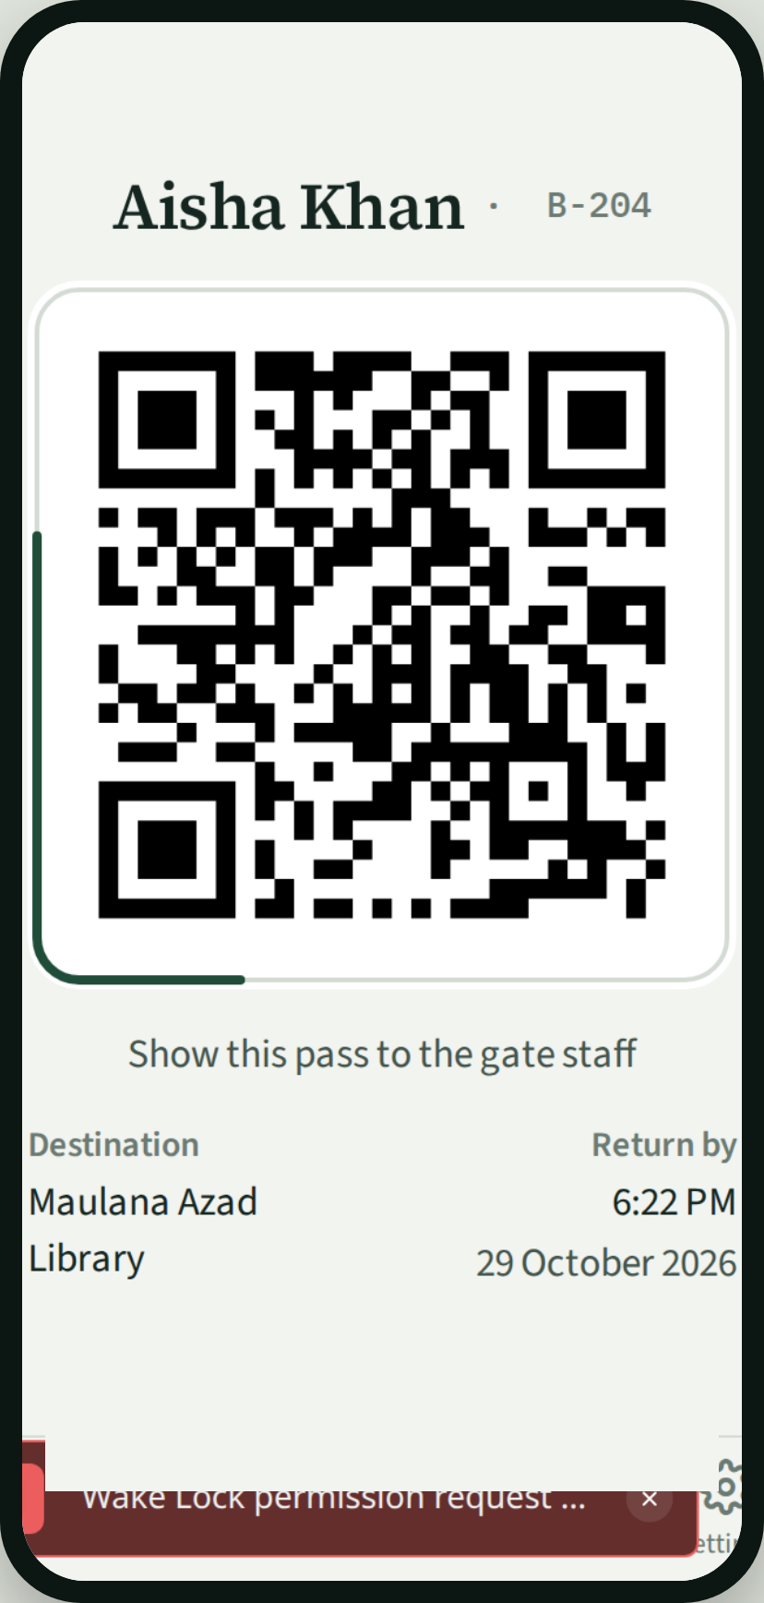
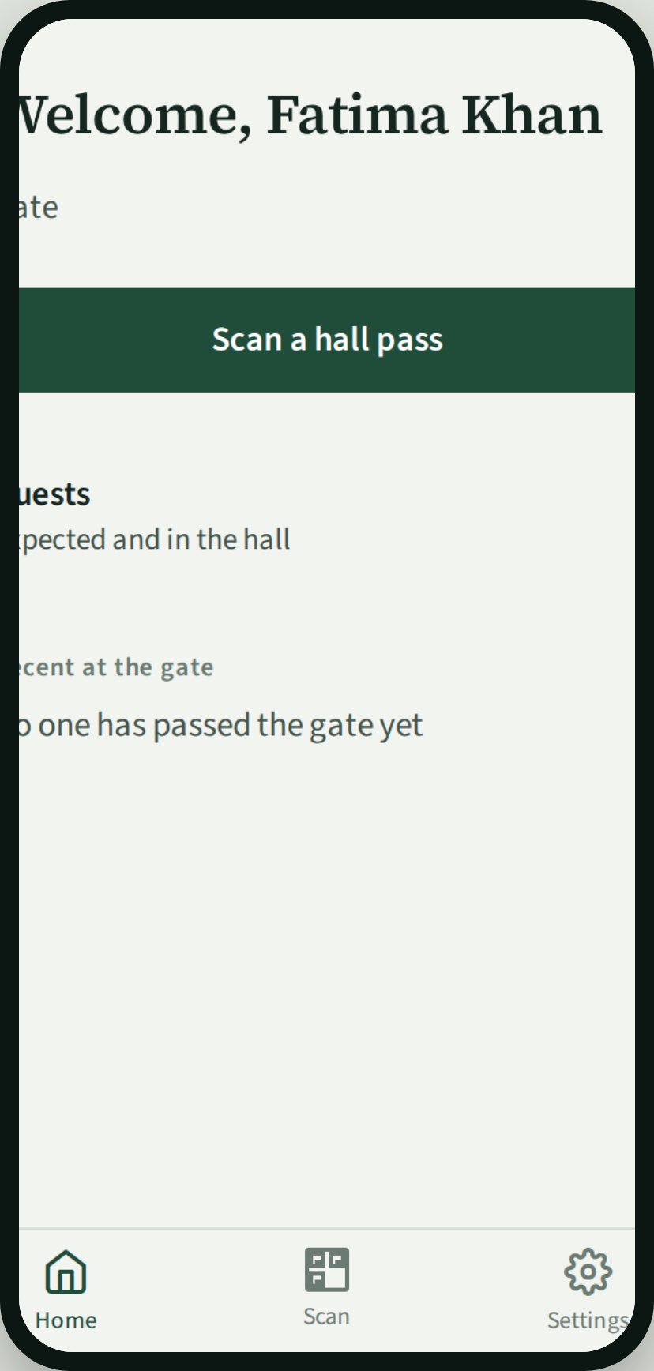
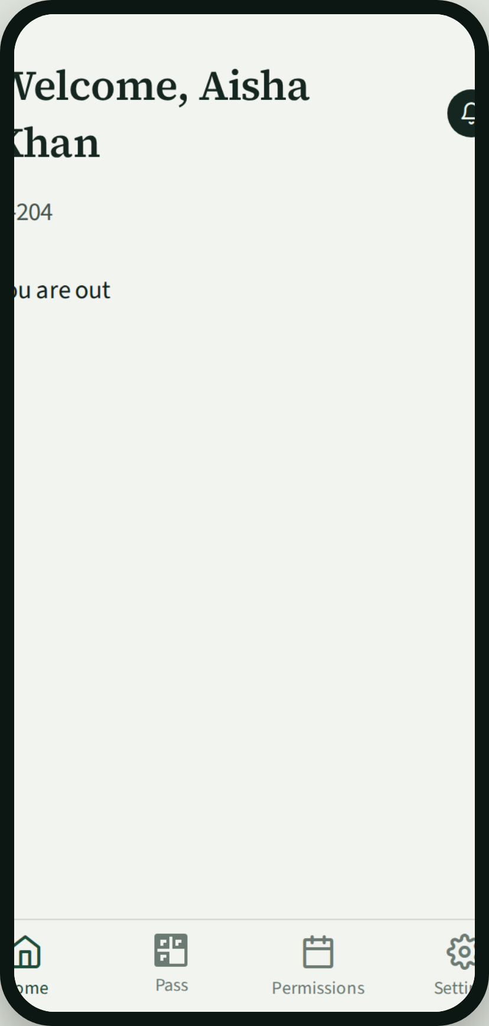
Ordinary outing
Student
Student
Gate staff
Student
1
Plans where she is going and when she will be back.
2
Opens her hall pass. The same QR is used both ways.
3
Scans the pass. Exit is recorded.
4
Home shows she is outside until she returns.
Begum Sultan Jahan Hall
4

Slide 5
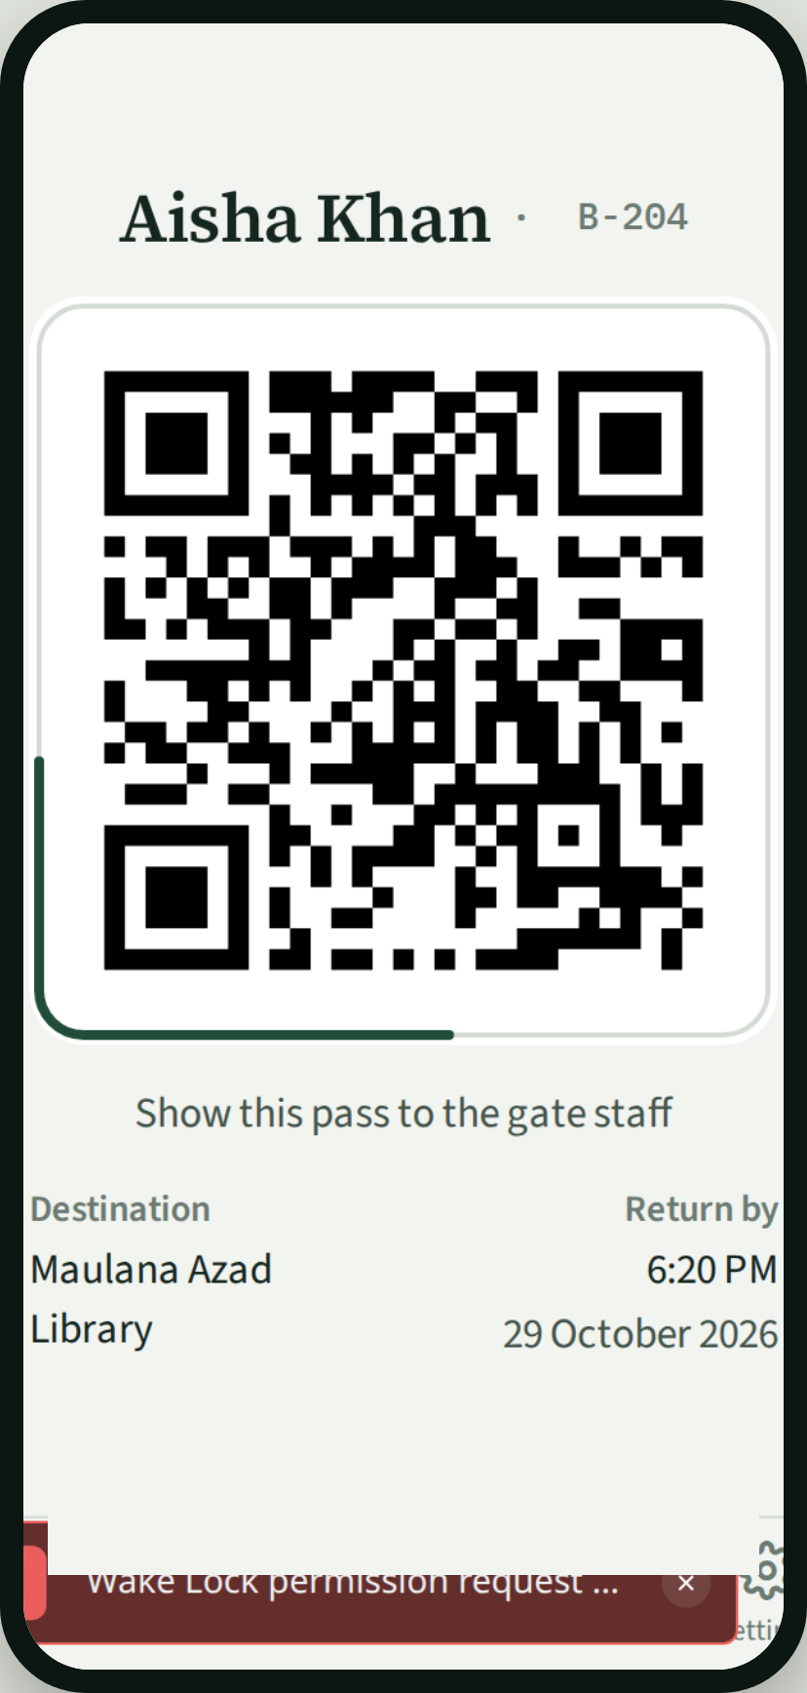
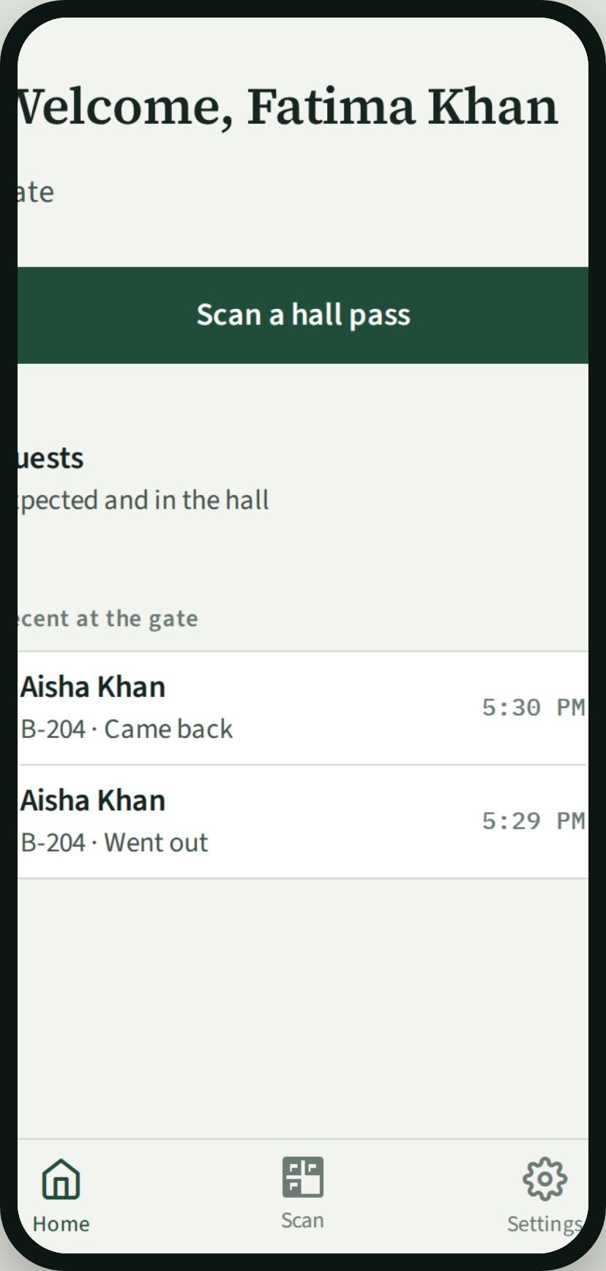
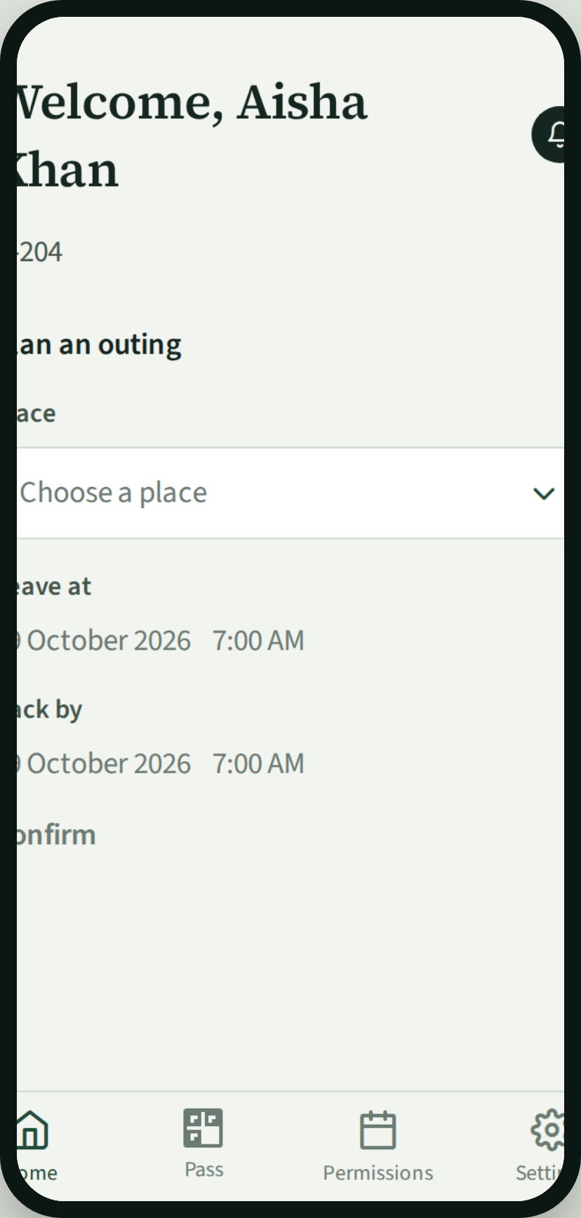
Return
Student
Gate staff
Student
1
Shows the same hall pass at the gate.
2
Scan records the return. Presence is inside again.
3
Home is clear for the next plan.
Begum Sultan Jahan Hall
5

Slide 6
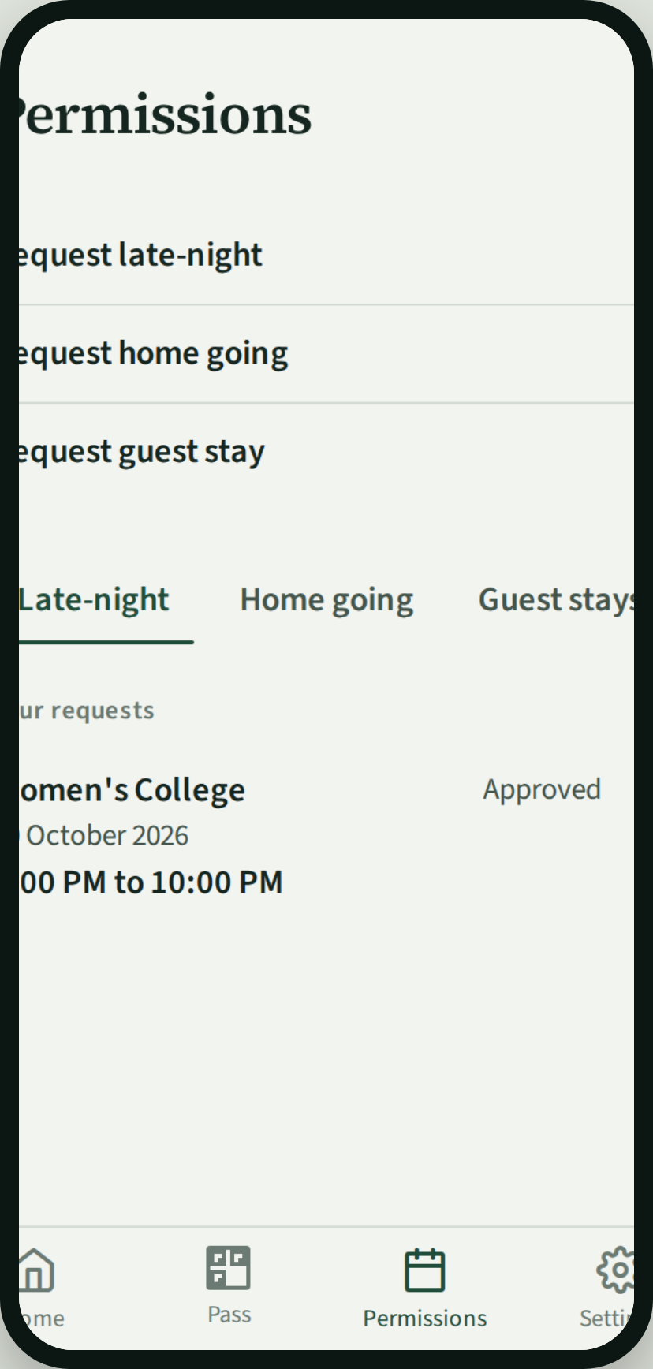
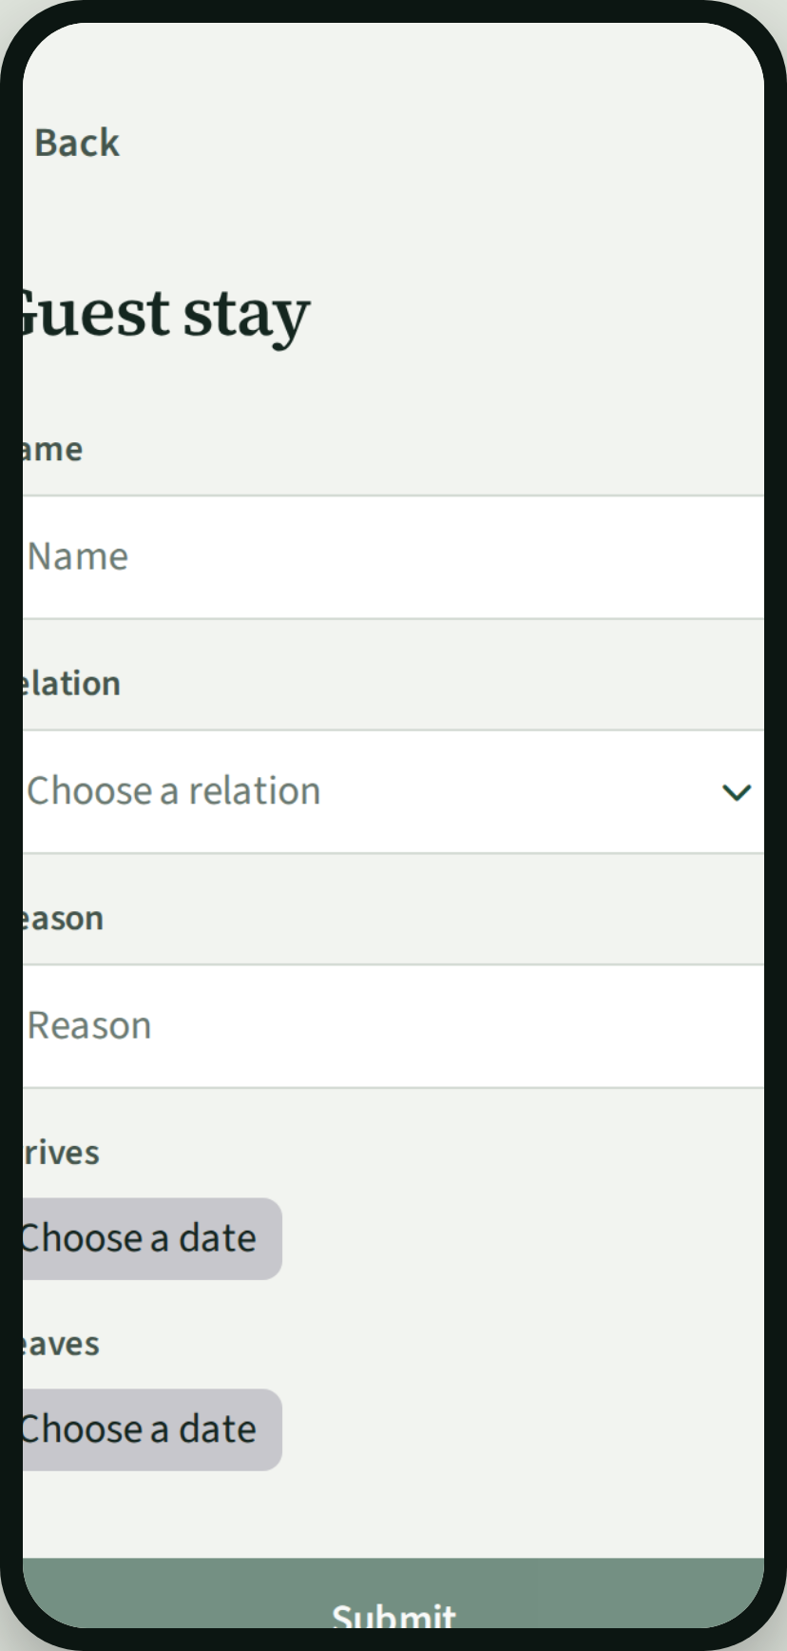
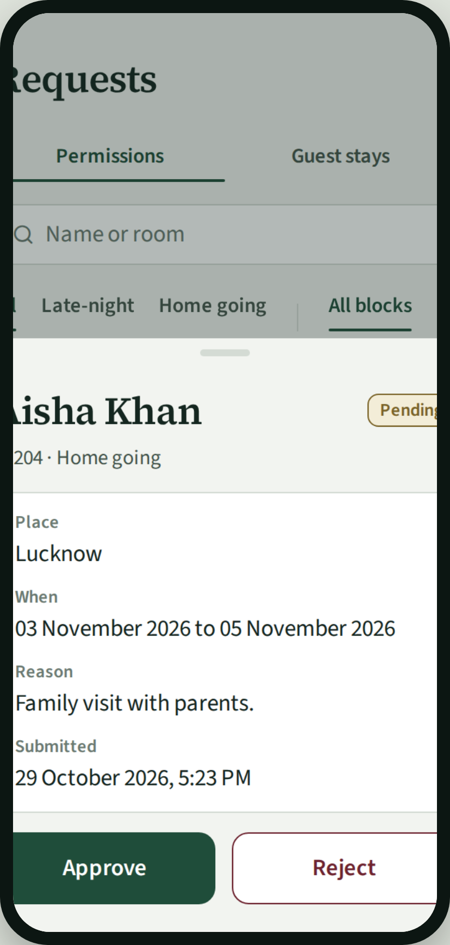
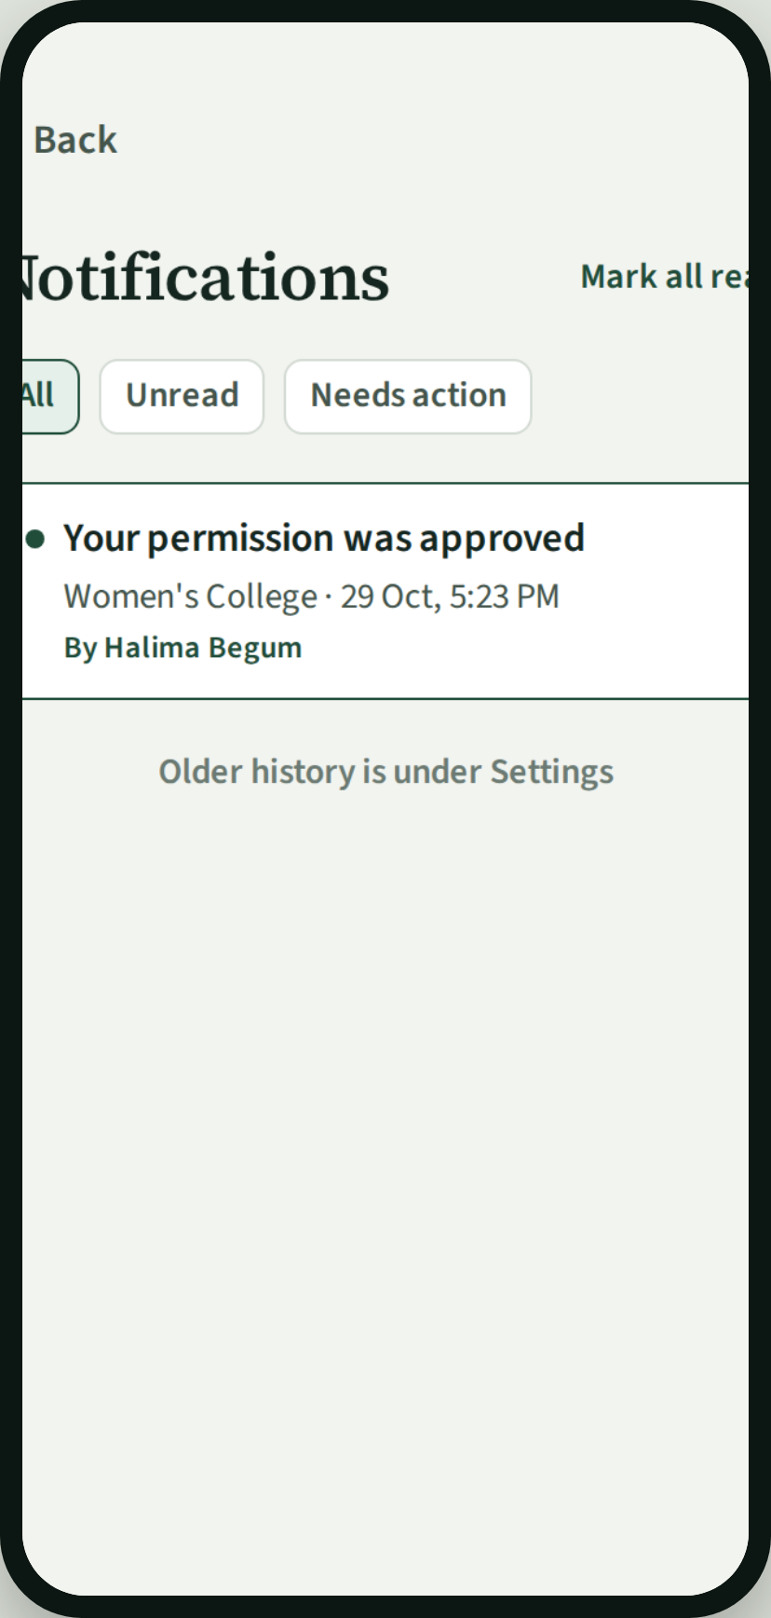
Special permission
Student
Student
Provost
Student
1
Asks for late-night or home going, or a guest stay.
2
Guest stays sit with special permission. Payment is at the office, outside the app.
3
Approves or rejects the request.
4
She is told on her phone when it is decided.
Begum Sultan Jahan Hall
6

Slide 7
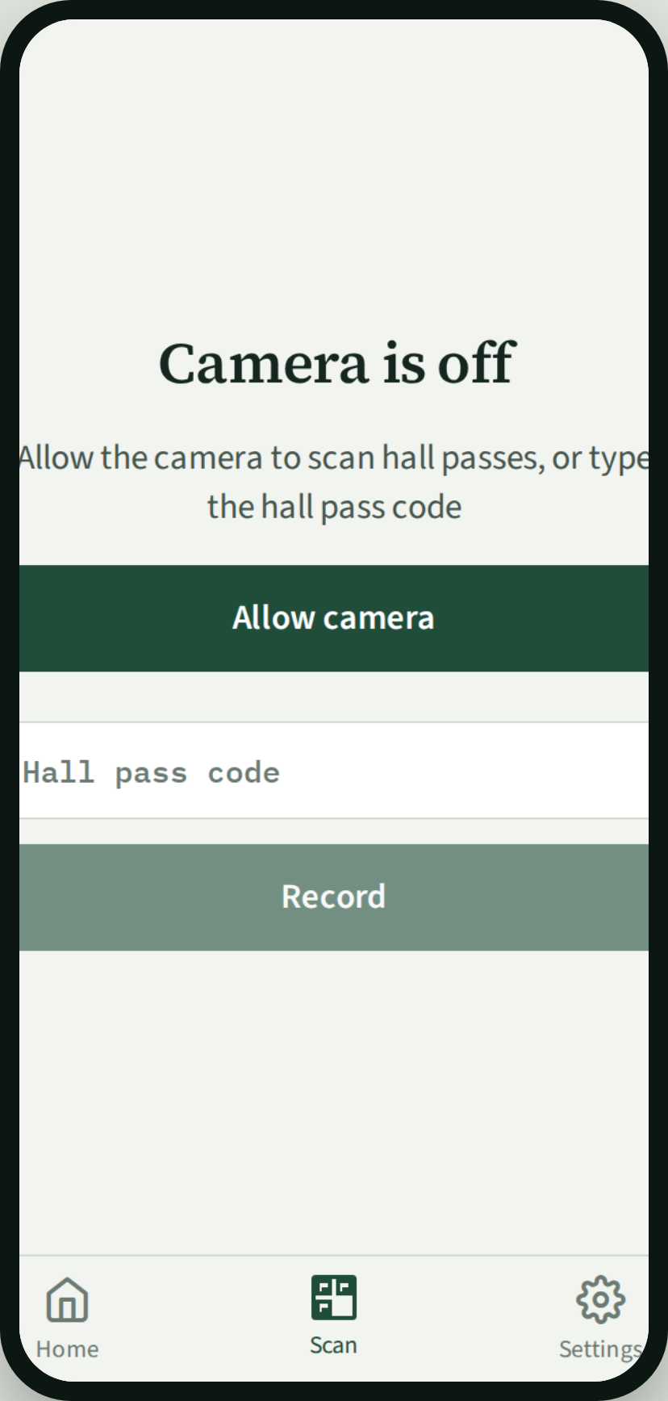
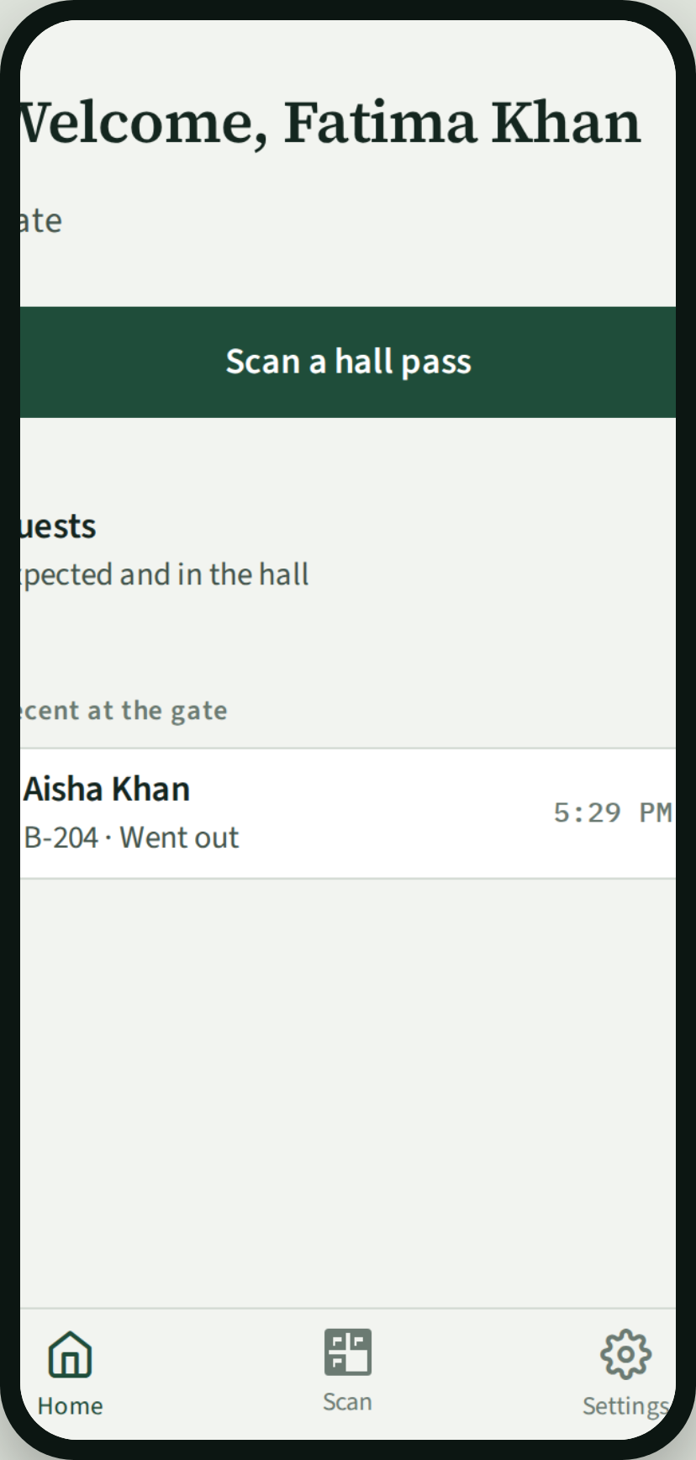
Gate staff
Gate staff
Gate staff
Gate staff
1
Home is ready to scan.
2
Opens Scan and reads the hall pass.
3
Exit or return is written into the register.
Begum Sultan Jahan Hall
7

Slide 8
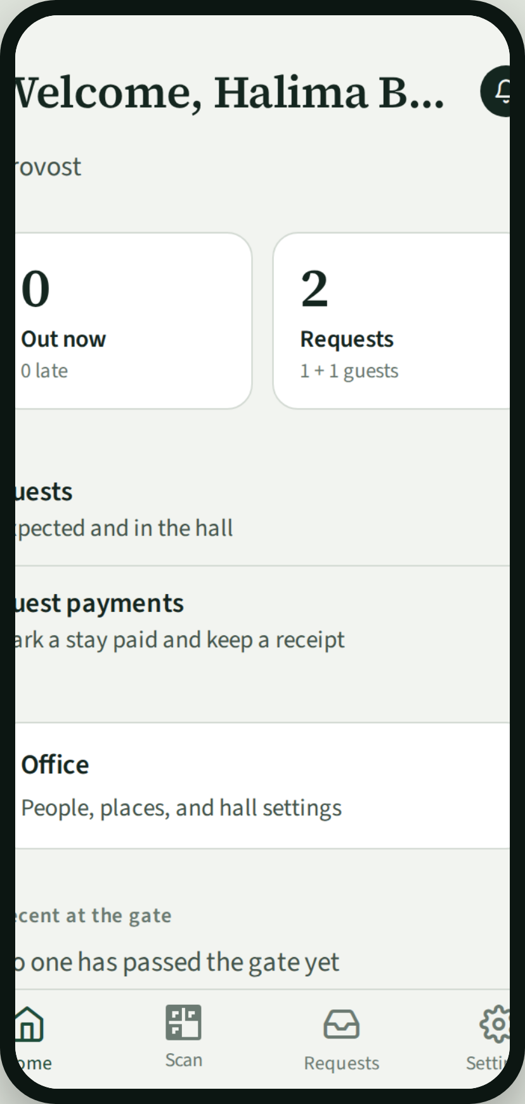
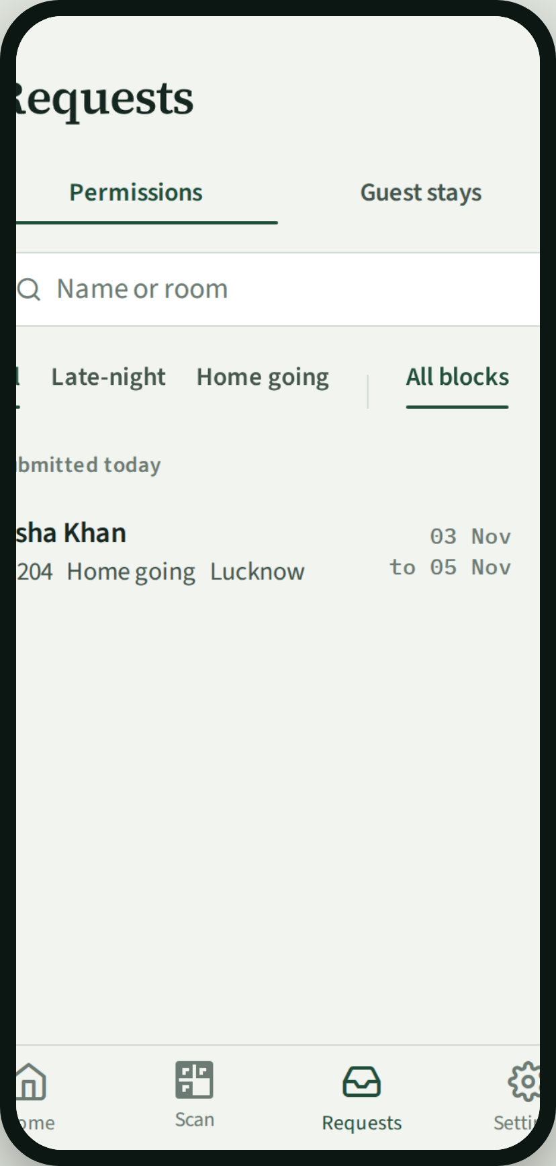
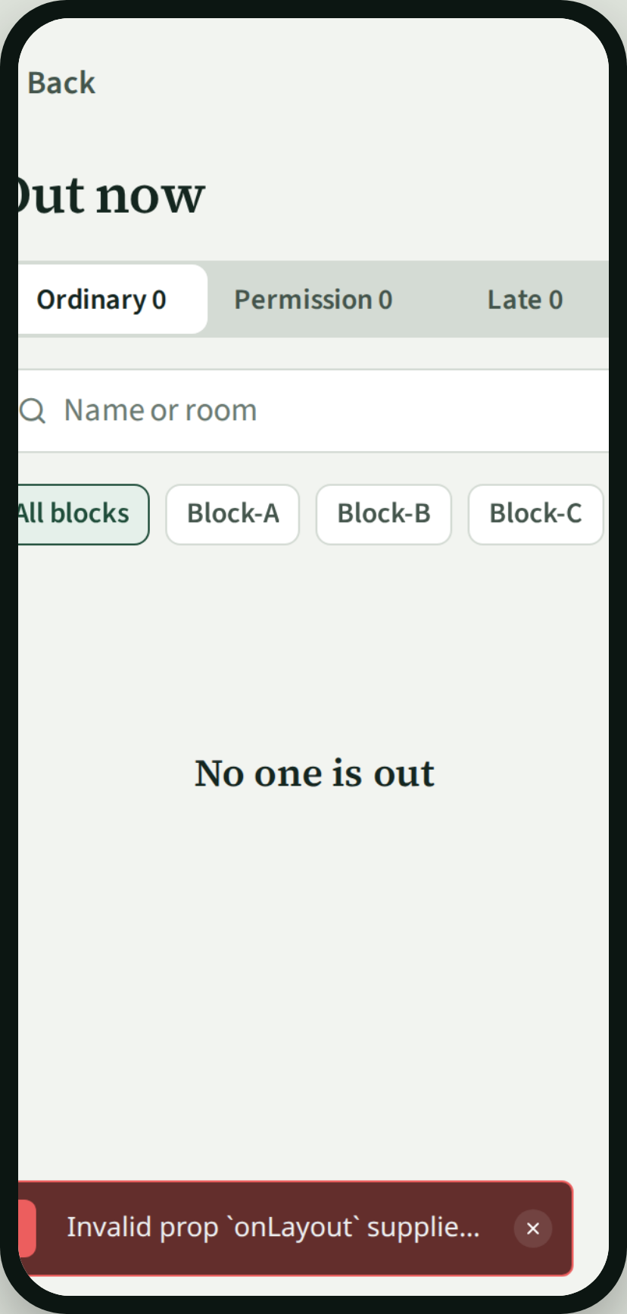
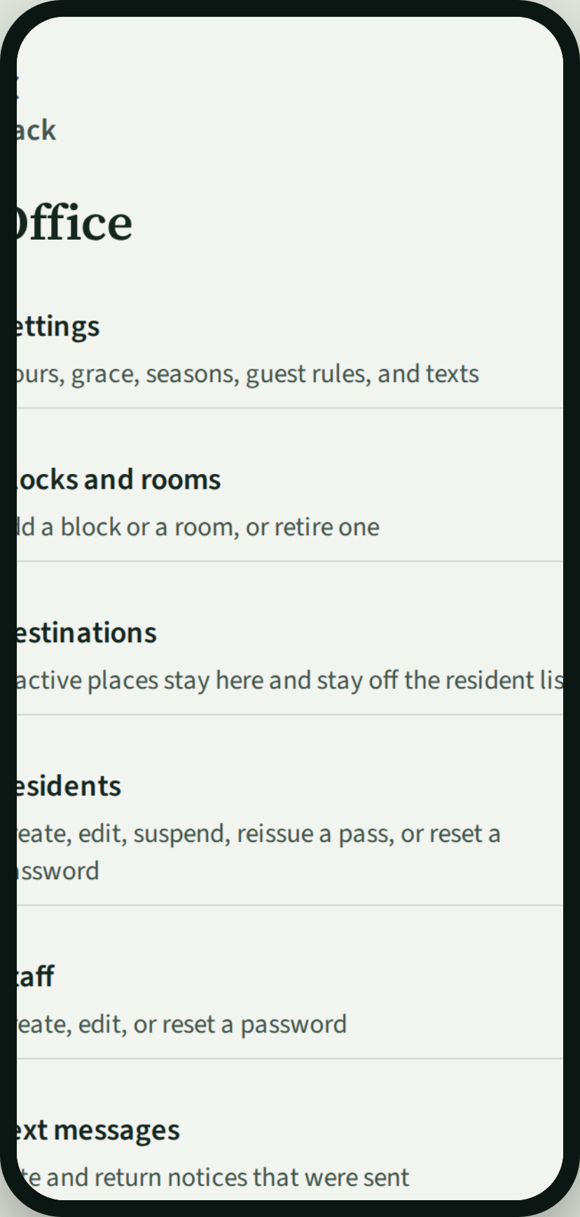
Provost
Provost
Provost
Provost
Provost
1
Dashboard: who is out, what is waiting.
2
Requests queue for permission and guests.
3
Register: inside, outside, late.
4
Hall office: people, rooms, and settings.
Begum Sultan Jahan Hall
8

