Slide 1


Slide 2
Welcome To Our Presentation

Slide 3
Course Title : Data Structure and Algorithm
Course Code : CS2510/CS2511
Semester : Fall - 2022
Prepared for
Miss Anam Javed
S No. | Name | ID No | Department
01 | Muhammad Noman | FA21-BSCS-0032 | BSCS
02 | Syed Mustafa Hassan | FA21-BSCS-0030 | BSCS
Prepared by
Team Name: Young Stunners

Slide 4
Hostel Management System

Slide 5
Table of Contents
The goal of the Project
Problem Statement
Issues/Limitations
Objectives
Feasibility
Types of stakeholders
Functional Requirements
Non-Functional Requirements
Overall Constraints
Use Case Diagram
Activity Diagram

Slide 6

Hostel Management System

Slide 7
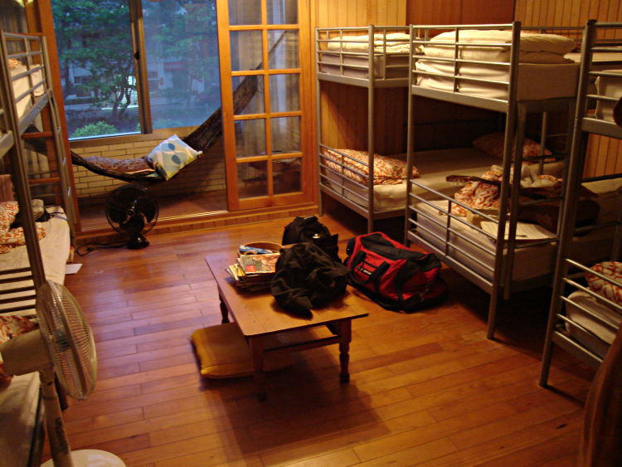
Goals of the Project
Provide quick and efficient service.
Efficient way data insert, update and delete.
To save records of student.
User friendly Interface.
Ensure high security.
Finding student details.

Slide 8

Problem Statement
Why we want to build new hostel system for our hostel?

Slide 9






Issues
Need more time to give any information
Don’t no which room are available
Unsecured information
Difficult to calculate student money
Don’t have any option for complain
Need time and registration paper

Slide 10
Objectives
01
Admin can give any notice through student profile
02
Instantly can see user information, available room
03
Provide high security for information
04
Admin can check the every month hostel free easily
05
Users can be able to give their complaints
06
Provide a web page for registration

Slide 11
Feasibility
1
Technical Feasibility
2
Economic Feasibility
3
Operational Feasibility

Slide 12
Cost-Benefit Analysis
Cost
1. Cost of computer systems
5. Cost of programmer’ developing salaries
2. Cost of systems analysis time
Tangible Cost
3. Cost of equipment, land or a new factory
4. Cost of Computer active server

Slide 13
Cost-Benefit Analysis
Cost
1. Cost of Internet.
5. Loss of employee morale
Build company logo
Intangible Cost
Customer satisfaction
Losing a competitive edge

Slide 14
Types of stakeholders (users) of the new system
Administrator
User
Visitor
Developer

Slide 15
Functionally Requirement
Report generation
Search module
User Module
Functional Requirement
Create Account and Login
Setting System
Mess bill
Student rating and review
Room allotment

Slide 16
Non-Functionally Requirement
Performance
Reliability
Non-Functional Requirement
Safety Requirements
Security Requirements

Slide 17
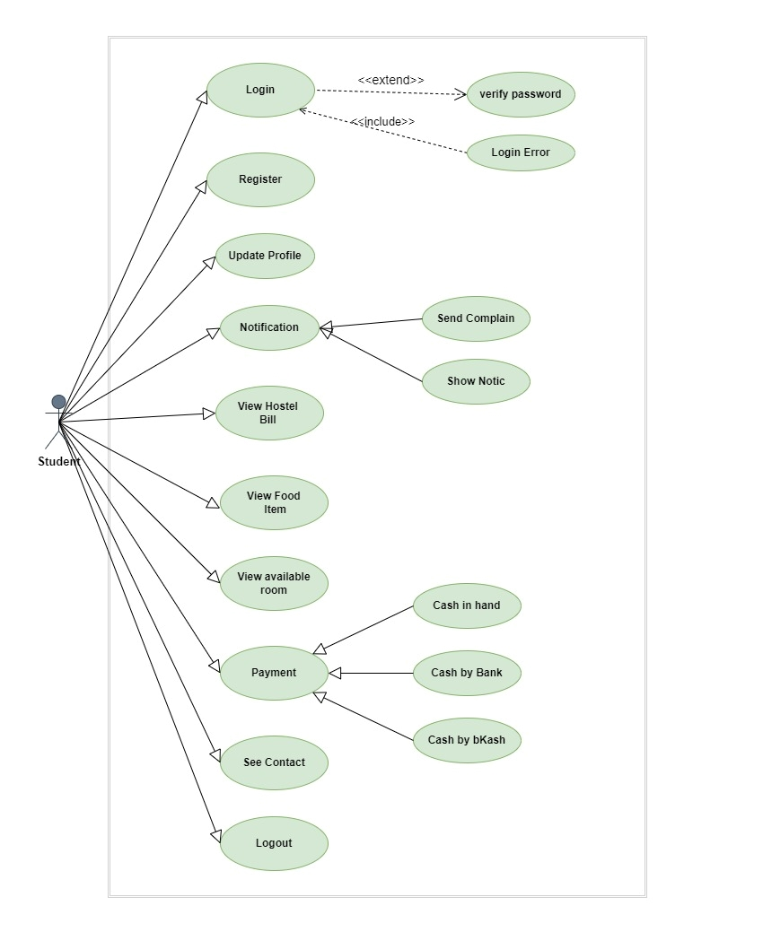
Use Case Diagram
Administrator
Figure: Use Case Diagram for Student management

Slide 18
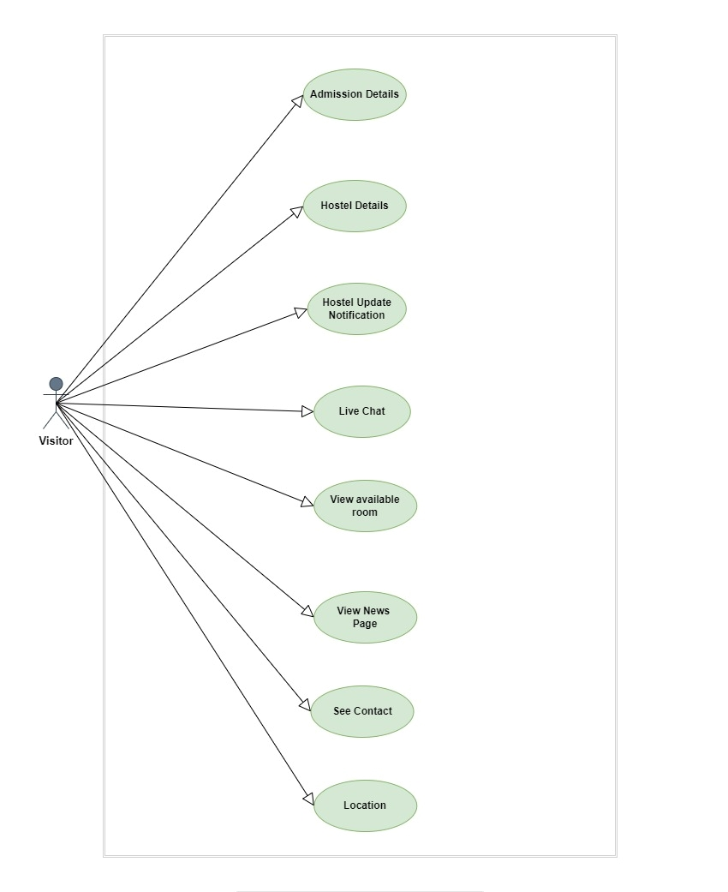
Use Case Diagram
Administrator
Figure: Use Case Diagram for Visitor management

Slide 19
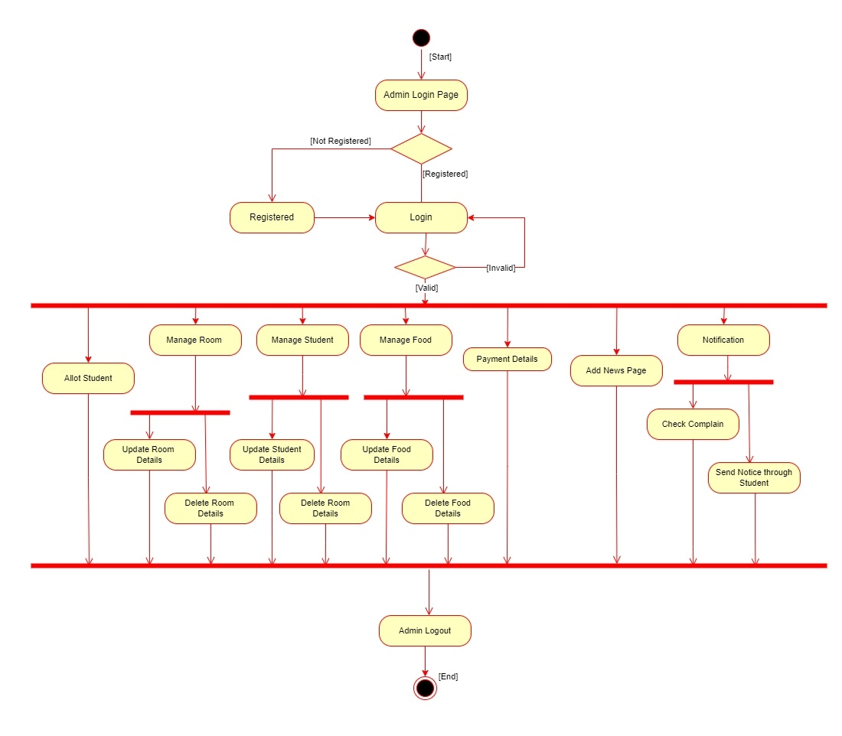
Administrator Activity Diagram

Slide 20
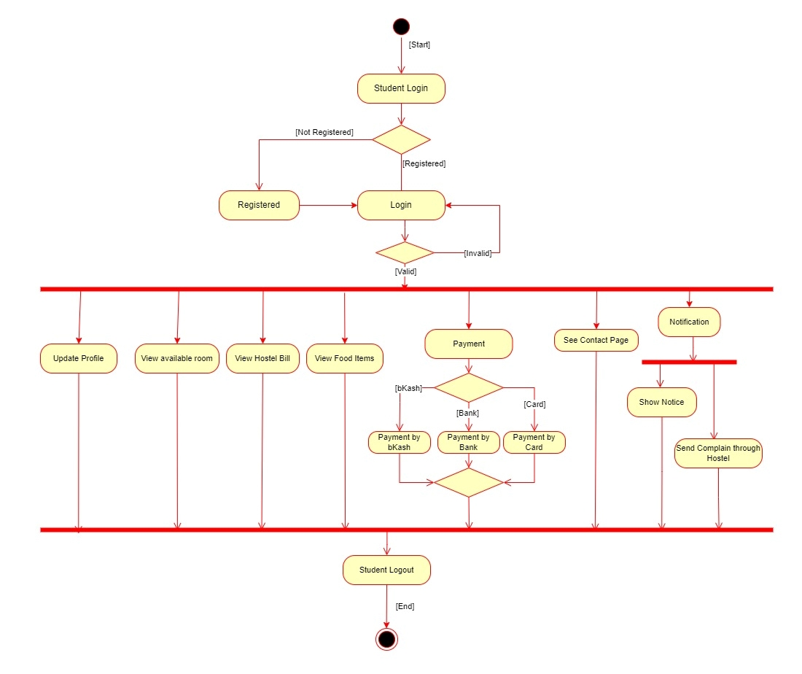
Student Activity Diagram

Slide 21
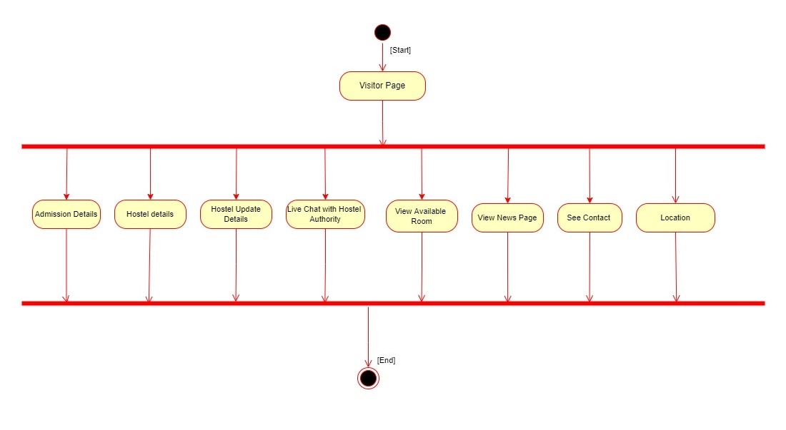
Visitor Activity Diagram

Slide 22
Thank You !

