Slide 1


PREDICTIVE
MAINTENANCE
ANALYSIS

Slide 2







Presented By
Philopater Emeel
Mina Saad
Aya Khaled
Nouran Hassan
Mariam Mahmoud
Malak Amr

Slide 3

AGENDA
Introduction
Dataset Overview — AI4I 2020
Data Cleaning in SQL
Exploratory Data Analysis (EDA) & Plotly Dashboard
Tableau Dashboard
Feature Engineering & Modeling
Model Comparison & Best Model
Streamlit Prediction App
Automation
Business Impact & Recommendations
Limitations, Future Work, Conclusion

Slide 4
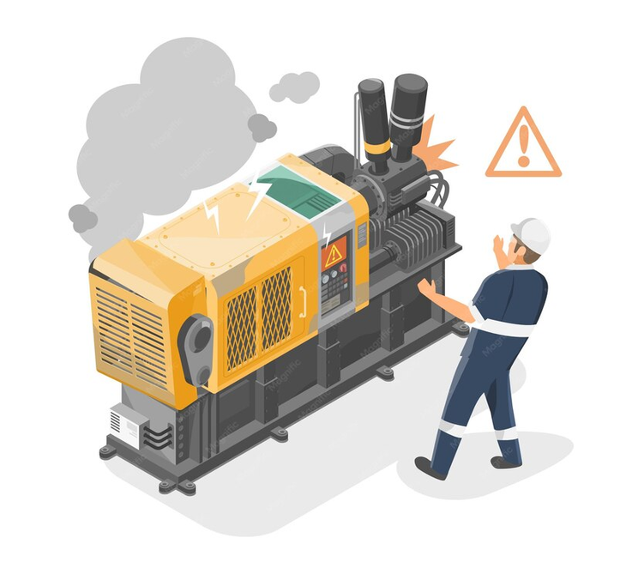
INTRODUCTION
Machine failures don't announce themselves — but the data often does
Before a machine fails, its sensors usually show early warning signs
Our project addresses this challenge by using machine learning to analyze sensor data and predict machine failures before they happen.
This enables maintenance teams to take preventive actions, reducing downtime, maintenance costs, and improving production efficiency.

Slide 5
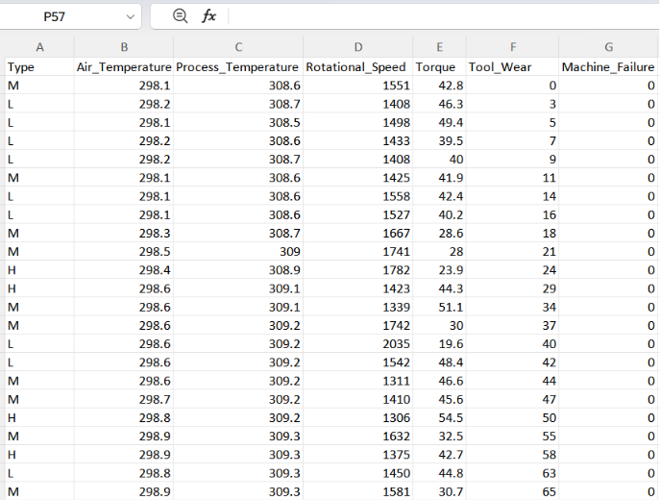
DATASET OVERVIEW — AI4I 2020
Source: UCI AI4I 2020 Predictive Maintenance dataset.
Size: 10,000 rows × 14 columns.
Features:
• Type — product quality (L / M / H)
• Air Temperature (K), Process Temperature (K)
• Rotational Speed (rpm), Torque (Nm), Tool Wear (min)
Target: Machine_Failure (binary — 0 = healthy, 1 = failure)
Failure sub-modes: TWF, HDF, PWF, OSF, RNF

Slide 6
PREDICTIVE MAINTENANCE PIPELINE
Raw CSV
AI4I 2020
SQL Server
Cleaning & QA
Python EDA
Insights
Modeling
6 algorithms
Best Model
Random Forest
Tableau
Dashboard
Streamlit
Prediction App

Slide 7
DATA CLEANING IN SQL SERVER — SCHEMA & IMPORT
-- Create the database and target table
CREATE DATABASE Machine_Failure_Project;
GO
USE Machine_Failure_Project;
GO
CREATE TABLE predictive_maintenance (
UDI INT, Product_ID VARCHAR(20), Type VARCHAR(2),
Air_Temperature FLOAT, Process_Temperature FLOAT,
Rotational_Speed FLOAT, Torque FLOAT, Tool_Wear FLOAT,
Machine_Failure INT,
TWF INT, HDF INT, PWF INT, OSF INT, RNF INT
);
-- Bulk-load the raw CSV
BULK INSERT predictive_maintenance
FROM 'ai4i2020.csv'
WITH (FIELDTERMINATOR = ',', ROWTERMINATOR = '\n', FIRSTROW = 2);
Database and table created in SQL Server; 10,000 rows imported from the raw CSV.

Slide 8
DATA CLEANING — QUALITY CHECKS
-- Check Missing Values
SELECT
SUM(CASE WHEN UDI IS NULL THEN 1 ELSE 0 END) AS Missing_UDI,
SUM(CASE WHEN Air_Temperature IS NULL THEN 1 ELSE 0 END) AS Missing_AirTemp,
SUM(CASE WHEN Torque IS NULL THEN 1 ELSE 0 END) AS Missing_Torque,
SUM(CASE WHEN Machine_Failure IS NULL THEN 1 ELSE 0 END) AS Missing_Target
FROM predictive_maintenance;
-- Duplicate detection on the full feature signature
SELECT COUNT(*) AS Total_Rows,
COUNT(DISTINCT CAST(UDI AS VARCHAR)+'|'+Product_ID+'|'+Type+'|'+
CAST(Air_Temperature AS VARCHAR)+'|'+
CAST(Torque AS VARCHAR)) AS Unique_Rows
FROM predictive_maintenance;
Result: no missing values and no duplicate rows — dataset is clean.

Slide 9
DATA CLEANING — OUTLIER HANDLING (IQR)
-- Calculate IQR and Bounds
WITH Quartiles AS
(
SELECT DISTINCT
PERCENTILE_CONT(0.25) WITHIN GROUP (ORDER BY Air_Temperature) OVER() AQ1, PERCENTILE_CONT(0.75) WITHIN GROUP (ORDER BY Air_Temperature) OVER() AQ3,
PERCENTILE_CONT(0.25) WITHIN GROUP (ORDER BY Process_Temperature) OVER() PQ1, PERCENTILE_CONT(0.75) WITHIN GROUP (ORDER BY Process_Temperature) OVER() PQ3,
PERCENTILE_CONT(0.25) WITHIN GROUP (ORDER BY Rotational_Speed) OVER() RQ1, PERCENTILE_CONT(0.75) WITHIN GROUP (ORDER BY Rotational_Speed) OVER() RQ3,
PERCENTILE_CONT(0.25) WITHIN GROUP (ORDER BY Torque) OVER() TQ1, PERCENTILE_CONT(0.75) WITHIN GROUP (ORDER BY Torque) OVER() TQ3,
PERCENTILE_CONT(0.25) WITHIN GROUP (ORDER BY Tool_Wear) OVER() WQ1, PERCENTILE_CONT(0.75) WITHIN GROUP (ORDER BY Tool_Wear) OVER() WQ3
FROM predictive_maintenance
)
SELECT
AQ1,AQ3, AQ3-AQ1 Air_IQR, AQ1-1.5*(AQ3-AQ1) Air_Lower, AQ3+1.5*(AQ3-AQ1) Air_Upper,
PQ1,PQ3, PQ3-PQ1 Process_IQR, PQ1-1.5*(PQ3-PQ1) Process_Lower, PQ3+1.5*(PQ3-PQ1) Process_Upper,
RQ1,RQ3, RQ3-RQ1 RPM_IQR, RQ1-1.5*(RQ3-RQ1) RPM_Lower, RQ3+1.5*(RQ3-RQ1) RPM_Upper,
TQ1,TQ3, TQ3-TQ1 Torque_IQR, TQ1-1.5*(TQ3-TQ1) Torque_Lower, TQ3+1.5*(TQ3-TQ1) Torque_Upper,
WQ1,WQ3, WQ3-WQ1 Wear_IQR, WQ1-1.5*(WQ3-WQ1) Wear_Lower, WQ3+1.5*(WQ3-WQ1) Wear_Upper
FROM Quartiles;
GO
Outlier Detection: Using the IQR (Q3 − Q1) , 418 outliers were detected in Rotational Speed and 69 in Torque.

Slide 10
DATA CLEANING — FEATURE ENGINEERING
-- Remove unnecessary columns
ALTER TABLE predictive_maintenance
DROP COLUMN UDI, Product_ID;
GO
-- Rename failure mode columns
EXEC sp_rename
'predictive_maintenance.TWF','Tool_Wear_Failure','COLUMN';
EXEC sp_rename
'predictive_maintenance.HDF','Heat_Dissipation_Failure','COLUMN';
EXEC sp_rename
'predictive_maintenance.PWF','Power_Failure','COLUMN';
EXEC sp_rename
'predictive_maintenance.OSF','Overstrain_Failure','COLUMN';
EXEC sp_rename
'predictive_maintenance.RNF','Random_Failure','COLUMN';
GO
Result: irrelevant columns were removed, and failure-related columns were renamed for better readability.

Slide 11
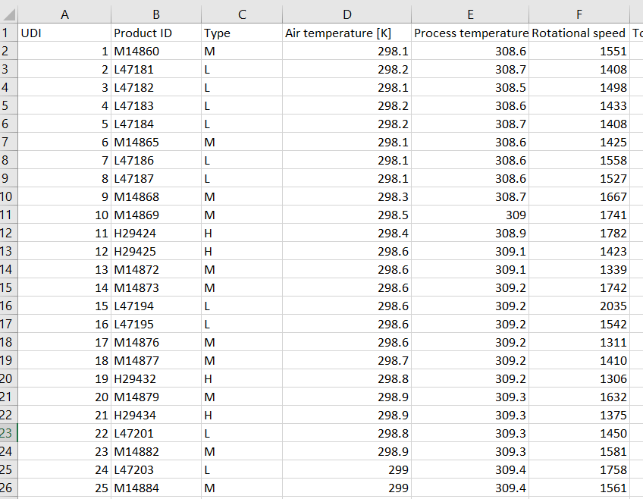
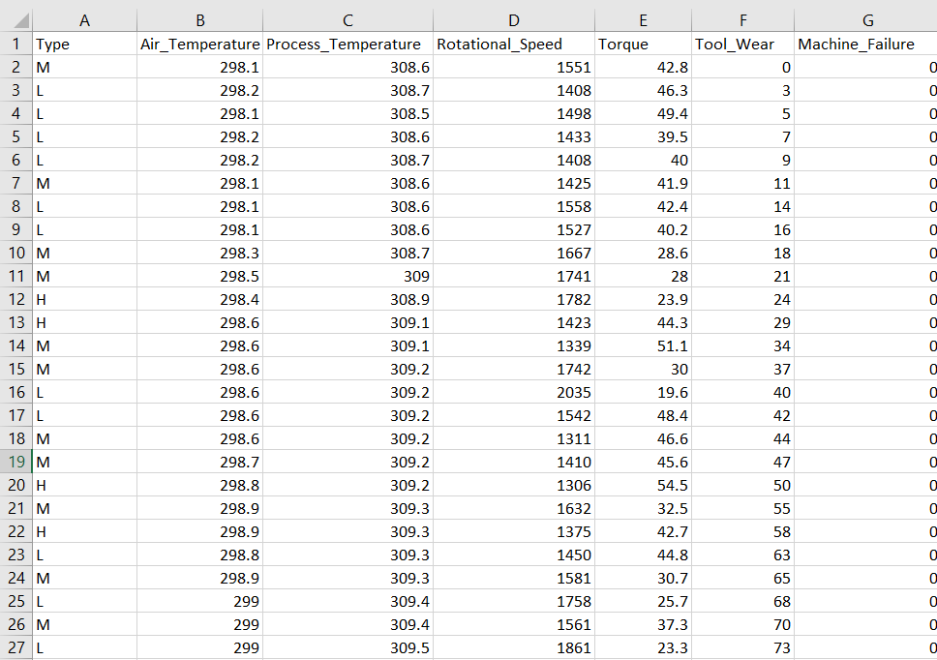
Before
After

Slide 12
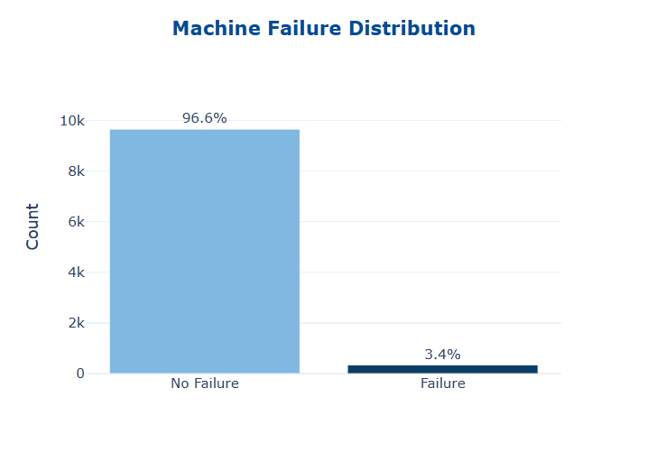
EDA — MACHINE FAILURE DISTRIBUTION
  Only 3.4% of machines failed (339/10,000), indicating a highly imbalanced dataset.
  Recall and ROC-AUC were prioritized to evaluate failure detection.
  Stratified K-Fold was used to preserve the class distribution during validation.

Slide 13
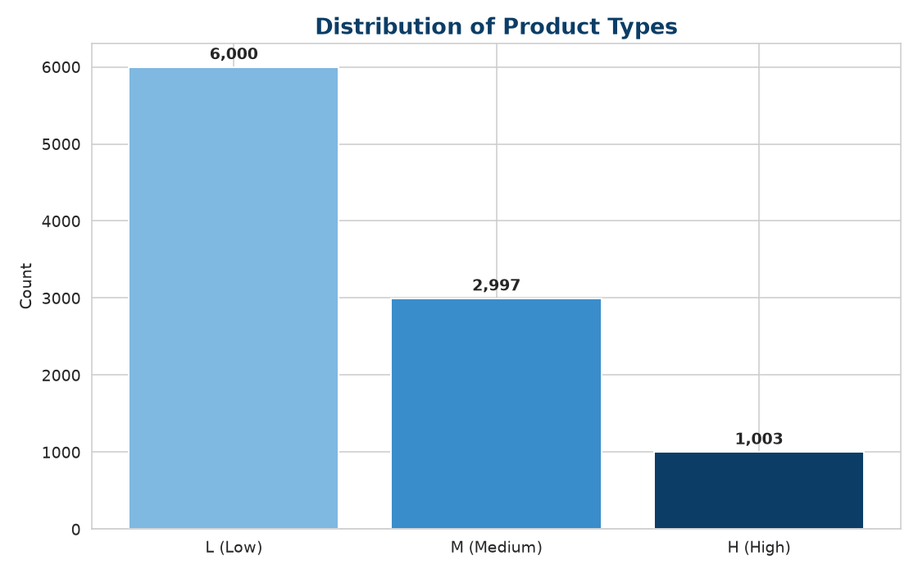
EDA — PRODUCT TYPE DISTRIBUTION
• Product quality is split into three tiers:
• - L (Low) — 60% of production
• - M (Medium) — 30%
• - H (High) — 10%
• L-type machines are the most common and also the most exposed to failure

Slide 14
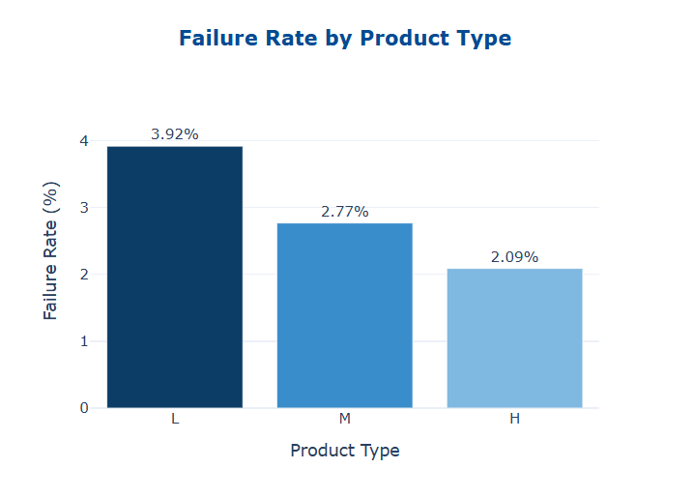
EDA — FAILURE RATE BY PRODUCT TYPE
  Low-quality (L) machines have the highest failure rate (3.92%).
  Failure risk decreases as product quality improves (L → M → H).
  L-type machines should receive more frequent inspections and preventive maintenance.

Slide 15
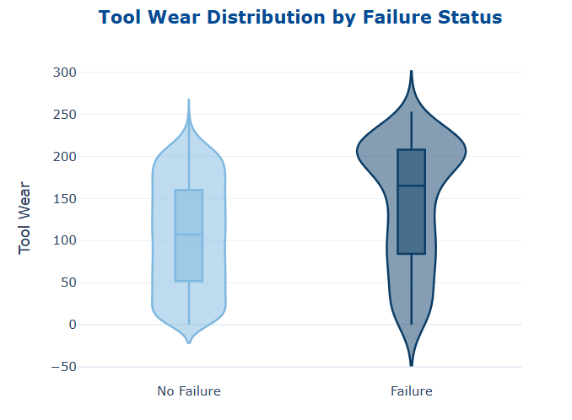
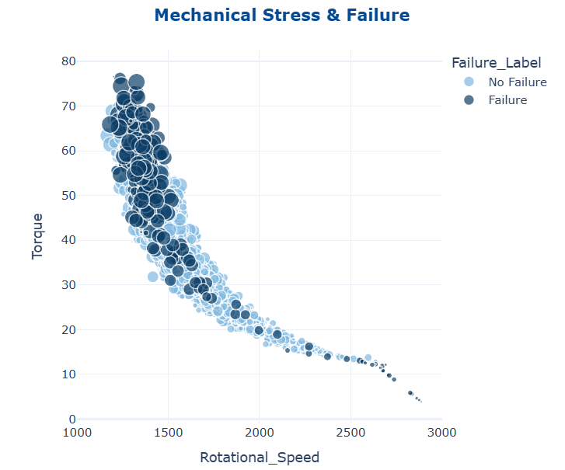
EDA — What's Really Driving Machine Failures?

Slide 16
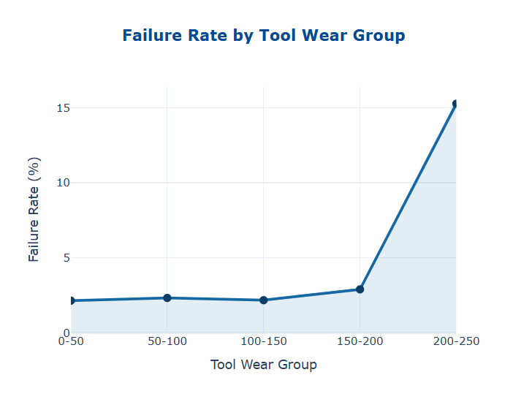
EDA — Tool Wear as an Early Indicator of Machine Failure
  As tool wear increases, the likelihood of machine failure rises significantly.
  A sharp increase is observed after 150 minutes, indicating a critical threshold for preventive maintenance and inspection.

Slide 17
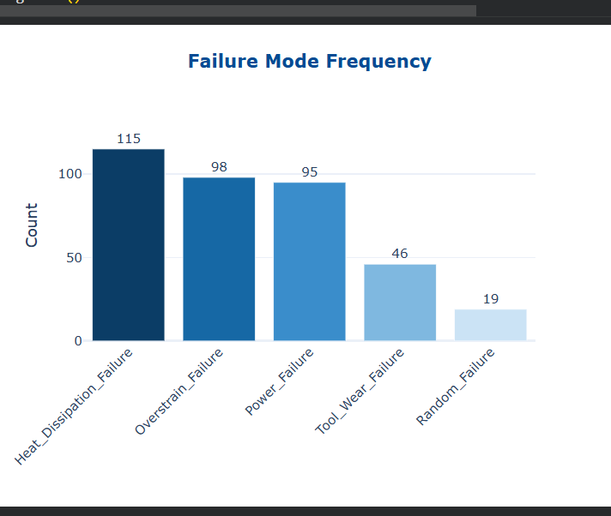
EDA — FAILURE MODE BREAKDOWN
  Top failure causes: Heat Dissipation (HDF) and Overstrain (OSF).
  Enhance cooling performance and control machine workload to improve reliability.

Slide 18
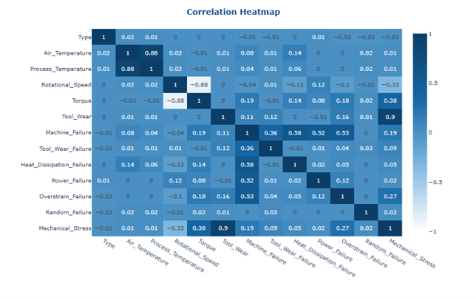
EDA — FEATURE CORRELATION HEATMAP
  Highest Positive Correlation: Air Temp ↔ Process Temp (0.88)
  Highest Negative Correlation: Rotational Speed ↔ Torque (-0.87)
  Main Failure Factors: Torque and Tool Wear

Slide 19
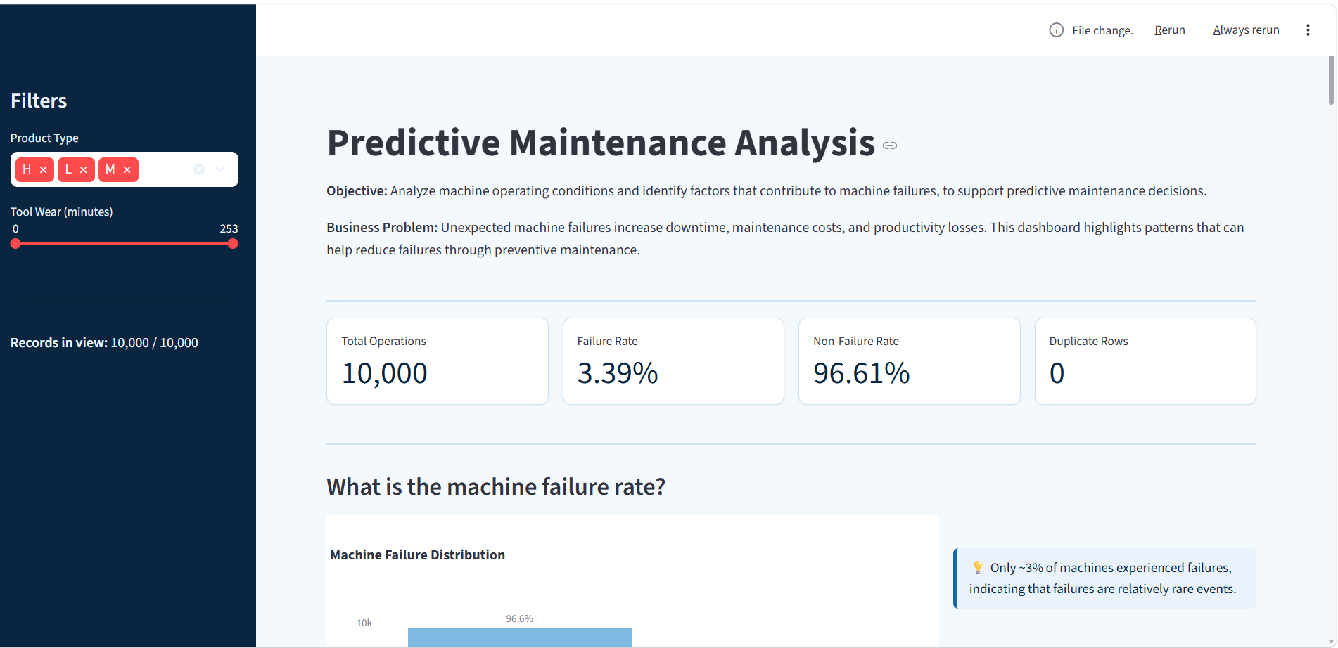
PLOTLY DASHBOARD

Slide 20
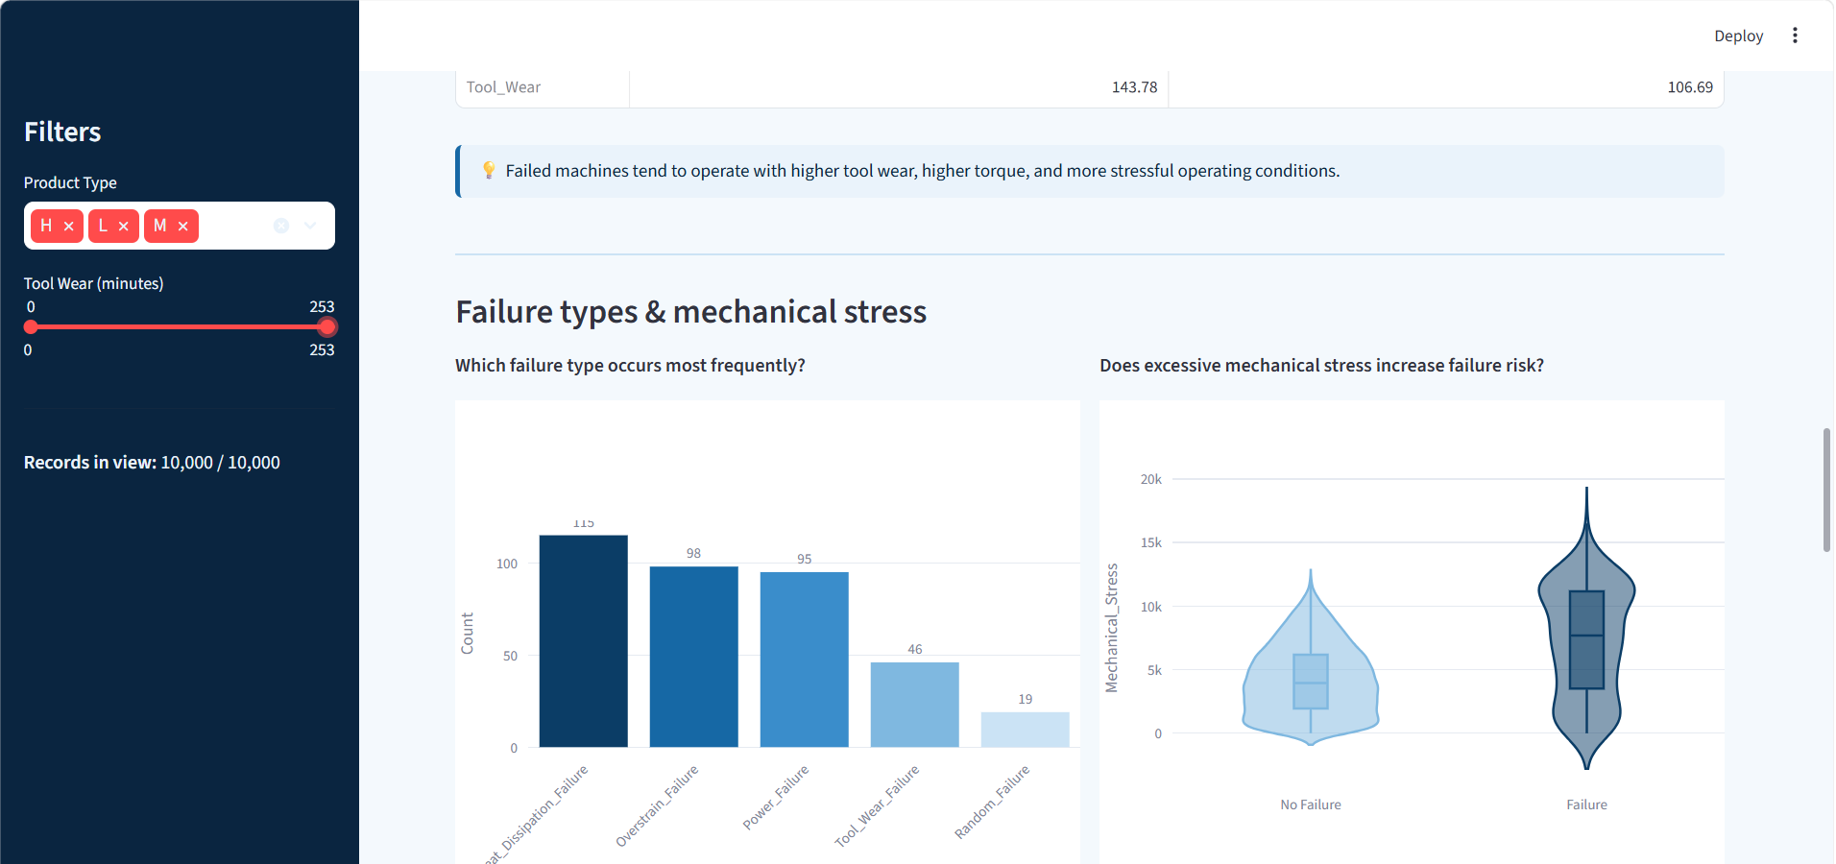
PLOTLY DASHBOARD

Slide 21
TABLEAU
DASHBOARD

Slide 22

HOME DASHBOARD

Slide 23
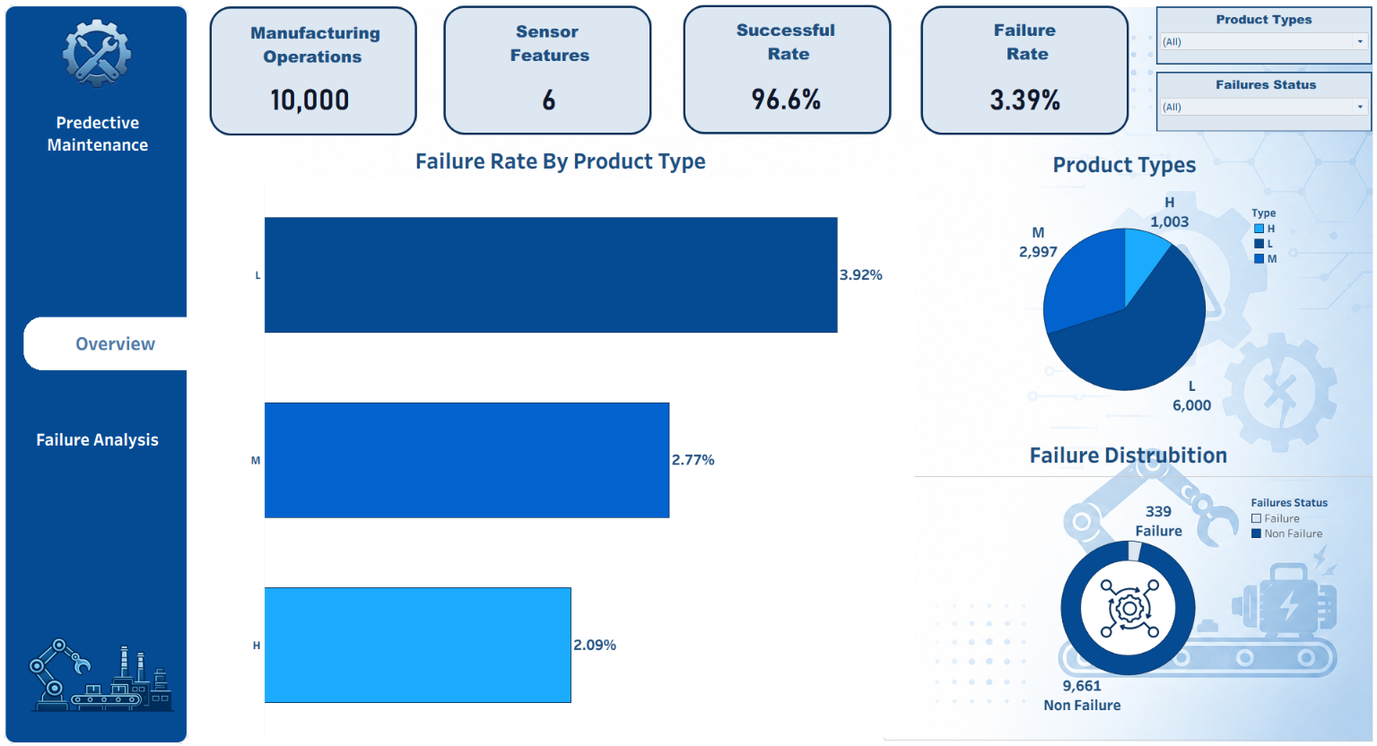
OVERVIEW DASHBOARD

Slide 24
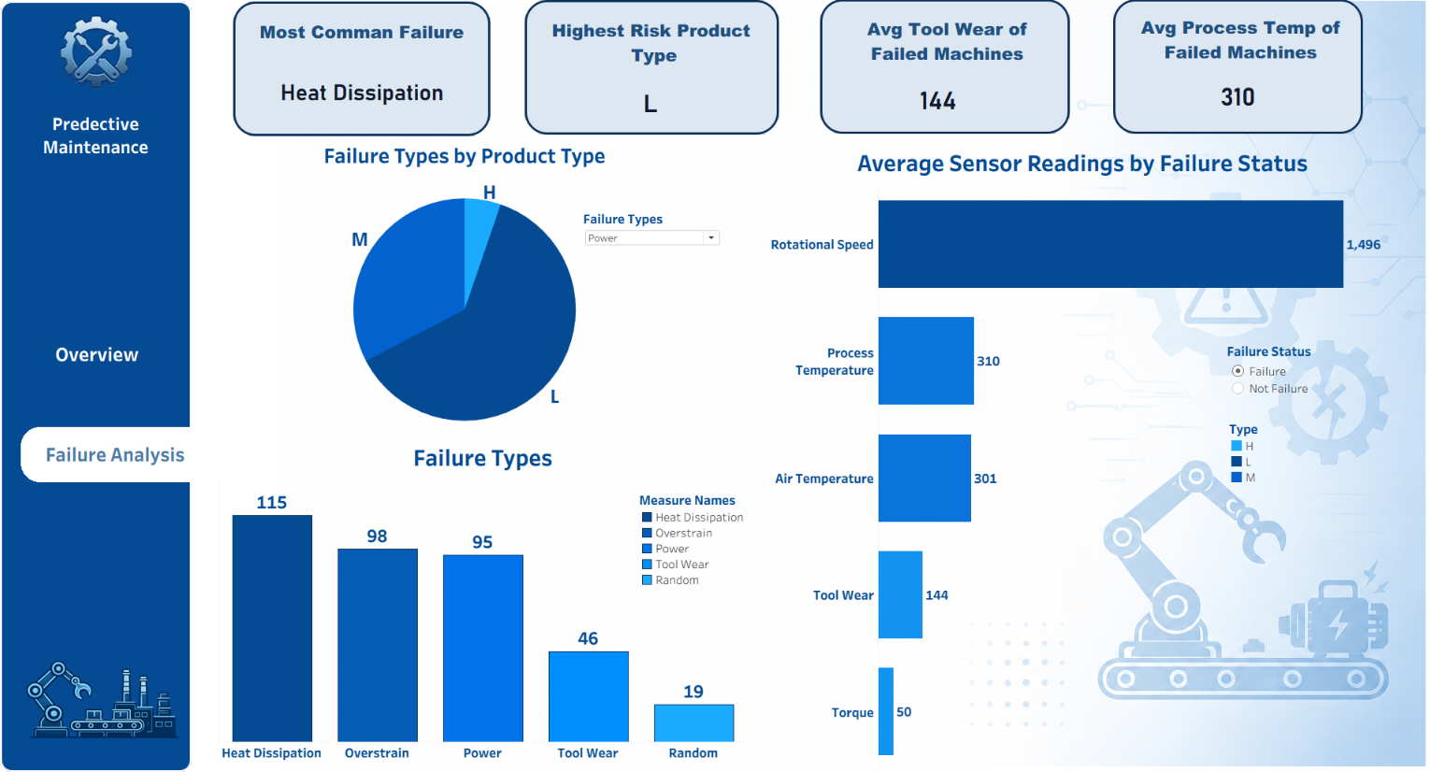
FAILURE ANALYSIS DASHBOARD

Slide 25
MACHINE
LEARNING

Slide 26
FEATURE ENGINEERING & PREPROCESSING
• Categorical encoding: Type → LabelEncoder (L = 0, M = 1, H = 2).
• Dropped failure-mode leakage columns: TWF, HDF, PWF, OSF, RNF.
• Final feature set: Type, Air_Temperature, Process_Temperature,
Rotational_Speed, Torque, Tool_Wear.
• Split: 80% train / 20% test with stratification on Machine_Failure.
• Scaling: StandardScaler inside sklearn Pipelines (for LR, SVM, KNN).
• Cross-validation: StratifiedKFold (k = 5) — preserves the 3.39% failure ratio.

Slide 27
MODELING APPROACH
• Six classifiers trained and tuned:
• - Logistic Regression (baseline)
• - K-Nearest Neighbors (GridSearchCV — n_neighbors, weights, p)
• - Support Vector Machine (GridSearchCV — C, gamma, kernel)
• - Random Forest (GridSearchCV— depth, estimators, splits)
• - XGBoost (GridSearchCV— depth, lr, subsample)
• - CatBoost (GridSearchCV— depth, lr, iterations)
• Metrics tracked: Accuracy, Precision, Recall, F1-Score, ROC-AUC.
• Primary selection metric: ROC-AUC (robust to class imbalance).

Slide 28
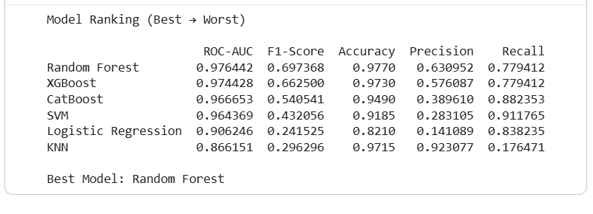
MODEL COMPARISON
• Random Forest achieved the best overall performance, with the highest ROC-AUC (0.976) and F1-Score (0.697).
• KNN achieved high Precision but the lowest Recall, making it less suitable for detecting machine failures.

Slide 29
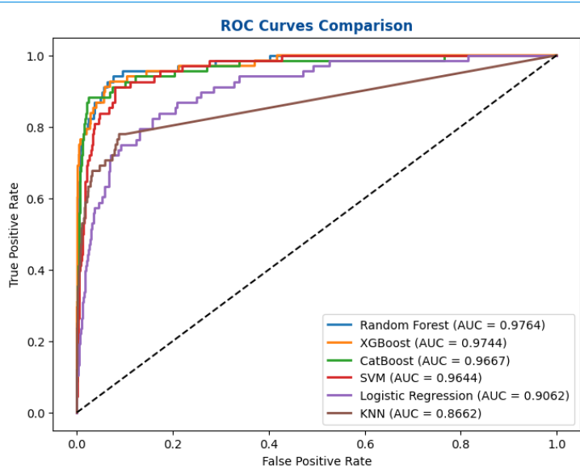
ROC CURVES — ALL MODELS
• ROC-AUC ranks the models cleanly:
• 1. Random Forest — 0.9764
• 2. XGBoost — 0.9760
• 3. CatBoost — 0.9689
• 4. SVM — 0.9644
• 5. Logistic Reg. — 0.9062
• 6. KNN — 0.8662
• Random Forest ships to production.

Slide 30
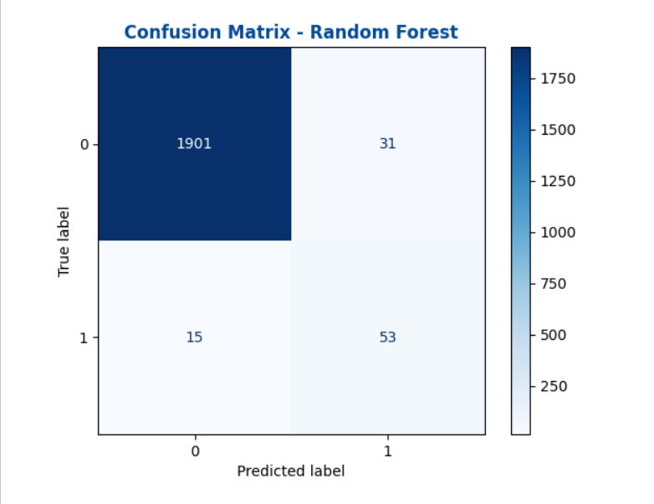
BEST MODEL — RANDOM FOREST
• High recall, low false alarms — Random Forest reliably catches real failures without overwhelming maintenance teams.
• 31 = false alarms (healthy machines wrongly flagged).
• 15 = missed failures (real breakdowns the model didn't catch)

Slide 31
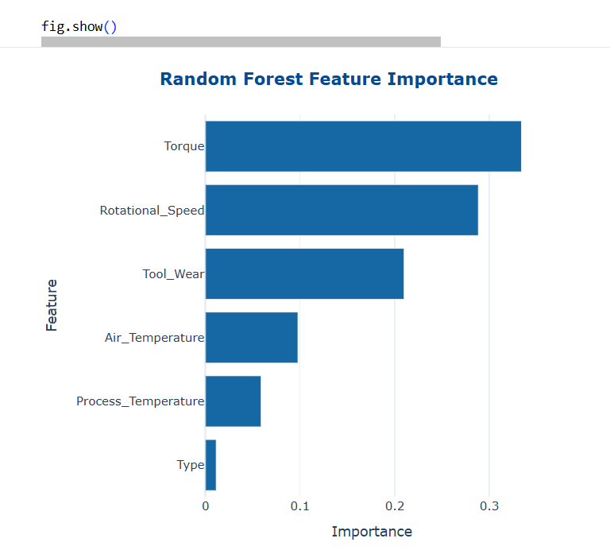
FEATURE IMPORTANCE — RANDOM FOREST
• Top drivers of predicted failure risk:
• 1. Torque
• 2. Tool Wear
• 3. Rotational Speed
• 4. Air Temperature
• 5. Process Temperature
• 6. Type

Slide 32
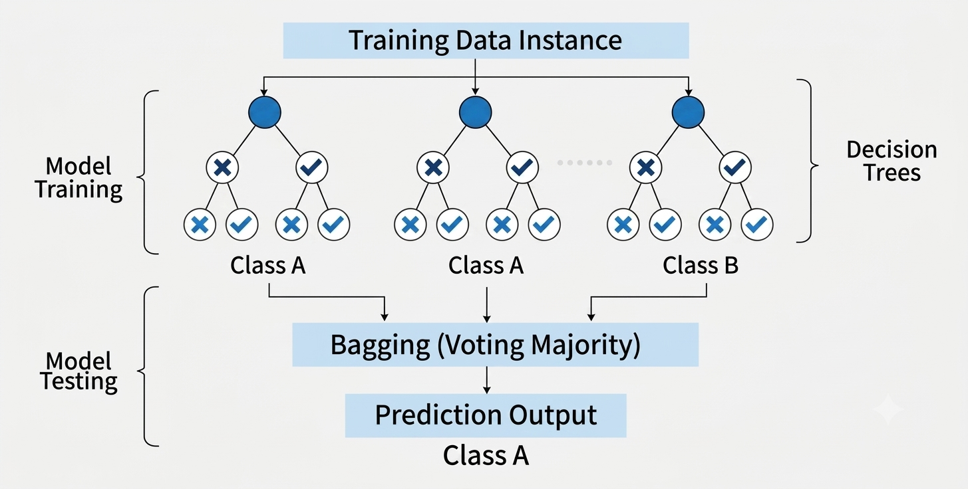
HOW RANDOM FOREST WORKS

Slide 33
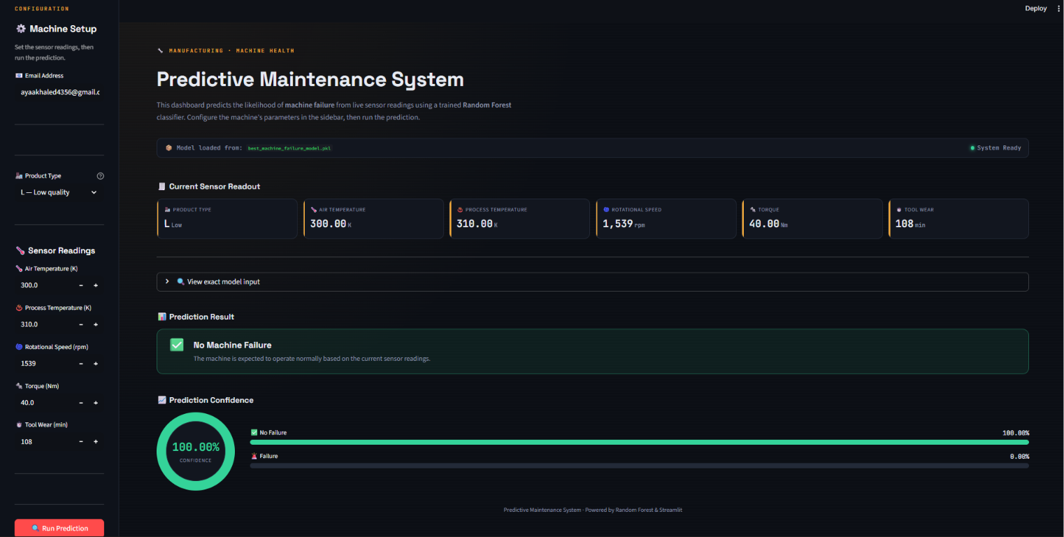
STREAMLIT PREDICTION DARK APP

Slide 34
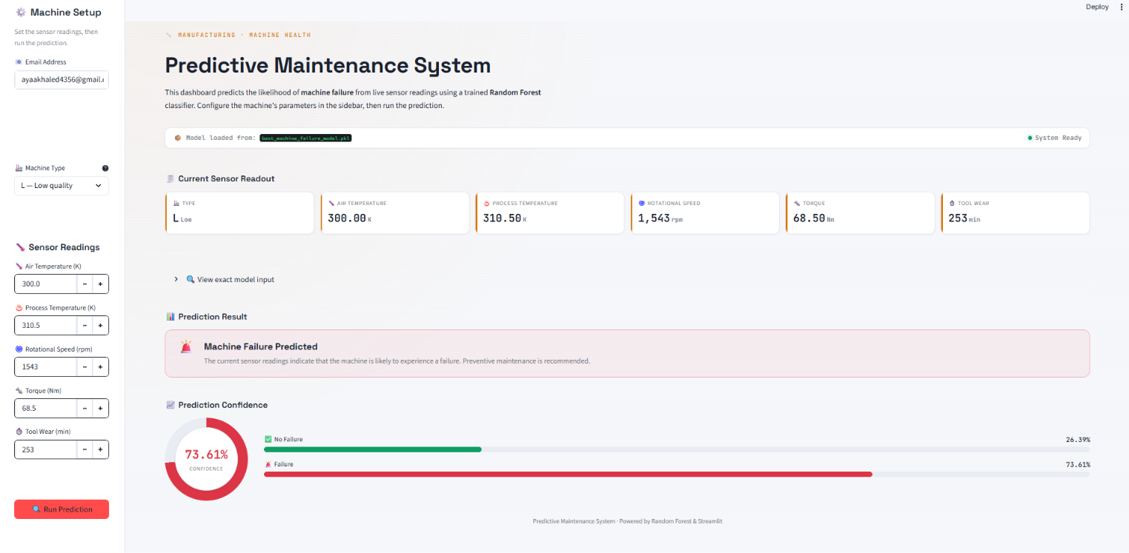
STREAMLIT PREDICTION LIGHT APP

Slide 35
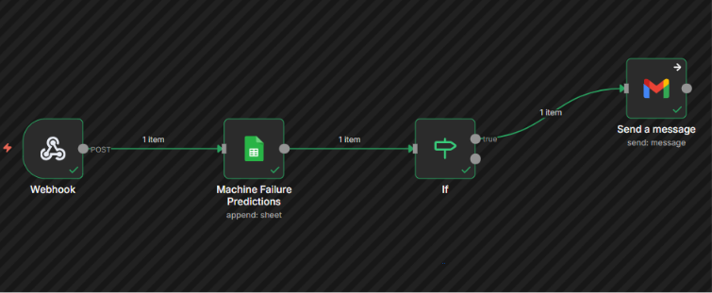
AUTOMATION WITH N8N
• Every prediction is automatically logged in Google Sheets.
• If the prediction is Failure, an email notification is sent automatically to the user.
• The alert includes the prediction details and recommends immediate preventive maintenance.

Slide 36
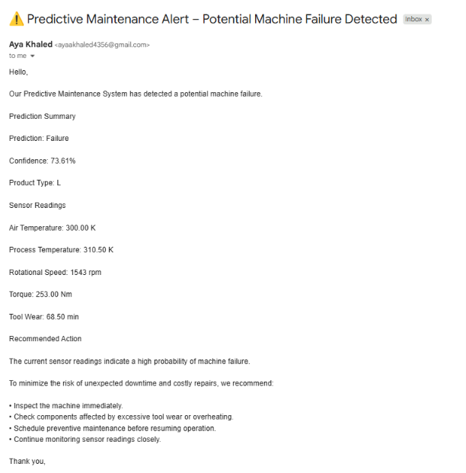
MESSAGE SENT

Slide 37
BUSINESS IMPACT & RECOMMENDATIONS
Business Impact
  Reduced unplanned machine downtime.
  Improved maintenance planning.
  Lower maintenance costs.
  Increased production efficiency.
Recommendations
  Prioritize maintenance for L-type machines.
  Inspect machines with Tool Wear > 150 min.
  Monitor extreme Torque × RPM conditions.
  Retrain the model regularly with new data.

Slide 38
LIMITATIONS & FUTURE WORK
Limitations
  Synthetic dataset may not reflect real factory conditions.
  Class imbalance affects prediction accuracy.
  Only tabular sensor data was used.
Future Work
  Apply SMOTE to handle class imbalance.
  Deploy the model for real-time prediction.
  Integrate live sensor data.
  Extend the model to predict failure types.

Slide 39


