Slide 1

Project Title:
HomeEase
Department of Computer Science
COMSATS University Islamabad, Abbottabad Campus
Group Members:
Hashir Hamid (CIIT/FA22-BSE-139/ATD)
Aman Ullah Khan (CIIT/FA22-BSE-074/ATD)
Umar Saeed (CIIT/FA22-BCS-041/ATD)
Supervisor-name:
Sir Sumair Khan

Slide 2
Agenda of the Presentation
Brief Introduction
Scope
Functional Requirements
Non-Functional Requirements
User Goals
Use Cases
Use Case Diagram
Architecture Diagram
Process Flow Diagram
Class Diagram
Sequence Diagram
Activity/State Machine Diagram
ER Diagram
Summary of Project Implementation (60% Milestone)
Schedule (Gantt Chart)
Details of Next Iteration (100% Roadmap)
Conclusion

Slide 3
Brief Introduction
HomeEase is an enterprise-grade, hyper-local domestic worker connect platform and marketplace engineered to formalize, organize, and secure the informal home services sector in Pakistan (piloted in Abbottabad).
The platform bridges the deep trust deficit between urban households needing domestic help (cooks, cleaners, maids, child nannies, elderly caregivers) and informal workers seeking reliable employment, fair wages, and reputation portability.
It addresses the critical challenges of informal hiring, such as absence of background checks, safety vulnerabilities, arbitrary wages, and unpredictable worker absenteeism.
A key innovation of HomeEase is its Content-Based AI Recommender Engine with Explainable AI (XAI) transparent match badges combining Cosine Similarity on skill vectors, Haversine geospatial proximity decay, and min-max rating normalization.
The platform introduces a Bidirectional Job Marketplace allowing households to publish open gigs and domestic workers to actively browse and apply for local neighbourhood opportunities.
The system comprises a Flutter mobile app, Supabase PostgreSQL backend with Row Level Security (RLS), and native bilingual English/Urdu (اردو) localization with low-literacy pictorial affordances.

Slide 4
Scope
Provide a cross-platform Flutter mobile application for households to discover verified domestic workers, inspect XAI match scores, create direct bookings, and post open gigs.
Provide a dedicated worker mobile interface with high-contrast pictorial icons, Urdu voice/text affordances, availability schedule management, and neighborhood gig feeds.
Implement an authentic Content-Based AI Recommender System matching household chore requirements to worker trade skill vectors and Abbottabad geospatial coordinates.
Deliver a Bidirectional Job Marketplace empowering domestic workers to proactively browse and apply to open gigs posted by nearby households.
Auto-generate formal digital service agreements and provide transparent manual payment logging (Cash, JazzCash, EasyPaisa) with audit trails.

Slide 5
Scope(cont)
Provide a React/Vite web administrative dashboard for KYC document inspection, CNIC verification, dispute mediation, and system analytics.
Enforce database-level scheduling integrity and double-booking locks preventing conflicting appointments for domestic workers.
Implement multi-dimensional review mechanisms evaluating punctuality, professional behavior, and task completion quality.
Implement Supabase JWT authentication and 24 Row Level Security (RLS) policies guaranteeing multi-tenant data isolation and privacy.
Validate system performance with an Abbottabad cold-start evaluation dataset covering real local neighborhoods (Mandian, Jinnahabad, Supply, PMA Kakul, Murree Road).

Slide 6
Functional Requirements
Household Functional Requirements
Household Registration & Profile: Allows households to create an account, manage contact information, and configure Abbottabad locality.
AI Worker Discovery & Search: Enables households to filter domestic workers by category, budget, and distance, receiving real-time Content-Based AI rankings.
Explainable AI Match Badging: Allows households to view transparent match percentages detailing skill alignment, distance, and past ratings.
Direct Booking Request Formulation: Enables households to schedule direct service requests specifying start dates, hours, and chore checklists.
Publish Open Neighborhood Gigs: Allows households to post customized chore requirements with defined budget and timeline to the job board.
Review Worker Applications: Enables households to evaluate applying domestic workers for posted gigs and accept the best candidate.
Digital Service Agreement Sign-off: Allows households to review and digitally sign auto-generated employment contracts prior to job commencement.
Manual Payment Logging & Receipts: Allows households to record payments via Cash, JazzCash, or EasyPaisa and attach screenshot receipts.

Slide 7
Functional Requirements(Cont.)
Domestic Worker Functional Requirements
Worker Registration & Profile Management: Allows workers to create a profile, specify bio, years of experience, and base Abbottabad neighborhood.
KYC & CNIC Document Submission: Enables workers to upload high-resolution front/back CNIC images and reference certificates for administrative vetting.
Service Category & Pricing Configuration: Allows workers to select service specialties (Cooking, Cleaning, Childcare, Elderly Care, Maid) and configure hourly or visit rates.
Weekly Availability Slot Management: Provides a weekly scheduling calendar enabling workers to toggle availability time slots by day.
Bidirectional Job Board Feed: Displays open gigs posted by nearby households matching registered trades and geographical radius.
One-Tap Job Application Submission: Enables domestic workers to proactively apply for open gigs with proposed rates and notes.
Booking Invitation Management: Allows workers to inspect, accept, or decline incoming household booking requests in real-time.
Payment Receipt Confirmation: Allows workers to inspect household payment logs and confirm receipt of cash or mobile wallet funds.
Bilingual Urdu Navigation: Enables workers to access complete app features in Urdu (اردو) supported by high-contrast pictorial visual icons.

Slide 8
Functional Requirements(Cont.)
AI Recommendation & Marketplace Functional Requirements
Skill Vectorization: Transforms household chore demands and worker capabilities into multi-hot binary attribute vectors across 50 skills.
Cosine Similarity Computation: Computes mathematical dot-product similarity between worker skill vectors and household demands.
Haversine Proximity Decay: Calculates geodesic distance in kilometers between coordinates and applies exponential spatial decay penalties.
Composite Match Scoring: Computes weighted score combining skill similarity (50%), proximity (30%), and normalized ratings (20%).
Explainable AI (XAI) Badging: Generates human-readable badges explaining why the worker was recommended (skills, distance, ratings).
Bidirectional Feed Matching: Filters open gigs for domestic workers matching their approved categories within their travel radius.
Double-Booking Conflict Lock: Enforces transactional database constraints preventing overlapping bookings for the same worker.
Dispute Ticket Logging: Allows either party to log formal dispute tickets with photographic evidence and detailed claims.

Slide 9
Functional Requirements(Cont.)
Admin Functional Requirements
Administrator Authentication: Provides secure role-based dashboard access for university evaluators and platform managers.
Worker Verification Queue: Allows administrators to inspect submitted CNIC cards, verify identity records, and approve or reject workers.
Dispute Mediation Console: Enables administrators to inspect disputed bookings, review photographic evidence and payment logs, and issue binding resolutions.
User & Booking Audit Ledgers: Allows administrators to monitor global platform activity, track booking lifecycles, and inspect audit records.
Platform Taxonomy & Skill Management: Enables administrators to manage domestic service categories, skills, and standardized rates.
Data Export & Compliance Reporting: Supports exporting platform activity, user rosters, and dispute statistics in CSV format for academic evaluation.

Slide 10
Non-Functional Requirements
Usability Requirements
NFR-USE-01 — Low-Literacy Accessibility
All critical worker actions (accept job, view feed, confirm pay) executable within ≤3 taps from home screen. High-contrast pictorial iconography for all tasks.
NFR-USE-02 — Native Urdu & RTL
Flawless bilingual layout switching with correct Right-to-Left (RTL) padding and Urdu typography.
Reliability Requirements
NFR-REL-01 — High Availability
The system shall maintain 99.5% uptime backed by Supabase cloud infrastructure.
NFR-REL-02 — Prevent Double Booking
The system shall ensure no worker can be double-booked across overlapping calendar time slots.
Performance Requirements
NFR-PERF-01 — Fast Response
Content-Based AI recommendation engine computes match scores across 500 worker profiles in <250 ms.
NFR-PERF-02 — Scalable User Load
Mobile UI maintains 60 FPS transitions with screen loading times under 2 seconds.

Slide 11
User Goals
Find a simple and centralized way to discover and hire verified domestic help with complete safety.
Evaluate transparent Explainable AI match scores combining skills, distance, and authentic community ratings.
Empower domestic workers with active marketplace agency to browse open household jobs and apply proactively.
Prevent disputes and wage ambiguity through formal digital service agreements and manual payment audit logs.
Overcome language and literacy barriers through native Urdu localization and visual pictorial guides.
Save time and eliminate stress by replacing unreliable word-of-mouth networks with a single, trusted mobile platform.

Slide 12
Use Cases
Household Use Cases
UC-1 Register / Login
UC-2 Profile & Abbottabad Locality Setup
UC-3 Discover Workers via AI Recommender
UC-4 View Explainable AI (XAI) Match Badges
UC-5 Send Direct Booking Request
UC-6 Publish Open Household Gig
UC-7 Review Worker Job Applications
UC-8 Sign Digital Service Agreement
UC-9 Log Payment & Upload Receipt
UC-10 Submit Multi-Dimensional Review

Slide 13
Use Cases(cont)
Domestic Worker Use Cases
UC-11 Register / Login
UC-12 Setup Trade Profile & Service Categories
UC-13 Submit KYC Verification (CNIC Upload)
UC-14 Configure Weekly Availability Calendar
UC-15 Browse Open Neighborhood Gigs Feed
UC-16 Submit One-Tap Job Application
UC-17 View & Accept Direct Booking Invitations
UC-18 Sign Service Agreement & Execute Chores
UC-19 Confirm Payment Receipt

Slide 14
Use Cases(cont)
Admin Use Cases
UC-20 Admin Authentication & Console Login
UC-21 Review & Approve/Reject Worker KYC (CNIC)
UC-22 Mediate & Resolve Booking Disputes
UC-23 View System Analytics & User Rosters
UC-24 Manage Domestic Service Categories & Skills
UC-25 Suspend / Deactivate Non-Compliant Users
UC-26 Export Platform Audit Logs (CSV)

Slide 15
Use Cases(cont)
System & Platform Use Cases
UC-27 Compute Content-Based Cosine Similarity
UC-28 Compute Haversine Geospatial Proximity Decay
UC-29 Generate Transparent Explainable AI (XAI) Badges
UC-30 Filter Bidirectional Job Feed by Proximity
UC-31 Enforce Double-Booking Concurrency Lock
UC-32 Dynamic Bilingual Language Toggle (EN / اردو)
UC-33 Render High-Affordance Pictorial Task Cards

Slide 16
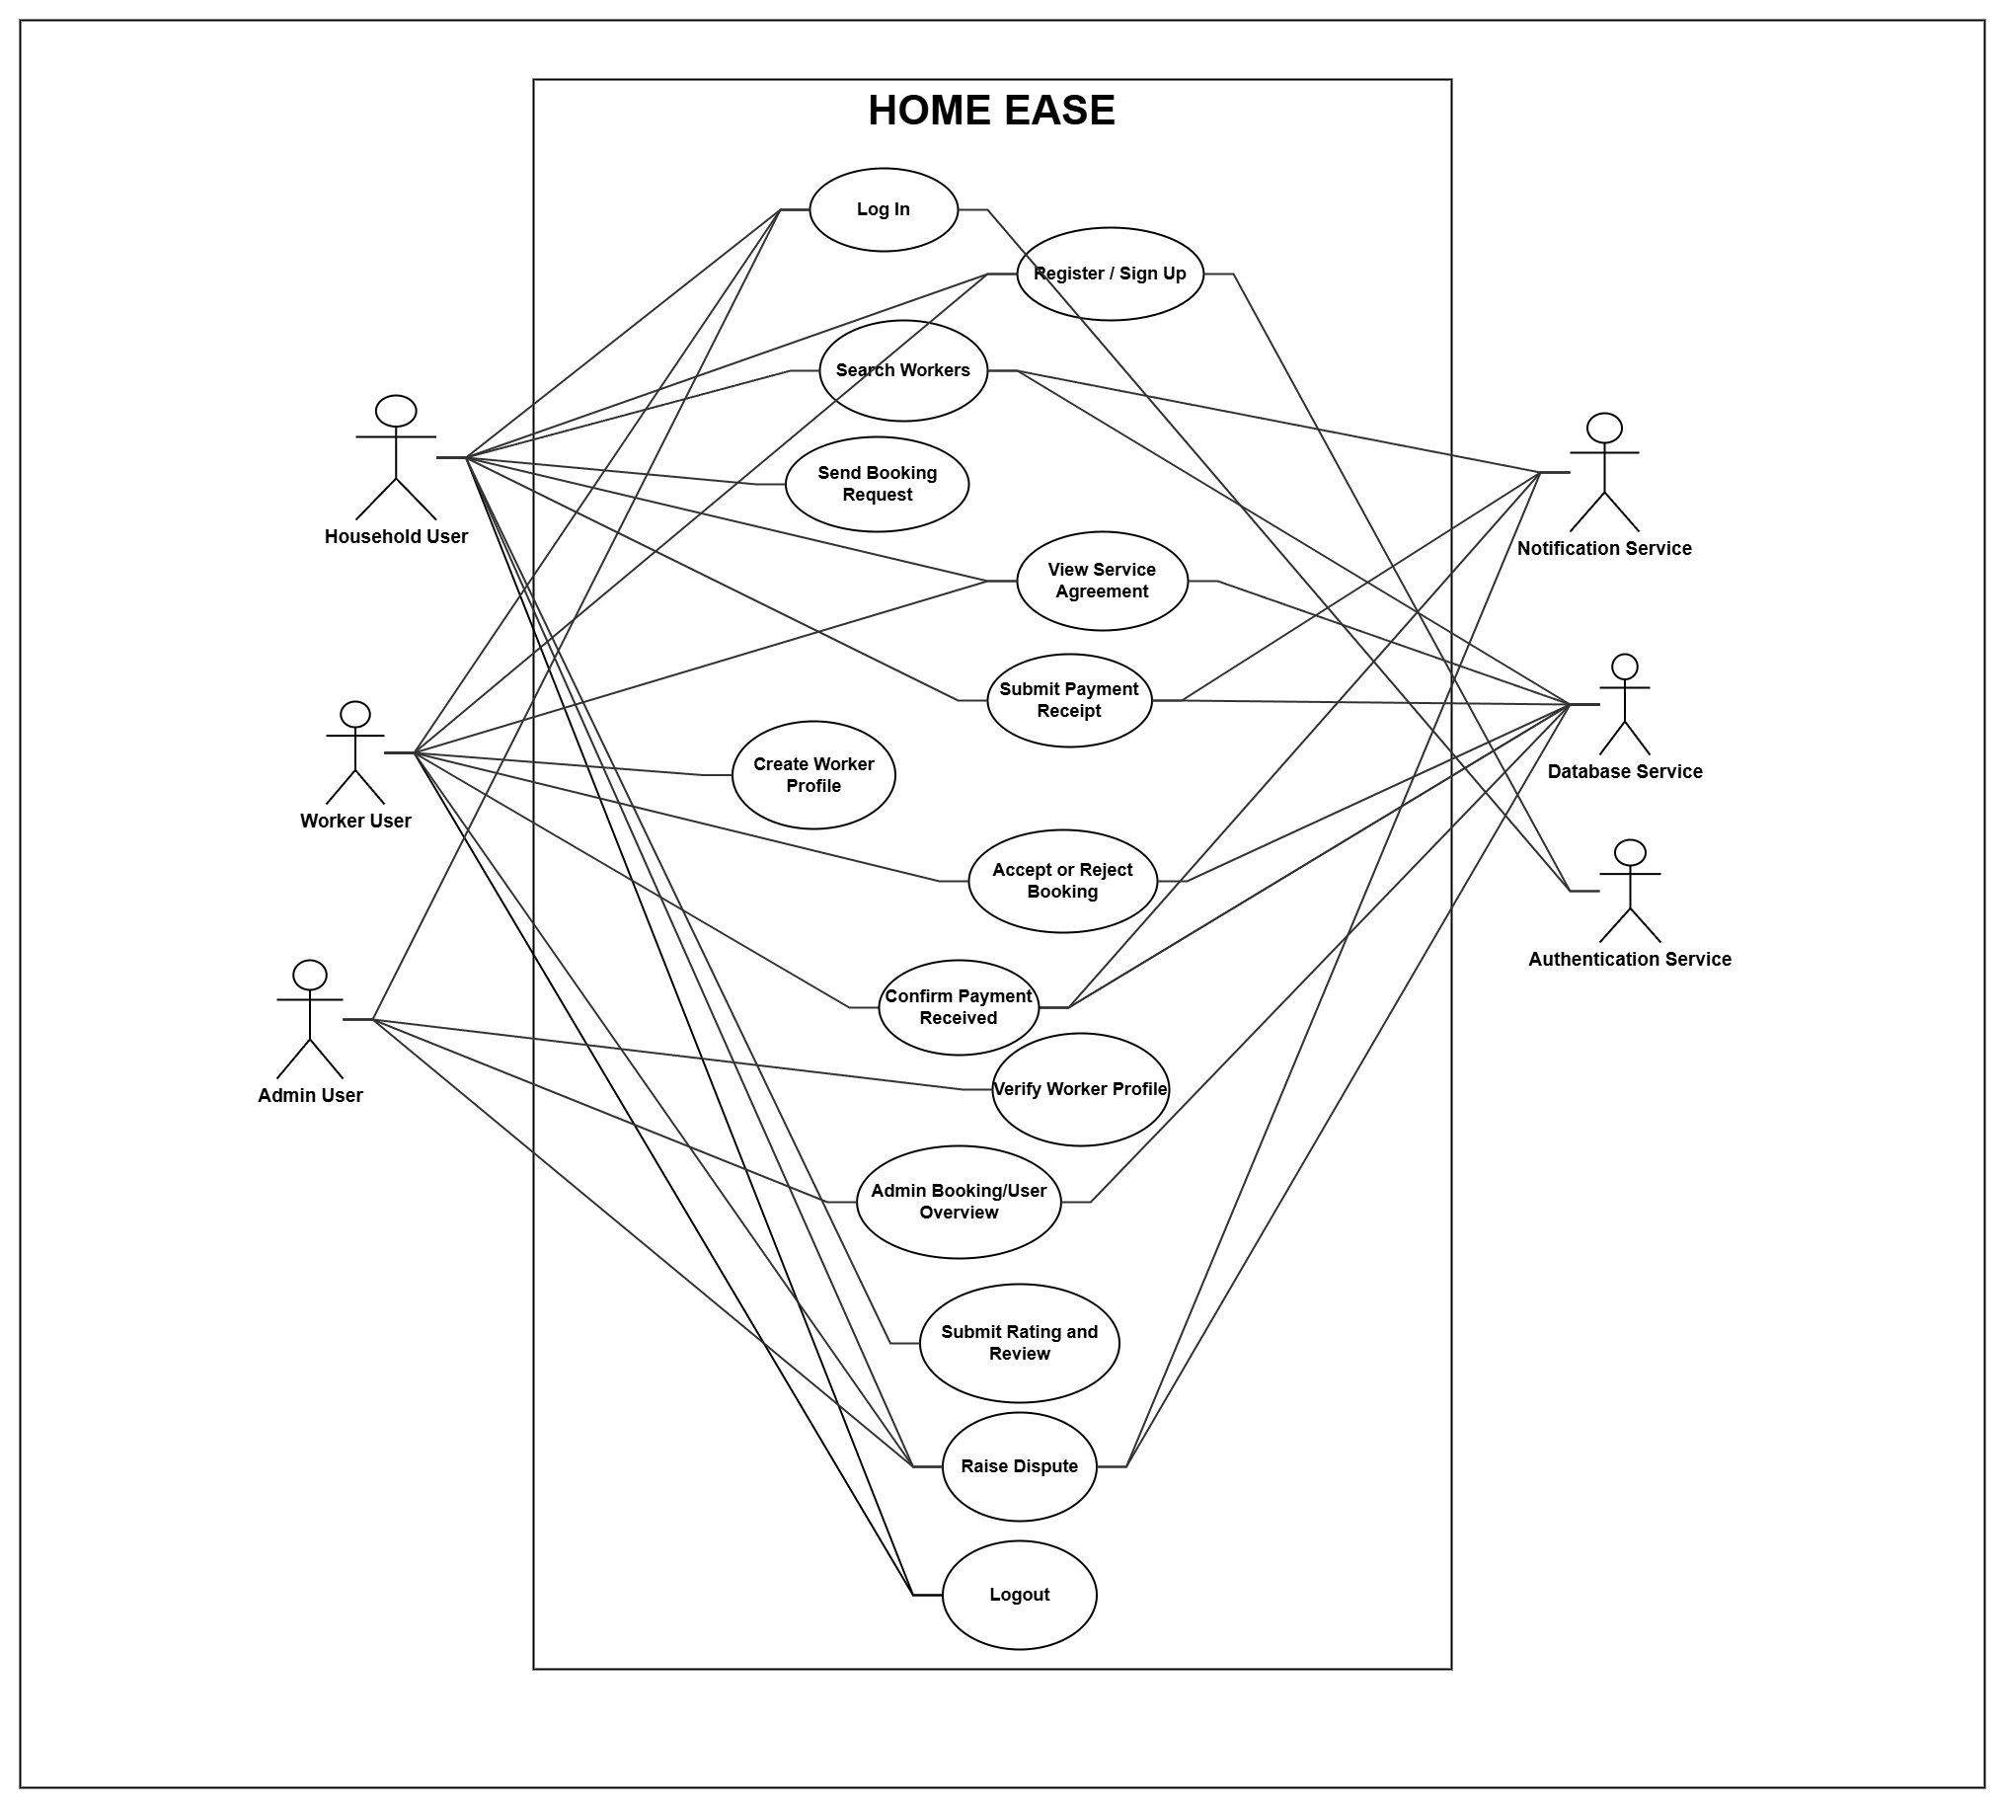
Use Case Diagram

Slide 17
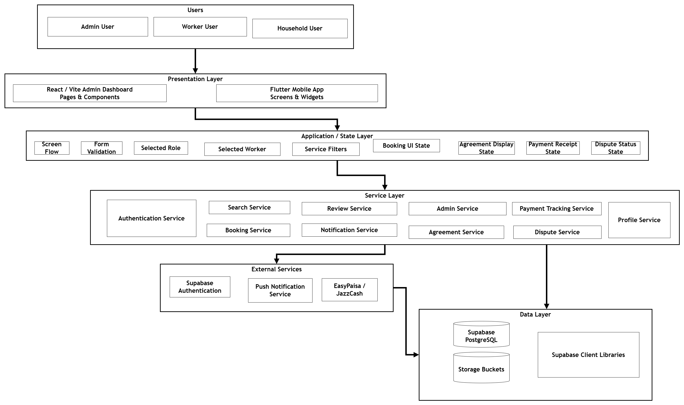
Architecture Diagram

Slide 18
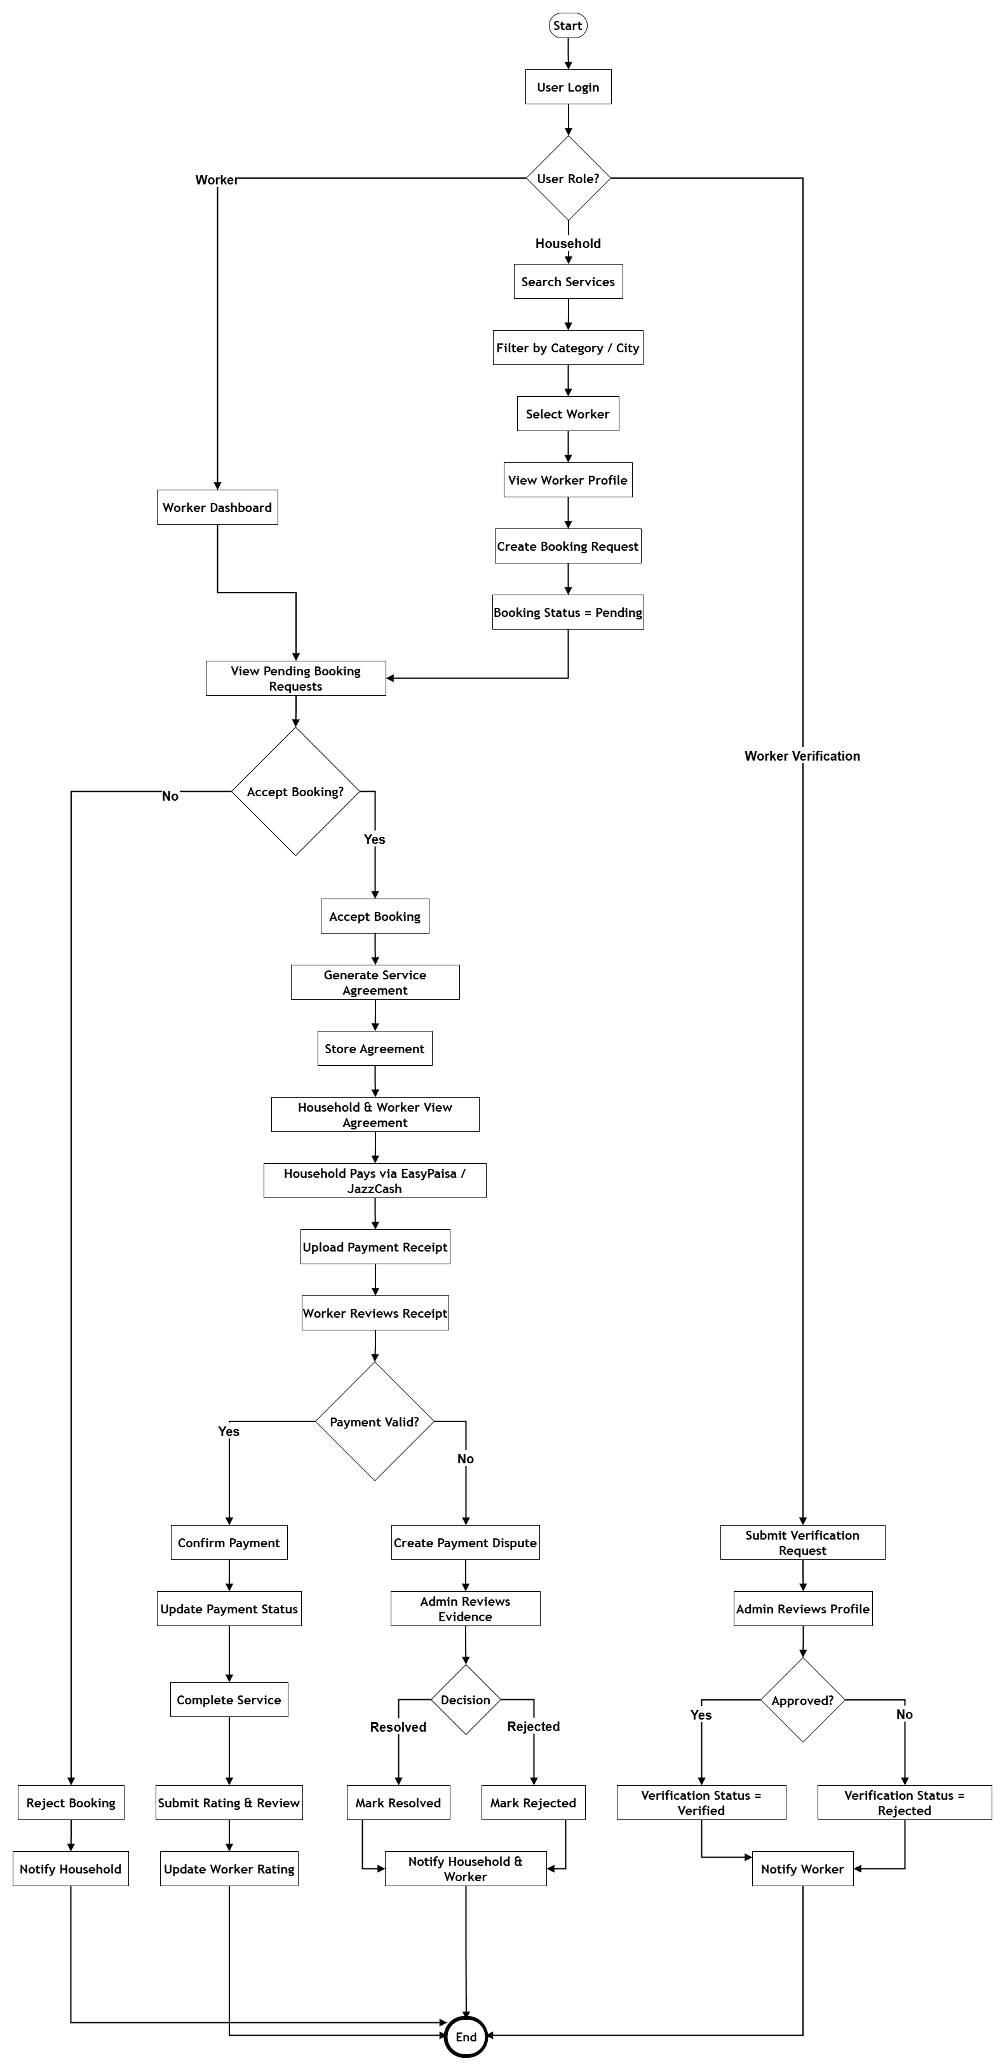
Process Flow Diagram

Slide 19
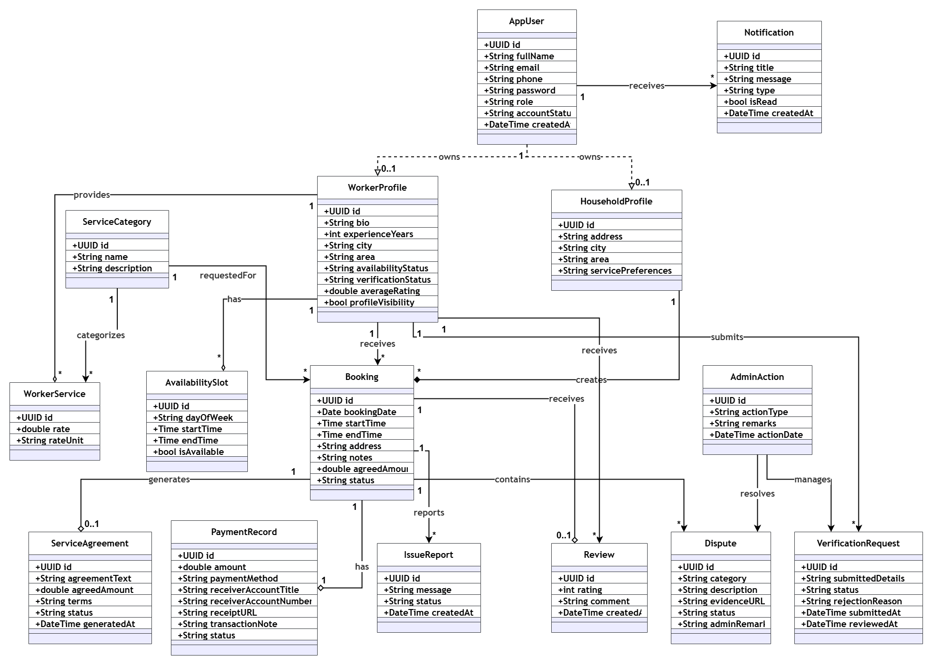
Class Diagram

Slide 20
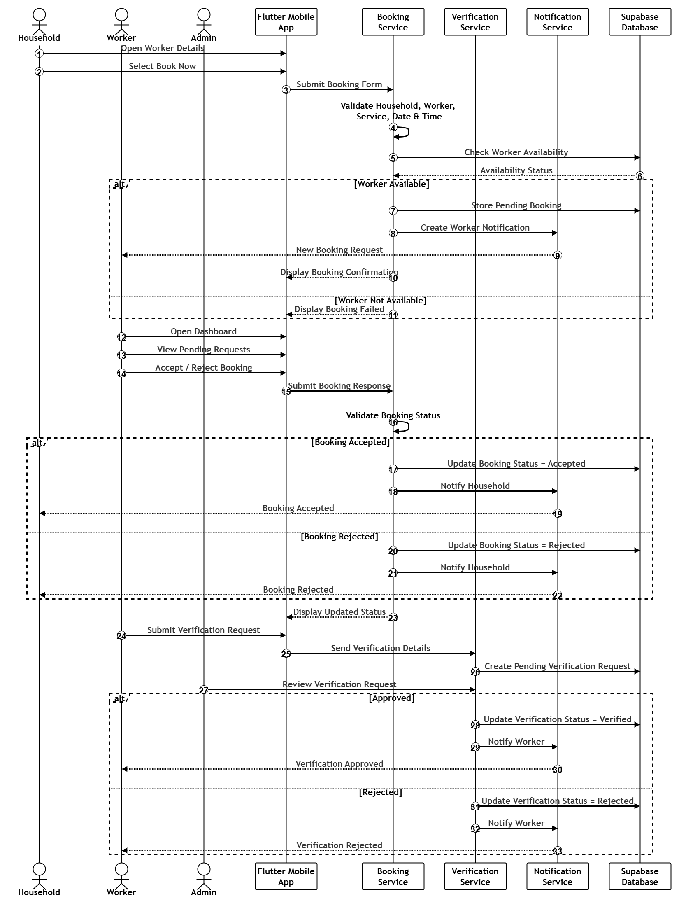
Sequence Diagram

Slide 21
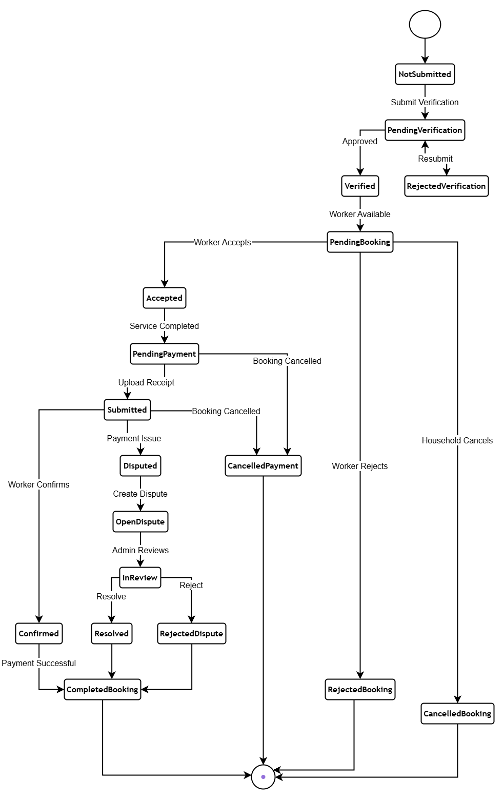
Activity/State Machine Diagram

Slide 22
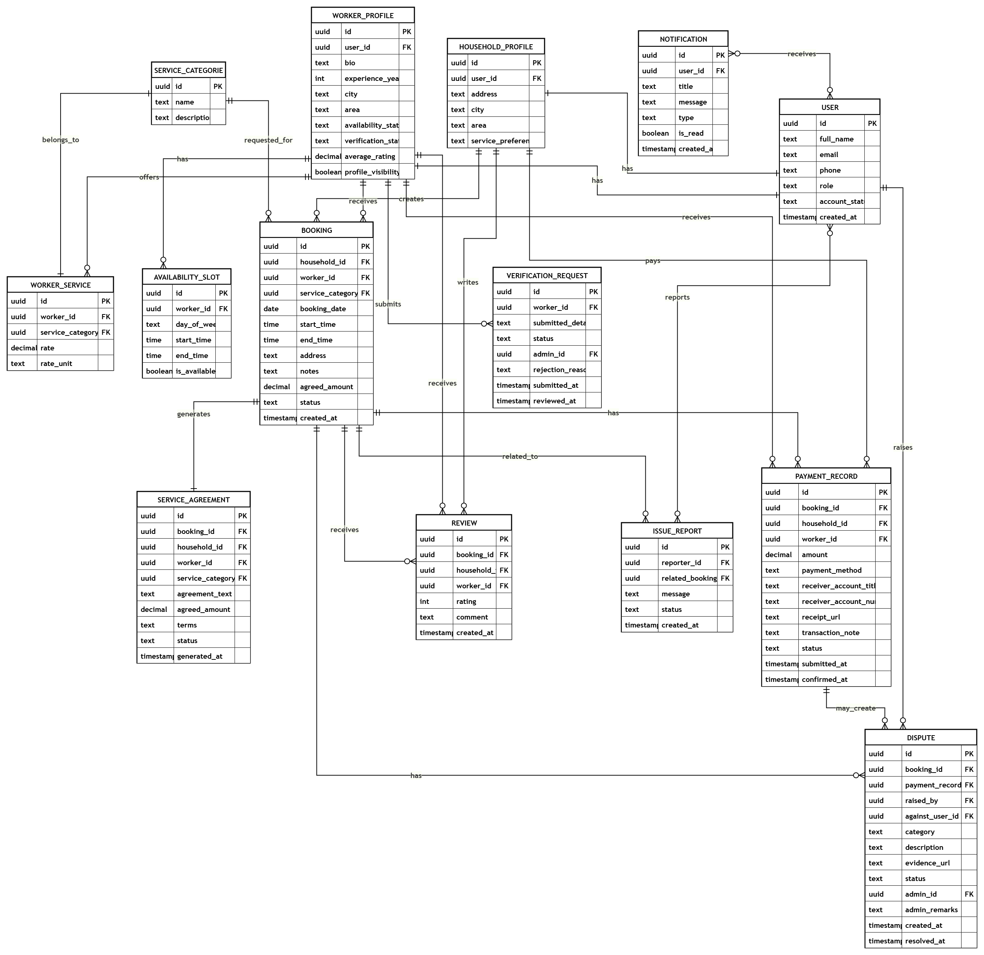
ER Diagram

Slide 23
Summary of Project Implementation
Multi-role platform architecture: HomeEase is designed as a unified ecosystem with dedicated interfaces for households, domestic workers, and administrators, so each user type can perform tasks relevant to their role.
Cross-platform mobile application: Built with Flutter & Dart, supporting rapid responsive performance, seamless role-switching, and full onboarding for both households and domestic workers.
Content-Based AI Recommender System: Instead of static dropdown filters, the system computes Cosine Similarity on skill vectors, Haversine geospatial proximity decay across Abbottabad coordinates, and min-max rating normalization with transparent Explainable AI (XAI) badges.
Bidirectional job marketplace: Allows households to publish open gigs specifying budget, schedule, and chore checklists, while domestic workers actively browse local neighbourhood feeds and apply with single-tap ease.
Booking & digital service agreements: End-to-end booking management supporting scheduling, transactional double-booking prevention, auto-generated service agreements with digital sign-off, and structured state transitions.

Slide 24
Summary of Project Implementation (cont.)
Admin control and verification: The React/Vite admin dashboard supports inspection and verification of worker CNIC documents, approval/rejection workflows, and platform-level governance ensuring trust across Abbottabad.
Bilingual localization & visual affordances: The platform includes complete English and Urdu (اردو) localization with right-to-left layout adaptation and high-contrast pictorial icons for low-literacy informal workers.
Manual payment audit trail: Supports logging of Cash, JazzCash, and EasyPaisa transactions with digital receipt screenshot uploads and worker receipt confirmation.
Dispute resolution workflow: Allows parties to submit evidence-backed dispute tickets with photos and descriptions for administrative arbitration.
Secure and scalable relational backend: Centralized Supabase PostgreSQL database featuring 16 normalized relational tables, strict foreign key constraints, and 24 Row Level Security (RLS) policies guaranteeing data isolation and security.

Slide 25
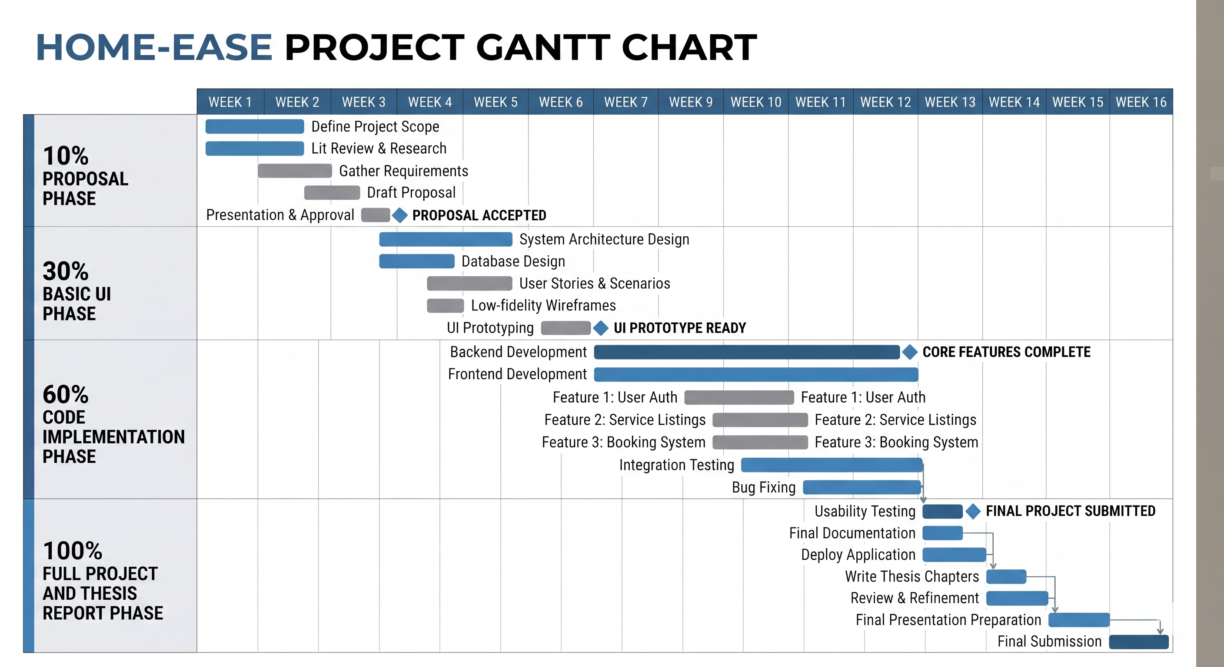
Schedule

Slide 26
Details of next Iteration (100%)
Real-Time Communication System
Bidirectional in-app live chat between households and domestic workers using Supabase Realtime WebSockets
In-app audio voice messaging to empower illiterate and low-literacy domestic workers
Read receipts and message delivery indicators
Automated Push Notification Infrastructure
integration of real-time mobile push notifications
Automated alerts for new job applications, booking responses, payment confirmations, and reminders
In-app notification center for persistent system alerts and updates

Slide 27
Details of next Iteration (100%)
Admin Web Dashboard
Admin Authentication & Console Login
Review & Approve/Reject Worker KYC (CNIC)
Mediate & Resolve Booking Disputes
View System Analytics & User Rosters
Manage Domestic Service Categories & Skills
Suspend / Deactivate Non-Compliant Users
Export Platform Audit Logs (CSV)

Slide 28
Details of next Iteration (100%)
Dispute Resolution & Policy Enforcement
Tiered penalty scoring and automated temporary account suspension for repeated cancellations
Comprehensive dispute arbitration console with audit trails and settlement logs
Deployment and Production Hardening
Migration of KYC documents and receipt uploads to secure S3 / Supabase cloud storage buckets
Empirical usability testing and pilot deployment with real households and workers in Abbottabad
Full regression testing, algorithmic latency benchmarking, and performance optimization
Comprehensive final thesis documentation, user manual, and live defense demonstration

