Slide 1

Home Ease
Hashir Hamid CIIT/FA22-BSE-139/ATD
Aman ullah khan CIIT/FA22-BSE-074 /ATD
Umar Saeed CIIT/FA22-BCS-041 /ATD
Supervisor: Sir Sumair khan
Department of Computer Science
COMSATS University Islamabad, Abbottabad Campus

Slide 2
Agenda of the Presentation
Motivation
Brief Introduction
Scope
Functionalities
Proposed Tools
Feasibility
Schedule
First iteration
Conclusion

Slide 3
Motivation
Hiring domestic workers in Pakistan is mostly informal and based on personal references. Households often face trust and safety concerns while hiring workers.
There is no centralized mobile platform dedicated to home care services. Workers struggle to find stable and regular job opportunities.
Existing hiring methods are time consuming and inefficient. There is a lack of transparency in worker experience, ratings, and pricing. Smartphones and mobile applications are becoming widely accessible in daily life.

Slide 4
Brief Introduction
HomeEase is a hyper local mobile application designed to connect households with trusted domestic workers such as maids, cooks, cleaners, nannies, and caregivers.
The application provides a digital platform where users can search, book, and communicate with nearby workers easily and securely. Workers can create professional profiles, manage availability, and receive job requests directly through the app.
The system includes features such as worker verification, location based search, booking and scheduling, ratings and reviews, and real time notifications.
HomeEase aims to improve trust, transparency, and efficiency in the home care services sector while creating better job opportunities for workers.

Slide 5
Scope
The project focuses on developing a mobile application for connecting households with domestic workers.
The system allows households to search for nearby workers based on location, skills, ratings, and availability.
Workers can create and manage professional profiles including experience, services, and pricing.
The application supports booking and scheduling of home care services through the mobile platform.

Slide 6
Scope(cont)
Users can provide ratings and reviews after service completion to improve transparency and trust.
The project mainly targets urban areas where smartphone usage and demand for home services are increasing.

Slide 7
Out of Scope(cont)
The system will not provide direct employment contracts between households and workers.
Online payment and digital wallet integration will not be included
The application will not provide transportation or logistics services for workers.
Background checks by government authorities or police verification are outside the project scope.

Slide 8
Out of Scope
The system will not include video calling or advanced real time communication features.
The application will not support web platform access in the initial release and will focus only on mobile devices.
The project will not include AI based recommendations or automated worker selection

Slide 9
Functionalities
Authentication and Role Management
User registration, login, logout, and role based access for households and workers.
Household User Management
Households can manage their profile, contact details, address, and booking history.
Worker Profile Management
Workers can create and update profiles with skills, experience, services, and contact information.
Worker Verification
Worker identity and profile details can be verified to build trust and reliability.
Service Category and Pricing
Workers can select service categories such as maid, cook, cleaner, nanny, and set expected charges.

Slide 10
Functionalities(cont.)
Search and Matching
Households can search and filter nearby workers based on skills, availability, and ratings.
Booking and Availability Management
Households can book services, while workers can accept, reject, and manage their availability.
Rating and Review System
Households can rate and review workers after service completion.
Notification, Communication and Admin Management
Users receive booking alerts and updates, communicate in app, and admins manage users and verification.

Slide 11
Proposed Tools/Platform
Category | Tools / Technologies | Purpose
Frontend | Flutter (Mobile), React.js (Web) | To build cross-platform user interfaces for mobile and web users.
Backend | Node.js (APIs) | To handle server-side logic, APIs, and communication between components.
Database | PostgreSQL | To store and manage structured data such as users, hotels, and trips.
Authentication & Notifications | supabase | To manage user sign-in, verification (KYC), and push notifications.
Design | Figma | To design and prototype UI/UX for both mobile and web applications.
Documentation & Planning | MS Project, Word, PowerPoint | To plan, document, and present project progress and deliverables.

Slide 12
Feasibility – Technical
Technology / Tool | Purpose | Feasibility
Flutter /Dart | Build cross-platform mobile and web applications with a unified codebase. | Easily implemented with standard developer hardware; both are open-source and widely supported.
PostgreSQL | Store and manage structured relational data for users, hotels, and trips. | Reliable and open-source; integrates seamlessly with Node.js for data handling.
supabase | Handle user authentication, verification, and push notifications. | Free tier sufficient for academic-scale projects; cloud-based and easy to integrate.
Star UML | For uml diagrams | Diagrams and system design

Slide 13
Feasibility – Financial
Cost Area | Purpose | Financial Feasibility
Flutter / Dart | Used to develop the mobile application for households and workers. | Open-source and free to use, so no licensing cost is required.
Supabase | Used for database, authentication, and basic backend services. | Free tier is sufficient for early-stage academic project development.
Hosting / Backend Services | Used to store data and manage application features online. | No expensive hosting or dedicated servers are needed initially because Supabase provides cloud-based services.
Development Team | System will be developed by students under supervision. | Development cost is low because no external developers are required.
Design and Documentation Tools | Used for UI design, diagrams, documentation, and project presentation. | Free or academic tools such as Draw.io, MS Word, and PowerPoint can be used.
Testing Devices | Used to test the mobile application on Android devices. | Testing can be done using personal mobile phones and emulators, reducing hardware cost.

Slide 14
Feasibility – Resource
Resource Type | Availability | Feasibility
Human Resources | 3 developers and supervisor | Team members can divide the modules and complete the project with supervisor guidance.
Software | Flutter, PostgreSQL, Supabase | Required tools are free or easily available for development.
Hardware | Laptops and smartphones | Existing devices are enough for development and testing.
Support Resources | MS Word, Figma, GitHub | These tools support documentation, design, and teamwork.
University Support | Lab and team setup | Current university resources are sufficient for project completion.

Slide 15
Feasibility – Operational
Easy-to-use interface for house hold users and workers
Verification ensures safety and reliability for trip companions.
Can be adopted by house hold users and workers as it is on mobile app
Promotes digital workspace and employment
Long-term usability with scalable, modular architecture.

Slide 16
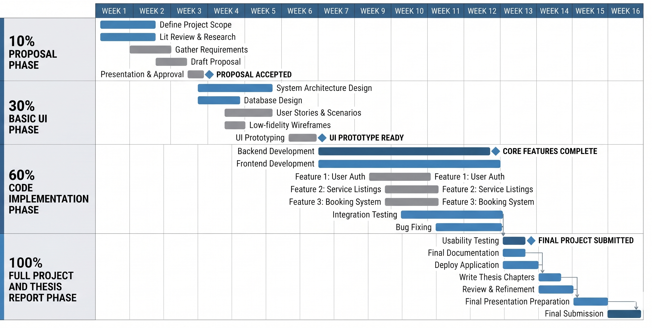
Schedule

Slide 17
Tasks for 1st Iteration (30%)
Flutter project setup
Splash and onboarding screens
Login and signup UI
Role selection screen
Basic home screen UI
Worker profile UI
Navigation setup
Supabase setup
Database structure creation

Slide 18
Conclusion
HomeEase aims to provide a secure and organized mobile platform for connecting households with trusted domestic workers. The application improves accessibility, transparency, and convenience through features such as location based search, booking, and worker verification.
Overall, the project helps modernize the home care services sector while creating better opportunities for both households and workers.

