Slide 1
GG TUBE
Introduction
ER Diagram
Relational Schema
Normalization Documentation
Implementation

Slide 2
Introduction

Slide 3
A channel can upload many videos.
A video can be uploaded by one channel.
-----------------------------------------------------------------------------
A channel can view many videos.
A video can be viewed by many channels.
(The channel can view the same video many times)
-----------------------------------------------------------------------------
A channel can like many videos.
A video can be liked by many channels.
(The channel can like the same video just once)
-----------------------------------------------------------------------------
A channel can dislike many videos.
A video can be disliked by many channels.
(The channel can dislike the same video just once)
A channel can comment on many videos.
A video can have many comments.
-----------------------------------------------------------------------------
A channel can subscribe to many channels.
A channel can have many channels.
-----------------------------------------------------------------------------
A channel can own many playlists.
A playlist can be owned by one channel.
-----------------------------------------------------------------------------
A playlist can contain many videos.
A video can be in many playlists.

Slide 4
ER-Diagram

Slide 5
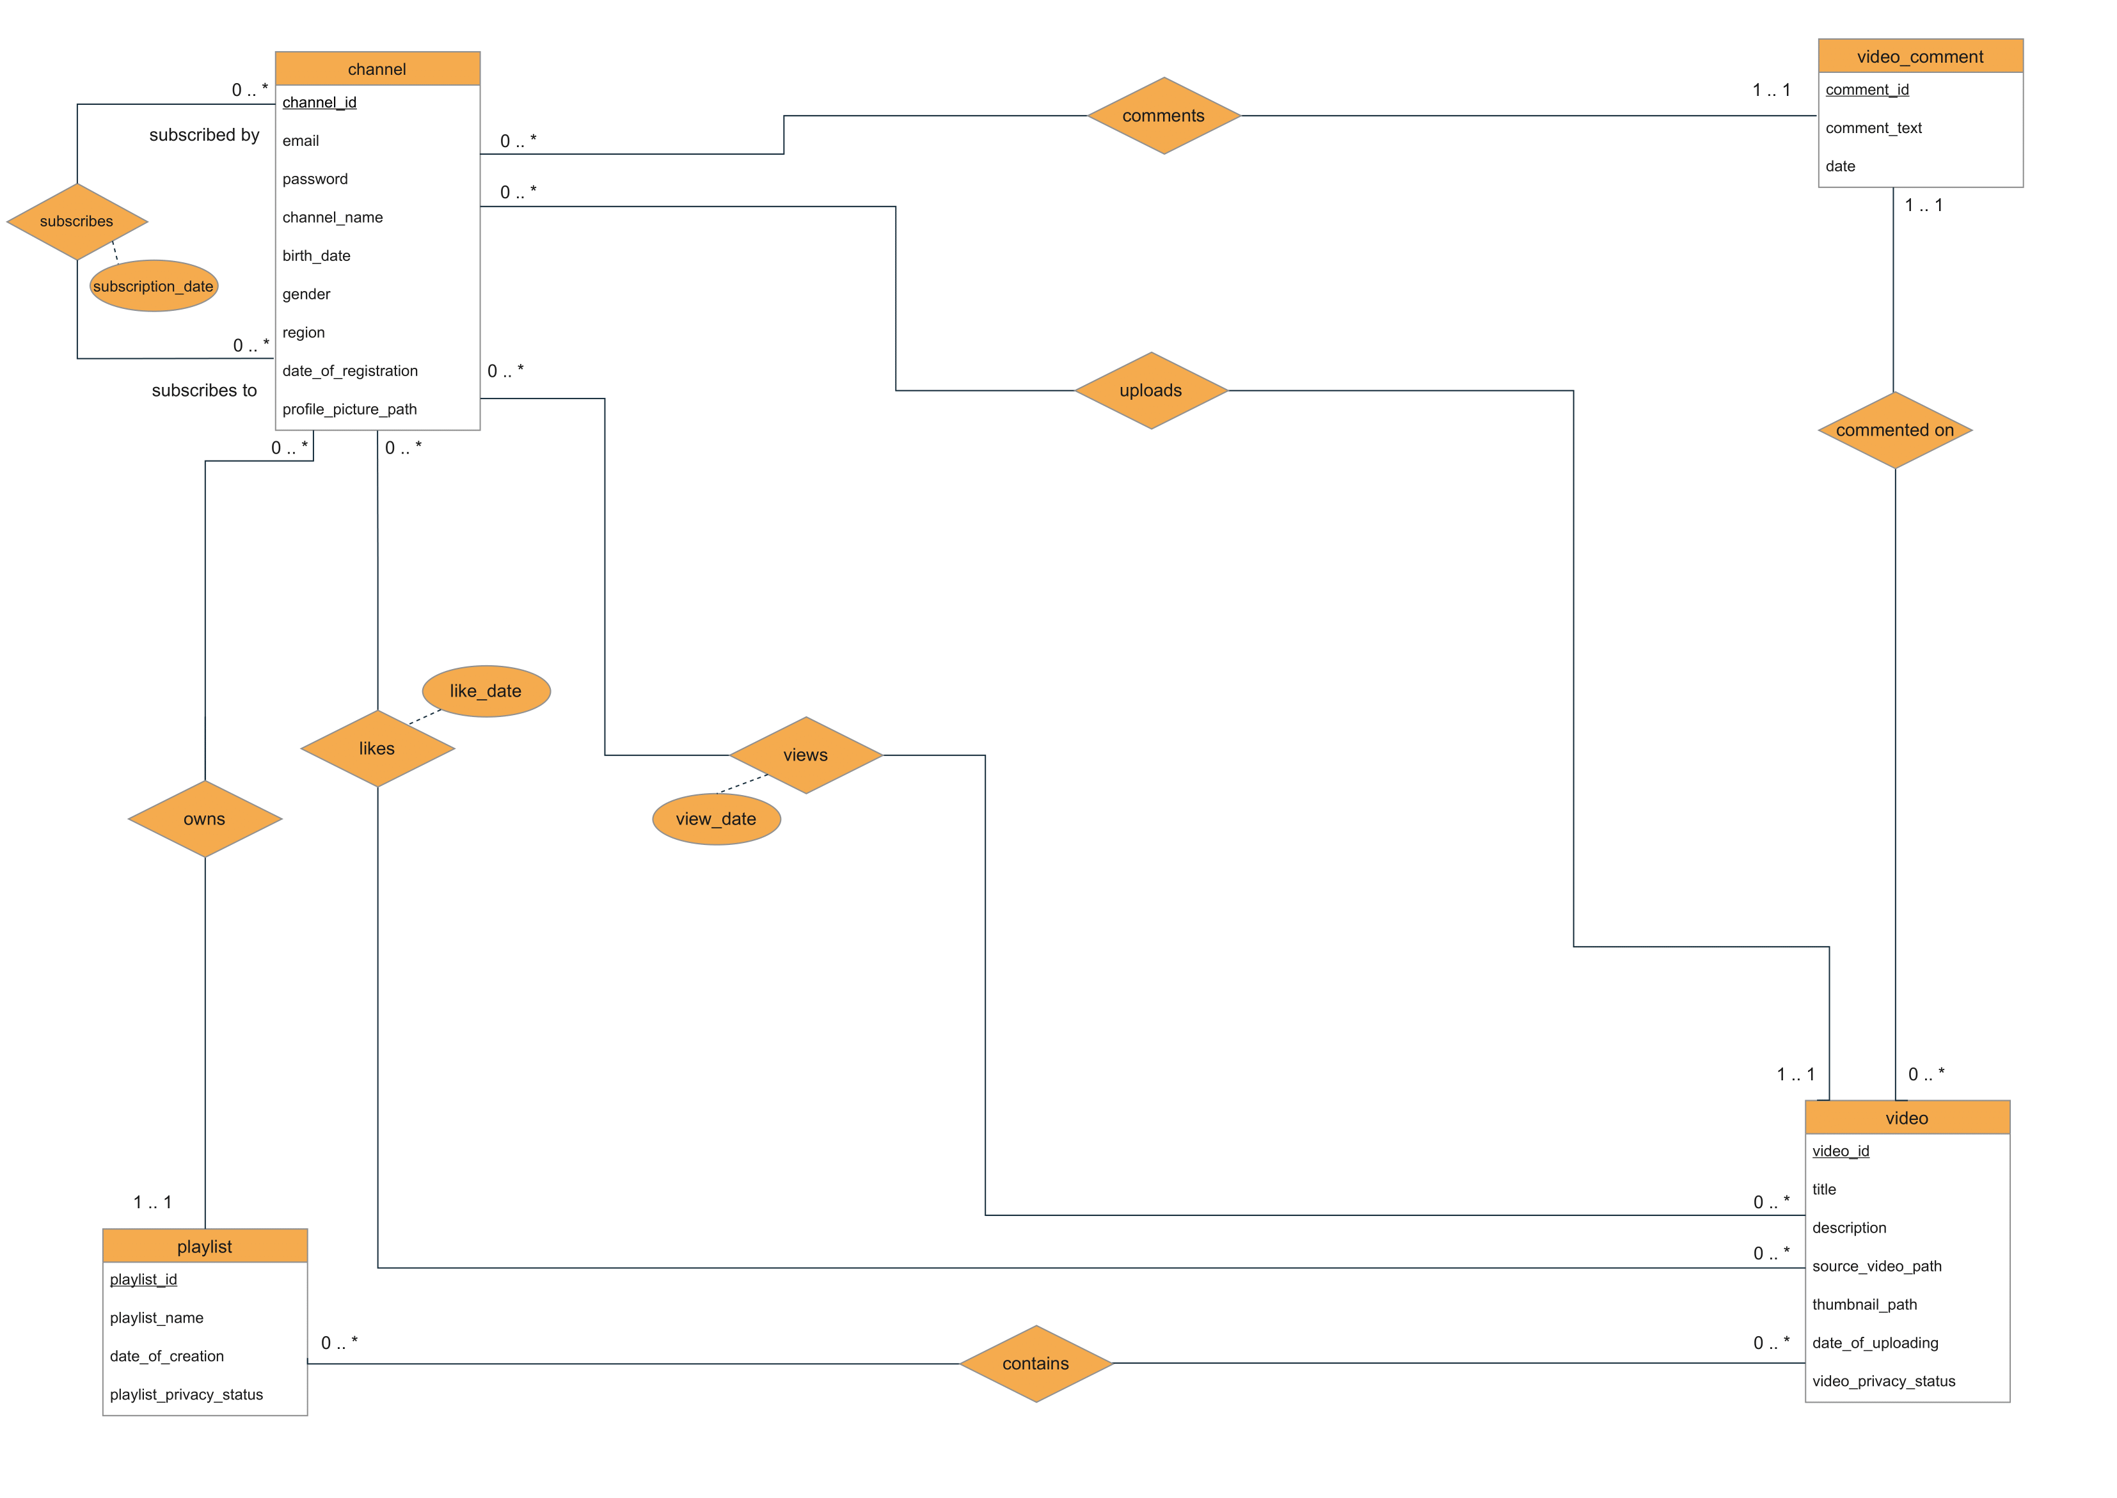

Slide 6
Relational Schema

Slide 7
channel(channel_id, email, password, channel_name, birth_date, gender, region, date_of_registration, profile_picture_path)
video_comment(comment_id, comment_text, commenting_date, channel_id, video_id)
video(video_id, title, description, source_video_path, thumbnail_path, date_of_uploading, video_privacy_status, channel_id)
playlist(playlist_id, playlist_name, date_of_creation, playlist_privacy_status, channel_id)
contains(video_id, playlist_id)
subscribes(subscriber_id, subscribed_to_id, subscription_date)
views(channel_id, video_id, view_date)
likes(channel_id , video_id , like_date)

Slide 8
Normalization Documentation

Slide 9
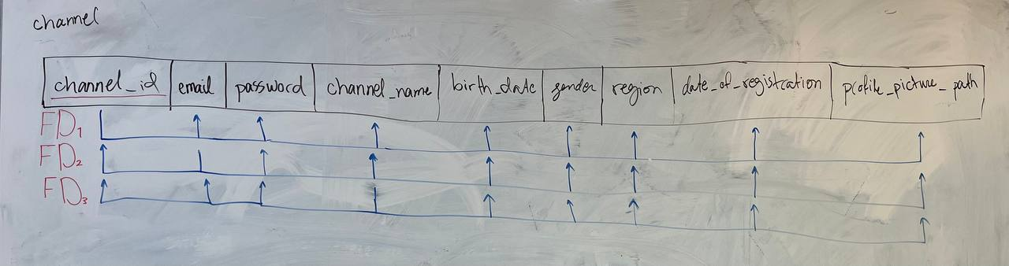
1 NF is satisfied because the relation has no multi-valued attributes.
2 NF is satisfied because no non-prime attribute is dependent on any proper subset of any candidate key of the relation.
3 NF is satisfied because there is no transitive dependency of a non-prime attribute on the primary key.
BCNF is satisfied because whenever a nontrivial functional dependency X → Y holds in the relation, then X is a super-key of the relation.

Slide 10

video_comment
1 NF is satisfied because the relation has no multi-valued attributes.
2 NF is satisfied because no non-prime attribute is dependent on any proper subset of any candidate key of the relation.
3 NF is satisfied because there is no transitive dependency of a non-prime attribute on the primary key.
BCNF is satisfied because whenever a nontrivial functional dependency X → Y holds in the relation, then X is a super-key of the relation.

Slide 11
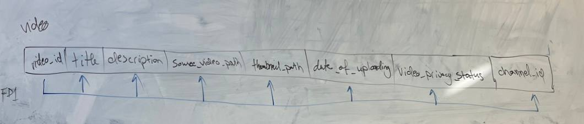
1 NF is satisfied because the relation has no multi-valued attributes.
2 NF is satisfied because no non-prime attribute is dependent on any proper subset of any candidate key of the relation.
3 NF is satisfied because there is no transitive dependency of a non-prime attribute on the primary key.
BCNF is satisfied because whenever a nontrivial functional dependency X → Y holds in the relation, then X is a super-key of the relation.

Slide 12
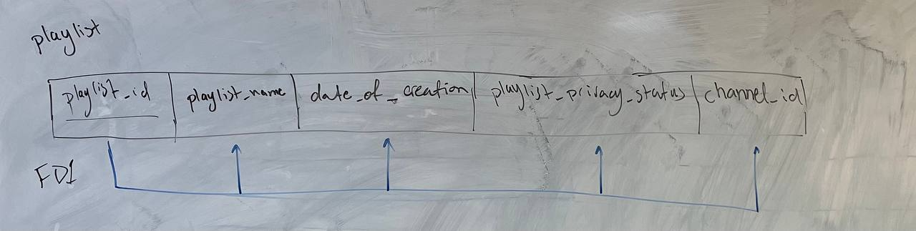
1 NF is satisfied because the relation has no multi-valued attributes.
2 NF is satisfied because no non-prime attribute is dependent on any proper subset of any candidate key of the relation.
3 NF is satisfied because there is no transitive dependency of a non-prime attribute on the primary key.
BCNF is satisfied because whenever a nontrivial functional dependency X → Y holds in the relation, then X is a super-key of the relation.

Slide 13

1 NF is satisfied because the relation has no multi-valued attributes.
2 NF is satisfied because no non-prime attribute is dependent on any proper subset of any candidate key of the relation.
3 NF is satisfied because there is no transitive dependency of a non-prime attribute on the primary key.
BCNF is satisfied because whenever a nontrivial functional dependency X → Y holds in the relation, then X is a super-key of the relation.

Slide 14

1 NF is satisfied because the relation has no multi-valued attributes.
2 NF is satisfied because no non-prime attribute is dependent on any proper subset of any candidate key of the relation.
3 NF is satisfied because there is no transitive dependency of a non-prime attribute on the primary key.
BCNF is satisfied because whenever a nontrivial functional dependency X → Y holds in the relation, then X is a super-key of the relation.

Slide 15
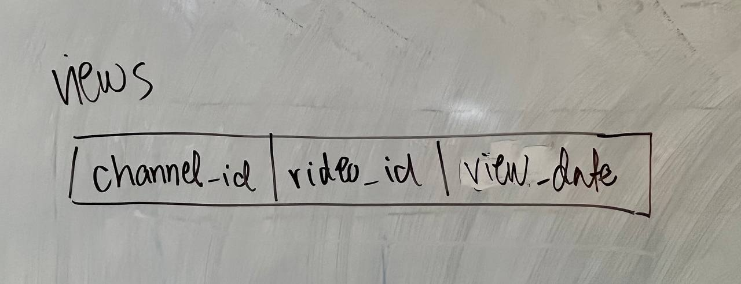
1 NF is satisfied because the relation has no multi-valued attributes.
2 NF is satisfied because no non-prime attribute is dependent on any proper subset of any candidate key of the relation.
3 NF is satisfied because there is no transitive dependency of a non-prime attribute on the primary key.
BCNF is satisfied because whenever a nontrivial functional dependency X → Y holds in the relation, then X is a super-key of the relation.

Slide 16
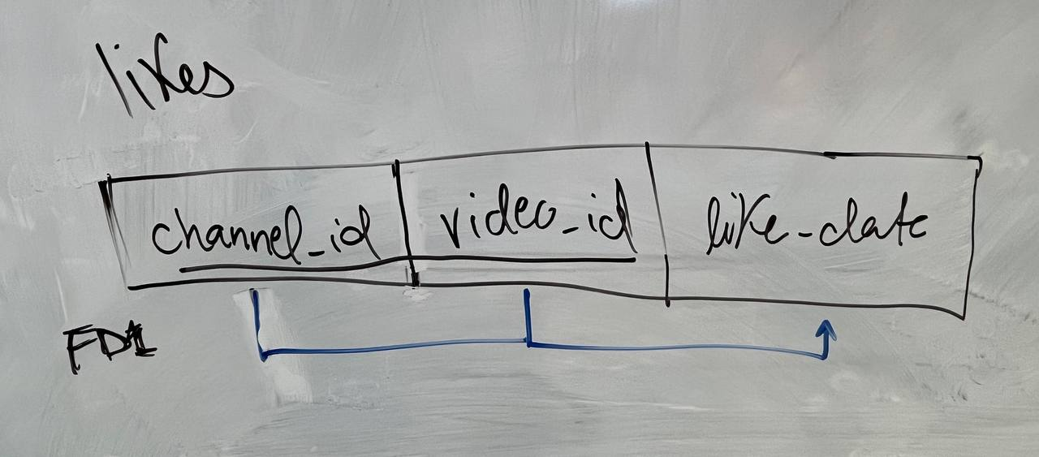
1 NF is satisfied because the relation has no multi-valued attributes.
2 NF is satisfied because no non-prime attribute is dependent on any proper subset of any candidate key of the relation.
3 NF is satisfied because there is no transitive dependency of a non-prime attribute on the primary key.
BCNF is satisfied because whenever a nontrivial functional dependency X → Y holds in the relation, then X is a super-key of the relation.

Slide 17
Implementation Time…

Slide 18
THE END

