Slide 1


Applied Psychometric Analysis with R Yogyakarta 11-13 Agustus 2016

Slide 2
Agenda
Hari | Acara
1 (11 Agustus 2016) | Dasar-dasar Pemrograman R dan penggunaan perintah (Syntax) sederhana Data Manipulasi Visualisasi Grafik
2 (12 Agustus 2016) | Exploratory Factor Analysis Confirmatory Factor Analysis SEM Classical Test Theory Rasch Model
3 (13 Agustus 2016) | Item Response Theory (IRT) Polytomous Computerized Adaptive Testing

Slide 3

ASWIN JANUARSJAF
+62 8158143441
aswin.januarsjaf@gmail.com
PENDIDIKAN
1986: Universitas Padjadjaran, Fakultas Psikologi
1991: LPKIA, Application Programmer
1993: PPM Institute of Management, Wijawiyata Manajemen
2007: PPM Institute of Management, Magister Management
KEGIATAN SAAT INI
Universitas YARSI, Fakultas Psikologi, Staf Pengajar Statistik
PPM Institute of Management, HR Trainner & Fasilitator
APLIKASI SOFTWARE YANG DIBUAT:
Pauli Software (1990)
EPPS Software (2003)
IST Intrepretation (2004)
DISC Software (2005)
Learning Style (2006)
Multirater Software (2007)
Performance Software (2013)
Fluid Intelligence Software (2014)
Automatic Report System (2014)
Organization Health Inventory (2015)
Leadership Software (2016)

Slide 4
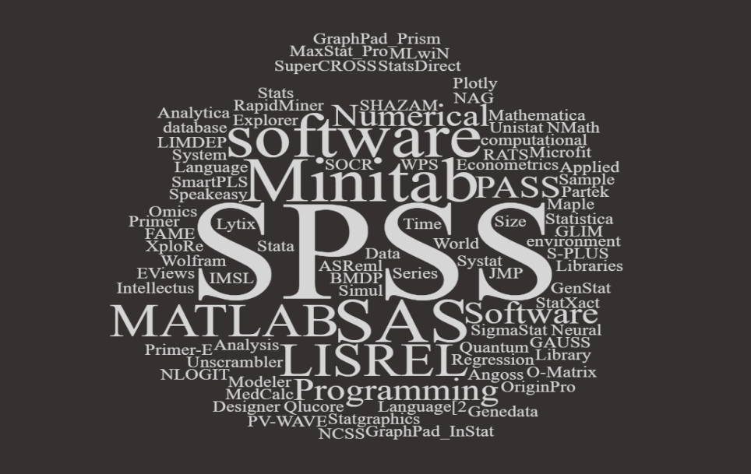
Berbagai Jenis Software Statistic berbayar

Slide 5
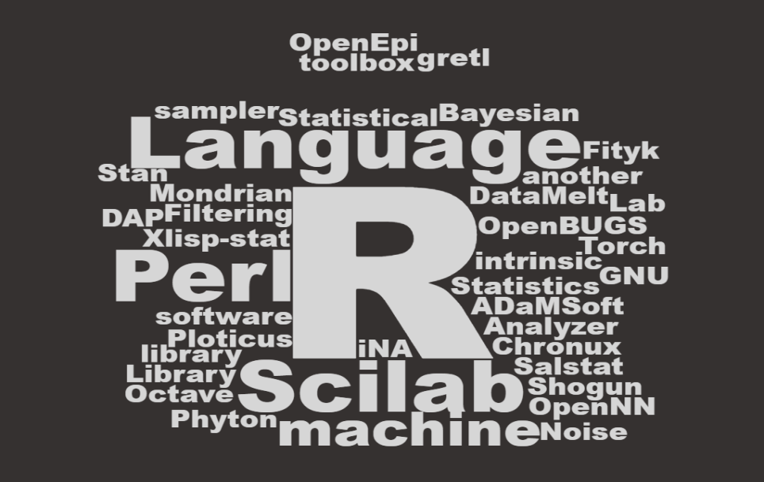
Berbagai Jenis Software Statistic GRATIS

Slide 6
What is R?

Slide 7


What is ?
The R statistical programming language
There are user-contributed packages available on Comprehensive R Archive Network (CRAN) (more than 7,801 additional packages (as of January 2016))
R programming language is a lot like magic... except instead of spells you have functions.

Slide 8
More about R
It was developed at Bell Laboratories by John Chambers and colleagues.
R can be considered as a different implementation of S
R provides a wide variety of statistical (linear and nonlinear modelling, classical statistical tests, time-series analysis, classification, clustering, …) and graphical.

Slide 9

1
OPEN SOURCE
WHY We Should learn
2
CROSS PLATFORM COMPATIBLE
3
VAST COMMUNITY
4
EXTREMELY COMPREHENSIVE
5
OUTSTANDING GRAPH
Notes:
R is the leading tool for statistics, data analysis, and machine learning. It is more than a statistical package; it’s a programming language, so you can create your own objects, functions, and packages.
Speaking of packages, there are over 2,000 cutting-edge, user-contributed packages available on CRAN (A core set of packages is included with the installation of R, with more than 7,801 additional packages (as of January 2016) available at the Comprehensive R Archive Network (CRAN)t). To get an idea of what packages are out there, just take a look at these Task Views. Many packages are submitted by prominent members of their respective fields.
Like all programs, R programs explicitly document the steps of your analysis and make it easy to reproduce and/or update analysis, which means you can quickly try many ideas and/or correct issues.
You can easily use it anywhere. It’s platform-independent, so you can use it on any operating system. And it’s free, so you can use it at any employer without having to persuade your boss to purchase a license.
Not only is R free, but it’s also open-source. That means anyone can examine the source code to see exactly what it’s doing. This also means that you, or anyone, can fix bugs and/or add features, rather than waiting for the vendor to find/fix the bug and/or add the feature–at their discretion–in a future release.
R allows you to integrate with other languages (C/C++, Java, Python) and enables you to interact with many data sources: ODBC-compliant databases (Excel, Access) and other statistical packages (SAS, Stata, SPSS, Minitab).
Explicit parallelism is straightforward in R (see the High Performance Computing Task View): several packages allow you to take advantage of multiple cores, either on a single machine or across a network. You can also build R with custom BLAS.
R has a large, active, and growing community of users. The mailing lists provide access to many users and package authors who are experts in their respective fields. Additionally, there are several R conferences every year. The most prominent and general is useR. Finance-related conferences include Rmetrics Workshop on Computational Finance and Financial Engineering in Meielisalp, Switzerland and R/Finance: Applied Finance with R in Chicago, USA.

Slide 10

+
__
R is the most comprehensive statistical analysis package available
R developed by practicing statisticians and researchers
The graphical capabilities of R are outstanding
R is free and open source software
R is up-to-date
R is cross-platform
R plays well with many other tools
Many R commands give little thought to memory management
Easy to make mistakes and not know.
The quality of some packages is less than perfect
Capabilities such as security were not built into the R language,
Advantage & Disadvantage of R

Slide 11
Many users think of R as a statistics system. We prefer to think of it of an environment within which statistical techniques are implemented. R can be extended (easily) via packages.

Slide 12
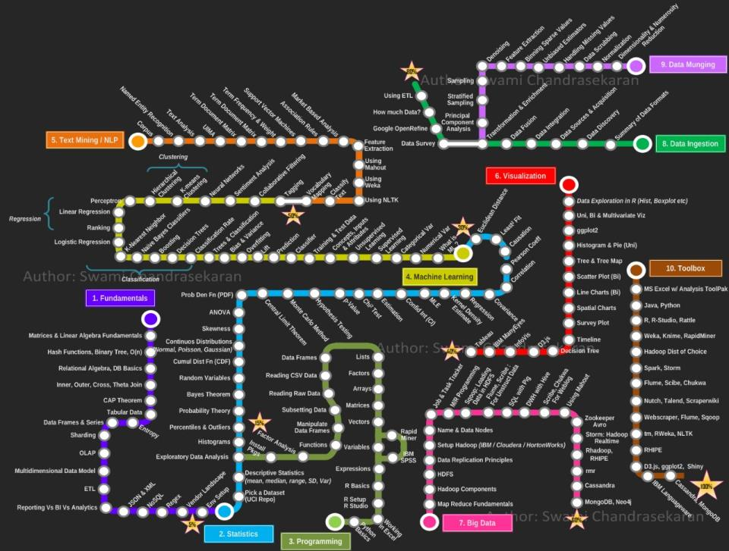

Slide 13
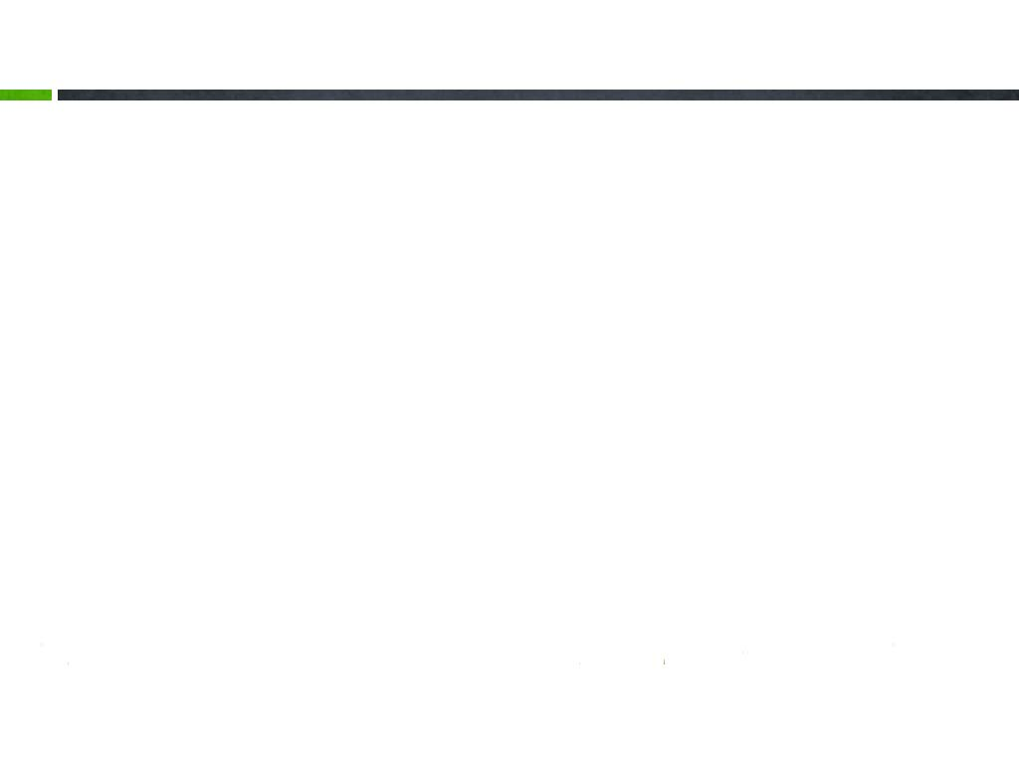
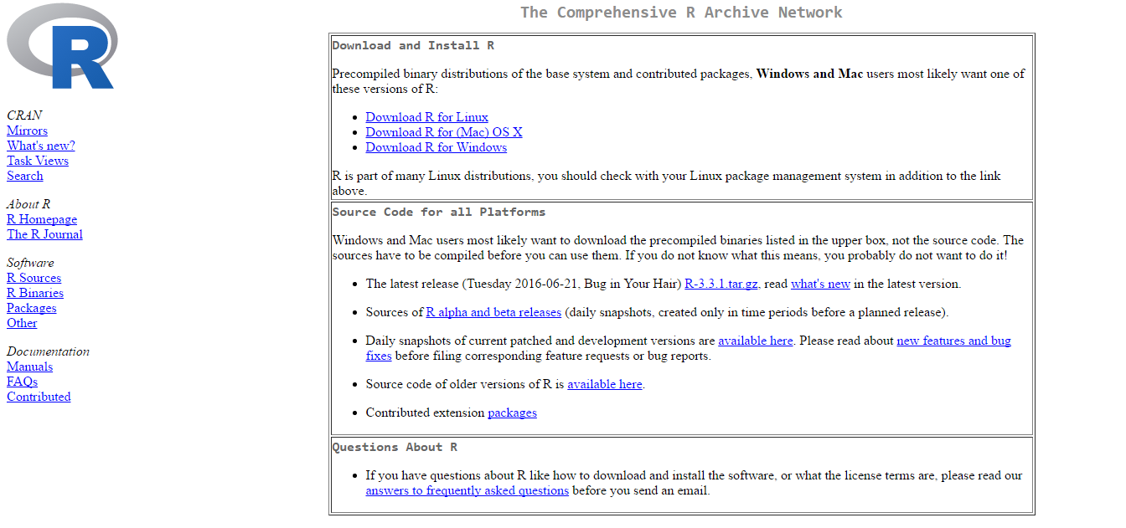
Installing R program (1/2)
Berikut ini langkah-langkah untuk instalasi program R:
Download program R dari Website: http://cran.r-project.org/

Slide 14
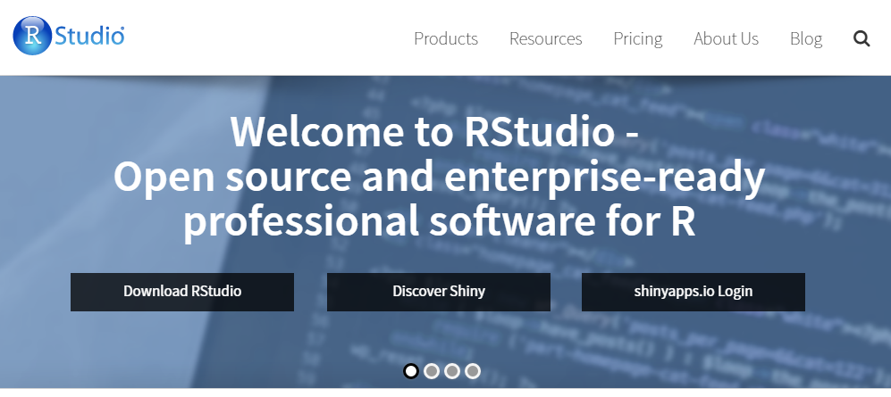
Installing R program (2/2)
Download interface R menggunakan Rstudio, alamat websitenya: http://www.rstudio.org/

Slide 15
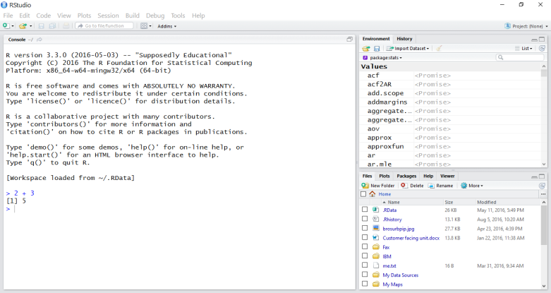
Rstudio screen
The workspace tab shows all the active objects (see next slide).
The history tab shows a list of commands used so far.
Starting up R
The files tab shows all the files and folders in your default workspace as if you were on a PC/Mac window.
The plots tab will show all your graphs.
The packages tab will list a series of packages or add-ons needed to run certain processes.
For additional info see the help tab
The console is where you can type commands and see output

Slide 16


Slide 17
Latihan R

Slide 18





Terimakasih
What’s Your Message?

